Slide 1
Eshara
إشارة
A Bilingual Sign Language Recognition
& Communication System
Real-Time Letter and Word Recognition with a Web-Based Deployment
PRESENTED BY
Ahmed Adel Sayed Gouda · Hadeel Gamal Eldin Mohamed
Alaa Osama Mohammed Shehab · Salah Mohamed Salah Ibrahim
SUPERVISED BY
Dr. Nada Mostafa Abdelaziem
Dr. Reham Taher Al Magraby
Arab Academy for Science, Technology & Maritime Transport · Computer Engineering Department · July 2026

Slide 2
MOTIVATION
The Communication Barrier
• Sign language is the primary means of communication for most deaf and hard-of-hearing people — not spoken language.
• Human interpreters are effective but scarce, costly, and cannot be present in every classroom, clinic, or service desk.
• Automated recognition can scale — yet most tools cover only one language, or only one recognition level.
• Arabic Sign Language is under-served despite large deaf populations across the Arab region.
466M
people worldwide live with disabling hearing loss
~7M
of them are in the Arab region
< 1 in 5
SLR research papers ship a usable, browser-accessible demo
Eshara · Bilingual Sign Language Recognition
02

Slide 3
RESEARCH GAP
What Existing Systems Miss
System / line | Lang. | Letters | Words | Live web
Typical WLASL work | EN | No | Yes | Rare
KArSL CNN–LSTM works | AR | No | Yes | No
ArASL2018 / ArSLA | AR | Yes | No | Limited
Eshara (this project) | EN + AR | Yes | Yes | Yes
Eshara fills a structural gap, not an accuracy gap:
one webcam-driven web product covering both languages at both granularities — four specialised models behind a single interface.
Eshara · Bilingual Sign Language Recognition
03

Slide 4
AIMS & OBJECTIVES
What We Set Out to Build
Aim Design, train, evaluate, and deploy a real-time bilingual ASL / ArSL system covering both letter and word recognition, accessible from a standard browser and webcam.
1
Four model pipelines
ASL & ArSL, letters & words
2
Per-model features
MediaPipe landmarks + RGB clips
3
Train / integrate models
MLP · Inception I3D · BiLSTM
4
Three-tier backend
Node gateway + FastAPI inference
5
React web client
live recognition + authenticated flow
6
Rigorous evaluation
Top-1/Top-5, macro-F1, latency
Out of scope: continuous sentence translation, grammatical parsing, other sign languages, multi-signer scenes, native mobile apps, depth-camera hardware.
Eshara · Bilingual Sign Language Recognition
04

Slide 5
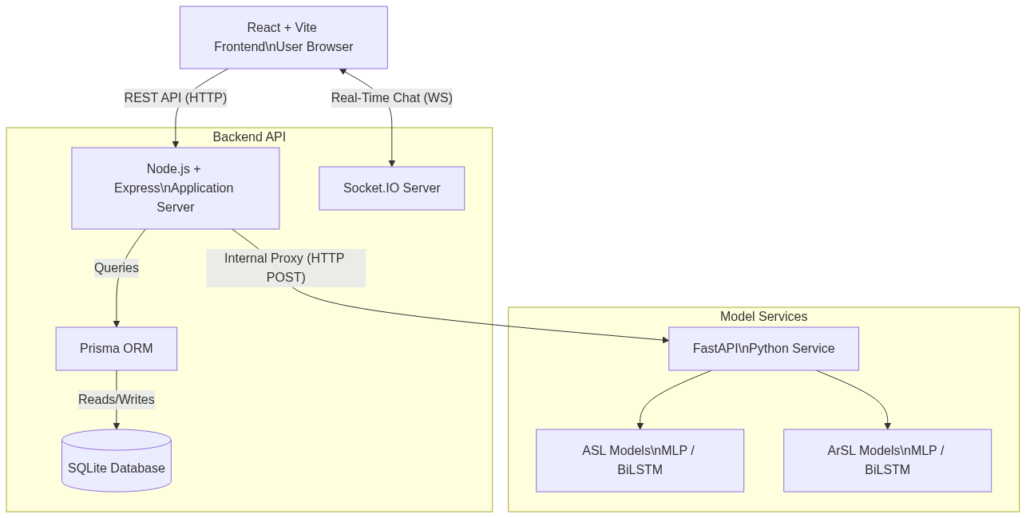
SYSTEM DESIGN
Three-Tier Web Architecture
Client Tier
React + Vite SPA
Captures webcam frames, renders skeletons & chat
Application Tier
Node.js + Express
JWT auth · Prisma/SQLite · Socket.IO · secure gateway
Inference Tier
FastAPI (Python)
Four models behind one /predict endpoint
Privacy by design: compact landmark vectors travel over the wire, not raw video — the FastAPI tier stays off the public internet.
Eshara · Bilingual Sign Language Recognition
05

Slide 6
THE FOUR MODELS
One Model Matched to Each Task
Model | Task | Architecture | Input | Classes | Params | Top-1
ASL Letter | Letter | MLP | 78-D hand | 28 | ~49 K | 99.06%
ArSL Letter | Letter | MLP | 63-D hand | 32 | ~183 K | 99.63%
ASL Word | Word | Inception I3D | 32× RGB clip | 100 | ~12.5 M | 65.89%
ArSL Word | Word | Stacked BiLSTM | 48× 225-D pose | 100 | ~255 K | 99.62%
Static finger-spelling needs only per-frame pose → compact MLPs. Word signs need temporal modelling → 3-D CNN (RGB) for ASL, BiLSTM (landmarks) for ArSL.
No shared label space — bilingual capability = four parallel pipelines behind one API.
Eshara · Bilingual Sign Language Recognition
06

Slide 7
RECOGNITION · PART 1
The Real-Time Letter Pipeline
Webcam
Frame
›
MediaPipe
Hands
›
Feature
Engineering
›
MLP
Classifier
›
Confidence
Gate
›
Stabilization
Tracker
›
Sentence
Output
• Seven sequential stages turn each webcam frame into a committed letter, entirely in real time.
• Frames are intentionally dropped to keep latency low — not every frame is processed.
• The model is pre-loaded from a saved .h5 file before the camera loop ever starts.
“
The system runs entirely in inference mode. No training happens at runtime.
Eshara · Bilingual Sign Language Recognition
07

Slide 8
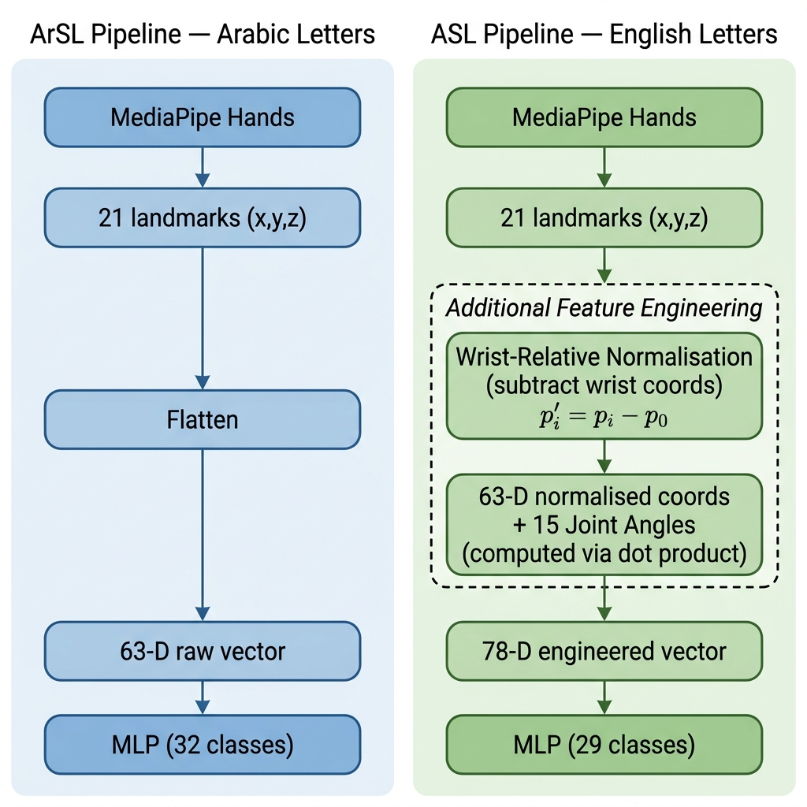
RECOGNITION · FEATURE EXTRACTION
From Landmarks to 78 Numbers
• 21 hand landmarks from MediaPipe — 63 raw (x, y, z) values per frame.
• Wrist-relative coordinates — 63 features. Subtracting the wrist from every landmark removes any dependence on where the hand sits in the frame.
• Joint bend angles — 15 features. The angle at each finger joint, computed with the dot-product formula — scale-invariant, identical whether the hand is near or far.
• 63 + 15 = 78-D input vector → fed straight into the MLP.
Eshara · Bilingual Sign Language Recognition
08

Slide 9
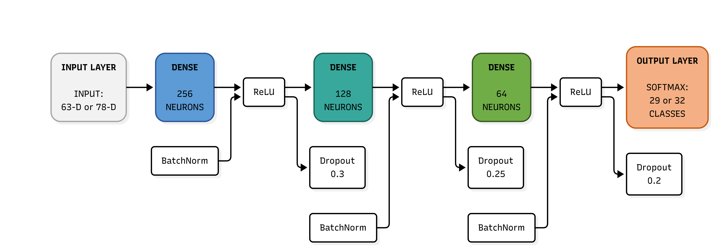
RECOGNITION · CLASSIFIER
The MLP Classifier Architecture
• Input is exactly 78 numbers — 63 position features + 15 angle features (the ArSL variant instead takes 63 raw landmarks).
• Each hidden block applies BatchNorm → ReLU → Dropout in that order, narrowing 256 → 128 → 64 neurons.
• Softmax output — 29 classes for ASL (A–Z plus space, del, nothing) and 32 for ArSL; 99.06% and 99.63% Top-1.
Eshara · Bilingual Sign Language Recognition
09

Slide 10
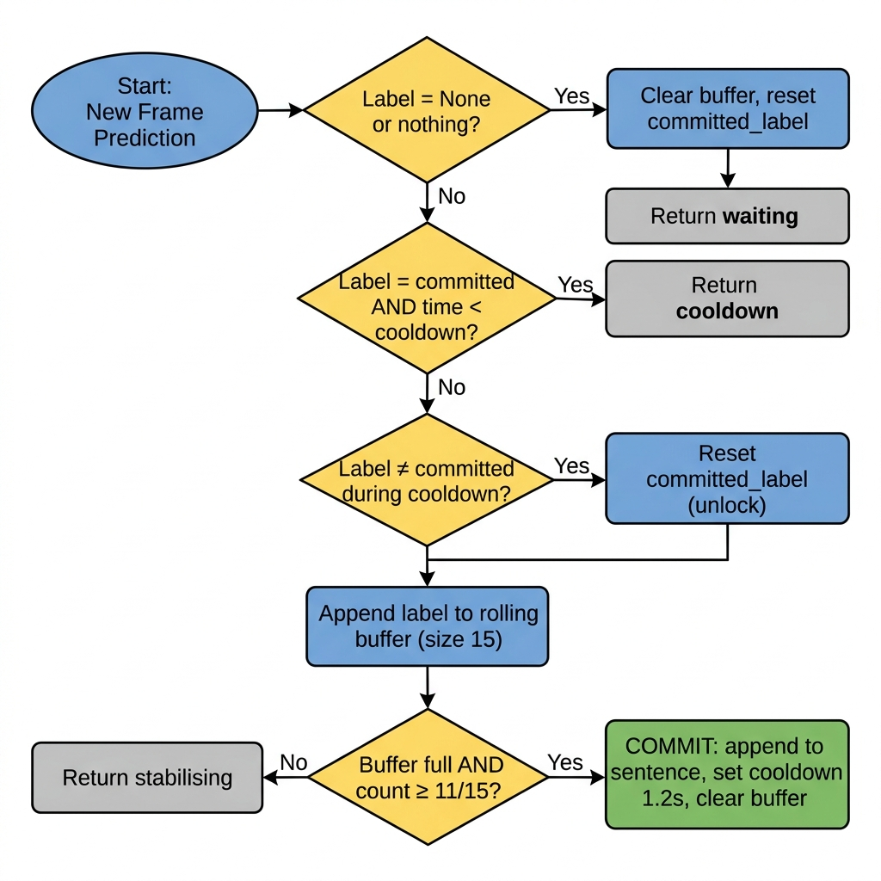
RECOGNITION · STABILISATION
Committing Letters, Not Flicker
Turning noisy per-frame predictions into committed letters — a four-state tracker:
• State 1 — No hand detected : the tracker resets completely.
• State 2 — Collecting votes : the last 15 frame predictions are held in a rolling buffer.
• State 3 — Commit : triggered when 11 of 15 frames agree on the same letter.
• State 4 — Cooldown : output is locked for 1.2 s to prevent duplicate letters.
• Confidence below 75% is rejected before it ever enters the tracker.
Eshara · Bilingual Sign Language Recognition
10

Slide 11
ENGINEERING
Optimising for Real-Time Inference
Three implementation choices keep single-frame inference smooth at ~30 fps:
ThreadedCamera
tf.function Graph
Direct Model Call
A background thread reads the webcam continuously.
A size-1 queue keeps only the newest frame, so the main loop never waits — it always gets the most recent frame instantly.
Decorating inference with tf.function traces it once into a static graph.
Later calls skip Python interpreter overhead; a dummy warm-up call before the loop means frame one has no stutter.
Calling the model directly with training=False skips model.predict's batching and callback overhead.
That matters when processing a single 1×78 input 30 times per second.
Eshara · Bilingual Sign Language Recognition
11

Slide 12
RECOGNITION · PART 2
Word Models — Motion Over Time
ASL WORDS · MODEL 3
Inception I3D (3-D CNN)
ArSL WORDS · MODEL 4
Stacked BiLSTM
• Raw RGB clips — 32 frames × 224×224, no landmark engineering
• Inflated 3-D convolutions learn spatio-temporal motion jointly
• 100 WLASL glosses, ~12.5 M params (pretrained checkpoint)
• 225-D Holistic landmarks — body + both hands, nose/wrist-normalised
• 48-frame sequences read forward & backward
• 100 KArSL classes, ~255 K params — lightweight for small data
65.89% Top-1 · 84.11% Top-5 (WLASL-100)
99.62% Top-1 · 99.58% macro-F1 (KArSL)
Why two architectures? 3-D CNN absorbs signer/background variance from pixels; BiLSTM generalises from compact landmarks on a small corpus.
Eshara · Bilingual Sign Language Recognition
12

Slide 13
RESULTS
Held-Out Test Accuracy
99.06%
99.63%
99.62%
65.89%
ASL Letters
ArSL Letters
ArSL Words
ASL Words
MLP · 78-D · 28 classes
MLP · 63-D · 32 classes
BiLSTM · 100 classes
I3D · Top-1 (84.11% Top-5)
Reading the numbers honestly. The three landmark-based models exceed 99% because MediaPipe factors out signer appearance, background, and lighting before the classifier sees the data.
The ASL word I3D solves a genuinely harder problem — recognising motion directly from raw RGB pixels — so 65.89% Top-1 / 84.11% Top-5 reflects task difficulty, not a weaker model.
Eshara · Bilingual Sign Language Recognition
13

Slide 14
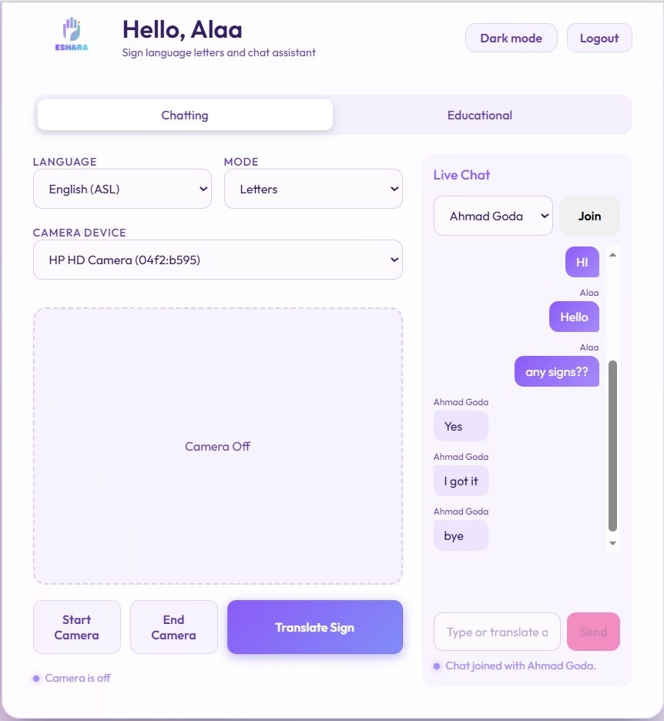
SYSTEM IMPLEMENTATION
A Deployable Web Product
• Live translation + chat — select language & mode, sign to the webcam, send the prediction into a Socket.IO chat room.
• Stateless JWT auth with bcrypt hashing; Prisma ORM over SQLite for users, rooms & messages.
• Encapsulated ML tier — the FastAPI service is reachable only through the authenticated Node gateway.
• Graceful degradation — webcam denial, offline model service, and invalid sessions all fail safely.
51 ms
3 tiers
letter-mode end-to-end latency (p50) — well under the 200 ms target
independently hostable: static SPA · Node server · FastAPI
Eshara · Bilingual Sign Language Recognition
14

Slide 15
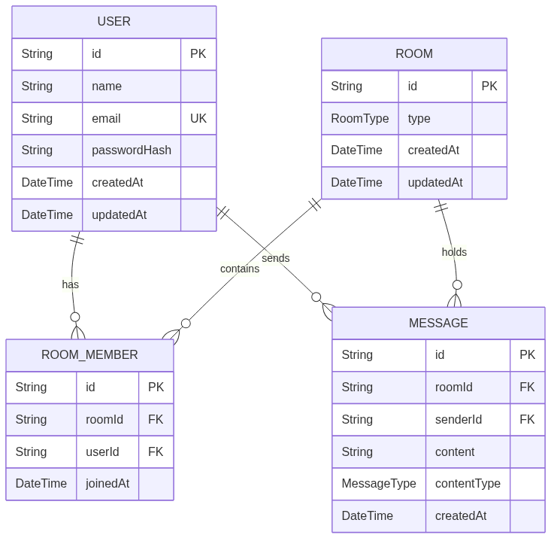
SYSTEM DESIGN · DATA
Data Model & Persistence
• Prisma ORM mediates every database access through a single typed schema (schema.prisma).
• Relational storage — SQLite in the current build, portable to Neon PostgreSQL for the cloud — centralized, secure and persistent.
• Four core entities — User, Room, RoomMember and Message.
• Relationships — users join one or more rooms; each room holds its members and the messages exchanged in it.
Eshara · Bilingual Sign Language Recognition
15

Slide 16
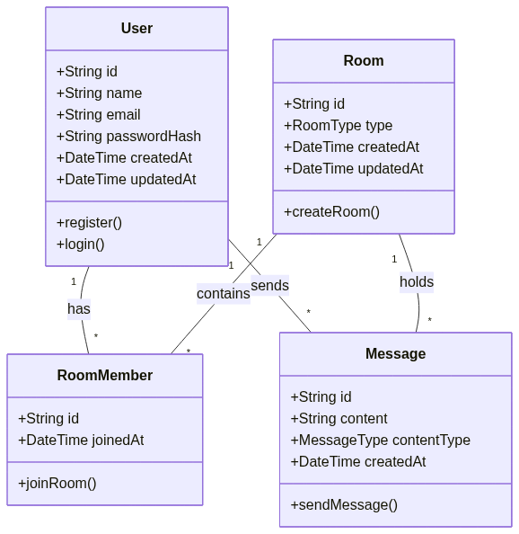
SYSTEM DESIGN · OBJECTS
Class Diagram
• Each entity maps to a class with typed attributes and its own behaviour.
• Key operations — User.register() / login(), Room.createRoom(), RoomMember.joinRoom(), Message.sendMessage().
• Associations mirror the ER model — has, contains, sends and holds, with their multiplicities.
• One schema, two views — the class model and the ERD describe the same four objects.
Eshara · Bilingual Sign Language Recognition
16

Slide 17
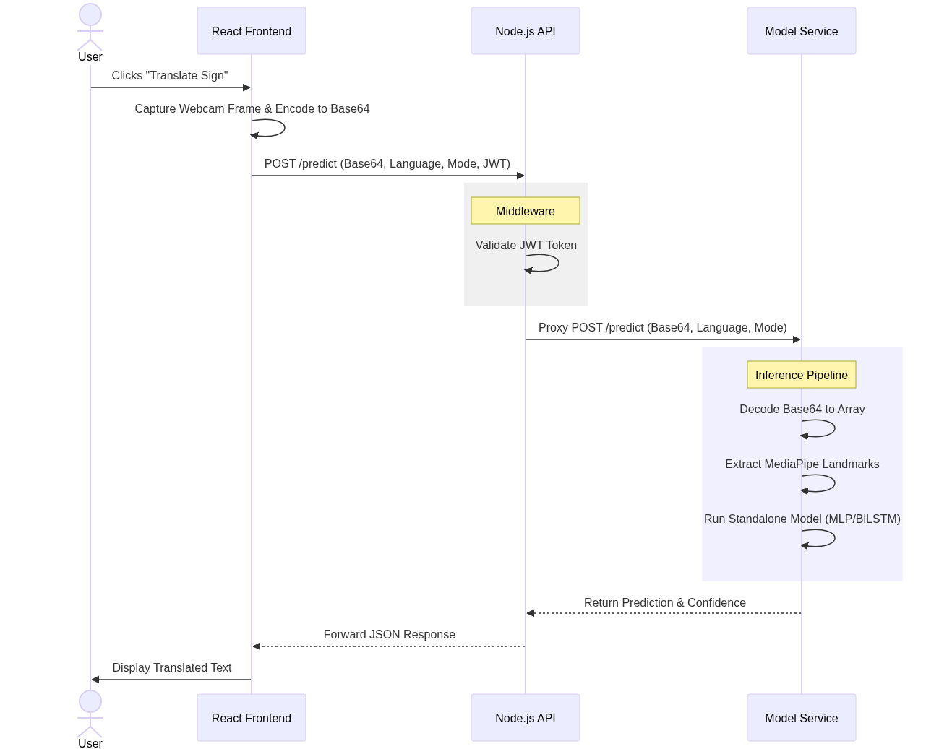
SYSTEM DESIGN · FLOW
Prediction Sequence
• Client captures a webcam frame, encodes it to Base64 and POSTs /predict with language, mode and JWT.
• Node middleware validates the JWT, then proxies the request to the model service.
• FastAPI pipeline decodes the frame, extracts MediaPipe landmarks and runs the standalone model.
• Response — prediction + confidence flow back through Node to the UI as translated text.
Eshara · Bilingual Sign Language Recognition
17

Slide 18
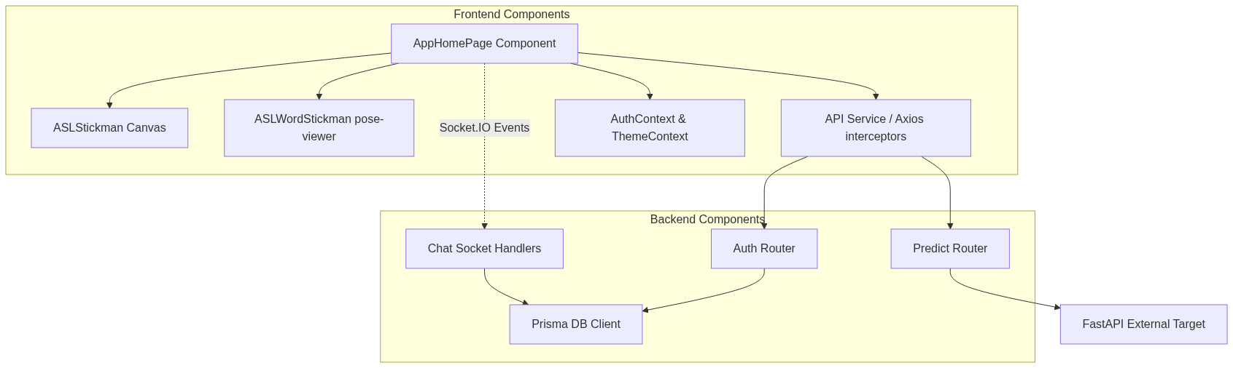
SYSTEM DESIGN · COMPONENTS
Component Architecture
• Frontend — AppHomePage orchestrates the stickman canvas, pose-viewer, auth/theme context and the Axios API layer.
• Backend — Auth and Predict routers sit over the Prisma DB client, while chat socket handlers stream messages.
• The Predict Router is the sole gateway to the external FastAPI inference target.
Eshara · Bilingual Sign Language Recognition
18

Slide 19
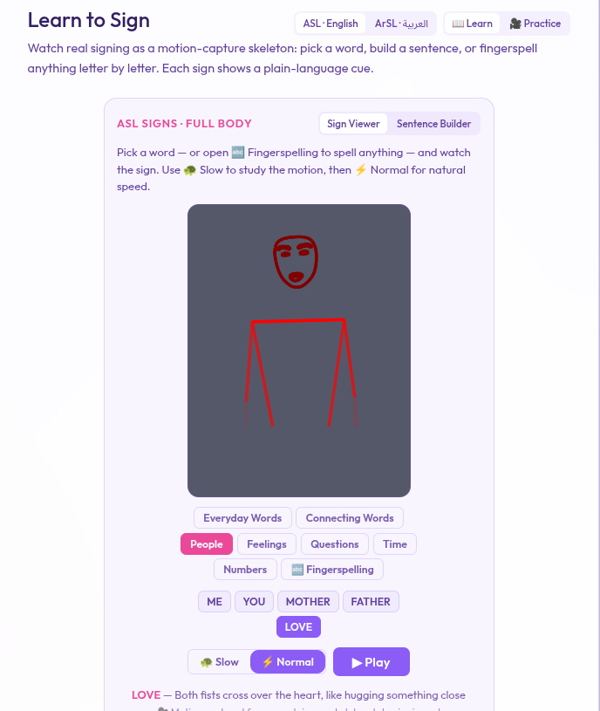
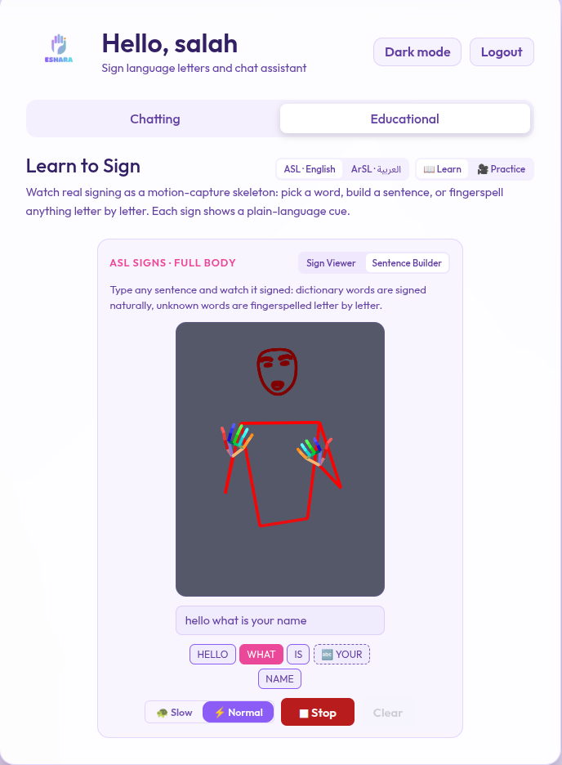
BEYOND TRANSLATION
The Education Module
Bilingual learning built on motion-capture skeletons of real signers — not stick figures. Three tools, in both ASL and ArSL:
Sign Viewer
Browse a categorised vocabulary and watch each sign; fingerspell any typed word.
Sentence Builder
Type a free-form sentence — known words are signed, unknown words fingerspelled.
Practice Mode
Perform a prompted sign to the webcam and get instant feedback from the models.
• Server-side animation stitching joins many clips into one smooth signing animation.
• 44 EN + 42 AR verified word signs across 9 categories, plus both full alphabets.
• Content sourced from sign.mt (ASL + Jordanian SL dictionaries), rendered by pose-viewer.
Eshara · Bilingual Sign Language Recognition
19

Slide 20
ENGINEERING HIGHLIGHT
Guaranteeing Genuine Signs
The problem: the sign.mt dictionary silently FINGERSPELLS any word it lacks — with HTTP 200. A successful fetch does not prove a real sign exists, and publishing a spelled clip would teach learners something wrong.
1
Fetch the word AND the doubled word
the doubled form is guaranteed out-of-vocabulary → the cloud's own spelling
2
Reduce to handshape descriptors
wrist-relative, scale-normalised right-hand landmarks per frame
3
Compare with dynamic time warping
spelled fallback < 0.9 · genuine sign ≥ 2.9 — a clean separation
Result: every Arabic word in the app is a verified genuine sign; everything else fingerspells honestly. Bonus discoveries: the dictionary keys entries under proper orthography and definite-article forms.
Eshara · Bilingual Sign Language Recognition
20

Slide 21
HONEST ASSESSMENT
Limitations & Failure Cases
MODEL & SCOPE
DATA & DEPLOYMENT
• Isolated signs only — the user pauses between signs; no continuous sentence decoding.
• Dialect mismatch — viewer teaches Jordanian SL, recognition trained on KArSL (Saudi).
• Motion letters (J, Z) — single-frame MLPs can't see the trajectory that defines them.
• ASL words at 65.89% — appearance-based recognition is inherently harder.
• Signer generalisation — accuracy drops on signers absent from training.
• Constrained compute — 4 GB GPU limited batch size and full-corpus training.
Positioning: Eshara is an assistive & educational tool — a demonstration of feasibility, not a replacement for certified human interpretation.
Eshara · Bilingual Sign Language Recognition
21

Slide 22
WHAT'S NEXT
Future Work
→
＋
⚡
Continuous recognition
Sentence-level SLR & translation on corpora like How2Sign.
Expanded Arabic vocabulary
More words & regional dialects, with deaf-community input.
Wire ArSL words to live web
Close the last integration gap in the deployed /predict path.
▢
⇄
★
Mobile & edge
On-device inference via TensorFlow.js / ONNX Runtime.
Bidirectional communication
Pair sign-to-text with text-to-sign avatar synthesis.
Formal user studies
SUS evaluation with deaf & hard-of-hearing participants.
Eshara · Bilingual Sign Language Recognition
22

Slide 23
CONCLUSION
What Eshara Delivers
✓
Unified bilingual web architecture
four heterogeneous SLR models served through one API
✓
Full ASL + ArSL coverage
letters and words, with reproducible training pipelines
✓
99.62% ArSL word recognition
a reliable 100-class Arabic word path on KArSL
✓
Privacy-oriented inference
compact landmarks over the wire, not raw video
✓
Verified bilingual education module
motion-capture signs guaranteed genuine, not fingerspelled
✓
Deployable, low-latency product
browser + webcam only — 51 ms letter-mode latency
Eshara · Bilingual Sign Language Recognition
23

Slide 24
Eshara
إشارة
Thank You
Questions & Discussion
Ahmed Adel · Hadeel Gamal · Alaa Osama · Salah Mohamed
Supervised by Dr. Nada Mostafa & Dr. Reham Taher Al Magraby

