Slide 1
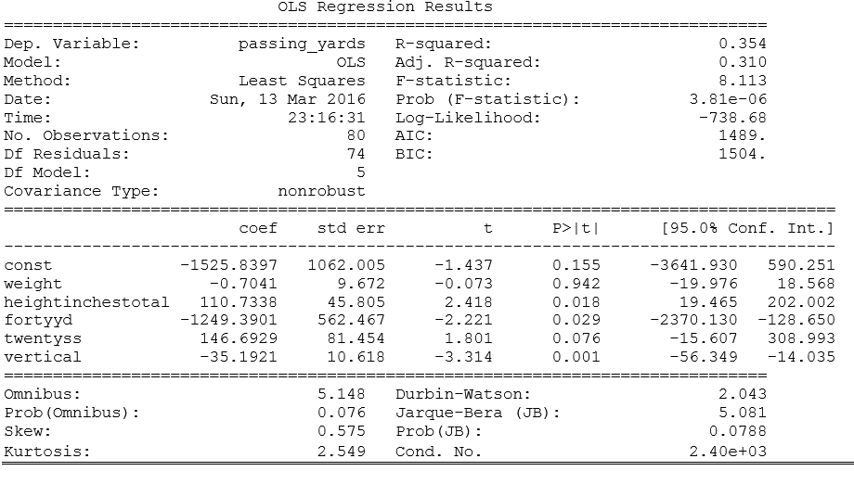
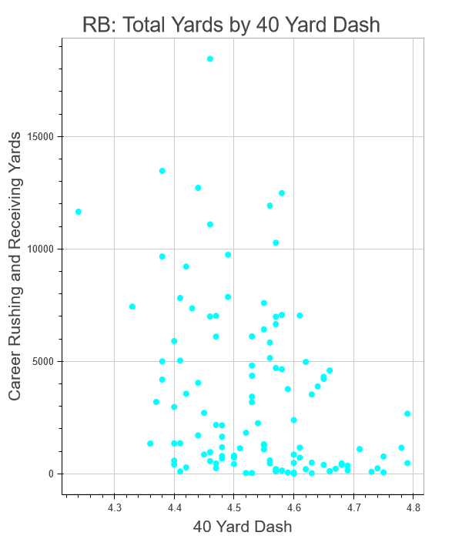
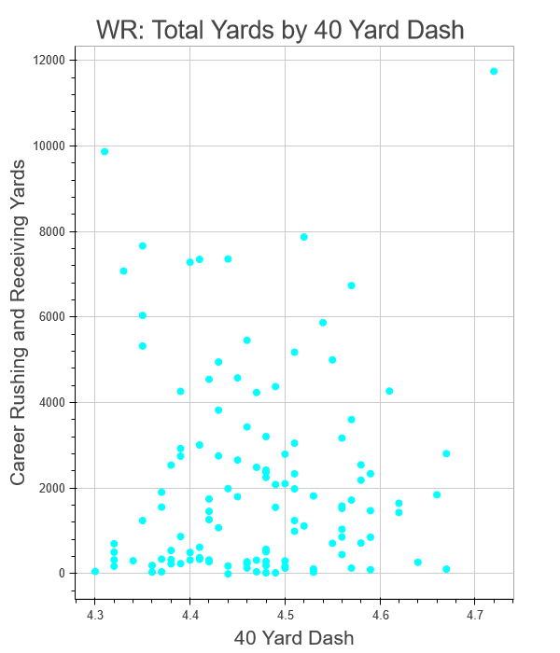
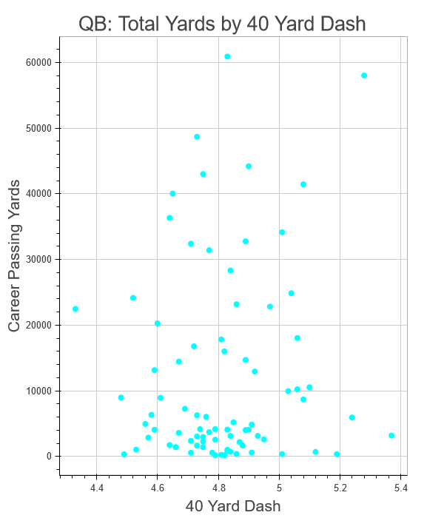
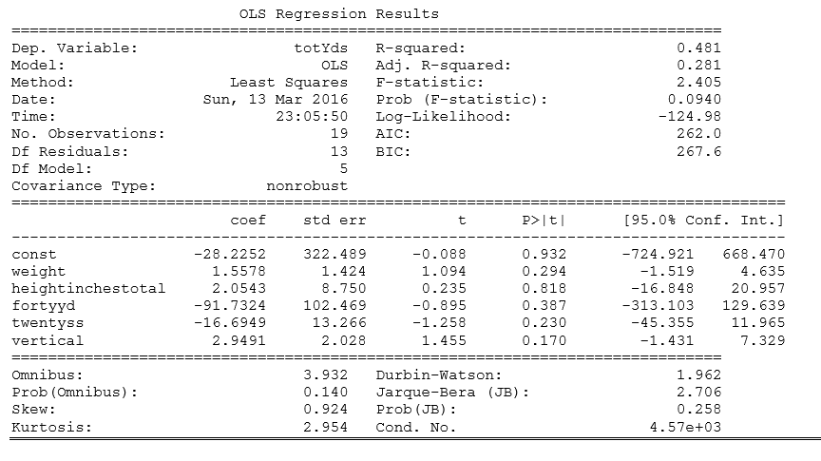
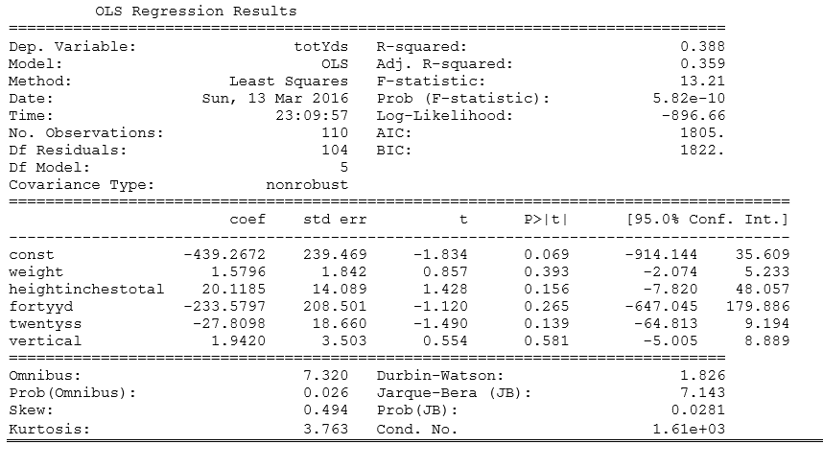
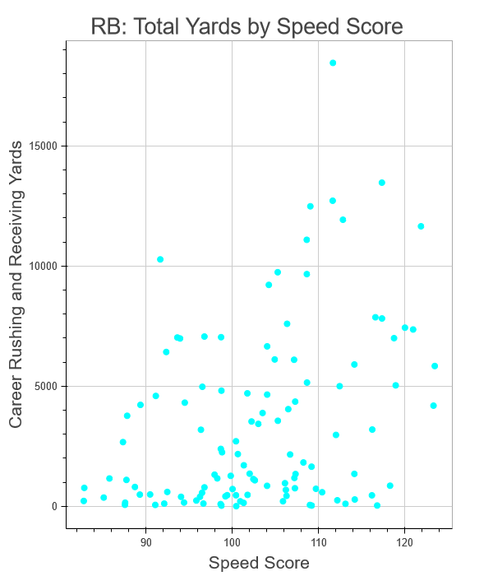
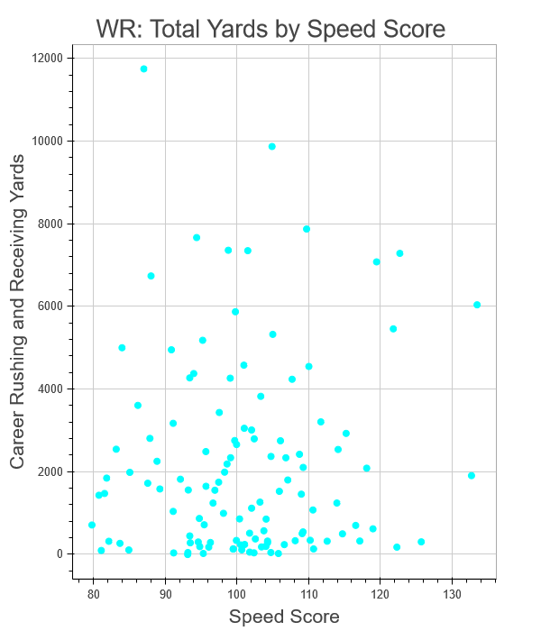
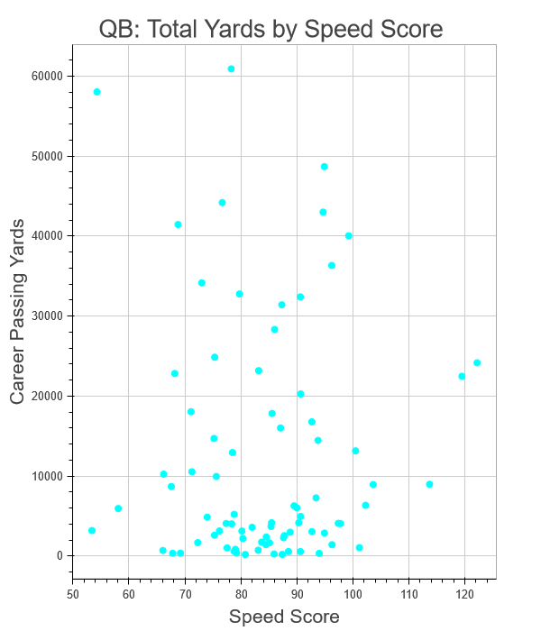
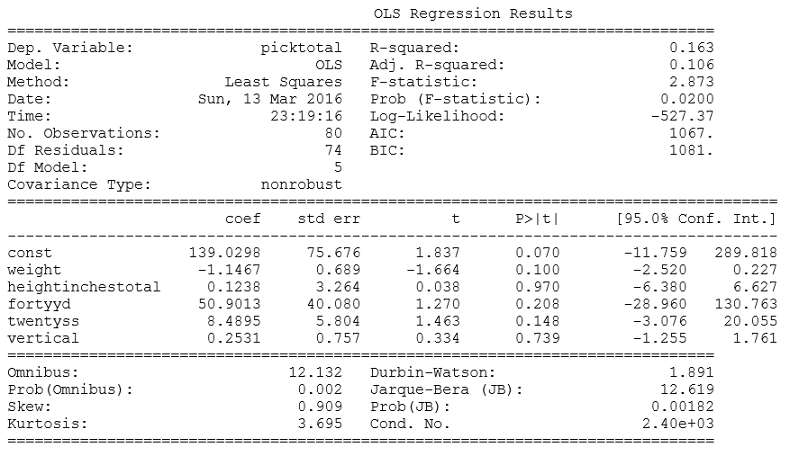
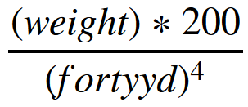
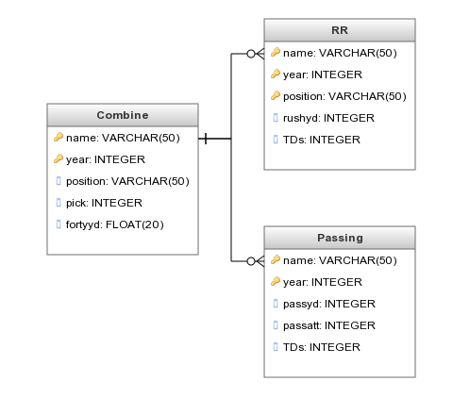
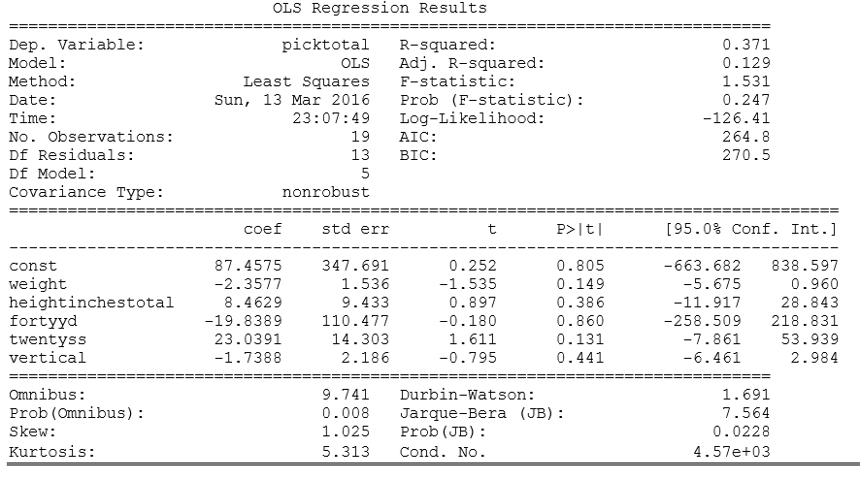
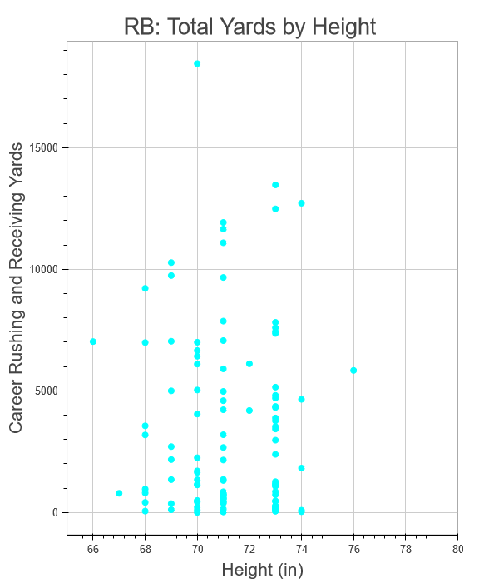
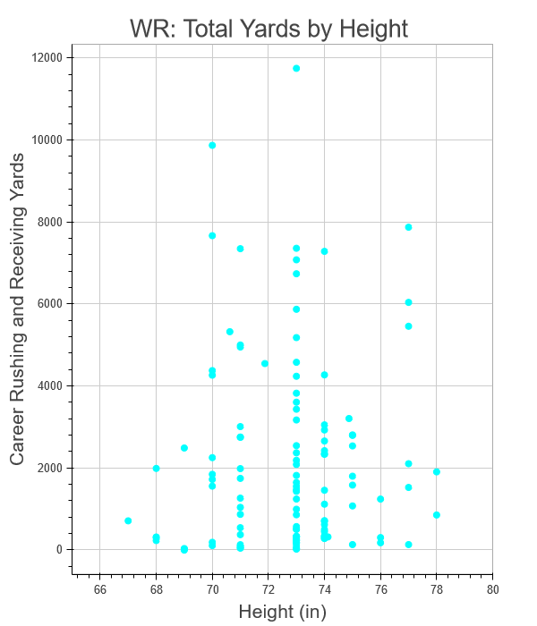
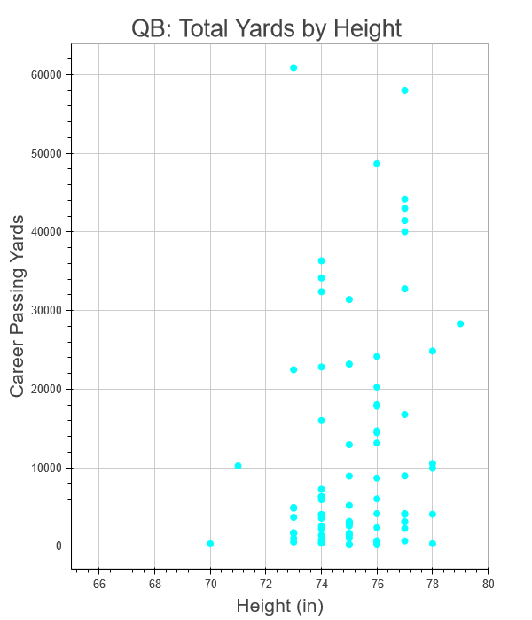
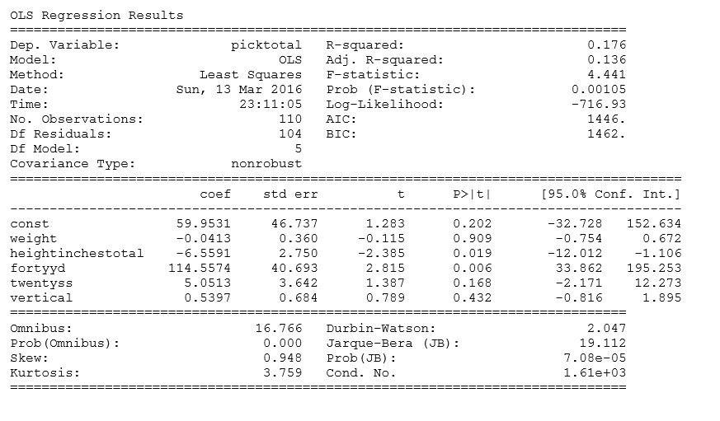
Predicting NFL Player Performance Using Pre-Draft Combine Measurables
Long Chen, Melaku Dubie, Rich Lee, and Kivan Polimis
Multivariable Regression Model
by Position
Intro
Every year, hundreds of collegiate football players are invited to participate in a week-long scouting combine. Players are evaluated by NFL personnel departments on a series of physical and mental tests. Results from these “measurables” influence positioning in the ensuing NFL draft. Our goal was to determine the association between pre-draft metrics and career performance .
Bivariate Analysis by Position
40 Yard Dash vs. Career Yardage
QB Yardage
Weight- higher weight shows negative impacts on yardage
Height- higher height shows positive impacts on yardage
40-Yard Dash- higher times shows negative impacts on yardage
Twenty Yard Shuttle- higher times shows positive impacts on yardage
Vertical Jump- lower jump shows negative impacts on yardage
RB Yardage
Weight- higher weight shows positive impacts on yardage
Height- higher height shows positive impacts on yardage
40-Yard Dash- higher times shows negative impacts on yardage
Twenty Yard Shuttle- higher times shows negative impacts on yardage
Vertical Jump- higher jump shows positive impacts on yardage
Data
Annual passing, rushing and receiving data: Pro-football-reference.com
Scouting combine and player database: NFLsavant.com
Speed Score vs. Career Yardage
WR Yardage
Weight- higher weight shows positive impacts on yardage
Height- higher height shows positive impacts on yardage
40-Yard Dash- higher times shows negative impacts on yardage
Twenty Yard Shuttle- higher times shows negative impacts on yardage
Vertical Jump- higher jump shows positive impacts on yardage
Processing and Database Design
We used pandas to wrangle and clean .csv files obtained online. Then, processed .csv files were merged and stored in relational databases with sqlite3 to handle analysis queries
QB Pick
Weight- higher weight shows positive impacts on pick
Height- higher height shows negative impacts on pick
40-Yard Dash- higher times shows negative impacts on pick
Twenty Yard Shuttle- higher times shows negative impacts on pick
Vertical Jump- higher jump shows negative impacts on pick
Speed score is a metric used to measure speed that adjusts for players' weight and is calculated using the following formula:
RB Pick
Weight- higher weight shows positive impacts on pick
Height- higher height shows negative impacts on pick
40-Yard Dash- higher times shows positive impacts on pick
Twenty Yard Shuttle- higher times shows negative impacts on pick
Vertical Jump- higher jump shows positive impacts on pick
Height vs. Career Yardage
WR Pick
Weight- higher weight shows positive impacts on pick
Height- higher height shows positive impacts on pick
40-Yard Dash- higher times shows negative impacts on pick
Twenty Yard Shuttle- higher times shows negative impacts pick
Vertical Jump- higher jump shows negative impacts on pick

