Slide 1
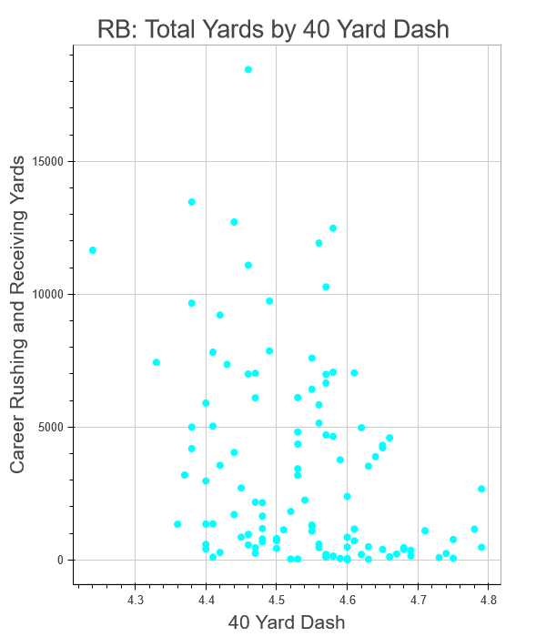
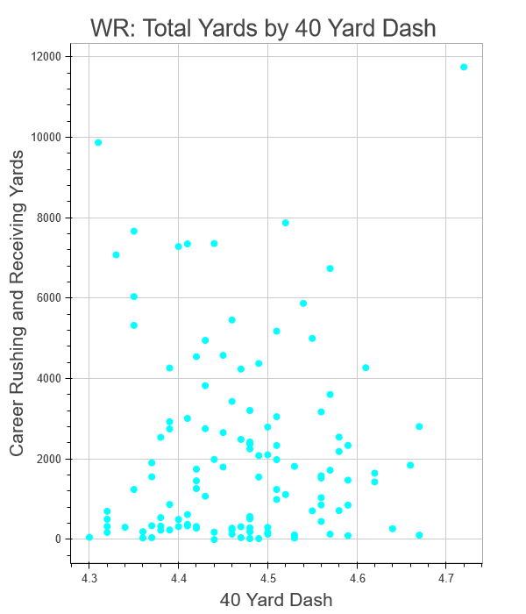
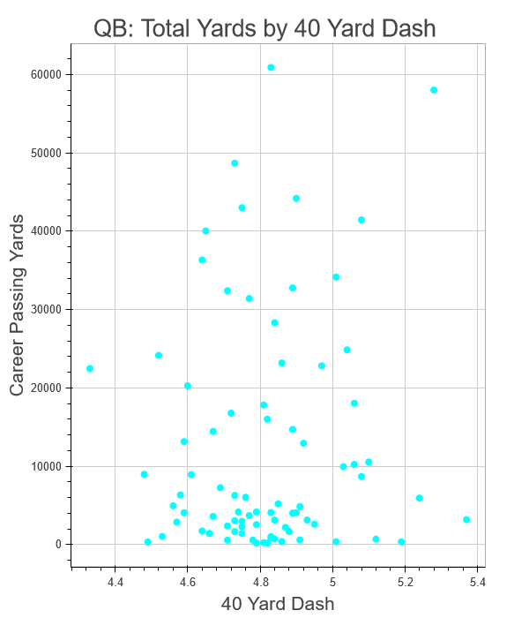
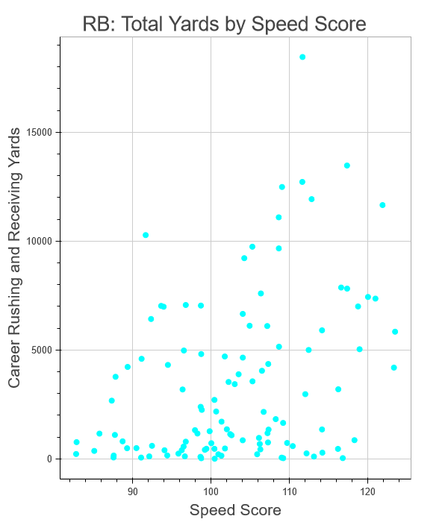
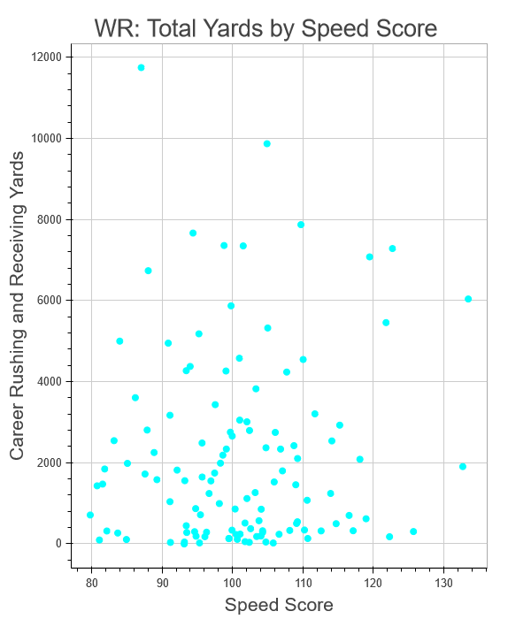
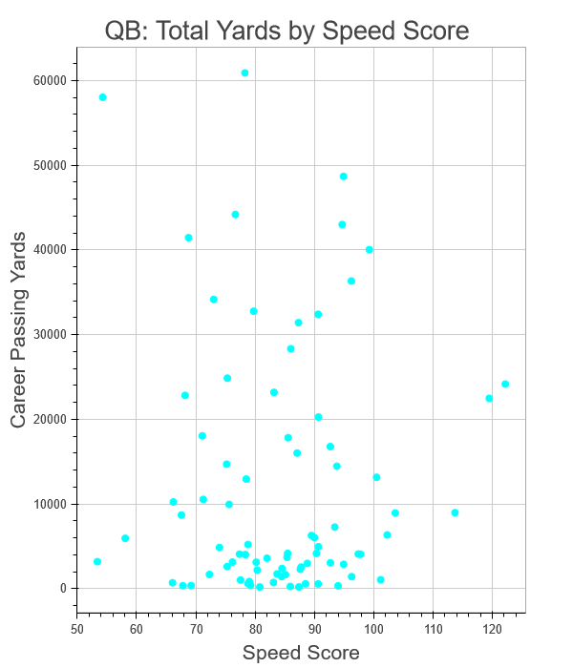
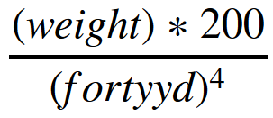
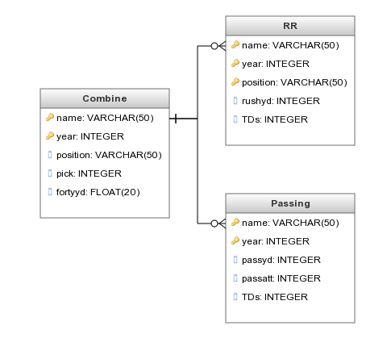
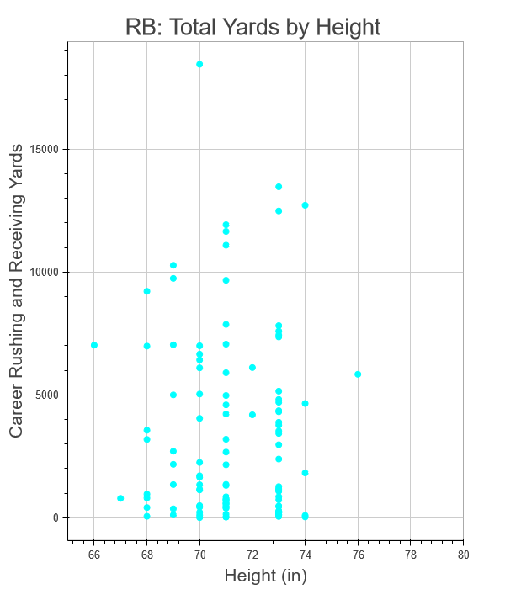
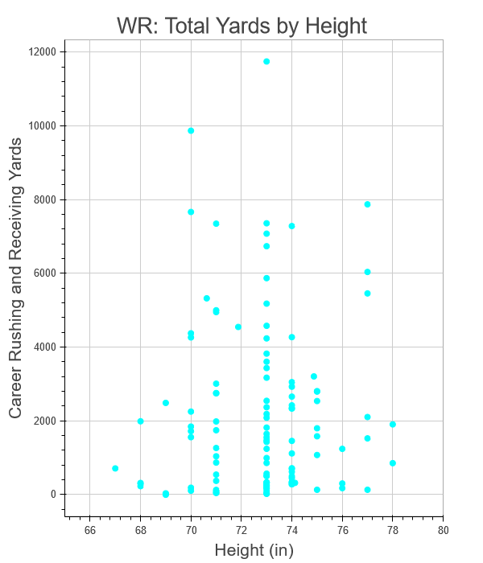
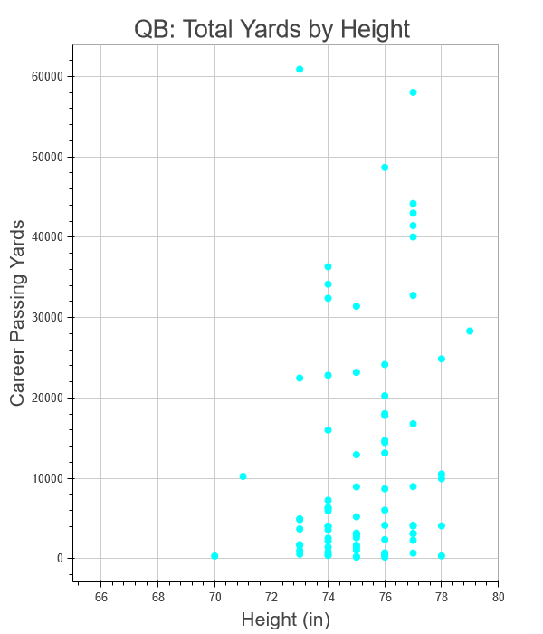
Predicting NFL Player Performance Using Pre-Draft Combine Measurables
Long Chen, Melaku Dubie, Rich Lee, and Kivan Polimis
Intro
Every year, hundreds of collegiate football players are invited to participate in a week-long scouting combine. Players are evaluated by NFL personnel departments on a series of physical and mental tests. Results from these “measurables” influence positioning in the ensuing NFL draft. Our goal was to determine the association between pre-draft metrics and career performance .
Bivariate Analysis by Position
40 Yard Dash vs. Career Yardage
Data
Annual passing, rushing and receiving data: Pro-football-reference.com
Scouting combine and player database: NFLsavant.com
Speed Score vs. Career Yardage
Processing and Database Design
We used pandas to wrangle and clean .csv files obtained online. Then, processed .csv files were merged and stored in relational databases with sqlite3 to handle analysis queries
Speed score is a metric used to measure speed that adjusts for players' weight and is calculated using the following formula:
Height vs. Career Yardage

