Slide 1
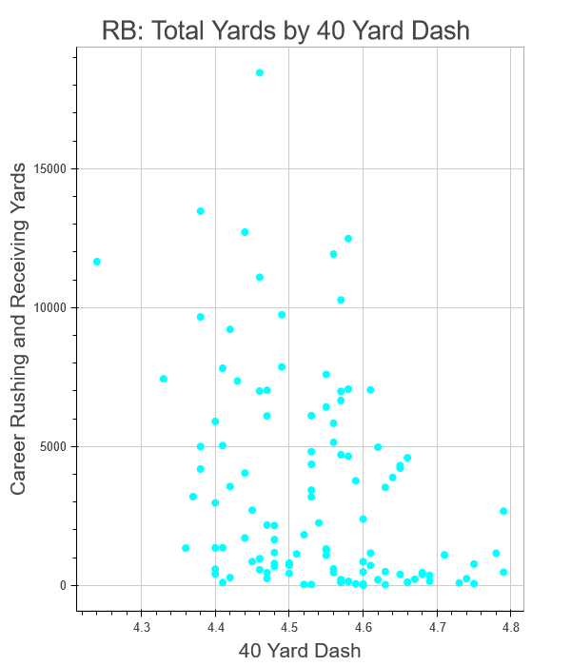
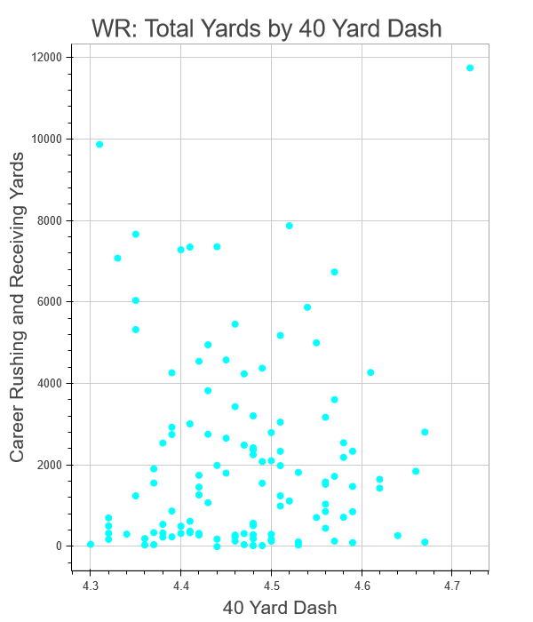
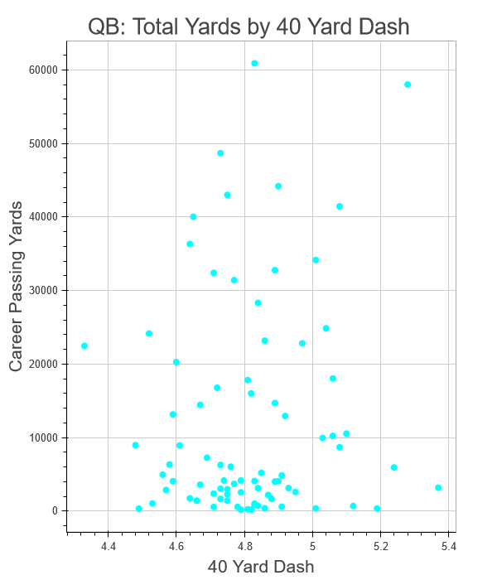
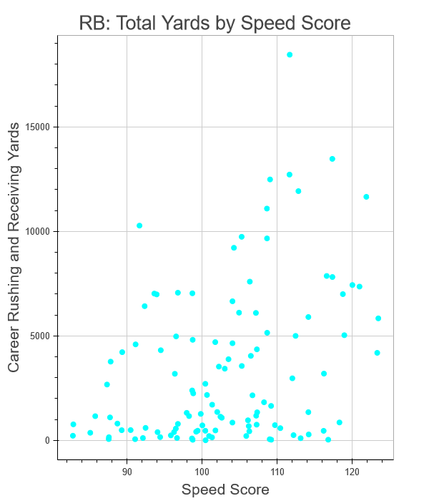
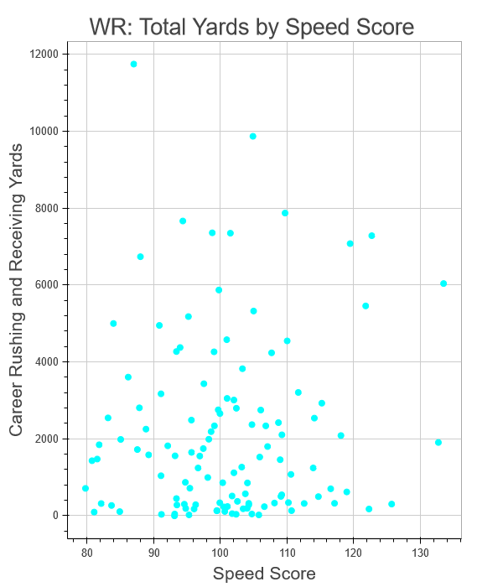
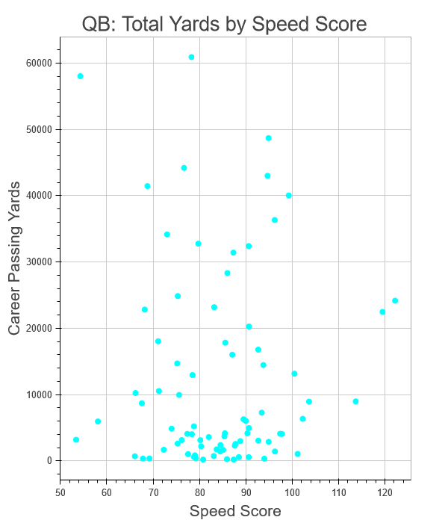
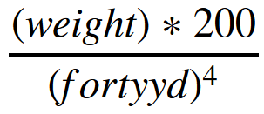
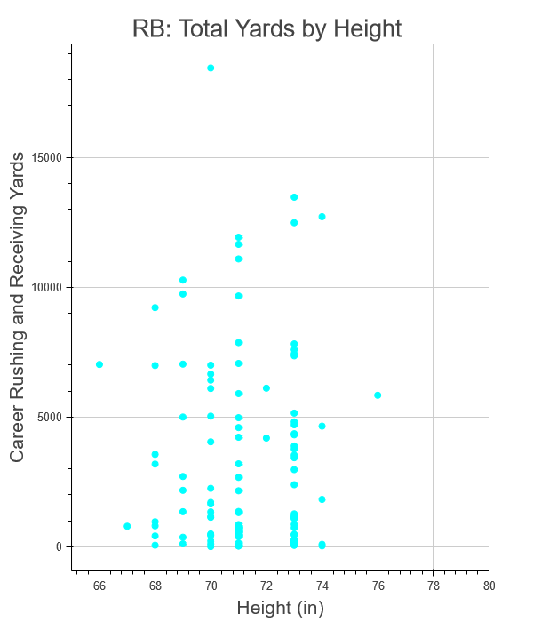
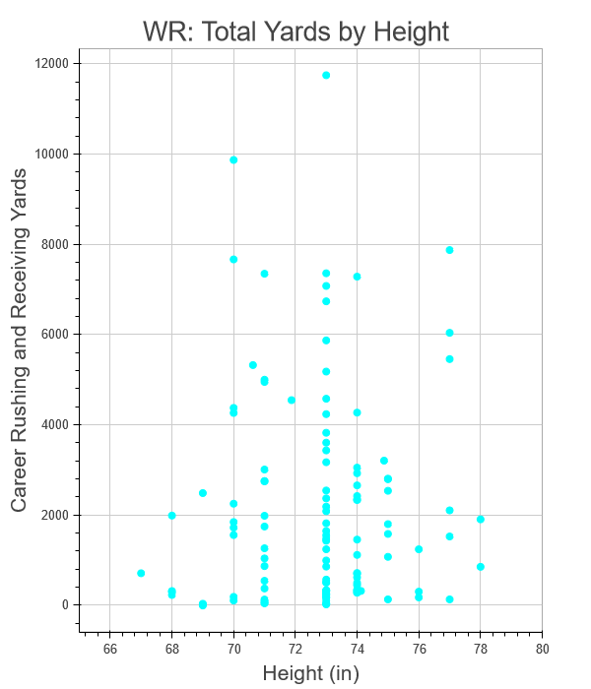
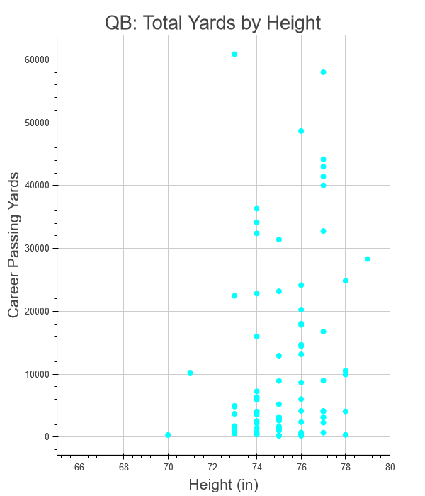
Predicting NFL Player Performance Using Pre-Draft Combine Measurables
Long Chen, Melaku Dubie, Rich Lee, and Kivan Polimis
Bivariate Analysis by Position
40 Yard Dash vs. Career Yardage
Speed Score vs. Career Yardage
Speed score is a metric used to measure speed that adjusts for players' weight and is calculated using the following formula:
Height vs. Career Yardage

