Slide 1

Dukaan Connect
From 17.6 days to one sitting
Dukaan Connect sells, verifies and installs small-business bundles on a phone, in the owner's own language.
Working prototype: 10 languages, 33 of 33 advisor scenarios, 12 of 12 KYC specimens, DPDP controls in code
Track A: Project Udyam Digital. Alabhya, IIIT-Delhi
Notes:
Dukaan Connect takes a small-business owner from first message to a verified, paid, booked installation in one sitting, in their own language. Everything in this deck is built and running; the numbers come from the official data pack.

Slide 2

7 in 100 leads become customers, after 17.6 days
Most leads leave before a quote; the ones who stay wait almost three weeks and chase us three times
17.6 days
from lead to activation, on average
2.0
3.0
4.1
3.8
4.8
Contact, assess, quote, KYC: 12.9 days before installation (4.8) begins
3.0
Rs 15,053
chase calls per customer
acquisition cost per activation
Leads reaching each stage; % is the share of the previous stage
Source: smb_leads.csv, official synthetic pack, 5,000 leads, April to June 2026. Days are averages for the 368 activated customers.
Notes:
Lead to activation is 7.4%. Contact, assessment, quote and KYC take 12.9 of the 17.6 days; installation itself is 4.8. Each activated customer called three times to ask about status, and acquisition cost Rs 15,053 per activation.

Slide 3
Two-thirds of lost leads are lost to the process
Every red bar is a step our journey removes; only the grey ones are about price, rivals or timing
67%
of drops (3,109 of 4,632) have a process cause a digital journey can fix
Process: we remove it
Market: price, rivals, timing
The top three need a salesperson to reach the owner. The journey needs neither a call nor a visit.
Source: smb_leads.csv, official synthetic pack, 5,000 leads, April to June 2026. Drop reasons of the 4,632 leads that did not activate.
Notes:
3,109 of 4,632 drops have a process cause. The top three, unreachable after three attempts, no time for a visit and visit not scheduled, all depend on a salesperson reaching the owner. A self-serve, WhatsApp-first journey needs neither.

Slide 4
Start where digital pays back fastest
Offices and micro retail first; multi-site and factories follow on an assisted path
Segment | Leads | Activation | Avg bundle | Cost to acquire | Payback | 6-mo churn | Launch
Micro retail and services | 54% | 4.1% | Rs 2,505 | Rs 20,007 | 8.0 months | 22.7% | Wave 1, via WhatsApp
Professional offices | 25% | 11.1% | Rs 6,796 | Rs 10,695 | 1.6 months | 13.8% | Wave 1, self-serve
Small multi-site | 15% | 11.0% | Rs 31,233 | Rs 15,614 | 0.5 months | 10.8% | Wave 2, assisted
Small manufacturers | 6% | 12.8% | Rs 19,980 | Rs 15,324 | 0.8 months | 8.1% | Wave 2, assisted
Dukaan Starter
Clinic and Office Pro
Multi-site One
Factory Connect
Kirana, 3 staff
Clinic, 5 staff
4 stores, 15 staff
Factory, 25 staff
Rs 2,196 a month
Rs 4,618 a month
Rs 23,779 a month
Rs 18,198 a month
Biz Fibre 100, 2 postpaid lines, Cloud POS. Add guest Wi-Fi, CCTV, website
Biz Fibre 300, 3 postpaid lines, 5 email seats, 1 TB backup, endpoint security
Per store: Biz Fibre 300, failover, SD-WAN, POS. Plus CCTV and 4 lines
Leased Line 20, managed firewall, 10 machine IoT kits, 25 email seats
Setup Rs 2,500 over 12 months
No setup fee
Setup Rs 45,000
Setup Rs 44,000
Segments: smb_leads.csv (synthetic). Bundles: our rules engine on product_catalogue.csv, 24-month price, before 18% GST.
Notes:
Professional offices convert at 11.1% and pay back in 1.6 months, so they go fully self-serve first. Micro retail is 54% of leads but takes 8 months to pay back through field sales; at Rs 300 to 500 a digital lead and 8% activation it pays back in about 1.5 to 2.5 months. Multi-site and manufacturers pay back in under a month even with a salesperson, so the advisor builds their quote and field sales close.

Slide 5
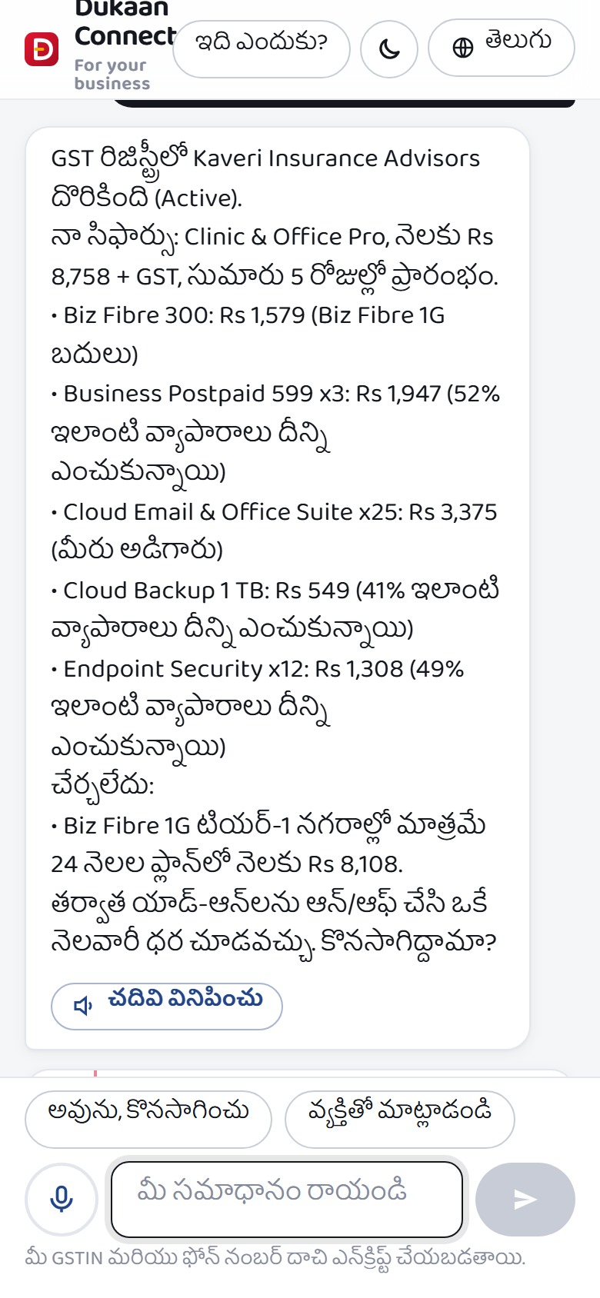
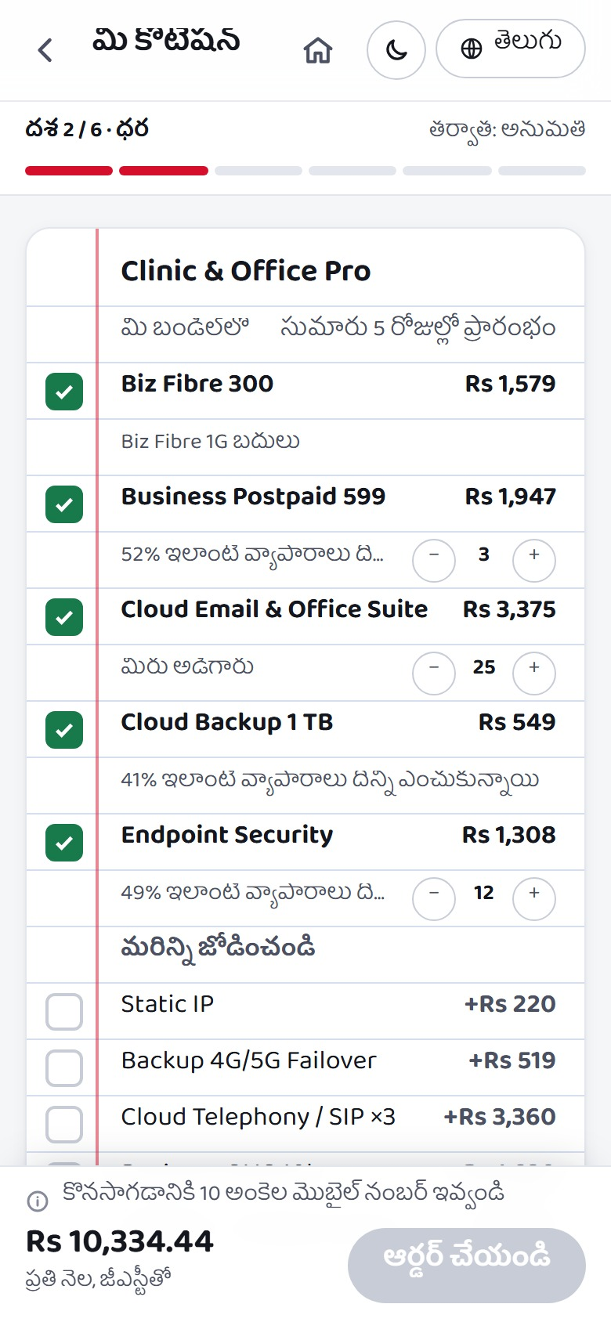
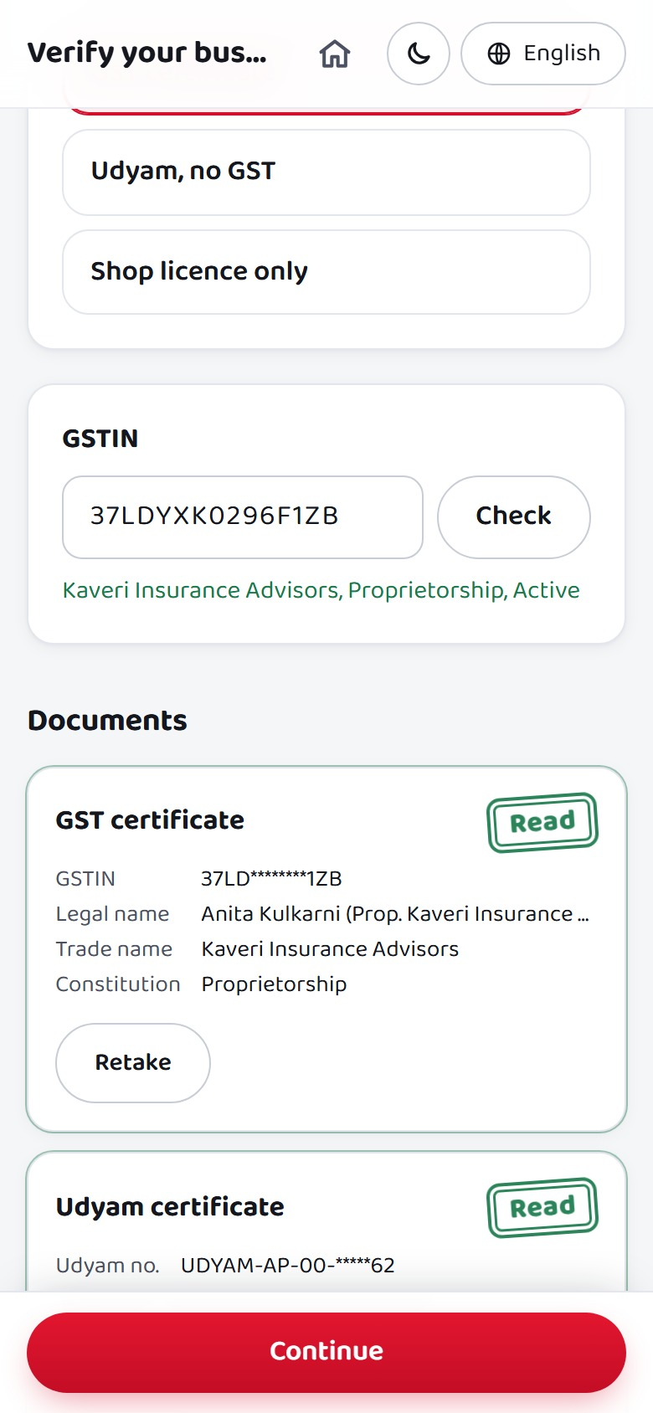
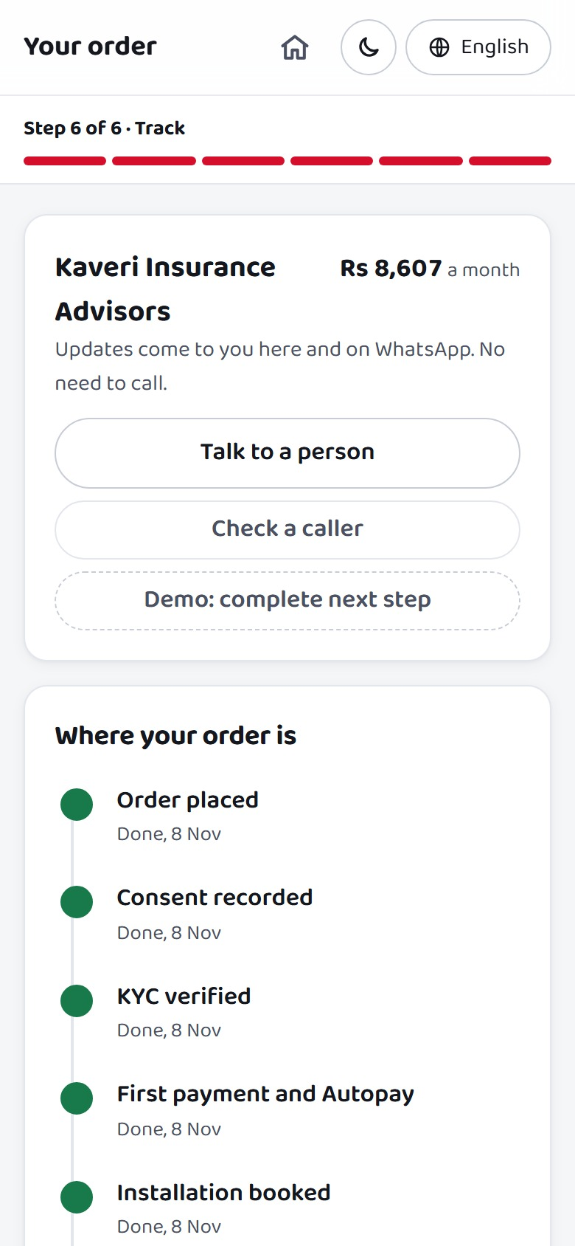
One sitting on a phone, in the owner's language
About 12 minutes from first message to booked install, consent and UPI included
1 Advisor, 4 min
2 Quote, 2 min
3 Smart KYC, 4 min
4 Tracker, until live
Chat or voice in 10 languages; the GSTIN fills in the business.
One monthly price; add-ons tick on and off; 12 or 24 months.
Registry first, then four photos read on our servers.
Every product dated; updates on WhatsApp, no calls.
Removes: no time for a visit (531), visit not scheduled (296)
Removes: quote too slow (179) or too complex (206)
Removes: paperwork too long (79), missing documents (94)
Chased 5 times: 27.9% churn. Once: 5.9%
Screens: the working prototype, specimen applicant K09 (Kaveri Insurance Advisors, Visakhapatnam). Drop counts: smb_leads.csv.
Notes:
The owner types or speaks in Telugu; the advisor reads the GSTIN and fills in the business. The quote is one monthly price with add-ons ticked on or off. KYC checks the registries first and reads four photos on our own servers. The tracker dates every product and sends WhatsApp updates, which matters: customers who chased five times churned 27.9%, against 5.9% after one call.

Slide 6
An advisor that cannot mis-sell
The language model talks and explains; a rules engine picks every product and price
"Insurance agency in Vizag, 25 staff, we need email", typed or spoken in Telugu
56 of 368
Owner
customers last quarter (15%) bought a product the catalogue forbids for them
Language model
Understands, asks what is missing, explains. Sees masked text only
Biz Fibre 1G in tier-2 cities: 24
GST-only products without an active GSTIN: 22
Static IP without fibre: 9
Below the minimum headcount: 8
calls as tools
Rules engine
Catalogue graph: eligibility, dependencies, quantities, price. Names the rule behind every exclusion
33 of 33
judge-style scenarios pass, tampered carts included. Zero eligibility violations, with or without an LLM
Guard
Every product and rupee in the reply must match the engine, or the engine's own wording is sent
Mis-selling: activated customers in smb_leads.csv against catalogue rules. Scenarios: /api/judge/scenarios.
Notes:
We answer the rule-based or RAG question with both. The model handles free text and voice in any of ten languages and explains the result. The engine walks the catalogue as a graph of needs, products, dependencies and eligibility. A guard blocks any reply that names a product or a rupee amount the engine did not produce. Last quarter 56 customers were sold something the catalogue forbids; the engine makes that zero, and runs without any model key at all.

Slide 7




KYC in minutes, private by design
Registries first, photos only corroborate; every problem comes with a fix the owner can do
1
Registry lookup
12 of 12 specimen applicants correct
GSTIN and Udyam status: Active, Cancelled or Suspended
Flagged
Passed
2
Photo quality gate
Planted defect
6
0
Blur and tilt; tilted photos are straightened
3
OCR on our servers
GSTIN checksum repairs misreads, never a digit
Clean
0
6
4
Cross-document checks
Legal name, address, bill from the last 90 days
Caught: cancelled GSTIN (K01), blurred photo (K04), missing Udyam (K05), tampered GSTIN (K06), name mismatch (K07), 257-day-old bill (K11). Last quarter, 22 activated customers held a cancelled or suspended GSTIN.
5
Signatory check
SIM swap in the last 72 hours, then a decision
Consent per purpose
Tokens, not raw IDs
AES-256-GCM per record
30-day photo shredding
Specimens: the 12 applicants in kyc_documents/ through the prototype's OCR. GSTIN status: smb_leads.csv.
Notes:
Lookups verify the business in seconds; DigiLocker can supply the Udyam certificate. Photos pass a quality gate, are read on our own servers, and a checksum repairs misread GSTIN characters without ever changing a digit. All 12 specimen applicants come out right: six planted defects caught, six clean applicants passed, no false rejections. Consent per purpose, tokens instead of raw identifiers and per-record encryption are covered in the one-page privacy note.

Slide 8



Partners earn more from digital, not less
Digital activations cost a fifth as much; partners keep their commission
Assist mode
Partners run the same app for a customer under their partner code. A digital close in their pin codes earns the same commission.
Callback queue
Stalled leads ranked by propensity (AUC 0.71) with the reason each stopped: 1,293 dropped leads in the top 30%. Calls go through a masked number.
Field sales where it pays
Multi-site and manufacturers, at Rs 20,000 to 31,000 a month, plus the exceptions: failed KYC, site surveys, installation.
Cost per activation by lead source. Blended: Rs 15,053
Cost: acquisition_cost_inr by lead source over activations, smb_leads.csv. Score: logistic regression, 5-fold CV.
Notes:
WhatsApp and referral activations cost about Rs 4,000, field sales over Rs 24,000. Partners are not cut out: they run the same app under their partner code and earn the same commission on digital closes in their pin codes. The back-office ranks the leads the advisor could not close by a propensity score; the top 30% hold 56% of all activations, and 1,293 dropped leads sit in that band.

Slide 9
Twice the conversion at a quarter of the cost
Conservative case 12.6%, target 15%: from fixing the process causes behind two-thirds of drops
Success metric | Baseline | 6-month target
Lead-to-activation conversion | 7.4% | 15%
Days from lead to activation | 17.6 | 7 or fewer
Cost per activation | Rs 15,053 | under Rs 4,000
Status-chase calls per customer | 3.0 | 0.5 or fewer
6-month churn | 15.2% | 10% or less
Guardrail: eligibility violations | 15.2% | 0
Guardrail: genuine applicants rejected at KYC | n/a | under 2%
Lead-to-activation conversion
+264
Rs 3.9 crore
activations a quarter
first-year contract value
Model: recovery share per drop reason through later stages, at 60% for the conservative case; Rs 400 a digital lead.
Notes:
For each drop reason we assume the share a digital journey recovers, for example 60% of 'quote took too long', 40% of 'no time for a visit', 5% of 'price too high' and none of 'locked in'. At 60% of those rates, conversion reaches 12.6%: 630 activations a quarter instead of 368. The 264 extra customers are worth about Rs 3.9 crore of first-year contract value. At Rs 400 per digital lead, cost per activation is Rs 3,175 at 12.6% and Rs 2,667 at 15%.

Slide 10






Pilot in 4 cities for 3 months, then scale
Measured against a control group, with the five metrics and two guardrails as the scorecard
Months 0 to 3
Months 3 to 6
Months 6 to 12
Pilot: Delhi, Mumbai, Vadodara, Kochi. Leads split against a control group
All tier-1 cities, 10 languages, WhatsApp at scale, partner assist live
Assisted path for multi-site and manufacturers; tier-2 cities
AI misquotes
KYC fraud
Partner conflict
Prices come only from the rules engine; a guard checks every rupee
Registry status, checksum, SIM swap, cross-document match, human review
Same commission on digital closes in a partner's pin codes
Installation capacity
Low digital literacy
Regulation
Slot booking at checkout; AirFiber where fibre is slow
Voice, 10 languages, partner assist on the same app
DPDP controls built in; DoT KYC rules for business SIMs followed
The ask: a 3-month, 4-city pilot with a control group, run on the prototype that works today
Pilot cities: the two tier-1 and two tier-2 cities with the most leads in smb_leads.csv.
Notes:
We ask for a three-month pilot in Delhi, Mumbai, Vadodara and Kochi, with leads split between the digital journey and the current process. If the scorecard holds, all tier-1 cities and ten languages follow by month six, and the assisted path for multi-site businesses and manufacturers by month twelve. Each top risk has a control already built into the prototype.

