Slide 1
SEO for CFS
-Team 3
1

Slide 2
Understanding the Market
2

Slide 3
Loans for bad credit, Emergency loans…
eChecking
Modestly wealthy customers
Open checking account
Carnegie Financial Services
eSavings
High yield saving accounts
Customers
eCDs
Certificate of Deposit
eLoans
Apply for loans
Wealthy customers
eMortgages
Mortgage against collateral
Custom loans, Luxury home loans…
3

Slide 4
SEO Results
Before optimization : 900/4544 (for specific keywords)
After optimization : 1.52/4544 (for specific keywords)
eLoans : 1/4500 eMortgages: 3.6/4500
eCDs : 1/4500 eChecks: 1/4500
eSavings: 1/4500
4

Slide 5
SEO process
Finding keywords and phrases
Analyzing
Redesigning
5

Slide 6
Finding keywords and phrases
1
6

Slide 7
1.Finding keywords and phrases
Define words: Google search, Wikipedia, Synonyms
Generate related keywords
Domain Specific keywords: Quora
Maximum traffic volume words: Google Trends
Differentiating between Attractors, Discriminators and General
81 relevant keywords
25 important keywords
7 attractors, 4 discriminators, 14 general
7

Slide 8
Analyzing keywords
2
8

Slide 9
2. Analyzing
Analyzed top 5 websites for each keyword
Studied top competitors
Site Design
Placement of content
Structural linking
Layout
Site Text
Keyword occurrence
Text relevance
Site Html
Html elements used
9

Slide 10
2. Analyzing(Observations)
Keywords in: Title (0.09) Body (0.63) URL (0.05) Meta (0.03) Alt (0.03) Inlink (0.18)
Ignoring Stop words
(Keywords : text) ratio
Heading text (h1~h2>h3..)
10

Slide 11
Redesigning
3
11

Slide 12
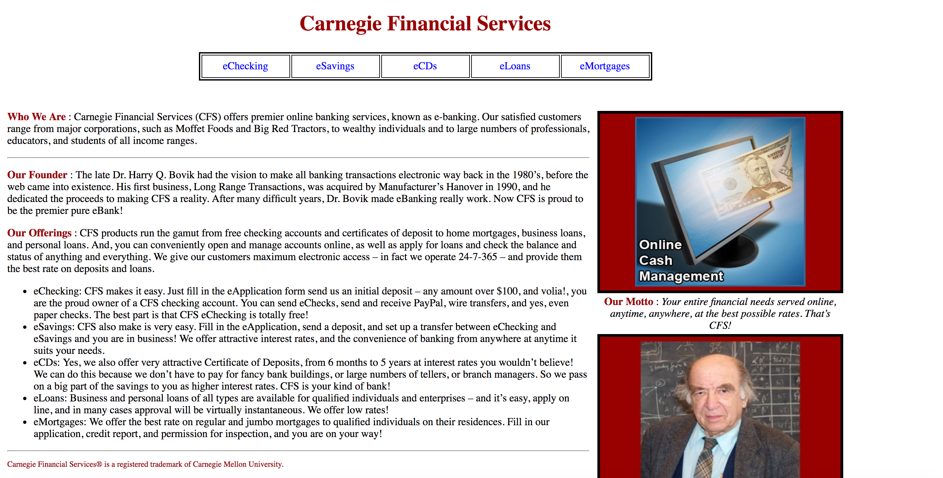
3. Redesigning(Old site)
<no title>
<All content in 1 page>
<no links>
<no alt>
<not focused text>
12

Slide 13
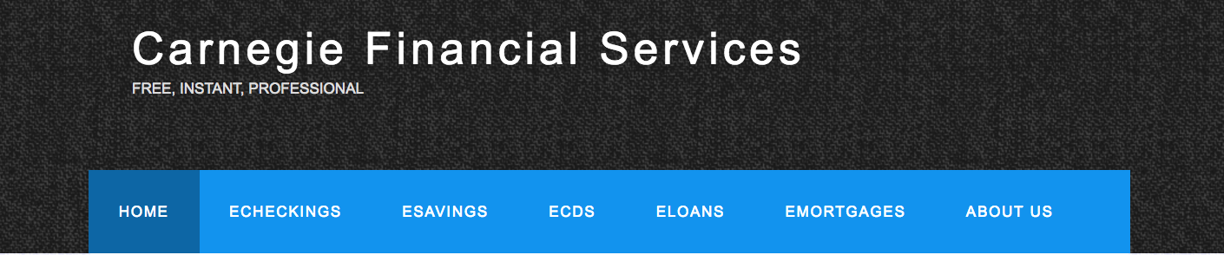
3. Redesigning(New site)
Relevant title tag
Meta description/keywords
Linked menu
13

Slide 14
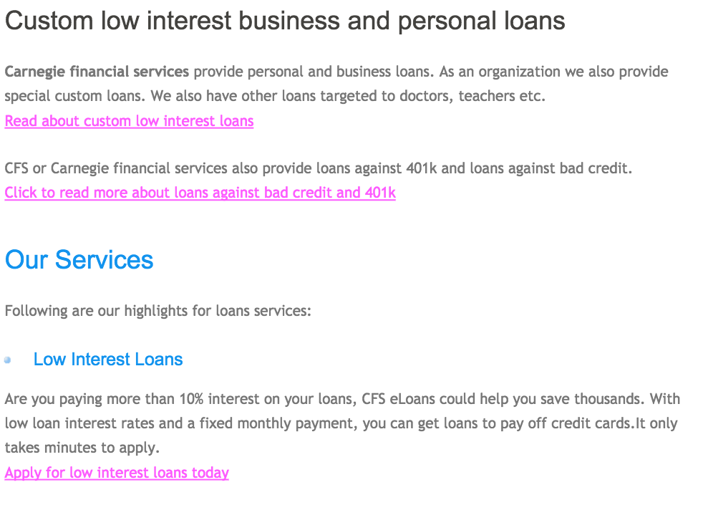
3. Redesigning(New site)
Links in body with relevant keywords
Use of multiple headers
Minimum stop words and irrelevant words
14

Slide 15
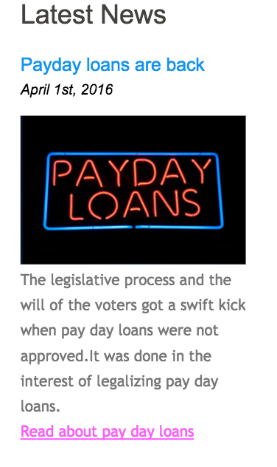
3. Redesigning(New site)
Images with alt tags
15

Slide 16
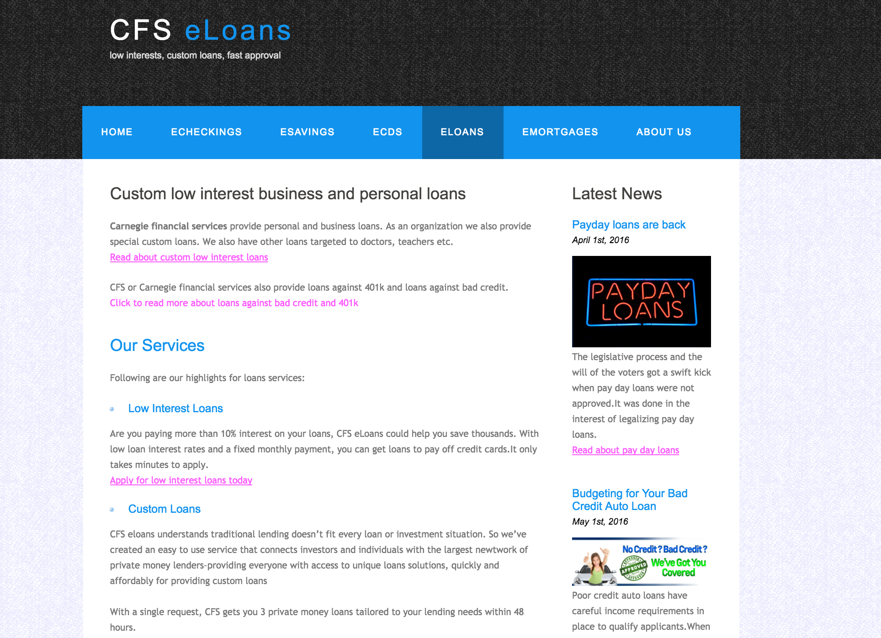
3. Redesigning(New site)
Optimal layout for covering maximum content
16

Slide 17
1.53/4544
Present ranking for specific keywords
17

Slide 18
Do’s & Don’t’s
Recommendations for further optimization
18

Slide 19
Do’s
easily optimizable keywords
keyword/text ratio
multiple linked pages
weights of keywords in each tag.
Substring identification not synonyms
Don'ts
Invalid links
Irrelevant content
<meta>
All content in one page
Bad layout
19

Slide 20
Q&A
Thank you
20

