Slide 1
Social Networks

Slide 2
Review and Background
Network = graph
Vertex (node, site)
Edge (link, bond)
graph (network) is
a pair of sets G ={V, E}
V is a set of N nodes (vertices)
E is a set of edges connecting elements of V
Edges do not have length (except in metric spaces)

Slide 3
Network Models
Random graphs
Taking n dots and drawing nz/2 lines between random pairs
Completely ordered lattice
A low dimension regular lattice
Watts-Strogatz model (Small-world)
A low dimension regular lattice with some degrees of randomness
Barabasi-Albert model (Scale-free)

Slide 4
Properties
Degree of a vertex is a number of edges attached to it (if directed – incoming and outgoing degree)
Geodesic path – the shortest path from one node to another (measured in nodes)
Diameter of the network – the longest geodesic path between any two vertices (not mean)
Average geodesic path length

Slide 5
Random Graphs
Studied by P. Erdös A. Rényi in 1960s
How to build a random graph
Take n vertices
Connect each pair of vertices with an edge with some probability p
There are n(n−1)/2 possible edges
The mean number of edges per vertex is

Slide 6
Degree Distribution
Probability that a vertex of has degree k follows binomial distribution
In the limit of n >> kz, Poisson distribution
z is the mean

Slide 7
Erdös-Rényi random graphs
Reminder: take N nodes, connect each pair with some probability p
If p large enough large clusters appear, at p=1 graph is fully connected

Slide 8
Characteristics
Small-world effect (Milgram 60s)
Diameter (Bollobas)
Average vertex-vertex distance
Grows slowly (logarithmically with the size)
Some inaccuracies describing real-world networks
Degree distribution (not Poisson!)
Clustering (Network transitivity)
If A and B have a common friend C it is more likely that they themselves will be friends.
Random graph : z / n
social networks, biological networks in nature, artificial networks – power grid, WWW ranging from 0.08 to 0.59

Slide 9
Clustering
If A is connected to B, and B is connected to C, then it is likely that A is connected to C
“A friend of your friend is your friend”
The average fraction of a node’s neighbor pairs that are also neighbors each other
Count up the total number of pairs of vertices on the entire graph that have a common neighbor and the total number of such pairs that are also themselves connected, and divide the one by the other

Slide 10
Clustering—cont.
Clustering measures the fraction of neighbors of a node that are connected themselves
Regular Graphs have a high clustering coefficient
– but also a high diameter
Random Graphs have a low clustering coefficient
– but a low diameter
Both models do match the properties expected from real networks!
Regular Graph (k=4)
Long paths
– L ~ n/(2k)
Highly clustered
– C~3/4
Random Graph (k=4)
Almost no clustering
– C~k/n

Slide 11
Small-World Model
Watts-Strogatz (1998) first introduced small world mode
connects regular and random networks
Regular Graphs have a high clustering coefficient, but also a high diameter
Random Graphs have a low clustering coefficient, but a low diameter
Characteristic of the small-world model
The length of the shortest chain connecting two vertices grow very slowly, i.e., in general logarithmically, with the size of the network
Higher clustering or network transitivity

Slide 12
Solvable small-world model
Starting with the lattice: every node is connected to its 2k nearest neighbors (N=24, k=3)
Newman, Moore, Watts, Phys.Rev.Lett. 84 (2000) 3201
Add new links without removing old ones
Equivalent to the original model in N tends to infinity limit

Slide 13
Scale-Free Network
A small proportion of the nodes in a scale-free network have high degree of connection
Power law distribution
A given node has k connections to other nodes with probability as the power law distribution with exponent γ ~ [2, 3]
Examples of known scale-free networks:
Communication Network - Internet
Ecosystems and Cellular Systems
Social network responsible for spread of disease

Slide 14
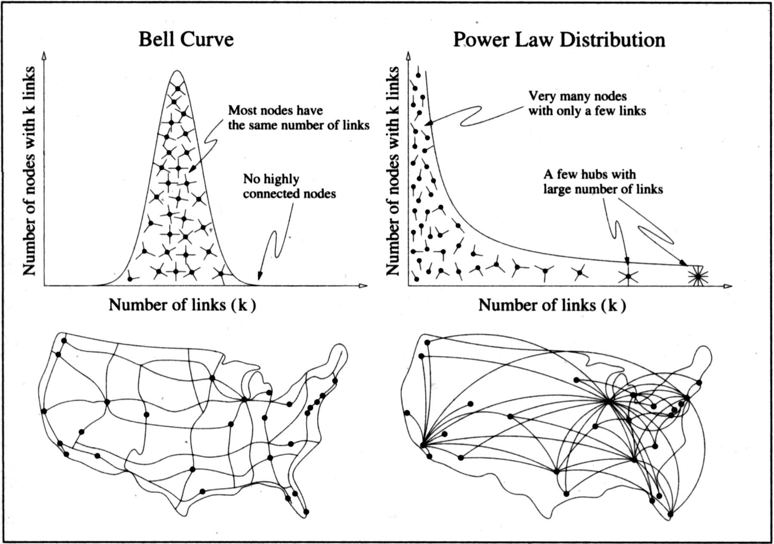
Reprinted from Linked: The New Science of Networks by Albert-Laszlo Barabasi

Slide 15
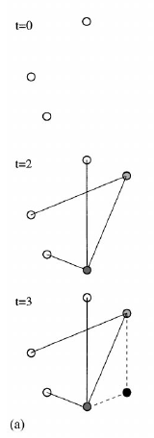
Barabasi-Albert Networks
Science 286 (1999)
Start from a small number of node, add a new node with m links
Preferential Attachment
Probability of these links to connect to existing nodes is proportional to the node’s degree
‘Rich gets richer’
This creates ‘hubs’: few nodes with very large degrees

Slide 16
Analysis
t_{i}: time vertex i is added

Slide 17
Scale-free Networks: Good and Bad
Scale-free networks cannot be broken by random node removal
‘Attacks’ can bring them down: hackers’ attacks, major servers (DNS) downed by a computer virus
In scale-free networks there is no epidemic threshold: any outbreak should become an epidemic
Berger et al, On the spread of viruses on the Internet, Proceedings of the 16th annual ACMSIAM symposium, 2005

