Slide 1
Roles and Positions

Slide 2
Outline
Background
Definition of Structural Equivalence
Positional Analysis
Measuring Structural Equivalence
- Euclidean Distance
- Correlation (Pearson product-moment)
- Other measures
Representation of Network Positions
- Partitioning Actors
- Spatial Representations of Actor Equivalences
- Ties between and Within positions

Slide 3
Social Roles and Positions
Position
A collection of individuals who are similarly embedded in networks of relations (ex. in social activity, ties, or intersections, with regard to actors in other positions)
This concept is quite different from the concept of cohesive subgroup (Why? based on the similarity of ties rather than their adjacency, proximity, or reachability.)
Example
Nurses in different hospitals occupy the position of “nurse” though individual nurses may not know each other, work with the same doctors, or see the same patients

Slide 4
Social Roles and Positions
Role
The patterns of relations which obtain between actors or between positions
An associations among relations that link social positions
Collections of relations and the associations among relations
Example
Kinship roles
Defined in terms of combinations of the relations of marriage and descent
Roles of corporate organization
Defined in terms of levels in a chain of command or authority

Slide 5
Overview of Positional and Role Analysis
Group relations
Multirelational
Data
(Global Roles)
Usual Role
Analysis
Associations among relations
for an entire group (ch11)
Positional analysis problem
Locating subsets of actors
who are similar across the
collection of relation
Grouping actors into
equivalence classes
Group actors
Group actors
Associations among relations
from the perspectives of
individual actors or subset of
Actors (ch12)
Usual Positional
Analysis
Roles and
Positions
Group relations
(Local (Individual) Roles)
The system of relations between the positions
=> Image matrices, density tables, and blockmodels

Slide 6
Definition of Structural Equivalence
Definition of SE:
Actor I and j are structurally equivalent if actor I has a tie to k, iff j
Also has a tie to k, and i has a tie from k iff j also has a tie from k.
Notations

Slide 7
Structural Equivalence
Example (Sociomatrix and directed graph)
Sociomatrix
1
2
Both have ties
to 3 and 4
 | 1 | 2 | 3 | 4 | 5
1 | - | 0 | 1 | 1 | 0
2 | 0 | - | 1 | 1 | 0
3 | 0 | 0 | - | 0 | 1
4 | 0 | 0 | 0 | - | 1
5 | 0 | 0 | 0 | 0 | -
Both have ties
to 5
3
4
5
Directed graph
3 subsets of structural equivalent actors
➔ B1 = {1,2}, B2 = {3,4}, B3 = {5}

Slide 8
Structural Equivalence
Some issues in Defining Structural Equivalence
First, we must note whether the data set is single or multirelation.
Then, we must consider whether it is,
Dichotomous or valued
Directional or nondirectional
A relation on which self-ties are substantively meaningful

Slide 9
Positional Analysis
Simplification of Multirelation Network
One of the major objectives of a positional analysis
Ideal positional analysis
Complete positional analysis
Image matrix
Describing the ties between positions
Rows and columns refer to positions rather than individual
Reduced graph
Nodes ≡positions, arcs ≡ties between positions
Graph homomorphism
Ex.

Slide 10
Positional Analysis
Sociomatrix
Permuted and partitioned sociomatrix
 | 1 | 2 | 3 | 4 | 5 | 6 | 7 | 8 | 9
1 | - | 0 | 0 | 1 | 0 | 0 | 0 | 0 | 1
2 | 0 | - | 0 | 0 | 1 | 0 | 1 | 0 | 0
3 | 0 | 1 | - | 0 | 1 | 1 | 1 | 1 | 0
4 | 1 | 0 | 0 | - | 0 | 0 | 0 | 0 | 1
5 | 0 | 1 | 0 | 0 | - | 0 | 1 | 0 | 0
6 | 0 | 1 | 1 | 0 | 1 | - | 1 | 1 | 0
7 | 0 | 1 | 0 | 0 | 1 | 0 | - | 0 | 0
8 | 0 | 1 | 1 | 0 | 1 | 1 | 1 | - | 0
9 | 1 | 0 | 0 | 1 | 0 | 0 | 0 | 0 | -
 | 6 | 3 | 8 | 4 | 1 | 9 | 2 | 5 | 7
6 | - | 1 | 1 | 0 | 0 | 0 | 1 | 1 | 1
3 | 1 | - | 1 | 0 | 0 | 0 | 1 | 1 | 1
8 | 1 | 1 | - | 0 | 0 | 0 | 1 | 1 | 1
4 | 0 | 0 | 0 | - | 1 | 1 | 0 | 0 | 0
1 | 0 | 0 | 0 | 1 | - | 1 | 0 | 0 | 0
9 | 0 | 0 | 0 | 1 | 1 | - | 0 | 0 | 0
2 | 0 | 0 | 0 | 0 | 0 | 0 | - | 1 | 1
5 | 0 | 0 | 0 | 0 | 0 | 0 | 1 | - | 1
7 | 0 | 0 | 0 | 0 | 0 | 0 | 1 | 1 | -
Image matrix
Three subsets of structural equivalent actors
B1 = {6,3,8}, B2 = {2,5,7}, B3 = {4,1,9}
 | B1 | B2 | B3
B1 | 1 | 0 | 1
B2 | 0 | 1 | 0
B3 | 0 | 0 | 1

Slide 11
Position Analysis
Graph
(from the partitioned sociomatrix)
Reduced Graph
(from the image matrix)
5
B3
B1
1
2
7
B2
4
9
B2
3
8
B3
6
B1

Slide 12
Position Analysis
Tasks in a Positional Analysis
We need an assessment of how good the represention is.
4 steps
Equivalence Definition
Specifying the formal mathematical conditions
Measure of Equivalence
Representation
Representation of the assignments of actors
Discrete model (sometimes, spatial model)
Statement of how the positions relate to each other
Reduced graph, image matrix, and blockmodel
Assessment of Adequacy
Goodness-of-fit

Slide 13
Position Analysis
Measuring Structural Equivalence
Euclidean Distance
Single relation
Multiple relation
The value of the tie from i to k on a single relation
Sum of the size of relations
The value of the tie from i to k on relation

Slide 14
Position Analysis
Measuring Structural Equivalence
Correlation (Pearson product-moment)
Single relation
Multiple relation
The mean of the values in column i
The mean of the values in row i
The correlation between two actors may be equal to +1, indicating perfect SE.

Slide 15
Position Analysis
Measuring Structural Equivalence
Some considerations
Other measures of structural equivalence
Multiple Relations and Multiple Sociomatrices
Calculating across two or more sociomatrices
Comparison of Some Measure of Structural Equivalence
The formal relationship between correlation and Euclidean distance using the means and the variance

Slide 16
Representation of Network Positions
Partitioning Actors
Partitioning Actors using CONCOR
Partitioning Actors using Hierarchical Clustering
Spatial Representations of Actors Equivalences
Ties Between and Within Positions
Density Tables: positions rather than individual actors
Values: the proportion of ties that are present from the actors in the row positions to the actors in column
Image Matrices
The fundamental to blockmodel
Reduced Graphs
Represented as nodes and ties between positions
From the image matrix, “1” indicates an arc form the node of the row positions to the node of the column.

Slide 17
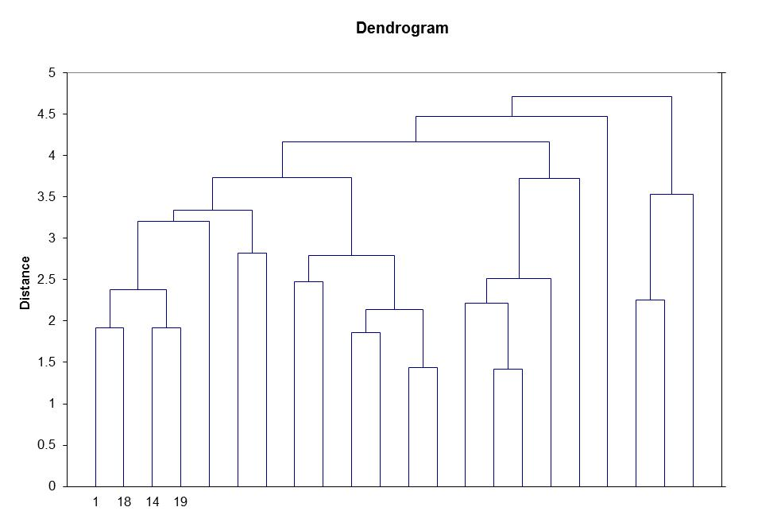
Hierarchical Clustering

Slide 18
Representation of Network Positions
Example (from the data of advice relation for Krackhardt’s high tech managers, p.389)
Density Table
Image matrix
 | B1 | B2 | B3 | B4
B1 | 0 | 1 | 1 | 1
B2 | 1 | 1 | 1 | 0
B3 | 0 | 0 | 0 | 1
B4 | 0 | 0 | 1 | 1
 | B1 | B2 | B3 | B4
B1 | 0.367 | 0.625 | 0.944 | 0.833
B2 | 0.708 | 0.750 | 0.528 | 0.375
B3 | 0.056 | 0.167 | 0.194 | 0.722
B4 | 0.250 | 0.250 | 0.667 | 1.000
Reduced graph
The total density = 0.452
< 0.452 → “0”, > 0.452 → “1”
Sharp Gap = 0.528 – 0.375 = 0.153
B3
B4
B1
B2

Slide 19
Advanced
Automorphic and Isomorphic Equivalence
Regular Equivalence (RE)
“Types” of Ties
Local Role Equivalence
Ego Algebras

