Slide 1
Structural Social Capital

Slide 2
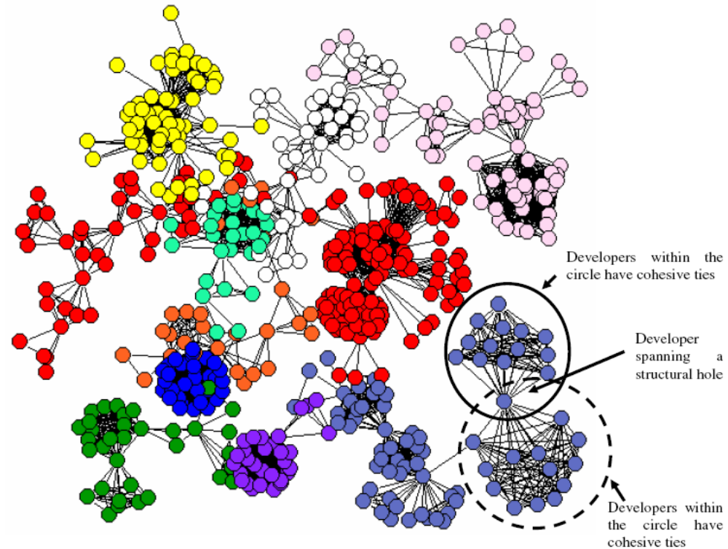
Illustrative Network

Slide 3
Network Elements – Network Cohesion
Cohesiveness means that ties are redundant
  To the degree that they lead back to the same actors
  Such redundancy increases the information transmission capacity in a group of actors having cohesive ties
  It promotes sharing and makes information exchange
    Speedy
    Reliable
    Effective
  Information between two actors in a cohesive group can flow through multiple pathways; this increases the speed as well as reliability of information transfer.

Slide 4
Network Cohesion
Cohesiveness in the group
  gives rise to trust, reciprocity norms, and a shared identity
  leads to a high level of cooperation
  facilitate collaboration by providing self-enforcing informal governance mechanisms
Cohesive ties enable richer and greater amounts of information and knowledge to be reliably exchanged
  The groups also provide meaningful context for information and resource sharing
  The trust among the members in the group affords them to be creative
  This creativity helps in coming up with alternative interpretation of current problems, or novel approaches to solve these problems

Slide 5
Network Elements – Structural Hole
Cohesion
  Lead to norms of adhering to established standards and conventions
  Potentially stifle innovation
The standards, conventions and knowledge stocks vary across groups.
Structural holes are the gaps in the information flow between these groups.
Actors who connect different groups are said to fill these structural holes.
Teams composed of actors who span different groups may have several advantages.

Slide 6
Structural Hole
Teams composed of actors who span different groups may have several advantages.
  Technical or organizational problems and difficulties of an actor in one group can be easily and reliably relayed to developers in other groups. The solutions for these problems may be obvious to someone and would be quickly and reliably relayed back.
  Each group has its own best practices (organizational or technical perspectives) which may have value for other groups. The actors who connect these groups can see how resources or practices in one may create value for other and synthesize, translate as well as transfer them across groups.
  Resource pooling across groups provide actors opportunities to work on different but related problem domains, which may help them in developing a better understanding of their own problems.

Slide 7
Structural Hole vs Network Closure
These two arguments promote two contradicting predictions.
The network cohesion argument predicts that teams formed of actors who share cohesive ties will be more successful due to better coordination and communication resulting from increased information transmission capacity.
The structural holes argument predicts that teams formed of actors who span structural holes will be more successful due to access to wider range of knowledge resources.

Slide 8
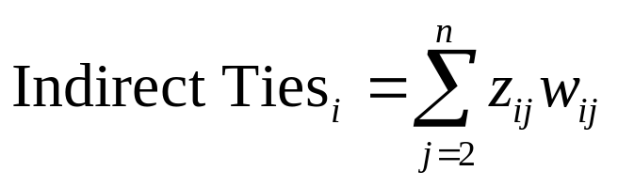
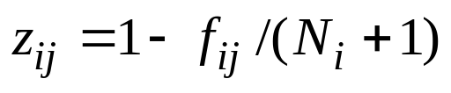
Measures
Direct Ties
Indirect Ties
  n: total number of actors in the network
  w_{ij}: number of actors that lie at a path length of j from i
  z_{ij}: decay associated with the information that is received from developers at path length j
    f_{ij}: number of developers that i can reach within and including path length j
    N_{i}: total number of developers that i can reach in the network

Slide 9
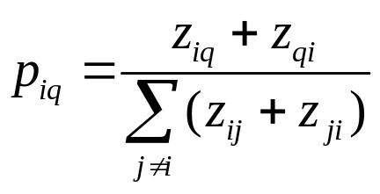
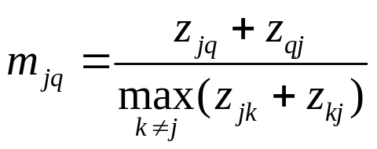
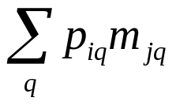
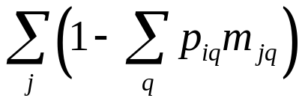
Measures - Redundancy
  p_{iq} → proportion of i’s time and effort invested in the relationship with q
  m_{jq} →marginal strength of j’s relation with q
  Redundancy of j
  Effective size of i

Slide 10
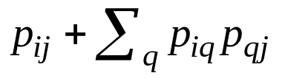
Measures - Constraint
Computed as:
  Where
    p_{iq} → proportion of i’s time and effort invested in the relationship with q

Slide 11
Example
Size 6
Non redundant size 4.667
Efficiency .778
Constraints
  A .1512
  B .0851
  C .0278
  D .0494
  E .0434
  F .0434
A
B
F
C
E
D

