Slide 1
Econometric Models

Slide 2
Outline
Challenges in observing and measuring social interaction
Diffusion
Dynamics
Latent space

Slide 3
Challenges - Conceptual
Confounding effects
  Social influence
  Homophily
  Exogenous shocks

Slide 4
Challenges - Conceptual
Social influence
  Time varying
  Targeted
Homophily
  Could be time invariant, for example, demographics
  What about taste?
Exogenous shocks
  Tim variant
  Homogenous – everyone is exposed to it

Slide 5
Challenges - Estimation
Specification
  Omitted variables
  Instrument variables
  Endogeneity
Identification
  Reflection problem
  Social structure
  Nonlinear
  Timing
Laboratory and field experiments

Slide 6
Overview
Social structure is generally endogenous and related to multiple characteristics of the agents involved
Homophily
How to single out social influence
  Account for other related characteristics
  Feedback
A model has to be properly specified so that different characteristics are “identifiable” and distinguishable given the data

Slide 7
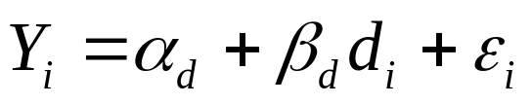
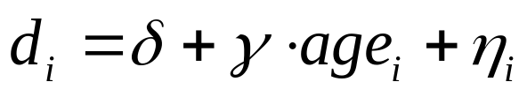
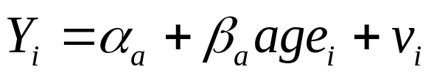
Specification
Omitted variables
Suppose that degree in a network is correlated with age
We hypothesize that people with higher degree behave differently
Degree varies with age
If the true relationship
Then, degree is just a proxy

Slide 8
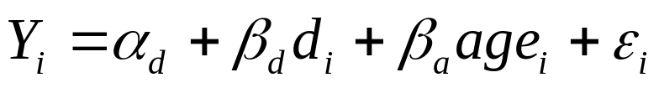
Specification
However, if the true relationship
Then, if age is omitted, we have a biased estimate of social influence (degree)
If γ > 0, then, β_{d} is inflated!
What about multicollinearity?

Slide 9
Instrument variable
Suppose we want to examine the effect of degree on wealth
Vary degree while holding other factors constant
Using controlled experiment
  Difficult
Instrument variable
  Vary with degree but not with omitted variable (for example age)

Slide 10
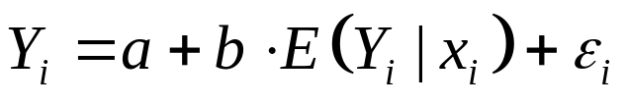
The reflection problem
Manski 1993, 2000
Identification problem
Behavior is determined by behavior, there is a circularity of cause and effect, so it is difficult to sort out the social influence of behavior on behavior
Consider that the behavior of an agent is a linear function of the average level of the behavior taken by other members of her/his cohort:
  Here we have the same attributes x_{i}

Slide 11
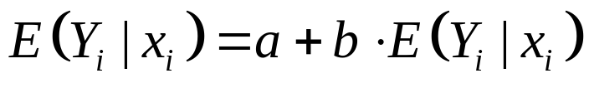
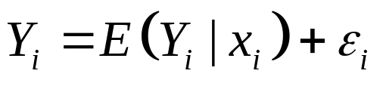
The reflection problem
What if we take the expectation
The solution a = 0, b =1
So we end up with a tautological relationship
Y_{i} is its expectation plus noise, tell us nothing about endogenous social interaction
i’s behavior is a function of the expectation of peer behavior, which is just the expectation of i’s behavior, which reflects i’s behavior
Relationship not properly defined

Slide 12
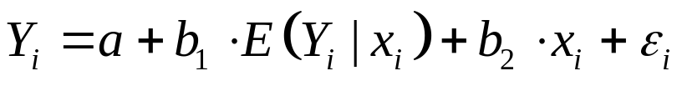
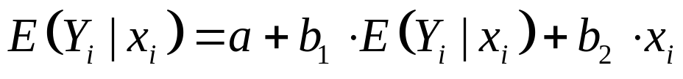
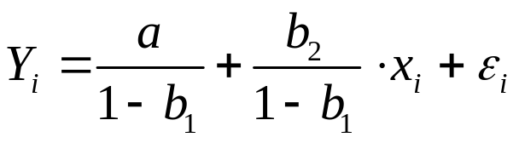
The reflection problem
What if we include agent’s attributes
Take the expectation
And, we get
But, we cannot uniquely identify a, b₁, b₂

Slide 13
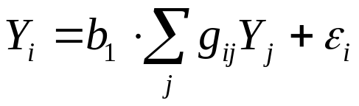
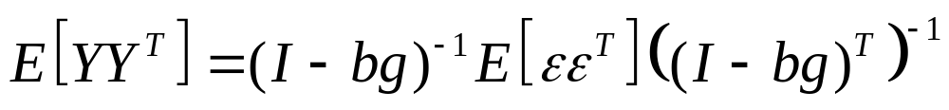
Social structure
Reflection problem: i’s peers are not identified directly but assumed to be similar.
But, we can track social structure and measures, then
This is identifiable

Slide 14
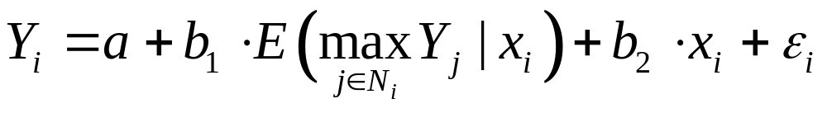
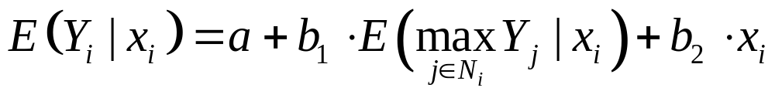
Other ways
Nonlinearities
No longer a tautology
Timing
  Lagged

Slide 15
Lab and field experiments
Observe how social structure affects behaviors
  Compare behaviors across network positions
  Communication and learning
  Behavior in networks exogenously imposed or chosen
Test alternative theories of behavior in network contexts
  Self-interest
  Homophily

Slide 16
Diffusion

Slide 17
Introduction
Framework by Strang and Soule
Build on the Bass model
Elements
  social

Slide 18
External Sources
Mass media
  Collective action
Change agents

Slide 19
Internal influence
Cohesion through strong ties
  Trust, conformity
News through weak ties
Structural equivalence and competition
  SE actors pay more attention
Prestige
Spatial proximity
Cultural categories

Slide 20
Dynamic Model

Slide 21


Introduction
Based on the work of Snijders
Consider n actors:
Longitudinal
Markov chain model of dichotomous social network
  Markov Chain Monte Carlo (MCMC)

Slide 22

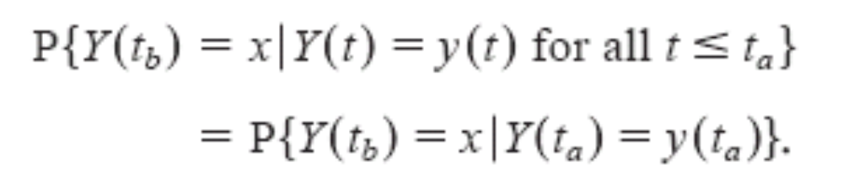
Model preliminaries
Stochastic actor
Outcome
The probability:

Slide 23
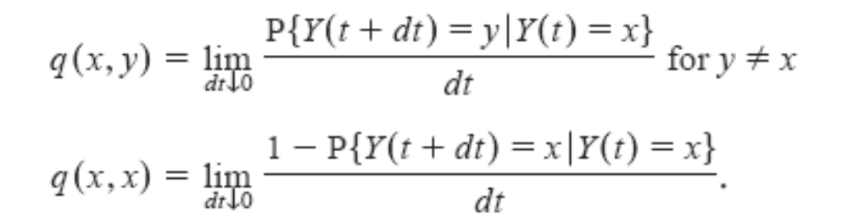
Model preliminaries
Continuous-time Markov transition density:
Interpreted as the rate of change

Slide 24
Model preliminaries
The transition matrix is defined as:
Where
And Q is the matrix with matrix element q(x, y)

Slide 25



Simple specification
Stochastic actor-oriented
Actor objective function for actor i:
indicate a change from to
A chance to change its social relation
Random

Slide 26

Random utility component
Actor m changes its social relation at a rate ρ_{m}
This defines the inter-event time interval
The probability that actor i changes its social relation with actor j is modeled as logit function:

Slide 27

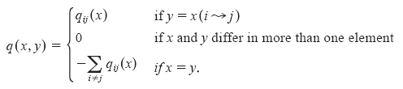

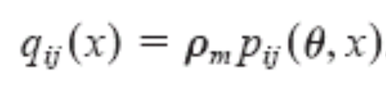
Intensity matrix
Change rate:
  Only allow one change at a time
For time period

Slide 28
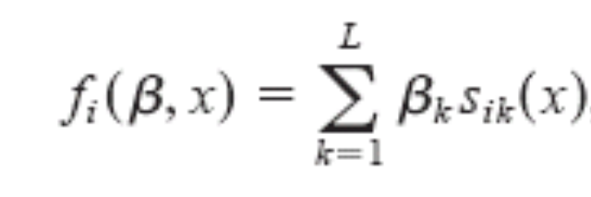

Specification
We specify the objective function
Here are the covariates
  Actor-dependent
  Pair-dependent

Slide 29
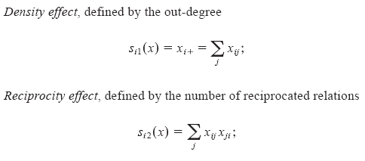
Covariates

Slide 30
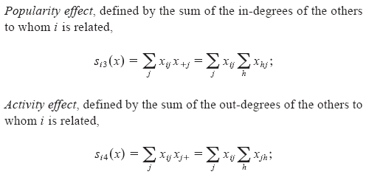
Covariates

Slide 31
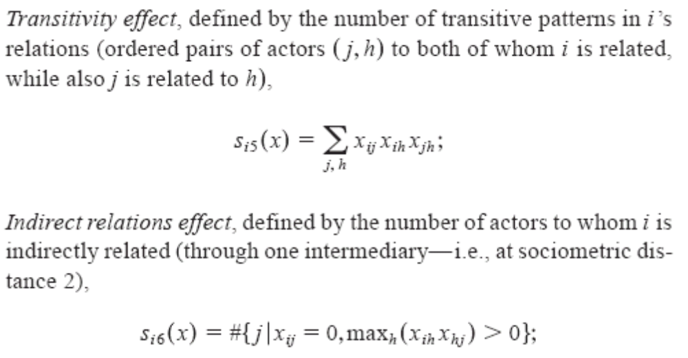
Covariates

Slide 32
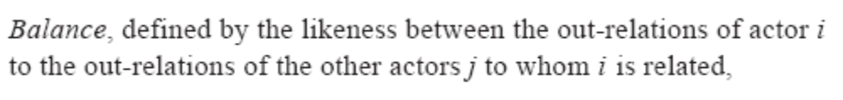
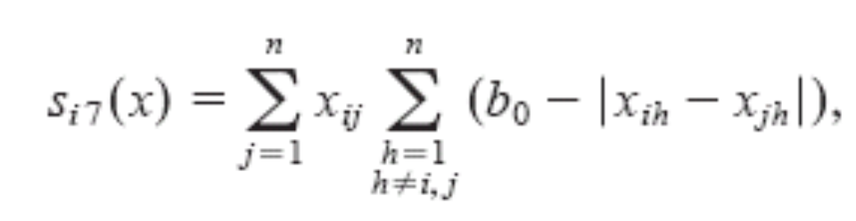
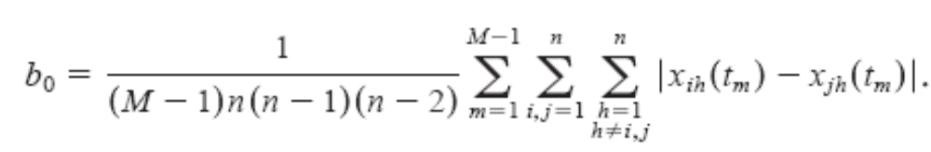
Covariates

Slide 33
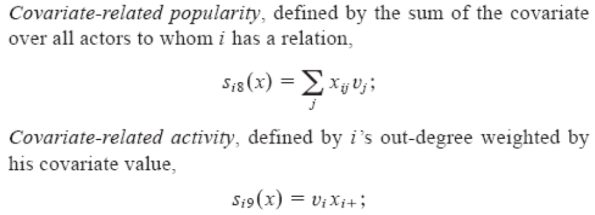
Covariates

Slide 34
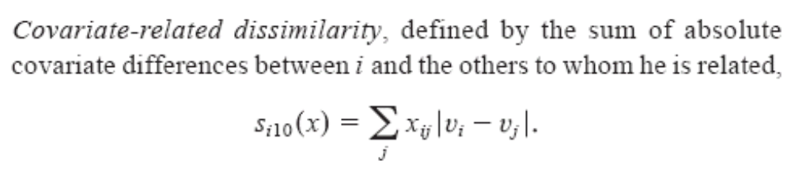
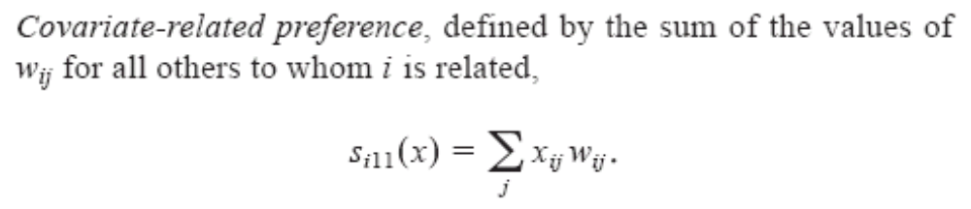
Covariates

Slide 35
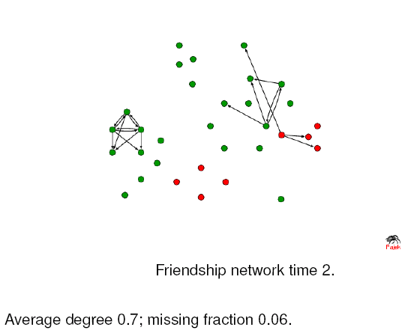
Example
32 students, 7 waves in a year

Slide 36
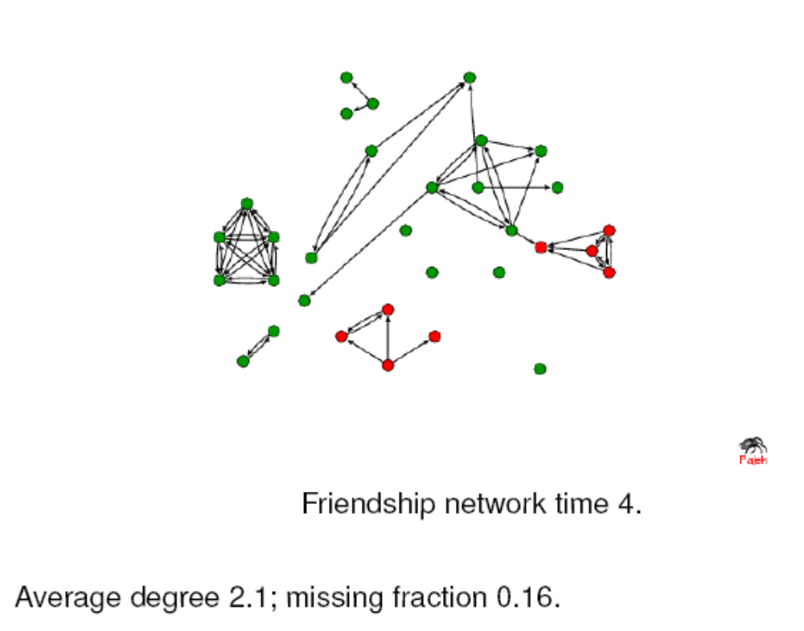
Example

Slide 37
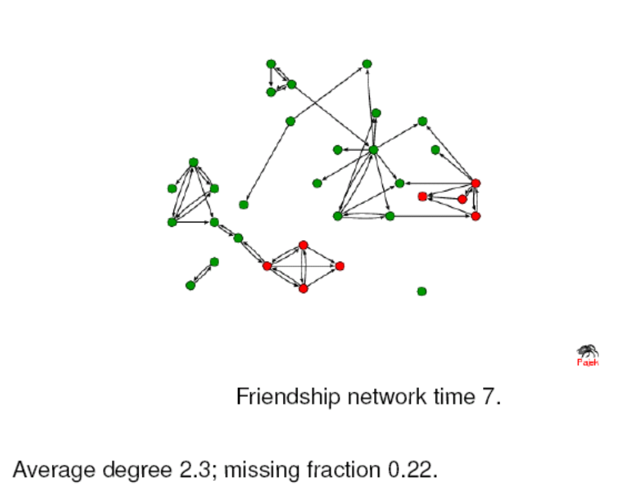
Example

Slide 38
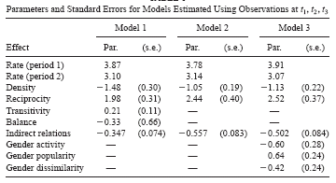
Example

Slide 39
Latent Space Model

Slide 40
Introduction
Hoff, Raftery and Handcock (2002)
Each actor is assumed to have a position in a social space
The positions are unknown and so the social space is a latent one
The probability of a link between two actors depends on the distance between them in the social space
Link:
http://www.stat.washington.edu/raftery/Research/latentnet.html
R module

Slide 41
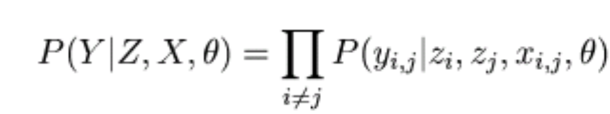
Latent position model
n x n sociomatrix Y with y_{i,j}
The probability of observing Y:
observed
Need to estimate

Slide 42
Distance models
A logistic regression with the probability of a tie between i and j
Depending the distance between z_{i} and z_{j}
The model is reciprocal and transitive
Also, symmetric

Slide 43
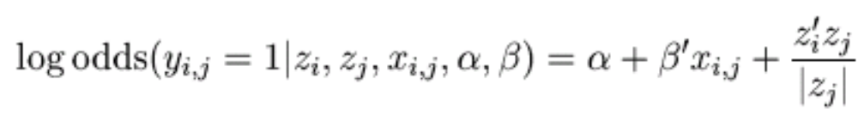
Projection models
A logistic regression with the probability of a tie between i and j
Depending the projection of z_{i} in the direction of z_{j}
Estimation using maximum likelihood

Slide 44
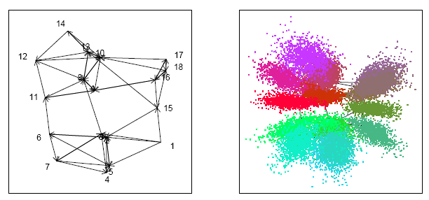
Monk data
Perform better than Block model

Slide 45
Latent constructs
Generalized latent variable models
  Unobservable
    Can it be inferred?
SEM
HMM
POMDP

