Slide 1
MicroMegas Trigger Processor Implementation
Nathan Felt
2015 May 4

Slide 2
ART Data/Trigger Processor Overview

Slide 3
ADDC GBT Data Packet
Each ADDC will service 2 sets of 32 VMMs and have 2 fiber outputs using the GigaBit Transceiver (GBT) architecture. One fiber per 32 VMMs
The GBT packet in widebus mode will provide 112 data bits at a rate of 4.8 Gbs and arrives once every bunch crossing
HIT_CNT = 4-bit number of hits (range 0 - 8; 9 - 15 invalid)
ART_DATA = 6-bit triggered VMM strip number
ARTDATA_PARITY = 8-bit parity, one per hit
HIT_LIST= The triggered state of each of the 32 VMMs will be represented as a single bit in this 32-bit field.

Slide 4
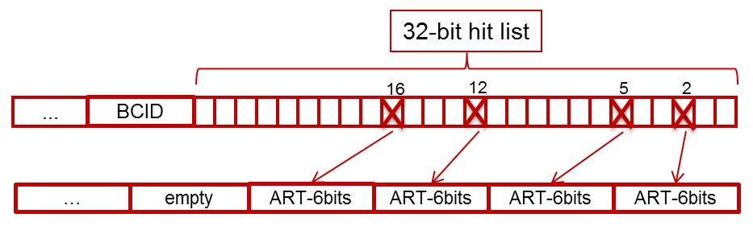
ADDC GBT Data Packet

Slide 6
Implementation
320 MHz Internal Clock
1/16th sector slice, containing all elements of algorithm implemented
Modelsim used for simulation
Xilinx Vivado 14.4 used for synthesis and PAR
No timing errors in algorithm
Extrapolated resource estimate
70% targeting a ‘485
50% targeting a ‘690.
Source code on SVN

Slide 7
Development Platform

Slide 8
Development Platform
Matlab used for all data formatting, communication and analysis
Communication uses TCP/IP on Mircroblaze with AXI interface to Programmable Logic
ADDC Emulator
Generates GBT packets from track data files
Currently lives in Trigger Processor FPGA
GBT Loopback
Option to bypass
Implementation uses code from the CERN GBT-FPGA project

Slide 9
Development Platform
Algorithm hardware results comparable to computer simulation
Currently working on increasing the bit resolution of some variables, This will likely increase latency by 6 – 9 ns
Initial data communication with BNL ADDC verified

Slide 10
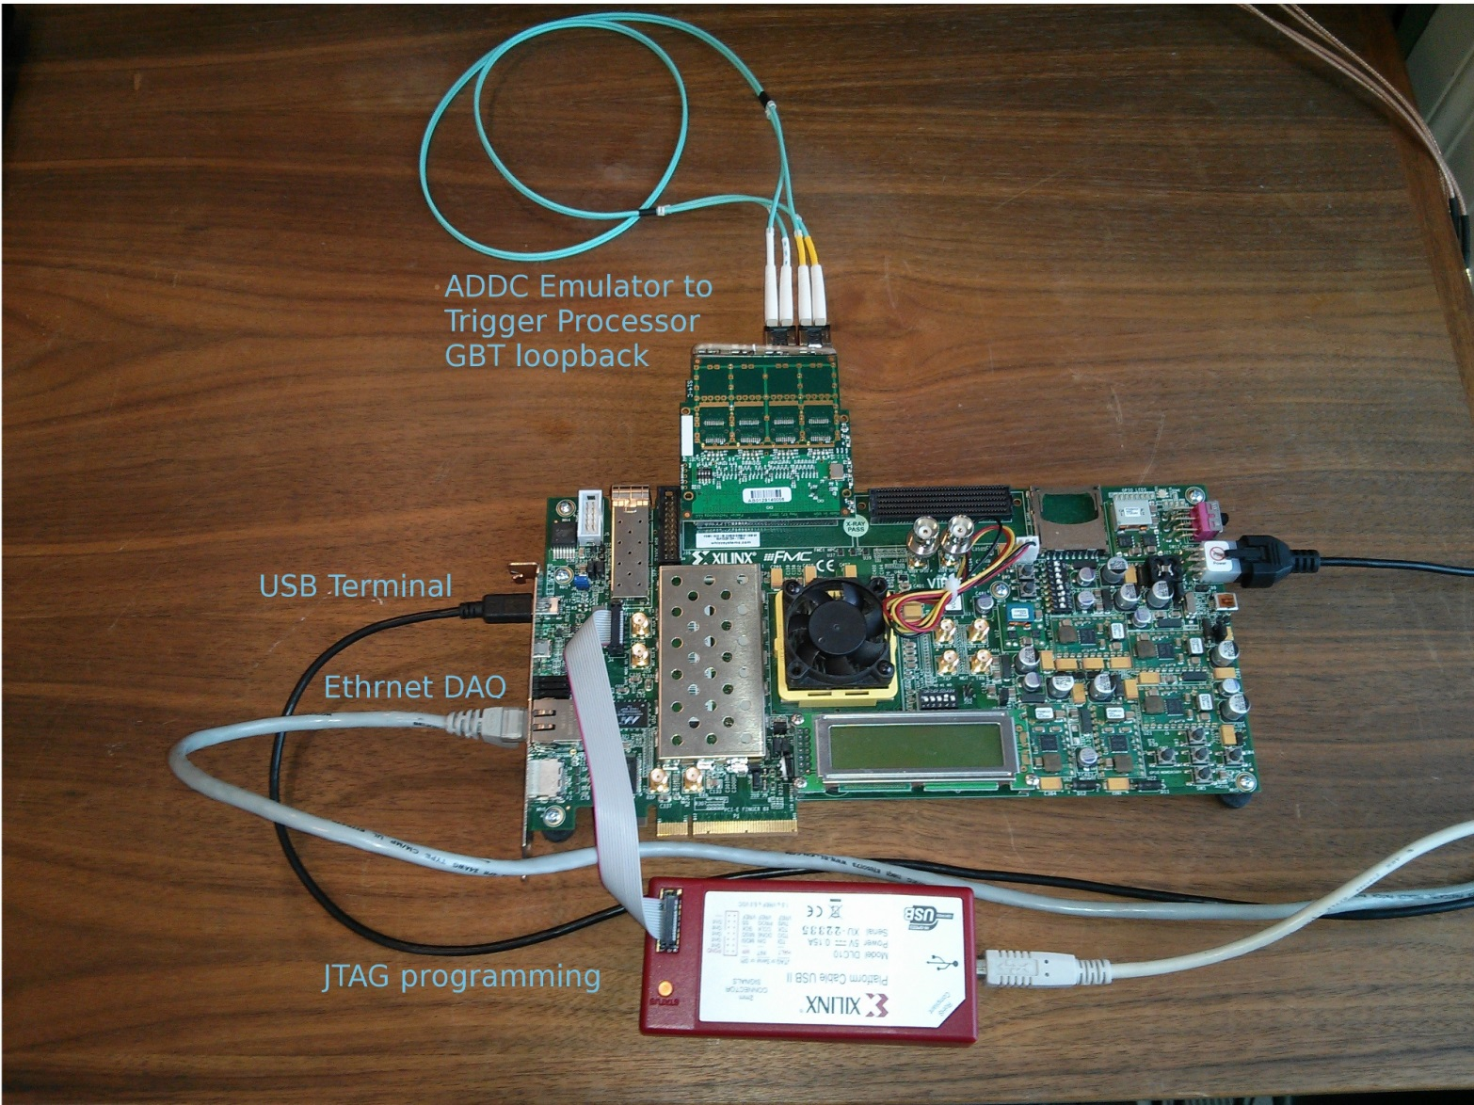
Development Platform

Slide 11
Ancillary functions
Ancillary functions common to both MM and sTGC can be shared as well-defined packages.
Ancillary functions Include
Timing and Trigger control (TTC)
Level-1 pipeline and derandomizer
read/write of configuration parameters
monitoring
playback for debugging
Segment output to Sector Logic
Segment output to “other” detector’s trigger processor
Three groups will participate in writing the firmware:
Harvard
Illinois
Weizmann

Slide 13
Backup

Slide 14
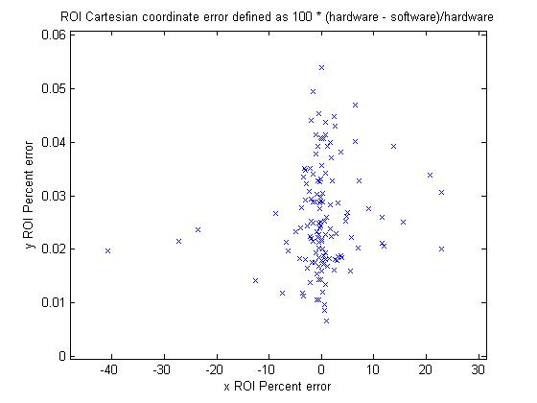
Hardware / Software Example Comparisons

Slide 15
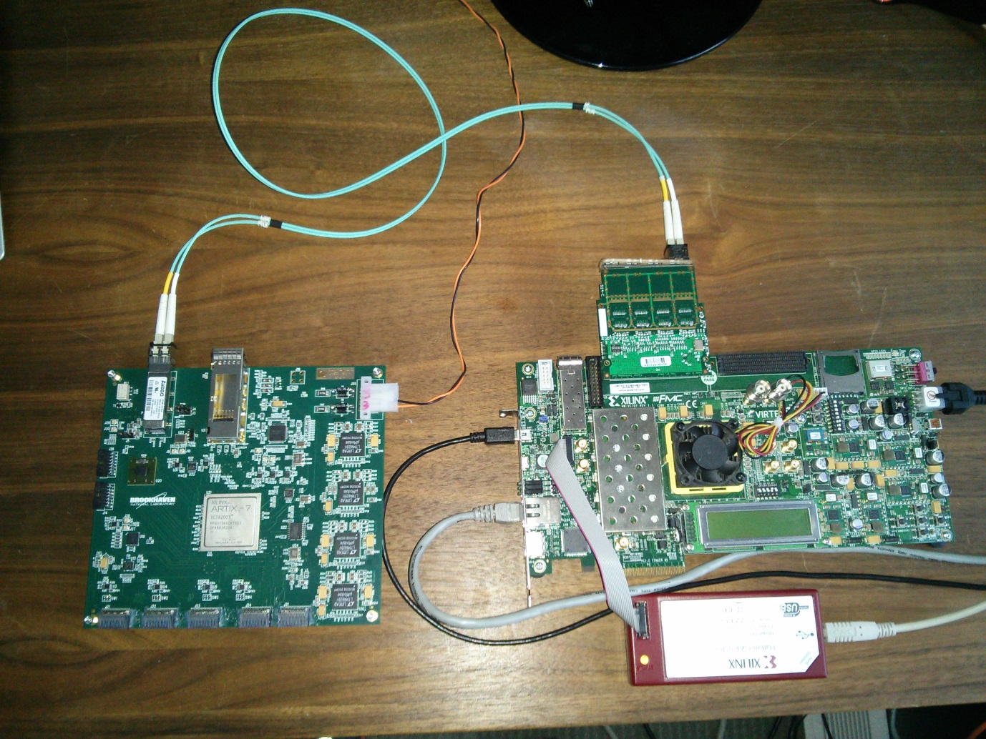
Trigger Processor with ADDC

Slide 16
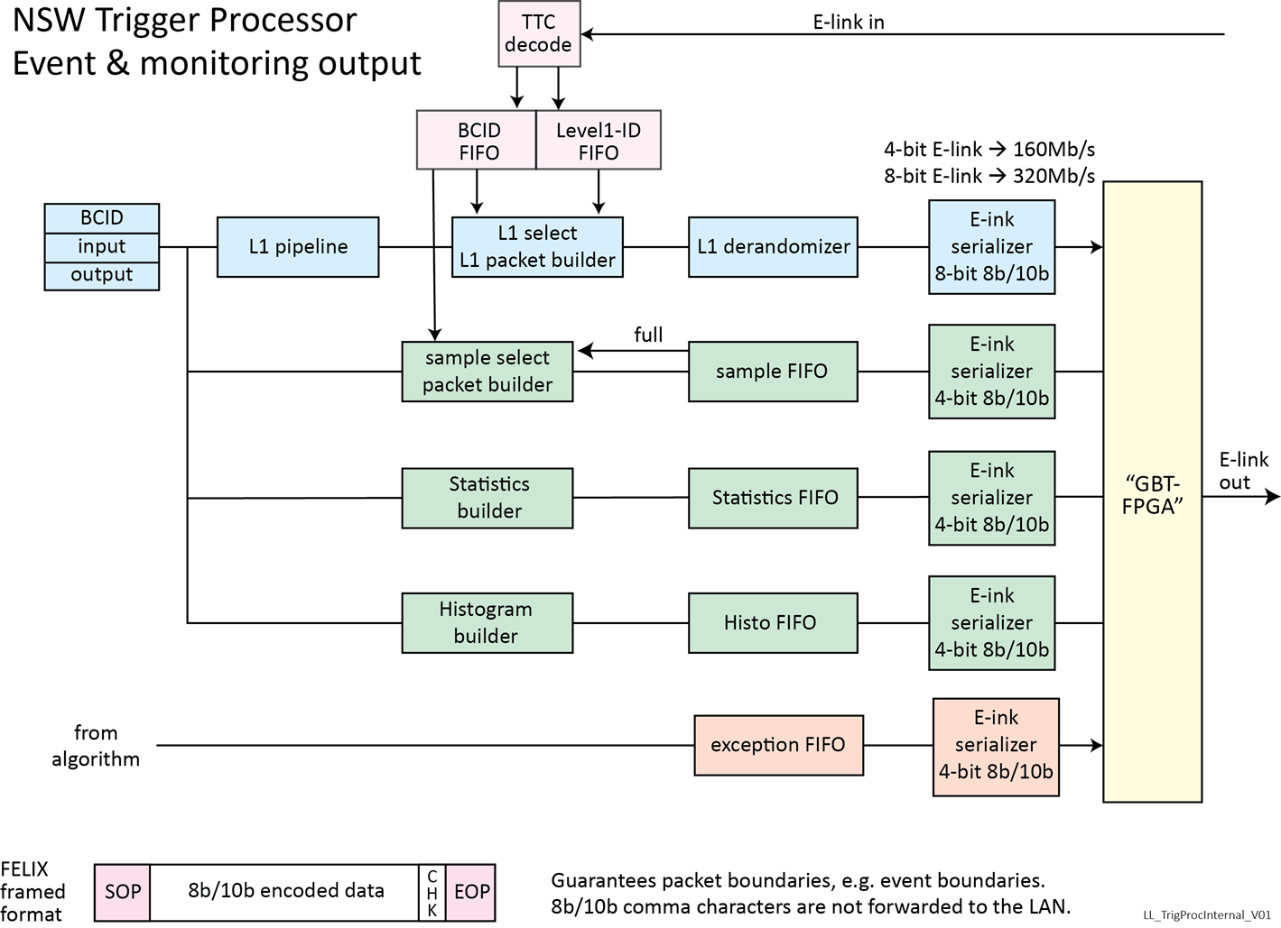
Monitoring Functions

Slide 17
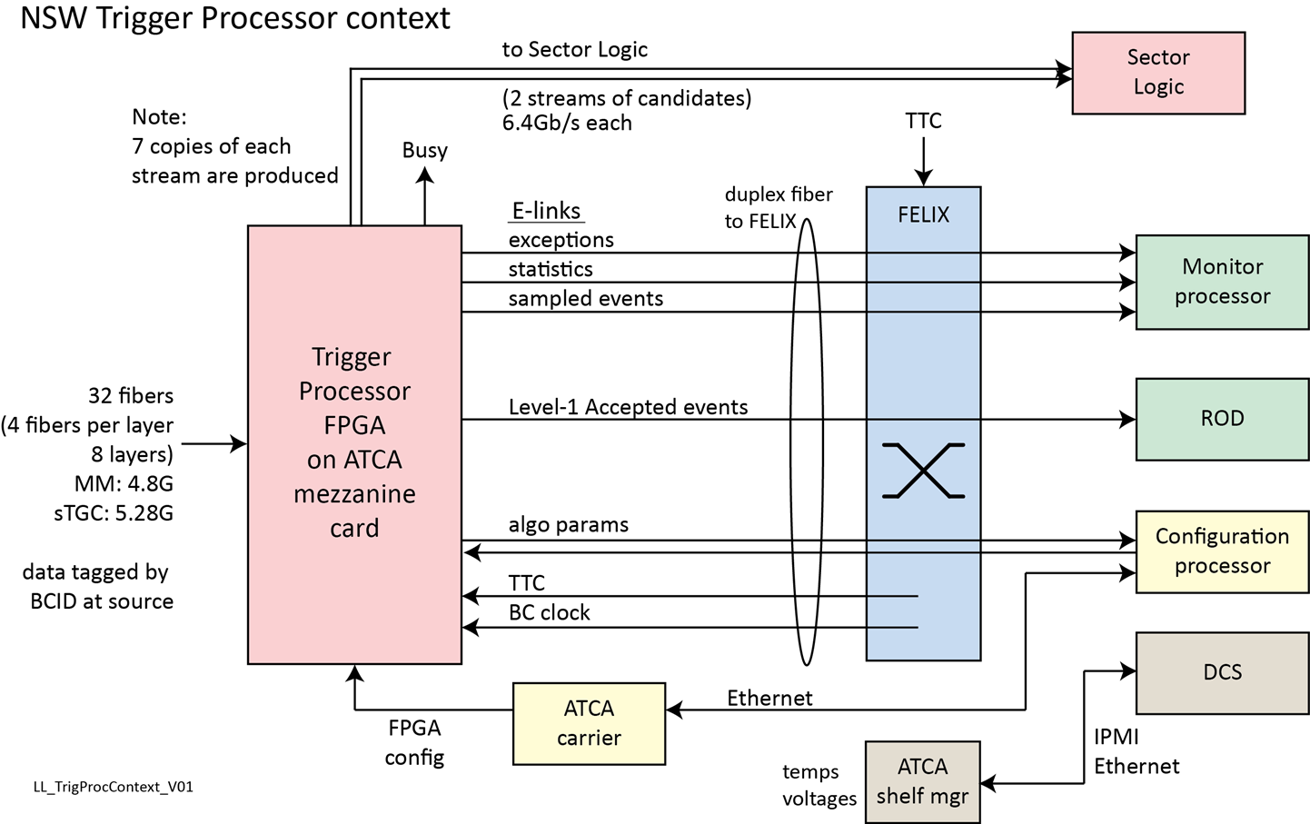
Data Path

