Slide 1
Trigger Processor
Implementation
Nathan Felt
Harvard University
2014 July 10

Slide 2
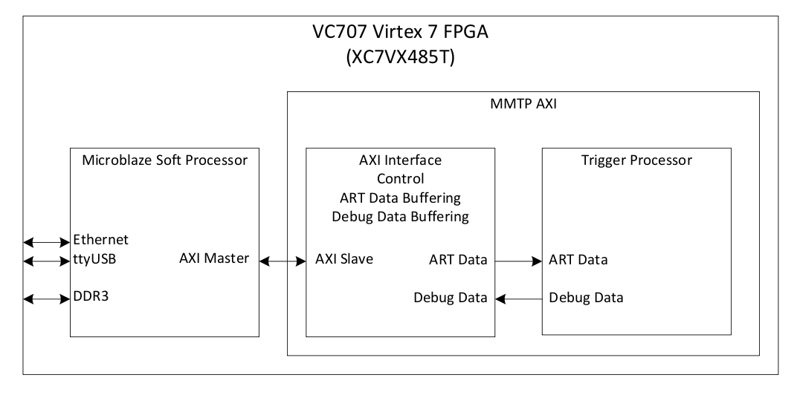
Eval Board Overview

Slide 3
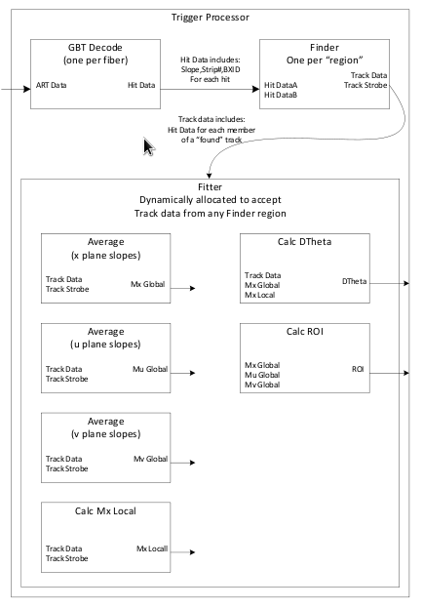
GBT Decode
  Deserialize ART data
  Calc slope using mult DSP slice
Finder
  Each finder has unique upper and lower slope road boundaries
  Collect hits within its boundaries
  Regions have overlapping boundaries
  Pass hits only from track candidate that satisfy plane occupancy requirements to Fitter
  Background hits will expire in Finder
Fitter
  Calculate ROI, dq
2 tics
3 tics
2 tics
3 tics
3 tics
2 tics
5 tics
2 tics
5 tics

Slide 4
Multi-Region Structure
ART Data
From ADDC
Finder
GBT Decode
Slope calc
Finder
Fitter
GBT Decode
Slope calc
Finder
...
ROI
...
Finder
x 32
...
GBT Decode
Slope calc
Fitter
Finder

Slide 5
Software
Simulation using Mentor Graphics Modelsim and Matlab
Trigger Processor algorithm synthesized using Mentor Graphics Precision Synthesis
Place and route using Xilnx Vivado
DAQ and analysis in Matlab

Slide 6
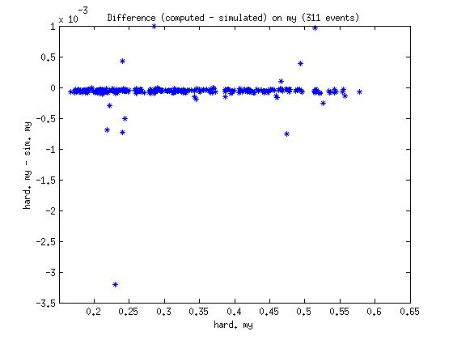
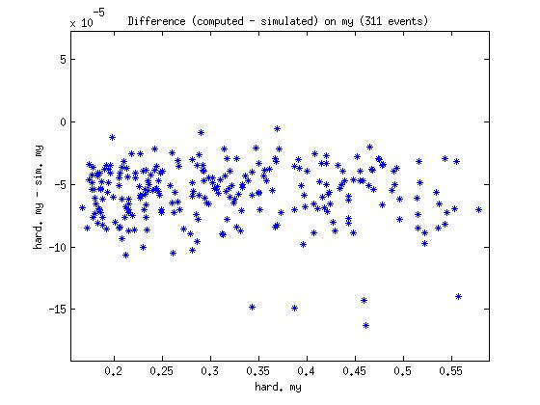
ROI Coordinates
Hardware vs Simulation

Slide 7
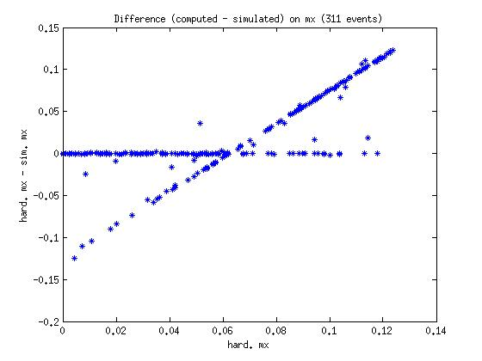
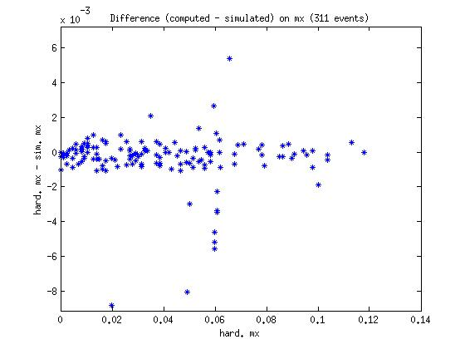
ROI Coordinates
Hardware vs Simulation

Slide 8
Backup

Slide 9
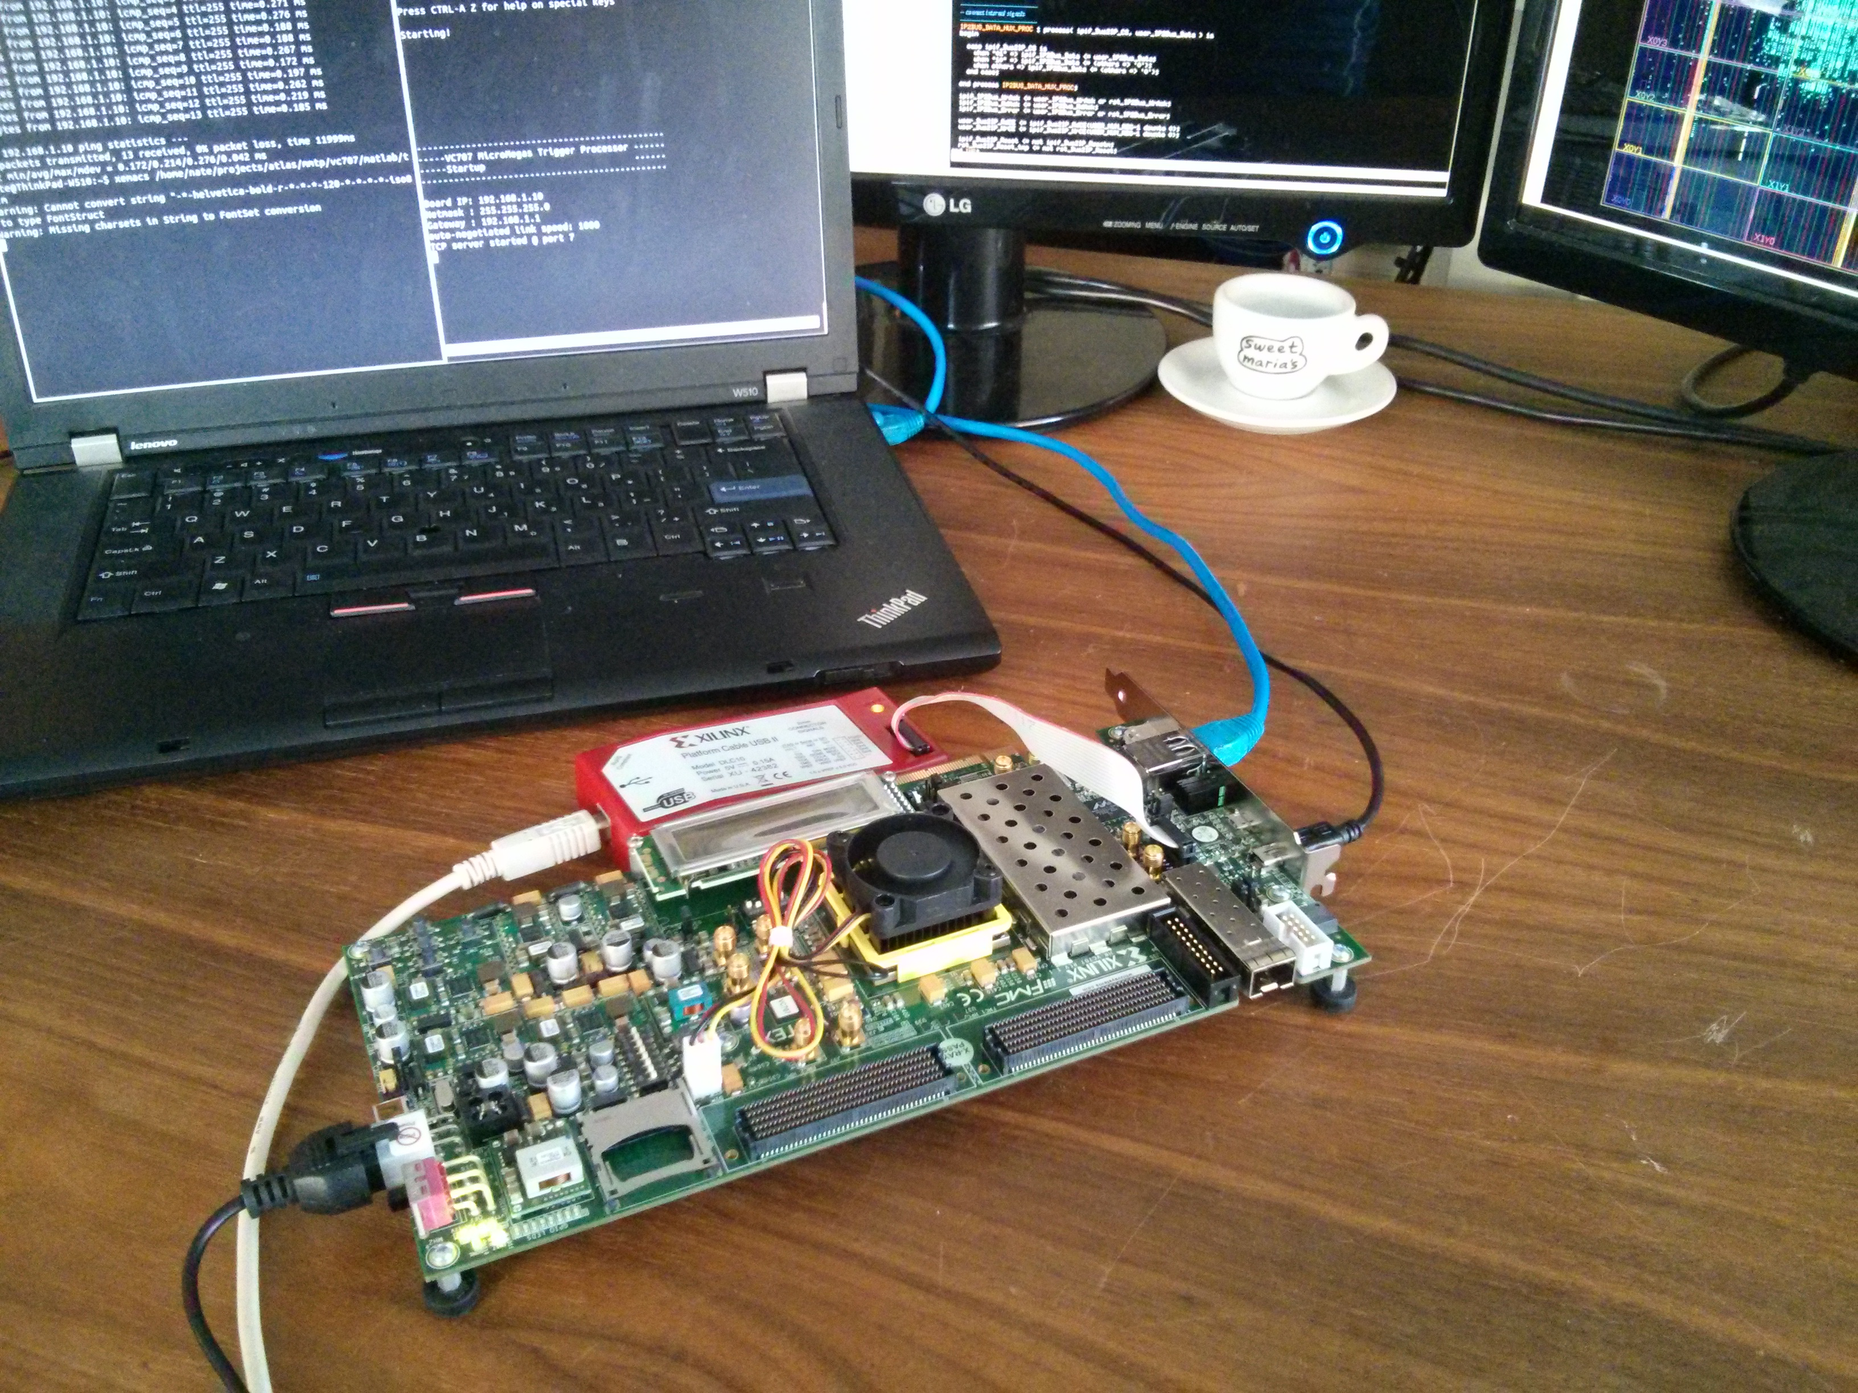

Slide 10
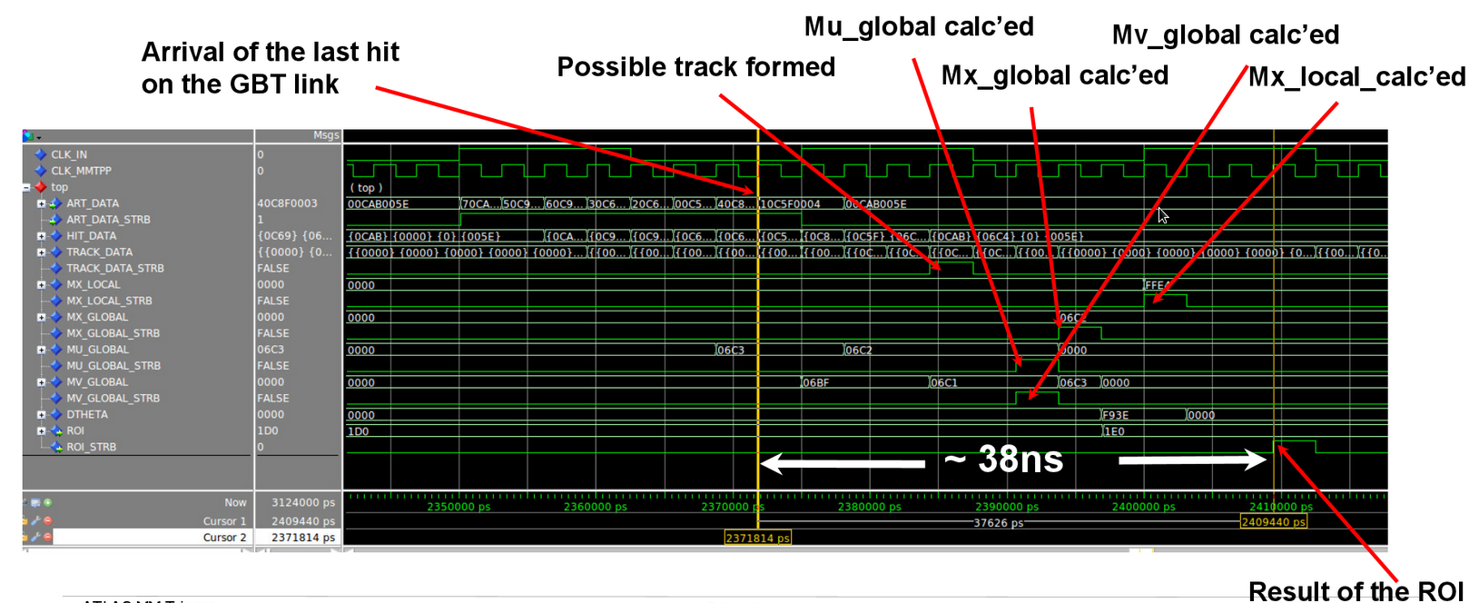
Timing Simulation

