Slide 1
ART Data Hardware Integration
Nathan Felt
Lin Yao
Tomo Lazovich

Slide 2
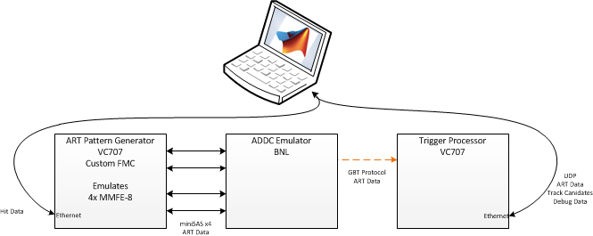
ART data path testing

Slide 3
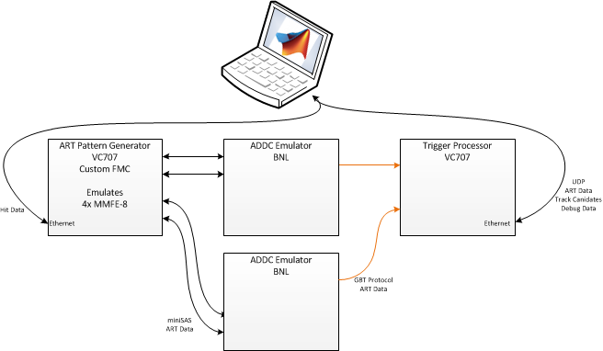
ART data path testing

