Slide 1
MM Trigger Processor Update

Slide 2
MMFE8 ART Data
Observed ART data from MMFE8 VMM using charge injection to various VMM / channels.
Sourced 160 Mhz clock signal from MMFE8
Ready to connect MMFE8 to existing test stand (Previously tested using ART Pattern Generator)

Slide 3
Existing Test Stand

Slide 4
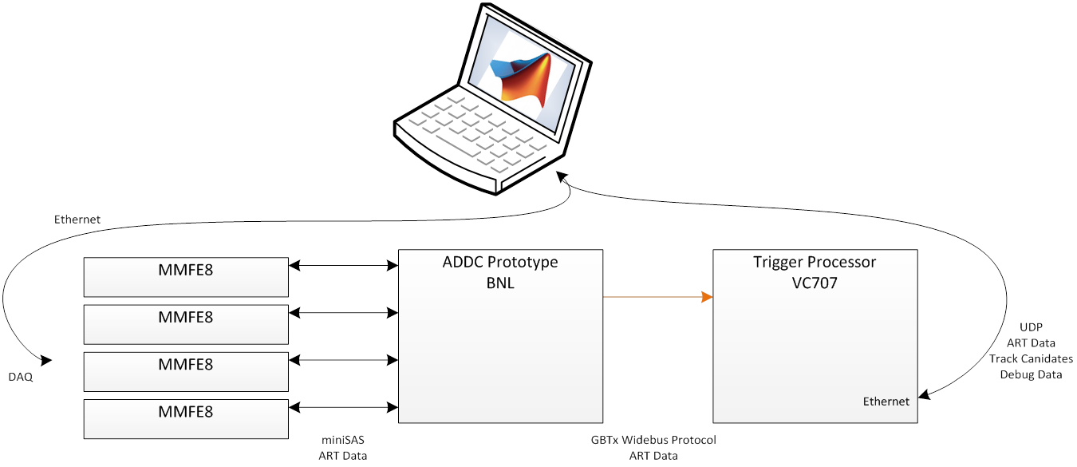
MMFE8 ART source

Slide 5
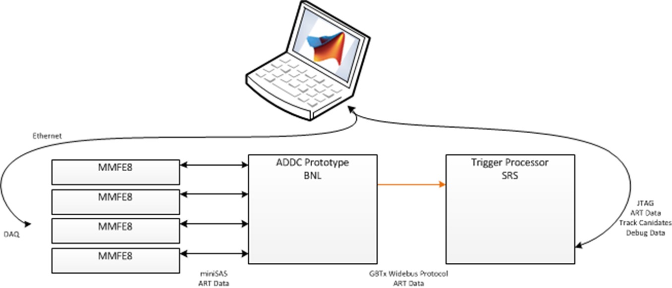
SRS Trigger Processor

Slide 6
Trigger Processor Firmware
Implementing GBT with SRS as a target
Reused Sorin’s AMC PLL configuration for clocks
David is working on Algorithm HDL simulation and bug fixes as well as Matlab DAQ code for software and hardware simulation.

Slide 10
local (FW - SW)
X Dm
-0.01 -0.005 0 0.005 0.01
Events
1
10
102
103
input muons: 791
no fit: 64, 8.1%
underflow: 21, 2.7%
overflow: 9, 1.1%

