Slide 1
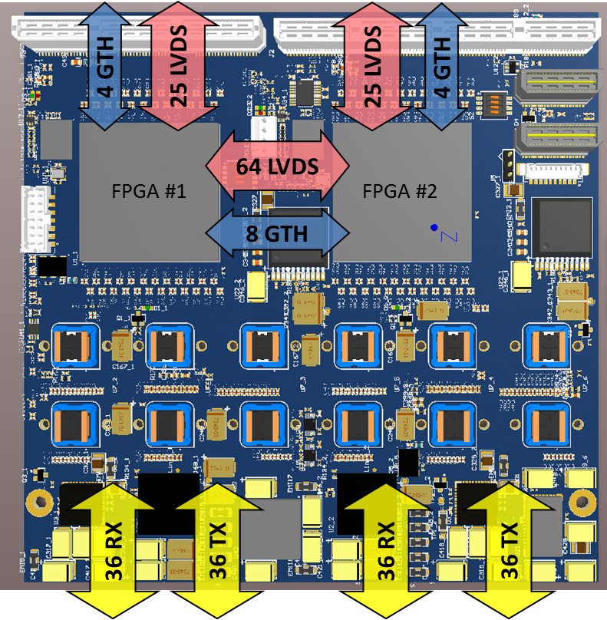
High Density Optical Mezzanine for ATCA-SRS
Dimensions: 145mm x 146 mm
FPGA: 2 x Virtex-7 (415T, 485T, 550T, 690T)
Front-End:
72 RX + 72 TX Optical Fibers (36/36 each FPGA)
12 x Avago MicroPod modules (up to 12.5Gbps)
Inter-FPGA interface
64 LVDS inter-FPGA
8 GTH inter-FPGA
Carrier interface:
50 LVDS to blade
8 GTH to blade
Separate System and GTH clocks
Power (12V) and management (IPMI, JTAG)

Slide 2
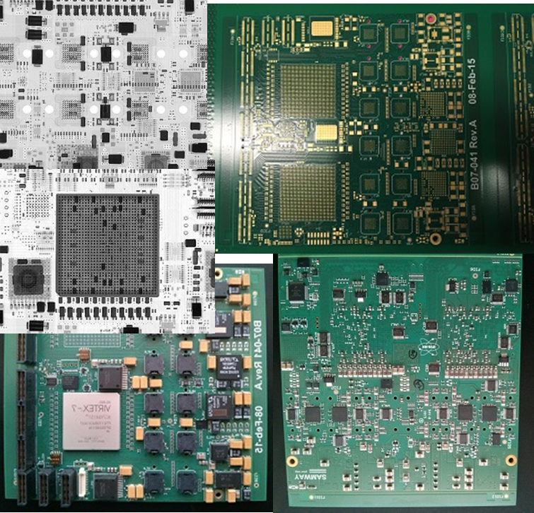
Prototype Production
Prototype took longer than expected
PCB was delayed and eventually produced by different manufacturer
Assembly job went at the back of the queue (high volume order in front of us)
No contingency plan here - wait more…
Finally on our table last Friday

Slide 3
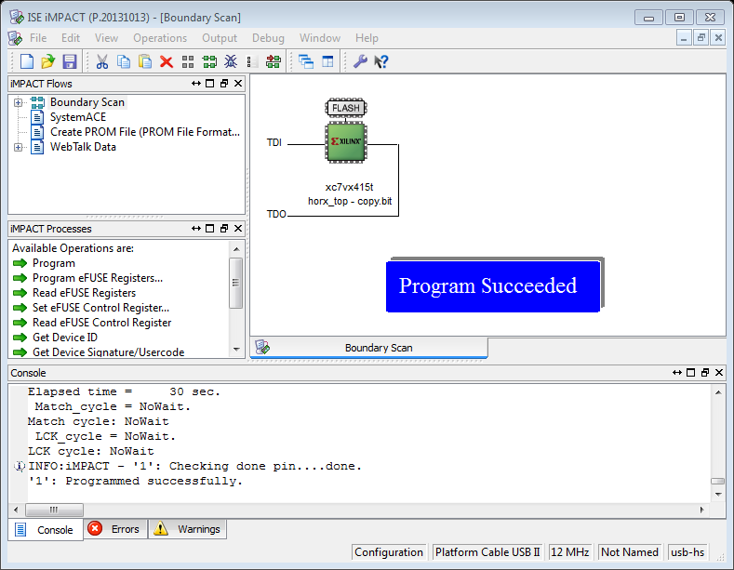
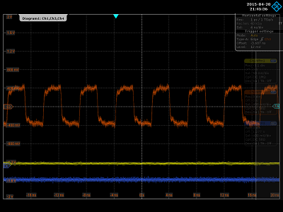
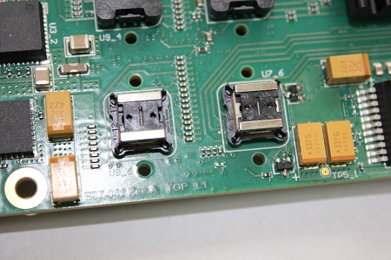
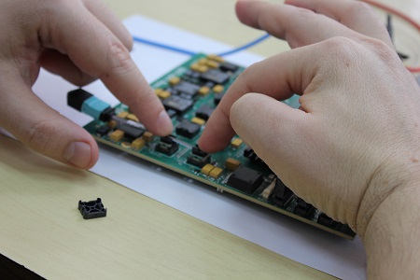
Prototype Setup and First Verifications
All power rails were verified initially without load
Verified JTAG access to FPGA
Verified programming to and configuration from on-board BPI Flash
Initial verification of clocks, PLLs, on-board I2C communication
Installed first MicroPods on the board; verified if our custom heatsinks make enough pressure for good connectivity.

Slide 4
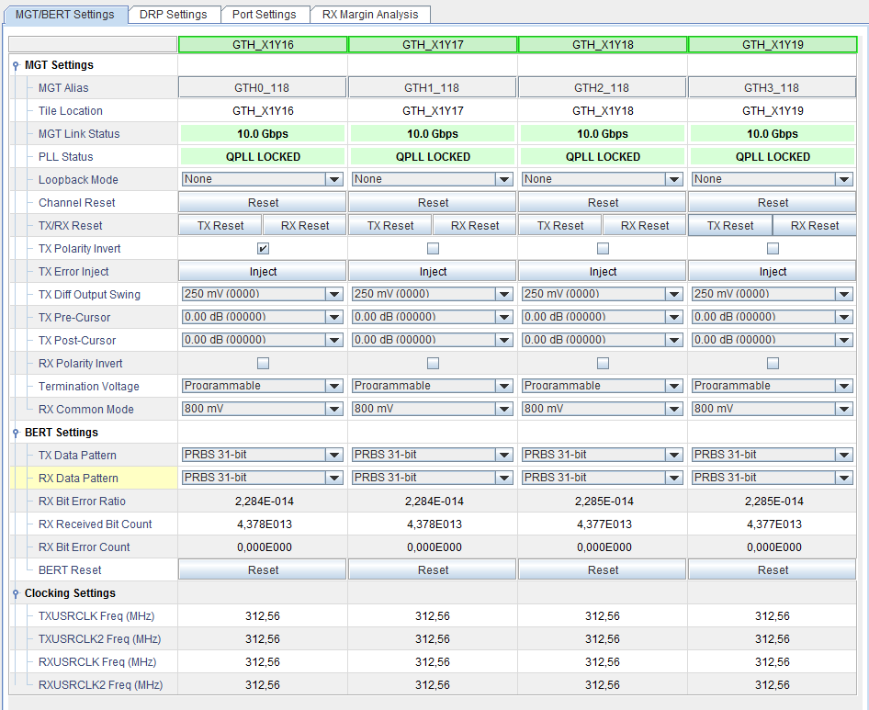
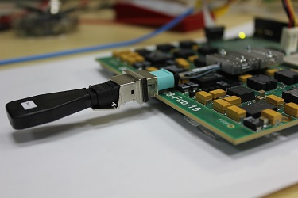
First Optical Tests
First IBERT tests with optical loopback at 10Gbps are ok.
We are setting up a testbench setup for covering a set of frequencies on all optical links

