Slide 1
TTC news
December 04

Slide 2
Summary
TTCrq
TTCoc
TTCex
TTC fibres
TTC relocation
TTC commissioning
TTC upgrade

Slide 3
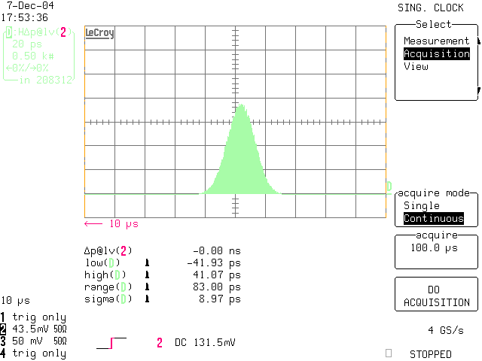
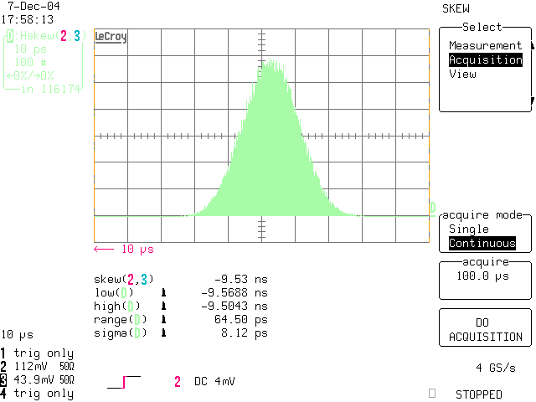
TTCrq
Activity Dips problem, by Paulo:
Prototype status (1):
  Production tests passed
  Jitter analysed

Slide 4
TTCrq
Prototype status (2)
  Temperature test running – 2 prototypes validated
  Radiation tests scheduled for the 14th of December on 2 of these boards (F. Anghinolfi). Main targets: LVDS driver and regulator.
Preproduction:
  200 boards for urgent needs
    50 for Atlas
    ~80 for CMS
    10 for Alice
  PCB & assembly at Barco (Belgium)
  Scheduled for mid January
Modifications of the previous version:
  If there is some interest, we can arrange a way to upgrade the old versions of the TTCrq at Millerin’s workshop

Slide 5

TTCoc
Problem description:
TTC crate
TTCex
MultiMode Fiber
TTCoc
MultiMode Fibers
MultiMode Fibers
TTC
receiver
TTC
receiver
TTC
receiver
1-16 or 1-32
TTC
receiver
TTC
receiver
TTC
receiver
  Single mode laser source
  Multimode system (including the coupler)

Slide 6
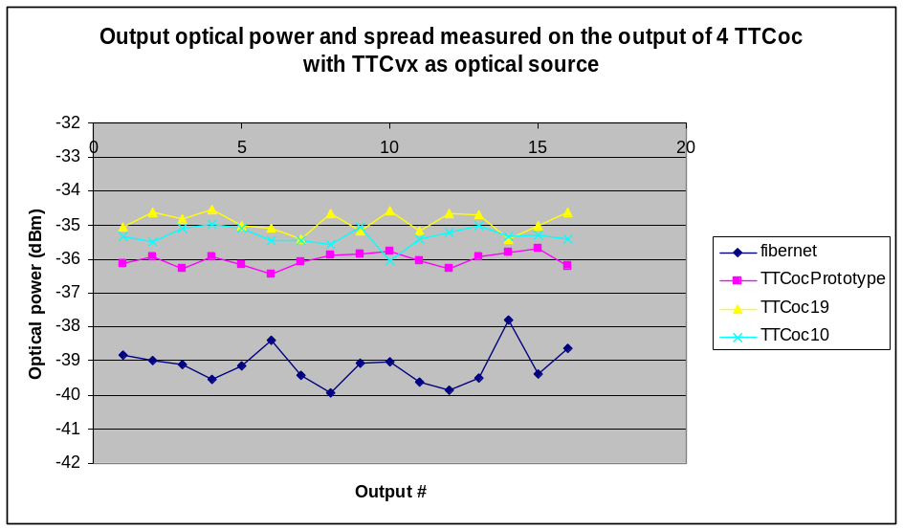
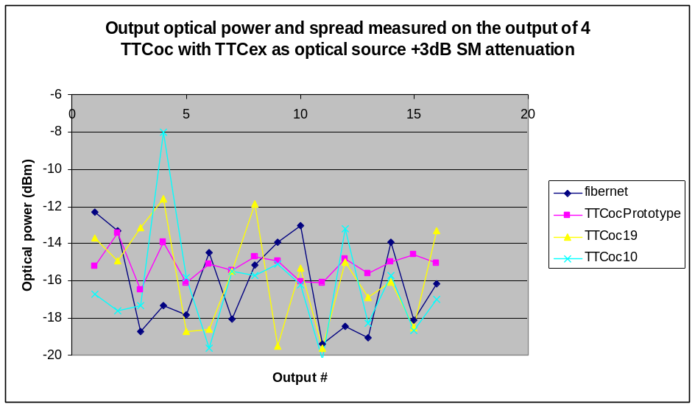
TTCoc
Consequences:
  Insertion loss can be from -17 up to -5 dB on the outputs of the same 1/16 coupler (specs -14dB)
  The signal timing is very sensitive to the motion of the first MM patch (between the laser and the coupler)
  Multimode attenuators are not efficient because the signal is not really a multimode signal
  Singlemode attenuator effect is ~x3 because of the diameter change
  We can not specify the maximum spread of the coupler for this type of use

Slide 7
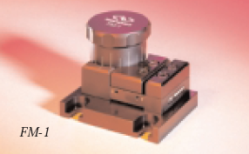
TTCoc
Possible solutions (1):
  MM source
  Mode scrambler on the output of the laser source
    Example from Newport – to be inserted on the input of the coupler
Figure 5: Mode scrambler from Newport
Newport Price: 794 CHF.
    Proposed solution from FCI: “special jumper” to be inserted on the output of the laser pigtail.
      Forces single mode signal (very directional and concentrated) to travel through multiple paths and have a broader and more even spatial distribution in the jumper fiber prior to reaching splitter.
      117€ and no need to change the couplers.
      Samples have been ordered.

Slide 8
TTCoc
Possible solutions (2):
  Single mode fibres up to the coupler, and then:
    SM2SM coupler + SM fibres up to the TRR
    SM2MM coupler + MM fibres up to the TRR. Samples ordered at Fibernet by Atlas.
Offers:
 | SM2SM 16 | SM2SM 32 | SM2MM 16 | SM2MM 32 | Scrambler + MM2MM 16 | Scrambler + MM2MM 32
Fibernet | 840$ 633€ | 1380$ 1041€ | 880$ 664€ | 1420$ 1071€
Comcore (China) | 480$ 362€ | 799$ 603€
FCI (CAN-CH) | 876€ | 1819€ |  |  | 388+117= 505€ | 950+117= 1067€
Comcore via Laser 2000 (F) | 532€ | 830€

Slide 9
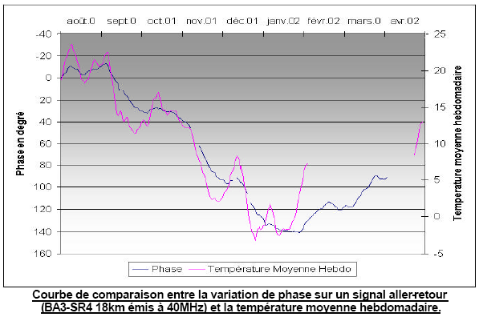
Fibres
Long term tests (annual) – BA3-SR4, 18km
  Made by Donat Stellfeld
  ~ 10 ns for 18 km and 25°C outdoor variation

Slide 10
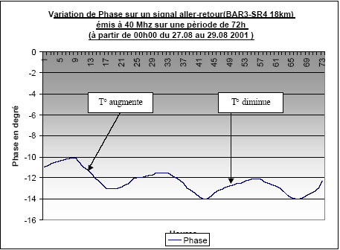
Fibres
Short term tests (diurnal)
  Made by Donat Stellfeld
  ~270ps / 18km / 72 hours

Slide 11
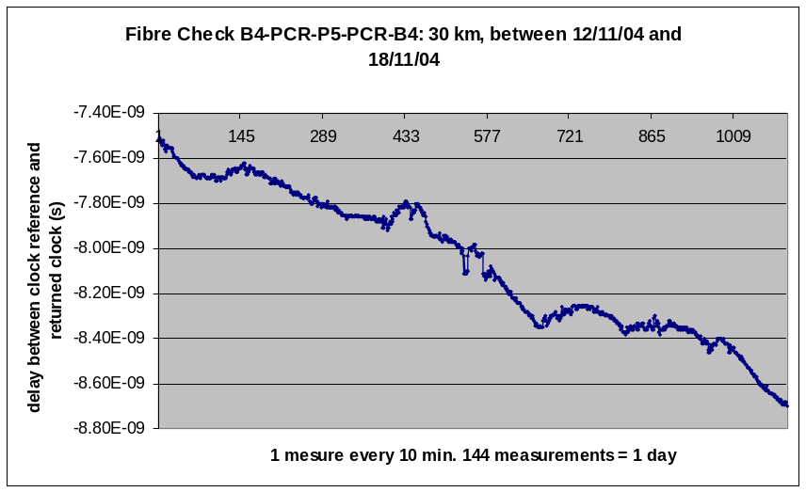
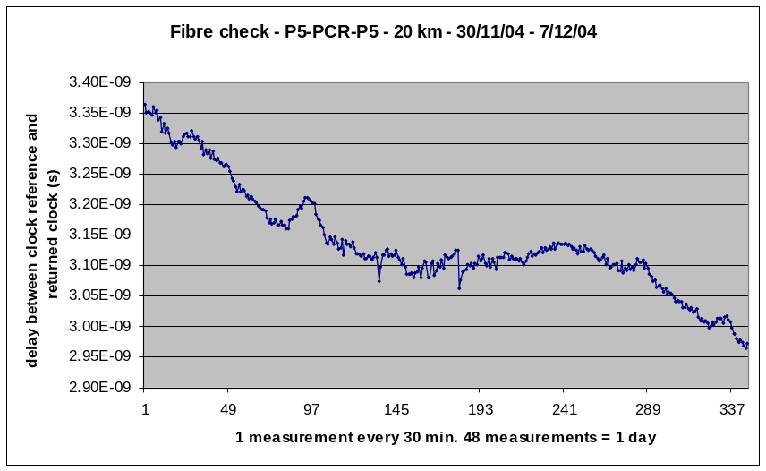
Fibres
Short term tests (diurnal) – P5-PCR-P5 - running
  Made by Jan Troska and Sophie Baron
  200ps / 10 km / 48 hours for small temperature change (max 6°C/48h)
  Could probably be up to 400 ps/ 48h for wider changes - test are still running
  Is it a problem?
  Temperature compensated fibres still exist on the market : divide by 15 the change against T

Slide 12
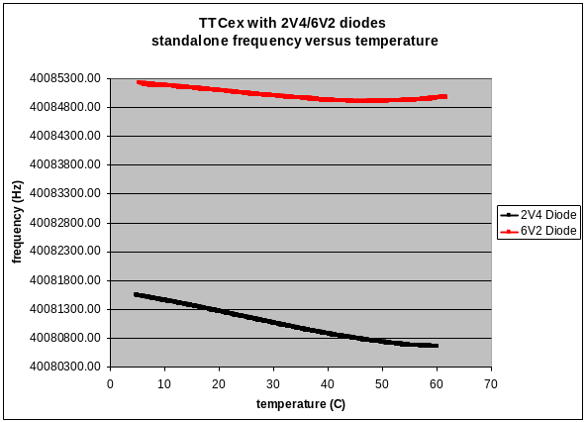
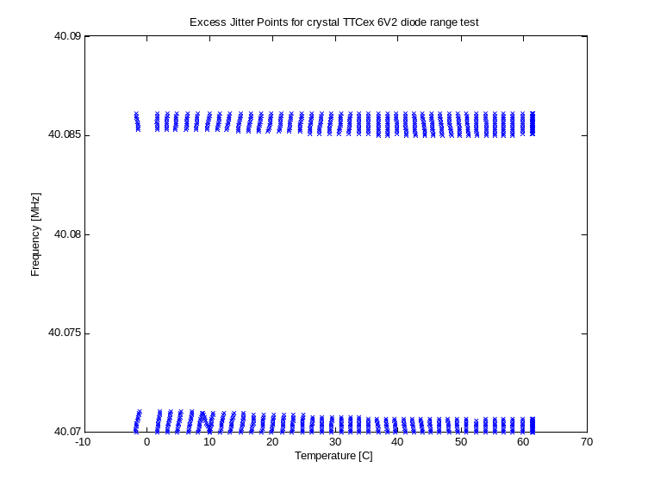
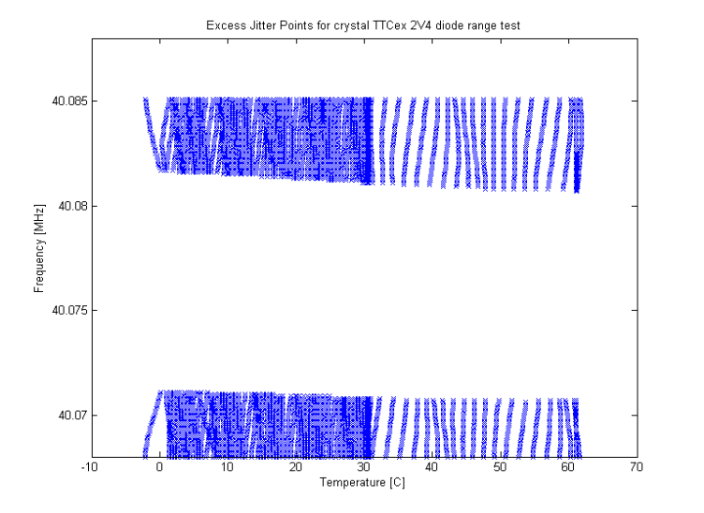
TTCex – Clock generation
Option 1: TTCex module modification to make the standalone clock fit with the TTCrq locking range (40.075-40.082MHz)
  VCXO voltage reference diode 6V2 => 2V4

Slide 13
TTCex – Clock generation
Option 2: New VME form-factor module with clock generator. 40.0787MHz with ECL fanout.
  1 quartz 80.1574MHz : 19-50 CHF (QuartzCom-Fordahl) (features from Per Gallno)
  Could be done 1st quarter of 2005

Slide 14
TTC relocation
PCR - AB/CO lab – CCC
  Relocation in the AB/CO lab on the 10th of January for one year
  New fibres installed on the 15th of January
  PCR computer room dismantled on the 24th of January
  Simulated 40.078MHz will be available end of January
  4 fibres available for the experiments. Possibly more punctually if needed (share with AB/CO)

Slide 15
Commissioning in the experiments
OTDR requested for fibres measurements
  Precision?
    >=1 m : classical OTDR (5000-20000 €)
    < 1 m : photon counting technique (22000-26000 €)
  Wavelength?
  Single-mode or Multi-mode?
  Can be purchased by the pool
Other needs?

Slide 16
TTC upgrade
Define upgrade of modules with AB/CO on Q1 of 2005
  Same principle
  VME form factor (?)
  Remote monitoring & diagnosis
  Maintenance simplified
  Spares easier to produce
  NEED TO FIND A WAY FOR: extra TTCrx chips for receivers
    PCR
    Experiments

