Slide 1
MM Trigger Processor
Hardware Testing Update

Slide 2
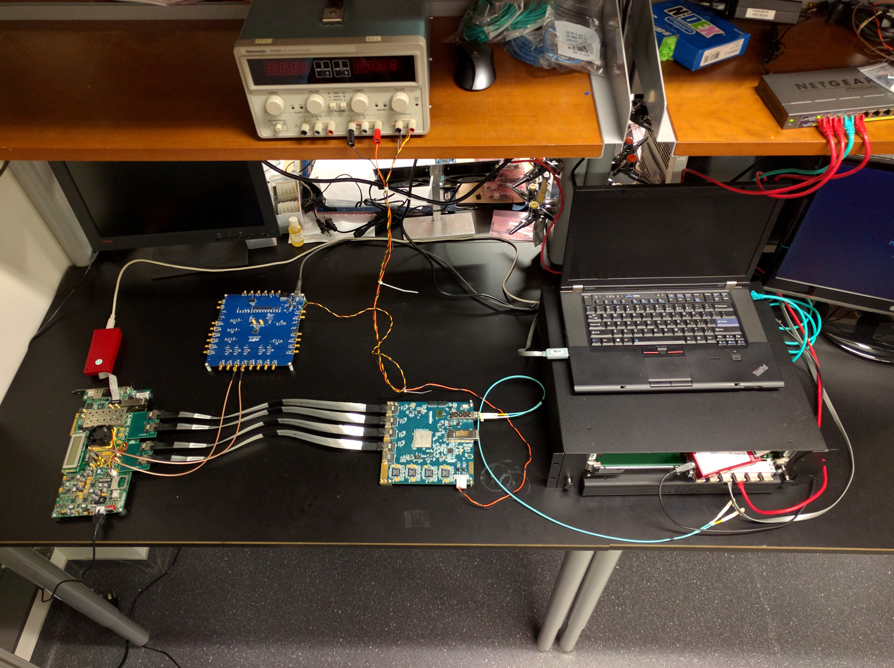
Xilinx HW Server
Clock Generator
ATCA Carrier / HORX)
MiniSAS (x4)
ADDC
Pattern Generator
GBT
(not yet connected)
Xilinx JTAG to AXI

Slide 3
Status
ATCA SRS/AMC Powered up with JTAG connected directly to AMC.
Trigger Processor implemented with JTAG to AXI interface and supports AXI bursts
DAQ written in TCL using Matlab to generate stimulus data and analyze results.

Slide 4
Status
Starting to send hit data to the Trigger Processor using an internal ADDC Emulator
Currently modifying HDL to include alignment corrections and other algorithm modifications
Changing DAQ software to accommodate hardware changes
GBT FPGA not yet included in SRS implementation. Looking into what cables we need.

Slide 5
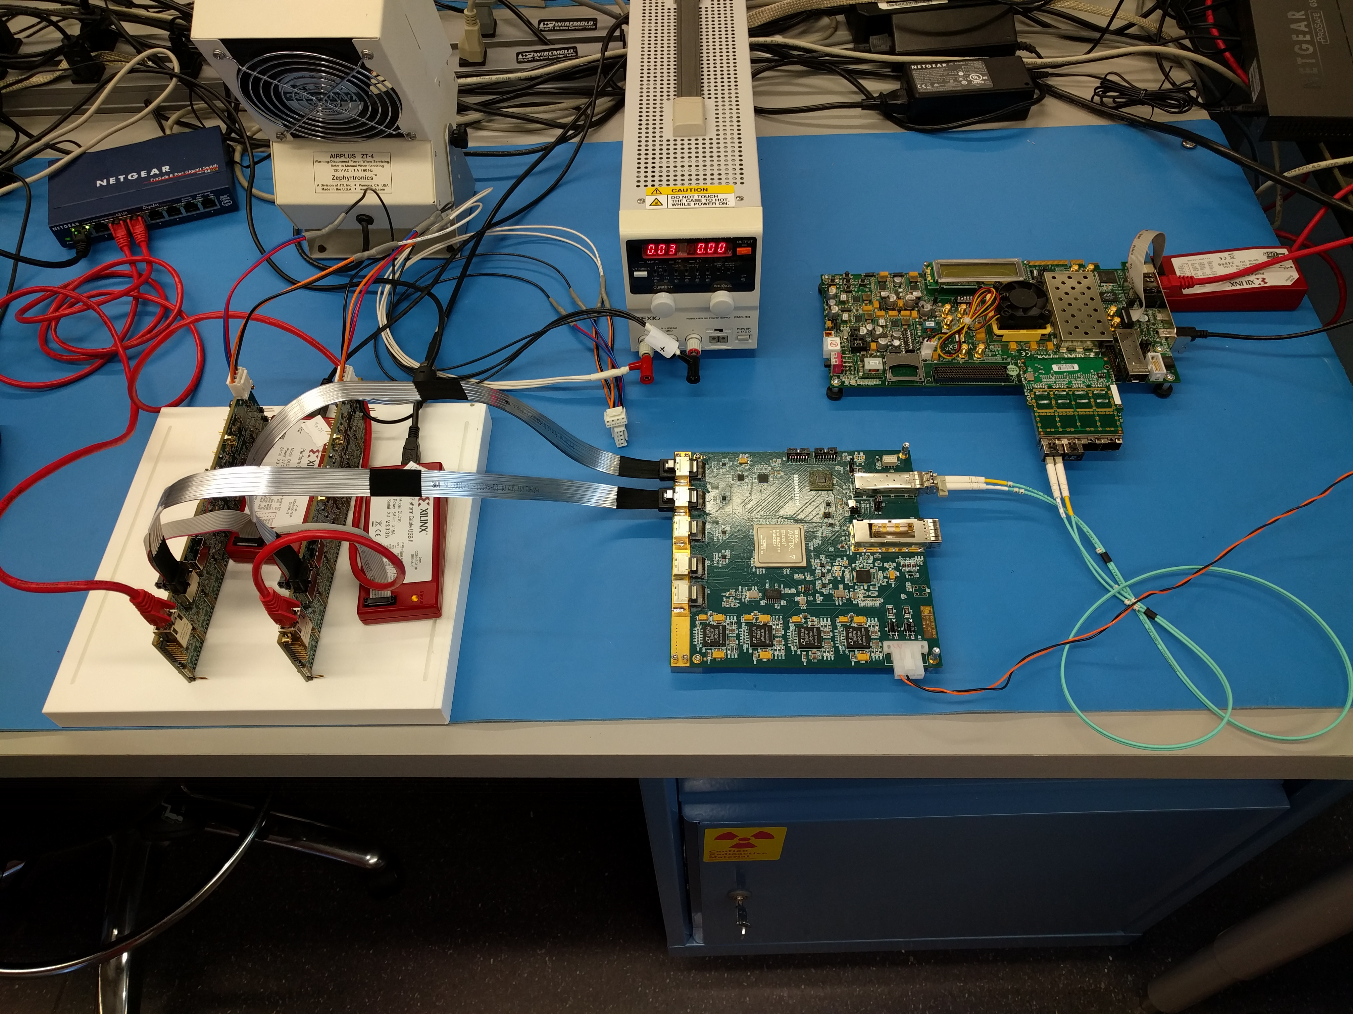
MM Trigger Processor
(Running on VC707)
MMFE8 x2
ADDC Prototype

