Slide 1
NSW Trigger Processor Hardware Platform Test Plans and Status
2015, April 21
Nathan Felt, Sorin Martoiu, John Oliver, Dean Schamberger, John Hobbs, Todd Moore, Joao Guimaraes da Costa, Lorne Levinson

Slide 2
Hardware Options
We have two options that we are considering (LAr and SRS)
Both have mezzanine cards on ATCA carrier boards
SRS option:
Version 1 of carrier card available
First prototype just became available --> we are testing this one
LAr options:
Earlier mezz cards available but not suitable as final solution for the TP. Modifications will need to happen.
Prototype carrier board will available later in the year
A task force was assembled to define a checklist for the boards
Task force membership: Nathan Felt, Sorin Martoiu, John Oliver, Dean Schamberger, John Hobbs, Todd Moore, Joao Guimaraes da Costa, Lorne Levinson

Slide 3
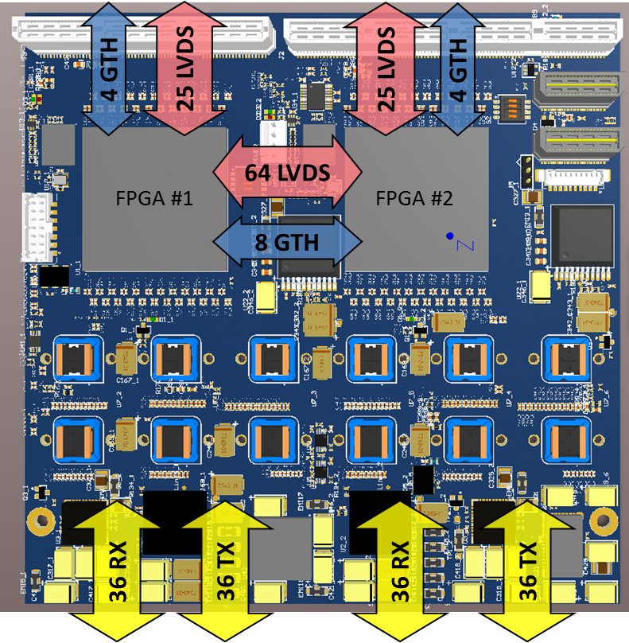
High Density Optical Mezzanine for ATCA-SRS
Dimensions: 145mm x 146 mm
FPGA: 2 x Virtex-7 (415T, 485T, 550T, 690T)
Front-End:
72 RX + 72 TX Optical Fibers (36/36 each FPGA)
12 x Avago MicroPod modules (up to 12.5Gbps)
Inter-FPGA interface
64 LVDS inter-FPGA
8 GTH inter-FPGA
Carrier interface:
50 LVDS to blade
8 GTH to blade
Separate System and GTH clocks
Power (12V) and management (IPMI, JTAG)

Slide 4
ATCA-SRS Carrier /AMC as a Trigger Processor
ATCA CARRIER BOARD (1/2)
TO OTHER CARRIER FPGA
FELIX (n x GBT)
HORX MEZZANINE BOARD
RTM
(TTC CONFIG Monitoring)
MM Sector
(32 fibers)
MEZZ. FPGA #1
LVDS(10)
GTX (2)
RTM Connection to external switch
MM TRIGGER ALGORITHM
TTC, MONITOR,CONFIG
GTH (4)
GTX (8)
CANDIDATE EXCHANGE
(x64 LVDS)
Sector Logic
LVDS (25)
ANCILIARY FUNCTIONS
(TTC, CONFIG, L1, MONITORING, …)
up to 14 fibers
FULL-MESH FABRIC
GTH (8)
LVDS (64)
LVDS (52)
sTGC Sector
(32 fibers)
GTX (4)
Backplane Connection to ATCA Switch in crate
GTH (4)
CARRIER FPGA
sTGC TRIGGER ALGORITHM
LVDS (25)
TTC, MONITOR,CONFIG
IPMC
BASE
Sector Logic
L1, MONITORING or CONFIG BUFFERS
FPGA
up to 14 fibers
MEZZ. FPGA #2
SODIMM DDR3/DDR4
JTAG

Slide 5
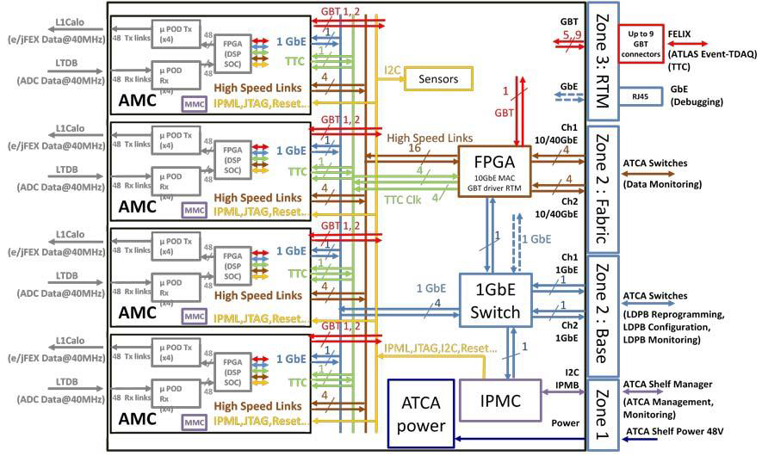
Lar AMC /Carrier

Slide 6
Trigger Processor ATCA Hardware Testing
Housekeeping
Power, FPGA Configuration, Monitoring
Communication
GTH, LVDS
Environment
Thermal testing

Slide 7
Housekeeping
Carrier and AMC power on/off through IPMC/MMC
e-keying with real port descriptors for carrier/IPMC and AMC/MMC
Carrier sensor read out.
FPGA Configuration
Remote and local JTAG configuration
FLASH Programming and power-up configuration

Slide 8
Communication Rear Transition Module
A RTM can be used as the connection to FELIX (TTC, TP algorithm configuration and Monitoring) and also provide Ethernet communication.
BERT on all available SFP connections on the rear transition module up to the limit of carrier FPGA (5-6Gbps)

Slide 9
Communication Lateral sTGC - MM
In order to merge track candidates found by the MM and sTGC algorithms, it is a Trigger Processor requirement to have communication between the MM FPGA and sTGC FPGA. The minimum throughput requirement is to send 8 track candidates (176 bits total) each BC or 4.4 Gbs.
However, the latency of the lateral communication will likely impact the total latency. This is an important consideration given the tight latency budget.
BERT on all LVDS lateral communication signals.

Slide 10
Communication AMC to Carrier
There is no Trigger Processor requirement for AMC to Carrier communication, however this could be used to move some of the ancillary functions from the AMC to the carrier card if desired.
BERT on all signals from AMC FPGA to Carrier FPGA

Slide 11
Communication AMC MicroPod Optical I/O
Each Trigger Processor FPGA is required to have 32 optical receivers for front-end data and 14 optical transmitters to sector logic. Additionally, one transceiver could be used as a connection to FELIX as an alternative to the RTM. These links will be configured to run at mixed speeds.
Test microPod links up to 10 Gbs.
Test microPod links at mixed speeds.

Slide 12
ATCA Thermal Testing
A critical aspect of the hardware testing is temperature tests at high power load. Full trigger algorithm implementation is not required but should include a power equivalent implementation.
Monitor temperature and link errors with the AMC in a worst case simulated environment.

Slide 13
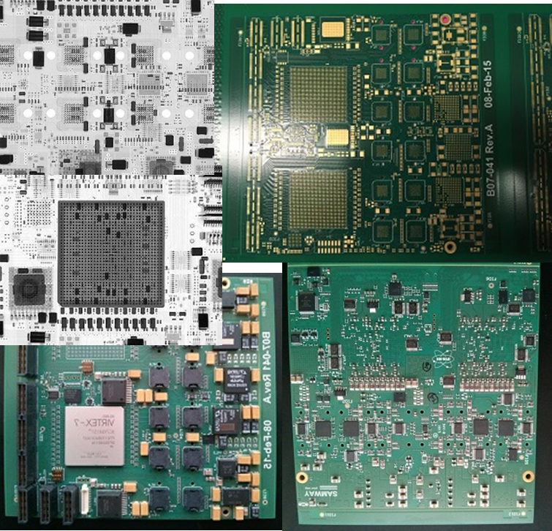
Prototype Production
Prototype took longer than expected
PCB was delayed and eventually produced by different manufacturer
Assembly job went at the back of the queue (high volume order in front of us)
No contingency plan here - wait more…
Finally on our table last Friday

Slide 14
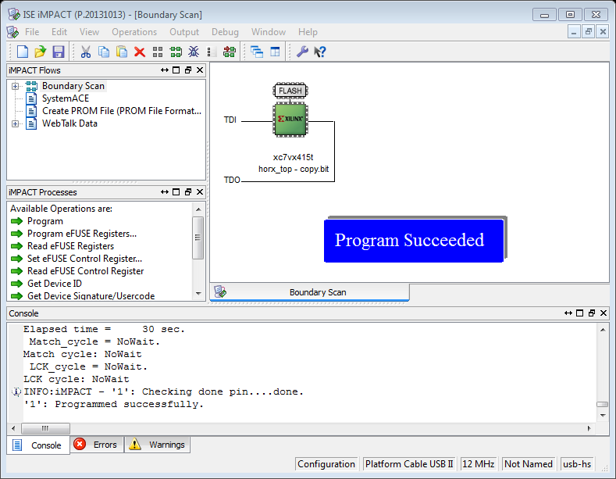
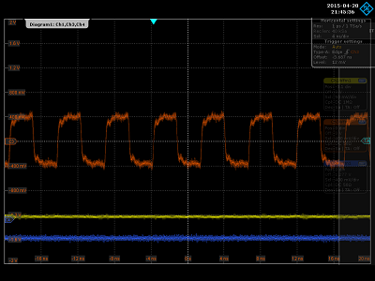
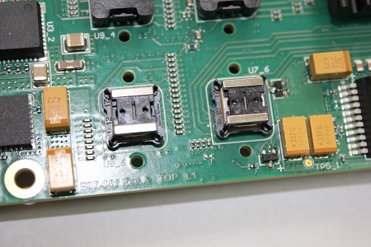
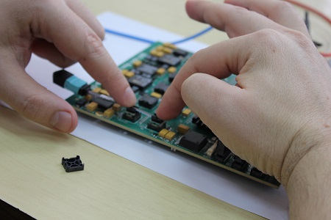
Prototype Setup and First Verifications
All power rails were verified initially without load
Verified JTAG access to FPGA
Verified programming to and configuration from on-board BPI Flash
Initial verification of clocks, PLLs, on-board I2C communication
Installed first MicroPods on the board; verified if our custom heatsinks make enough pressure for good connectivity.

Slide 15
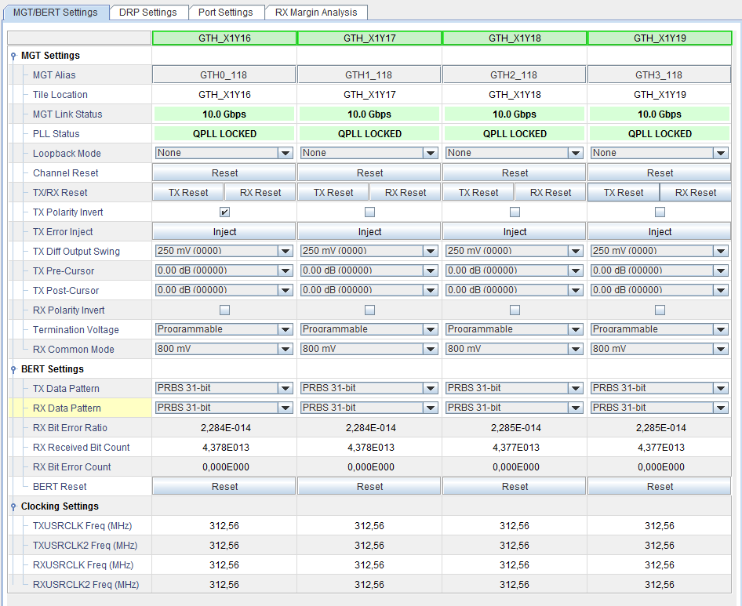
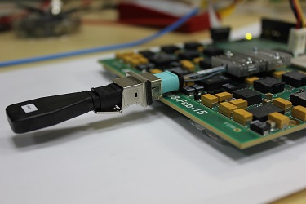
First Optical Tests
First IBERT tests with optical loopback at 10Gbps are ok.
We are setting up a testbench setup for covering a set of frequencies on all optical links

