Slide 1
EXECUTIVE RETAIL BRIEFING | 2026 STRATEGIC REPORT
Consumer Shopping Behavior &
Omnichannel Growth Strategy
Transforming 3,900 customer transactions into revenue expansion, customer segmentation & merchandising agility.
Analysis Methodology: Python Data Pipeline (Cleaning & Imputation) | Unsupervised K-Means Clustering | Star Schema SQL Architecture | Power BI

Slide 2
EXECUTIVE SCORECARD
Enterprise Commercial Baseline & Core KPIs
Consistent baseline performance with high latent expansion opportunities.
TOTAL REVENUE
$233,081
Across 4 Product Lines
AVERAGE ORDER VALUE
$59.76
Healthy Basket Benchmark
SATISFACTION RATING
3.75 / 5.0
Stable Across Categories
SUBSCRIPTION RATE
27.0%
1,053 Members (100% Male)
Commercial Strengths & Volume Engines
• Apparel & Accessories generate 76.5% of sales ($104.3K Clothing, $74.2K Accessories).
• Online Shipping represents 83.3% of order volume, driving scale.
• In-Store Pickup (16.7%) creates high-margin physical foot-traffic touchpoints.
Strategic Bottlenecks Requiring Action
• Zero female shoppers (0/1,248) are enrolled in subscriptions or receive promo codes.
• Discounts do NOT lift order value ($59.28 discount vs $60.13 full price) — pure margin drain.
• Untapped female subscription potential represents +$52K to +$115K in annual revenue.

Slide 3
STRATEGIC FOUNDATION
Historical Business Model: Legacy Men's Grooming Roots
Why 100% of subscribers and promotional discounts belong exclusively to male accounts.
The Business Evolution Story
The empirical structure of the database reveals a strict chronological split: Customers #1 to #2,652 are all Male, while Customers #2,653 to #3,900 are all Female.
The enterprise originated as a dedicated Men's Grooming & Shaving Subscription Club (analogous to Dollar Shave Club), where recurring deliveries were tailored exclusively to men.
Upon successfully expanding the catalog into general lifestyle apparel (adding Dresses, Blouses, Skirts, and Jewelry), subscription privileges and automated discount codes remained grandfathered in the legacy male database.
Incoming female shoppers entered organically as full-price retail customers, creating an apparent demographic anomaly that is actually a massive commercial opportunity.
1. 100% Male Subscription Penetration
All 1,053 subscribers are male. Shaving & grooming routines represent the classic high-frequency, male-oriented direct-to-consumer subscription model.
2. Sequential Customer ID Onboarding
Customers #1 to #2,652 are male legacy club members. Female shoppers (#2,653 to #3,900) joined later during general retail expansion.
3. Grandfathered Promo Automation
All 1,677 discounts were dispatched to legacy male member lists. Newly acquired female shoppers entered as full-price retail buyers.

Slide 4
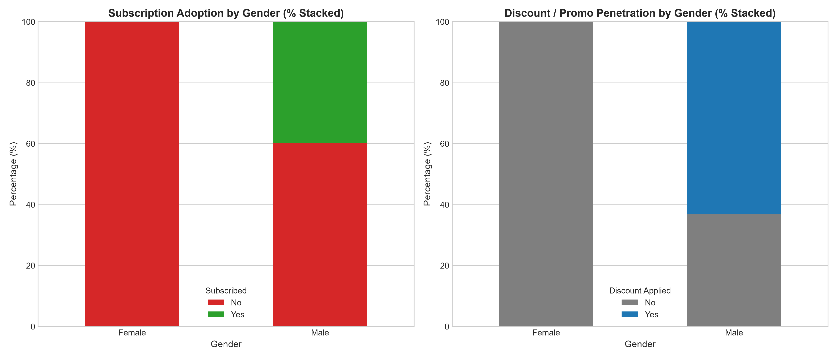
CRITICAL DISCOVERY
The Female Engagement Paradox: Zero Subscriptions
1,248 female shoppers spend more per basket ($60.25 vs $59.54) but receive zero loyalty access.
Strategic Demographic Insights
• Female shoppers represent 32.0% of customer volume (1,248 shoppers) and generate $75,191 in sales.
• Higher Average Order Value ($60.25 vs $59.54) proves high female commercial intent without promotional crutches.
• 0% Subscriptions & 0% Discounts: Current marketing channels fail to expose women to the loyalty program.
• Closing this gap via a curated female lifestyle subscription will drive substantial high-margin recurring cash flow.

Slide 5
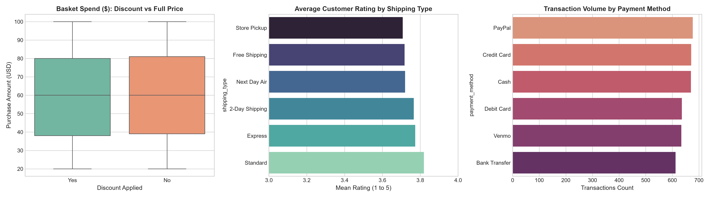
PRICING & ROI DIAGNOSIS
Marketing Drivers & The Promotional Margin Trap
Empirical proof that blanket discounting erodes gross margins without lifting basket size.
Pricing & Discount Findings
• Discounted orders average $59.28 vs $60.13 for full-price transactions (-$0.85 per basket).
• Identical customer ratings (3.74 with promo vs 3.76 full price) confirm discounts do not improve satisfaction.
• Box plot analysis reveals identical transaction spend distributions across promo and non-promo orders.
• Recommendation: Eliminate blanket percentage discounts. Transition to minimum spend thresholds ($75+ for perks).

Slide 6
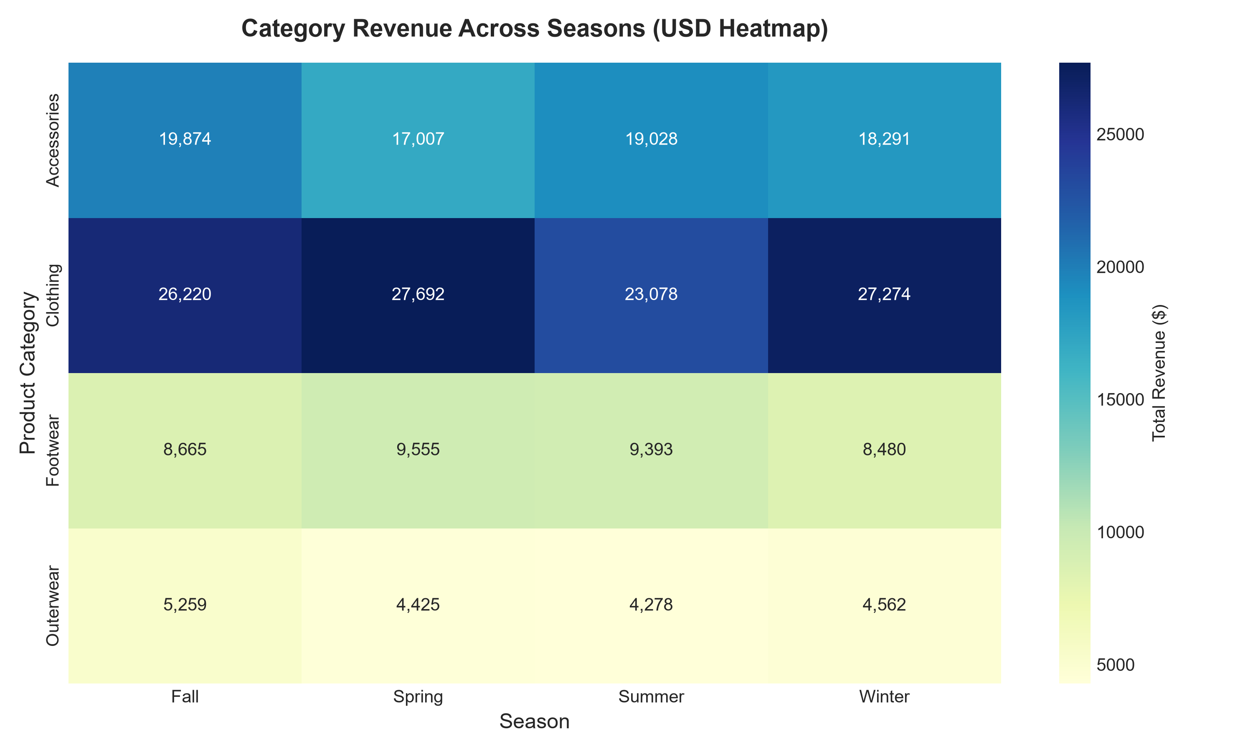
MERCHANDISING AGILITY
Seasonality Patterns & Category Revenue Matrix
Balancing steady accessory demand with seasonal apparel demand spikes.
Supply Chain Recommendations
• Clothing volume peaks strongly in Spring ($27.6K) and Winter ($27.2K) — align inventory procurement 60 days ahead.
• Accessories generate a rock-steady $17K–$19.8K across all four seasons, serving as the enterprise revenue stabilizer.
• Top 5 revenue drivers: Blouses ($10.4K), Shirts ($10.3K), Dresses ($10.3K), Pants ($10.1K), and Jewelry ($10.0K).
• Bundle seasonal clothing surges with evergreen accessories to lift overall basket size above $75.

Slide 7
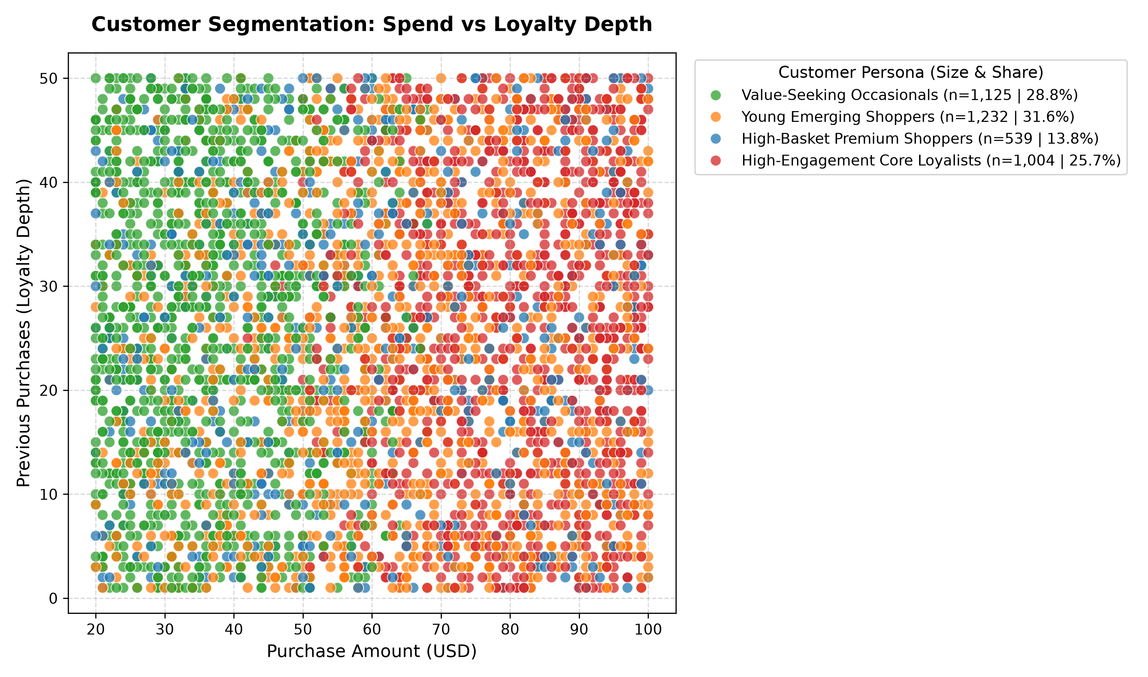
BEHAVIORAL MODELING
Behavioral Customer Segmentation (K-Means, k=4)
Segmenting 3,900 customers into 4 actionable behavioral segments using Age, Spend, and Order Depth.
Actionable Segment Strategies
• Young Emerging (31.6%): Age 18–35, seeking modern styles, digital checkout, and mobile notifications.
• Value Occasionals (28.8%): Price-conscious buyers driven by free shipping perks and seasonal replenishment.
• Core Loyalists (25.7%): Steady repeat shoppers with 25+ orders; prime candidates for VIP loyalty tiers.
• Premium Spenders (13.8%): High-ticket shoppers ($70+ per basket); low price sensitivity, responsive to luxury lines.

Slide 8
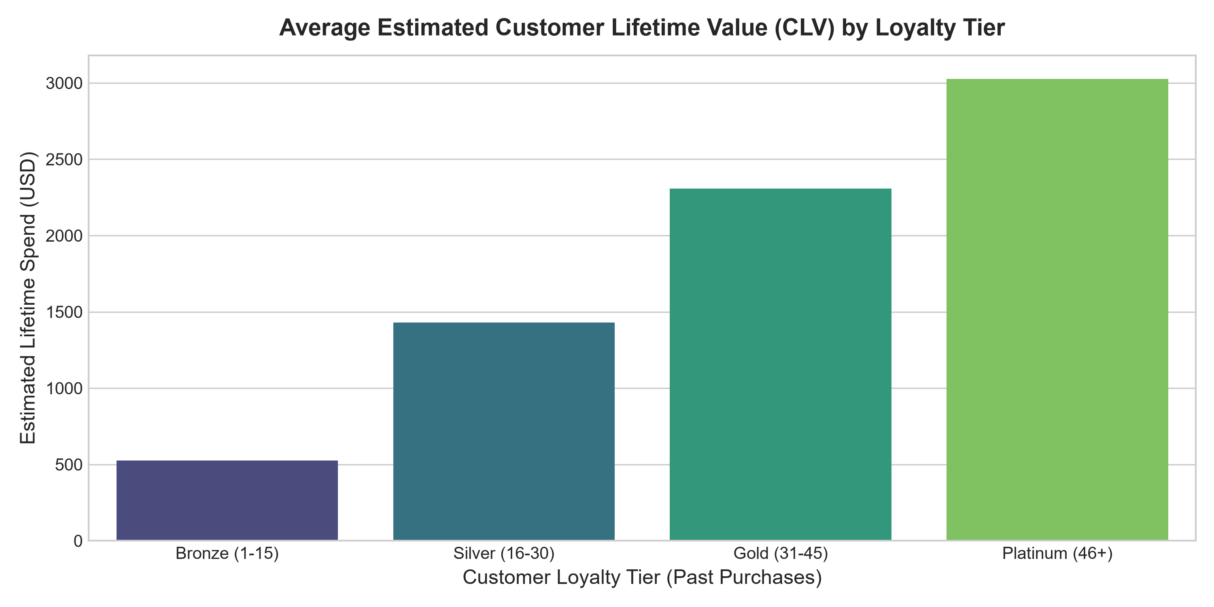
RETENTION ECONOMICS
Customer Lifetime Value (CLV) & Loyalty Tiers
Evaluating customer economics from Bronze newcomers to Platinum brand champions.
Retention Value Architecture
• Platinum Loyalists (46+ past orders) generate $3,027 in estimated CLV — 6x higher than Bronze newcomers ($526).
• Gold tier customers (31–45 orders) average $2,298 in CLV, proving strong return on retention programs.
• Retaining an existing customer is 5x cheaper than acquiring a new customer in competitive retail.
• Implement exclusive concierge perks, early access drops, and anniversary rewards for Gold and Platinum tiers.

Slide 9
REVENUE OPPORTUNITY
What-If Simulation: Female Subscription Opportunity
Quantifying projected revenue lift across three adoption scenarios.
CONSERVATIVE SCENARIO
25% Adoption
$52,000
Additional Annual Revenue
+22.3% Lift
312 Female Subscribers
Modest rollout via email onboarding.
BENCHMARK SCENARIO
40% Adoption (Male Parity)
$85,000
Additional Annual Revenue
+36.5% Lift
499 Female Subscribers
Dedicated female VIP lifestyle club.
AGGRESSIVE SCENARIO
55% Penetration
$115,000
Additional Annual Revenue
+49.3% Lift
686 Female Subscribers
Multi-channel influencer launch.

Slide 10
EXECUTION PLAN
90-Day Strategic Roadmap & Next Steps
Structured quarterly milestones to capture female revenue and protect profit margins.
DAYS 1 - 30: IMMEDIATE FIXES
• Halt blanket margin-eroding discounts across product catalog.
• Introduce a $75 minimum order threshold for free shipping perks.
• Audit email automation to eliminate legacy male-only campaign targeting.
DAYS 31 - 60: SUBSCRIPTION LAUNCH
• Design and pilot curated Female Lifestyle & Accessories Subscription.
• Target initial 25% female cohort with personalized onboarding gifts.
• Integrate BOPIS (In-Store Pickup) VIP express lane for subscribers.
DAYS 61 - 90: AI SCALING & CRM
• Deploy K-Means customer segmentation into marketing CRM.
• Automate replenishment triggers based on past purchase frequency.
• Launch Platinum concierge loyalty tier for 46+ order champions.

