Slide 1

FAMZYIELD
Earn Yield on BTC and Staked Assets — Seamlessly

Slide 2
FAMZYIELD?
FamzYield is a decentralized yield vault deployed on the CORE Blockchain that enables users to deposit Wrapped Bitcoin (wBTC) and Liquid Staking Tokens (LSTs) — such as stCORE — and receive a single, yield-bearing token: lstBTC.
The protocol combines BTC exposure with staking yield, allowing users to earn passive income while maintaining full liquidity and the ability to redeem their original assets at any time.
By leveraging a custodian-based model and on-chain smart contracts, FamzYield ensures security, transparency, and efficiency in asset management.

Slide 3
The Problem – Our Philosophy
In the vast expanse of digital wealth, Bitcoin sits idle — a sleeping giant of value. Staking opportunities are scattered, locked away in silos, while liquidity is trapped behind complex walls. Users navigate a maze of systems, chasing yield without clarity, without unity, without trust. The world does not lack wealth — it lacks the tools to awaken it.
Underutilized BTC Holdings
Fragmented Yield & Staking
Liquidity Locking
High Complexity for Users
Lack of Transparent Distribution Models

Slide 4
Our Solutions
Unified yield vault for wBTC and LSTs (starting with stCORE).
Converts deposits into lstBTC via a trusted custodian.
Dual-source yield (BTC strategies + staking rewards).
Liquidity preserved with secure redemption.
Emerging Economies → Offset inflation with stable BTC yield.

Slide 5
$4,030,775,847,787
- BTC is booming — over $4Tn market cap, but most sits idle. - LST adoption is exploding in DeFi, yet BTC integration is missing. - CORE Blockchain growth creates demand for innovative yield products. - Rising inflation and currency instability push global demand for stable, yield-bearing assets. - First-mover advantage in dual-yield BTC + LST vaults on CORE
Why Now?

Slide 6
Market Opportunity
Total Addressable Market (TAM) |  | 20B+ (BTC and LSTs already in DeFi)
Serviceable Market (SAM) |  | $1–3B+ (Yield strategies combining BTC + LSTs on EVM chains)
Realistic Target (SOM) |  | $25M–$100M AUM in 12–18 months (Early-mover advantage on CORE with focused niche)

Slide 7
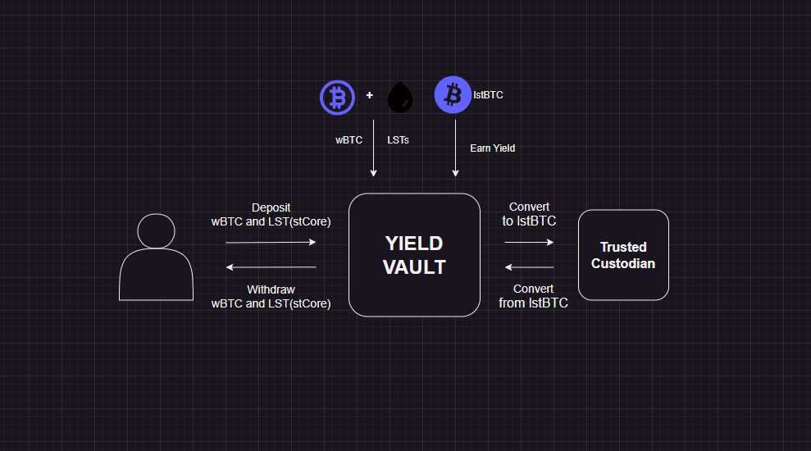
Architecture – How it works
Flow: Deposits Custody LstBTC Mint Epoch Yield Redemption
Yields tracked per token, converted to BTC – equivalent , combined by user share each epoch

Slide 8
Key Features
Wrapped BTC & LST integration
Epoch-based yield distribution
Custodian-managed security
Per-token yield tracking
Flexible redemption
Enhanced yield efficiency

Slide 9
Why CORE Blockchain
01
02
03
04
EVM-compatible and developer-friendly
Lower fees than Ethereum mainnet
Native BTC bridging capabilities
Growing DeFi ecosystem

Slide 10
Team
Abdulazeez
Toheeb
Teslim
Mubarak
Blockchain/Back-End Developer
Full Stack Developer
Full Stack Developer
Front-End Engineer

Slide 11
Future Plans
Launch on CORE Mainnet: Deploy and secure the vault, custodian, and lstBTC contracts with full audits.
Add More LSTs: Expand deposit support beyond stCORE to include LSTs like rETH, ezETH, and stSOL via whitelisting.
Launch Yield Incentives: Introduce liquidity mining or farming rewards to accelerate adoption and TVL growth.
List lstBTC on DEXs & Enable DeFi Use: Build liquidity pools and work to get lstBTC accepted as collateral in lending protocols.

Slide 12
Thank You
We look forward to working with you
Do you have any questions?
Twitter: @famz_yield

