Slide 1

Team Name: The Brainy Fools
Flappy Bird

Slide 2
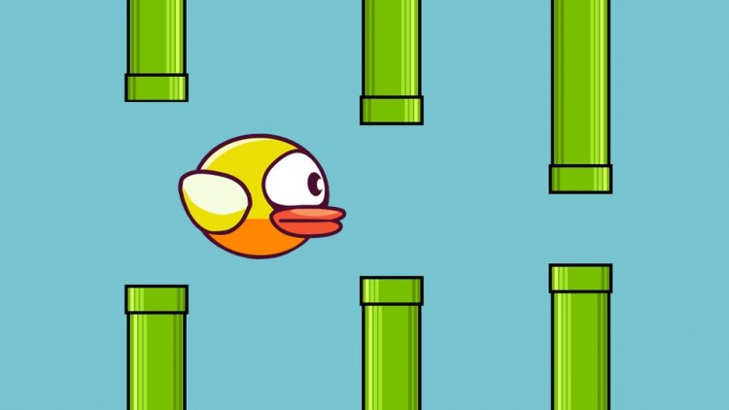
.
Project Mentor:
Falguni Roy
Lecturer
IIT,NSTU
Team Members:
1.Md Al-Adnan(ASH1825008M)
2. Moonmoon Das(ASH1825027F)
3.Akash Chandra Debnath(ASH1825037M)

Slide 3

CONTENTS
Favourite and hardest functionality
Motivation
Deliverables
Work Distribution
Timeline
Future Plan
Introduction
Gameplay
Medals
Game Layout
Game Design
Objectives
Scope

Slide 4
Introduction
Flappy bird is a side-scroller game where the player controls a bird, attempting to fly between columns of green pipes without hitting them.
It’s a simple game of infinite level type.
It is a challenging game for anyone.

Slide 5
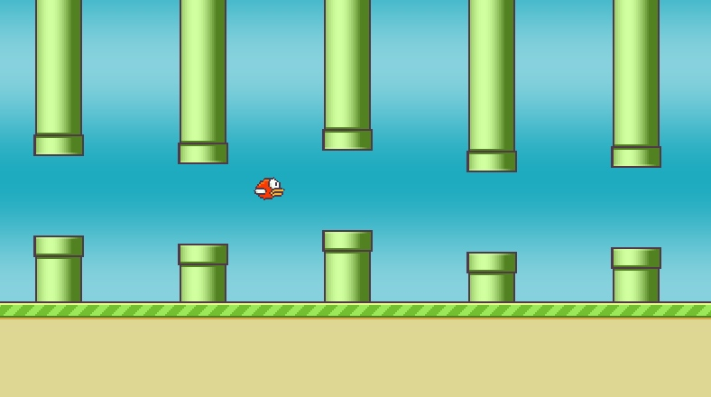
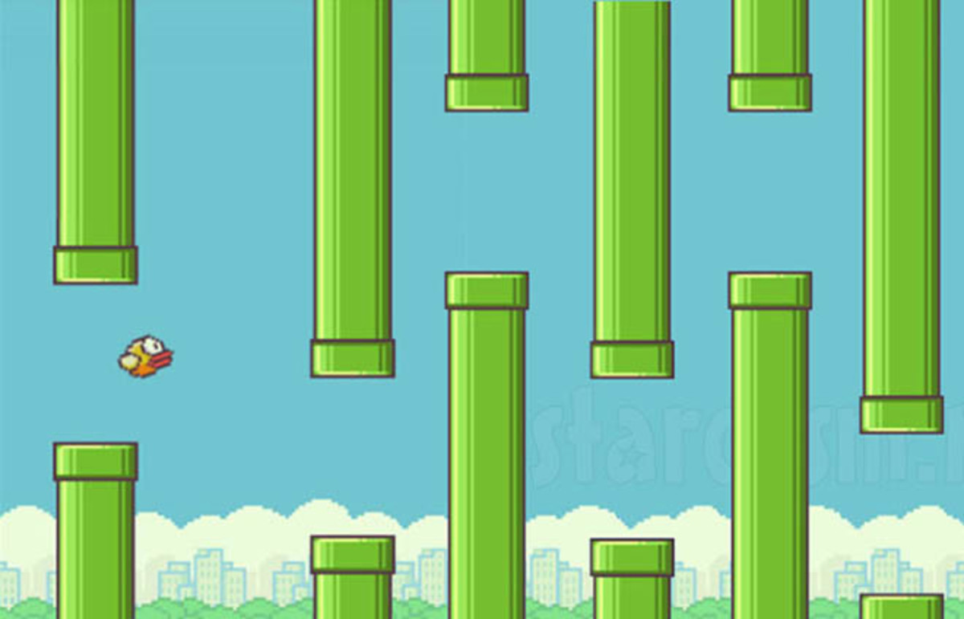

Gameplay
We plan on creating a 2D version of Flappy Bird.
The bird will be moving forward continuously between sets of pipes.
The bird jumps up a small amount whenever the spacebar is
pressed and can move to the left or right using the left and
right arrow keys.
If the bird collides with a pipe, the ground, or the ceiling,
then the game is over. The pipes will have a random size
and be created in random locations.
If any player navigates between each pair of pipes,
the player earn a single point.
Player score will be tracked throughout the level.

Slide 6
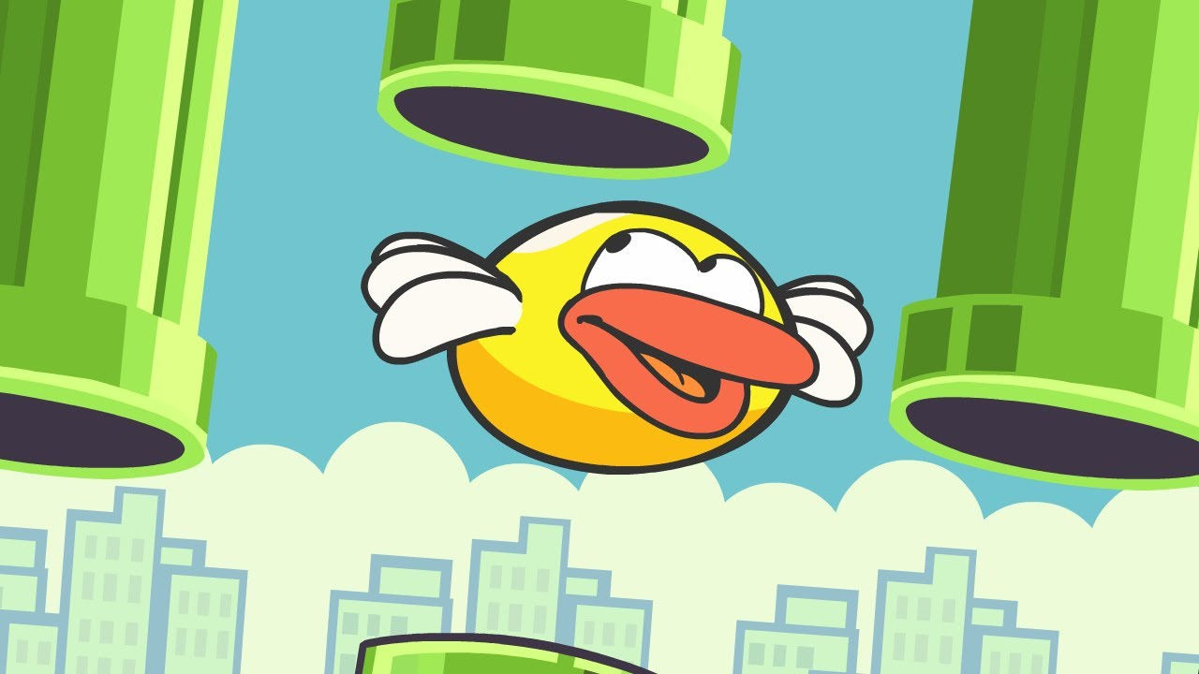




Medals
Up till 40, every ten pipes you pass you will earn a medal ranging from bronze to platinum.These do not affect the gameplay, but they are an achievement to earn:
10 pipes- Bronze Medal
20 pipes- Silver Medal
30 pipes- Gold Medal
40+ pipes- Platinum Medal
Bronze |  | Silver |  | Gold |  | Platinum

Slide 7
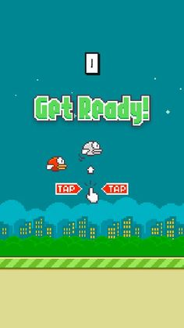
Game Layout

Slide 8
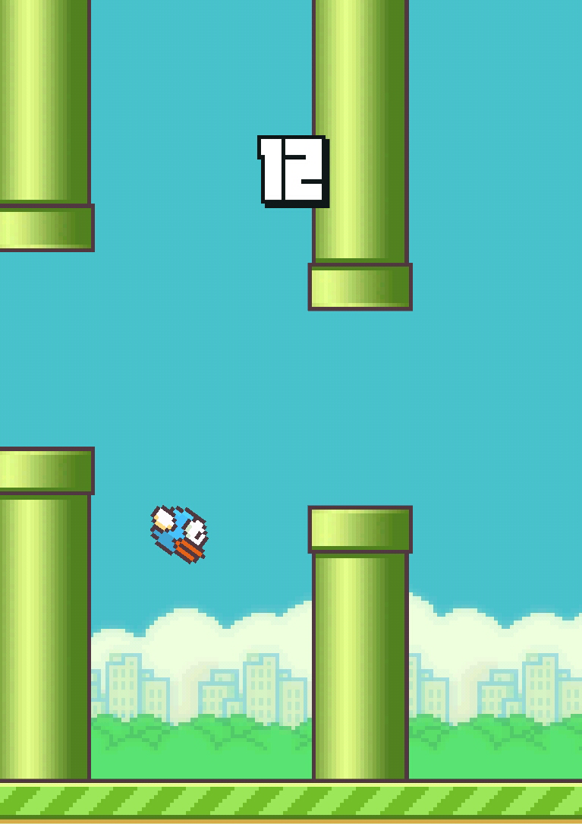
Game design
We will design a static bird and many pipes for the obstacle.
We will rotate the pipe 180 degrees and used two separate images for the top and bottom pipes.
We will use Photoshop Elements to design the images.
In the concept building phase, we will use the idea of the GUI layout and general gameplay characteristics of the game.
In the center of the screen will be a button to click when players are ready to play.

Slide 9
Objectives
Through this project our goal is to learn-
User :
1. Entertainment
2. Be more diligent
Developer :
1. Competent OOP using JAVA.
2. Graphics.
3. To Work in a group
4. To create desktop-application.

Slide 10
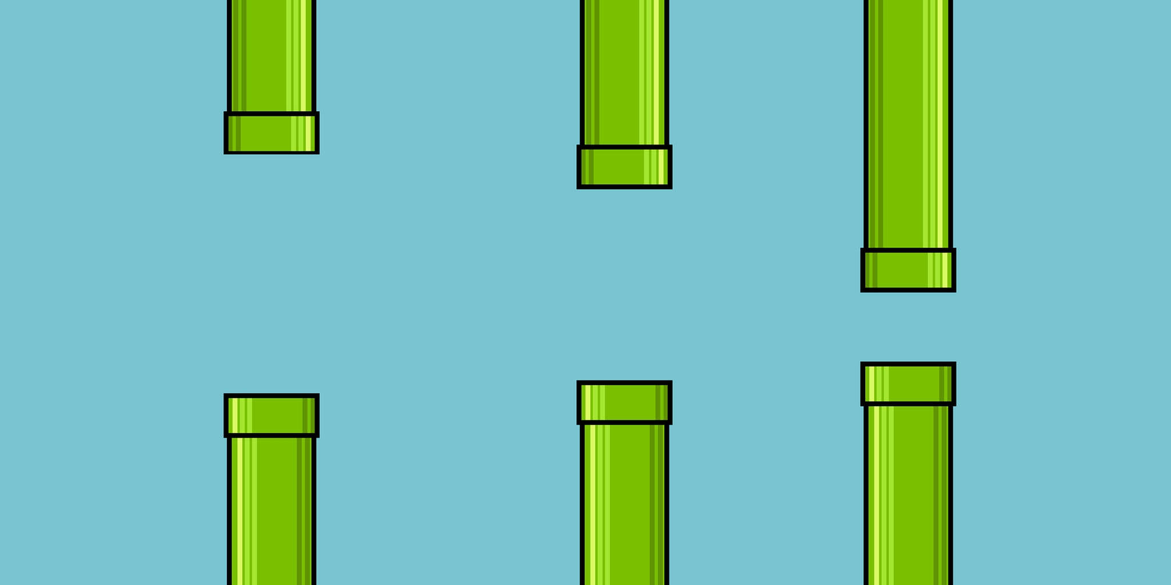
Scope
This game will be available on Desktop and PC version.
Later version may be developed for Android.

Slide 11
Favourite and hardest functionality
Favourite Feature :
The flapping function and the art.
Most difficult part to code :
The flapping function

Slide 12
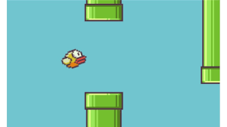
Motivation
Flappy Bird is a popular game among children in Bangladesh.
Previously Nokia 3310 model mobile gives scope to play this game which was not available at any other mobile phone. As new android mobile are available in our local market, the previous version of Nokia will be vanished.
That’s why we wanted to implement this game on Desktop.
ersion.

Slide 13
Deliverables
Source code
Documentation
User Manual

Slide 14
Work Distribution
Task | Active Memberser
Proposal | Md Al-Adnan,Moonmoon Das,Akash Chandra Debnath
Requirement Analysis, Specification | Md Al-Adnan, Moonmoon Das,Akash Chandra Debnath
Design | Md Al-Adnan, Moonmoon Das,Akash Chandra Debnath
Study | Md Al-Adnan,Moonmoon Das,Akash Chandra Debnath
Coding | Md Al-Adnan,Moonmoon Das,Akash Chandra Debnath
Final Testing | Md Al-Adnan, Moonmoon Das,Akash Chandra Debnath

Slide 15
Proposed Time Line
Task | Deadline
Proposal | Within 3rd week of January
Requirement Analysis, Specification | Within 21th January
Designing, Study | Within 28th January
Coding | Within 24th February
Final Testing | Within 3rd March

Slide 16
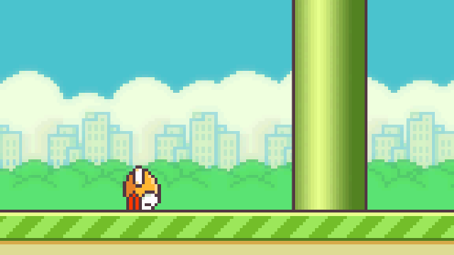
Future Plan
Add power ups and other features once the base game is done.
Algorithm for image moving.

Slide 17
Refference
https://www.wikipedia.org/flappybirds
https://mashable.com/2014/02/10/flappy-bird-story/
https://www.wired.com/2014/02/flappy-bird/
http://frivetenskapligpublicering.blogspot.se/
http://worldwithoutexcuses.blogspot.se/
http://ingaursakter.blogspot.se/

Slide 18


