Slide 1

MID
PRESENTATION
Presented By
Md. Al Adnan
ASH1825008M

Slide 2
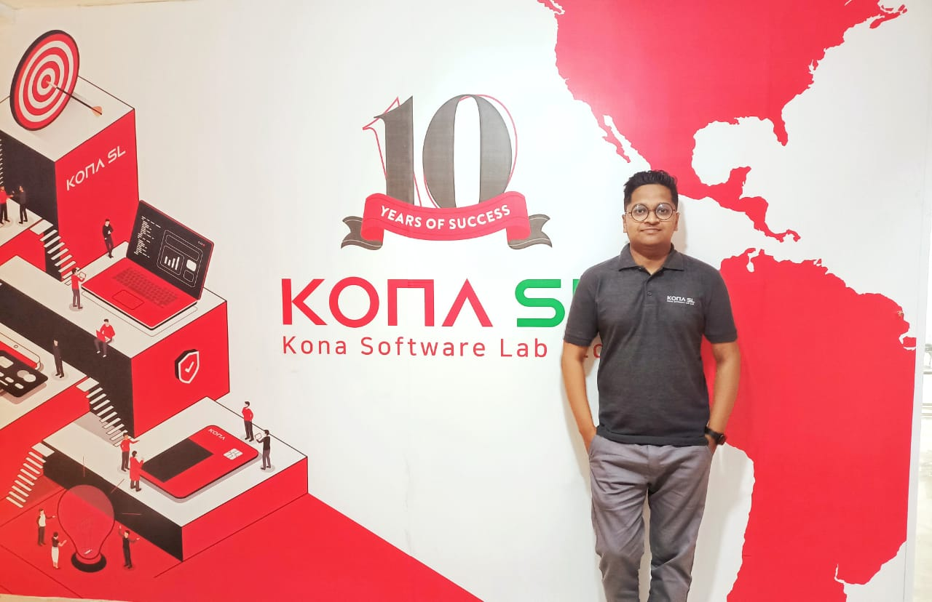

KONA Software Lab Ltd.
Police Plaza Concord, 8th Floor, Tower - A Plot - 2, Road - 144, Dhaka 1212, Bangladesh
Address: https://konasl.com

Slide 3
About KONASL
Kona Software Lab Ltd. marks its 10th year in Bangladesh as R&D Center and Global Solution Business Wing of KONA which has over 20 years of dominant
international presence. Globally, KONA serves 500 customers in 90 countries (ranks among top 4 banking card manufacturers).In Bangladesh,
KONA serves more than 30 banks and owns 50% card market share
2012
• Established as an R&D Center of KONA I Co., Ltd.

Slide 4
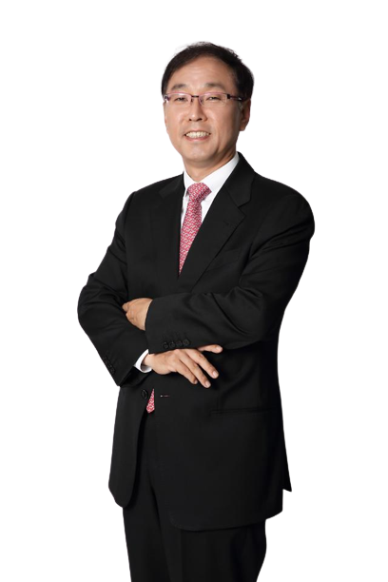
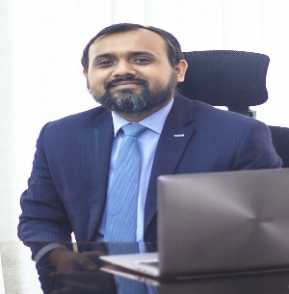
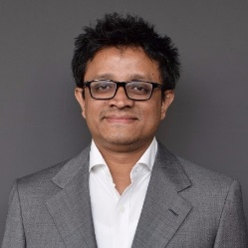
Company Hierarchy
Minaoar Hossain Tanzil
Managing Director, Kona Software Lab Ltd
Cho Chung-il
Topu Newaj
Chairman, Kona Software Lab Ltd.
EVP- Kona Software Lab Ltd
Notes:
https://www.freepik.com/free-photo/businessman-leader-modern-office-with-businesspeople-working_1174193.htm
https://www.freepik.com/free-photo/confident-business-people-diversity-teamwork-concept_17229697.htm

Slide 5
Business Unit
Fintech
Platform
Blockchain
Ecommerce
DFS
Notes:
https://www.freepik.com/free-photo/happy-business-woman-pointing-copyspace_7379048.htm
https://www.freepik.com/free-photo/happy-young-man-using-laptop-computer_8195606.htm
https://www.freepik.com/free-photo/smiling-confident-businesswoman-posing-with-arms-folded_5546285.htm
https://www.freepik.com/free-photo/portrait-handsome-businessman-with-glasses_12232405.htm
https://www.freepik.com/free-photo/confident-stylish-handsome-young-businessman-adjusting-necktie-looking-camera_2788501.htm#page=1&query=business%20man&position=45&from_view=search

Slide 6
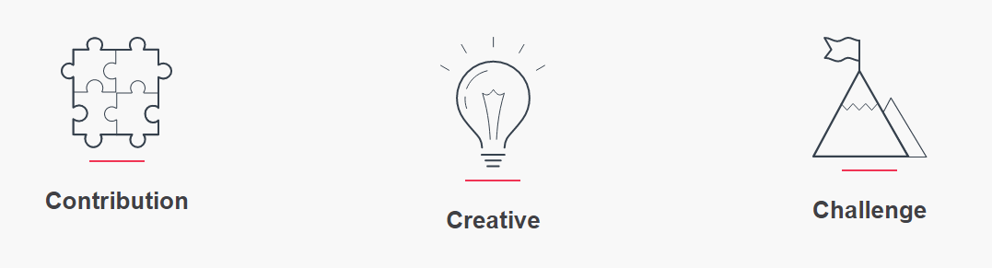
Motives

Slide 7
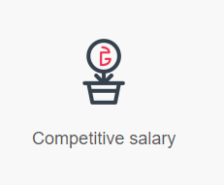
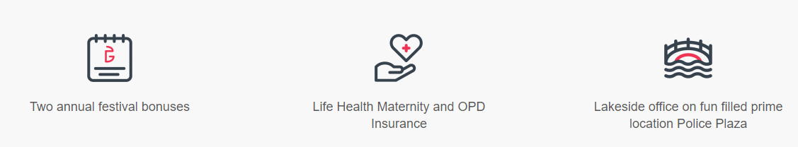
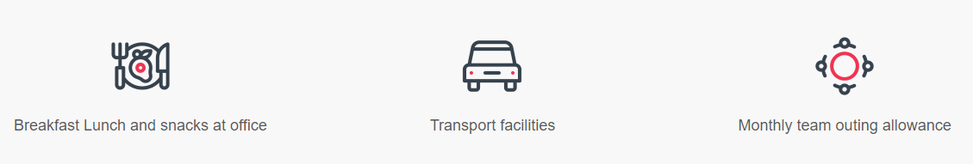
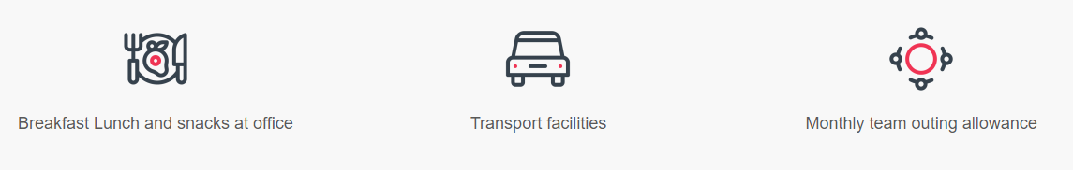
KONASL
Facilities

Slide 8

Rules And Regulations
Office Hour 9am-6pm
Need to add Clokify Entry
Employee Verification

Slide 9

HR Policies
Leave and Time-Off Benefits
Safety and Health
Leave and Time-Off Benefits
Finding Talent
Employee Data Security
Filling High-Tech Positions
Telecommuting

Slide 10

Renowned Clients of the Company
Nagad
Nexuspay
Merchantile
Bank Finnovation
Kona Card
DBBL
City Bank
EBL
IFIC Bank
EXIM Bank
Trust Bank
Jamuna Bank

Slide 11
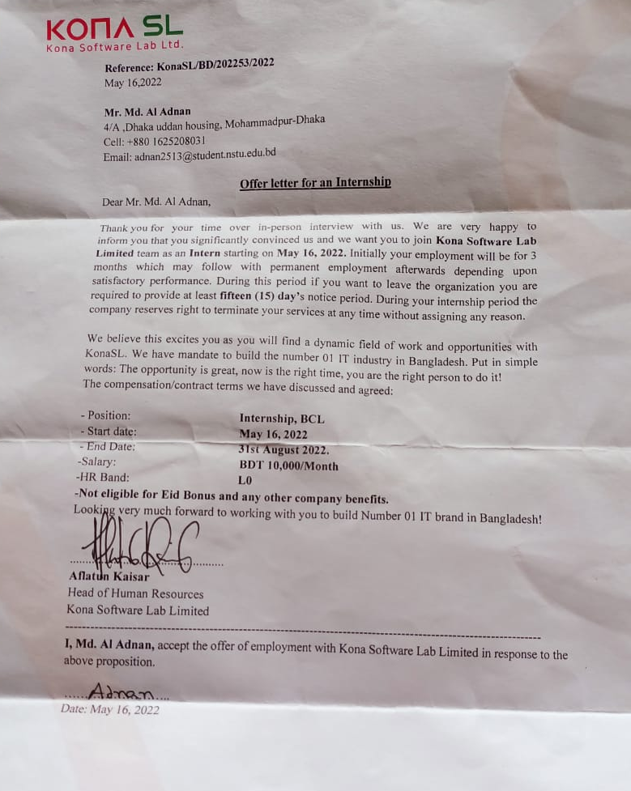
Joining Date At KONASL
Starting : 16-05-2022
Ending : 31-08-2022
Position: Software Engineer (Intern)

Slide 12
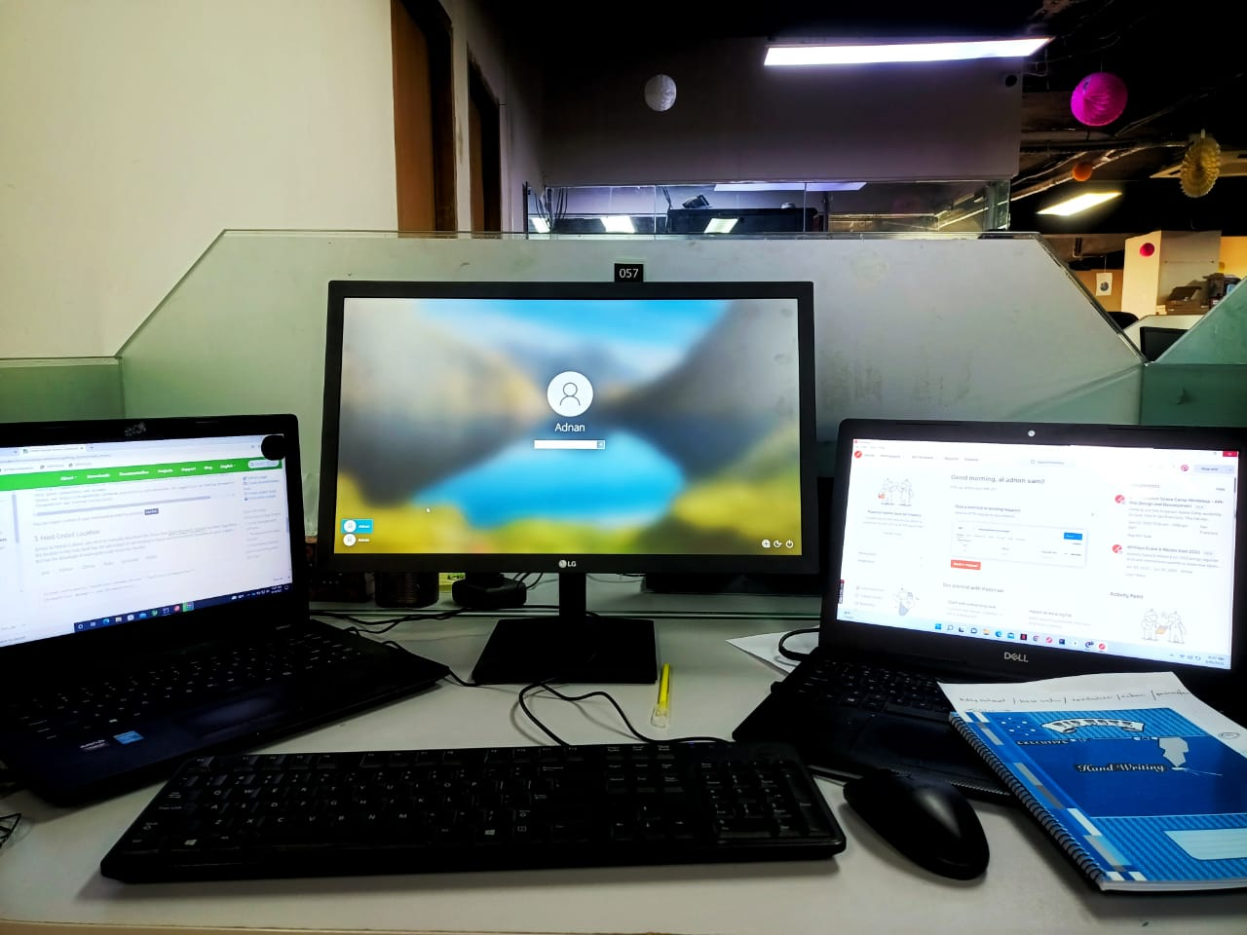
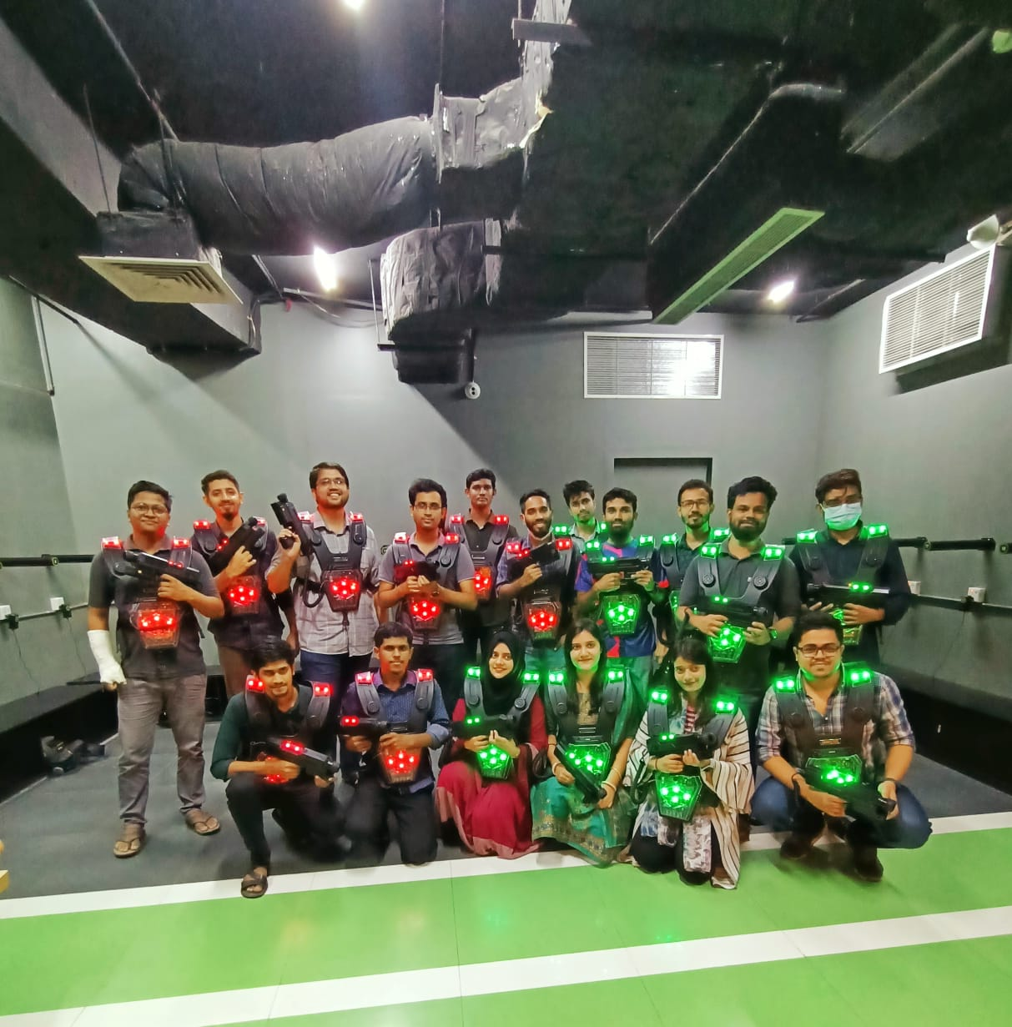
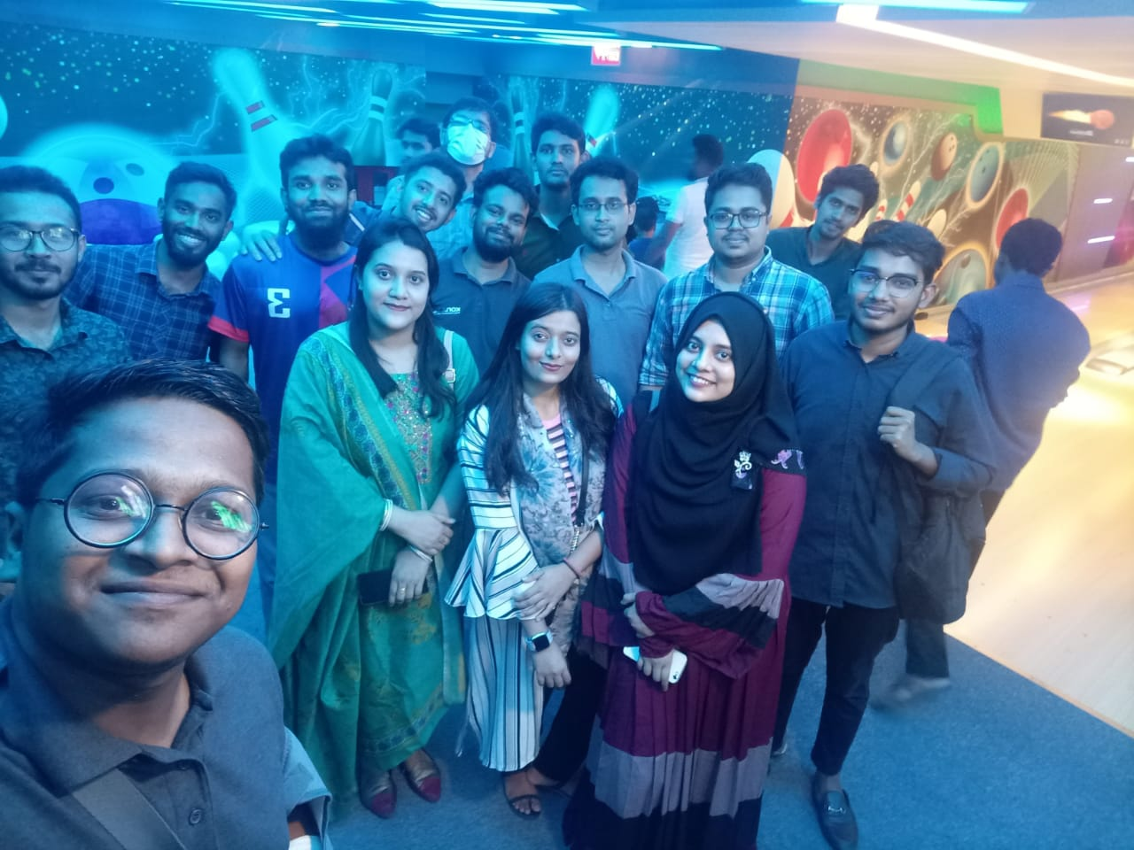
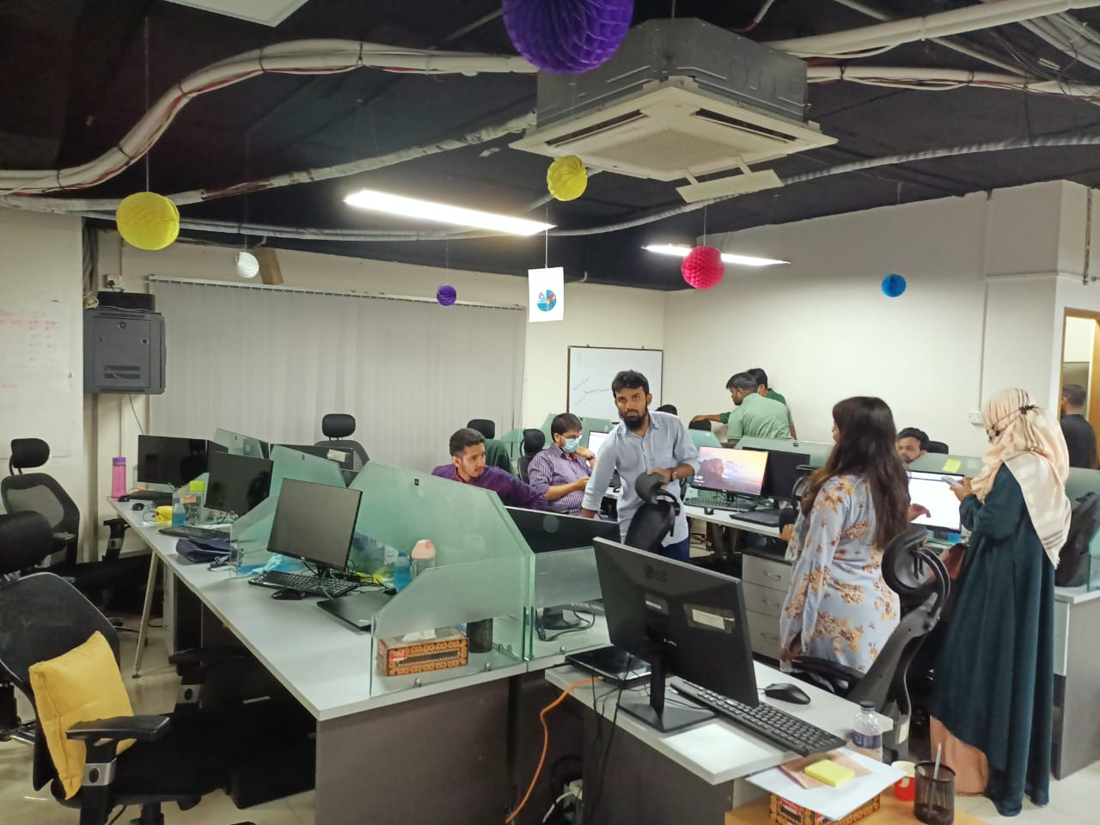
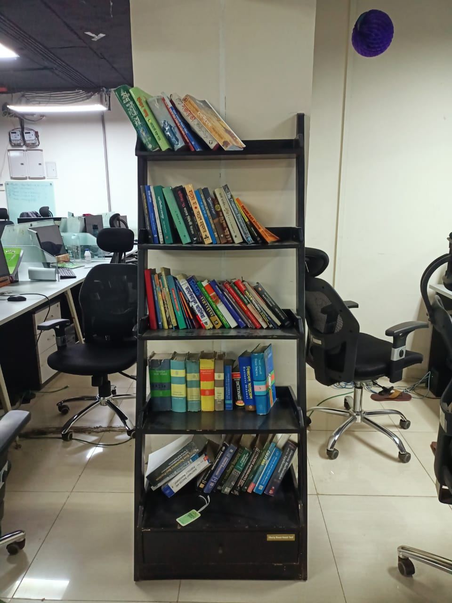
Office Environment

Slide 13
Assign Project
Project Name - Kona Treading System
Backend- Block Chain, Spring boot
Database- MongoDB, Postgres, Hexlant
Frontend- React
Automation – Selenium

Slide 14
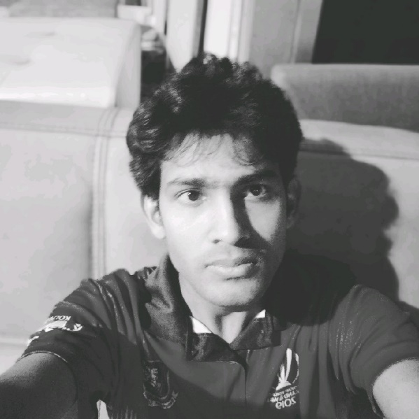
Project Supervisor
Shahidul Islam
Engineering Manager- KONASL
Lead- P2P Kona Trading System

Slide 15

Challenges I have faced in new place
Transportation
Food
Meeting new colleagues
Fitting into the company culture
Maintaining work-life balance
Arrive early every day

Slide 16
What new skill I have learnt
Unit Testing
Automation In Selenium
Spring Boot
MongoDB
Postgress

Slide 17


