Slide 1
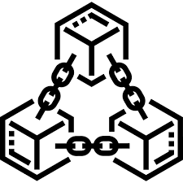
Proposal Presentation
Presented By
Nowal Benta Basher
ID No: BFH1825041F
Supervisor
Rafid Mustafiz
Lecturer,IIT,NSTU

Slide 2
Research Area
I will do research implementation. So my research area is
Defining Regions by Data Clustering for Increasing the TPS Rate of Block chain & Parallel Mining

Slide 3
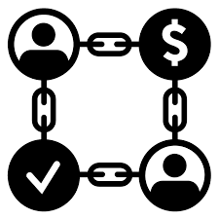
Introduction
Blockchain:
Blockchain is a collection of blocks. Each block contains a cryptographic hash, which means that if we change any small number or digit, the hash will change, which means that if we tamper with anything, the link to the previous block will be lost due to the hash changing, which is why this technology is so powerful.

Slide 4
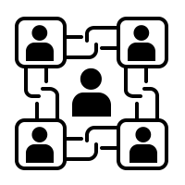
Motivation on this Research
In this research I use supply chain based blockchain.
In a traditional supply chain, there are various issues. For example, in the food supply chain, we don't know how the food is processed, whether it's organic or not, there is a lack of information, data retrieval takes a long time, and the data is unreliable for product tracing.
We can fix this issue through the use of blockchain technology but there is scalability issue.
Thus, this is one of the major blockchain difficulties. In this research, I try to improve the TPS rate of a blockchain, by clustering the transactions and parallel mining.

Slide 5
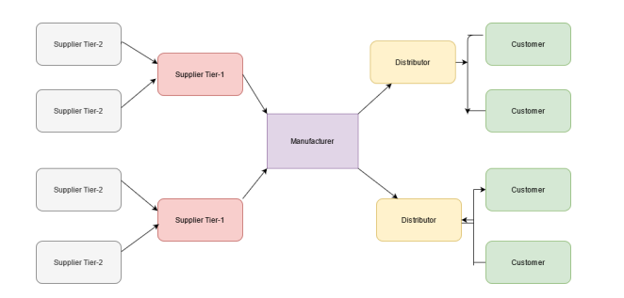
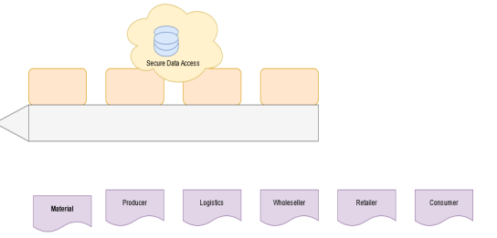
Traditional SCM VS Blockchain based SCM
Traditional SCM
Blockchain based SCM

Slide 6
Problem Statement
The primary difficulty with the blockchain is its limited throughput, which results from its slow transaction speed. when we increase the number of concurrent jobs in a chaincode, this supply chain-based blockchain takes a long time and its response time decreases. Additionally, data retrieval takes a long time.
For example, if we send 20 queries to the supply chain-based blockchain technology, we will receive a response in 0.5 sec. However, if we send 50 inquiries, it will take significantly longer, approximately 1 sec. The reason of low TPS rate is that the transactions are processed and verified serially.
The goal of this research is to increase a blockchain's TPS rate through the use of the region-based parallel mining concept. This is accomplished by grouping transactions into distinct subsets. The proposed methodology not only increases the TPS rate, but also makes it easier to locate linked transactions in the blockchain.

Slide 7

Proposed Work
In this research, I investigate a framework for improving the TPS rate of current day blockchains, by clustering the transactions into disjoint subsets and mining them in parallel.
The proposed system can be used in any system that generates huge number of transactions and needs to validate the transactions in quickly, such as in supply chains or trading.
In this proposed framework, we try to define the concept of regions by clustering the transactions into disjoint subsets to assist parallel mining for improving the TPS rate of a blockchain. We perform a detailed evaluation to analyze the performance of the proposed system.

Slide 8




Overview of Proposed Framework
Users
Send Transactions to manager for approval
I consider the inclusion of a designated server for clustering the transactions. It is referred to as the Manager in the proposed framework. It is assumed that the transactions of all users, passes through the manager.
The manager collects all transactions and can cluster the data into disjoint subsets. Finally it broadcasts each cluster to the miners. The miners can accept any cluster or clusters that it wants to mine and finally upon successful verification the transactions are included in the blockchain.
Manager
Cluster the transactions and broadcast the miners
Cluster 1
Cluster 3
Cluster 2
……
Miners
Perform Parallel Mining

Slide 9
Clustering of Transactions
Various data like fruits, vegetables and meat.
Since data of various transactions are distributing throughout the ledger, I need to cluster these to form a similar related transaction for a block.
In research implementation, I apply the K-Means clustering algorithm to group these similar transactions into different clusters. For finding K value I use Elbow method.
Elbow method shows how many cluster will be good for this transaction dataset.
Fruits Cluster
Veg Cluster
Meat Cluster
Transactions Cluster

Slide 10
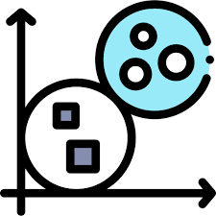
Cluster Based Parallel Mining
After clustering, the manager broadcast this cluster to the miners and then miners mined it region based parallel mining. I can achieve the better TPS rate by using parallel mining rather than solo mining.
For that I have to divide the blockchain network into different segments called as regions and cluster this regions.in this method a miner can only mine for a specific region.

Slide 11
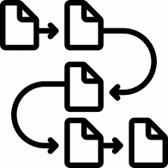

Comparison of Sequential & Parallel Mining
After clustering and Parallel mining we build up a data representation as we can see comparison and choose parallel mining.
Sequential
Parellal

Slide 12
Roadmap of My Research
Implement Supply Chain Management in Blockchain
Learn research related alogithm
Cluster Transaction and Parallel concept apply
1
3
5
2
4
6
Learn about Parallel Execution Concept in Blockchain
System Model Design and Block Transaction Design
Comparisn sequesntial & parallel mining and complete research implementation

Slide 13
THANK YOU!!

