Slide 1

Presentation
on
“NSTU Website integrated With Chatbot”
19-06-2023

Slide 2


Presented By
MD AL ADNAN
MUH1825008M
@aladnansami
2
19-06-2023
Notes:
© Copyright Showeet.com – Creative & Free PowerPoint Templates

Slide 3
Supervised by
TASNIYA AHMED
Assistant Professor -IIT
NSTU
3
19-06-2023

Slide 4
Content
01
Problem statement
Tools and Technology
04
02
Stakeholder
Limitation
05
03
System Design
Future work
06
4
19-06-2023
19-06-2023

Slide 5
Problem Statement
Chatbot
Teacher, Student Profile(Publication,Education Qualifications)
Notices,News,Events
Administration, Academic
19-06-2023

Slide 6
Stakeholder
Teacher
Student
Cyber center
User
19-06-2023

Slide 7

Cyber center can control Administration, Academic,News, Events, Notice Board section.
Teachers can update their profile(Publication,Educational Qualification,Research Interest)
Students can update their profile(Publication,Educational Qualification,Research).
Users can search queries using chatbot.
7
19-06-2023

Slide 8
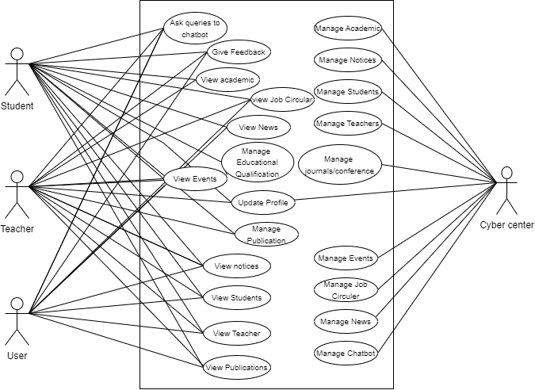
‘System Design’
1.Use Case Diagram
19-06-2023

Slide 9
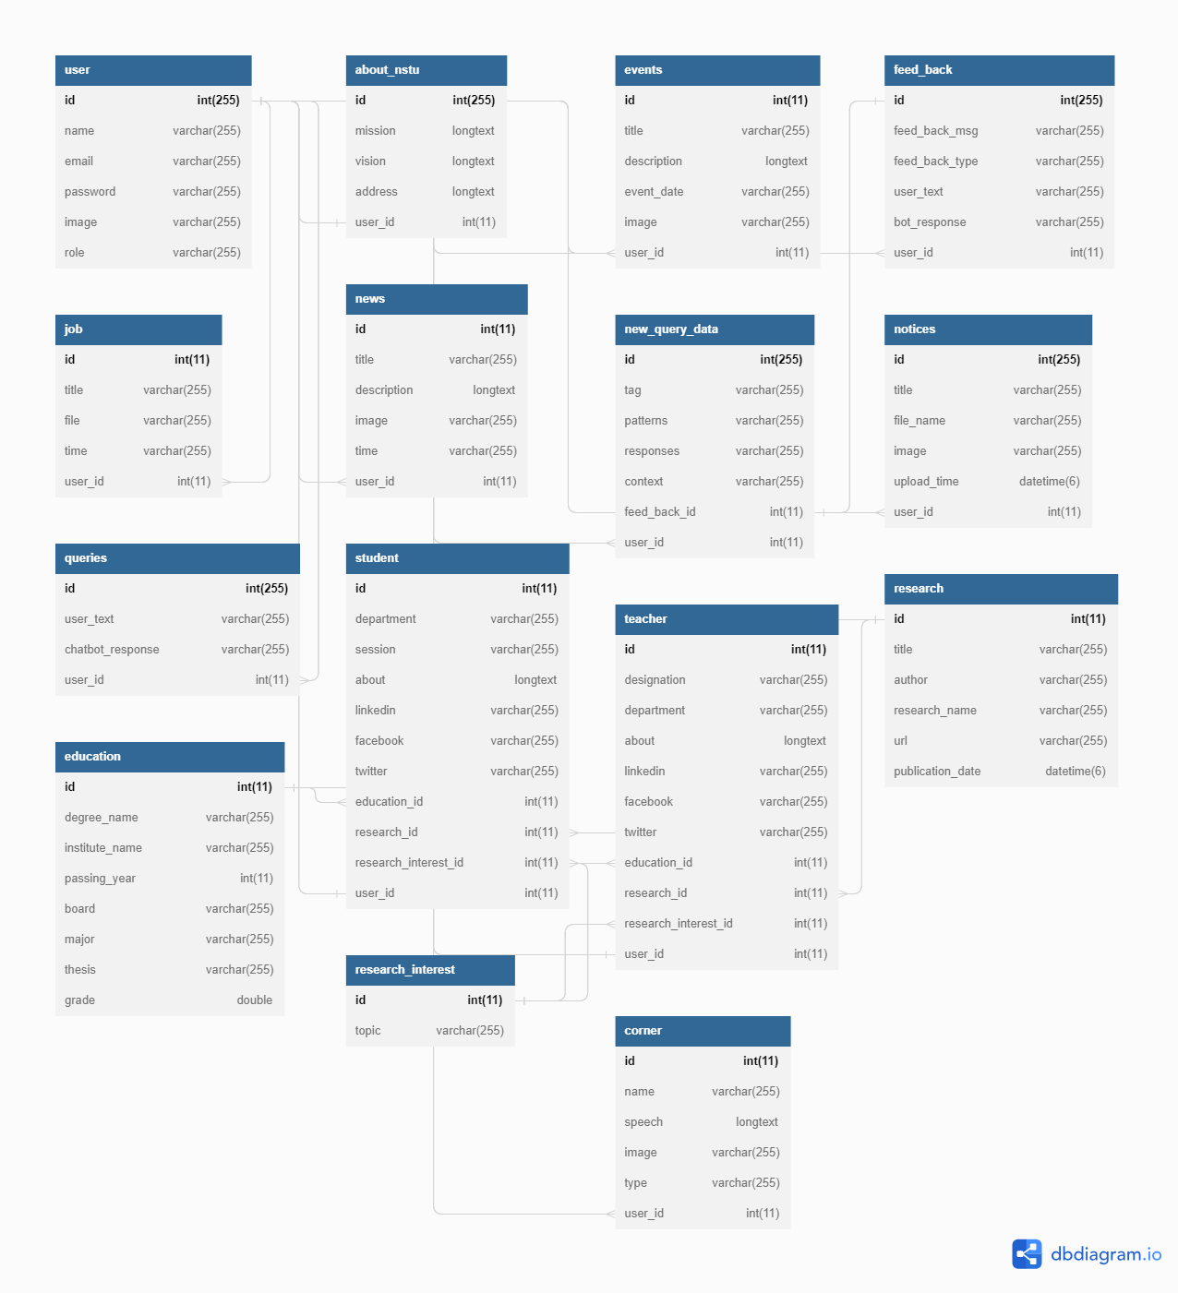
‘System Design’
2.Database Schema Diagram
19-06-2023

Slide 10
Tools & Technologies
01
Tools
02
Frameworks
PyCharm's, xampp
Python flask
10
19-06-2023

Slide 11
Limitations
01
02
Cannot manage staff information
Cannot manage photo gallery dynamically
03
Cannot manage office information
11
19-06-2023

Slide 12
Maintenance
01
01
Bug Fixing
02
Evolving Reguirements
02
12
19-06-2023

Slide 13
Future Plans
Adding Staff Information(Work History)
Manage Office Information Dynamically
2022
13
19-06-2023

Slide 14


