Slide 1
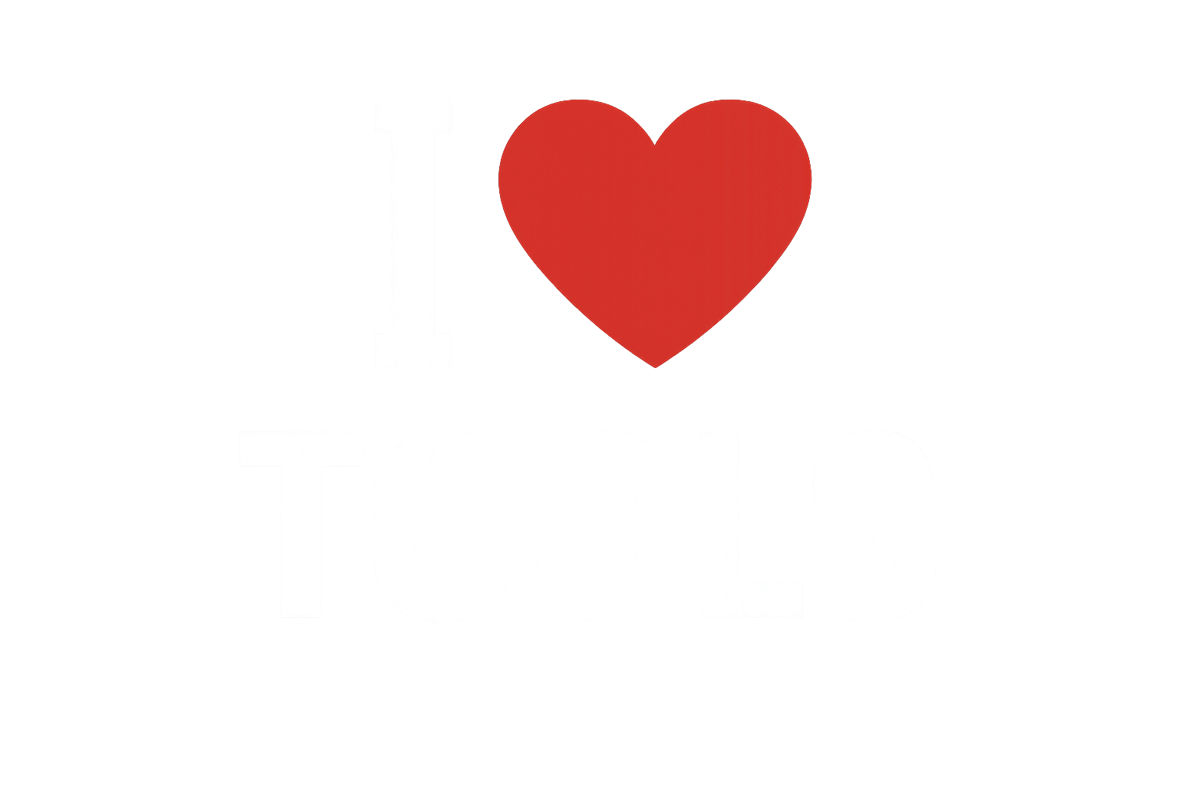
n8n
Workflows + AI
2025.10.21
Aladroc.io

Slide 2
Problem:
# I have repetitive tasks that need automation # I like it simple, no code… visual
# I need to connect to multiple systems
# Needs to be extremely versatile & easy
# Documentation updated… we need living docs
aladroc.io

Slide 3
Solution:
# Visual coding using grafical interface workflows # AI on premises or on cloud not important
# Workflows themselves can be generate using MCP
# Its Free its open source and is a company behind it
aladroc.io

Slide 4
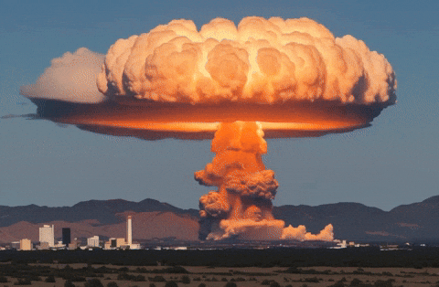
aladroc.io
Boom!!! n8n

Slide 5
Today:
# Getting Started flow + simple AI # ChatBots :: My virtual Employee Terry
Time is limited today I will be jumping uninteresting parts
aladroc.io

Slide 6
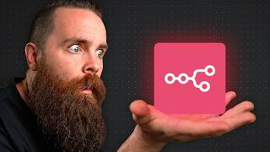
n8n: Basic Workflows + simple AI
aladroc.io

Slide 7
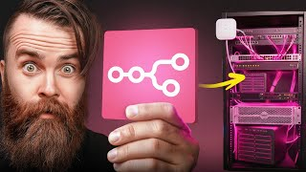
n8n: My virtual employee Terry
aladroc.io

Slide 8
aladroc.io

Slide 9
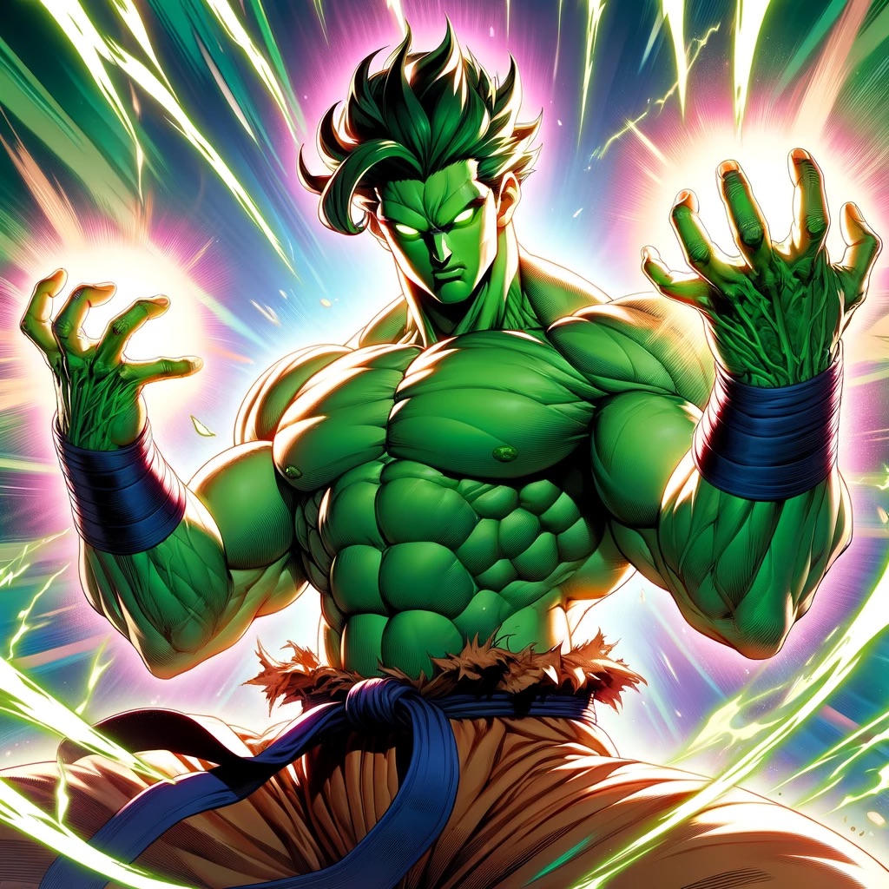
Links & thanks
Jose Romero
Sharing is caring
jose.romero@aladroc.io
https://github.com/aladrocMatiner
aladroc.io
| Links
https://n8n.io/
Basic Workflows + AI
Chatbots + Troubleshooting

