Slide 1
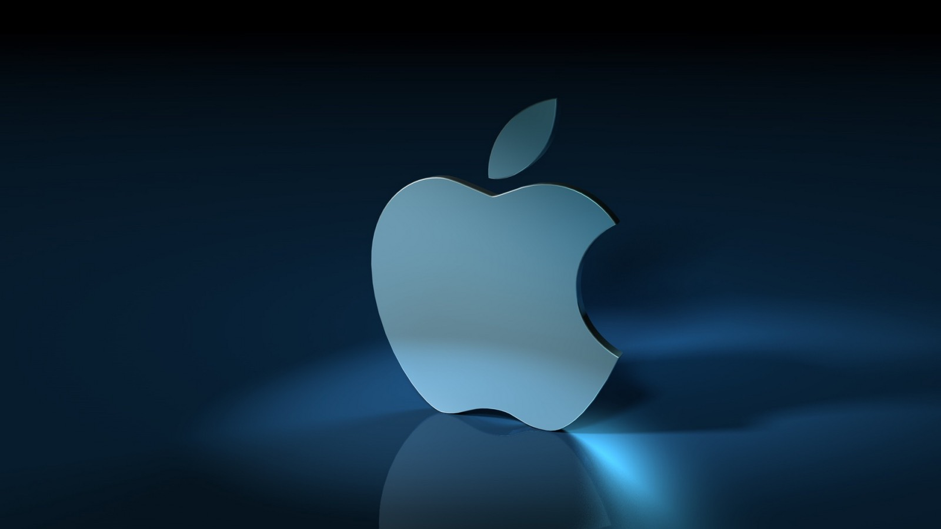
Mac OS

Slide 2
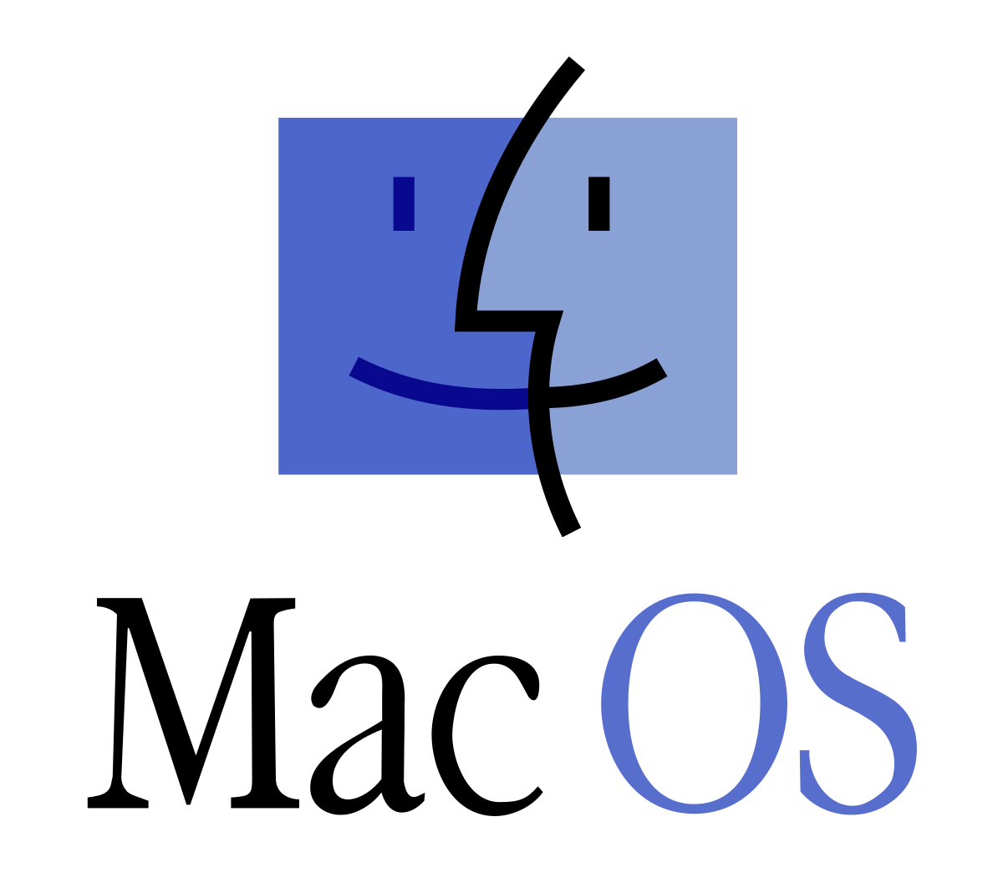
History
Mac OS was released in 1984 along with Apple's first Macintosh personal computer. The ideas embodied in the first version of the Mac OS system, its authors learned from Xerox.
It already used the familiar window interface, folders with files, and for the first time a manipulator was used, called a computer mouse, capable of moving the cursor over the entire area of the screen. This concept was quite consistent with the main idea of Apple itself.

Slide 3
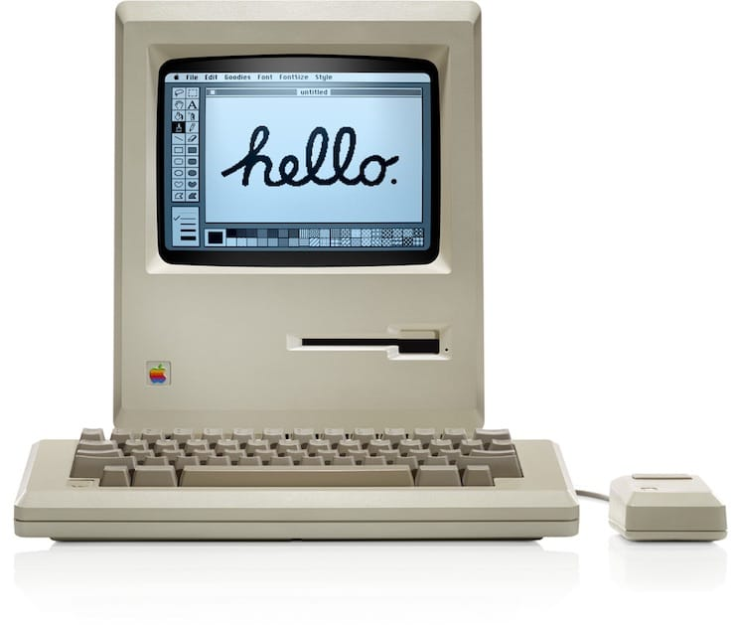
Versions
The first Macintosh
From 1984 to 2001, the versions of System 1 – Mac OS 9, which are considered classic, were released. Since 2000, the operating system has been named Mac OS X, and since 2016 – macOS.

Slide 4
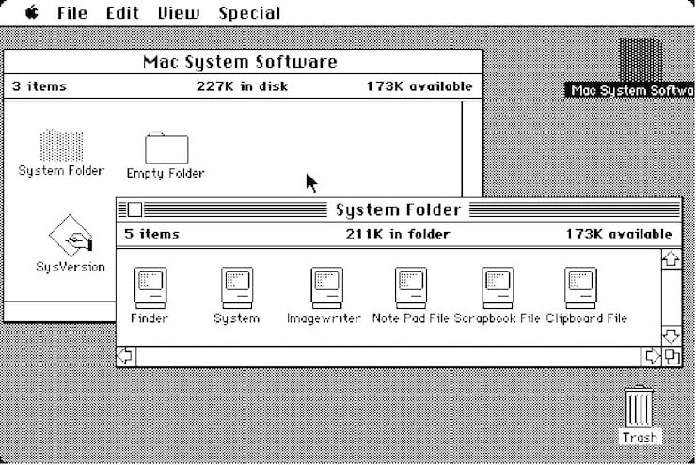
System 1.0
In the System 1.0 version, Apple has implemented a user-friendly graphical interface.

Slide 5
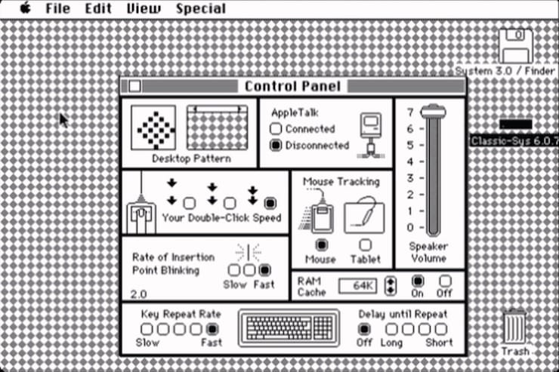
System 2.0 – 6.0 (1985-1988)
During this period, the developers added additional features, settings and standard applications, and a hierarchical file system also appeared.
System 3.0

Slide 6
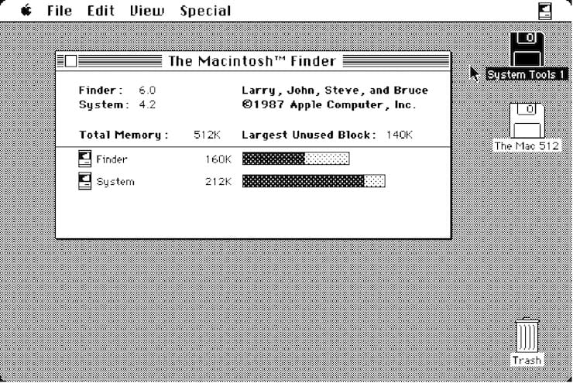
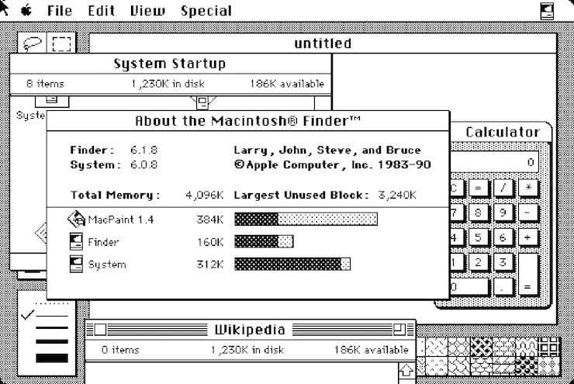
System 4.2
System 6.0

Slide 7
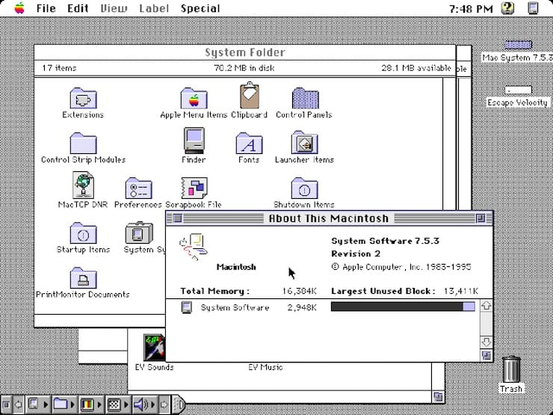
System 7.0 – 7.6 (1991-1996)
The first large-scale OS update was received only after seven years of existence. The upgrade brought a color interface, although many elements were still gray, some of them were colored. The developers have significantly improved the multitasking mode. In subsequent updates, Apple fixed bugs, added support for new components, implemented new programs, both its own and from third-party software developers.

Slide 8
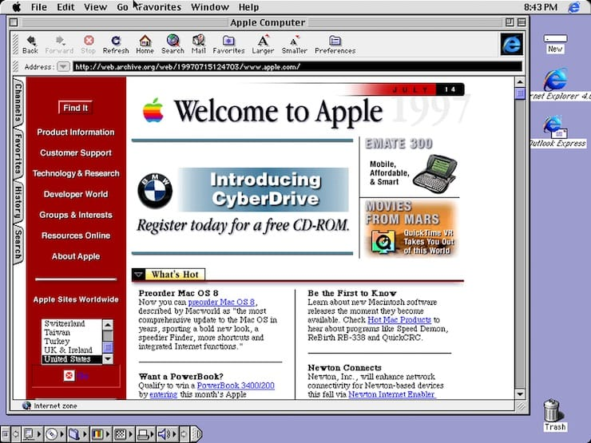
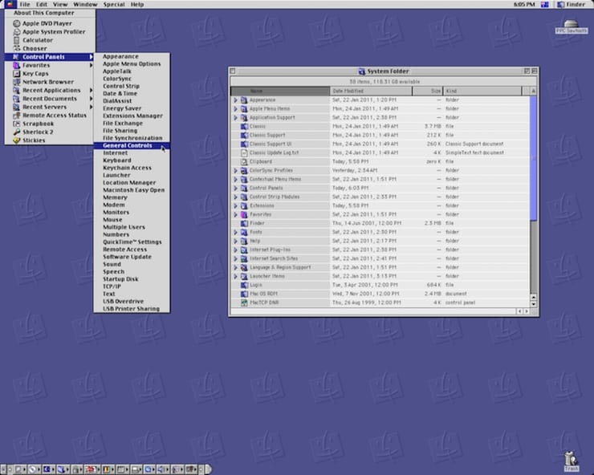
System 8(1997)
Mac OS 9 (1999)
On October 23, 1999, the Cupertinos released a version of Mac OS 9, which became the last update of the classic Mac OS. Users of this edition have the opportunity to store their information and set system settings.

Slide 9
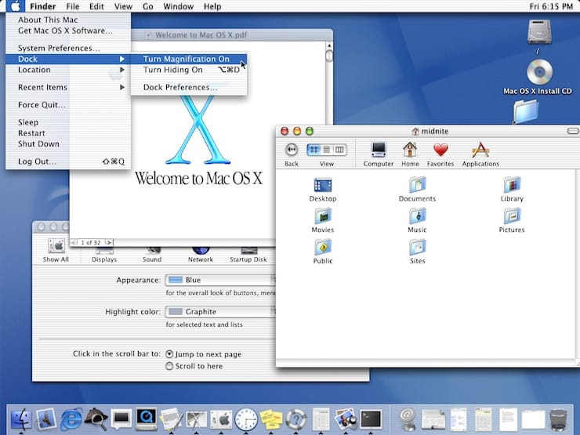
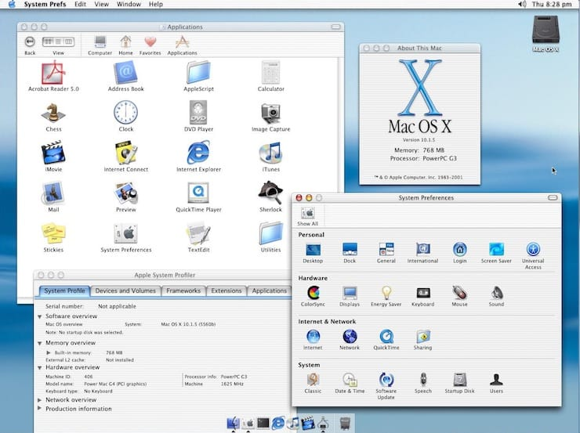
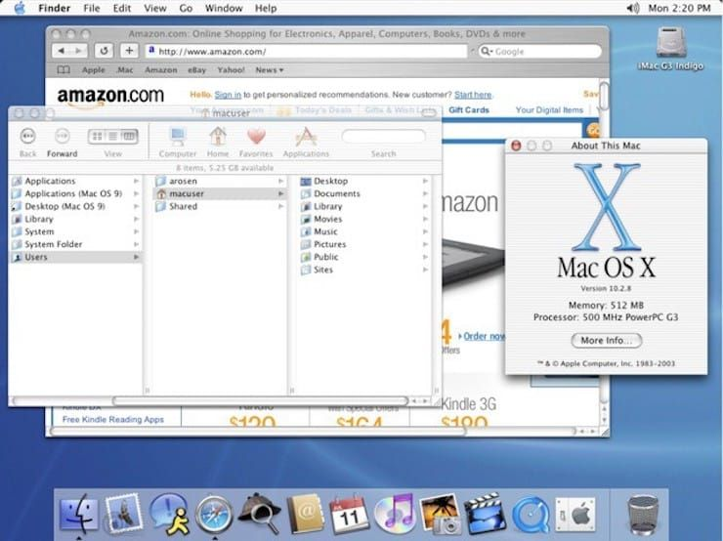
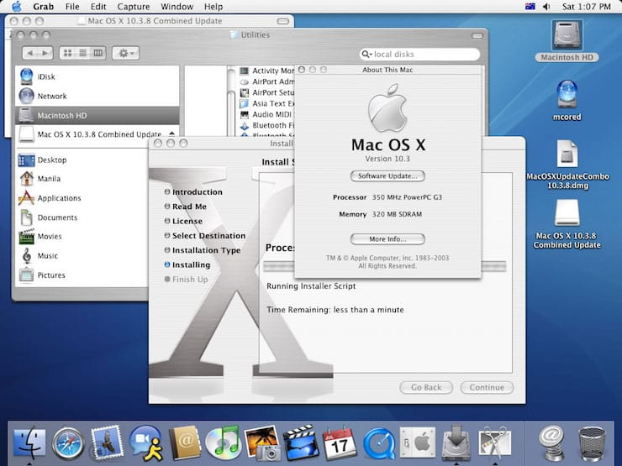
Mac OS X 10.0 Cheetah (2000)
Mac OS X 10.1 Puma (2001)
Mac OS X 10.2 Jaguar (2002)
Mac OS X 10.3 Panther (2003)
Apple has decided to abandon Internet Explorer for Mac in favor of its own Safari browser.
There was a start screen saver: instead of a happy Mac, the Apple logo in the form of a fruit began to be displayed.

Slide 10
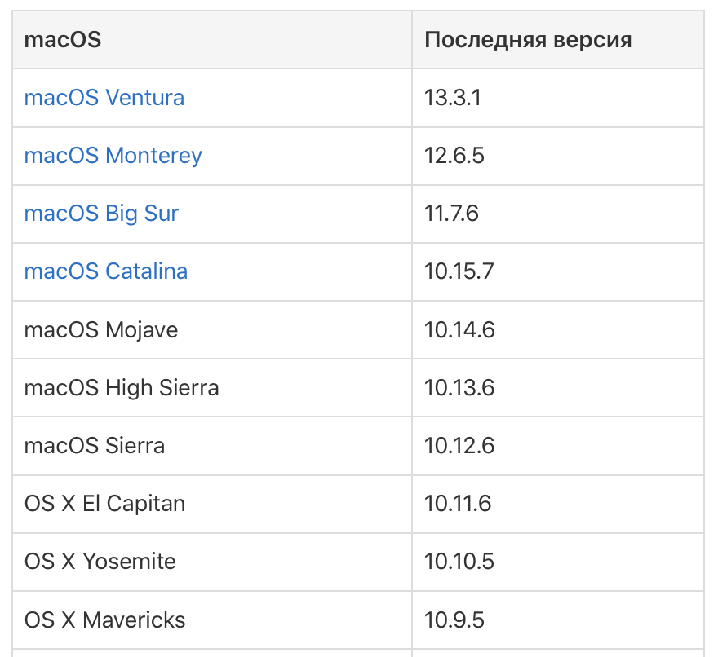
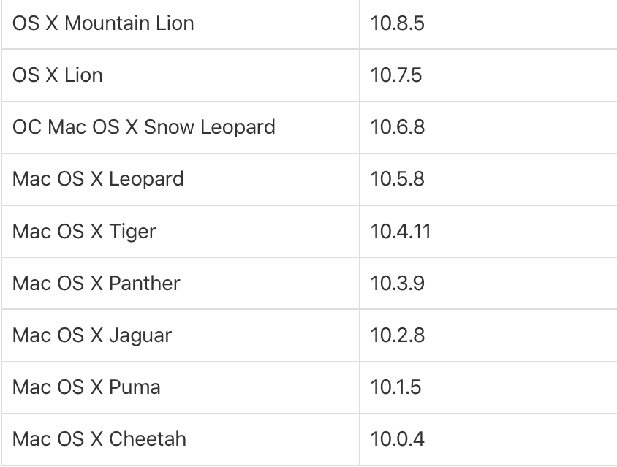
Versions

Slide 11

macOS 13 Ventura (2022)
The main innovations include: the appearance of a new tool called Stage Manager, which is designed to organize windows on the desktop; a new design of "System Settings" corresponding to a similar application in iPadOS.
In addition, the applications have been updated: Mail, Clock, Messages, Safari, Maps, FaceTime. The design of the Siri personal assistant has changed.

Slide 12
Interesting facts
1. Macintosh is really a slightly modified name of the apple variety, which is spelled McIntosh in English.
2. When Steve Jobs joined the project, he wanted to change the name of the project: instead of Macintosh, the name Bicycle was proposed.
3. The first application for computer layout of newspapers and magazines appeared on Macintosh — Aldus PageMaker. The graphical interface and the choice of fonts — such a wealth at that time could not be offered by any other computer.
4. On the keyboard from which the first Macintoshes were sold, the arrow keys were deliberately removed to encourage users to use the mouse more actively.

Slide 13
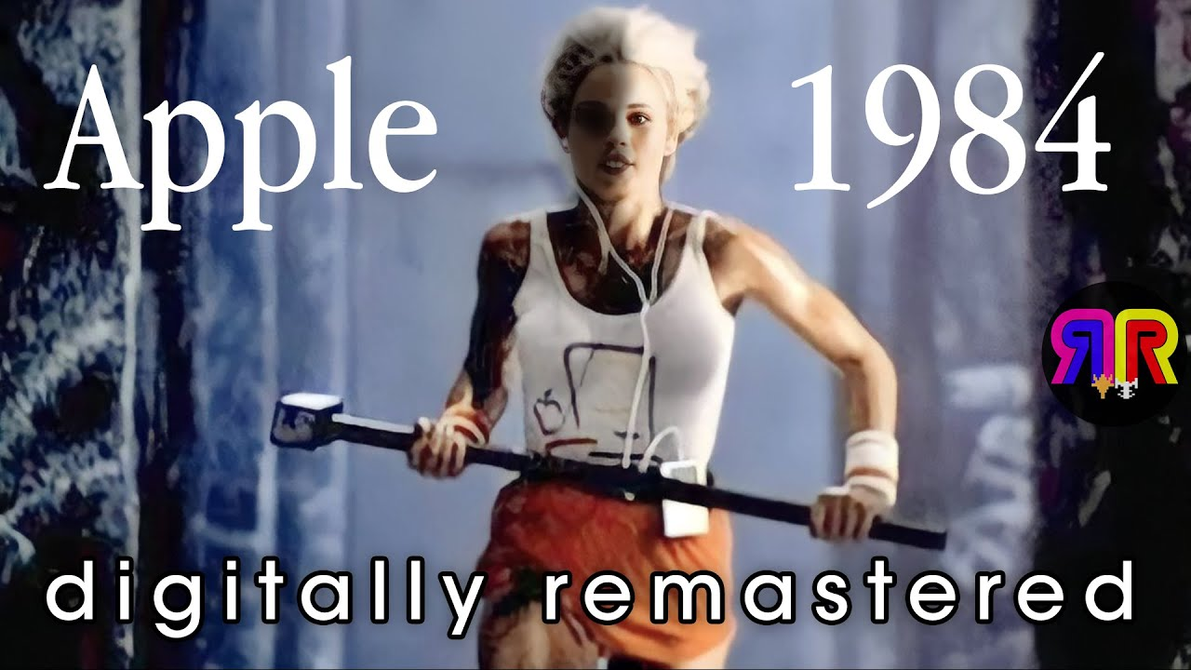
Interesting facts
5. The Macintosh commercial was shot by Hollywood director Ridley Scott, known primarily for the films Alien and Blade Runner. This video is recognized as one of the best video ads of all time. The basis of this advertisement was the plot of the novel by J. Orwell's "1984".

Slide 14
Thank you for your attention!

