Slide 1



Multimodal RAG Application for Veterinary Assistance
This report provides a comprehensive overview of the Multimodal Retrieval-Augmented Generation (RAG) application designed to assist veterinarians in providing accurate and comprehensive information on canine health. The application integrates natural language processing (NLP) capabilities with document retrieval, leveraging a multimodal approach to analyze text, images, and tables.
by apaia tech

Slide 2

Introduction to the Application Purpose
The application aims to streamline veterinary research and information retrieval by providing veterinarians with a quick and efficient way to access relevant data on canine health. It empowers veterinarians by eliminating the need for extensive manual searching through multiple resources.
The core functionality of the application is powered by a multimodal RAG pipeline that seamlessly combines NLP and document retrieval. This integrated approach enables the application to process queries and retrieve information from diverse data formats, including text, images, and tables, delivering comprehensive and insightful answers.
The application excels in its ability to handle complex queries and provide detailed responses. By leveraging a multimodal approach, it goes beyond simple text-based retrieval, offering veterinarians a richer understanding of canine health issues based on a wide range of data sources. This comprehensive approach significantly enhances the accuracy and relevance of the information provided.

Slide 3
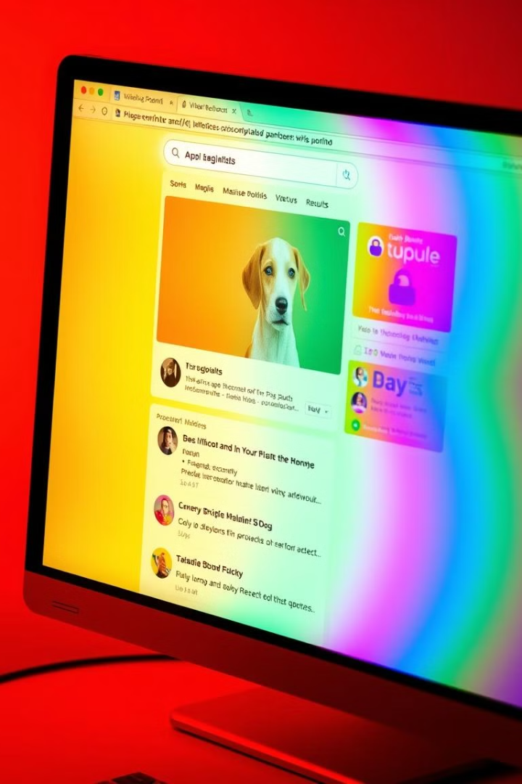
Technical Overview
The application's backend is built on the robust and efficient FastAPI framework. FastAPI's asynchronous nature and support for websockets allow for fast and scalable API interactions. The framework leverages LangChain, a powerful library for building and orchestrating NLP workflows, facilitating the integration of various NLP models and techniques within the application.
For vector-based similarity searches, the application relies on FAISS, a library specifically designed for efficient similarity search in high-dimensional vector spaces. FAISS optimizes the retrieval process by indexing and storing document vectors, enabling the application to quickly identify relevant documents based on similarity to the user's query.
The user interface is developed using HTML and Jinja2 templates. This combination provides flexibility and ease of development for a user-friendly interface. Jinja2's templating capabilities allow for dynamic content generation, adapting the interface based on user interactions and application data.

Slide 4
Main Components
The application is built upon a foundation of key components that work together to deliver accurate and informative responses.
Language Model
Embeddings
Vector Store
The application utilizes the powerful ChatOpenAI with GPT-4 as its language model. GPT-4 excels in generating human-quality text and comprehending natural language, enabling the application to provide detailed and contextually relevant answers to user queries.
To enable similarity search, the application uses OpenAIEmbeddings for converting text data into vector representations. This process transforms text into numerical vectors that capture semantic meaning, allowing the application to determine the similarity between documents based on their vector representations.
The application leverages FAISS as its vector store, efficiently storing and retrieving document vectors. FAISS's specialized indexing techniques and optimized algorithms allow for fast and accurate retrieval of documents based on similarity to the query embeddings.

Slide 5
Data Indexing and Retrieval
The application's knowledge base is built upon a comprehensive dataset containing documents related to canine health. These documents encompass various content types, including text, tables, and images, offering a diverse and rich source of information.
The indexing process begins by preprocessing and indexing the PDF file "AC-Aids-for-Dogs_Canine-Periodontal-Disease.pdf" using the Unstructured Python library. Unstructured enables the application to extract text, tables, and images from the PDF file, preparing them for indexing and retrieval.
When a user submits a query, the application retrieves relevant documents from the FAISS index. The retrieval process leverages the similarity between the query embeddings and the document embeddings stored in the FAISS index. Documents with the highest similarity scores are retrieved and used as context for response generation.

Slide 6
Application Workflow
The application follows a structured workflow to handle user queries and provide informative responses.
User Interaction
Query Handling
Response Generation
Output
The user interacts with the application through a web interface, submitting queries related to canine health. The query is processed by the application, generating embeddings to represent its semantic meaning. Relevant documents are then retrieved from the FAISS index based on similarity to the query embeddings.
Using the retrieved documents, the application creates a context that captures the relevant information. This context is then passed to the GPT-4 model using the LLMChain, enabling the model to generate a detailed and informative response based on the retrieved context.
Finally, the application displays the generated answer to the user, potentially incorporating relevant images extracted from the retrieved documents to enhance the user's understanding.

Slide 7
Sample Output
Consider the following example interaction with the application:
**Input Question:** What is tartare?
**Generated Response:** Tartare, also known as dental calculus, is a hard, mineralized deposit that forms on the teeth of dogs. It is composed of bacteria, food debris, and saliva, which harden over time. The formation of tartare can be triggered by a variety of factors, including poor oral hygiene, certain types of food, and genetic predisposition. It is essential to regularly brush your dog's teeth to prevent the buildup of plaque and tartare, as it can lead to dental problems such as gum disease, tooth loss, and even systemic health issues.
This response demonstrates the application's ability to provide comprehensive and insightful information based on the query. The response covers the definition, formation process, and implications of tartare for canine health, highlighting the application's value for veterinarians seeking accurate and detailed information.

Slide 8
Security and Privacy
Security and privacy are paramount considerations in any application that handles sensitive data. The application employs robust measures to protect user privacy and ensure the security of the OpenAI API key.
The application emphasizes secure management of the OpenAI API key through the use of environment variables. This approach ensures that the key is not exposed in the source code, protecting it from unauthorized access. Best practices, such as using the load_dotenv library, are employed to load environment variables securely.
Data handling is a core element of the application's security posture. All personal and sensitive data is handled according to best practices, ensuring the protection of user privacy. The application also implements CORS configuration for secure web requests, further enhancing data security and preventing unauthorized access to application resources.

Slide 9

Performance and Scalability
The application is designed to scale effectively with increasing data size and user requests. FAISS plays a crucial role in efficient retrieval, handling large volumes of data with optimized algorithms for similarity search.
GPT-4's processing capabilities allow the application to handle complex queries and generate detailed responses without compromising performance. This robust combination ensures that the application can scale seamlessly to meet the demands of a growing user base and expanding data set.
Evaluating the application's performance requires careful consideration of relevant metrics. Response time is a critical factor, measuring the time taken to process queries and generate responses. Retrieval accuracy is another crucial metric, assessing the application's ability to retrieve relevant documents based on user queries. These metrics provide valuable insights into the application's overall performance and guide future optimizations.

Slide 10
Future Enhancements
The application can be further enhanced with the inclusion of advanced features and continuous improvements.
Additional Features
Model Updates
Incorporating more sophisticated image analysis techniques, such as object recognition and image classification, can significantly enhance the application's ability to analyze and interpret visual information. This could enable the application to provide more comprehensive and insightful responses based on images, enriching the user experience.
Expanding the application to encompass more diverse data types, such as audio or video, would further broaden its information retrieval capabilities. This would enable veterinarians to access a wider range of data sources, providing a more comprehensive view of canine health.
Integrating with other veterinary databases and platforms would allow the application to access a wider range of information, potentially offering veterinarians a unified platform for research and data exploration. This integration could streamline workflows and provide veterinarians with a comprehensive and easily accessible knowledge base.
Regularly updating the language model and retraining the embeddings are crucial for maintaining accuracy and relevance. This ongoing process ensures that the application keeps pace with advancements in NLP and remains current with the latest knowledge in canine health.

