Slide 1
Teamwork Project
Team Chalkhos
Pong Game C#

Slide 2
Game description:
Pong is a two-dimensional sports game that simulates table tennis. The player controls an in-game paddle by moving it vertically across the left side of the screen, and can compete against either a computer-controlled opponent or another player controlling a second paddle on the opposing side. Players use the paddles to hit a ball back and forth. The aim is for each player to reach eleven points before the opponent; points are earned when one fails to return the ball to the other.

Slide 3

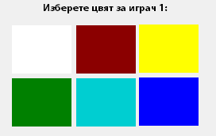
Functionality: main features
Names
Computer ( 5 difficulties )
Colors
Ball speed (3 speeds)
Initial help (an arrow representing
the direction in which the ball will
move after a scored point)
Data validation
Scores are tracked up to a maximum of 9 points.
Random “walls” are being spawned during the game, from which
the ball can bounce off, just to make it harder ☺ .

Slide 4
Source code
2 empty pictureBoxes, that are being filled with each player’s selected color.
The ball is drawn using the System.Drawing library
2 timers – one running while the game is being played, and the other one is used for counting down the seconds between each round.
A class, containing the variables used in both forms.
Events for moving the players. Up/Down for player 1 and W/S for player 2.

Slide 5
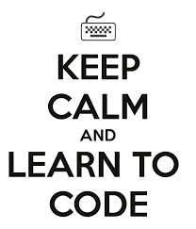

Participants:
Galya Georgieva (GalyaGeorgieva)
Natalia Trencheva (Nataliqqq)
Martin Nazakov (aleriox3)
Alexander Anguelov (aanguelov)
Todor Petkov (tp_petkov)
Steliyan Tokmakchiev (stelt3)
GitHub: https://github.com/alagalia/GameBallPong
Trello: https://trello.com/b/cxAaBRHU/softuni-teamproject-pong-todo

