Slide 1

Department of Computer Science and Engineering
(Cyber Security)
CS23533– Foundations of Artificial Intelligence
2026-2027
AI BASED MAZE NAVIGATION AND
PATHFINDING SYSTEM | MODEL REVIEW
Supervisor: Dr. S. Bhuvana
Assistant Professor (SG)
Team members:
Alagappan R (241901003)
Aswin J (241901010)

Slide 2
Abstract
An AI system that finds the least-cost route through a grid maze and navigates it when the maze changes after planning. Cells are states, four moves are actions and every move has a cost.
BFS, DFS, Dijkstra, Greedy Best-First and A* run on one maze model; for navigation the agent follows its A* plan, senses walls within a range r, records them in a belief map and re-plans from where it stands.
On 400 mazes A* was always optimal and expanded up to 87 % fewer cells than BFS. After walls appeared, a fixed plan failed in 66 of 80 runs while re-planning A* always reached the goal (12–23 % mean detour); a sensing range of 5 instead of 1 cut the detour with four new walls from 31 % to 16 %.
Keywords: A* search · pathfinding · heuristic search · dynamic re-planning · sensing range · state-space search · input validation

Slide 3
Problem Statement and Motivation
▪
Classical maze solvers use one fixed strategy (DFS or BFS), expand cells far from the route and count moves, not cost.
▪
A plan is computed once and never checked: when a corridor closes after planning, the agent walks into the new wall and stops.
▪
Few tools compare search algorithms on the same mazes or measure what re-planning costs, and maze files are rarely validated.
▪
Our goal: an agent that plans optimally with A*, senses and re-plans when the maze changes, and handles files safely.

Slide 4
Objectives
▪
Model the maze as a state space: cells, four moves, entry costs, and a sensing range for the moving agent.
▪
Implement A* with BFS, DFS, Dijkstra and Greedy baselines on one maze model, and measure them on generated mazes.
▪
Build a navigating agent that senses new walls, keeps a belief map and re-plans with A*; compare it with a fixed plan.
▪
Visualise every step in Pygame and load every file safely. Achieved: 24/24 tests, 400-maze search benchmark, 80 dynamic scenarios, 240-run sensing study.

Slide 5
Literature Survey
No. | Author(s), Year | Paper Title | Method / Algorithm | Limitations
1 | Dijkstra (1959) | A Note on Two Problems in Connexion with Graphs | Uniform-cost shortest path | Explores in every direction; many cells expanded
2 | Hart, Nilsson & Raphael (1968) | A Formal Basis for the Heuristic Determination of Minimum Cost Paths | A* search, f = g + h | Needs a known map; savings depend on h
3 | Stentz (1994) | Optimal and Efficient Path Planning for Partially-Known Environments | D*: re-planning as the map is corrected | Complex; designed for robots
Sources and limitations adapted from the Phase I Report, literature review (Section 2.1).

Slide 6
Literature Survey
No. | Author(s), Year | Paper Title | Method / Algorithm | Limitations
4 | Yamauchi (1997) | A Frontier-Based Approach for Autonomous Exploration | Frontier-based exploration with limited sensing | Explores; does not plan least-cost routes
5 | Koenig & Likhachev (2002) | D* Lite | Incremental re-planning | More complex than re-running A*
6 | Harabor & Grastien (2011) | Online Graph Pruning for Pathfinding on Grid Maps | Jump Point Search | Uniform move costs only
These studies motivate sensing, belief-map updates and re-planning in our agent.

Slide 7
Research Gap and Project Response
1. Literature findings
2. Limitations
A* is optimal with an admissible heuristic; D* and D* Lite re-plan when a robot finds its map is wrong.
Teaching tools plan once on a static map; the cost of re-planning and the role of sensing go unmeasured; files are loaded unsafely.
3. Refined research gap
4. Progress toward the solution
No classroom-scale tool measures the search algorithms and re-planning after a change on the same mazes.
Complete system: A* optimal on 400/400 mazes; a 5-cell sensing range roughly halves the detour after a change.

Slide 8
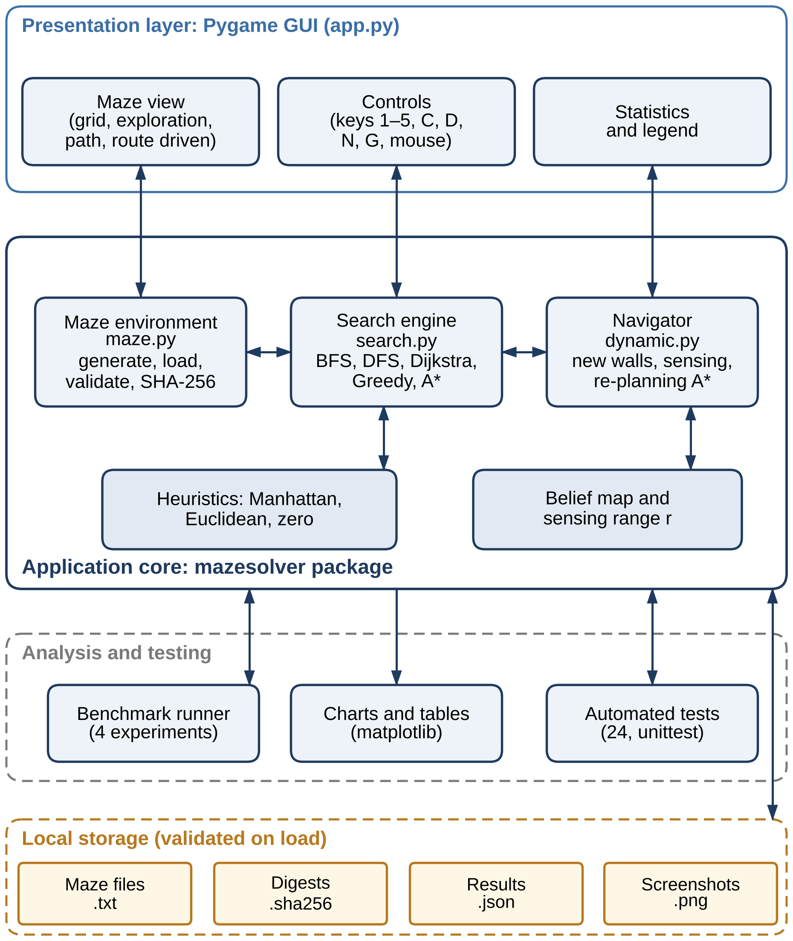
System Architecture
Presentation layer
Pygame window: maze view, controls, statistics and the route driven.
Application core
mazesolver package: maze environment, search engine and navigator (belief map, sensing, re-planning A*).
Analysis and testing
Benchmark runner, charts and 24 tests use the same core as the interface.
Local storage
Maze files with SHA-256 digests, results — all checked on load.

Slide 9
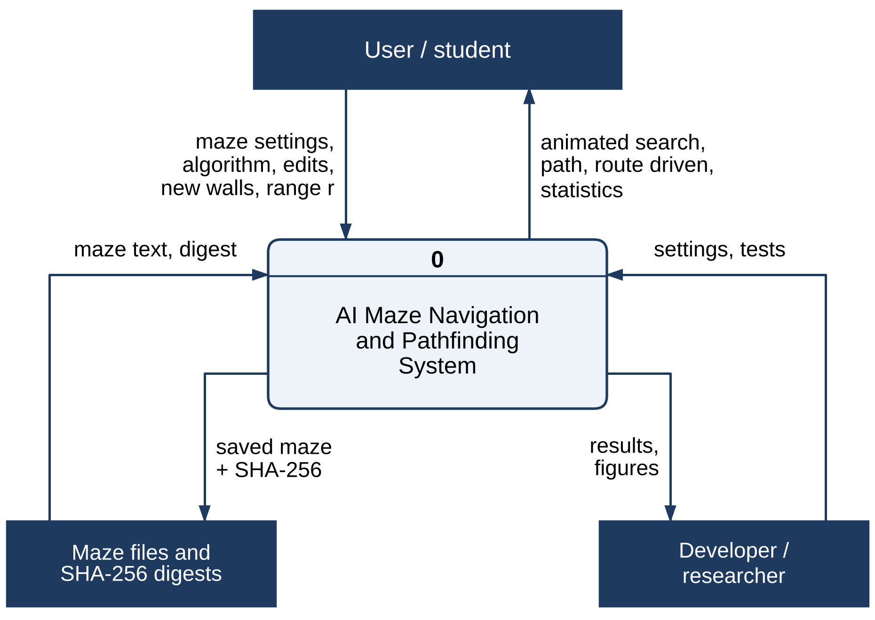
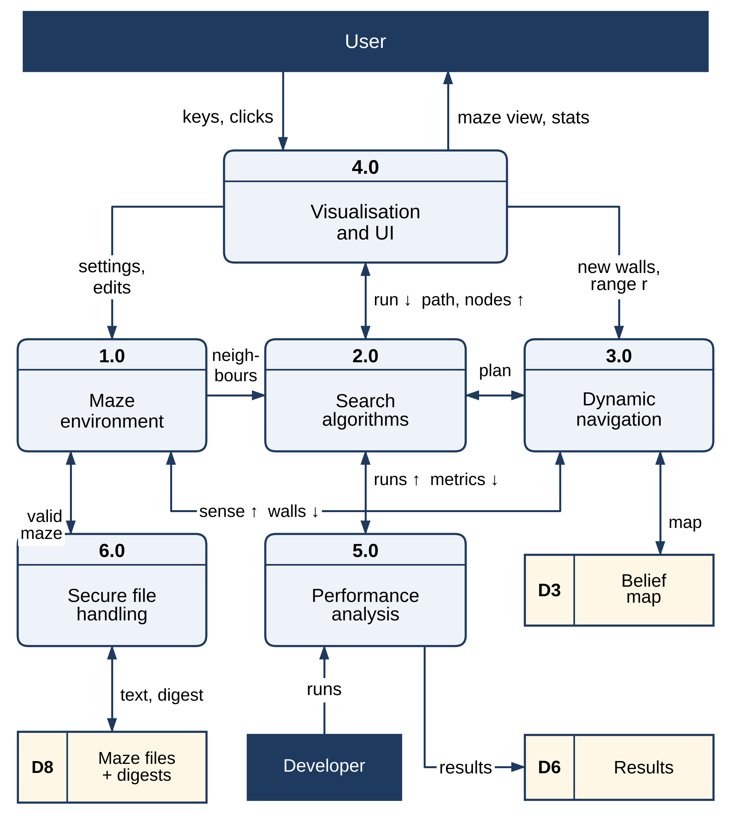
DFD Diagram
Level 0 (context) and Level 1 DFD. Stores: D3 belief map, D6 results, D8 maze files + digests. Level-2 diagrams are in the Phase I report.

Slide 10
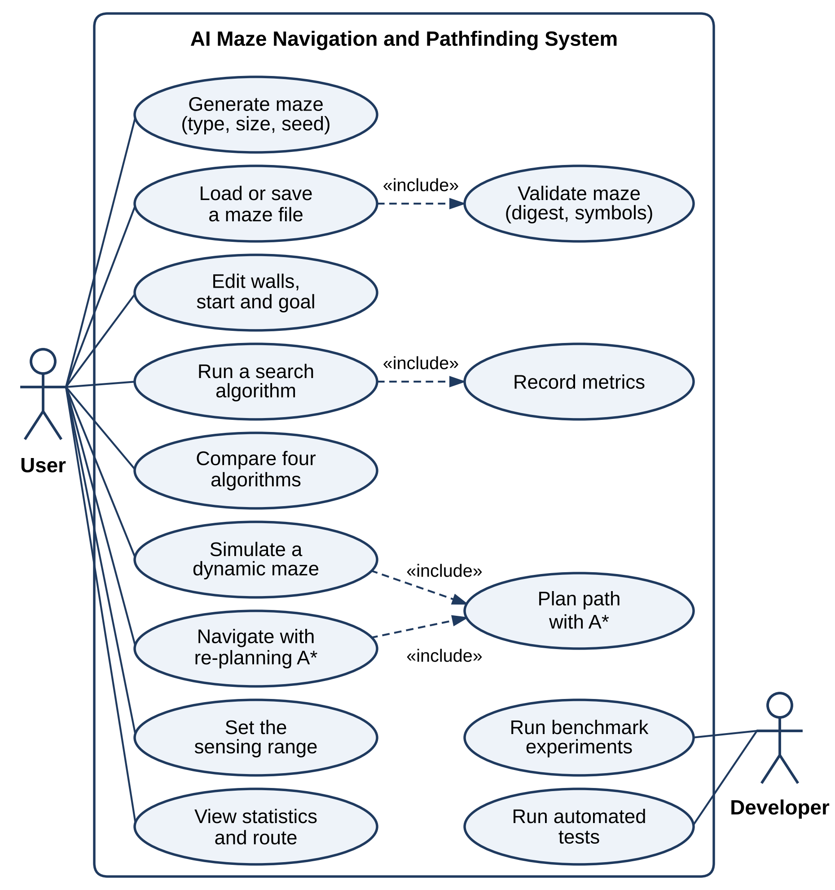
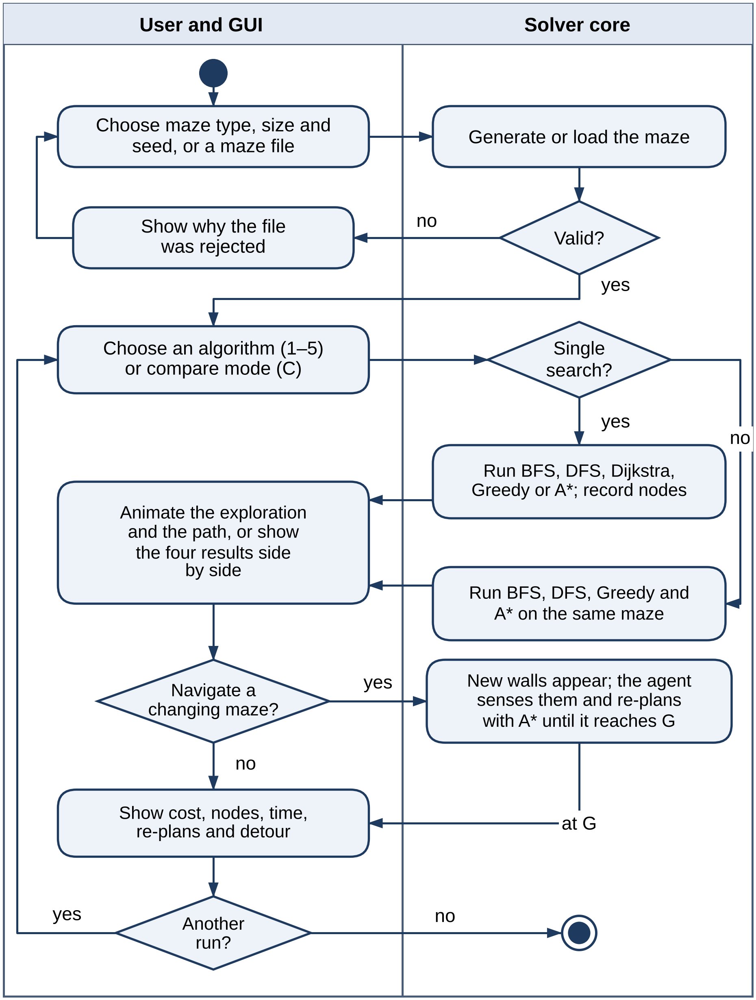
UML – Use Case and Activity
Use case: the user generates, loads or edits a maze, runs a search, compares algorithms, simulates a dynamic maze and navigates it with re-planning A*; the developer runs benchmarks and tests.
Activity: validate → choose an algorithm or comparison → animate; navigating a changing maze triggers sensing and re-planning.
Loading a maze always includes validation; the dynamic simulation and navigation both include A* planning.

Slide 11
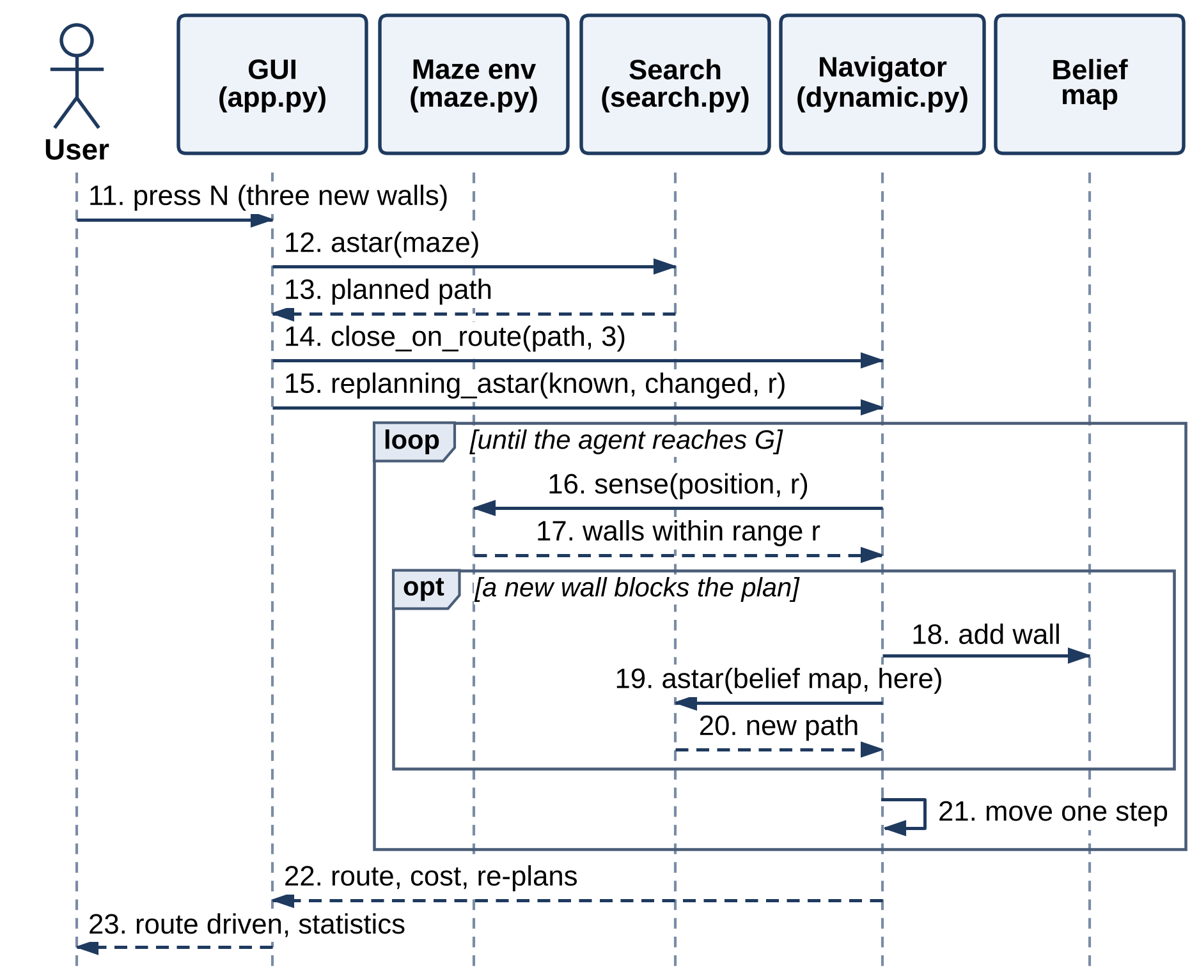
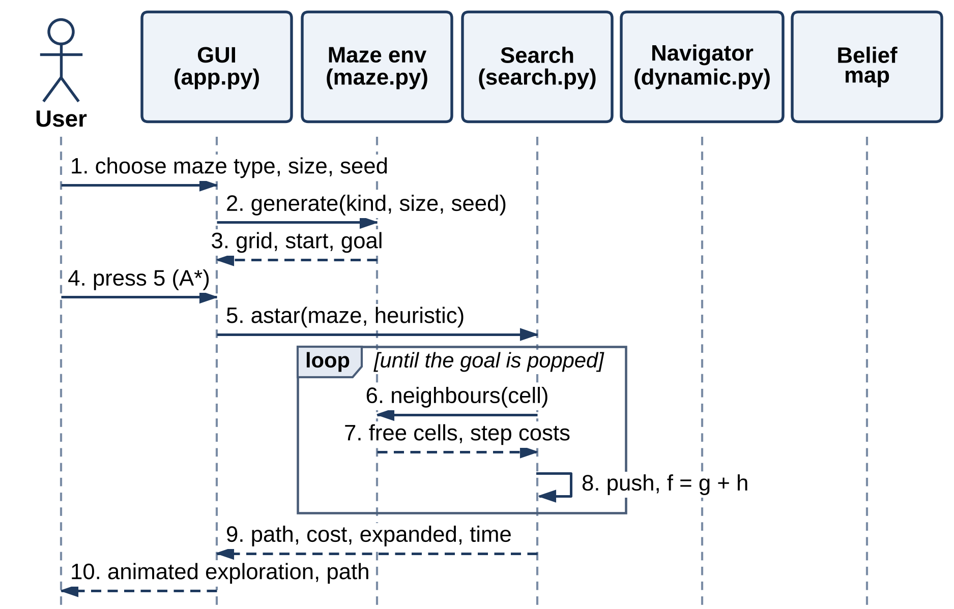
UML – Sequence Diagram
Left: an A* run (messages 1–10). Right: navigation after three new walls, with sensing and re-planning (11–23).

Slide 12
Methodology / Workflow Diagram
01 · INPUT
02 · VALIDATE
03 · PLAN
04 · NAVIGATE
05 · OUTPUT
Maze type, size, seed or file
Digest, symbols, one S and G
A* · BFS · DFS · Dijkstra · Greedy
Sense · belief map · re-plan
Path, route, metrics
TEST
BENCHMARK
VISUALISE
24 unit tests → all pass
E1–E4 with fixed seeds
Pygame views and charts
No dataset or training data is needed: mazes are generated from a seed and every result can be regenerated.

Slide 13
Core Algorithms
A* SEARCH
NAVIGATION LOOP
BASELINES & METRICS
f(n) = g(n) + h(n)
h = Manhattan distance: admissible and consistent on a 4-connected grid
Ties broken towards larger g
Optimal; expands each cell at most once
Follow the A* plan one move at a time
Sense every wall within Manhattan distance r
Record new walls in the belief map
Re-plan from the current cell when the plan is blocked
Fixed plan: no sensing, fails at the first new wall
Oracle: A* on the changed maze gives the optimal cost
Detour = cost ÷ optimal − 1
Effort = re-plans and nodes of all plans
Dijkstra’s algorithm is the same best-first procedure with h = 0; Greedy Best-First orders the frontier by h alone.

Slide 14
List of Modules
M1
Maze environment and representation
✓ Completed
M2
Search algorithms (BFS, DFS, Dijkstra, Greedy, A*)
✓ Completed
M3
Dynamic navigation and re-planning
✓ Completed
M4
Visualisation and user interface
✓ Completed
M5
Performance analysis and testing
✓ Completed
M6
Secure file handling
✓ Completed
Module mapping follows the Phase I report (Table 3.3).

Slide 15
Results – Search Algorithms
84 %
fewer nodes than BFS on open fields
400 / 400
optimal paths from A* and Dijkstra
19–44 %
extra cost of Greedy paths (0 / 20 optimal)
4.4×
optimal cost: DFS paths on open fields
Manhattan heuristic: 46 % fewer expansions than h = 0 on braided mazes, 84 % on open fields (E2).

Slide 16
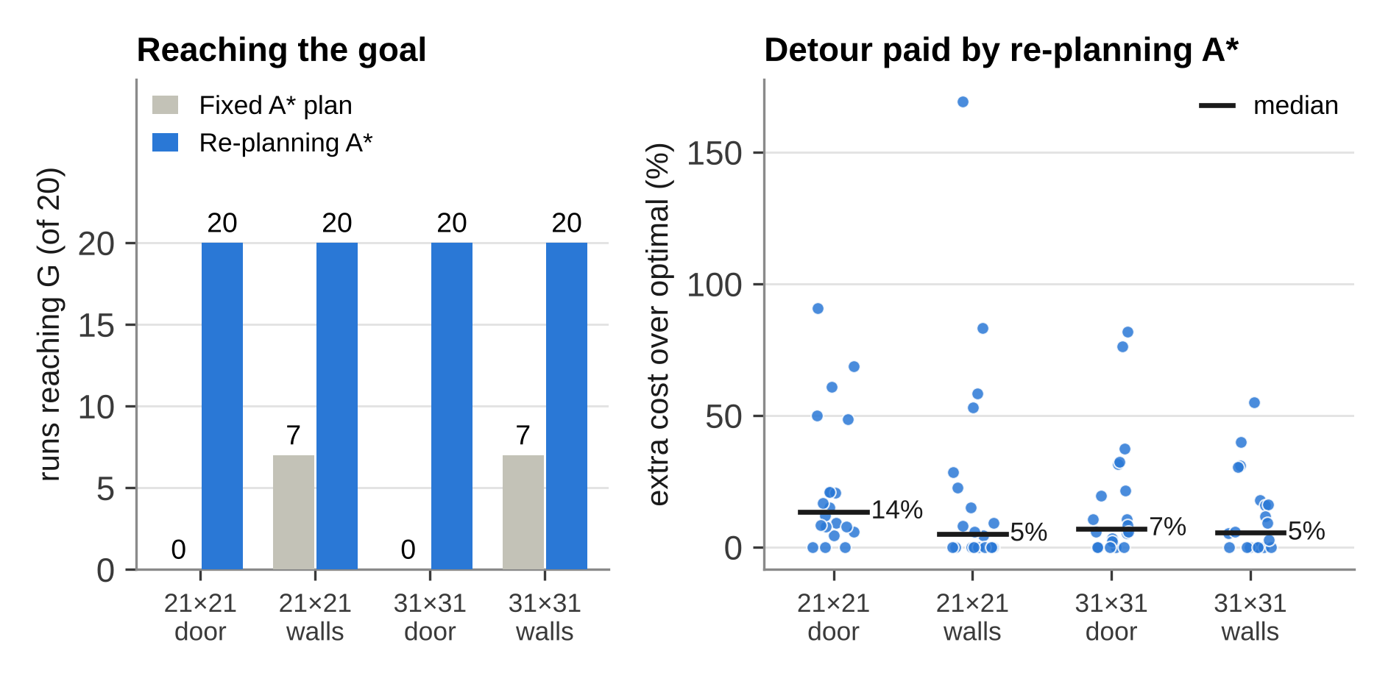
Results – Dynamic Mazes
Scenario | Fixed plan | Re-plan A* | Mean detour | Re-plans | Nodes vs oracle
21×21 door | 0/20 | 20/20 | 23 % | 1.00 | 1.7×
21×21 walls | 7/20 | 20/20 | 23 % | 1.10 | 1.9×
31×31 door | 0/20 | 20/20 | 18 % | 1.00 | 1.5×
31×31 walls | 7/20 | 20/20 | 12 % | 0.95 | 1.6×
Fixed plan and Re-plan A*: runs reaching G. Detour: extra cost over the optimal cost of the changed maze. Nodes: all plans together ÷ one A* search on the changed maze.
Re-planning A* always reached the goal; mean detour 12–23 % (median 5–14 %) with a sensing range of one cell.

Slide 17
Results – Sensing Range
31 → 16 %
mean detour with 4 new walls, range 1 → 5
60 → 27 %
mean detour with 16 new walls, range 1 → 5
2.2 → 4.8
re-plans per run, 4 → 32 new walls (r = 1)
240 / 240
runs reached G; the fixed plan failed in all of them
Seeing farther cut the mean detour by 39–56 % while changing the search effort by at most about 11 % (E4, 20 mazes per point).

Slide 18
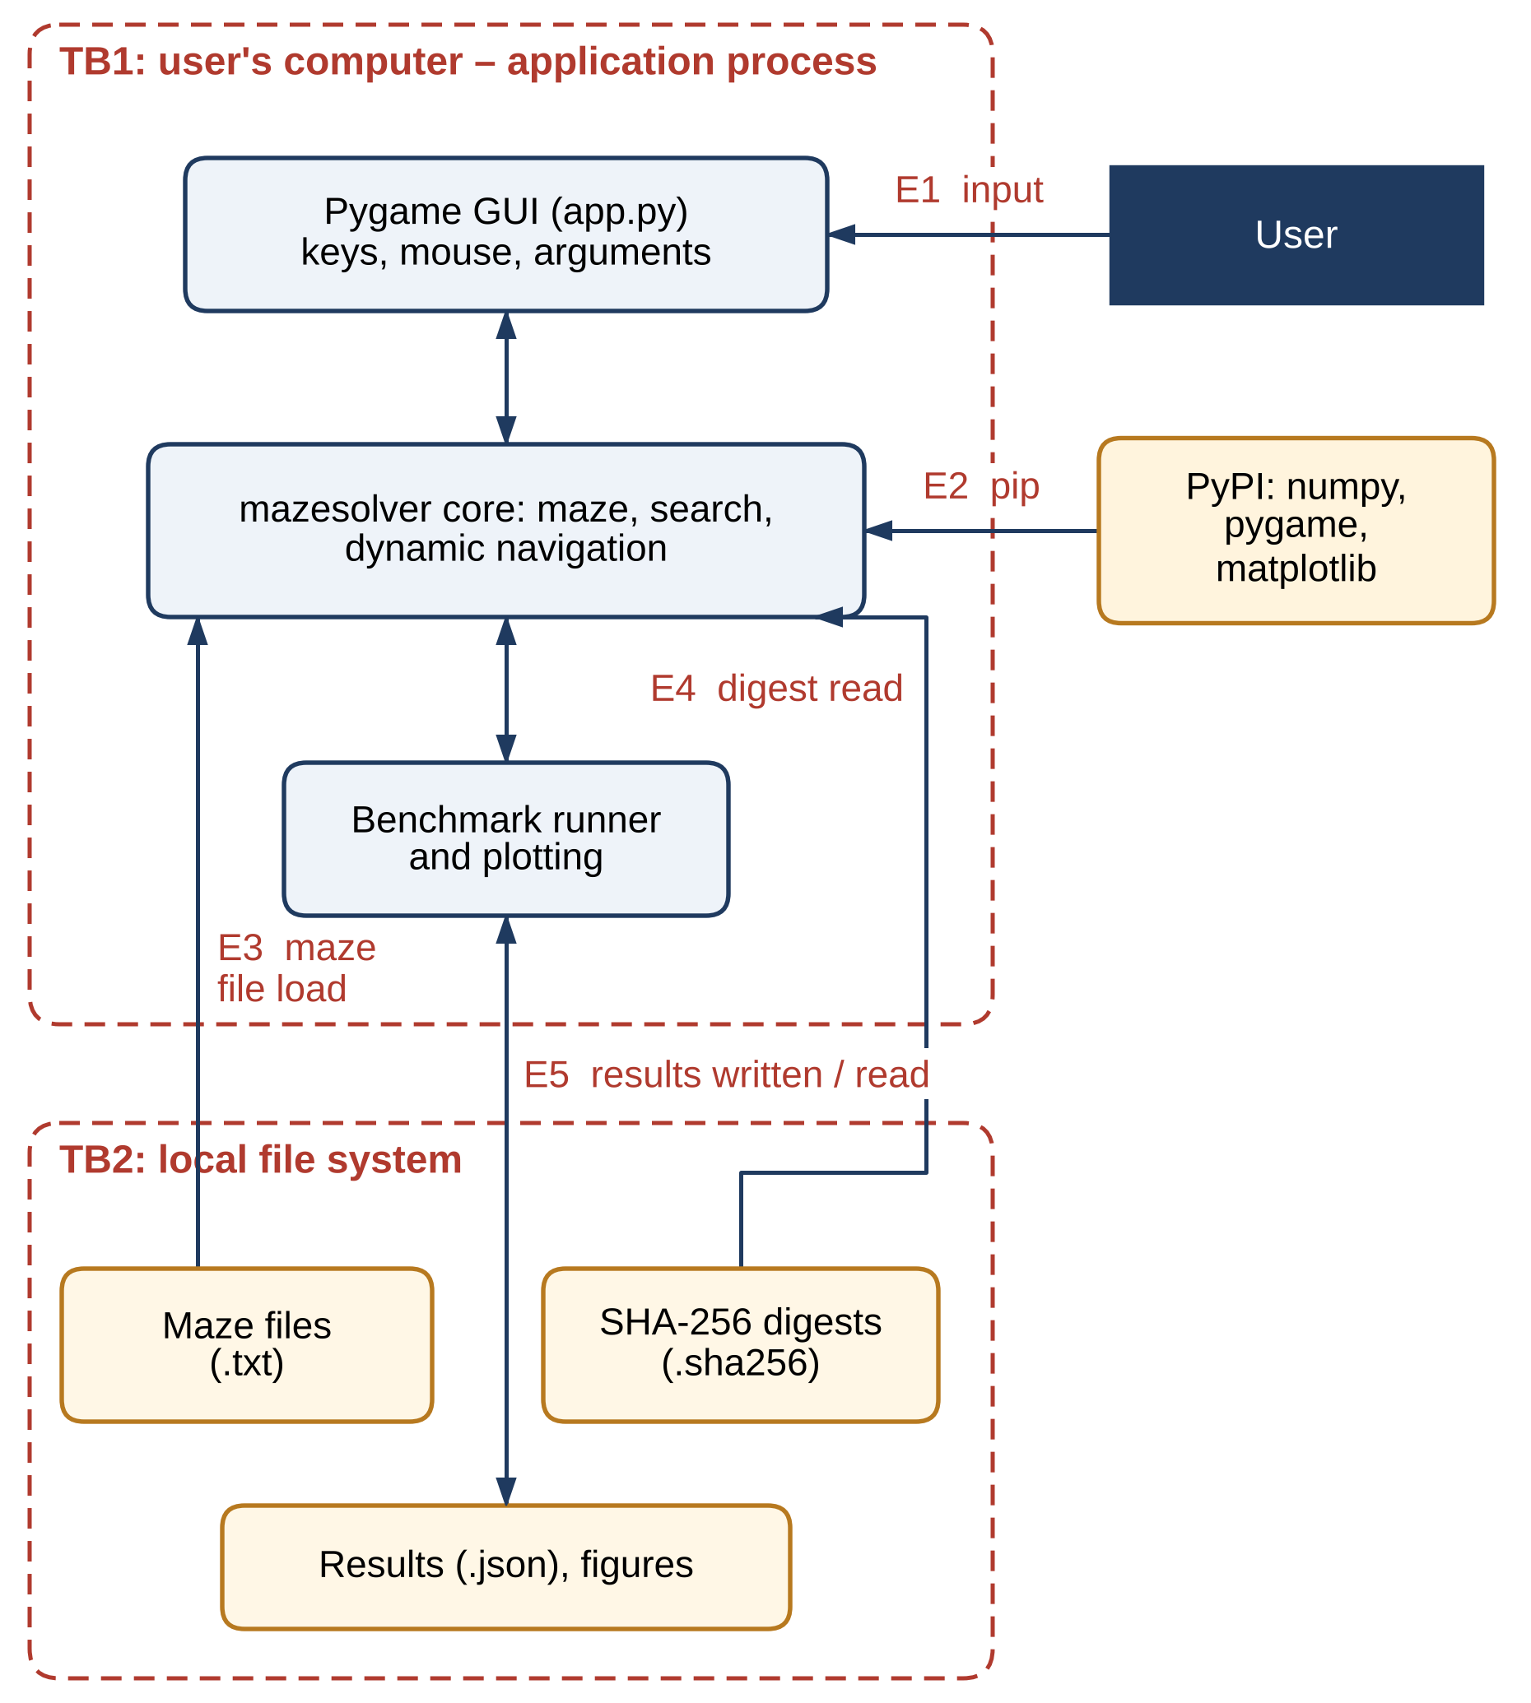
Security – Threat Model and Controls
Threat (STRIDE) | Entry | Control
Oversized or malformed maze file (DoS, tampering) | E3 | Allow-list parser; ≤ 201 × 201; one S and G
Maze changed after saving (tampering) | E3, E4 | SHA-256 digest; --strict requires it
File crafted to run code (elevation of privilege) | E3 | Plain text only; nothing deserialised
Compromised package (spoofing) | E2 | Pinned NumPy, Pygame, Matplotlib
Runaway request (DoS) | E1 | Caps: size, walls, range, steps
Error details leak (disclosure) | E1, E3 | One-line reason, no stack trace
Planned: keyed (HMAC) digests, hash-checked installation and dependency auditing.

Slide 19
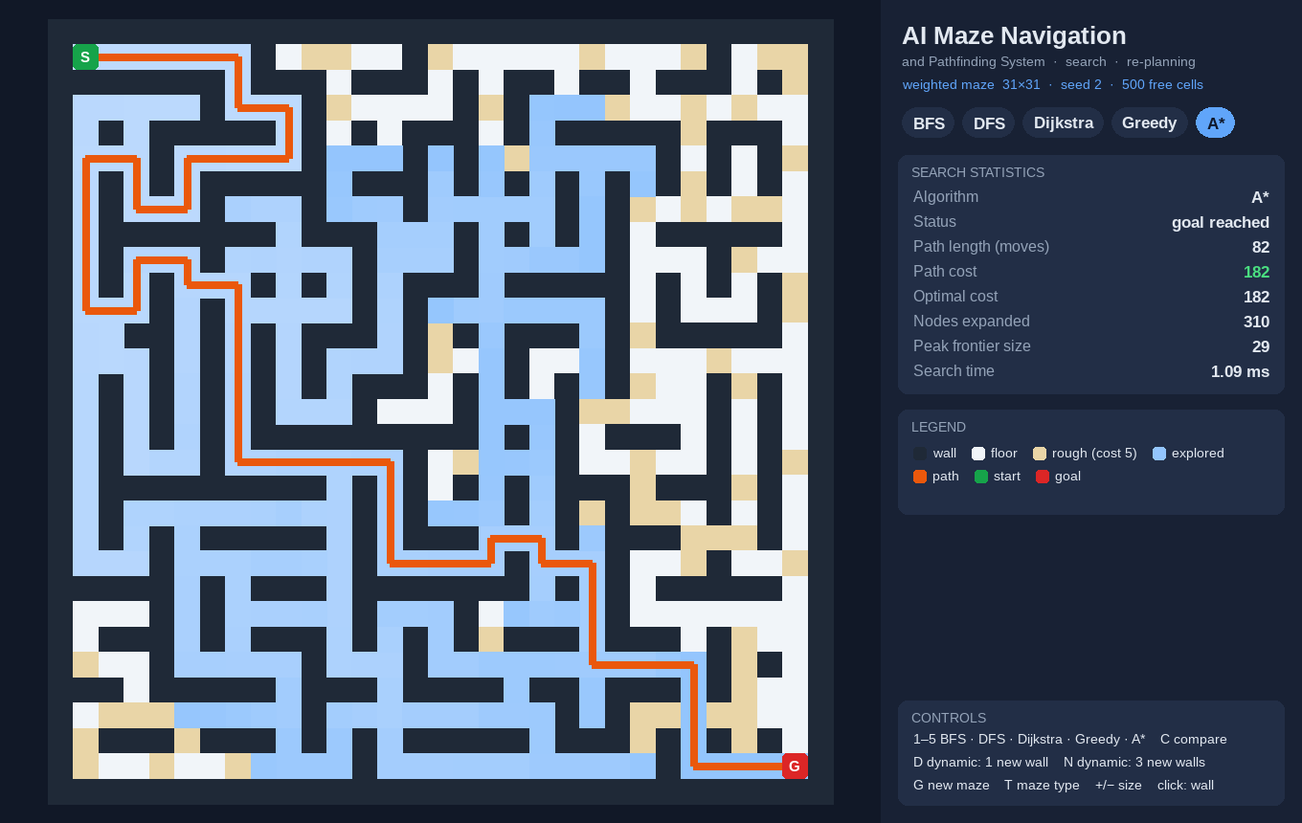
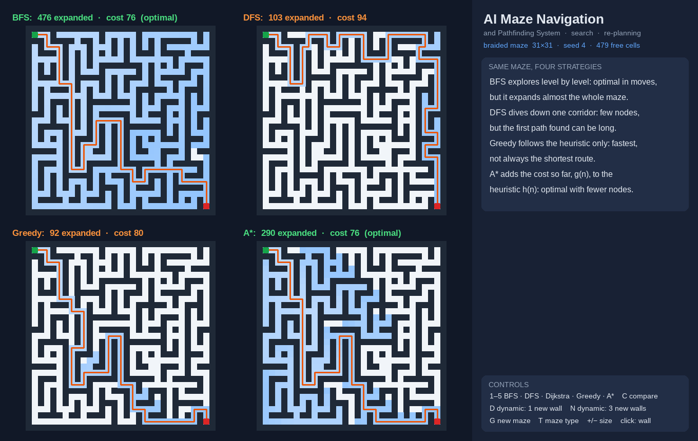
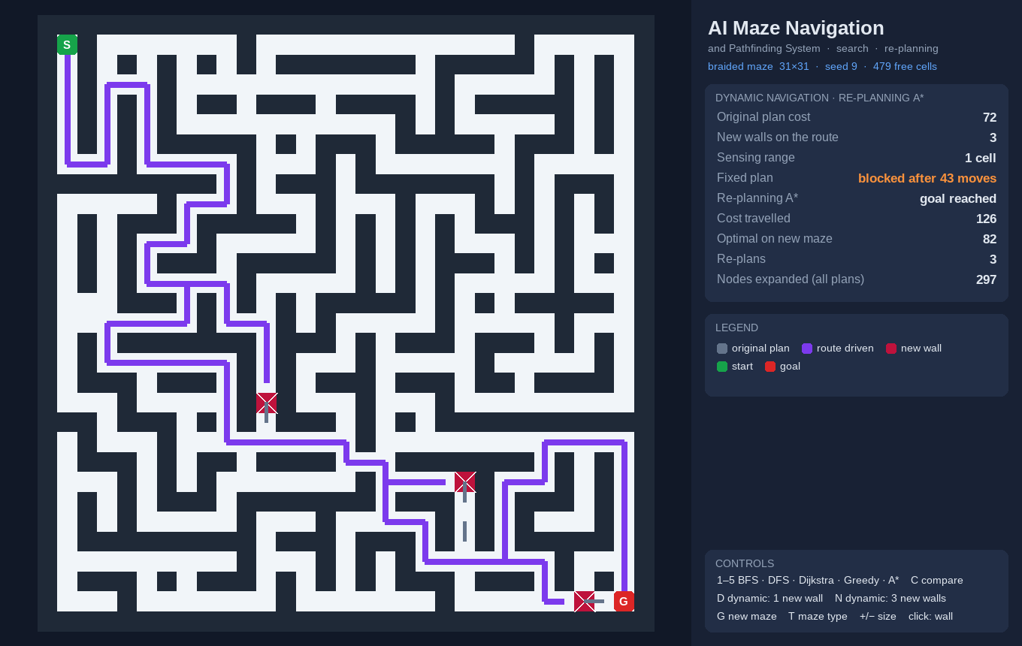
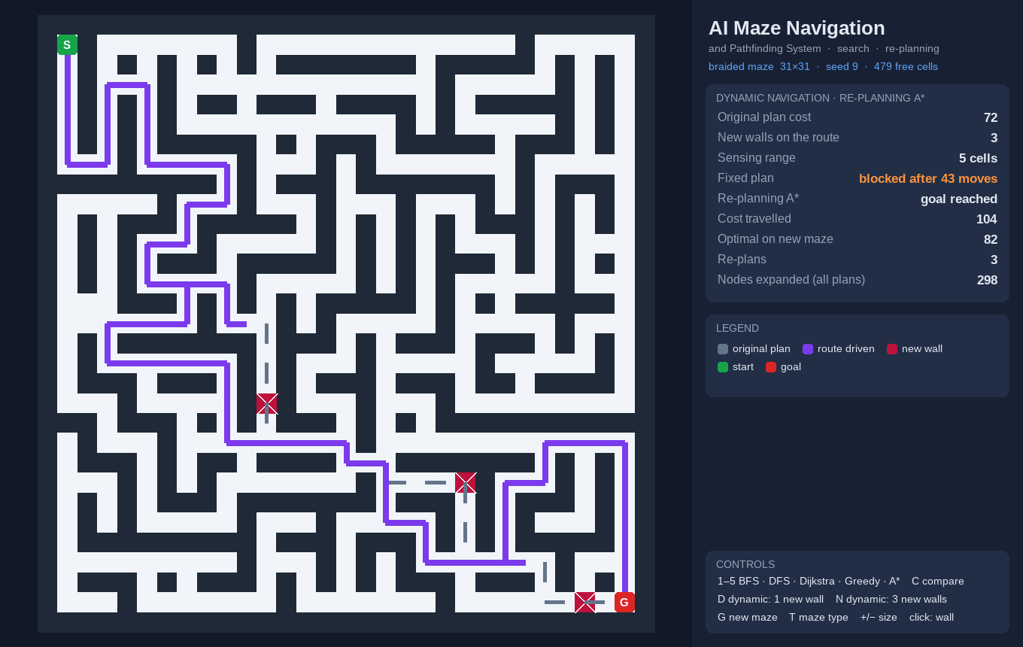
Implementation Screenshots
A* on a weighted maze (rough terrain)
Four algorithms on one maze
Three new walls, sensing range 1: cost 126
Same maze, sensing range 5: cost 104

Slide 20
Challenges Faced and Solutions
Plans broken by new walls
The agent senses walls within range r, records them in its belief map and re-plans with A* from its current cell.
Walls found too late
With range 1 the agent meets a wall only on arrival (mean detour 12–23 %); range 5 cuts the detour by 39–56 %.
Keeping the goal reachable
Every new wall is checked with BFS before it is kept, so each dynamic scenario stays solvable.
Tampered maze files
Saved mazes carry a SHA-256 digest; a changed file is rejected, and --strict demands a digest.
Re-planning starts from scratch: all plans together expanded 1.5–1.9× the cells of one search — D* Lite is future work.

Slide 21
Conclusion
▪
A* gave the optimal route on all 400 test mazes and expanded up to 87 % fewer cells than BFS on open fields.
▪
When walls appeared after planning, a fixed plan failed in 66 of 80 runs; re-planning A* always reached the goal.
▪
The detour depends on sight: a sensing range of 5 instead of 1 cut it by 39–56 % at almost no extra computation.
▪
Files are untrusted input: allow-list parsing, SHA-256 digests, strict mode and resource caps.

Slide 22
Future Work
▪
Incremental re-planning with D* Lite to reuse search effort after each change.
▪
Jump Point Search, weighted and bidirectional A*, and the standard benchmark maps.
▪
Partial observability with frontier exploration, moving obstacles and several agents in one maze.
▪
Keyed (HMAC) digests, hash-checked installation and a web version of the visualiser for classrooms.

Slide 23
References
[1] E. W. Dijkstra, “A Note on Two Problems in Connexion with Graphs,” Numerische Mathematik, 1959.
[2] P. E. Hart, N. J. Nilsson and B. Raphael, “A Formal Basis for the Heuristic Determination of Minimum Cost Paths,” IEEE Trans. SSC, 1968.
[3] A. Stentz, “Optimal and Efficient Path Planning for Partially-Known Environments,” IEEE ICRA, 1994.
[4] B. Yamauchi, “A Frontier-Based Approach for Autonomous Exploration,” IEEE CIRA, 1997.
[5] S. Koenig and M. Likhachev, “D* Lite,” AAAI, 2002.
[6] D. Harabor and A. Grastien, “Online Graph Pruning for Pathfinding on Grid Maps,” AAAI, 2011.
[7] N. R. Sturtevant, “Benchmarks for Grid-Based Pathfinding,” IEEE Trans. CIAIG, 2012.
[8] S. Russell and P. Norvig, Artificial Intelligence: A Modern Approach, 4th ed., Pearson, 2021.

Slide 24
Thank You
AI Based Maze Navigation and Pathfinding System
Alagappan R (241901003) · Aswin J (241901010)
Supervisor: Dr. S. Bhuvana, Assistant Professor (SG)

