Slide 1

Department of Cyber Security 2026-2027- Odd Semester
III Year /V Sem
CS23533-FOUNDATIONS OF ARTIFICIAL INTELLIGENCE
Zeroth Review – 31.07.2026

Slide 2
PROJECT TITLE
Batch Members : 1.Name:Reg.no Alagappan R 241901003
2.Name:Reg.no Aswin J
241901010
Supervisor: Dr. S.Bhuvana
Assistant Professor[SG]

Slide 3
OUTLINE
Abstract
Objective
Literature Survey
Summary of Literature
Proposed System & Novelty
Block Diagram
Hardware/Software requirements
References

Slide 4
ABSTRACT
The Intelligent Maze Solver is an Artificial Intelligence project that finds the optimal path from a starting point to a destination in a maze using AI-based search and learning techniques. It employs algorithms such as A* Search and Q-Learning to enable an intelligent agent to navigate complex maze environments efficiently. Unlike traditional pathfinding methods that rely on fixed search patterns, the AI agent uses heuristic information or learns from experience to make better navigation decisions.
The system represents the maze as a two-dimensional grid consisting of walls, open paths, a start point, and a goal point. It explores possible routes, avoids obstacles, and identifies the shortest and most efficient path while minimizing travel time and distance. A graphical interface displays the maze, the agent's exploration process, and the final solution, making it easier to understand how the algorithms work and how the agent reaches its destination.
This project demonstrates important Artificial Intelligence concepts, including search algorithms, heuristic optimization, decision-making, and autonomous problem-solving. Its applications extend to robotic navigation, autonomous vehicles, game development, logistics, and route optimization. The Intelligent Maze Solver serves as an effective platform for learning AI techniques while showcasing their practical use in solving real-world navigation and pathfinding challenges.
Keywords:
ArtificialIntelligence(AI),Maze Solver,Pathfinding ,A* Search Algorithm,Reinforcement Learning, Heuristic Search,Autonomous Navigation,Graph Search

Slide 5
OBJECTIVE
→To develop an intelligent navigation system that can efficiently find the optimal path from a starting point to a destination in a maze using Artificial Intelligence techniques.
→To implement AI-based pathfinding algorithms such as A* Search and Q-Learning for accurate, efficient, and intelligent route planning.
→To minimize travel time and distance by identifying the shortest and most efficient path while avoiding obstacles within the maze.
→To demonstrate AI concepts including heuristic search, reinforcement learning, decision-making, and autonomous problem-solving in a practical environment.
→To provide a graphical visualization of the maze, the agent's exploration process, and the final path to improve understanding of algorithm behaviour.
→To compare the performance of different AI algorithms based on factors such as path length, execution time, and exploration efficiency.
→To create a foundation for real-world applications such as robotic navigation, autonomous
vehicles, game AI, logistics, and route optimisation.

Slide 6
Literature Survey
TITLE | YEAR | AUTHOR | TECHNIQUE
A Formal Basis for the Heuristic Determination of Minimum Cost Paths | 1968 | Peter Hart, Nils Nilsson, Bertram Raphael | A* Search
Q-Learning | 1992 | Christopher J. C. H. Watkins & Peter Dayan | Reinforcement Learning (Q-Learning)
Dijkstra's Algorithm for Shortest Path | 1959 | Edsger W. Dijkstra | Dijkstra's Shortest Path Algorithm

Slide 7
EXISTING SYSTEM
→Traditional maze-solving systems primarily use algorithms such as Depth-First Search (DFS), Breadth-First
Search (BFS), and Dijkstra's Algorithm.
→These algorithms follow predefined search strategies without any learning capability.
→They often explore many unnecessary nodes before reaching the goal, increasing computation time.
→Performance decreases significantly as the maze size and complexity increase.
→Most existing systems cannot adapt to dynamic or changing maze environments.
→They do not utilize heuristic information effectively, resulting in slower pathfinding in many cases.
→Traditional methods lack intelligent decision-making and experience-based learning.
→Existing systems generally provide limited visualization of the search process and path exploration.
→They are less suitable for modern applications such as autonomous robots, intelligent navigation systems, and
real-time route optimization due to their limited adaptability and efficiency.

Slide 8
PROPOSED SYSTEM
→Uses Artificial Intelligence techniques to solve maze navigation problems efficiently.
→Implements A* Search Algorithm to identify the shortest and optimal path from start to goal.
→Integrates Q-Learning (Reinforcement Learning) to allow the agent to learn from previous experiences.
→Enables intelligent decision-making by analyzing possible routes and avoiding obstacles.
→Reduces unnecessary exploration and improves pathfinding speed and accuracy.
→Represents the maze environment as a 2D grid with walls, paths, start point, and destination.
→Provides a graphical visualization of agent movement, exploration process, and final path.
→Improves adaptability for dynamic environments compared to traditional pathfinding methods.
→Supports real-world applications such as robot navigation, autonomous vehicles, gaming, logistics, and route
optimization.

Slide 9
Novelty in Proposed System
→Hybrid AI Approach: Combines A Search Algorithm and Q-Learning Reinforcement Learning* to achieve both optimal pathfinding and intelligent learning capability.
→Self-Learning Navigation: Unlike traditional algorithms that only calculate paths, the system allows the agent to learn from previous navigation experiences and improve future decisions.
→Adaptive Path Optimization: The agent can dynamically adjust its route based on obstacles, environmental
changes, and learned knowledge.
→Intelligent Decision Making: Uses AI-based reasoning to evaluate multiple possible paths and select the most
efficient route.
→Reduced Search Complexity: Minimizes unnecessary exploration by combining heuristic-based search with
reinforcement learning techniques.
→Dynamic Maze Handling: Capable of adapting to changing maze conditions where obstacles or paths may vary.
→Visual AI Simulation: Provides real-time visualization of exploration, learning process, obstacle avoidance, and
final optimized path.

Slide 10
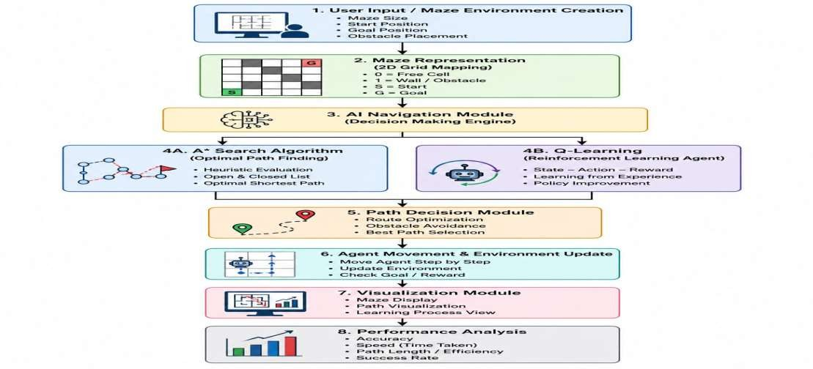
BLOCK DIAGRAM(PROPOSED SYSTEM)

Slide 11
Hardware/Software Requirements
Hardware Requirement:
→Processor: Intel Core i3 or above
→RAM: 4 GB or above
→Storage: 256 GB HDD/SSD
→System: Laptop/Desktop Computer
→Input Devices: Keyboard and Mouse
Software Requirement:
→Operating System: Windows 10/11 or Linux
→Programming Language: Python 3.x
→IDE: Visual Studio Code / PyCharm
→Libraries: NumPy, Pygame, Matplotlib
→Algorithms: A* Search Algorithm and Q-Learning
→Visualization: Graphical Maze Simulation Environment

Slide 12
References
→Russell, S. and Norvig, P., Artificial Intelligence: A Modern Approach, 4th Edition, Pearson Education, 2021.
→Hart, P. E., Nilsson, N. J., and Raphael, B., "A Formal Basis for the Heuristic Determination of
Minimum Cost Paths", IEEE Transactions on Systems Science and Cybernetics, 1968.
→Watkins, C. J. C. H. and Dayan, P., "Q-Learning", Machine Learning Journal, 1992.
→Sutton, R. S. and Barto, A. G., Reinforcement Learning: An Introduction, 2nd Edition, MIT Press,
2018.
Rajalakshmi Engineering College,Department of Cyber Security

