Slide 1

Department of Cyber Security
2026-2027- Odd Semester
III Year /V Sem
CS23533-FOUNDATIONS OF ARTIFICIAL INTELLIGENCE
AI Based Maze Navigation and Pathfinding System
Review 1 – 25.09.2026
Alagappan R (241901003) | Aswin J (241901010)
Supervisor: Dr. S. Bhuvana, Assistant Professor [SG]
Rajalakshmi Engineering College,Department of Cyber Security

Slide 2
Introduction
2
The project builds an AI agent that finds the least-cost route from a start cell to a goal cell in a grid maze, and navigates it when the maze changes.
Two parts: pathfinding — A* search plans over a known map — and navigation — the agent senses new walls while moving and re-plans.
The maze is a formal state space: cells are states, the four moves are actions and every move has a cost (floor 1, rough terrain 5).
BFS, DFS, Dijkstra and Greedy Best-First Search run on the same maze model as baselines for a fair comparison.
A Pygame interface animates the exploration, the final path and the route the agent drives.
TASK ENVIRONMENT (AIMA)
Observable
Fully (planner); within range r (agent)
Agents
Single agent
Deterministic
Yes — a move succeeds unless blocked
Episodic
No — sequential
Dynamics
Static; dynamic when walls appear
State / Actions
Discrete cells × 4 moves
Department of Cyber Security | Project Review – 1 | 2026–2027

Slide 3
Problem Statement
3
Classical solvers apply one fixed strategy (DFS or BFS) and expand many cells far from the route.
They count moves only, so they cannot prefer an easy route to a short but difficult one.
A plan computed once is never checked while the agent moves, so it fails when a corridor closes after planning.
The cost of re-planning — and the effect of how far the agent can sense — is rarely measured.
Maze files are often loaded without validation or any integrity check.
Needed: an agent that plans optimally, re-plans when the maze changes and handles files safely.
7,606
cells expanded by BFS on a 101 × 101 open field (99 % of the free cells)
4.4×
the optimal cost: DFS paths on 61 × 61 open fields
0 / 20
optimal paths from Greedy search on 61 × 61 braided mazes
Department of Cyber Security | Project Review – 1 | 2026–2027

Slide 4
Motivation
4
Pathfinding is at the heart of robot navigation, warehouse logistics, route guidance and game AI.
A* is optimal and efficient when the map is known — but real maps go out of date, so the agent must sense and re-plan.
Few tools measure search algorithms, and re-planning after a change, on the same mazes with the same metrics.
A visual, measurable solver makes these AI concepts easy to see, compare and teach.
1959
Moore, Dijkstra: shortest paths
1968
Hart, Nilsson & Raphael: A* search
1994
Stentz: D* re-planning for robots
2002
Koenig & Likhachev: D* Lite
2011
Harabor & Grastien: Jump Point Search
Ours
A* navigation with sensing and re-planning
Department of Cyber Security | Project Review – 1 | 2026–2027

Slide 5
Objectives
5
1
To formulate maze navigation as a state-space search problem with step costs and a sensing range.
2
To implement A* with an admissible heuristic, with BFS, DFS, Dijkstra and Greedy search as baselines.
3
To compare the Manhattan, Euclidean and zero heuristics for A*.
4
To navigate dynamic mazes by sensing new walls and re-planning with A*, compared with a fixed plan.
5
To visualise the exploration, the paths and the route the agent drives in a graphical interface.
6
To compare all methods on path cost, nodes expanded, time, success and detour, and to load every file safely.
Department of Cyber Security | Project Review – 1 | 2026–2027

Slide 6
Literature Survey
6
S.No. | Author & Year | Method / Technique | Key Findings | Limitations
1 | Dijkstra (1959) | Uniform-cost shortest path | Optimal least-cost paths in graphs with non-negative costs | Explores in every direction; many cells expanded
2 | Hart, Nilsson & Raphael (1968) | A* search, f(n) = g(n) + h(n) | Optimal with an admissible heuristic; fewest expansions for that heuristic | Needs a known map; savings depend on h
3 | Stentz (1994) | D* path planning | A robot re-plans efficiently when it finds that its map is wrong | Complex; designed for robots
4 | Koenig & Likhachev (2002) | D* Lite | Incremental re-planning that reuses the earlier search | More complex than re-running A*
5 | Harabor & Grastien (2011) | Jump Point Search | Prunes symmetric paths on grids; far fewer expansions than A* | Uniform move costs only
6 | Russell & Norvig (2021) | Agent framework and search | Task-environment properties and standard formulations | Textbook level; no measured system
Department of Cyber Security | Project Review – 1 | 2026–2027

Slide 7
Existing System
7
Pathfinding visualisers (e.g. PathFinding.js): animate A*, Dijkstra and BFS on a static, fully known grid; no learning.
Micromouse robots: flood fill on a partly known maze, updating the map while exploring; tuned to one competition format.
Typical course projects: one algorithm, usually DFS or BFS, showing only the final path.
Limitations: no comparison between methods, uniform move costs, no re-planning when the maze changes, unchecked maze files.
TYPICAL BASIC SOLVER FLOW
Maze grid
Fixed strategy (DFS or BFS)
Expand cells blindly, one by one
First path found
Output path
No heuristic, no step costs and no re-planning when the maze changes.
Department of Cyber Security | Project Review – 1 | 2026–2027

Slide 8
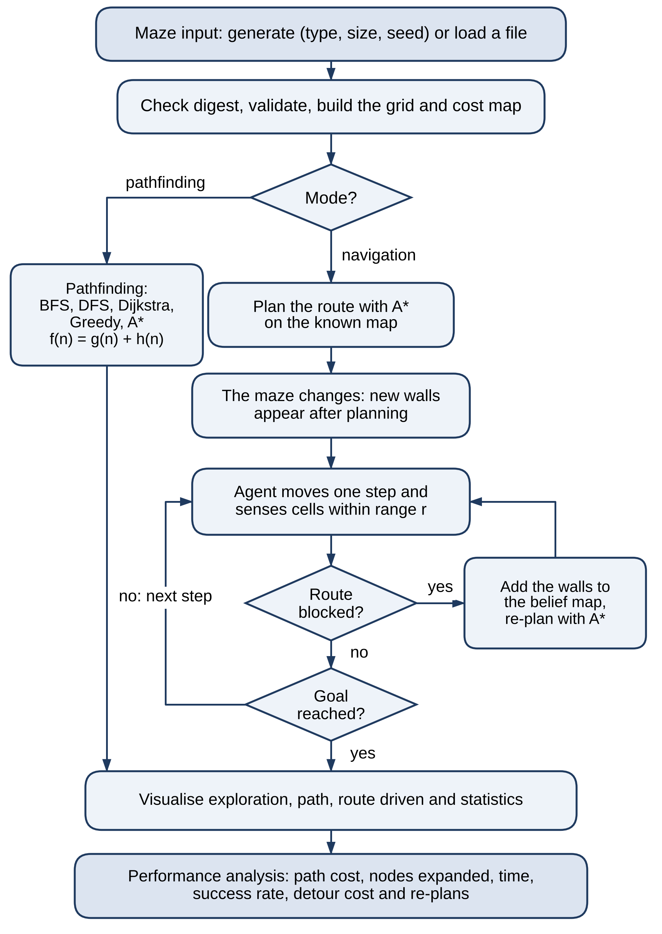
Proposed System
8
One maze model (wall grid + cost map) shared by every algorithm, with four generators and a validated file format.
A* with the Manhattan heuristic plans the optimal route; BFS, DFS, Dijkstra and Greedy are measured on the same mazes.
Navigation: the agent follows its A* plan, senses walls within range r and re-plans from where it stands when blocked.
A fixed plan and an oracle that knows the change frame the comparison of detour cost and effort.
A Pygame interface shows every step; maze files are validated and carry a SHA-256 digest.
Department of Cyber Security | Project Review – 1 | 2026–2027

Slide 9
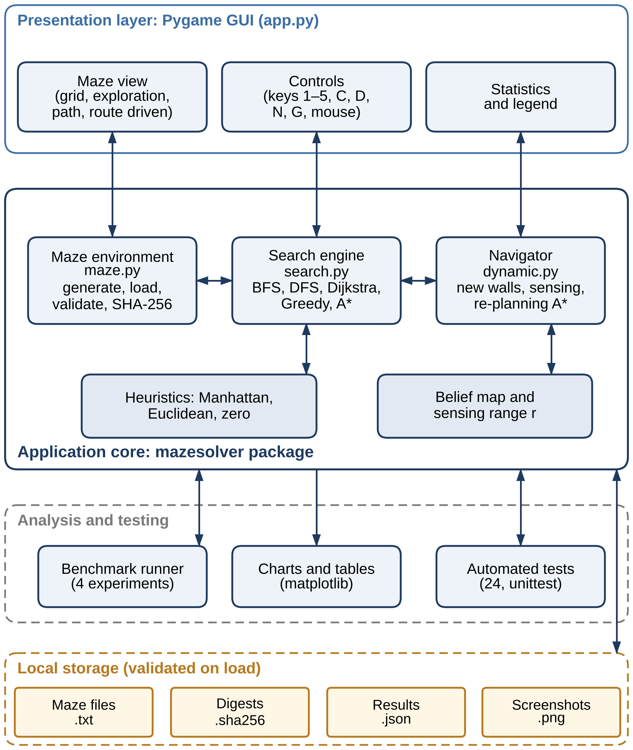
System Architecture / Block Diagram
9
Presentation layer: Pygame window with the maze view, controls and statistics.
Application core (mazesolver package): maze environment, search engine and navigator (belief map, sensing, re-planning A*).
Analysis and testing: benchmark runner, charts and automated tests use the same core as the interface.
Local storage: maze files with SHA-256 digests, results and screenshots — checked on load.
Runs entirely on the user’s computer: no server, no network, no personal data.
Department of Cyber Security | Project Review – 1 | 2026–2027

Slide 10
Methodology
10
1
State-Space Formulation
2
Maze Generation & Validation
3
Search Algorithms
Cells as states, four moves as actions, an entry cost per cell; goal test s = G.
Perfect, braided, open-field and weighted mazes from a seed; files checked before use.
BFS, DFS, Dijkstra, Greedy and A* behind one interface; nodes, cost and time recorded.
4
Dynamic Mazes
5
Sensing & Re-planning
6
Evaluation & Visualisation
Cells of the planned route closed, or random walls added, after planning; goal kept reachable.
The agent senses walls within range r, updates its belief map and re-plans with A* when blocked.
Fixed-seed experiments, charts and an animated Pygame interface.
Department of Cyber Security | Project Review – 1 | 2026–2027

Slide 11
Technologies Used
11
Programming Language
Python 3.13 — all modules
Libraries
NumPy 2.5 (grid, cost map) · Pygame 2.6 (interface) · Matplotlib 3.11 (charts)
Algorithms
A*, BFS, DFS, Dijkstra, Greedy Best-First Search, re-planning A* with a sensing range
Testing
Python unittest — automated tests for the maze, search and navigation modules
Security
Validated maze parser, SHA-256 integrity digests, resource limits
Tools / IDE
Visual Studio Code, Git & GitHub
Operating System
Windows 10/11 or Linux
Hardware
Intel Core i3 or above, 4 GB RAM, 256 GB storage; no GPU required
Department of Cyber Security | Project Review – 1 | 2026–2027

Slide 12
Module Description
12
Module 1 – Maze Environment & Representation
Module 2 – Search Algorithms
maze.py
search.py
Wall grid and cost map; perfect, braided, open-field and weighted generators; validated text loader.
BFS, DFS, Dijkstra, Greedy and A* (Manhattan, Euclidean, zero heuristics) with nodes, cost and time.
Module 3 – Dynamic Navigation & Re-planning
Module 4 – Visualisation & Interface
dynamic.py
app.py
New walls after planning; belief map, sensing within range r, re-planning A*.
Pygame window: animated search, comparison view, original plan and route driven.
Module 5 – Performance Analysis & Testing
Module 6 – Secure File Handling
bench/ · tests/
maze.py · app.py
Fixed-seed experiments, charts and automated tests.
Size-capped reading, SHA-256 digest check, allow-list parser, validation.
Department of Cyber Security | Project Review – 1 | 2026–2027

Slide 13
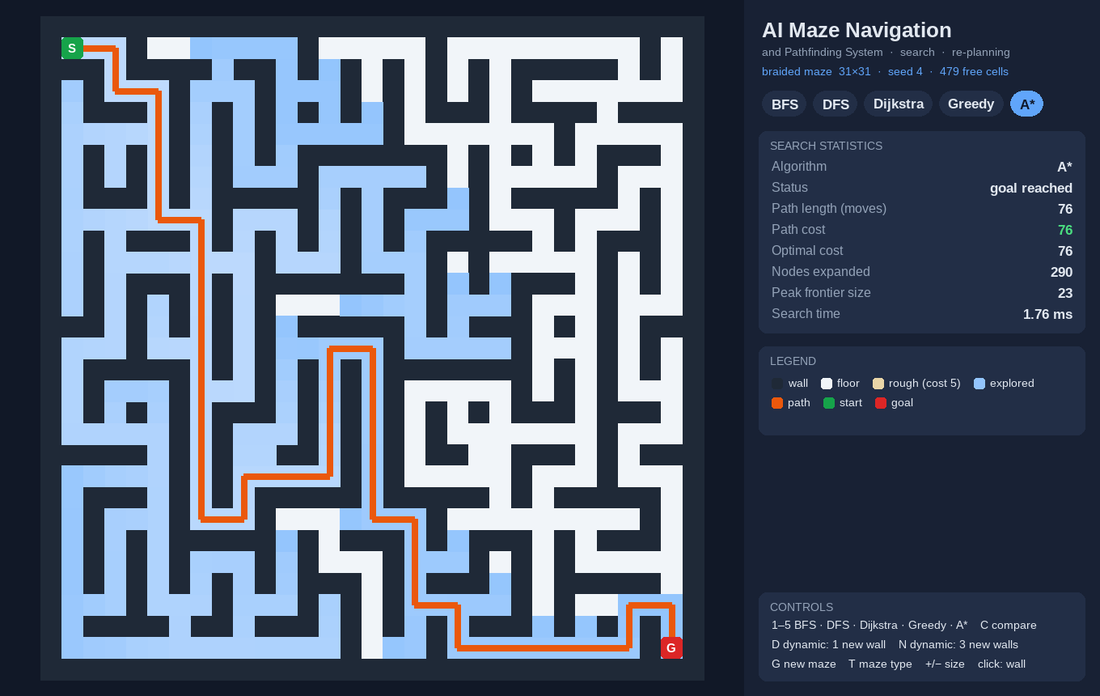
Working Prototype – Search Visualiser
13
Keys 1–5 run BFS, DFS, Dijkstra, Greedy or A*; cells are animated in the order they are expanded.
Explored cells are shaded blue and the final path is drawn in orange.
The panel reports path length and cost, the optimal cost, nodes expanded, peak frontier and time.
G generates a new maze, T changes its type, +/− its size; a click toggles a wall.
A* on a 31 × 31 braided maze — optimal cost 76 after 290 expansions in 1.28 ms.
Department of Cyber Security | Project Review – 1 | 2026–2027

Slide 14
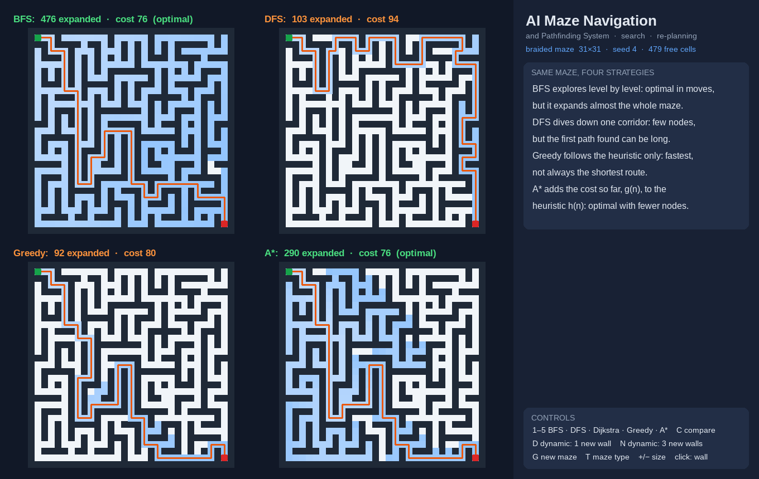
Working Prototype – Algorithm Comparison
14
Key C runs four algorithms side by side on the same maze.
BFS: 476 cells expanded, cost 76 (optimal).
DFS: 103 cells, but a path of cost 94.
Greedy: only 92 cells, path of cost 80.
A*: 290 cells, cost 76 (optimal).
Same 31 × 31 braided maze, seed 4.
Department of Cyber Security | Project Review – 1 | 2026–2027

Slide 15
Preliminary / Expected Results
15
MEASURED ON THE PROTOTYPE (400 MAZES)
Nodes expanded — 61 × 61 open field
Correct: A* matched Dijkstra’s optimal cost in all 400 test mazes (4 types × 5 sizes × 20 seeds).
Efficient: on 61 × 61 open fields A* expanded 451 cells against 2,766 for BFS — 84 % fewer — in 2.30 ms against 8.12 ms.
Greedy is fast but unreliable: 181 cells, yet paths 19 % costlier; DFS paths cost 4.4× the optimum.
Expected next: re-planning A* should reach the goal whenever a path exists, where a fixed plan fails at the first new wall.
84 %
400 / 400
0 / 20
fewer nodes than BFS
optimal paths from A*
optimal from Greedy (braided)
Mean of 20 mazes per cell; times from the Python prototype on one laptop core.
Department of Cyber Security | Project Review – 1 | 2026–2027

Slide 16
Project Schedule
16
Activity | Month 1 (Aug) | Month 2 (Sep) | Month 3 (Oct) | Month 4 (Nov) | Status
Literature survey | ✔ |  |  |  | Done
Problem identification & state-space formulation | ✔ |  |  |  | Done
System design & architecture | ✔ | ✔ |  |  | Done
Maze environment & search algorithms |  | ✔ |  |  | Done
Search visualiser (Pygame) |  | ✔ |  |  | Prototype done
Dynamic mazes & re-planning agent |  | ✔ | ✔ |  | In progress
Sensing-range study & benchmarking |  |  | ✔ |  | Planned
Testing, report & final evaluation |  |  | ✔ | ✔ | Planned
Department of Cyber Security | Project Review – 1 | 2026–2027

Slide 17


Current Progress
17
Literature survey and problem formulation complete
Architecture and six modules defined
6 / 10
Maze model, four generators and validated file loader
BFS, DFS, Dijkstra, Greedy and A* implemented
milestones complete
Pygame search visualiser and comparison view
Search benchmark on 400 mazes
The pathfinding half is working and measured — dynamic mazes, sensing and re-planning come next.
Dynamic mazes and re-planning agent (in progress)
Sensing range and belief map
Navigation experiments and automated test suite
python app.py
Final evaluation, report and documentation
Department of Cyber Security | Project Review – 1 | 2026–2027

Slide 18
Future Work
18
1
Simulate dynamic mazes: close cells of the planned route, or add random walls, after planning.
2
Build the navigating agent: belief map, sensing within range r and re-planning with A* from its current cell.
3
Compare a fixed plan with re-planning A*, and measure the effect of the sensing range on the detour.
4
Save mazes with a SHA-256 digest, add strict loading, and build the automated test suite.
5
Run the navigation experiments, and prepare the final report and comparative evaluation.
Department of Cyber Security | Project Review – 1 | 2026–2027

Slide 19



Conclusion
19
Maze navigation is formulated as a state-space search problem with step costs and a sensing range.
The pathfinding half of the system works: five algorithms on one maze model with an animated, measurable interface.
First measurements confirm that A* is optimal and expands far fewer cells than uninformed search.
The remaining work adds dynamic mazes, sensing and re-planning, all measured on the same mazes.
Optimal and efficient
A* with an admissible heuristic
Adapts to change
Sensing and re-planning (next phase)
Safe by design
Validated files, SHA-256 digests
Department of Cyber Security | Project Review – 1 | 2026–2027

Slide 20
References
20
[1] Dijkstra, E. W. (1959). A Note on Two Problems in Connexion with Graphs. Numerische Mathematik, 1, 269–271.
[2] Hart, P. E., Nilsson, N. J. & Raphael, B. (1968). A Formal Basis for the Heuristic Determination of Minimum Cost Paths. IEEE Trans. Systems Science and Cybernetics, 4(2), 100–107.
[3] Stentz, A. (1994). Optimal and Efficient Path Planning for Partially-Known Environments. Proc. IEEE ICRA, 3310–3317.
[4] Koenig, S. & Likhachev, M. (2002). D* Lite. Proc. AAAI, 476–483.
[5] Harabor, D. & Grastien, A. (2011). Online Graph Pruning for Pathfinding on Grid Maps. Proc. AAAI, 1114–1119.
[6] Sturtevant, N. R. (2012). Benchmarks for Grid-Based Pathfinding. IEEE Trans. Computational Intelligence and AI in Games, 4(2), 144–148.
[7] Russell, S. & Norvig, P. (2021). Artificial Intelligence: A Modern Approach (4th ed.). Pearson.
Department of Cyber Security | Project Review – 1 | 2026–2027

