Slide 1

Department of Computer Science and Engineering
(Cyber Security)
CS23533– Foundations of Artificial Intelligence
2026-2027
AI BASED MAZE NAVIGATION AND
PATHFINDING SYSTEM | REVIEW 2
Supervisor: Dr. S. Bhuvana
Assistant Professor (SG)
Team members:
Alagappan R (241901003)
Aswin J (241901010)

Slide 2
Problem Statement and Motivation
▪
Classical maze solvers use one fixed strategy (DFS or BFS), expand cells far from the route and count moves, not cost.
▪
A plan is computed once and never checked: when a corridor closes after planning, the agent walks into the new wall and stops.
▪
Few tools compare search algorithms on the same mazes or measure what re-planning costs, and maze files are rarely validated.
▪
Our goal: an agent that plans optimally with A*, senses and re-plans when the maze changes, and handles files safely.

Slide 3
Objectives
▪
Model the maze as a state space: cells, four moves, entry costs, and a sensing range for the moving agent.
▪
Implement A* with BFS, DFS, Dijkstra and Greedy baselines on one maze model, and measure them on generated mazes.
▪
Build a navigating agent that senses new walls, keeps a belief map and re-plans with A*; compare it with a fixed plan.
▪
Visualise every step in Pygame and load every file safely. Achieved so far: 24/24 tests, 400-maze search benchmark, 80 dynamic scenarios.

Slide 4
Project Progress Since Review 1
▪
Built dynamic mazes: cells of the planned route closed (door) or random walls added, always keeping the goal reachable.
▪
Implemented the navigating agent: belief map, sensing within range r and re-planning with A* from its current cell.
▪
Added a fixed-plan baseline and an oracle on the changed maze, plus SHA-256 digests and strict loading of maze files.
▪
Completed 24 automated tests and experiments E1–E3; the interface shows the original plan, new walls and route driven.

Slide 5
Literature Survey
No. | Author(s), Year | Paper Title | Method / Algorithm | Limitations
1 | Dijkstra (1959) | A Note on Two Problems in Connexion with Graphs | Uniform-cost shortest path | Explores in every direction; many cells expanded
2 | Hart, Nilsson & Raphael (1968) | A Formal Basis for the Heuristic Determination of Minimum Cost Paths | A* search, f = g + h | Needs a known map; savings depend on h
3 | Stentz (1994) | Optimal and Efficient Path Planning for Partially-Known Environments | D*: re-planning as the map is corrected | Complex; designed for robots
Sources and limitations adapted from the Phase I Report, literature review (Section 2.1).

Slide 6
Literature Survey
No. | Author(s), Year | Paper Title | Method / Algorithm | Limitations
4 | Yamauchi (1997) | A Frontier-Based Approach for Autonomous Exploration | Frontier-based exploration with limited sensing | Explores; does not plan least-cost routes
5 | Koenig & Likhachev (2002) | D* Lite | Incremental re-planning | More complex than re-running A*
6 | Harabor & Grastien (2011) | Online Graph Pruning for Pathfinding on Grid Maps | Jump Point Search | Uniform move costs only
These studies motivate sensing, belief-map updates and re-planning in our agent.

Slide 7
Research Gap and Project Response
1. Literature findings
2. Limitations
A* is optimal with an admissible heuristic; D* and D* Lite re-plan when a robot finds its map is wrong.
Teaching tools plan once on a static map; the cost of re-planning and the role of sensing go unmeasured; files are loaded unsafely.
3. Refined research gap
4. Progress toward the solution
No classroom-scale tool measures the search algorithms and re-planning after a change on the same mazes.
All six modules built; re-planning A* reached the goal in 80/80 dynamic runs; 24/24 tests pass.

Slide 8
System Architecture / Proposed System
Pygame interface
Maze environment
Planner / navigator
Route and metrics
Maze view, controls, statistics
Grid, costs, validated loader
A* + baselines · re-planning
Path, cost, nodes, re-plans
Search algorithms
Dynamic navigation
Belief map
Analysis and tests
BFS · DFS · Dijkstra · Greedy · A*
New walls · sensing range r
Sensed walls · re-plan from here
Benchmarks · 24 unit tests
Everything runs locally: no server, no network and no personal data; every maze file is validated and integrity-checked on load.

Slide 9
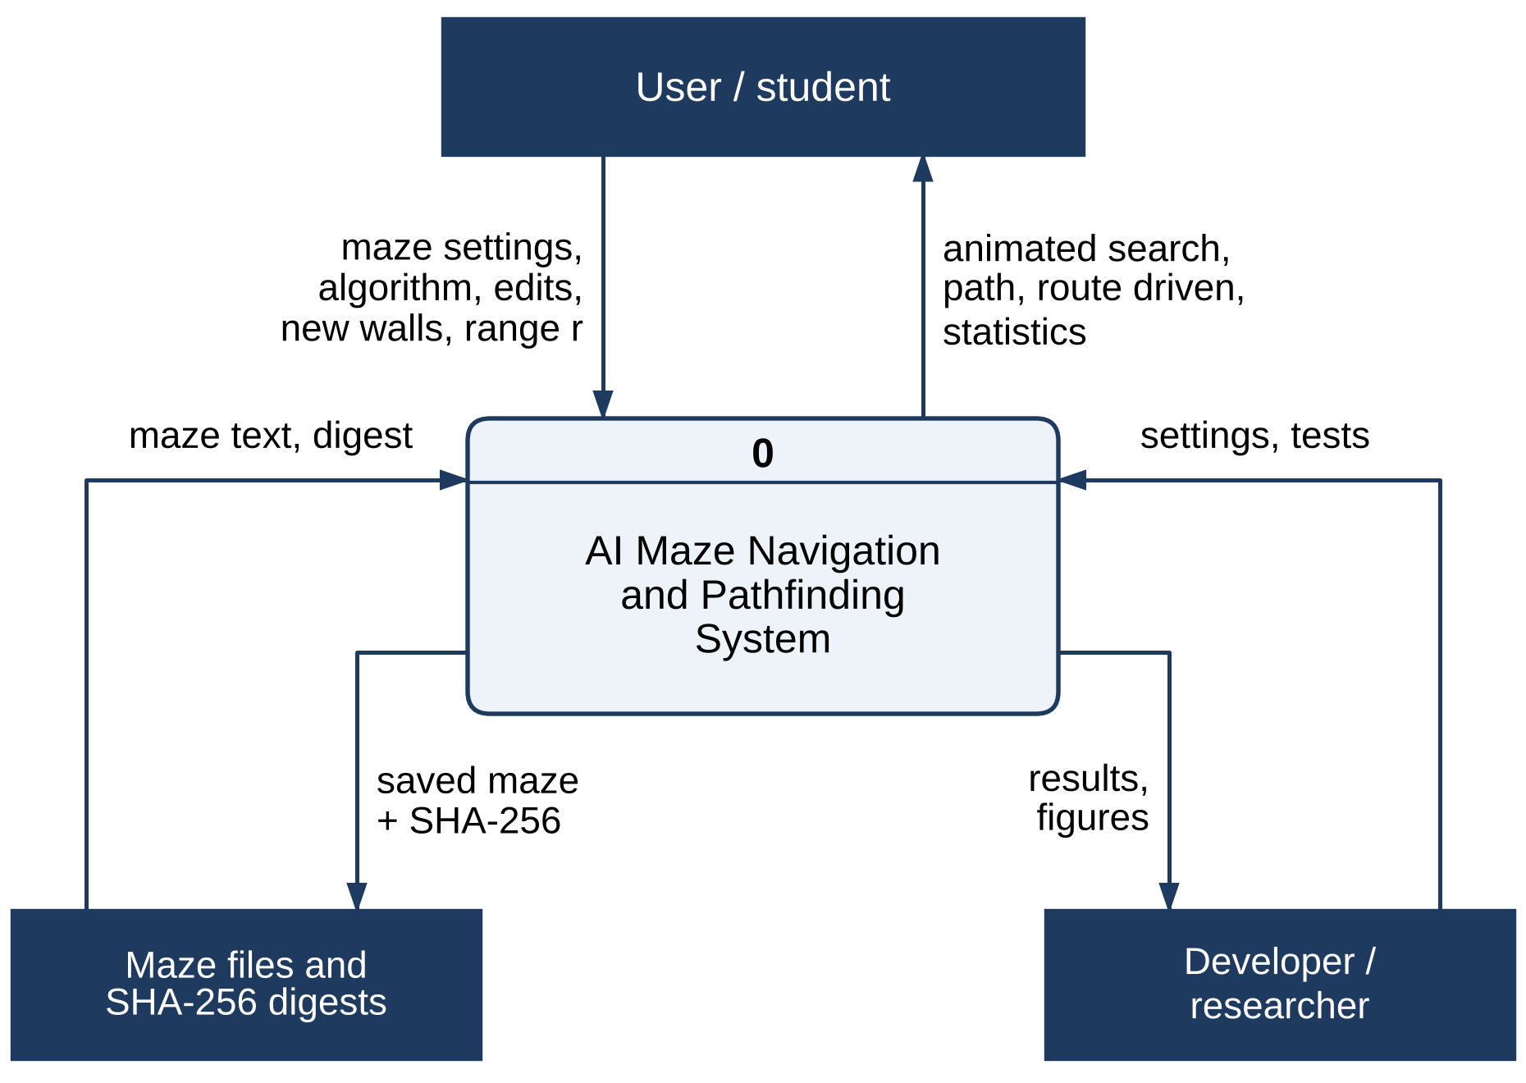
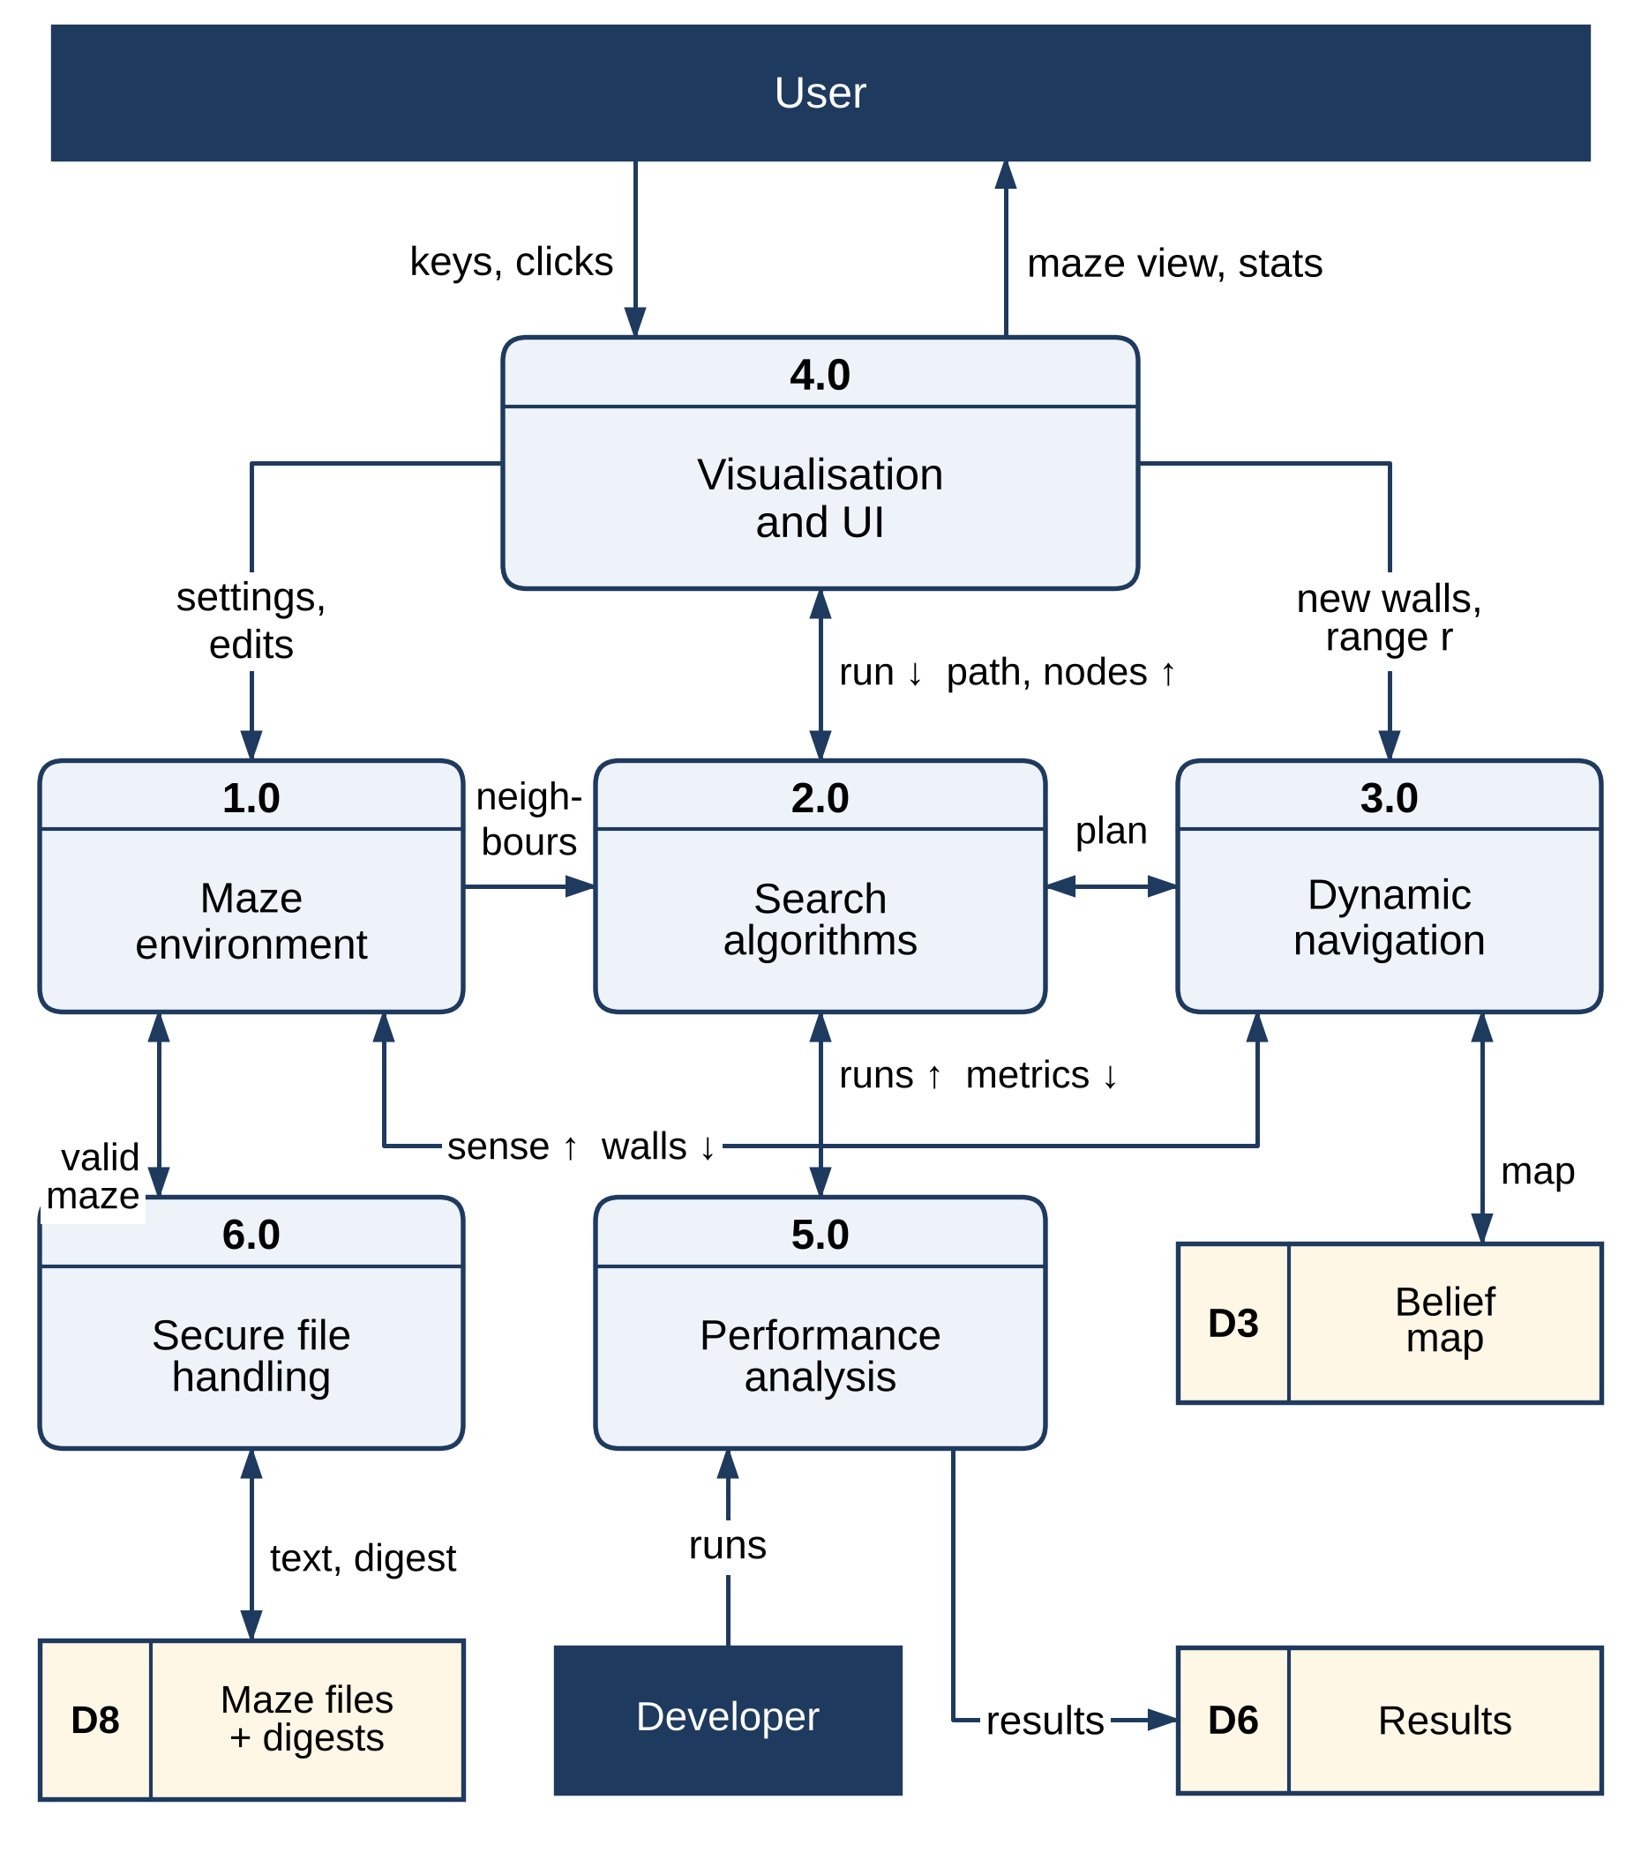
DFD Diagram
Level 0 (context) and Level 1 DFD. Stores: D3 belief map, D6 results, D8 maze files + digests. Level-2 diagrams are in the Phase I report.

Slide 10
Methodology / Workflow Diagram
01 · INPUT
02 · VALIDATE
03 · PLAN
04 · NAVIGATE
05 · OUTPUT
Maze type, size, seed or file
Digest, symbols, one S and G
A* · BFS · DFS · Dijkstra · Greedy
Sense · belief map · re-plan
Path, route, metrics
TEST
BENCHMARK
VISUALISE
24 unit tests → all pass
E1–E4 with fixed seeds
Pygame views and charts
No dataset or training data is needed: mazes are generated from a seed and every result can be regenerated.

Slide 11
Tools and Technologies
▪
Language and data: Python 3.13; NumPy 2.5 for the wall grid and cost map.
▪
Interface: Pygame 2.6 window with animated search, comparison view and dynamic navigation view.
▪
Validation: Python unittest (24 tests), a fixed-seed experiment runner and Matplotlib 3.11 charts.
▪
Security: allow-list maze parser, SHA-256 digests with a strict mode, and resource caps. No GPU or dataset.

Slide 12
List of Modules
M1
Maze environment and representation
✓ Completed
M2
Search algorithms (BFS, DFS, Dijkstra, Greedy, A*)
✓ Completed
M3
Dynamic navigation and re-planning
✓ Completed
M4
Visualisation and user interface
✓ Completed
M5
Performance analysis and testing
◐ In progress
M6
Secure file handling
✓ Completed
Module mapping follows the Phase I report (Table 3.3). M5: experiment E4 (sensing range) and the final charts remain.

Slide 13
Module Implementation – Part 1
MODULE 1 · MAZE ENVIRONMENT
MODULE 2 · SEARCH ALGORITHMS
Wall grid + cost map · four generators · validated loader
BFS · DFS · Dijkstra · Greedy · A* behind one interface
Maze model and generators
Search logic
Perfect, braided, open-field and weighted mazes
Text format # . ~ S G with an allow-list
At most 201 × 201 cells; exactly one S and one G
One best-first search: f = g + h (A*), h only (Greedy), g only (Dijkstra)
Ties broken towards the larger g
Records nodes, frontier, path cost and time
Verified: A* matches Dijkstra’s optimal cost on all 400 benchmark mazes.

Slide 14
Module Implementation – Part 2
MODULE 3 · DYNAMIC NAVIGATION
MODULE 6 · SECURE FILE HANDLING
New walls · sensing range r · re-planning A*
Byte cap · SHA-256 digest · allow-list · validation
Navigation loop
Implementation evidence
1. Follow the A* plan one move
2. Sense the walls within range r
3. Record new walls in the belief map
4. Re-plan from here if the plan is blocked
Re-planning reached G in all 80 dynamic runs
The fixed plan failed in 66 of 80
A maze changed after saving fails its SHA-256 check
Module 4 animates the modules; Module 5 runs the controlled experiments.

Slide 15
Preliminary Results and Discussion
61 × 61 open-field mazes · mean of 20 mazes
BFS
A* (Manhattan)
Greedy Best-First
2,766
451
181
baseline · 8.12 ms
84 % fewer nodes · 2.30 ms
paths 19 % costlier than optimal
80 / 80
400 / 400
24 / 24
dynamic runs reaching G with re-planning (fixed plan: 14 / 80)
optimal paths from A*
automated tests pass
E1: 400 mazes, 2,000 searches · E3: 80 dynamic runs · results from the Phase I report, Chapter 4.

Slide 16
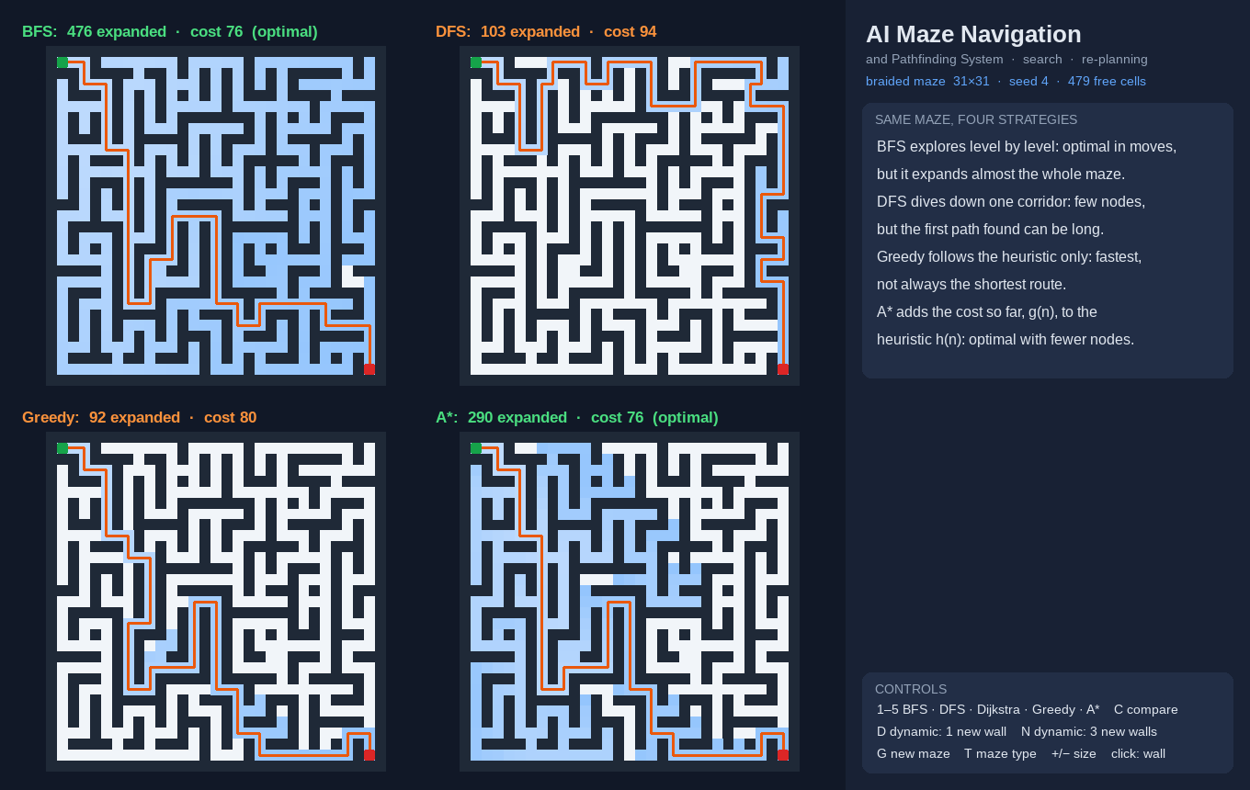
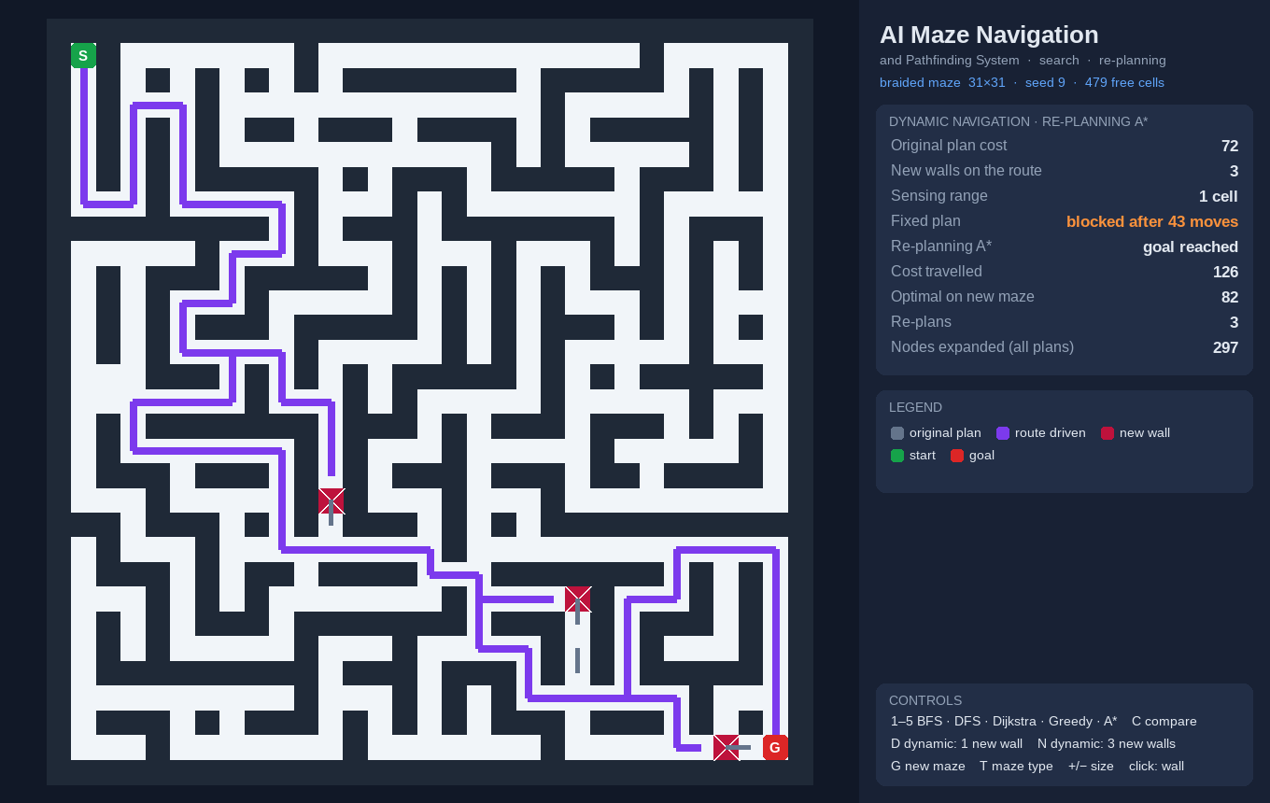
User Interface / Implementation Screenshots
Comparison view: BFS, DFS, Greedy and A* on one maze
Navigation: three new walls, three re-plans to reach G

Slide 17
Challenges Faced and Solutions
Plans broken by new walls
The agent senses walls within range r, records them in its belief map and re-plans with A* from its current cell.
Walls found too late
With range 1 the agent meets a wall only on arrival and walks back (mean detour 12–23 %); a longer range is being studied.
Keeping the goal reachable
Every new wall is checked with BFS before it is kept, so each dynamic scenario stays solvable.
Tampered maze files
Saved mazes carry a SHA-256 digest; a changed file is rejected, and --strict demands a digest.
Remaining: experiment E4 on the sensing range and the final charts.

Slide 18
Work Plan Until Final Review
1 · SENSING STUDY
Run E4 on 31 × 31 mazes: 4–32 new walls × sensing range 1, 3 and 5; measure detour and re-plans.
2 · INTERFACE
Add the sensing-range option and show short- and long-range navigation side by side.
3 · SECURITY
Keyed (HMAC) digests for maze files; hash-checked installation and dependency audit.
4 · FINAL REVIEW
Complete the report, demo script and charts, and rehearse the model review.
Planned milestones from the Phase I report, Chapter 5; the core system and the interface already work.

Slide 19
References
[1] E. W. Dijkstra, “A Note on Two Problems in Connexion with Graphs,” Numerische Mathematik, 1959.
[2] P. E. Hart, N. J. Nilsson and B. Raphael, “A Formal Basis for the Heuristic Determination of Minimum Cost Paths,” IEEE Trans. SSC, 1968.
[3] A. Stentz, “Optimal and Efficient Path Planning for Partially-Known Environments,” IEEE ICRA, 1994.
[4] B. Yamauchi, “A Frontier-Based Approach for Autonomous Exploration,” IEEE CIRA, 1997.
[5] S. Koenig and M. Likhachev, “D* Lite,” AAAI, 2002.
[6] D. Harabor and A. Grastien, “Online Graph Pruning for Pathfinding on Grid Maps,” AAAI, 2011.
[7] N. R. Sturtevant, “Benchmarks for Grid-Based Pathfinding,” IEEE Trans. CIAIG, 2012.
[8] S. Russell and P. Norvig, Artificial Intelligence: A Modern Approach, 4th ed., Pearson, 2021.

Slide 20
Thank You
AI Based Maze Navigation and Pathfinding System
Alagappan R (241901003) · Aswin J (241901010)
Supervisor: Dr. S. Bhuvana, Assistant Professor (SG)

