Slide 1
Adaptive Mail: A Flexible Email Client App

Slide 2
Project Objectives:
The objective of this project is to create a comprehensive and user-friendly email management application for Android that allows users to efficiently manage their email communication within a single interface. This application will ensure a secure environment for users to compose, view, search, filter, and delete emails, all while maintaining an organized and easily navigable interface.
Implement user authentication to ensure only authorized users access the application, enhancing security and personalized user experience.
Develop features for composing, saving, and managing emails, allowing users to handle communication efficiently.
Enable a search and filtering system for quick access to emails, providing a streamlined experience.
Integrate SQLite to manage data storage and retrieval, ensuring persistence of user data across sessions.

Slide 3
Functionalities:
The functionalities of this project focus on providing a seamless and efficient experience for users to manage their email interactions. The app integrates various features to ensure a smooth workflow for composing, viewing, filtering, and managing emails, while also ensuring data persistence and a secure user interface.
User Authentication: Allows users to securely log in and access their email functionalities, ensuring that only authorized users can interact with their data.
Compose Email: Users can create and send emails, including adding a subject, body content, and receiver email address, with the ability to mark emails as favorites.
View Emails: Users can view emails in a list format, with details like subject, sender/receiver, and body content. Favorite emails are highlighted for quick access.
Search and Filter: The app enables users to search emails by subject and filter them by favorite status, providing a quick way to access relevant emails.
Delete Emails: Users can delete unwanted emails with a simple tap, ensuring that their email list remains manageable.
Database Management: SQLite is used to store and manage email data, including user authentication and email details, ensuring data persistence across sessions.

Slide 4
Additional Requirements:
App Security: Basic security measures are implemented, including storing user passwords securely and ensuring that only logged-in users can access sensitive features like sending emails or viewing the inbox.
Shared Preferences: This is utilized to store and manage user login data, such as user ID, ensuring that logged-in sessions are maintained across app restarts.
Room Database: Room is used for local data persistence, allowing seamless management of user and email data. This helps in efficiently storing, updating, and retrieving email details, ensuring the app functions smoothly even without an internet connection.
SQLite Database: SQLite is used in conjunction with Room for structured data storage. Custom database helpers are implemented to handle user authentication, email storage, and data management tasks.
Lifecycle Management: Proper lifecycle management is implemented for activities to ensure the app maintains a smooth user experience, including handling database operations and UI updates appropriately across different stages of the app’s lifecycle.

Slide 5
MainActivity. kt:
package com.example.emailapplication
import android.content.Context
import android.content.Intent
import android.os.Bundle
import android.util.Log
import androidx.activity.ComponentActivity
import androidx.activity.compose.setContent
import androidx.compose.foundation.Image
import androidx.compose.foundation.background
import androidx.compose.foundation.layout.*
import androidx.compose.foundation.shape.RoundedCornerShape
import androidx.compose.material.*
import androidx.compose.runtime.Composable
import androidx.compose.ui.Alignment
import androidx.compose.ui.Modifier
import androidx.compose.ui.graphics.Color
import androidx.compose.ui.layout.ContentScale
import androidx.compose.ui.res.painterResource
import androidx.compose.ui.text.font.FontWeight
import androidx.compose.ui.unit.dp
import androidx.compose.ui.unit.sp
class MainActivity : ComponentActivity() {
override fun onCreate(savedInstanceState: Bundle?) {
super.onCreate(savedInstanceState)
val sharedPreferences = getSharedPreferences("user_prefs", Context.MODE_PRIVATE)
val userId = sharedPreferences.getInt("logged_in_user_id", -1)
Log.d("UserActivityLog", "User ID: $userId is accessing MailActivity")

Slide 6
if (userId == -1) {
startActivity(Intent(this, LoginActivity::class.java))
finish()
return
}
setContent {
Surface(
modifier = Modifier
.fillMaxSize()
.background(Color.White),
) {
Email(this)
} }}
fun logout() {
val sharedPreferences = getSharedPreferences("user_prefs", Context.MODE_PRIVATE)
val editor = sharedPreferences.edit()
editor.putInt("logged_in_user_id", -1)
editor.apply()
startActivity(Intent(this, LoginActivity::class.java))
finish()
}}
@Composable
fun Email(context: Context) {
Column(
horizontalAlignment = Alignment.CenterHorizontally,
verticalArrangement = Arrangement.Center,
modifier = Modifier
.fillMaxSize()
.padding(16.dp)
) {
Text(
text = "Welcome to Email App!",
modifier = Modifier.padding(top = 40.dp),
color = Color.Black,
fontWeight = FontWeight.Bold,
fontSize = 32.sp
)
Spacer(modifier = Modifier.height(16.dp))
Box(
modifier = Modifier
.size(120.dp)
.background(color = Color(0xFF4db6ac), shape = RoundedCornerShape(10.dp))
.padding(16.dp),
contentAlignment = Alignment.Center
) {
Image(
painter = painterResource(id = R.drawable.email),
contentDescription = null,
modifier = Modifier.fillMaxSize(),
contentScale = ContentScale.Crop
)
}

Slide 7
Spacer(modifier = Modifier.height(24.dp)
Button(
onClick = {
context.startActivity(
Intent(context, SendMailActivity::class.java)
)},
colors = ButtonDefaults.buttonColors(backgroundColor = Color(0xFF4db6ac)),
modifier = Modifier.fillMaxWidth()
) {
Text(
text = "Send Email",
modifier = Modifier.padding(10.dp),
color = Color.White,
fontSize = 15.sp
)
}
Spacer(modifier = Modifier.height(16.dp))
Button(
onClick = {
context.startActivity(
Intent(context, ViewMailActivity::class.java))},
colors = ButtonDefaults.buttonColors(backgroundColor = Color(0xFF4db6ac)),
modifier = Modifier.fillMaxWidth()) {
Text(
text = "View Emails",
modifier = Modifier.padding(10.dp),
color = Color.White,
fontSize = 15.sp
)
}
Spacer(modifier = Modifier.height(24.dp))
Button(
onClick = {
(context as MainActivity).logout()
},
colors = ButtonDefaults.buttonColors(backgroundColor = Color.Red),
modifier = Modifier.fillMaxWidth()
) {
Text(
text = "Logout",
modifier = Modifier.padding(10.dp),
color = Color.White,
fontSize = 15.sp
)
}
}
}

Slide 8
RegisterActivity.kt
package com.example.emailapplication
import android.content.Context
import android.content.Intent
import android.os.Bundle
import androidx.activity.ComponentActivity
import androidx.activity.compose.setContent
import androidx.compose.foundation.Image
import androidx.compose.foundation.background
import androidx.compose.foundation.layout.*
import androidx.compose.material.*
import androidx.compose.runtime.*
import androidx.compose.ui.Alignment
import androidx.compose.ui.Modifier
import androidx.compose.ui.graphics.Color
import androidx.compose.ui.layout.ContentScale
import androidx.compose.ui.res.painterResource
import androidx.compose.ui.text.font.FontFamily
import androidx.compose.ui.text.font.FontWeight
import androidx.compose.ui.text.input.PasswordVisualTransformation
import androidx.compose.ui.unit.dp
import androidx.compose.ui.unit.sp
import androidx.core.content.ContextCompat
class RegisterActivity : ComponentActivity() {
private lateinit var databaseHelper: UserDatabaseHelper
override fun onCreate(savedInstanceState: Bundle?) {
super.onCreate(savedInstanceState)
databaseHelper = UserDatabaseHelper(this)
setContent {
RegisterScreen(this, databaseHelper)
}
}
}
@Composable
fun RegisterScreen(context: Context, databaseHelper: UserDatabaseHelper) {
var username by remember { mutableStateOf("") }
var password by remember { mutableStateOf("") }
var email by remember { mutableStateOf("") }
var error by remember { mutableStateOf("") }
Box(modifier = Modifier.fillMaxSize().background(Color.White)) {
Column(
modifier = Modifier
.fillMaxSize()
.padding(16.dp),
horizontalAlignment = Alignment.CenterHorizontally,
verticalArrangement = Arrangement.Center
) {
Image(
painter = painterResource(id = R.drawable.email),
contentDescription = null,
modifier = Modifier.size(200.dp),
contentScale = ContentScale.Crop
)

Slide 9
Text(
fontSize = 32.sp,
fontWeight = FontWeight.Bold,
fontFamily = FontFamily.SansSerif,
text = "Register",
color = Color.Black
)
Spacer(modifier = Modifier.height(24.dp))
TextField(
value = username,
onValueChange = { username = it },
label = { Text("Username", color = Color.Black) },
modifier = Modifier.fillMaxWidth().padding(10.dp),
colors = TextFieldDefaults.textFieldColors(
textColor = Color.Black,
backgroundColor = Color.White,
focusedIndicatorColor = Color(0xFF4db6ac),
unfocusedIndicatorColor = Color.LightGray
)
)
Spacer(modifier = Modifier.height(16.dp))
TextField(
value = email,
onValueChange = { email = it },
label = { Text("Email", color = Color.Black) },
modifier = Modifier.fillMaxWidth().padding(10.dp),
colors = TextFieldDefaults.textFieldColors(
textColor = Color.Black,
backgroundColor = Color.White,
focusedIndicatorColor = Color(0xFF4db6ac),
unfocusedIndicatorColor = Color.LightGray
)
)
Spacer(modifier = Modifier.height(16.dp))
TextField(
value = password,
onValueChange = { password = it },
label = { Text("Password", color = Color.Black) },
visualTransformation = PasswordVisualTransformation(),
modifier = Modifier.fillMaxWidth().padding(10.dp),
colors = TextFieldDefaults.textFieldColors(
textColor = Color.Black,
backgroundColor = Color.White,
focusedIndicatorColor = Color(0xFF4db6ac),
unfocusedIndicatorColor = Color.LightGray
)
)
if (error.isNotEmpty()) {
Text(
text = error,
color = MaterialTheme.colors.error,

Slide 10
modifier = Modifier.padding(vertical = 16.dp)
)
}
Button(
onClick = {
if (username.isNotEmpty() && password.isNotEmpty() && email.isNotEmpty()) {
val user = User(
id = null,
firstName = username,
lastName = null,
email = email,
password = password
)
databaseHelper.insertUser(user)
error = "User registered successfully"
context.startActivity(Intent(context, LoginActivity::class.java))
} else {
error = "Please fill all fields"
}
},
colors = ButtonDefaults.buttonColors(backgroundColor = Color(0xFF4db6ac)),
modifier = Modifier
.fillMaxWidth()
.padding(top = 16.dp)
.height(48.dp)
) {
Text(text = "Register", color = Color.White)
}
Spacer(modifier = Modifier.height(16.dp))
Row(modifier = Modifier.fillMaxWidth(), horizontalArrangement = Arrangement.Center) {
TextButton(onClick = {
context.startActivity(Intent(context, LoginActivity::class.java))
}) {
Text(color = Color(0xFF00796b), text = "Log in")
}
}
}
}
}
private fun startLoginActivity(context: Context) {
val intent = Intent(context, LoginActivity::class.java)
ContextCompat.startActivity(context, intent, null)
}

Slide 11
SendMailActivity.kt
package com.example.emailapplication
import android.content.Context
import android.content.Intent
import android.os.Bundle
import android.util.Log
import androidx.activity.ComponentActivity
import androidx.activity.compose.setContent
import androidx.compose.foundation.layout.*
import androidx.compose.material.*
import androidx.compose.runtime.*
import androidx.compose.ui.Alignment
import androidx.compose.ui.Modifier
import androidx.compose.ui.graphics.Color
import androidx.compose.ui.text.font.FontWeight
import androidx.compose.ui.unit.dp
import androidx.compose.ui.unit.sp
class SendMailActivity : ComponentActivity() {
override fun onCreate(savedInstanceState: Bundle?) {
super.onCreate(savedInstanceState)
val sharedPreferences = getSharedPreferences("user_prefs", Context.MODE_PRIVATE)
val userId = sharedPreferences.getInt("logged_in_user_id", -1)
Log.d("UserActivityLog", "User ID: $userId is accessing SendMailActivity")
if (userId == -1) {
startActivity(Intent(this, LoginActivity::class.java))
finish()
return
}
setContent {
SendEmailUI(this)
}
}
}
@Composable
fun SendEmailUI(ctx: Context) {
var receiverEmail by remember { mutableStateOf("") }
var subject by remember { mutableStateOf("") }
var body by remember { mutableStateOf("") }
var isFavorite by remember { mutableStateOf(false) }
var error by remember { mutableStateOf("") }
Column(
horizontalAlignment = Alignment.CenterHorizontally,
verticalArrangement = Arrangement.Center,
modifier = Modifier
.fillMaxSize()
.padding(16.dp)
) {
Text(
text = "Compose Email",
color = Color.Black,
fontWeight = FontWeight.Bold,
fontSize = 32.sp,

Slide 12
modifier = Modifier.padding(bottom = 20.dp)
)
OutlinedTextField(
value = receiverEmail,
onValueChange = { receiverEmail = it },
label = { Text("Receiver Email") },
modifier = Modifier
.fillMaxWidth()
.padding(bottom = 16.dp)
)
OutlinedTextField(
value = subject,
onValueChange = { subject = it },
label = { Text("Subject") },
modifier = Modifier
.fillMaxWidth()
.padding(bottom = 16.dp)
)
OutlinedTextField(
value = body,
onValueChange = { body = it },
label = { Text("Body") },
modifier = Modifier
.fillMaxWidth()
.padding(bottom = 16.dp)
)
Row(
verticalAlignment = Alignment.CenterVertically,
modifier = Modifier
.fillMaxWidth()
.padding(bottom = 16.dp)
) {
Text(text = "Mark as Favorite", modifier = Modifier.padding(end = 8.dp))
Switch(checked = isFavorite, onCheckedChange = { isFavorite = it })
}
Button(
onClick = {
if (receiverEmail.isNotEmpty() && subject.isNotEmpty() && body.isNotEmpty()) {
val email = Email(
id = null,
recevierMail = receiverEmail,
subject = subject,
body = body,
favorite = isFavorite
)
val databaseHelper = EmailDatabaseHelper(ctx)
databaseHelper.insertEmail(email)
error = "Mail Saved"
val intent = Intent(Intent.ACTION_SEND).apply {
putExtra(Intent.EXTRA_EMAIL, arrayOf(receiverEmail))
putExtra(Intent.EXTRA_SUBJECT, subject)

Slide 13
putExtra(Intent.EXTRA_TEXT, body)
type = "message/rfc822"
}
ctx.startActivity(Intent.createChooser(intent, "Choose an Email client: "))
} else {
error = "Please fill all fields"
}
},
colors = ButtonDefaults.buttonColors(backgroundColor = Color(0xFFd3e5ef)),
modifier = Modifier.fillMaxWidth()
) {
Text(text = "Send Email", color = Color.Black, fontSize = 15.sp)
}
if (error.isNotEmpty()) {
Spacer(modifier = Modifier.height(16.dp))
Text(text = error, color = Color.Red, fontWeight = FontWeight.Bold)
}
}
}
LoginActivity.kt
package com.example.emailapplication
import android.content.Context
import android.content.Intent
import android.content.SharedPreferences
import android.os.Bundle
import android.util.Log
import androidx.activity.ComponentActivity
import androidx.activity.compose.setContent
import androidx.compose.foundation.Image
import androidx.compose.foundation.background
import androidx.compose.foundation.layout.*
import androidx.compose.material.*
import androidx.compose.runtime.*
import androidx.compose.ui.Alignment
import androidx.compose.ui.Modifier
import androidx.compose.ui.graphics.Color
import androidx.compose.ui.layout.ContentScale
import androidx.compose.ui.res.painterResource
import androidx.compose.ui.text.font.FontFamily
import androidx.compose.ui.text.font.FontWeight
import androidx.compose.ui.text.input.PasswordVisualTransformation
import androidx.compose.ui.unit.dp
import androidx.compose.ui.unit.sp
import androidx.core.content.ContextCompat

Slide 14
class LoginActivity : ComponentActivity() {
private lateinit var databaseHelper: UserDatabaseHelper
private lateinit var sharedPreferences: SharedPreferences
override fun onCreate(savedInstanceState: Bundle?) {
super.onCreate(savedInstanceState)
databaseHelper = UserDatabaseHelper(this)
sharedPreferences = getSharedPreferences("user_prefs", Context.MODE_PRIVATE)
val userId = sharedPreferences.getInt("logged_in_user_id", -1)
Log.d("UserActivityLog", "User ID: $userId is accessing loginActivity")
if (userId != -1) {
startMainPage(this)
finish()
} else {
setContent {
LoginScreen(this, databaseHelper, sharedPreferences)
}
}
}
}
@Composable
fun LoginScreen(context: Context, databaseHelper: UserDatabaseHelper, sharedPreferences: SharedPreferences) {
var username by remember { mutableStateOf("") }
var password by remember { mutableStateOf("") }
var error by remember { mutableStateOf("") }
Box(modifier = Modifier.fillMaxSize().background(Color.White)) {
Column(
modifier = Modifier
.fillMaxSize()
.padding(16.dp),
horizontalAlignment = Alignment.CenterHorizontally,
verticalArrangement = Arrangement.Center
) {
Image(
painter = painterResource(id = R.drawable.email),
contentDescription = null,
modifier = Modifier.size(300.dp),
contentScale = ContentScale.Crop
)
Text(
fontSize = 32.sp,
fontWeight = FontWeight.Bold,
fontFamily = FontFamily.SansSerif,
text = "Login",
color = Color.Black
)
Spacer(modifier = Modifier.height(24.dp))
TextField(
value = username,
onValueChange = { username = it },
label = { Text("Username", color = Color.Black) },

Slide 15
modifier = Modifier.fillMaxWidth().padding(vertical = 8.dp),
colors = TextFieldDefaults.textFieldColors(
textColor = Color.Black,
backgroundColor = Color.White,
placeholderColor = Color.Gray,
focusedIndicatorColor = Color(0xFF4db6ac),
unfocusedIndicatorColor = Color.LightGray
)
)
TextField(
value = password,
onValueChange = { password = it },
label = { Text("Password", color = Color.Black) },
visualTransformation = PasswordVisualTransformation(),
modifier = Modifier.fillMaxWidth().padding(vertical = 8.dp),
colors = TextFieldDefaults.textFieldColors(
textColor = Color.Black,
backgroundColor = Color.White,
placeholderColor = Color.Gray,
focusedIndicatorColor = Color(0xFF4db6ac),
unfocusedIndicatorColor = Color.LightGray
)
)
if (error.isNotEmpty()) {
Text(
text = error,
color = MaterialTheme.colors.error,
modifier = Modifier.padding(vertical = 8.dp)
)
}
Button(
onClick = {
if (username.isNotEmpty() && password.isNotEmpty()) {
val user = databaseHelper.getUserByUsername(username)
if (user != null && user.password == password) {
with(sharedPreferences.edit()) {
putInt("logged_in_user_id", user.id ?: -1)
apply()
}
context.startActivity(Intent(context, MainActivity::class.java))
} else {
error = "Invalid username or password"
}
} else {
error = "Please fill all fields"
}
},
colors = ButtonDefaults.buttonColors(backgroundColor = Color(0xFF4db6ac)),
modifier = Modifier
.fillMaxWidth()
.padding(top = 16.dp)

Slide 16
ViewMailActivity.kt
package com.example.emailapplication
import android.annotation.SuppressLint
import android.content.Context
import android.content.Intent
import android.os.Bundle
import android.util.Log
import androidx.activity.ComponentActivity
import androidx.activity.compose.setContent
import androidx.compose.foundation.layout.*
import androidx.compose.foundation.lazy.LazyColumn
import androidx.compose.foundation.lazy.items
import androidx.compose.foundation.shape.RoundedCornerShape
import androidx.compose.material.*
import androidx.compose.runtime.*
import androidx.compose.ui.Modifier
import androidx.compose.ui.draw.clip
import androidx.compose.ui.graphics.Color
import androidx.compose.ui.text.font.FontWeight
import androidx.compose.ui.text.style.TextAlign
import androidx.compose.ui.unit.dp
import androidx.compose.ui.unit.sp
import androidx.compose.material.icons.Icons
import androidx.compose.material.icons.filled.Star
import androidx.compose.material.icons.filled.Delete
import androidx.compose.ui.text.style.TextOverflow
.height(48.dp)
) {
Text(text = "Login", color = Color.White)
}
Spacer(modifier = Modifier.height(16.dp))
Row(modifier = Modifier.fillMaxWidth(), horizontalArrangement = Arrangement.Center) {
TextButton(onClick = {
context.startActivity(Intent(context, RegisterActivity::class.java))
}) {
Text(color = Color(0xFF00796b), text = "Sign up")
}
}
}
}
}
private fun startMainPage(context: Context) {
val intent = Intent(context, MainActivity::class.java)
ContextCompat.startActivity(context, intent, null)
}

Slide 17
class ViewMailActivity : ComponentActivity() {
private lateinit var emailDatabaseHelper: EmailDatabaseHelper
@SuppressLint("UnusedMaterialScaffoldPaddingParameter")
override fun onCreate(savedInstanceState: Bundle?) {
super.onCreate(savedInstanceState)
val sharedPreferences = getSharedPreferences("user_prefs", Context.MODE_PRIVATE)
val userId = sharedPreferences.getInt("logged_in_user_id", -1)
Log.d("UserActivityLog", "User ID: $userId is accessing ViewMailActivity")
if (userId == -1) {
startActivity(Intent(this, LoginActivity::class.java))
finish()
return
}
emailDatabaseHelper = EmailDatabaseHelper(this)
setContent {
var showFavorites by remember { mutableStateOf(false) }
var searchQuery by remember { mutableStateOf("") }
var emails by remember { mutableStateOf(emailDatabaseHelper.getAllEmails()) }
Scaffold(
topBar = {
TopAppBar(
backgroundColor = Color(0xFF4db6ac),
modifier = Modifier.height(80.dp),
title = {
Text(
text = "View Mails",
fontSize = 32.sp,
color = Color.White,
modifier = Modifier.fillMaxWidth(),
textAlign = TextAlign.Center,
)
}
)
},
floatingActionButton = {
FilterButton(showFavorites) { showFavorites = it }
},
floatingActionButtonPosition = FabPosition.End,
) {
Column(modifier = Modifier.padding(16.dp)) {
TextField(
value = searchQuery,

Slide 18
onValueChange = { searchQuery = it },
label = { Text("Search by Subject") },
modifier = Modifier.fillMaxWidth(),
colors = TextFieldDefaults.textFieldColors(backgroundColor = Color.White)
)
val filteredEmails = if (showFavorites) {
emailDatabaseHelper.getFavoriteEmails()
} else {
emailDatabaseHelper.getAllEmails()
}.filter {
it.subject?.contains(searchQuery, ignoreCase = true) == true
}
emails = filteredEmails
EmailListSample(emails) { emailId ->
emailDatabaseHelper.deleteEmail(emailId)
emails = emailDatabaseHelper.getAllEmails()
}
}
}
}
}
}
@Composable
fun FilterButton(showFavorites: Boolean, onFilterChanged: (Boolean) -> Unit) {
FloatingActionButton(
onClick = {
onFilterChanged(!showFavorites)
},
backgroundColor = Color(0xFF4db6ac),
modifier = Modifier
.padding(16.dp)
.width(160.dp)
.height(56.dp)
.clip(RoundedCornerShape(12.dp))
) {
Text(
text = if (showFavorites) "Show All" else "Show Favorites",
color = Color.White,
style = MaterialTheme.typography.body1,
modifier = Modifier.padding(8.dp)
)
}
}
@Composable
fun EmailListSample(emails: List<Email>, onDelete: (Int) -> Unit) {
LazyColumn(
modifier = Modifier.fillMaxSize(),
verticalArrangement

Slide 19
= Arrangement.spacedBy(12.dp)
) {
items(emails) { email ->
EmailCard(email, onDelete)
}
}
}
@Composable
fun EmailCard(email: Email, onDelete: (Int) -> Unit) {
Card(
modifier = Modifier
.padding(horizontal = 16.dp, vertical = 8.dp)
.fillMaxWidth(),
shape = RoundedCornerShape(12.dp),
elevation = 4.dp
) {
Column(
modifier = Modifier
.padding(16.dp)
) {
if (email.favorite) {
Icon(
imageVector = Icons.Filled.Star,
contentDescription = "Favorite",
modifier = Modifier
.size(24.dp)
.padding(bottom = 8.dp),
tint = Color(0xFFFFD700)
)
}
Text(
text = "Receiver: ${email.recevierMail}",
fontWeight = FontWeight.Bold,
fontSize = 16.sp,
color = Color.Black,
modifier = Modifier.padding(bottom = 4.dp)
)
Text(
text = "Subject: ${email.subject}",
fontWeight = FontWeight.SemiBold,
fontSize = 14.sp,
color = Color.Black,
modifier = Modifier.padding(bottom = 4.dp))
Text(
text = "Body: ${email.body}",
fontSize = 12.sp,
color = Color.Gray,
maxLines = 2,
overflow = TextOverflow.Ellipsis,
modifier = Modifier.padding(bottom = 8.dp))
Row(
modifier = Modifier.fillMaxWidth(),
horizontalArrangement = Arrangement.End
) {
IconButton(onClick = { onDelete(email.id ?: 0) }) {
Icon(
imageVector = Icons.Filled.Delete,
contentDescription = "Delete",
tint = Color.Red
)}}}}}

Slide 20
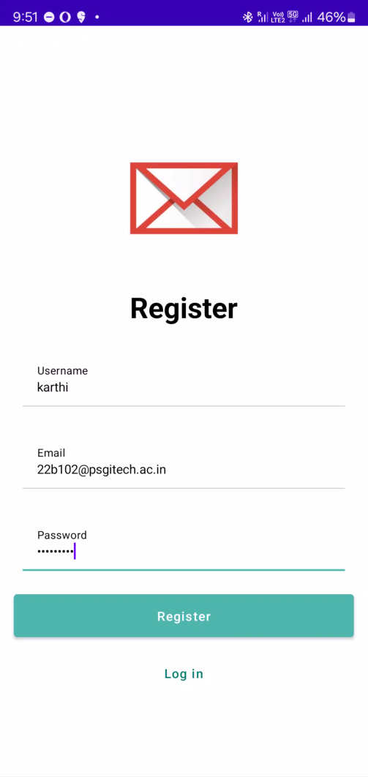
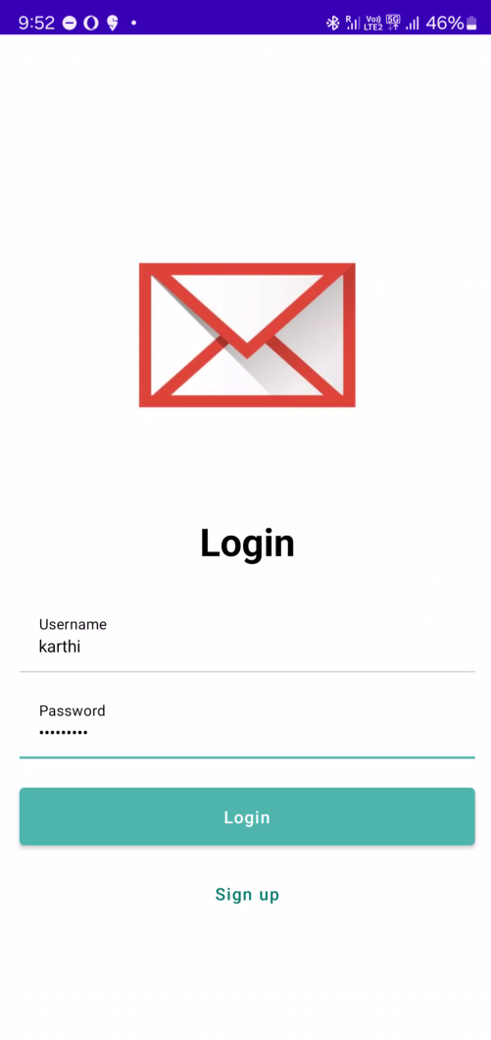
OUTPUT:
Fig 1: Register Page
Fig 2: Login Page

Slide 21
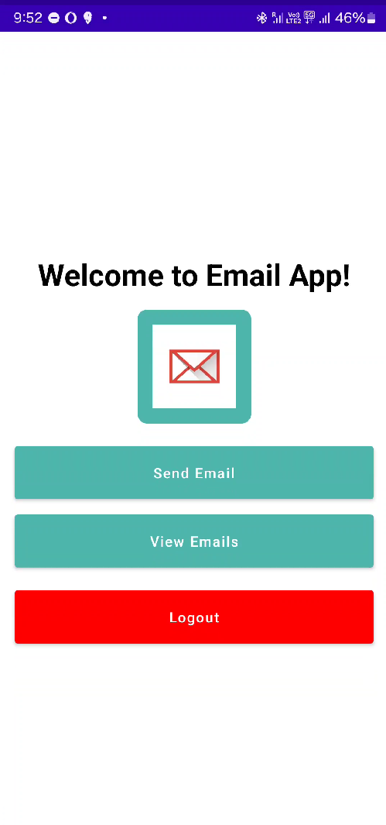
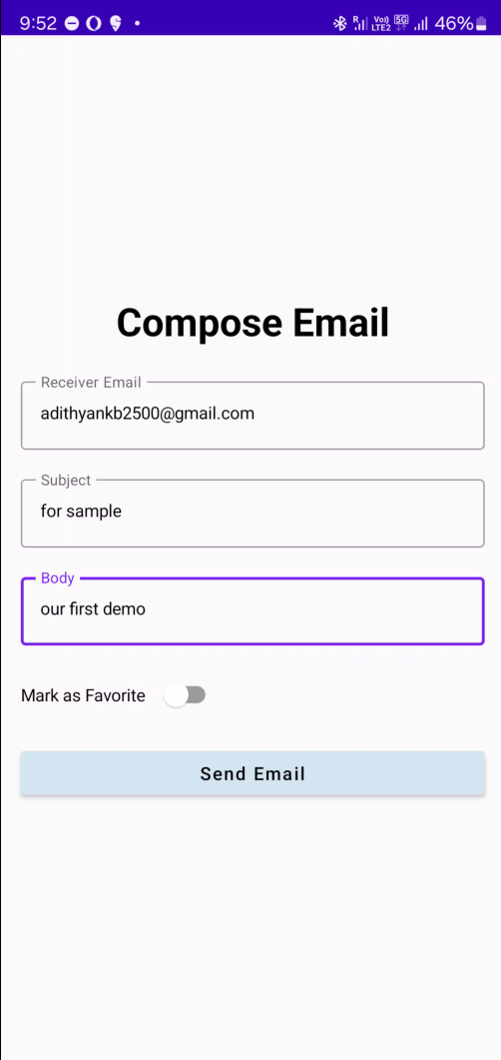
Fig 3: Home Page
Fig 4: Send Mail Page

Slide 22
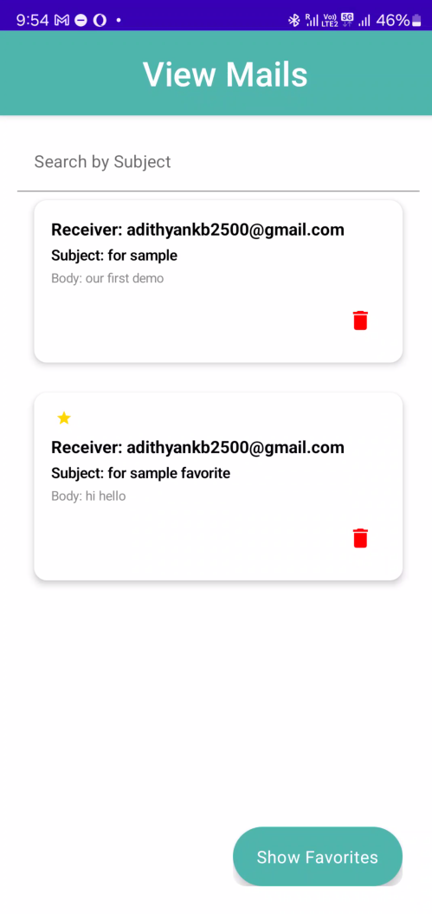
Fig 5: View Mail page

