Slide 1
DIGITAL PORTFOLIO

Slide 2
DIGITAL PORTFOLIO
STUDENT NAME : ARCHANA A
REGISTER NO AND NMID : 2426J1143 AND asbru4q2426j1143
DEPARTMENT : INFORMATION TECHNOLOGY
COLLEGE : KSG COLLEGE OF ARTS AND SCIENCE
UNIVERSITY : BHARATHIYAR UNIVERSITY

Slide 3
STUDENT PORTFOLIO
USING FRONTEND DEVELOPMENT

Slide 4
AGENDA
1. PROBLEM STATEMENT
2. PROJECT OVERVIEW
3. END USERS
4. TOOLS AND TECHNOLOGIES
5. PORTFOLIO DESIGN AND LAYOUT
6. FEATURES AND FUNCTIONALITY
7. RESULTS AND SCREENSHOTS
8. CONCLUSION

Slide 5
PROBLEM STATEMENT
Problem Statement Create a digital portfolio that effectively showcases my skills, experience, and accomplishments in a visually appealing and user-friendly manner, allowing potential employers, clients, or collaborators to easily navigate and understand my value proposition.

Slide 6
PROJECT OVERVIEW
Project Title Digital Portfolio Project Description Create a visually appealing and user-friendly digital portfolio that showcases my skills, experience, and accomplishments in a clear and concise manner. Goals and Objectives 1. *Showcase skills and experience*: Highlight my technical skills, projects, and achievements. 2. *Improve visibility*: Increase my online presence and make it easy for others to find and access my portfolio. 3. *Enhance credibility*: Establish myself as a professional in my field.

Slide 7
END USERS
The end users for a digital portfolio can include: Potential Employers Hiring managers Recruiters HR professionals
Collaborators Other professionals
Partners Team members

Slide 8
TOOLS AND TECHNOLOGIES
Digital Portfolio Tools and Technologies - *OnePlan*: An AI-enabled strategic portfolio management platform for project portfolios, financial planning, resource planning, and work management. - *Bynder*: A cloud-based DAM platform for centralizing and managing digital assets, with features like brand guidelines management and real-time analytics. - *Wix*: A popular website builder for creating custom websites and portfolios, with drag-and-drop tools and templates

Slide 9
PORTFOLIO DESIGN AND LAYOUT
Portfolio Design and Layout
A well-designed portfolio is crucial for showcasing your work and skills. Design Principles 1. *Balance*: Balance your design elements to create a visually appealing layout. 2. *Contrast*: Use contrast to create visual interest and draw attention. 3. *Alignment*: Align your design elements to create a clean and organized layout. 4. *Repetition*: Use repetition to create a consistent visual identity.

Slide 10
FEATURES AND FUNCTIONALITIES
Core Features 1. *Project showcases*: Detailed descriptions and examples of your projects. 2. *Image and video galleries*: Visual showcases of your work. 3. *Case studies*: In-depth analyses of your projects. 4. *Skills and expertise*: A clear and concise list of your technical skills. Analytics and Performance Features 1. *Google Analytics integration*: Integration with Google Analytics to track website traffic and behavior. 2. *Performance monitoring*: Tools to monitor the performance of your portfolio.

Slide 11
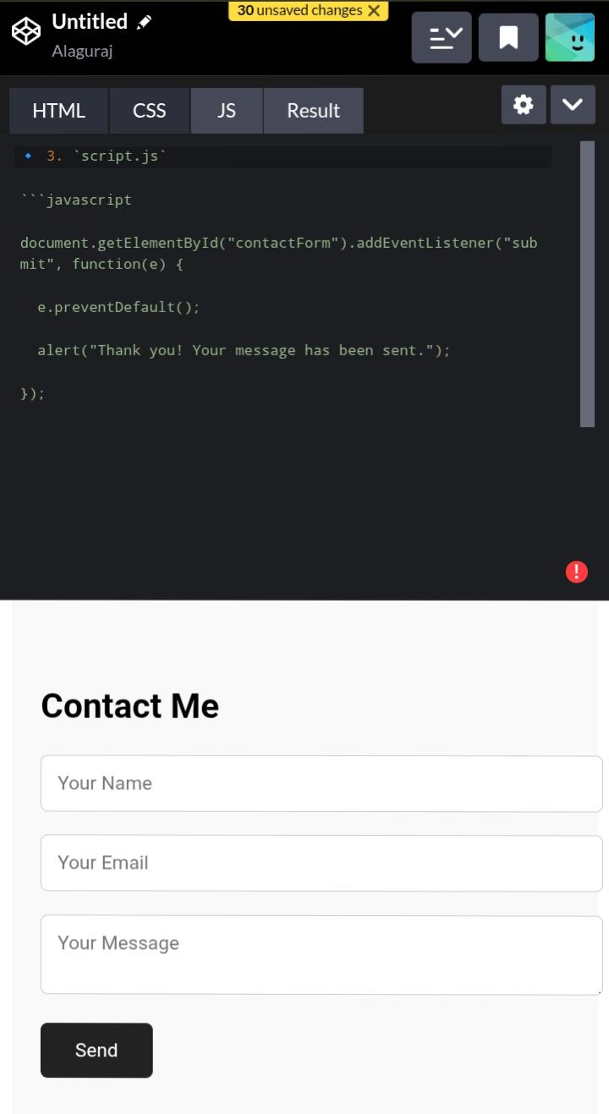
RESULTS AND SCREENSHOTS

Slide 12
CONCLUSION
A well-designed digital portfolio is a powerful tool for showcasing your skills, experience, and accomplishments. By incorporating key features such as project showcases, image and video galleries, case studies, and skills and expertise, you can create a comprehensive and effective portfolio.

