Slide 1
Chapter 7 Error Detection and Correction
Types of Errors
Detection
Correction

Slide 2
Basic concepts
Networks must be able to transfer data from one device to another with complete accuracy.
Data can be corrupted during transmission.
For reliable communication, errors must be detected and corrected.
Error detection and correction are implemented either at the data link layer or the transport layer of the OSI model.

Slide 3
Types of Errors

Slide 4
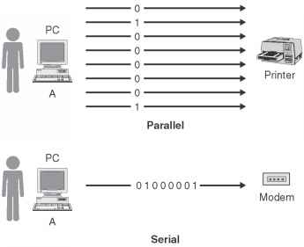

Slide 5
Single-bit error

Slide 6
Single bit errors are the least likely type of errors in serial data transmission because the noise must have a very short duration which is very rare. However this kind of errors can happen in parallel transmission.
Example:
If data is sent at 1Mbps then each bit lasts only 1/1,000,000 sec. or 1 μs.
For a single-bit error to occur, the noise must have a duration of only 1 μs, which is very rare.

Slide 7
Burst error

Slide 9
The term burst error means that two or more bits in the data unit have changed from 1 to 0 or from 0 to 1.
Burst errors does not necessarily mean that the errors occur in consecutive bits, the length of the burst is measured from the first corrupted bit to the last corrupted bit. Some bits in between may not have been corrupted.

Slide 10
Burst error is most likely to happen in serial transmission since the duration of noise is normally longer than the duration of a bit.
The number of bits affected depends on the data rate and duration of noise.
Example:
If data is sent at rate = 1Kbps then a noise of 1/100 sec can affect 10 bits.(1/100*1000)
If same data is sent at rate = 1Mbps then a noise of 1/100 sec can affect 10,000 bits.(1/100*10⁶)

Slide 11
Error detection
Error detection means to decide whether the received data is correct or not without having a copy of the original message.
Error detection uses the concept of redundancy, which means adding extra bits for detecting errors at the destination.
Notes:
Make sense of message.
Make sense of message.

Slide 12
Redundancy

Slide 13
Four types of redundancy checks are used
in data communications

Slide 14
Vertical Redundancy Check
VRC

Slide 15
Performance
It can detect single bit error
It can detect burst errors only if the total number of errors is odd.

Slide 16
Example
Suppose the sender wants to send the word world. In ASCII the five characters are coded as
1110111 1101111 1110010 1101100 1100100
The following shows the actual bits sent
11101110 11011110 11100100 11011000 11001001

Slide 17
Example
Now suppose the word world in Example 1 is received by the receiver without being corrupted in transmission.
11101110 11011110 11100100 11011000 11001001
The receiver counts the 1s in each character and comes up with even numbers (6, 6, 4, 4, 4). The data are accepted.

Slide 18
Example
Now suppose the word world in Example 1 is corrupted during transmission.
11111110 11011110 11101100 11011000 11001001
The receiver counts the 1s in each character and comes up with even and odd numbers (7, 6, 5, 4, 4). The receiver knows that the data are corrupted, discards them, and asks for retransmission.

Slide 19
Longitudinal Redundancy Check
LRC

Slide 20
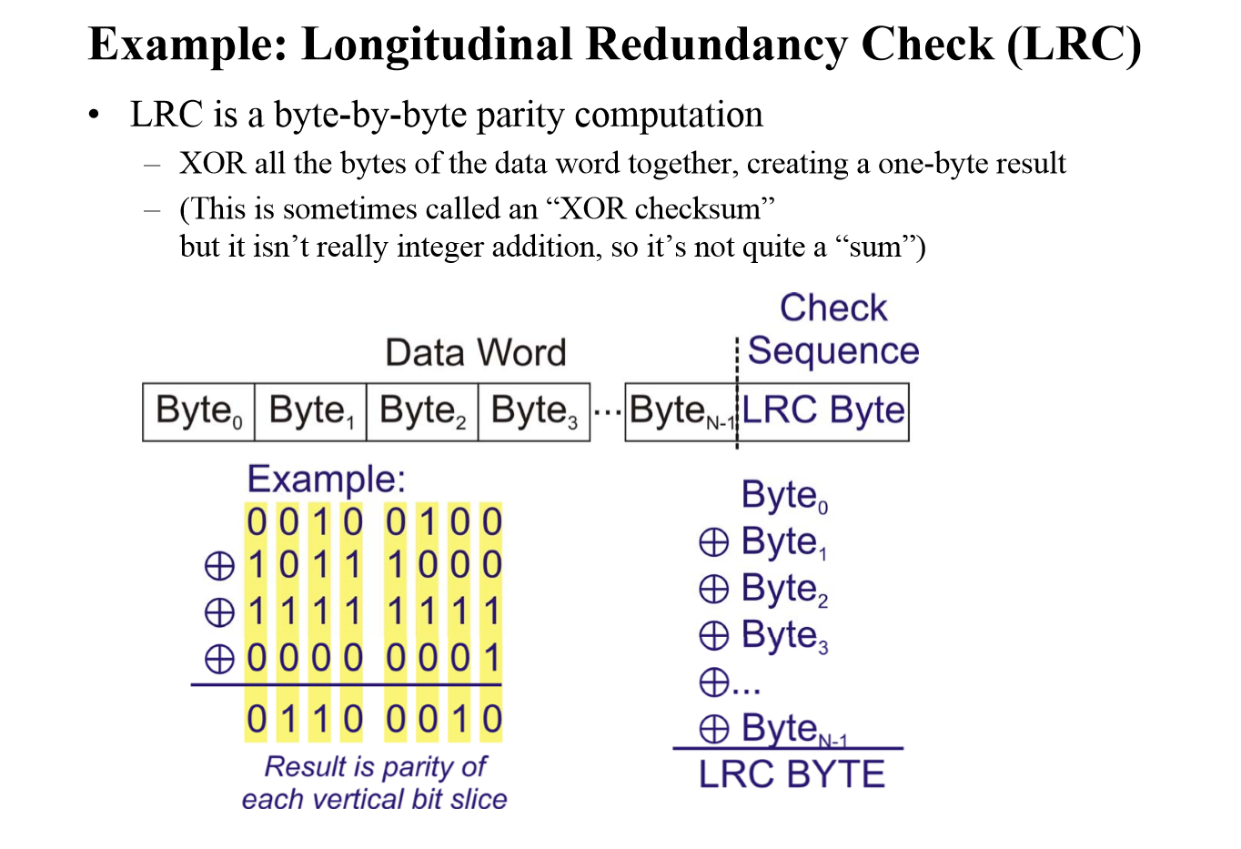

Slide 21
Performance
LCR increases the likelihood of detecting burst errors.
If two bits in one data units are damaged and two bits in exactly the same positions in another data unit are also damaged, the LRC checker will not detect an error.

Slide 22
VRC and LRC

Slide 23
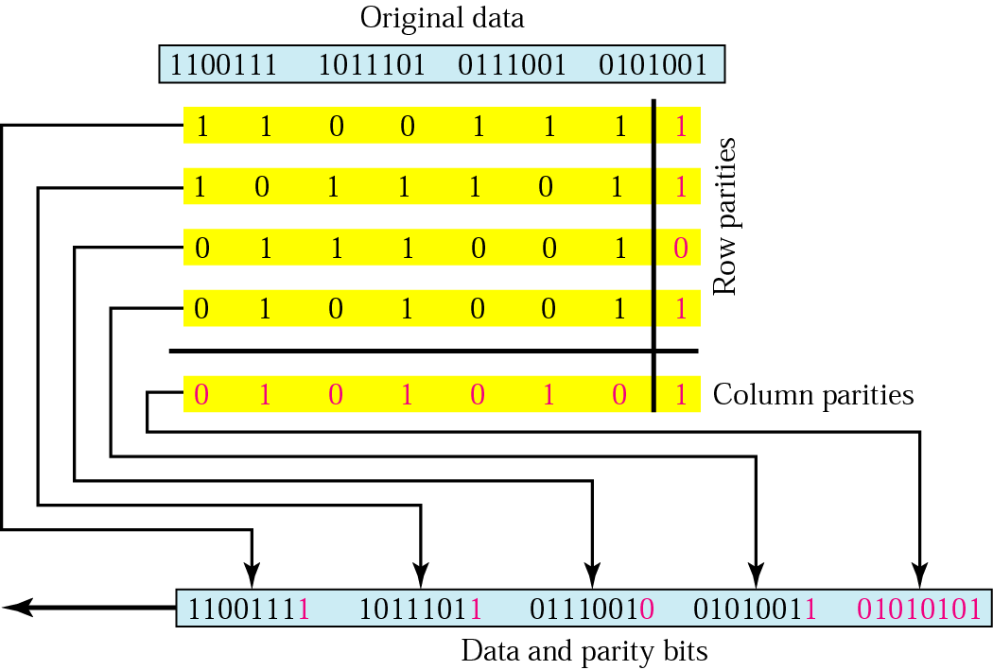
Two –Dimensional Parity Check

Slide 24
Example
Suppose the following block is sent:
10101001 00111001 11011101 11100111 10101010
However, it is hit by a burst noise of length 8, and some bits are corrupted.
10100011 10001001 11011101 11100111 10101010
When the receiver checks the parity bits, some of the bits do not follow the even-parity rule and the whole block is discarded.
10100011 10001001 11011101 11100111 10101010

Slide 25
Cyclic Redundancy Check
CRC

Slide 26
Cyclic Redundancy Check
Given a k-bit frame or message, the transmitter generates an n-bit sequence, known as a frame check sequence (FCS), so that the resulting frame, consisting of (k+n) bits, is exactly divisible by some predetermined number.
The receiver then divides the incoming frame by the same number and, if there is no remainder, assumes that there was no error.

Slide 27
CRC example
want:
D.2^{r} XOR R = nG
equivalently:
D.2^{r} = nG XOR R
equivalently:
if we divide D.2^{r} by G, want remainder R to satisfy:
G
D
r = 3
1
01000
1001
101110000
1001
101
000
1010
1001
010
000
100
000
R
1000
0000
D.2^{r}
G
1000
R = remainder[ ]
Link Layer
5-15

Slide 28
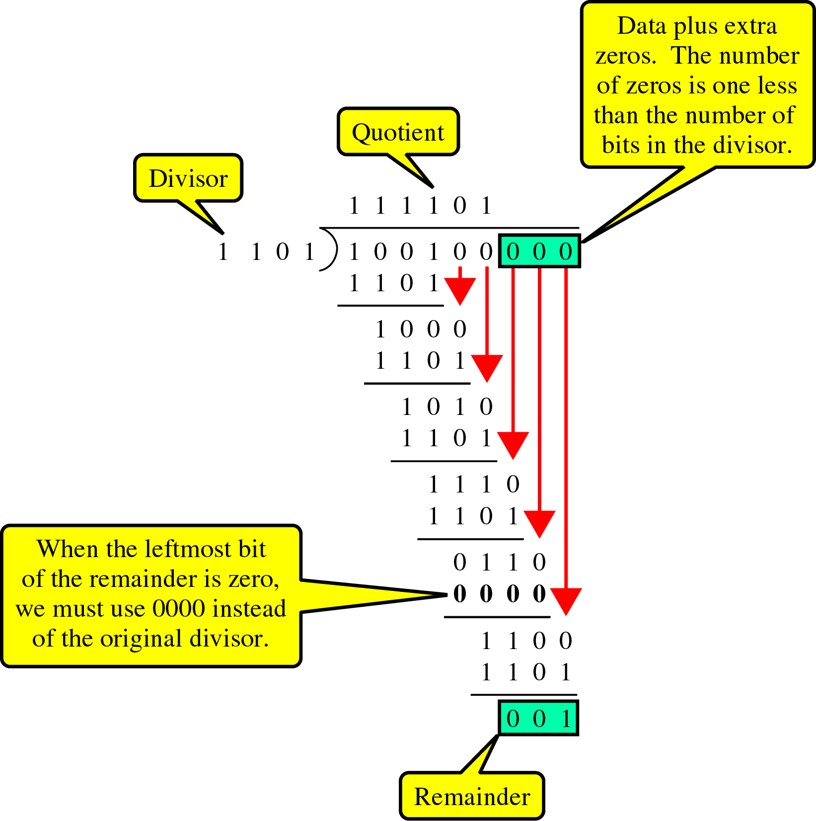
Send

Slide 29
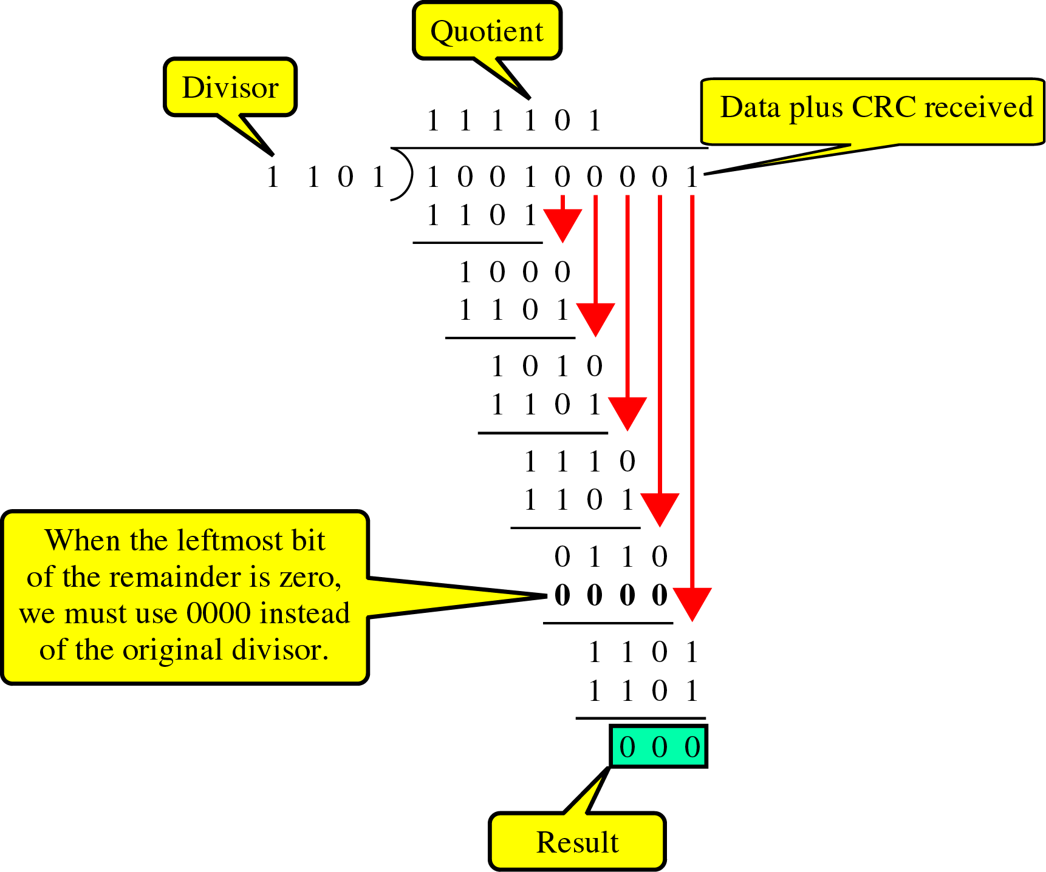
Receive

Slide 30
Polynomial
CRC generator(divisor) is most often represented not as a string of 1s and 0s, but as an algebraic polynomial.

Slide 31
Polynomial and Divisor

Slide 32
Standard Polynomials

Slide 33
Checksum
~ used by the higher layer protocols
~ is based on the concept of redundancy(VRC, LRC, CRC ….)

Slide 34
At the sender
The unit is divided into k sections, each of n bits.
All sections are added together using one’s complement to get the sum.
The sum is complemented and becomes the checksum.
The checksum is sent with the data

Slide 35
At the receiver
The unit is divided into k sections, each of n bits.
All sections are added together using one’s complement to get the sum.
The sum is complemented.
If the result is zero, the data are accepted: otherwise, they are rejected.

Slide 36
To create the checksum the sender does the following:
The unit is divided into K sections, each of n bits.
Section 1 and 2 are added together using one’s complement.
Section 3 is added to the result of the previous step.
Section 4 is added to the result of the previous step.
The process repeats until section k is added to the result of the previous step.
The final result is complemented to make the checksum.

Slide 37
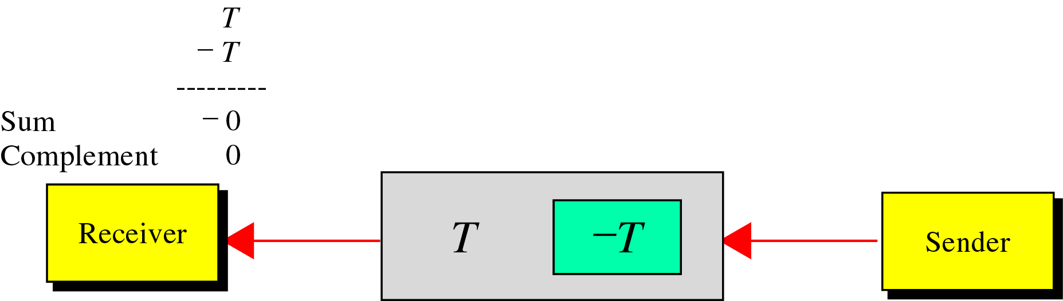
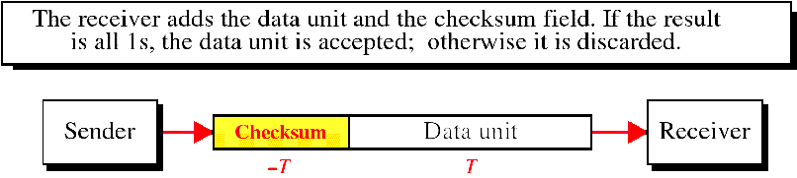
data unit and checksum

Slide 38
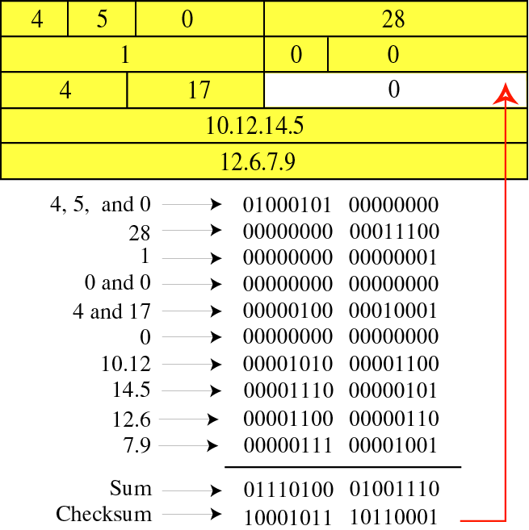

Slide 39
Example
( at a sender)
Original data : 10101001 00111001
10101001
00111001
--------------
11100010 Sum
00011101 Checksum
10101001 00111001 00011101 ←send

Slide 40
Example
( at a receiver)
Received data : 10101001 00111001 00011101
10101001
00111001
00011101
---------------
11111111 ← Sum
00000000 ← Complement

Slide 41
Performance
The checksum detects all errors involving an odd number of bits.
It detects most errors involving an even number of bits.
If one or more bits of a segment are damaged and the corresponding bit or bits of opposite value in a second segment are also damaged, the sums of those columns will not change and the receiver will not detect a problem.

Slide 42
Error Correction
It can be handled in two ways:
receiver can have the sender retransmit the entire data unit.
The receiver can use an error-correcting code, which automatically corrects certain errors.

Slide 43
Single-bit error correction
To correct an error, the receiver reverses the value of the altered bit. To do so, it must know which bit is in error.
Number of redundancy bits needed
Let data bits = m
Redundancy bits = r
∴Total message sent = m+r
The value of r must satisfy the following relation:
2^{r} ≥ m+r+1

Slide 44
Error Correction

Slide 45
Hamming Code

Slide 46
each r bit is the VRC bit for one combination of data bits
r₁ = bits 1, 3, 5, 7, 9, 11
r₂ = bits 2, 3, 6, 7, 10, 11
r₄ = bits 4, 5, 6, 7
r₈ = bits 8, 9, 10, 11

Slide 47
Hamming Code

Slide 48
Hamming Code

Slide 49
Example of Hamming Code

Slide 50
Single-bit error

Slide 51
Error
Detection

