Slide 1

Database Programming
By
Abdul Hadi M. Alaidi

Slide 2

Motivation
In most environments, all our data is stored in a database. Therefore, we should know how to get data from a database, how to display data from a database, how to interact with a database, and how to create an application where data can be retrieved, stored, etc.
In this lecture, we will learn fundamental concepts of databases, and how do we write C# program to access and manipulate data in the database.

Slide 3

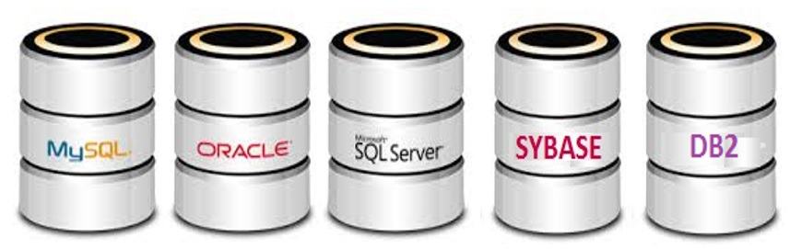
Database – .Net
Example:
We have our application which is Vb.net or C# program that we have written, and it is running on our computer.
Also, we will have a database server which
can be on the same computer that has our Vb.net or C# code, or on a separate computer.
Typically, database resides on a server, which
is a separate entity from a personal computer.
Vb.net, C# program
Database server

Slide 4
Database – .Net
Typical database code will go through the following steps ( in plain English):
Step 1. Select a driver/ provider to talk to the Database.
Vb.net or C# program
Many drivers have been available to us over the
years. For example: Approximately, 25 years ago:
there was a driver called ODBC driver which stand
for Open Database Connectivity. It was originally
developed by Microsoft during the early 1990s.
ODBC driver
Database server
We do not want to change our code if tomorrow
we change from one database to another.
Therefore, the driver will go through and then it
will talk to the database.

Slide 5
Database – .Net
For example, if we are talking to Oracle Database and if we are using ODBC technology, we
can go to the oracle website and download the oracle driver, and then writing our code to
communicate to Oracle via ODBC driver for Oracle.
Vb.net or C# program
ODBC driver
Database server

Slide 6
Database – .Net
Tomorrow, if we switch to from Oracle to MySQL, all what we have to do is change
our driver. Therefore, our code will not change unless we are writing some special
stored procedures where the different databases have their variation of the SQL
language, but for the most part, our code will stay the same.
About 20 years ago, Microsoft try to improve upon ODBC and they give us OLEDB.

Slide 7
Database – .Net
Vb.net or C# program
OLEDB Provider
ODBC driver
Database server

Slide 8
Database – .Net
If you are using Oracle, you will need to download an Oracle OLEDB provider on
your machine . Then , your code will be able to talk to the Database through
OLEDB provider.
Tomorrow, if you have to talk to MySQL , or SQL Server, all what you have to do is
plug in a different OLEDB provider and without changing too much code, you still
will be able to talk to a different database.
These days we deal with huge data and our data size keeps increasing every year. For
example, 20 years ago, million records was considered big data, however, these days
trillion records is considered as big data.

Slide 9
Database – .Net
The objectives from using OLEDB are:
Make the communication faster than ODBC,
make it more flexible.
15 years ago, when .Net come along, they try to improve upon it, which means make it
faster, make it more memory safe. Remember that . Net can not have memory leaks.
However, OLEDB was based on C++ where we can have memory leaks.

Slide 10
Database – .Net
These days you have a choice of three drivers: ODBC, OLEDB, and the latest is managed
provider.
The later it is, the more flexible, the higher speed it is.
The benefits from going through a driver is to make our code independent of the actual
database. Therefore, in our database code, we will identify a driver/ provider.

Slide 11
Database – .Net
Our code
Managed provider
OLEDB Provider
ODBC driver
Database server

Slide 12
Database – .Net
Step 2.a Specify the connection string.
Connection string has three parts:
1. Name of the machine where database server resides.
When you install the database server, you need to give it a name.
2. Authentication information: we need to identify ourselves whenever we need to talk
to the database. e.g. user name, and a password. It is important in order to make the
other side know that the user who is trying to access the database is a valid user.
Authentication information is required regardless of whether database server on the same machine
or on a different machine.
3. Name of database we are trying to communicate with, because one machine can
have multiple databases. e.g. database server may has students database, employees
database, and products database, etc.
Database provides certain rules to interact with it. E.g. it allows the user to read the data, and modify
the data, and so on.

Slide 13
Database – .Net
Connection String
Server name
Authentication information. e.g. Username, and password.
Database name

Slide 14
Database – .Net
Example: A user in a network with a username = ubstudent, and a password = myub, is trying to connect to a database called MyDB which resides on SQL Server. The server name is Alpha, and server IP address is 129.128.0.25. How he can write the connection string?
The parts of the connection string should be separated by a semicolon in our code
CONNSTR= “ Server= 129.128.0.25; uid=ubstudent;pwd=myub;database=MyDB”
It also can be replaced by the name of the Database server:
Server = alpha;
Also, If the DB server on your laptop, this can be replaced by the name of the database server on your laptop
IP = 129.128.0.25
In this scenario, we have 2 databases available on one machine
Database server
Our code
Socket connection
Student DB
MyDB

Slide 15
Database – .Net
For security part of the connection string, if you are using the Authentication approach, windows authentication, which means that you are using the same username and password that you are using to login to your laptop. So the username and password part of the connection string can be replaced with: integrated security = true; as follows:
string CONNSTR = "server= Alpha;integrated security = true;database=MyDB“;
ConnStr As String = "Data Source=.;Initial Catalog=asd2;Integrated Security=True"
server= . , (local) , Computer Name, or IP Address

Slide 16
Database – .Net
Step 2.b Create a connection object, and tied the connection string to it.
Socket connection
Our code
Database
Database may resides on the same computer, or in a different computer. It is basically a different Program.
One of the ways to communicate with another program is through TCP/IP socket.
The first thing we do is, establish a socket connection to a database.
It is like when you call somebody over the phone, once the connection is established, then you can talk.
Similarly, once we establish a connection to the database server, then we can send sql statement, such as, “select * from products”, then the server will reply back with the data, and we can then display the data in our
application.

Slide 17
Database – .Net
Step 2.b Create a connection object, and tied the connection string to it.
Socket connection
Our code
Database
The job of connection object is , to know where to go, and how to access the database.
In the constructor of the connection object, we pass the connection string, and this is how we tied the connection string to the connection object.
There is a class available to us for communicating with SQL Server called SqlConnecton. For this step, the typical code is one line of code: Dim conn As New SqlConnection(CONNSTR) ‘VB
SqlConnection conn = new SqlConnection ( CONNSTR); //C#
The connection object
The connection string
Note: Classes that start with Sql… access data in Sql server via managed provider.
In addition, if you are trying to connect with oracle, the Sql part of SqlConnection will get replaced by Oracle, and it is a class called OracleConnection, and if we are using BD2, the class will be called DB2Connection, and so on.

Slide 18
Database – .Net
Step 3: Open Connection to Database.
To open a connection, we need to write one line of code.
conn.open( );
Step 4: Compose SQL.
If we are selecting a field from the Database, we will use SQL select statement. If we are inserting data into the database, we will use SQL insert statement, and if we are updating the Database, we will use update statement.
e.g. “select * from Products”;

Slide 19
Database – .Net
Step 5: Issue SQL to Database server, and process results.
SQL that we are issuing could be:
Insert statement.
Select statement.
Update statement.
Call for a stored procedure.
Step 6: Close the connection to the Database server.
To close a connection, we also need to write one line of code.
conn.close( );

Slide 20

Database – .Net
Among all these steps, the changing in our code will be in Composing SQL step , and issuing SQL and Processing results step. The change depending upon what we are trying to do to our Database. Therefore, the code for these two steps will be different for different types of need.

Slide 21
Database – .Net
As seen below, compose SQL and issue SQL and process results can be divided into four
categories:
Issue SQL and process results in .Net
Get a single answer from a database
Obtain many rows or many columns from a database
Insert, update, or delete data to a database
Call a stored procedure in a database

Slide 22
Database – .Net
Suppose we have our Database server, and our code.
Socket connection
Our code
DB server
At some point of time, our code will make a socket connection to the DB server, and this connection object identifies which machine (server) we want , how to identify ourselves to the Database, and what database we are interested in.
Once we create the connection object and pass the connection string, and then call
conn.open( ), essentially what that does is :
It opens a socket connection to the database server, and once the socket connection is
established,
Then, we will compose the SQL and issue the SQL and process results.

Slide 23
First Category: Single answer from the Database
Example 1 , if you try to login, and you want to check if the username and password exist in
the database.
Example 2 , if we want to retrieve the price of a product from product table in our Database,
the SQL statement will be :
string sql = “Select price from Products where productid = 123456”; C#
Dim sql As String = "select * from student“ VB
In both examples, we only need one thing from our Database.

Slide 24
First Category: Single answer from the Database
Regardless how complicated the SQL is, whether we are joining 10 tables or 20 tables.
SQL is just a string.
String is very easy to send, string does not require too much memory. Therefore, it is very
easy to send over a socket.
However, depending on what kind of data we need to return back, the data can be small,
such as, in last example where we need to return the value of the price (30.7).

Slide 25
First Category: Single answer from the Database
.Net give us an object which capable of carrying one piece of information on the way back from the Database to our code, and this object called Command object.
Think of a Command object like light weight method, but very quick, and it can carry back
one piece of information.
We can think of a command object like a motorcycle. So we will create a motorcycle in our
code, and we will tell the motorcycle whatever the connection string is. Think of the
connection string like the address, so the motorcycle will know what machine he needs to go,
and what username and password to deliver the data to, and what database to talk to as we
may have many databases on the server. Through the motorcycle, we will also send the SQL
to the database server, and it will bring back one piece of information.
Both Sql and Connection object are giving a complete information to access the database.

Slide 26


First Category: Single answer from the Database
What sql we want to carry to the DB
The connection object which has connection string information:
Server name, username and password, and database name
^{sql and conn}
Command object
cmd will establish the socket connection to the database
Our code
Socket connection
DB server
(30.7)
Will bring the value of the price

Slide 27
First Category: Single answer from the Database
Our typical code if we want a single answer from the Database:
conn.open( ); // Open the connection to the Database
// we identify what SQL statement
string sql = “ select price from Products where productid =123456”;
Dim sql As string = "select price from Products where productid =123456"
// Create the command object and give it a name: cmd.
// If we are communicating with SQLServer, the class name will be SqlCommand.
// We need to give two pieces of information to the command object: sql, and Connection object (Conn) which
tied to the connection string which carry the information that cmd needs to access SQL Server
SqlCommand cmd= new Sqlcommand(sql,conn); C#
Dim cmd As SqlCommand = New SqlCommand(Sql, conn) VB
This part can be replaced with Oracle, and the class will be OracleCommand if we want to connect with oracle database. Similarly, it can be replaced with DB2, and the class will be DB2Command if we want to connect with DB2 database.

Slide 28
First Category: Single answer from the Database
Our typical code if we want a single answer from the Database:
// Issue the call, the command object will submit our request to the SQLServer.
// The command object will pick one thing and bring it to us and store it in an object.
// we need to invoke ExecuteScaler() method. It is a simple method where Scaler means one.
object obj = cmd. Executescalar( );
// We process the result.
// We read the price, and convert it to a double
// if the productid (123456) does not exist, it will give us null.
// So, before we process the result, we should check that obj is not equal to null, So we do not blindly try to // //convert it to String (obj.ToString()); because it will generate a run time error.
If (obj != null)
Double price = double.parse(obj.Tostring()); // or
Double price = (double) obj;
// once we done we close the connection.
conn.close( );

Slide 29
First Category: Single answer from the Database
Note: it is important when we deal with databases to keep the connection for short period of time, because you are not the only user connecting to the database server. Often, in case of a web application or a desktop application, we may be running multiple copies of the database, for different people on your organization, if many clients are using it, the performance will go down, and it may ends up that database runs out of connections.

Slide 30
First Category: Single answer from the Database
If the product table will have a lot of rows and columns. what will happen if our sql in the same code was :
string sql = “select * from products where productid = 123456”;
Will the code throw an error?

Slide 31
First Category: Single answer from the Database
The answer is: No. it will not throw an error. Database has multiple rows and multiple columns. However, the command object will pick the first row and the first column and bring it back to us, and ignore the rest.
Command object
^{sql and conn}
Our code
DB server
- - - -
- - - -
- - - - -
e.g (30.7)

Slide 32
First Category: Single answer from the Database
If each product in the product table in the database has 10 columns, it supposed to give us
10 pieces of information, but when we invoke ExecuteScaler() method, the way
ExecuteScaler() designed is only to give us the first one, regardless of if the server is
giving us 10 pieces of information.
So in this case, we will get the value of the first raw and the first column whatever it
happened to be. If it a price, we will get the price value (30.7), and
If the first raw and first column happened to be a productid, we will get the value of the
productid (123456).

Slide 33
Second category: select many rows /columns from a database
What if we want to bring more than one row and column from the database? Will the
motorcycle be able to carry all the large amount of data?
The answer is No, because Command object has been designed in a way it can only store
one piece of information. Therefore, we need a flexible data structure so that we can
retrieve many rows and many columns.
Instead of creating a command object, we will have to create another object called
DataAdapter object.
Think of DataAdapter like a truck which can bring a lot of heavy load.
DataAdapter will bring back form the Database server all rows and columns that we
asked for.

Slide 34

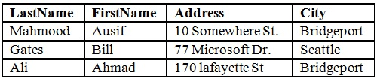

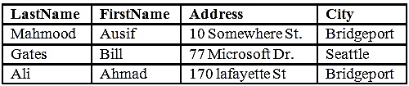
Second category: select many rows /columns from a database
DataAdapter
^{C}
^{sql and conn}
Our code
DB server

Slide 35
Second category: select many rows /columns from a database
In case we need to retrieve many rows and columns, our typical code will look like:
conn.open( ); // open a connection to the Database.
// Create sql
String sql= “ select * from products” ;
// Create a DataAdapter object
// If we are working with SQLServer, the DataAdapter called SqlDataAdapter,
// We still need to send two pieces of information: sql, and Connection object (Conn)
// We should specify what sql to carry to the server, and Conn to tell the DataAdapter object where to go.
SqlDataAdapter da = new SqlDataAdapter(sql,conn);
Dim da As SqlDataAdapter = New SqlDataAdapter(Sql, conn)
Note: If we are working with Oracle server, the DataAdapter will be called OracleDataAdapter, and so on, and the code will be as follws:
OracleDataAdapter da = new OracleDataAdapter(sql,Conn);

Slide 36
Second category: select many rows /columns from a database
In .Net there is a pre-built class called DataTable which is very flexible and can store many rows and many columns. It dynamically expands and shrinks.
// First we create a blank DataTable in our code. We will have dt.
DataTable dt= new DataTable ( ); C#
Dim dt As New DataTable ‘VB
// DataAdapter has the method Fill(). As soon as we execute the following statement,
// technically at this point of time, the truck/dataAdapter will go to the database server, deliver the sql, and
// bring back all the rows and all the columns in our machine memory. Essentially, da.Fill(dt) will
transfer all the data and dump it into our DataTable.
da.Fill(dt);
// As soon as we have all rows and all columns in dt, we can close the connection.
conn.close ( );
// In our code, we can loop through all rows and columns and get the data.

Slide 37
Second category: select many rows /columns from a database
DataAdapter
Our code
DB server

Slide 38



Command object vs DataAdapter
.Net give us an option of two kinds of objects for the amount of data in the way back. One
which can carry one piece of information back from the Database to our code, and this object
called Command object. The second which can carry multiple rows and columns, and this
object called DataAdapter object.
Motorcycle (it only can bring and store one box)
Truck (it can bring many boxes)
Command object
DataAdapter

Slide 39
Third Category: Insert, update, or delete to the Database
Question : in case of insert, update, or delete from the database, should we send a lightweight
object to the Database server (Command object), or should we send a heavy duty truck to the
database server (DataAdapter)?
In order to answer this question, we should know what kind of reply does the database server
will give us, if we issue an insert statement, update statement, or delete statement.
For example, if you issue a delete statement to delete 20 rows. The reply will be 20 rows
were modified, and this let us know that 20 rows got affected. For example:
string sql = “ Delete from Products where ProductId= 12346”;
The reply is a simple number, meaning we need to get one piece of information. Therefore,
return type of the answer is int.
Based on that, the answer is: motorcycle will work, and we should use a Command object.
If we modify 1000 records on the Database. Even though the modification on the database
server is huge, the reply will always be a number, e.g, 1000 got modified.

Slide 40
Third Category: Insert, update, or delete to the Database
Also, if we issue an update statement to the database, it does reply the number of records
that were affected. So the reply is a number. For example:
string sql = " Update Products set Price =" + newPrice + " where PID=" + pid;
The SQL is case-insensitive
We will create a command object and the constructor will give it the sql, and the
connection object (Conn).
Remember, previously we did call the executeScalar which will bring one item. Now in this
category we will invoke a method called ExecuteNonQuery( ) to distinguish between the first
category and this category. Therefore, through the command object we say:
int rows = cmd.ExecuteNonQuery( ) ;
Note: Does not matter whether it is a delete statement, or update statement, or insert statement. This statement tells us how many rows were affected by insert statement, update statement, or delete statement.

Slide 41
Third Category: Insert, update, or delete to the Database
In Third approach, The typical code will be as follows:
// initialize the value of rows to 0.
// create a connection object, and ties the connection string to it.
int rows = 0;
SqlConnection conn = new SqlConnection(CONNSTR);
// open the connection
conn.Open();
// issue sql
string sql = " Update Products set Price = 50.000 where PID= 123456”;
// create a Command object
// send two pieces of information: sql, and Connection object (conn)
// call ExecuteNonQuery() method which will return how many rows were modified by update statement.
SqlCommand cmd = new SqlCommand(sql, conn);
rows = cmd.ExecuteNonQuery();
// Close the connection
conn.Close();

Slide 42
Fourth Category: Call a stored procedure in the Database
Call a stored procedure is not really a separate technique, because
Stored procedure could be simply giving us one answer.
Stored procedure could bringing back many rows and many
columns.
Stored procedure could be doing an insert, update, or delete.
So depending upon what the stored procedure is doing, we will pick one of the three
techniques. Further, you will either create a command object, or create a dataAdapter.

Slide 43
Fourth Category: Call a stored procedure in the Database
For example: suppose the stored procedure is simply giving us one answer back. We should use a Command object.
Once we create a command object, we give it two things
sql : what sql statement the Command object should carry
to the Database server.
Connection string: to tell the Command object where to go.
Then we will write :
Object obj = cmd.ExecuteScaler();
In the case of stored procedure, what is the sql ?
The answer is : sql will be the name of stored procedure in the database.

Slide 44
Fourth Category: Call a stored procedure in the Database
Suppose the stored procedure was doing insert, update, or delete.
string sql = “ name of SP”; SP is the stored procedure.
SqlCommand cmd = new SqlCommand (sql, conn);
Sql is the name of the stored procedure.
Object obj = cmd.ExecuteNonQuery();

Slide 45
Fourth Category: Call a stored procedure in the Database
If the stored procedure is returning many rows and many columns. So instead of creating a Command object, we will create a DataAdapter.
Stored procedure are like functions. Functions have parameters.
How do we pass the parameters?
Simply, name is not enough, we have to pass the parameters. So, for passing
parameters, we have a SqlPrameter class.
Example, Suppose we are writing a delete to a stored procedure. If it is a delete for a product, and the parameter was called pid.
SqlPrammeters p1= new SqlPrammeters(“@pid”,sqlDbType.Int);
P1.value = 123456;
The IntelliSense will tell us that we have to identify what is the data type of this parameter. In this case, pid is of type integer.

Slide 46
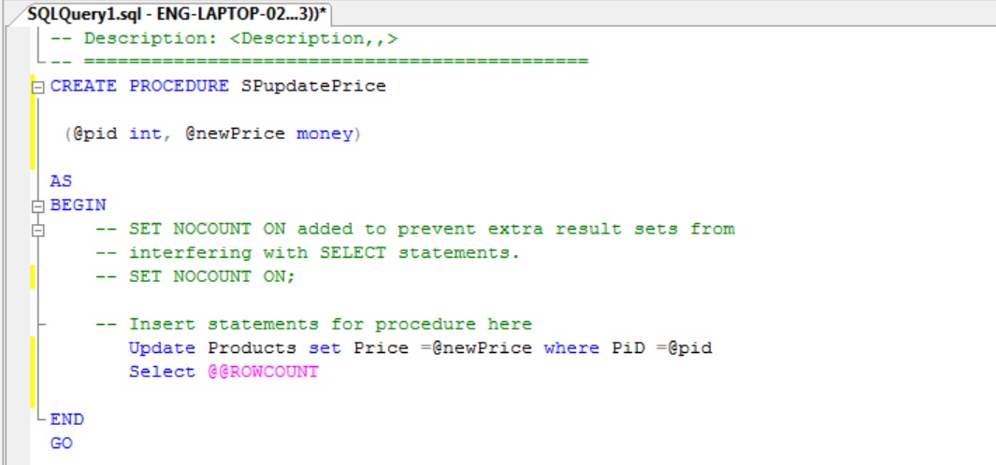
Fourth Category: Call a stored procedure in the Database
Assume that we already have the following stored procedure written in our database to update
a price of a product in Products table:
The convention in sql is, the variable name is declared using @ sign and the name of the variable, and it is followed by the type of the variable.
The function @@ROWCOUNT will return how many rows were modified.

Slide 47
Fourth Category: Call a stored procedure in the Database
If we want to write C# code to trigger that stored procedure, the typical code will be as follows:
// the stored procedure in this case will bring back how many rows were affected.
// We initialize the value of rows to 0.
// We create a connection object, and ties the connection string to it.
int rows = 0;
SqlConnection conn = new SqlConnection(CONNSTR);
// open a connection to the Database.
conn.open( );
// Issue the sql
string sql = "SPUpdatePrice";
// Create a Command object
// We still need to send two pieces of information: sql, and Connection object (conn)
SqlCommand cmd = new SqlCommand(sql, conn);
//Set the command type
cmd.CommandType = CommandType.StoredProcedure;

Slide 48
Fourth Category: Call a stored procedure in the Database
// Create new parameters which are inputs to the stored Procedure
// Create the first parameter which is the product id: @pid
// SqlDbType is a numeration
// then specify the value of the parameter
// Add the parameter to the command object
SqlParameter P1 = new SqlParameter("@pid", SqlDbType.Int);
P1.Value = pid;
cmd.Parameters.Add(P1);
// Add the second parameter which is the new price: @newPrice
// newPrice is money in SQLServer and it corresponds to decimal in C#
// Add the parameter to the command object
SqlParameter P2 = new SqlParameter("@newPrice", SqlDbType.Money);
P2.Value = newPrice;
cmd.Parameters.Add(P2);

Slide 49
Fourth Category: Call a stored procedure in the Database
// ExecuteNonQuery() will tell us how many rows were modified in the stored procedure
rows = cmd.ExecuteNonQuery();
// Close the connection
conn.close ( );

Slide 50
Summary
In order to write a database code under .Net, we break it into four categories:
Issue SQL and process results
Get a single answer from a database
Obtain many rows or many columns from a database
Insert, update, or delete data
Call a stored procedure in a database
The main thing to remember is, we have two main objects to take sql to the Database. One is the Command object. Second is the DataAdapter.

Slide 51
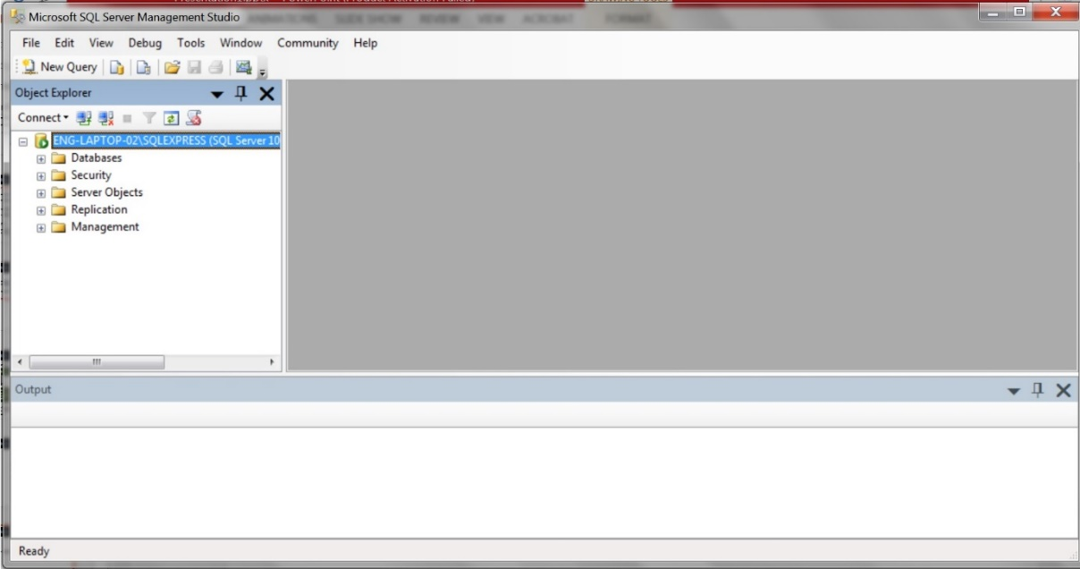
Requirement
Install Microsoft SQL Server Management Studio Software
Go to dreamspark website: www.dreamspark.com , and you can install one of the following:
Microsoft SQL Server 2014 Express Edition – the latest,
Microsoft SQL Server 2012 Express Edition, or
Microsoft SQL Server Express Edition 2008 R2
You also can download it from the internet, it is free.
Next lecture we will see the real code for implementing four categories.

