Slide 1
Application Layer Functionality and Protocols Abdul Hadi Alaidi
http://alaidi.net/

Slide 2
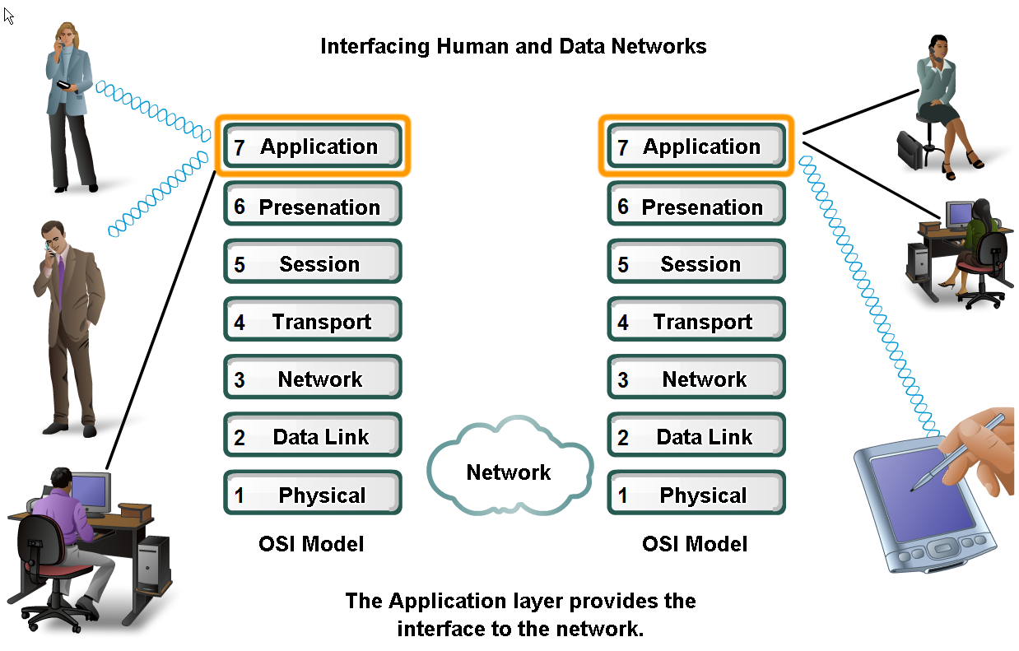
Applications – The Interface Between Human and Data Networks
Applications provide the means for generating and receiving data that can be transported on the network

Slide 3
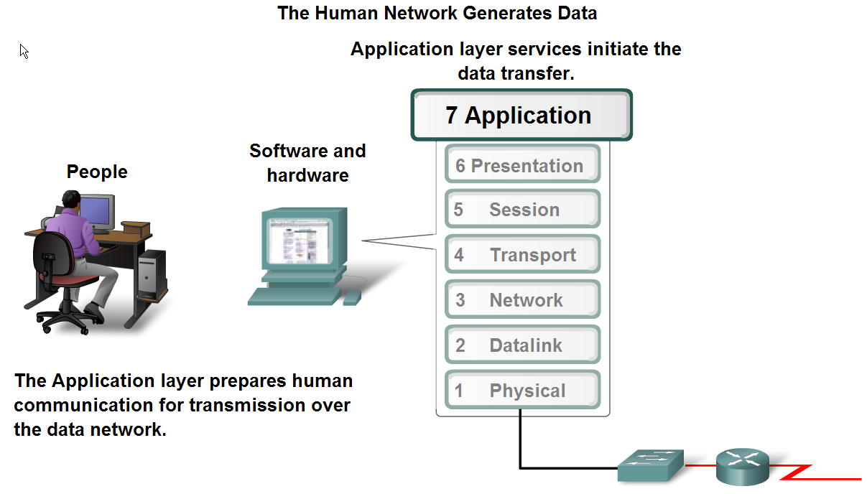
Applications – The Interface Between Human and Data Networks
Application Layer prepares data for transmission over the network.

Slide 4
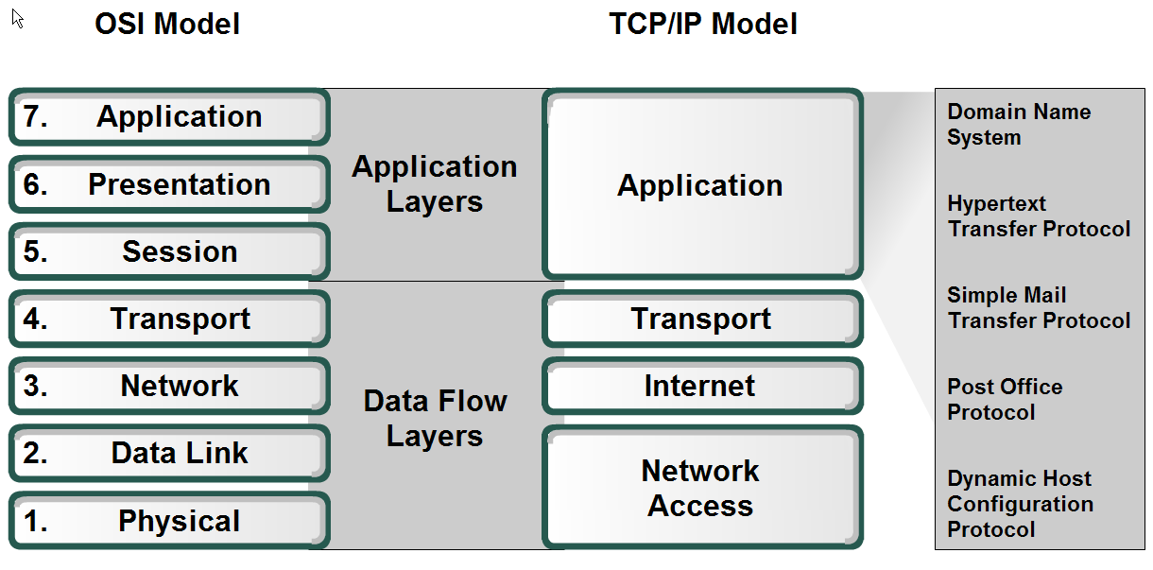
Applications – The Interface Between Human and Data Networks
Application Layer in OSI & TCP/IP Models
Services in Application Layer

Slide 5
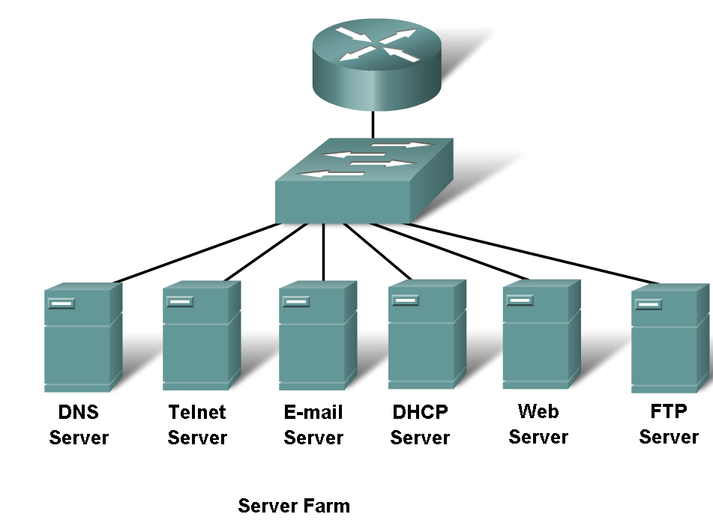
Applications – The Interface Between Human and Data Networks
Different Services (Protocols) in application layer

Slide 6
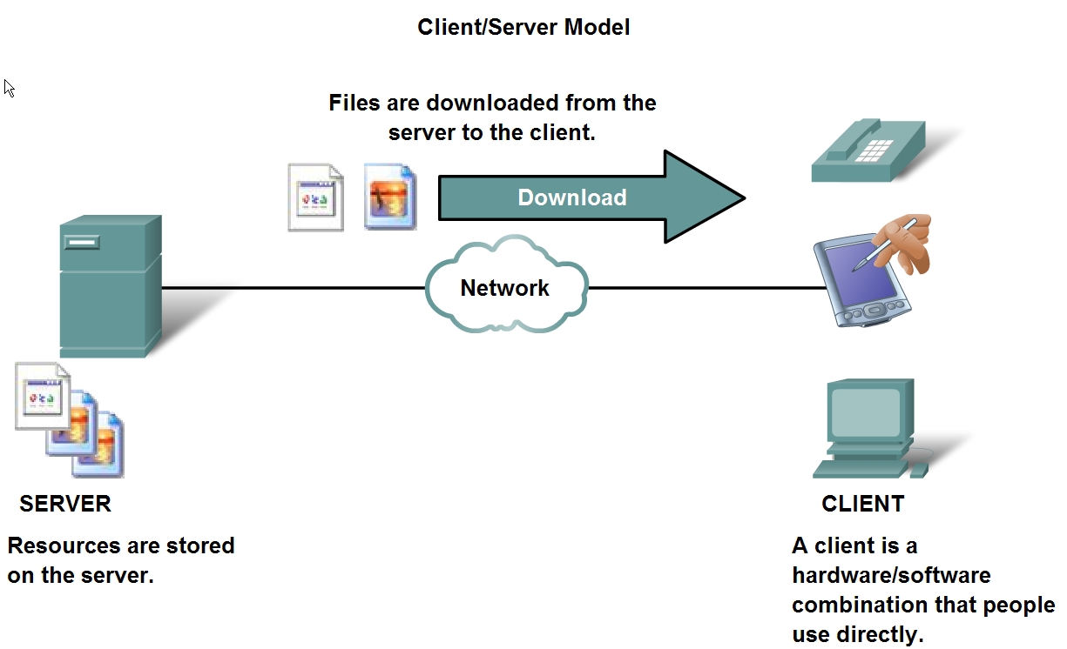
The Role of Protocols in Supporting Communication
May be required authentication

Slide 7
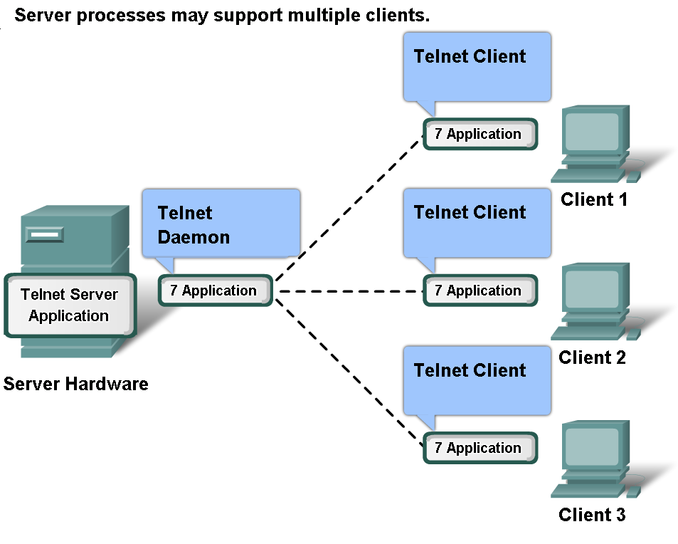
The Role of Protocols in Supporting Communication
Server processes may support multiple clients

Slide 8
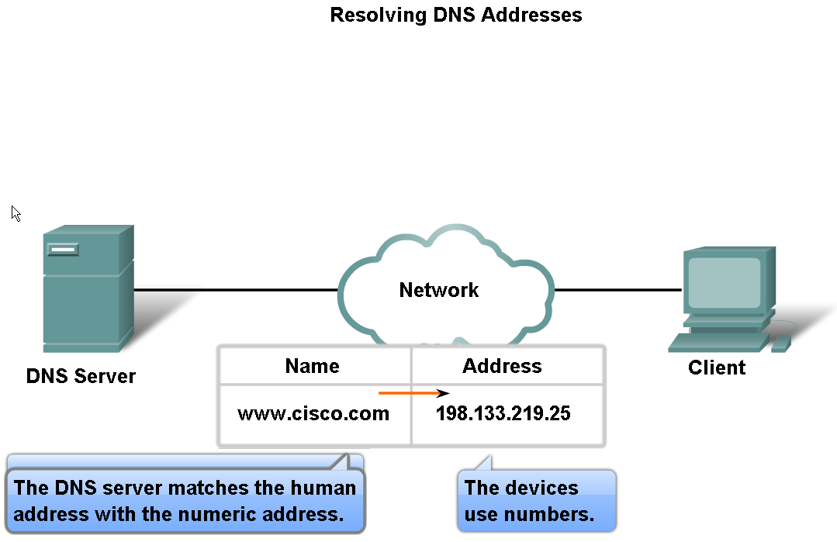
Features, Operation, and Use of TCP/IP Application Layer Services
DNS converts (translates) host name (URL) to IP address

Slide 9
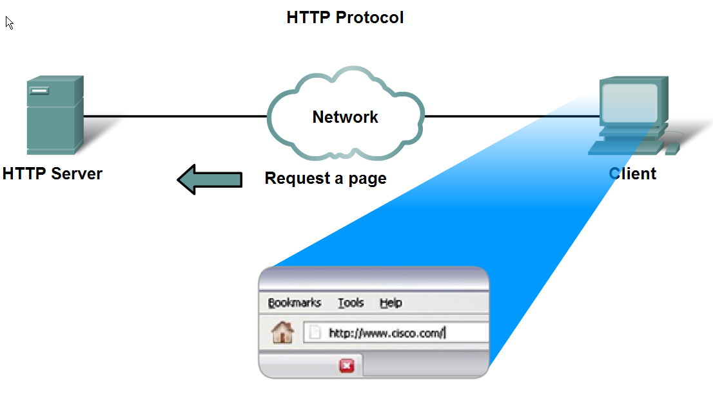
Features, Operation, and Use of TCP/IP Application Layer Services
HTTP protocol supports the delivery of web pages to the client

Slide 10
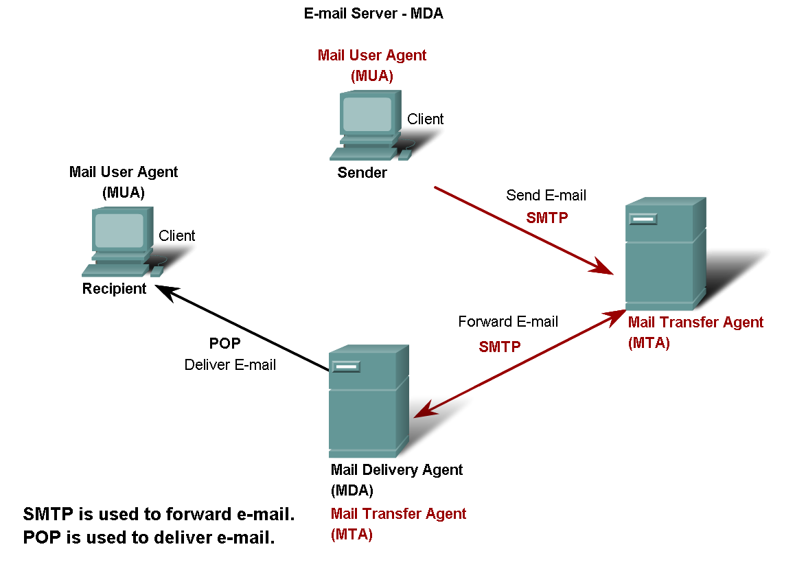
Features, Operation, and Use of TCP/IP Application Layer Services
POP and SMTP protocols support e-mail services
MUA
SMTP
MTA
SMTP
MTA
MDA
POP
MUA
Q: When can server be MTA & MDA at the same time?
A: In Receiving Mail Server

Slide 11
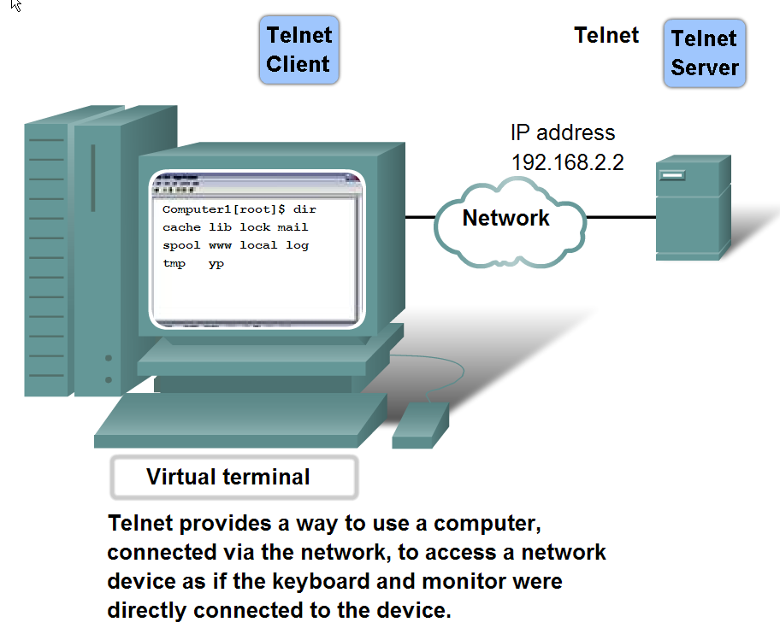
Features, Operation, and Use of TCP/IP Application Layer Services
Telnet protocol (Remote Control)

Slide 12
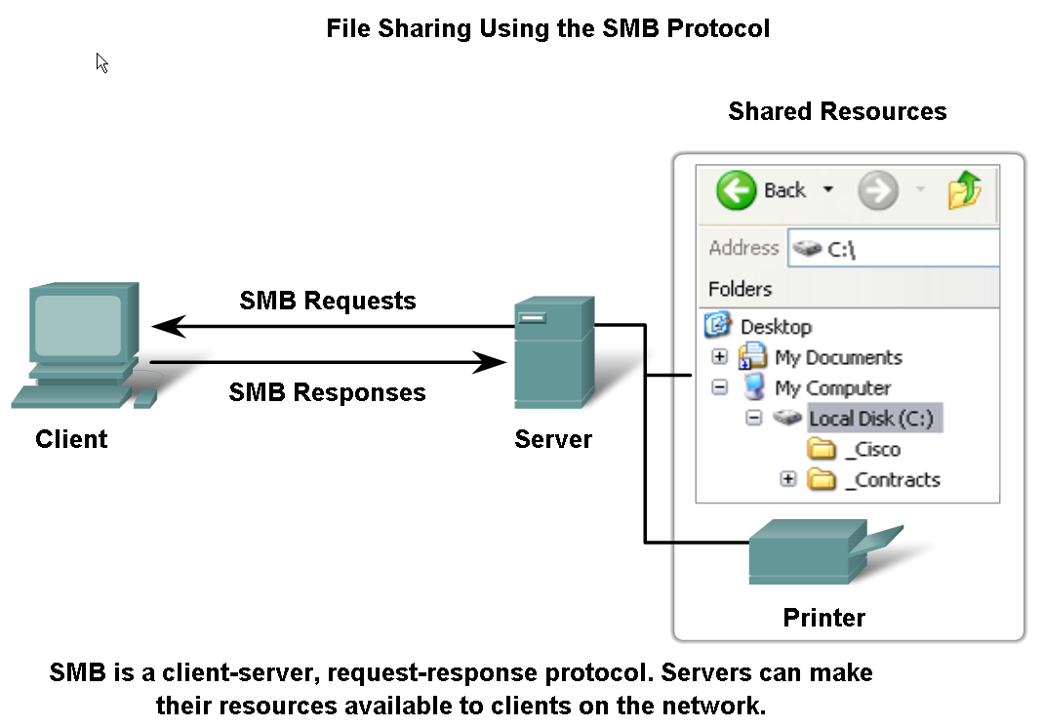
Features, Operation, and Use of TCP/IP Application Layer Services
SMB (Server Message Block) protocol supports file sharing in Microsoft-based networks

Slide 13
Classification of Application Layer Protocols
Protocols | TCP | UDP | Function
FTP (20/21) | √ |  | Transfer data between client & Server
Telnet (23) | √ |  | Remote Control
HTTP (80) | √ |  | Transfer of web pages
HTTPS (443) | √ |  | Secure Transfer of web pages
SMTP (25) | √ |  | Transfer E-Mail to Server
POP (110) | √ |  | Receive E-Mail from Server
TFTP (69) |  | √ | Transfer data without check delivery
DHCP (67/68) |  | √ | Automatic assigning of IP to PCs
SMB |  | √ | File sharing in MS operating systems
DNS (53) |  | √ | Translating hostname to IP address
TCP (connection) & UDP (connectionless) are protocols of Transport Layer

Slide 14
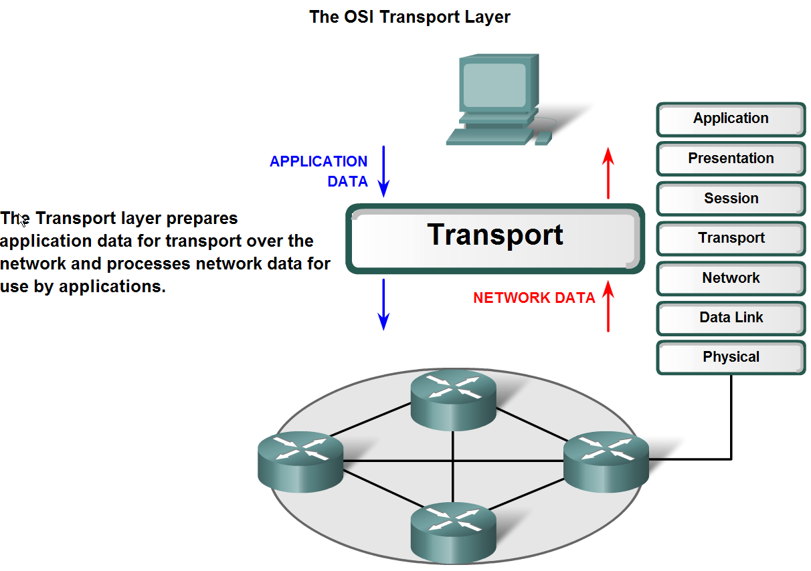
Transport Layer Role and Services
The purpose of the Transport layer

Slide 15
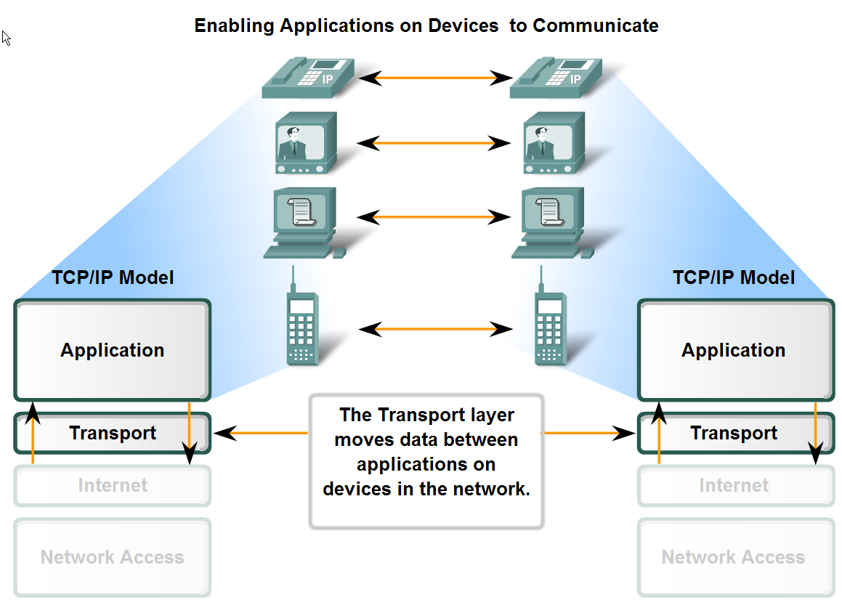
Transport Layer Role and Services
Major functions of the transport layer and the role it plays in data networks

Slide 16
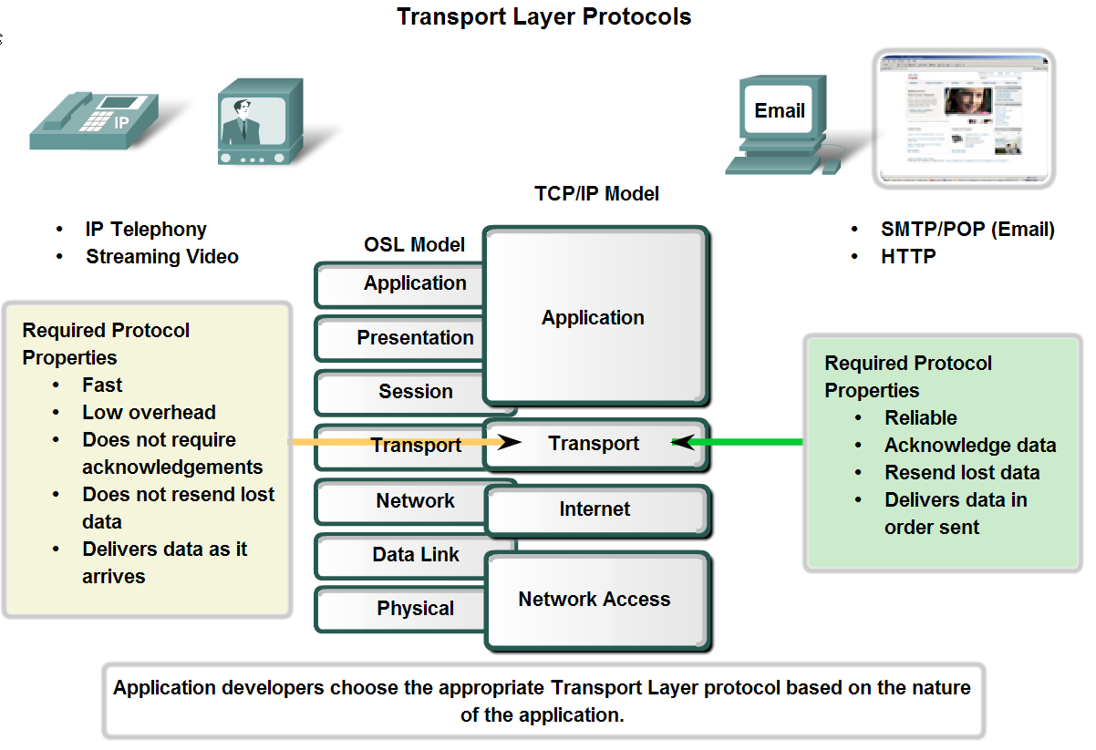
Transport Layer Role and Services
Supporting Reliable Communication
UDP
TCP

Slide 17
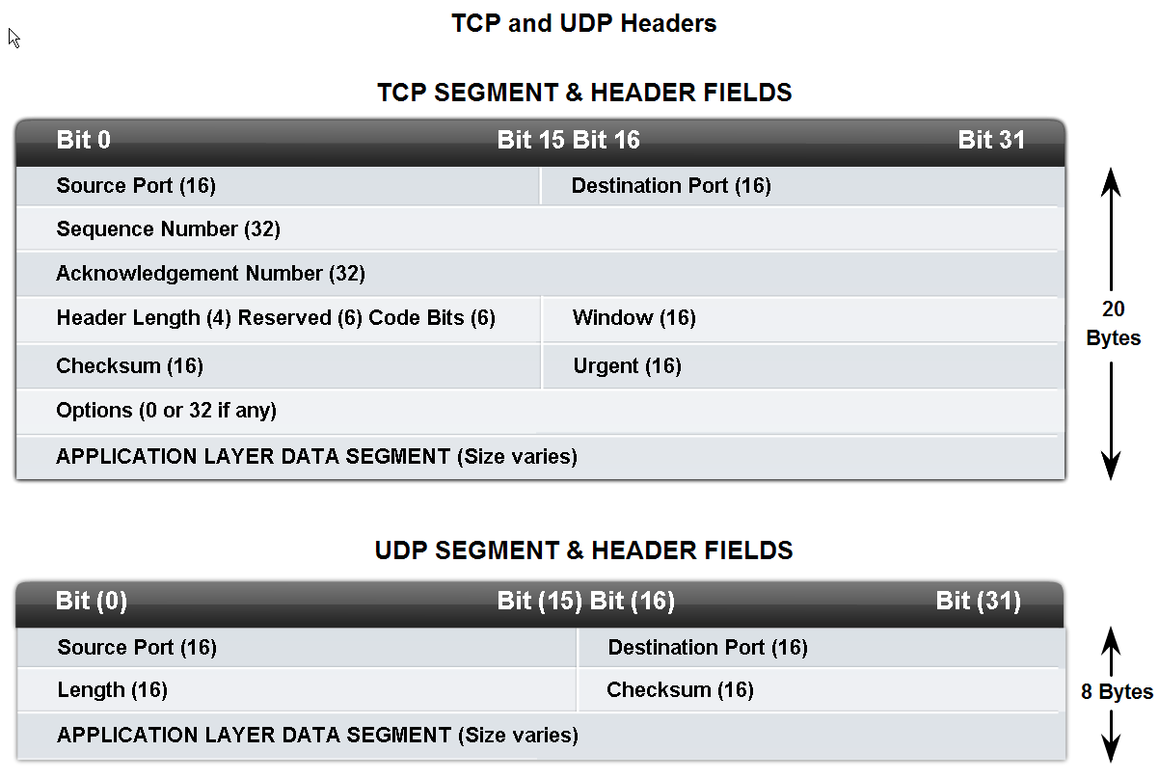
Transport Layer Role and Services
Identify the characteristics of the UDP (User Datagram Protocol) and TCP (Transmission Control protocol)

Slide 18
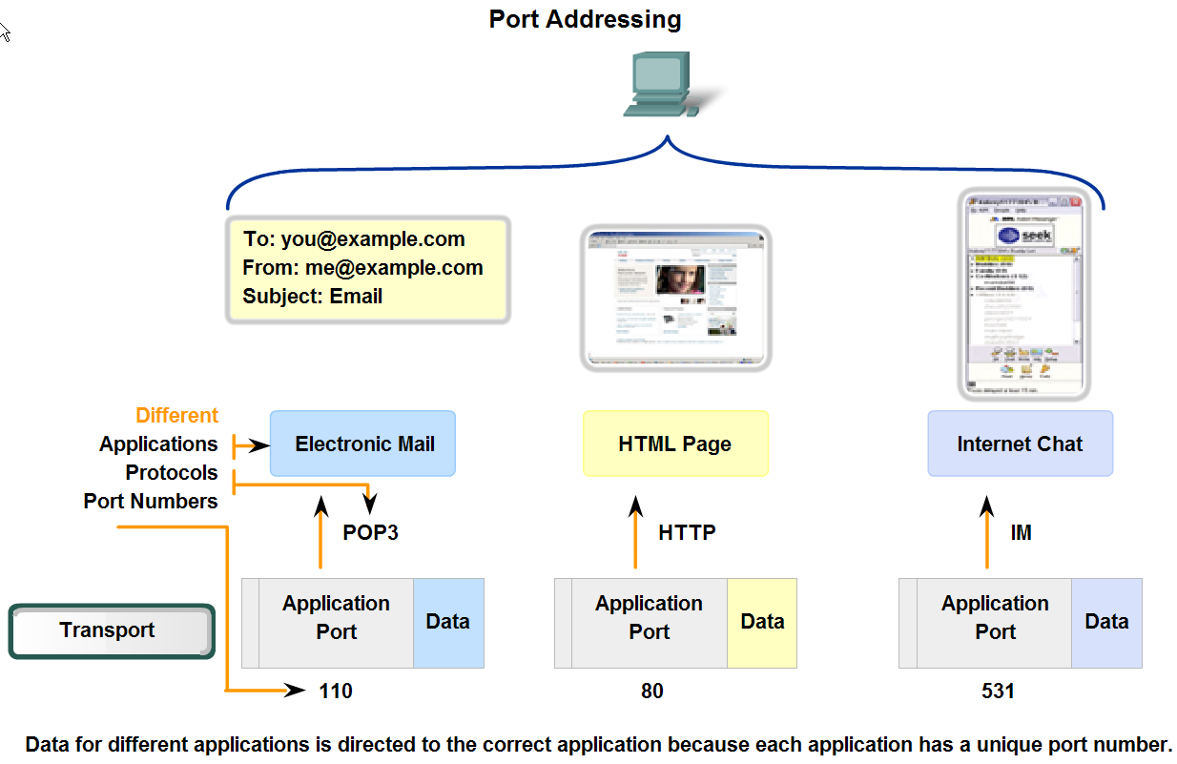
Transport Layer Role and Services
Identify how a port number is represented and describe the role port numbers play in the TCP and UDP protocols.
Identified communicated applications
Identified conversation between hosts
both TCP & UDP use source & destination port numbers

Slide 19
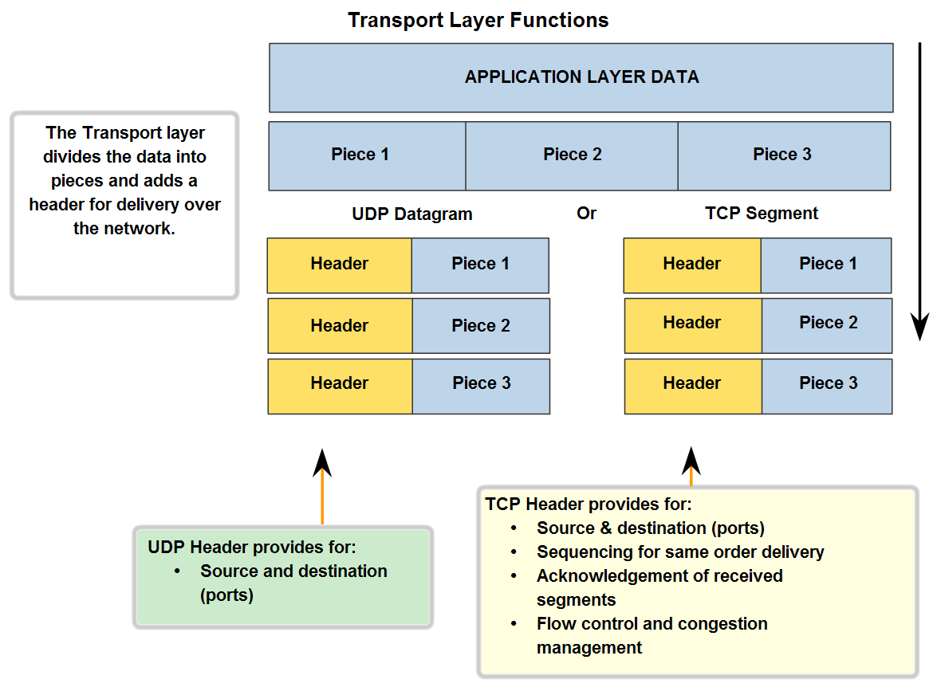
Transport Layer Role and Services
The role of segments in the transport layer and the two principle ways segments can be marked for reassembly.

Slide 20
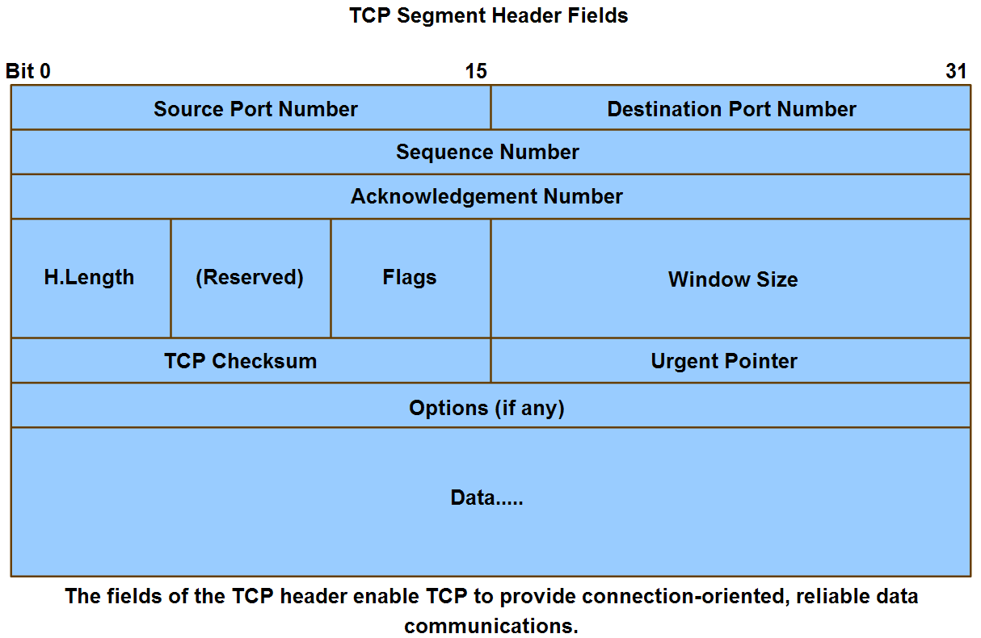
Application and Operation of TCP Mechanisms
Trace the steps that show how the TCP reliability mechanism works as part of a session

Slide 21
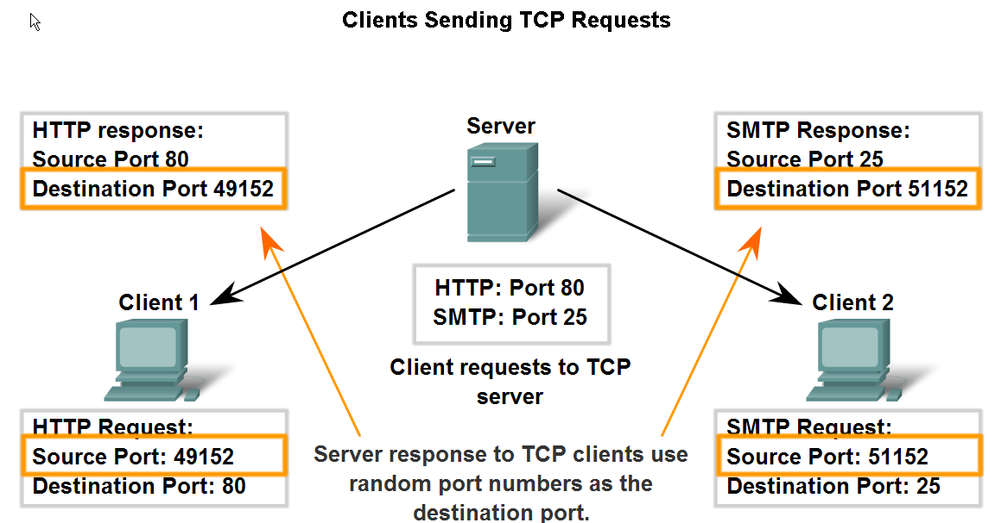
Application and Operation of TCP Mechanisms
The role of port numbers in establishing TCP sessions and directing segments to server process

Slide 22
Q : Which port describes service in client, source or destination?
Well Known ports numbers are 0-1023 (reserved for services).
Registered Ports are 1024 – 49151.
Dynamic Ports are 49152 – 65535.
Source port number > 1023, in client (requester)
Remember services & their port numbers

Slide 23
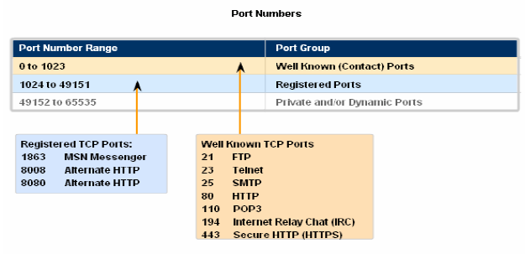

Slide 24
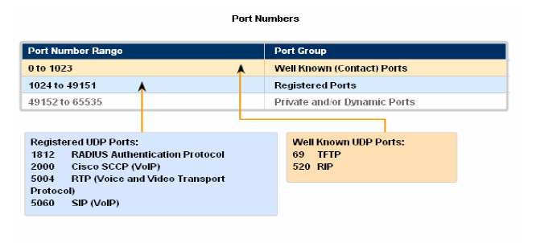

Slide 25
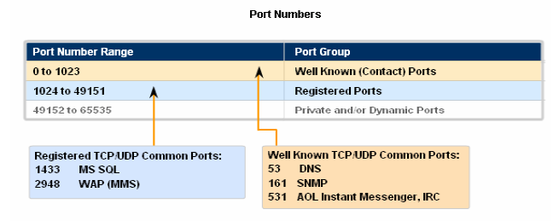

Slide 26
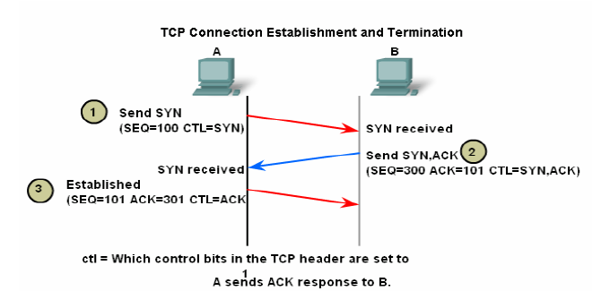
Three Ways Handshake

Slide 27
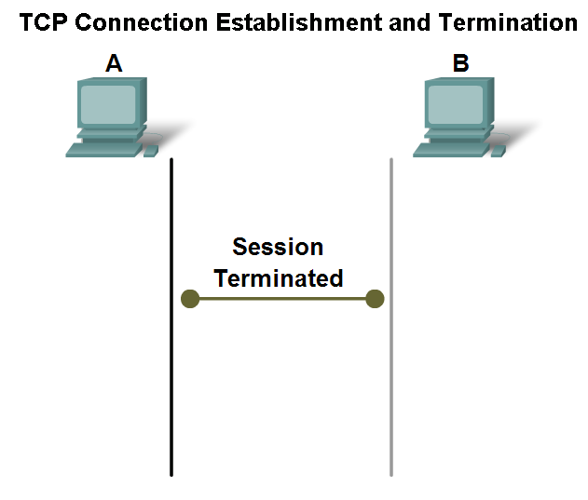
Application and Operation of TCP Mechanisms
Trace the steps in the handshake in the termination of TCP sessions

Slide 28
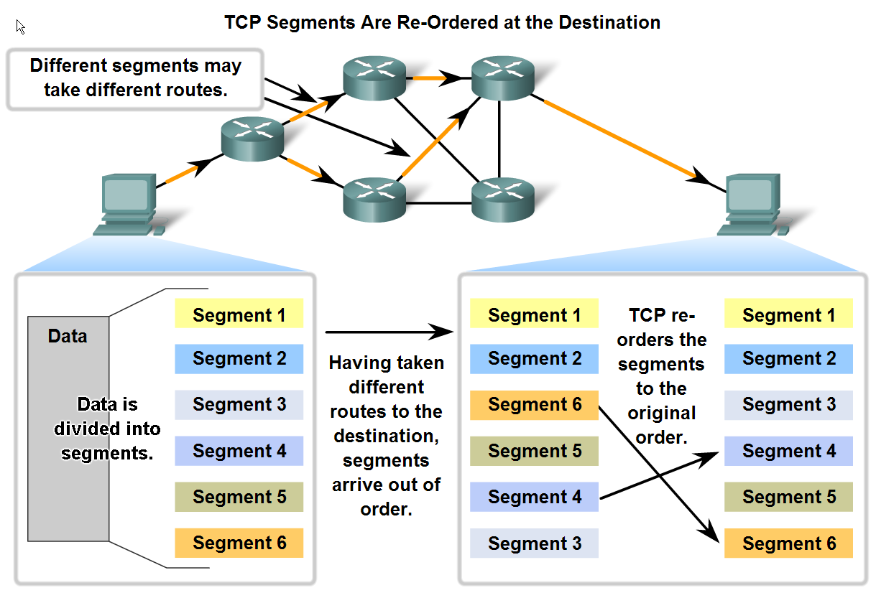
Managing TCP Sessions
Describe how TCP sequence numbers are used to reconstruct the data stream with segments placed in the correct order

Slide 29
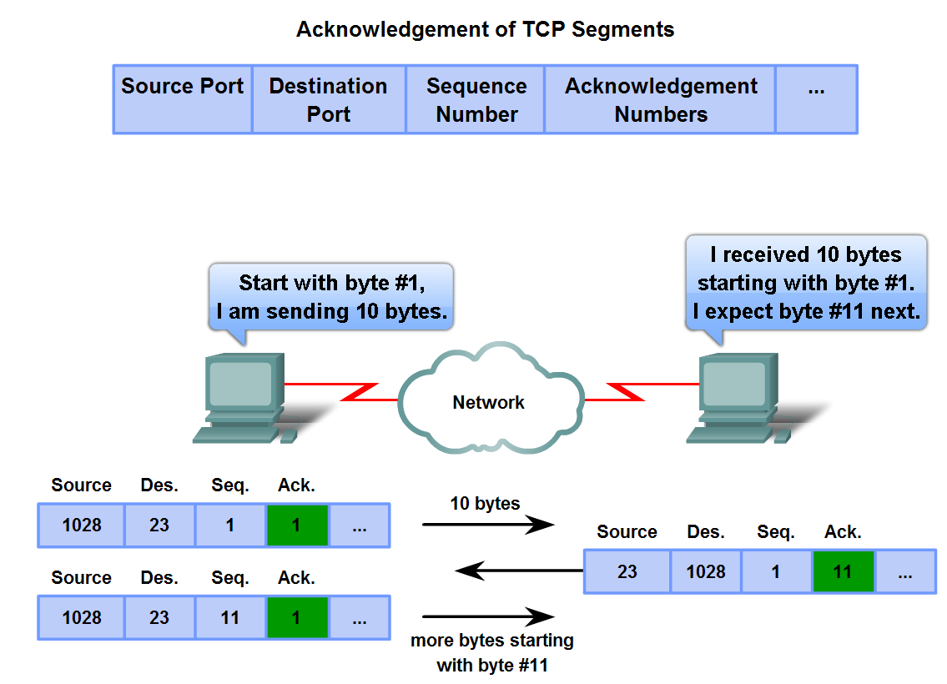
Managing TCP Sessions
Trace the steps used by the TCP protocol in which sequence numbers and acknowledgement numbers are used to manage exchanges in a conversation
Socket No. : IP Add with Port No.
200.5.5.5 : 80

Slide 30
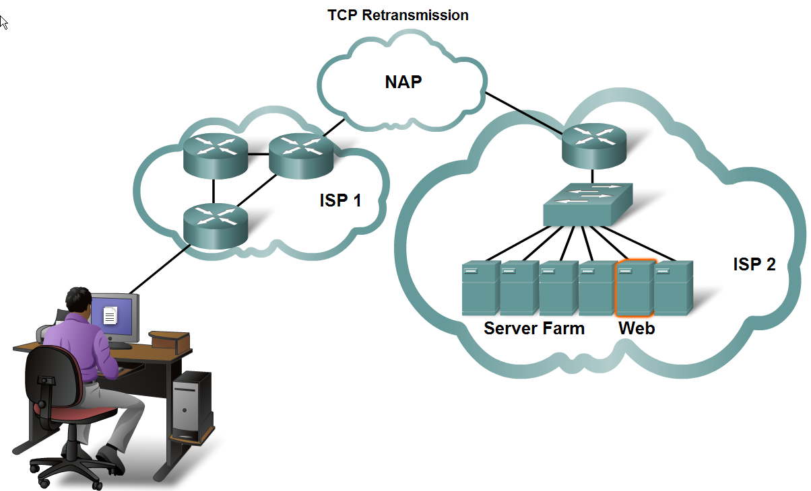
Managing TCP Sessions
Describe the retransmission. remedy for lost data employed by TCP

Slide 31
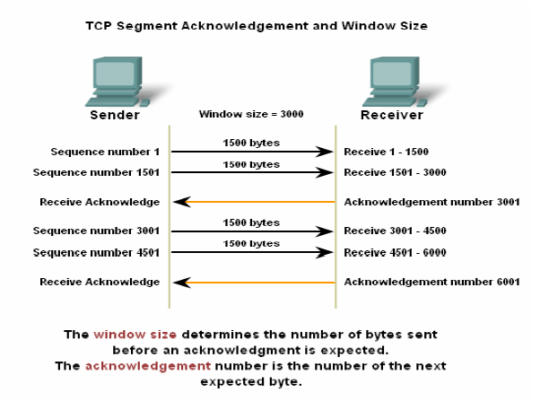

Slide 32
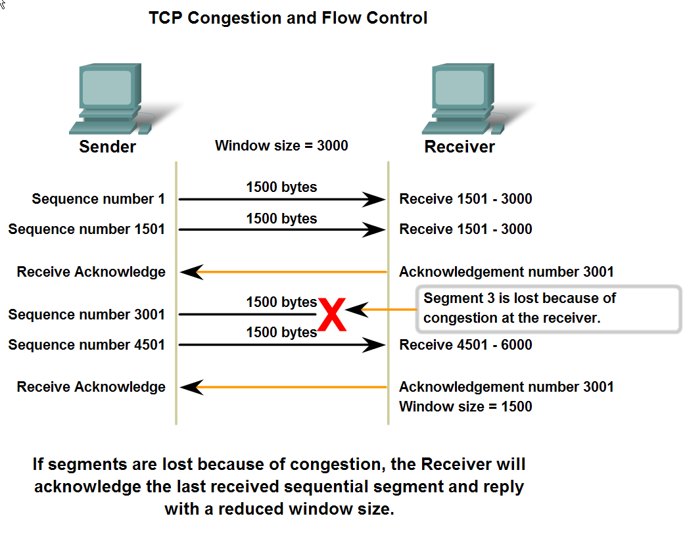
Managing TCP Sessions
The relationship between window size, data loss and congestion during a session (when receiver is overloaded)

Slide 33
Managing TCP Sessions
When source of data (server) reaches time out, it will resend the data that needs to be acknowledged.
Connection Services use TCP
Connectionless Services use UDP

Slide 34
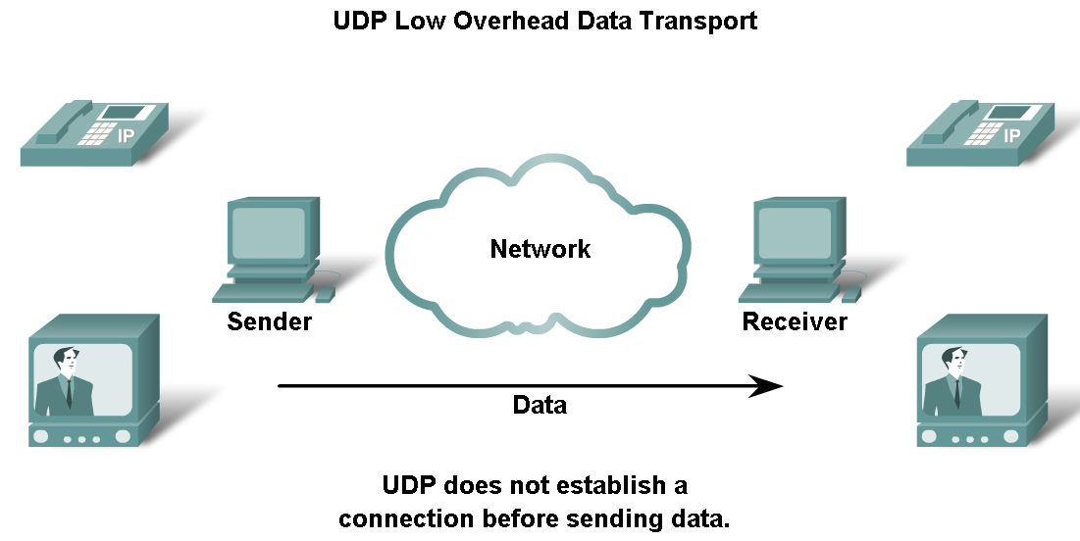
UDP Protocol
Describe the characteristics of the UDP protocol and the types of communication for which it is best suited
Faster

Slide 35
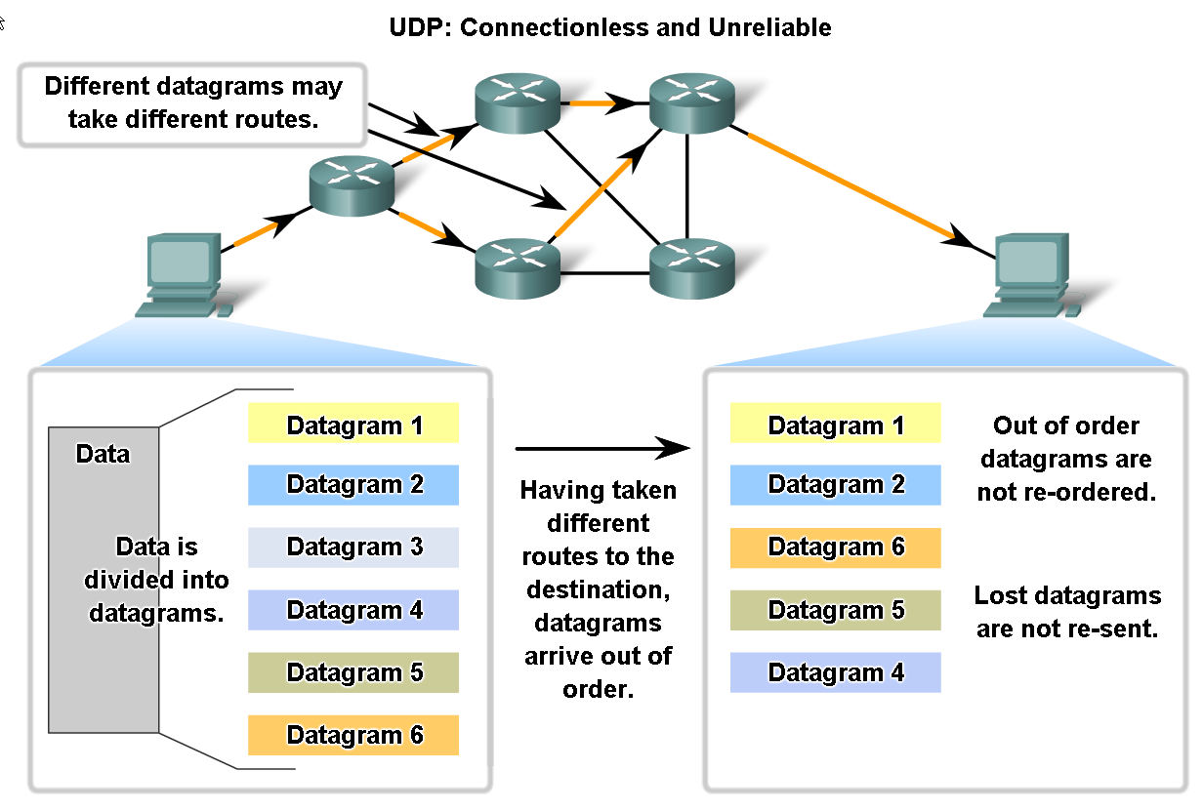
UDP Protocol
Describe in detail the process specified by the UDP protocol to reassemble PDUs at the destination device

Slide 36
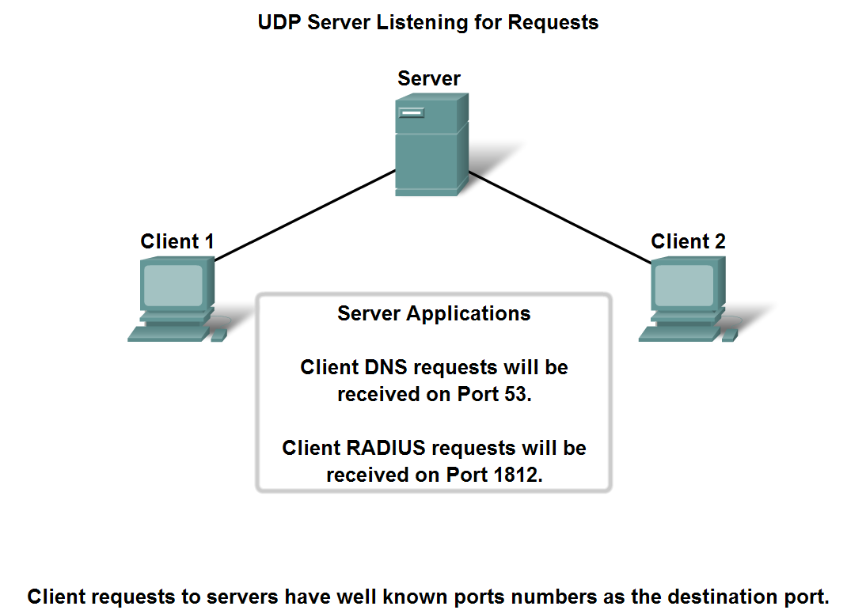
UDP Protocol
Describe how servers use port numbers to identify a specified application layer process and direct segments to the proper service or application

Slide 37
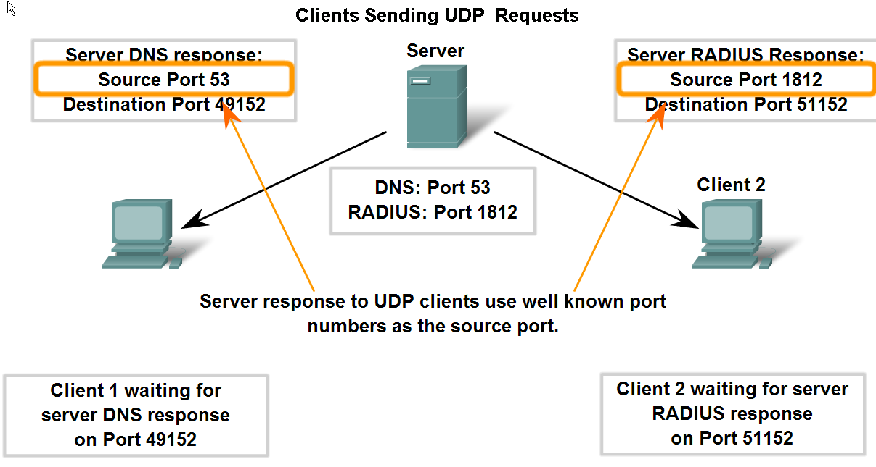
UDP Protocol
Trace the steps as the UDP protocol and port numbers are utilized in client-server communication.

Slide 38
Although the total amount of UDP traffic found on a typical network is often relatively low, key Application layer protocols that use UDP include:
• Domain Name System (DNS)
• Simple Network Management Protocol (SNMP)
• Dynamic Host Configuration Protocol (DHCP)
• Routing Information Protocol (RIP)
• Trivial File Transfer Protocol (TFTP)
• Online games

Slide 39
Words indicating Transport Layer of IOS Model
Reliability
Connection layer
Port Addressing
Segments
Flow Control
End to End Connection
Control Conversation Between Applications

