Slide 1

Visual Basic 2010 How to Program
© 1992-2011 by Pearson Education, Inc. All Rights Reserved.

Slide 2
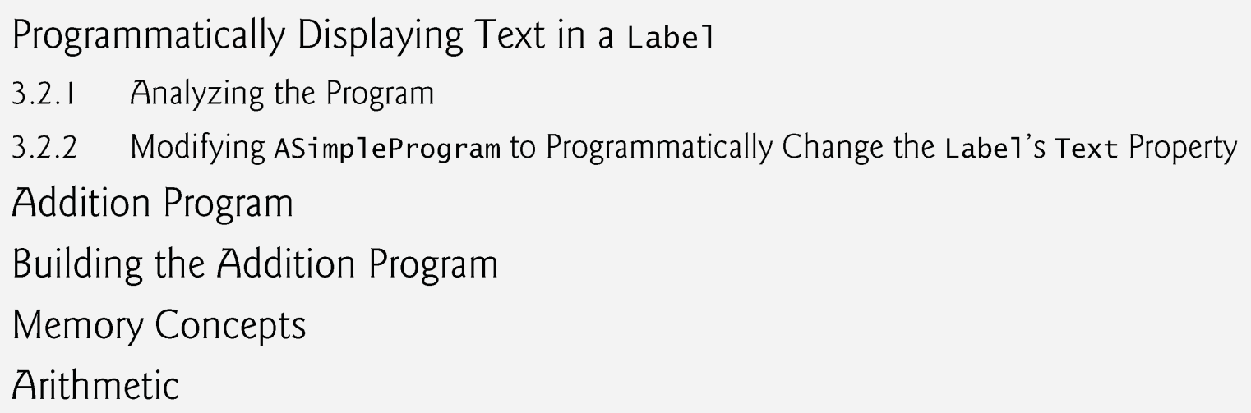
© 1992-2011 by Pearson Education, Inc. All Rights Reserved.

Slide 3

In Fig. 3.2, displays a code that modify a Label’s text programmatically.
The text displayed on the Form to change when you execute the program.
This code performs an action (change the label’s text) when the Form loads that is, when the program executes and displays the Form.
© 1992-2011 by Pearson Education, Inc. All Rights Reserved.

Slide 4
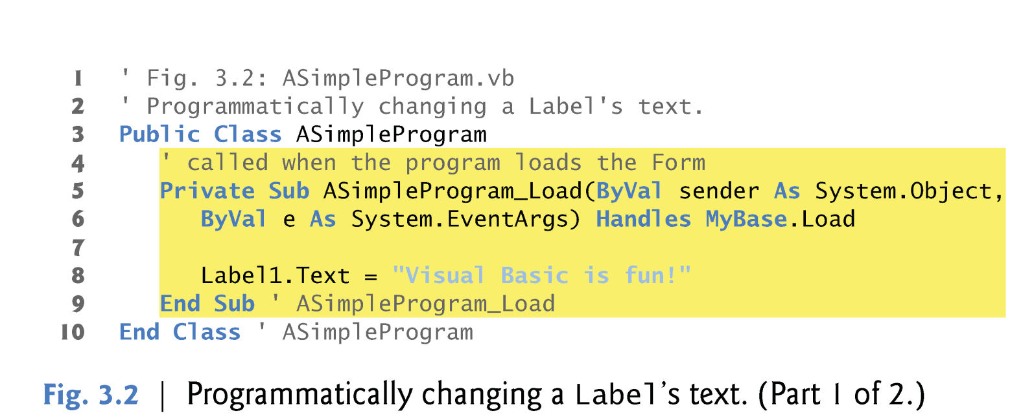
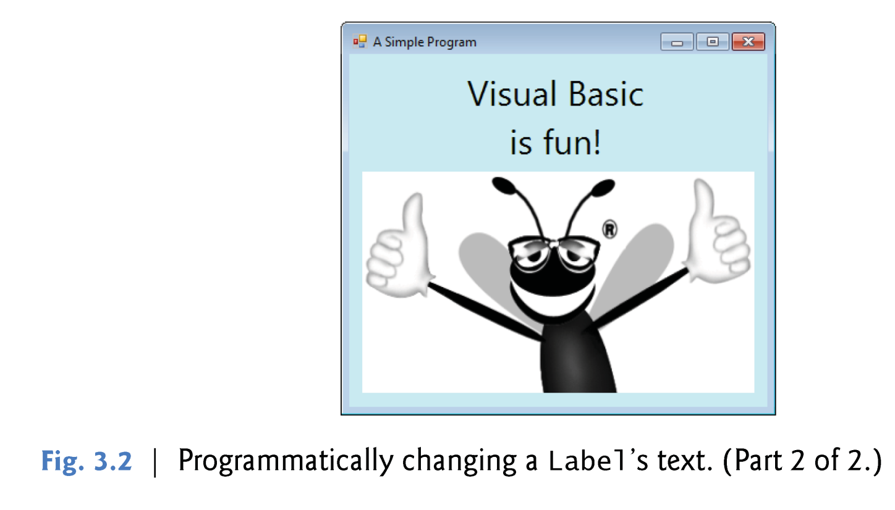
© 1992-2011 by Pearson Education, Inc. All Rights Reserved.

Slide 5

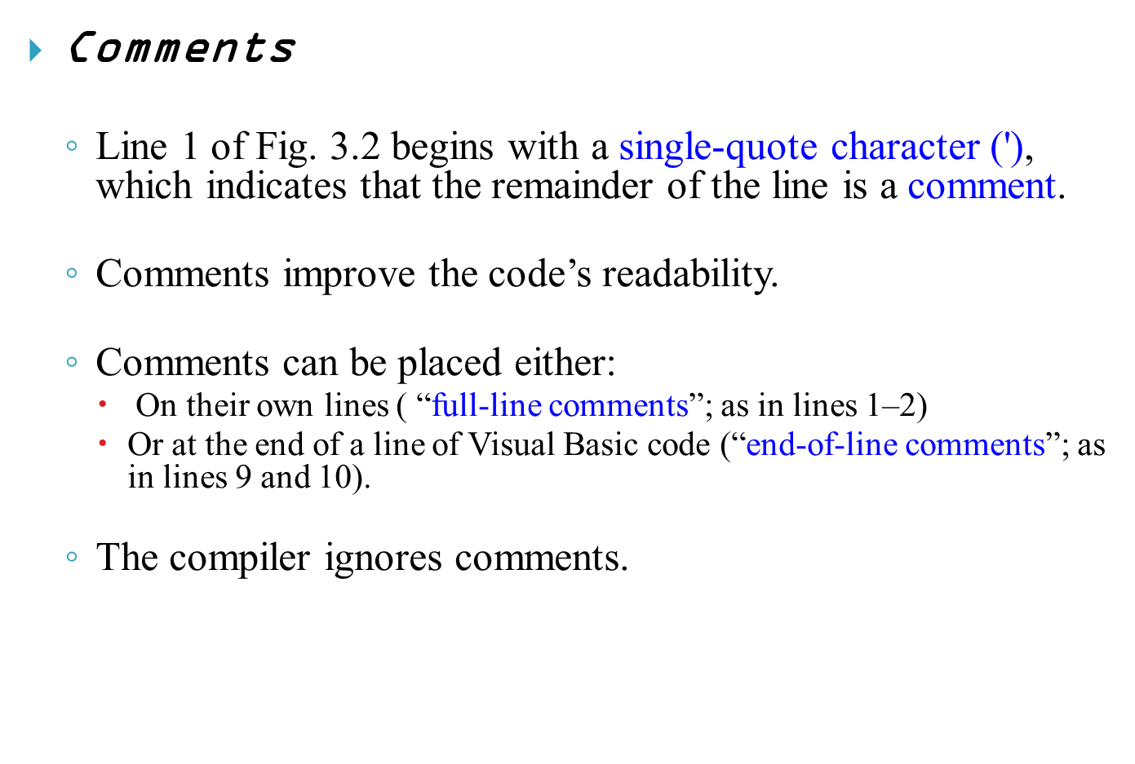
© 1992-2011 by Pearson Education, Inc. All Rights Reserved.

Slide 6

Classes
  Windows Forms applications consist of pieces called classes.
  Classes are logical groupings of methods and data that simplify program organization.
  Methods perform tasks and can return information when the tasks are completed.
  Lines 3–10 define a class that represents our Form.
  Every Windows Forms application consists of at least one class.
© 1992-2011 by Pearson Education, Inc. All Rights Reserved.

Slide 7
Keywords
  The words Public and Class (line 3) are examples of keywords.
  Keywords are words reserved for use by Visual Basic.
© 1992-2011 by Pearson Education, Inc. All Rights Reserved.

Slide 8
Class Names and Identifiers
  The name of the Class—ASimpleProgram in line 3—is an identifier, which is a series of characters consisting of letters, digits and underscores (_).
  Identifiers cannot begin with a digit and cannot contain spaces.
valid identifiers | Invalid identifiers
value1 | 7Welcome invalid because it begins with a digit
Welcome1-
xy_coordinate, _total | input field invalid because it contains a space
grossPay.
© 1992-2011 by Pearson Education, Inc. All Rights Reserved.

Slide 9
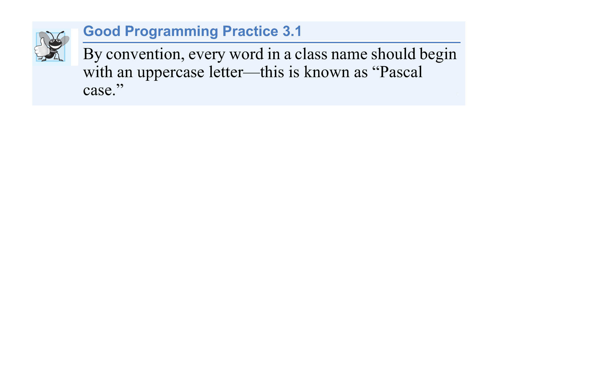
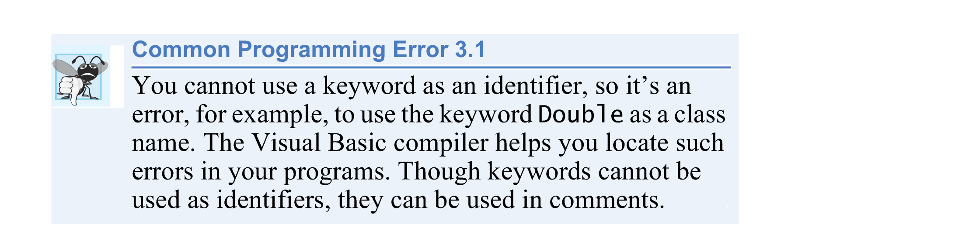
© 1992-2011 by Pearson Education, Inc. All Rights Reserved.

Slide 10
Visual Basic Is Not Case Sensitive
  Visual Basic keywords and identifiers are not case sensitive.
  Uppercase and lowercase letters are considered to be identical, so asimpleprogram and ASimpleProgram are interpreted as the same identifier.
© 1992-2011 by Pearson Education, Inc. All Rights Reserved.

Slide 11
The Form’s Load Event and Method ASimpleProgram_Load
  GUIs are event driven.
  When the user interacts with a GUI component, the interaction—known as an event—causes the program to perform a task by “calling” a method.
  Common events (user interactions) include clicking a Button, selecting an item from a menu, closing a window and moving the mouse.
© 1992-2011 by Pearson Education, Inc. All Rights Reserved.

Slide 12

All GUI controls, including Forms, have events associated with them.
A method that performs a task in response to an event is called an event handler,
The process of responding to events is known as event handling.
Most of a GUI application’s functionality executes based on events.
Event handling methods are called automatically.
© 1992-2011 by Pearson Education, Inc. All Rights Reserved.

Slide 13
A common event for a Form is its Load event, which occurs just before a Form is displayed on the screen—typically as a result of executing the program.
Lines 5–9 define the method ASimple-Program_Load as the Form’s Load event handler.
When this event is raised (that is, the event occurs), method ASimple-Program_Load executes to perform its task—changing the text in the Label.
© 1992-2011 by Pearson Education, Inc. All Rights Reserved.

Slide 14
At the end of line 6, the clause
    Handles MyBase.Load
indicates that method ASimple-Program_Load is the one that will be called to handle the Form’s Load event.
The IDE automatically inserts this clause for you when you create the event handler.
© 1992-2011 by Pearson Education, Inc. All Rights Reserved.

Slide 15
Defining a Method
  The keyword Sub (line 5) begins the method declaration
  The keywords End Sub (line 9) close the method declaration.
  The body of the method declaration appears between the keywords Sub and End Sub.
  The keyword Sub is short for “subroutine”
  Methods are also sometimes called procedures.
© 1992-2011 by Pearson Education, Inc. All Rights Reserved.

Slide 16
When this line executes, it changes the Label’s Text
property to the message Visual Basic is fun!.
This updates the text on the Form (Fig. 3.2).
The statement uses the assignment operator (=) to give the Text property a new value.
© 1992-2011 by Pearson Education, Inc. All Rights Reserved.

Slide 17
The expression Label1.Text contains two identifiers separated by the dot separator (.).
  The identifier to the right of the dot is the property name
  The identifier to the left of the dot is the name of the Label control.
When you add a Label to a Form, the IDE gives it the name Label1 by default for the first Label you add.
© 1992-2011 by Pearson Education, Inc. All Rights Reserved.

Slide 18
Note About Public and Private
  Most classes you’ll define begin with keyword Public
  Most event-handling methods begin with the keyword Private.
© 1992-2011 by Pearson Education, Inc. All Rights Reserved.

Slide 19

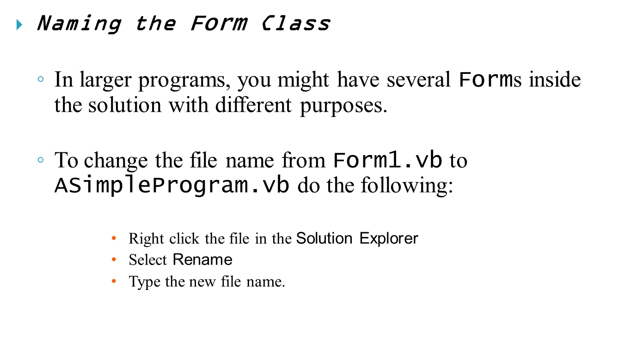
Note: Don’t forget to put “.vb” at the end of the file name when you rename it, or you will get an error.
© 1992-2011 by Pearson Education, Inc. All Rights Reserved.

Slide 20

Writing Code and Using IntelliSense
  As you begin typing, a small window appears (Fig. 3.6).
  This IDE feature, called Intelli-Sense,
    lists keywords, class names, members of a class (which include property and method names)
  Tabs (Common and All) in Intelli-Sense
    Common : view the most commonly used matches.
    All: view all the available matches.
© 1992-2011 by Pearson Education, Inc. All Rights Reserved.

Slide 21
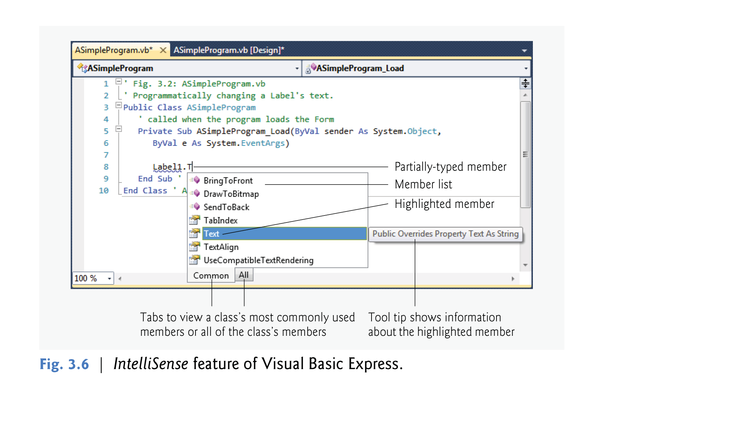
© 1992-2011 by Pearson Education, Inc. All Rights Reserved.

Slide 22

Compiling and Running the Program
  To execute your program :
    Select Debug > Start Debugging
    Or press F5
    Or the toolbar button .
  When you run a program, the IDE first compiles it.
© 1992-2011 by Pearson Education, Inc. All Rights Reserved.

Slide 23
You can also compile the program without running it by:
  selecting Debug > Build ASimpleProgram.
This creates a new file with the project’s name and the .exe file-name extension (ASimpleProgram.exe).
This file contains a program’s code, which executes on the .NET Framework.
The .exe file extension indicates that the file is executable.
© 1992-2011 by Pearson Education, Inc. All Rights Reserved.

Slide 24
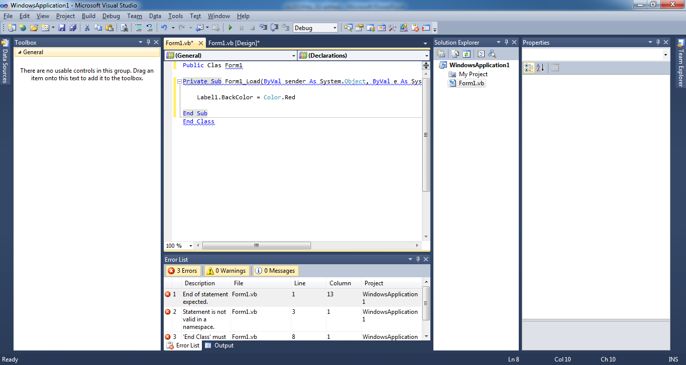
  When you type a line in an incorrect way a syntax error occur.
      Happens before execution time.
      Detected by the IDE before the execution .
      The IDE places a blue squiggle below the error, example:
      A detailed description of the error is shown in the Error List window.
  Runtime error is a logical mistake in the code.
      Happens at the execution time.
      Cannot be detected by the IDE before the execution.
      It interrupts the execution of the program.
      A detailed description of the error is shown in the Error List window.
© 1992-2011 by Pearson Education, Inc. All Rights Reserved.

Slide 25

If the Error List window is not visible in the IDE, select View > Other Windows > Error List to display it.
In Fig. 3.7, we removed the parenthesis “)” at the end of line 6.
The error contains the text “')' expected.” and specifies that the error is in column 33 of line 6.
This informs you that a right parenthesis is missing in line 6.
You can double click an error message in the Error List to jump to the line of code that caused the error.
For some errors (such as this one), the IDE shows the Error Correction Options drop-down list and allows you to simply click a link to fix the error.
© 1992-2011 by Pearson Education, Inc. All Rights Reserved.

Slide 26
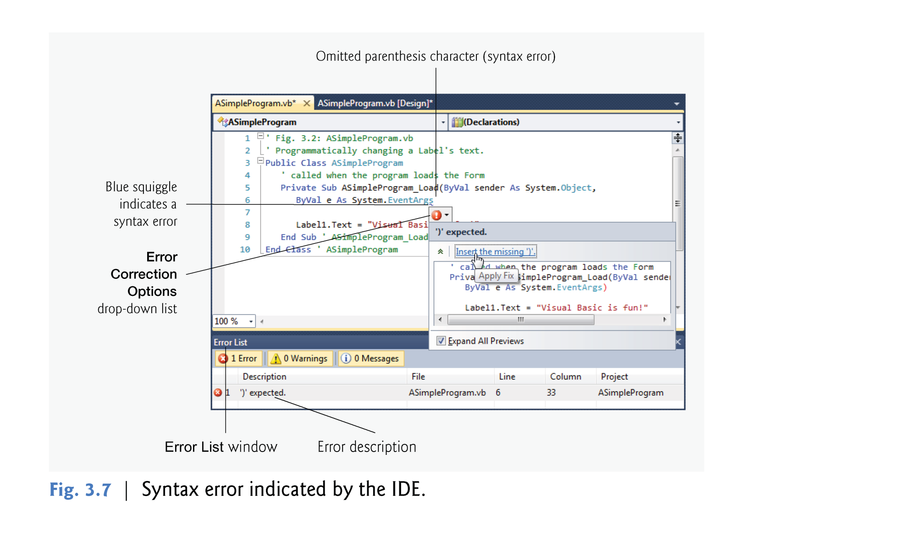
© 1992-2011 by Pearson Education, Inc. All Rights Reserved.

Slide 27
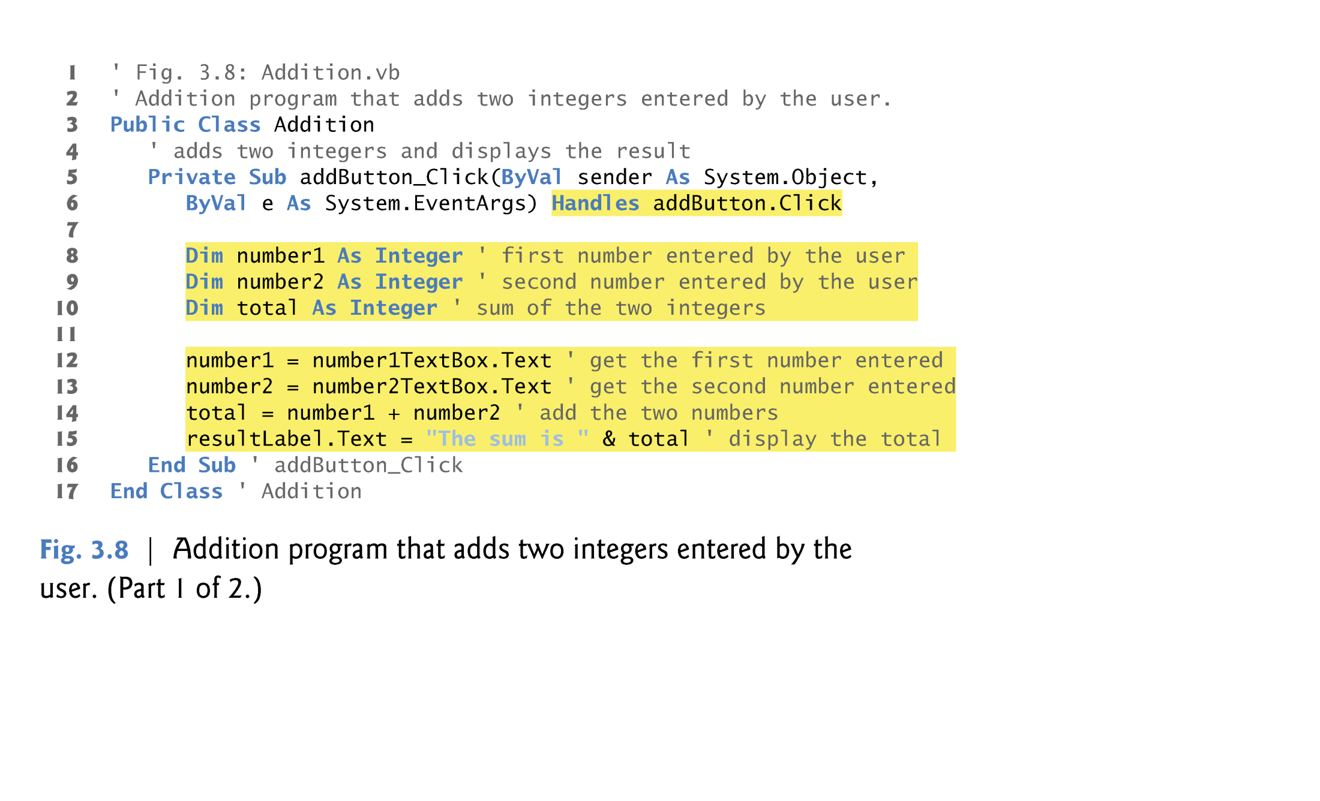
© 1992-2011 by Pearson Education, Inc. All Rights Reserved.

Slide 28

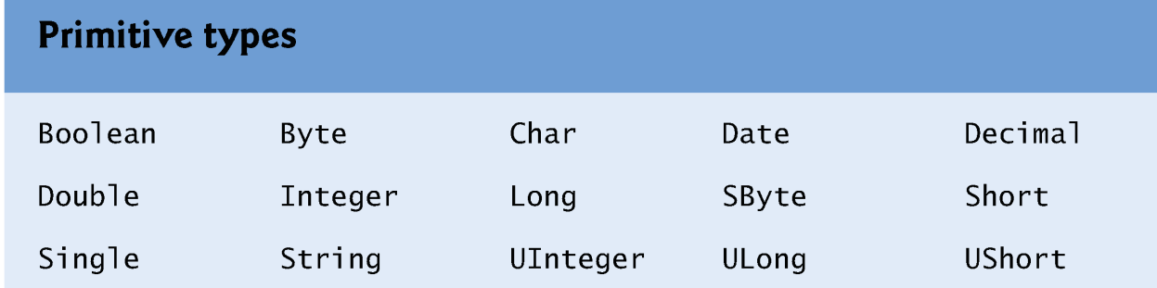
Variable Declarations and Naming
  Lines 8–10 are declarations, which begin with keyword Dim.
  The words number1, number2 and total are identifiers for variables
  Variables are locations in the computer’s memory where values can be stored for use by a program.
  All variables must be declared before they can be used.
  The variables number1, number2 and total are data of type Integer I
© 1992-2011 by Pearson Education, Inc. All Rights Reserved.

Slide 29

A variable name can be any valid identifier.
Variables of the same type can be declared in separate statements or they can be declared in one statement separated by a comma.
You should choose meaningful variable names to make your programs “self-documenting” & more readable.
© 1992-2011 by Pearson Education, Inc. All Rights Reserved.

Slide 30
Tips in naming variables
- The “camel case”.
  It is a way for naming variables so that The first word in a variable-name begins with a lowercase letter and every word after the first one should with an uppercase letter.
    Example: firstNumber.
  Helps make your programs more readable.
© 1992-2011 by Pearson Education, Inc. All Rights Reserved.

Slide 31

Using Variables to Store the Values Entered by the User
  Line 12: number1 = number1TextBox.Text
  We call this statement an assignment statement because it assigns a value to a variable.
  The expression number1TextBox.Text gets the value that the user typed in the TextBox.
© 1992-2011 by Pearson Education, Inc. All Rights Reserved.

Slide 32

What if the User Doesn’t Enter an Integer?
  For this program, if the user types a noninteger value, such as "hello," a runtime error occurs.
  A detailed description of the error is displayed in the Error List window.
  The message displayed in Fig. 3.10 appears when you run the application using Debug > Start Debugging (or press F5).
  In this case, you can stop running the program by selecting Debug > Stop Debugging or typing Shift+ F5.
© 1992-2011 by Pearson Education, Inc. All Rights Reserved.

Slide 33
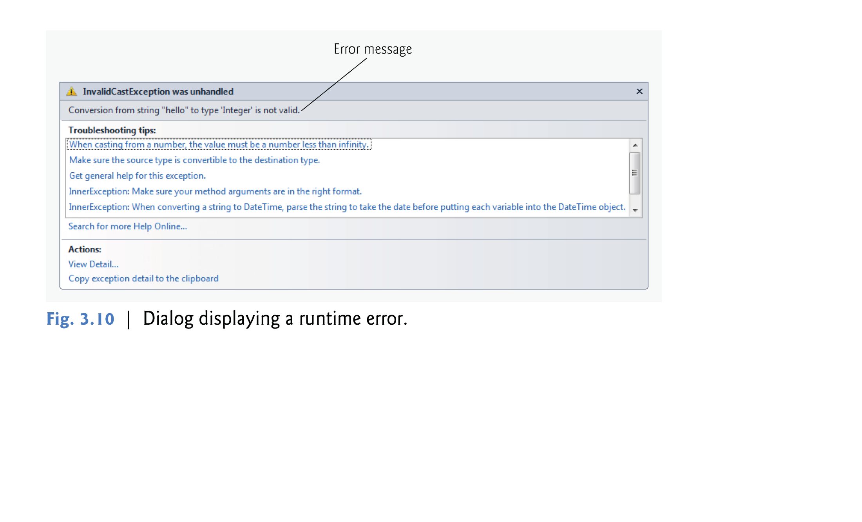
© 1992-2011 by Pearson Education, Inc. All Rights Reserved.

Slide 34

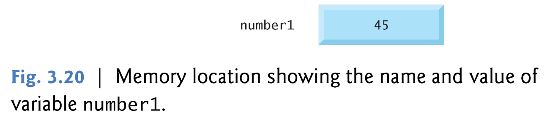
Suppose the user enters the characters 45.
This input is returned by number1TextBox.Text and assigned to number1.
The program places the Integer value 45 into location number1, as shown in Fig. 3.20.
Whenever a value is placed in a memory location, this value replaces the value previously stored in that location.
The previous value is lost.
© 1992-2011 by Pearson Education, Inc. All Rights Reserved.

Slide 35
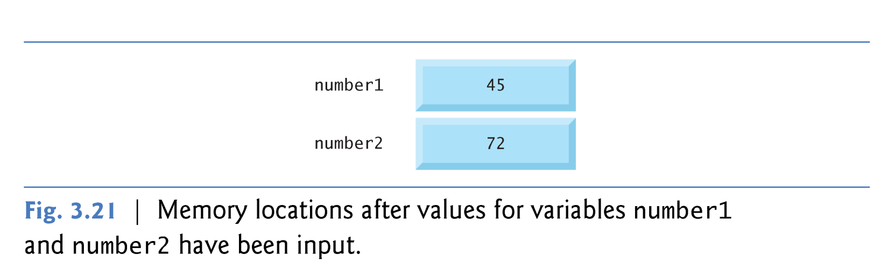
Suppose that the user then enters the characters 72 in number2TextBox.
Line 13
    ' get the second number entered number2 = number2TextBox.Text
places the Integer value 72 into location number2, and memory appears, as shown in Fig. 3.21.
© 1992-2011 by Pearson Education, Inc. All Rights Reserved.

Slide 36

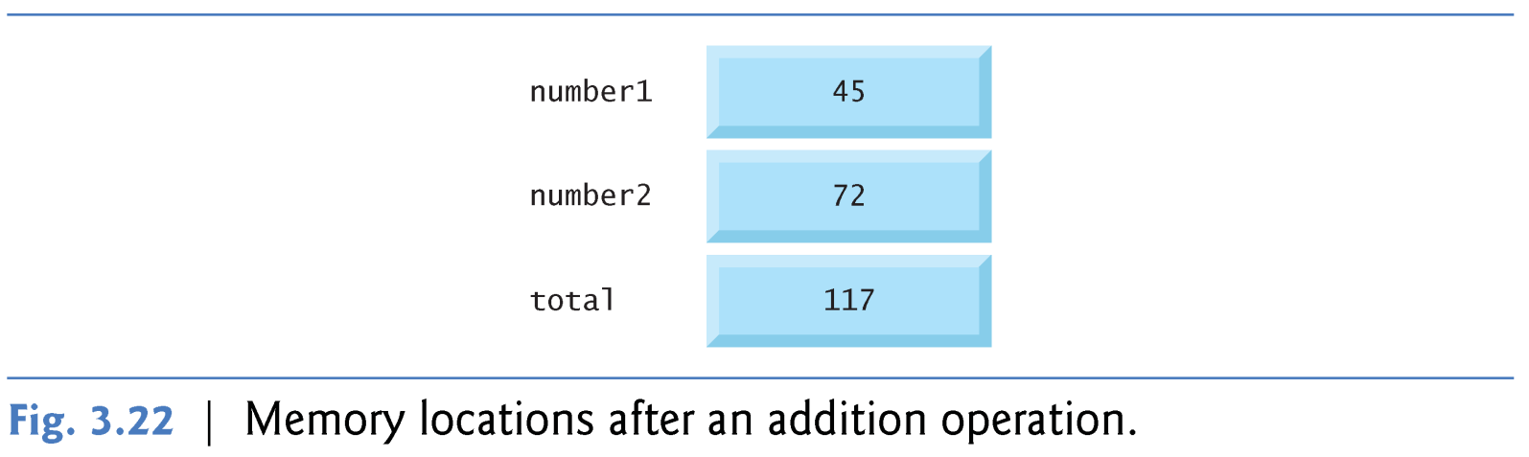
Once the program has obtained values for number1 and number2, it adds these values and places their total into variable total.
The statement (line 14)
total = number1 + number2 ' add the two numbers
After total is calculated, memory appears, as in Fig. 3.22.
The values of number1 and number2 appear exactly the same as they did before they were used in the calculation of total.
© 1992-2011 by Pearson Education, Inc. All Rights Reserved.

Slide 37

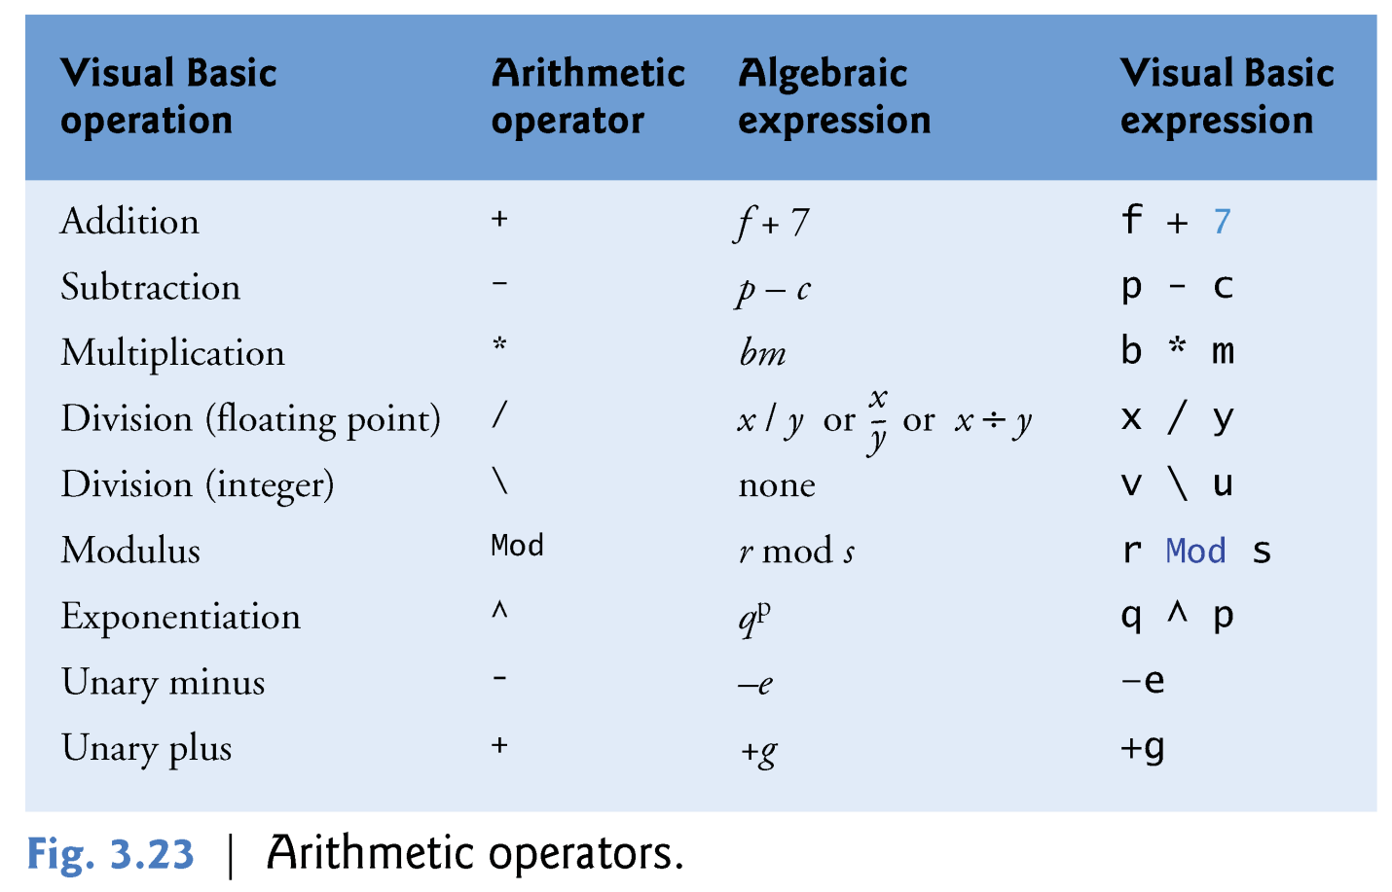
Programs often perform arithmetic calculations.
  The arithmetic operators are summarized in Fig. 3.23.
© 1992-2011 by Pearson Education, Inc. All Rights Reserved.

Slide 38

  the asterisk (*) indicates multiplication, and the keyword Mod represents the Mod operator (also known as the modulus or modulo operator)
Most of the arithmetic operators in Fig. 3.23 are binary operators, because each operates on two operands.
  Example: The addition operator: 1+2
Visual Basic also provides unary operators that take only one operand.
    Example: The minus sign: (-2) ,and the plus sign: (+2)
© 1992-2011 by Pearson Education, Inc. All Rights Reserved.

Slide 39

Visual Basic has two types of division:
Integer division (\):
  Gives an Integer result.
  Operands are rounded to the nearest integer number before performing division.
  Any fractional part in the result simply is discarded .
  Example:
    7\2 =3
    7.1 \ 2 = 7\2 = 3
  7.1 is rounded to 7 before the division.
    7.7 \2 = 8 \2 = 4
  7.7 is rounded to 8 before the division.
floating-point division (/):
  Gives a Float number result.
  Operands are not rounded before performing division.
  Fractional part in the result is kept.
  Example:
    7/2 =3.5
    7.1 / 2 = 3.55
    7.7 / 2 = 3.85
© 1992-2011 by Pearson Education, Inc. All Rights Reserved.

Slide 40
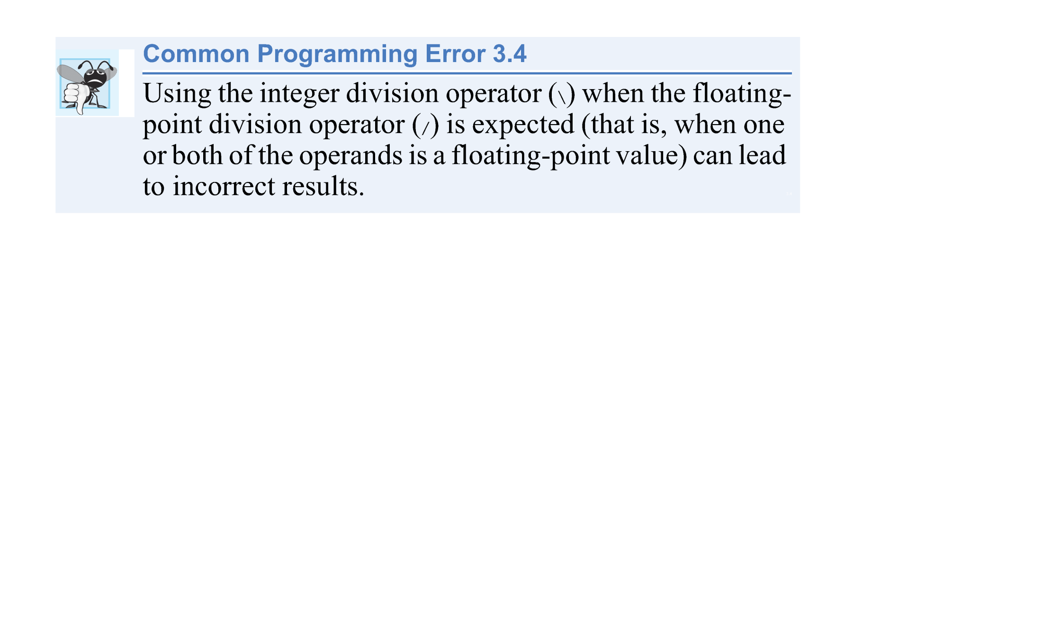
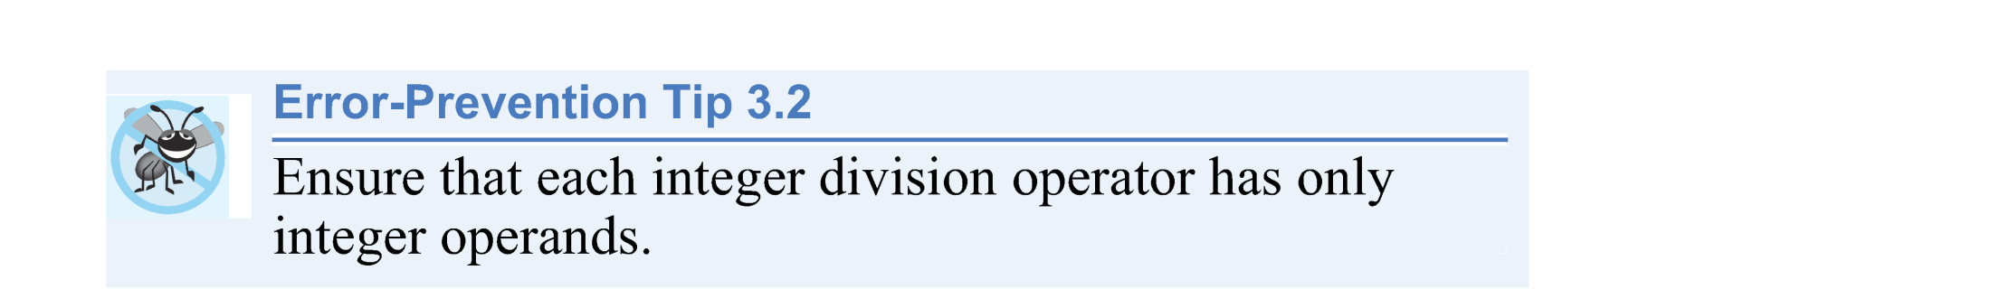
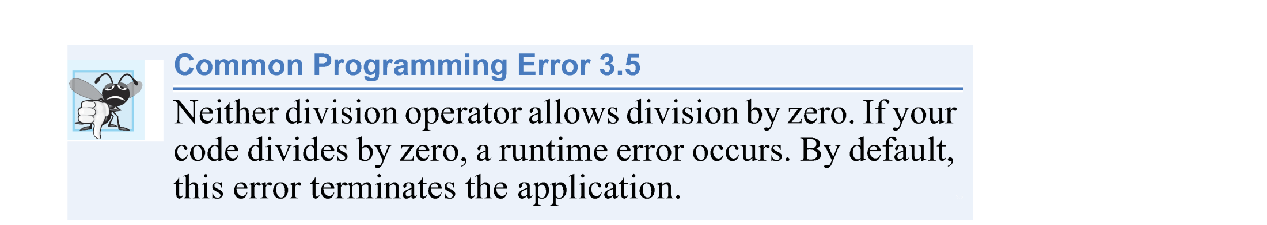
© 1992-2011 by Pearson Education, Inc. All Rights Reserved.

Slide 41
Mod Operator
  The Mod operator gives the remainder after division.
  The expression x Mod y gives the remainder after x is divided by y.
  Example: 7 Mod 4 = 3, and 17 Mod 5 = 2.
  You use this operator mostly with Integer operands, but it also can be used with other types.
© 1992-2011 by Pearson Education, Inc. All Rights Reserved.

Slide 42
Operators in arithmetic expressions are applied in a precise sequence determined by the rules of operator precedence (Fig. 3.24), which are similar to those in algebra.
Operators in the same row of the table have the same level of precedence.
When we say operators are evaluated from left to right, we’re referring to the operators’ associativity.
If there are multiple operators, each with the same precedence, the order in which the operators are applied is determined by the operators’ associativity.
© 1992-2011 by Pearson Education, Inc. All Rights Reserved.

Slide 43
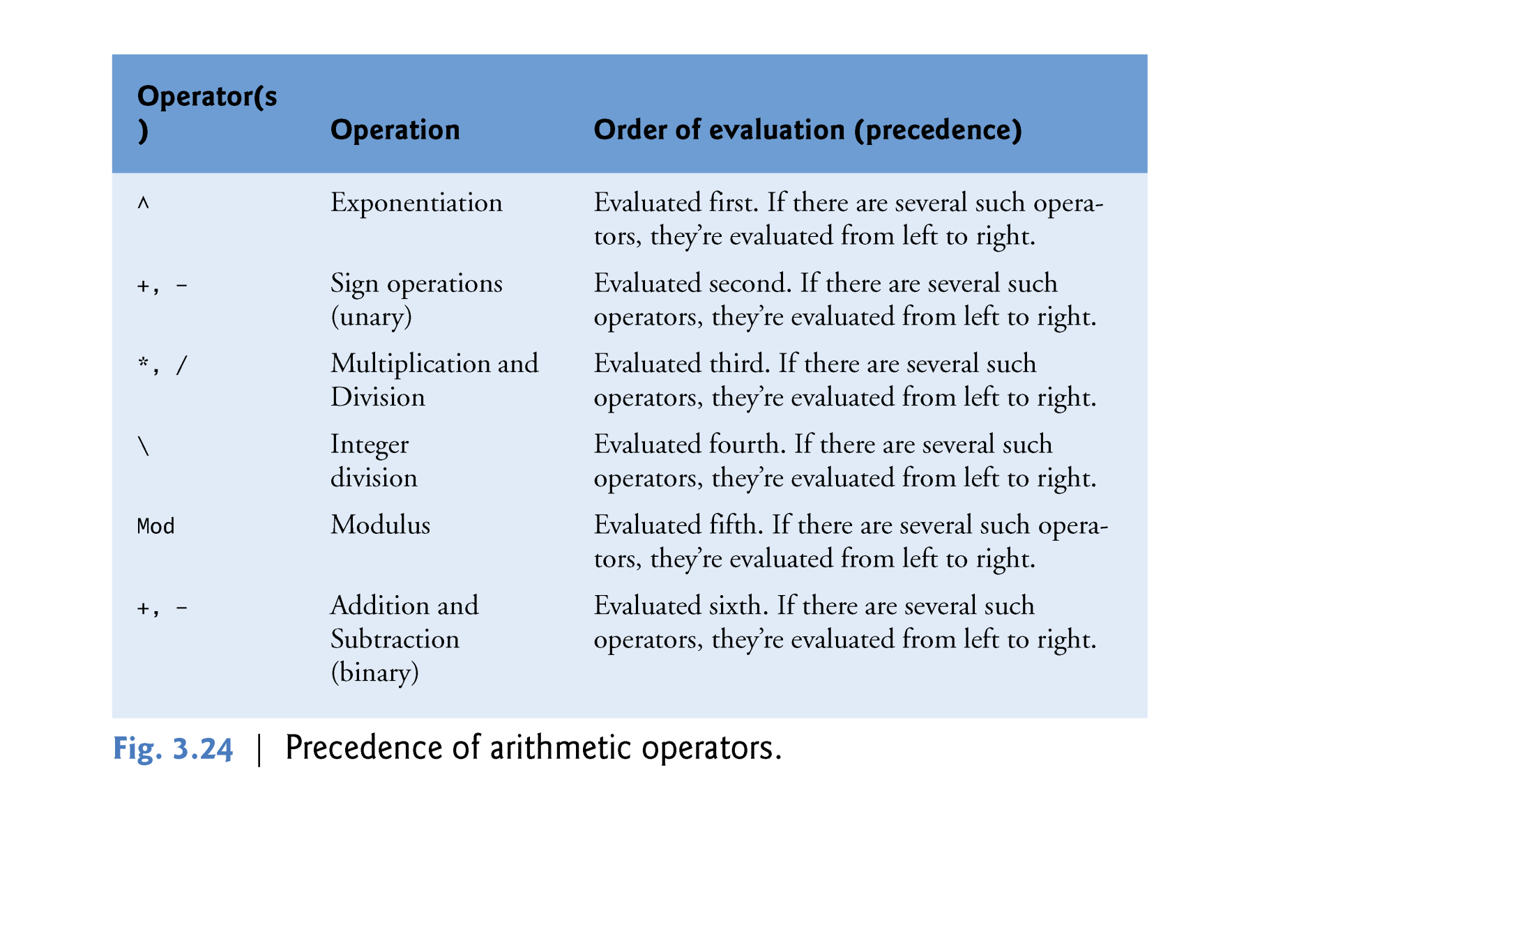
© 1992-2011 by Pearson Education, Inc. All Rights Reserved.

Slide 44
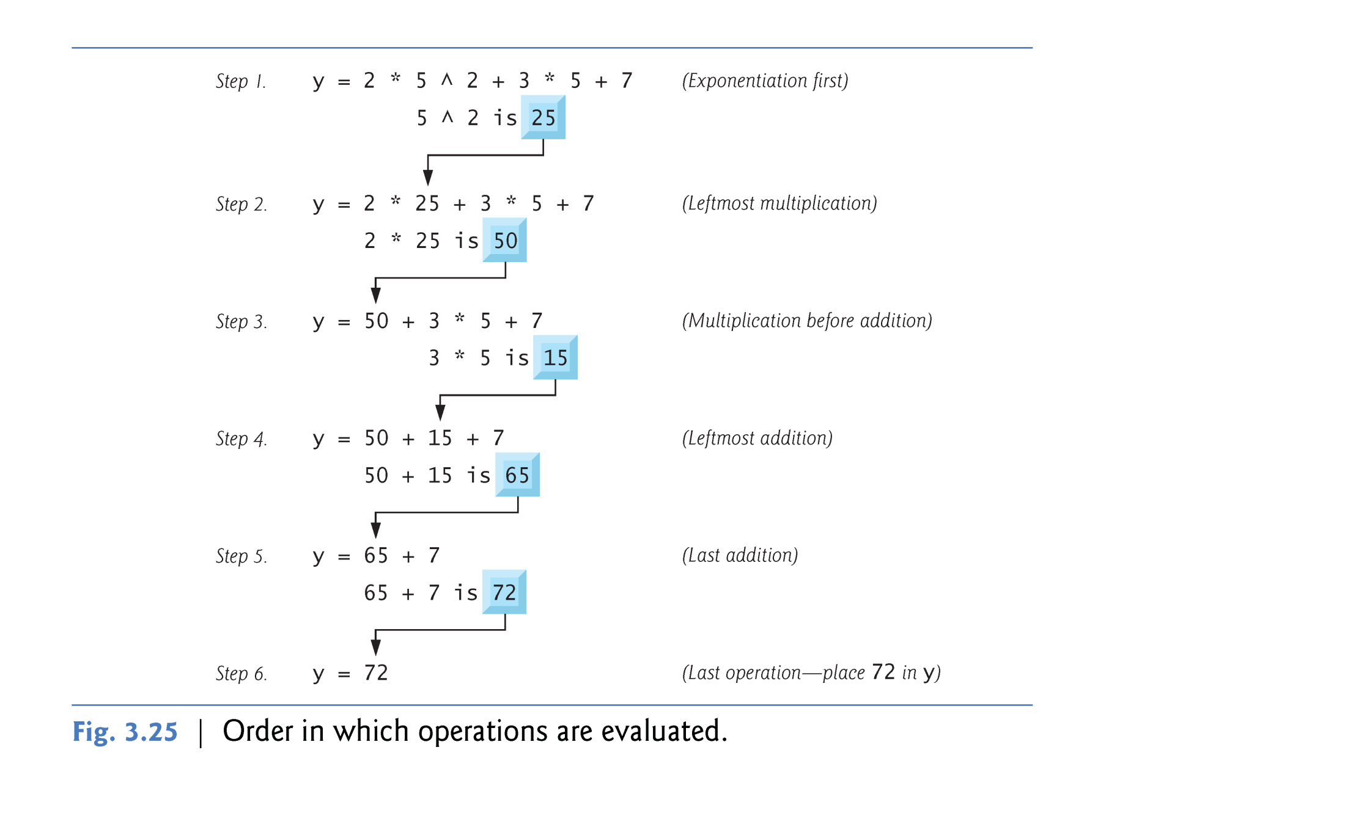
© 1992-2011 by Pearson Education, Inc. All Rights Reserved.

Slide 45
Operators in expressions contained within a pair of parentheses “()” are evaluated before those that are outside the parentheses.
Parentheses can be used to group expressions and change the order of evaluation to occur in any sequence you desire.
With nested parentheses, the operators contained in the innermost pair of parentheses are applied first.
© 1992-2011 by Pearson Education, Inc. All Rights Reserved.

Slide 46
Redundant Parentheses
  As in algebra, it is acceptable to place unnecessary parentheses in an expression to make the expression clearer—these are called redundant parentheses.
  For example, many people might parenthesize the preceding assignment statement for clarity as
      y = (a * x ^ 2) + (b * x) + c
© 1992-2011 by Pearson Education, Inc. All Rights Reserved.

Slide 47

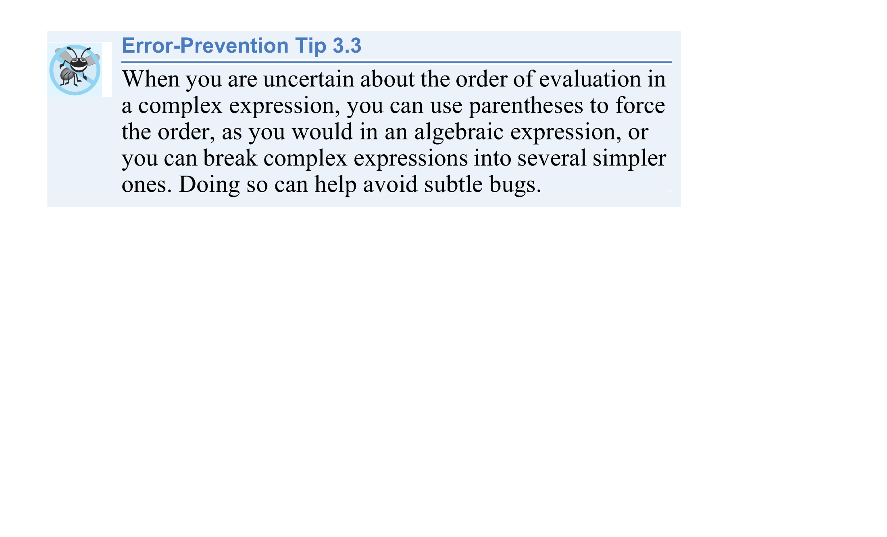
© 1992-2011 by Pearson Education, Inc. All Rights Reserved.

Slide 48
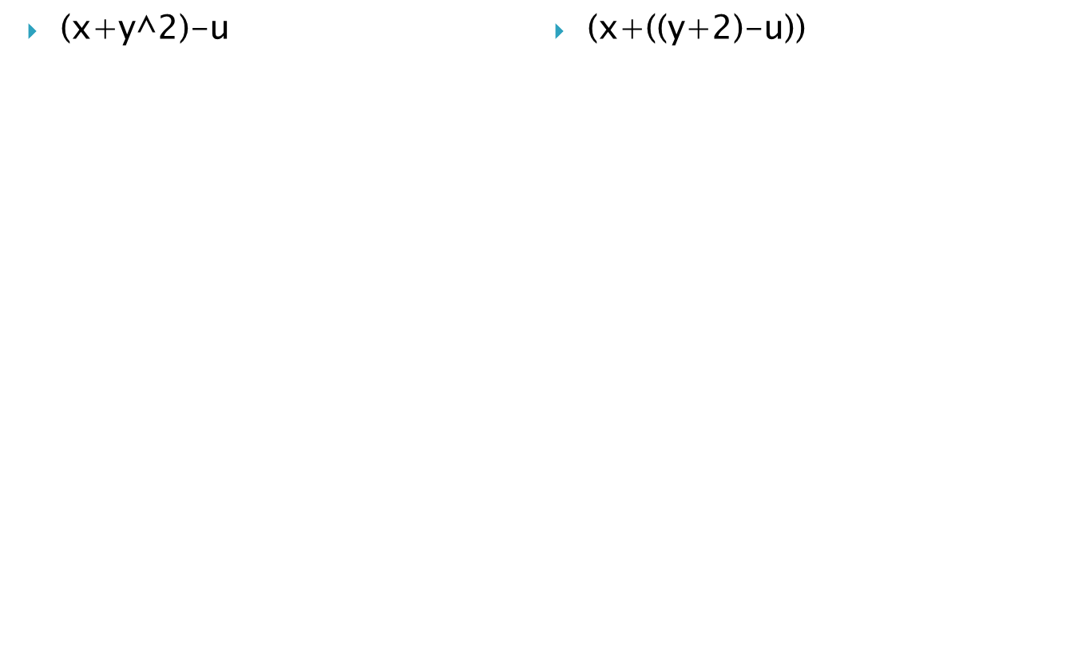
1
1
2
2
3
3
Note: Don’t forget that parenthesis () has the highest priority amongst all the operators & anything inside them should be executed first.
© 1992-2011 by Pearson Education, Inc. All Rights Reserved.

