Slide 1

Visual Basic 2010 How to Program
© 1992-2011 by Pearson Education, Inc. All Rights Reserved.

Slide 2
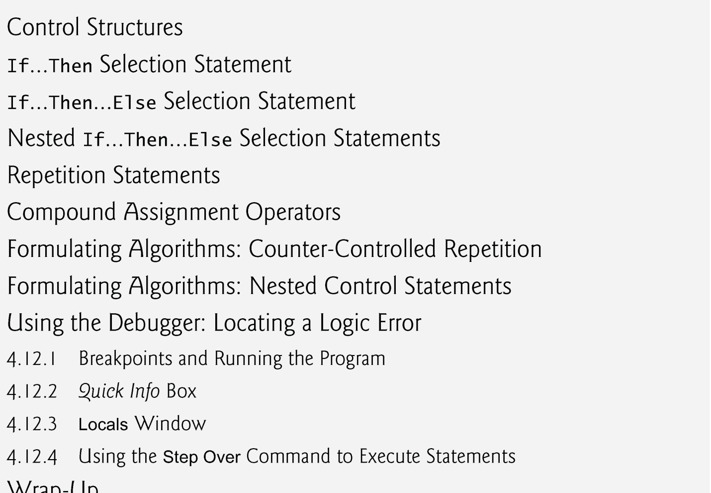
© 1992-2011 by Pearson Education, Inc. All Rights Reserved.

Slide 3

We introduce the If…Then, If…Then…Else, Do While…Loop, While…End While and Do Until…Loop statements—five of the building blocks that allow you to specify the logic required for methods to perform their tasks.
© 1992-2011 by Pearson Education, Inc. All Rights Reserved.

Slide 4

The If…Then statement allows a program to make a decision based on the truth or falsity of some expression.
The expression in an If…Then statement is called a condition.
Conditions in If…Then statements can be formed by using the equality operators and relational operators, summarized in Fig. 3.26.
The relational and equality operators all have the same level of precedence and associate from left to right.
© 1992-2011 by Pearson Education, Inc. All Rights Reserved.

Slide 5
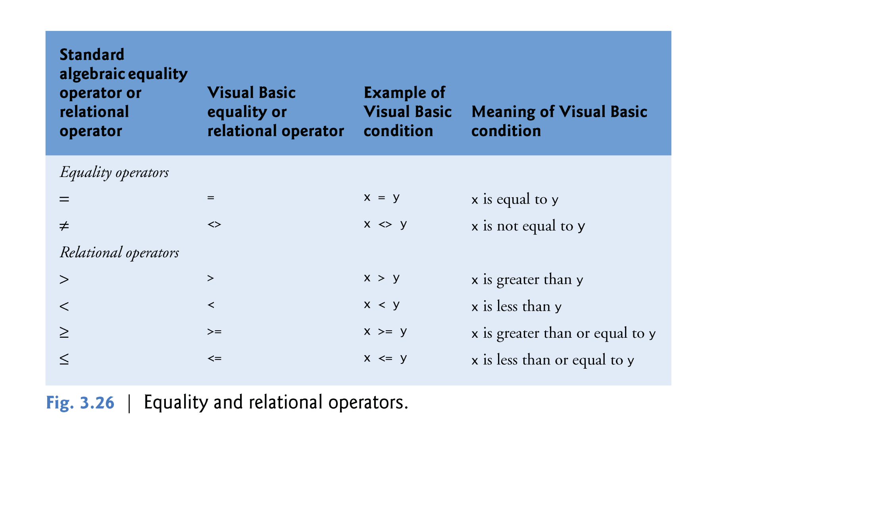
© 1992-2011 by Pearson Education, Inc. All Rights Reserved.

Slide 6

If Condition(s) Then
Body
End If
If the condition(s) is/are not met (false) the Body of the if Statement will not be executed
Any thing between Then and End If (the Body) will be executed only when the Condition(s) is/are met (true)
© 1992-2011 by Pearson Education, Inc. All Rights Reserved.

Slide 7

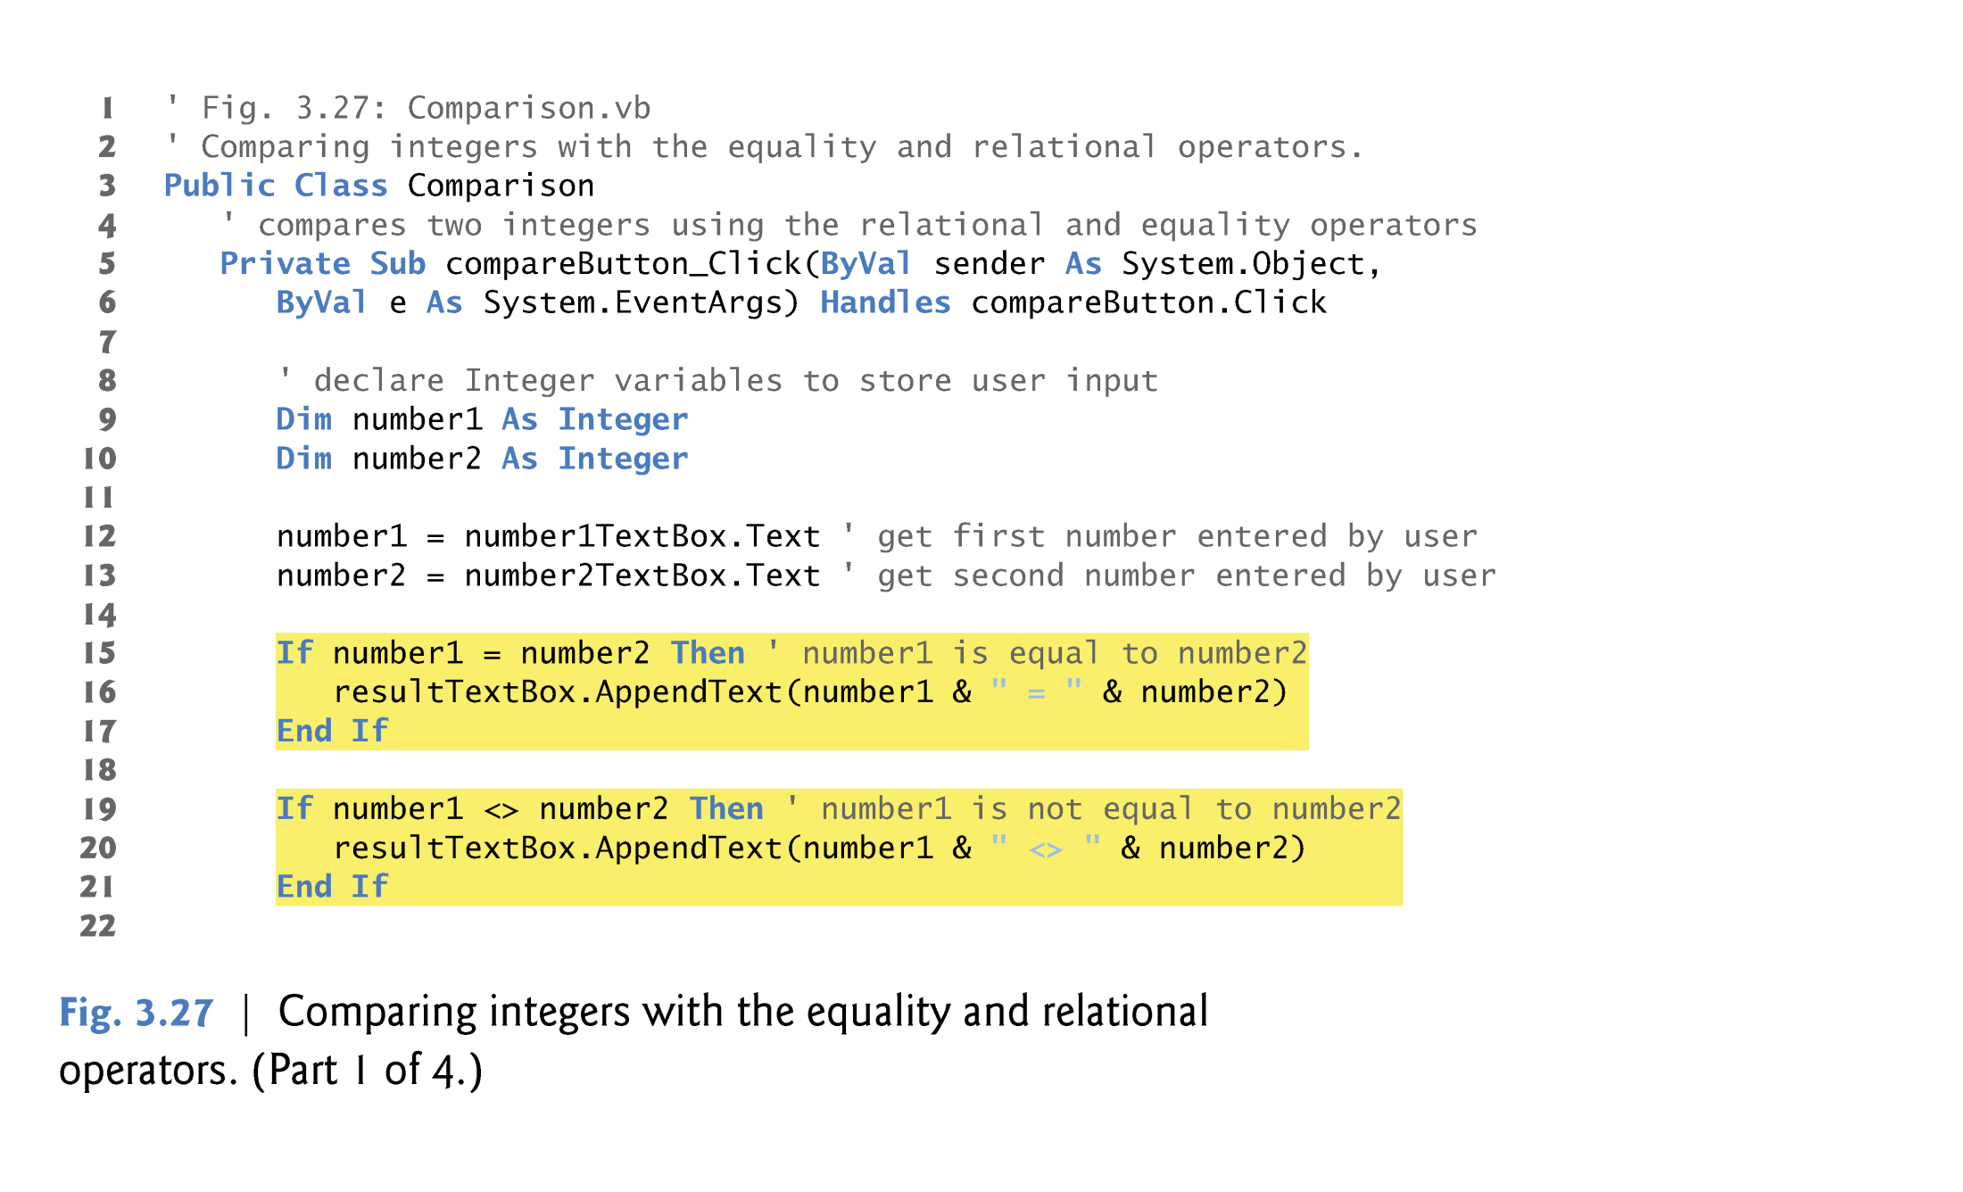
© 1992-2011 by Pearson Education, Inc. All Rights Reserved.

Slide 8
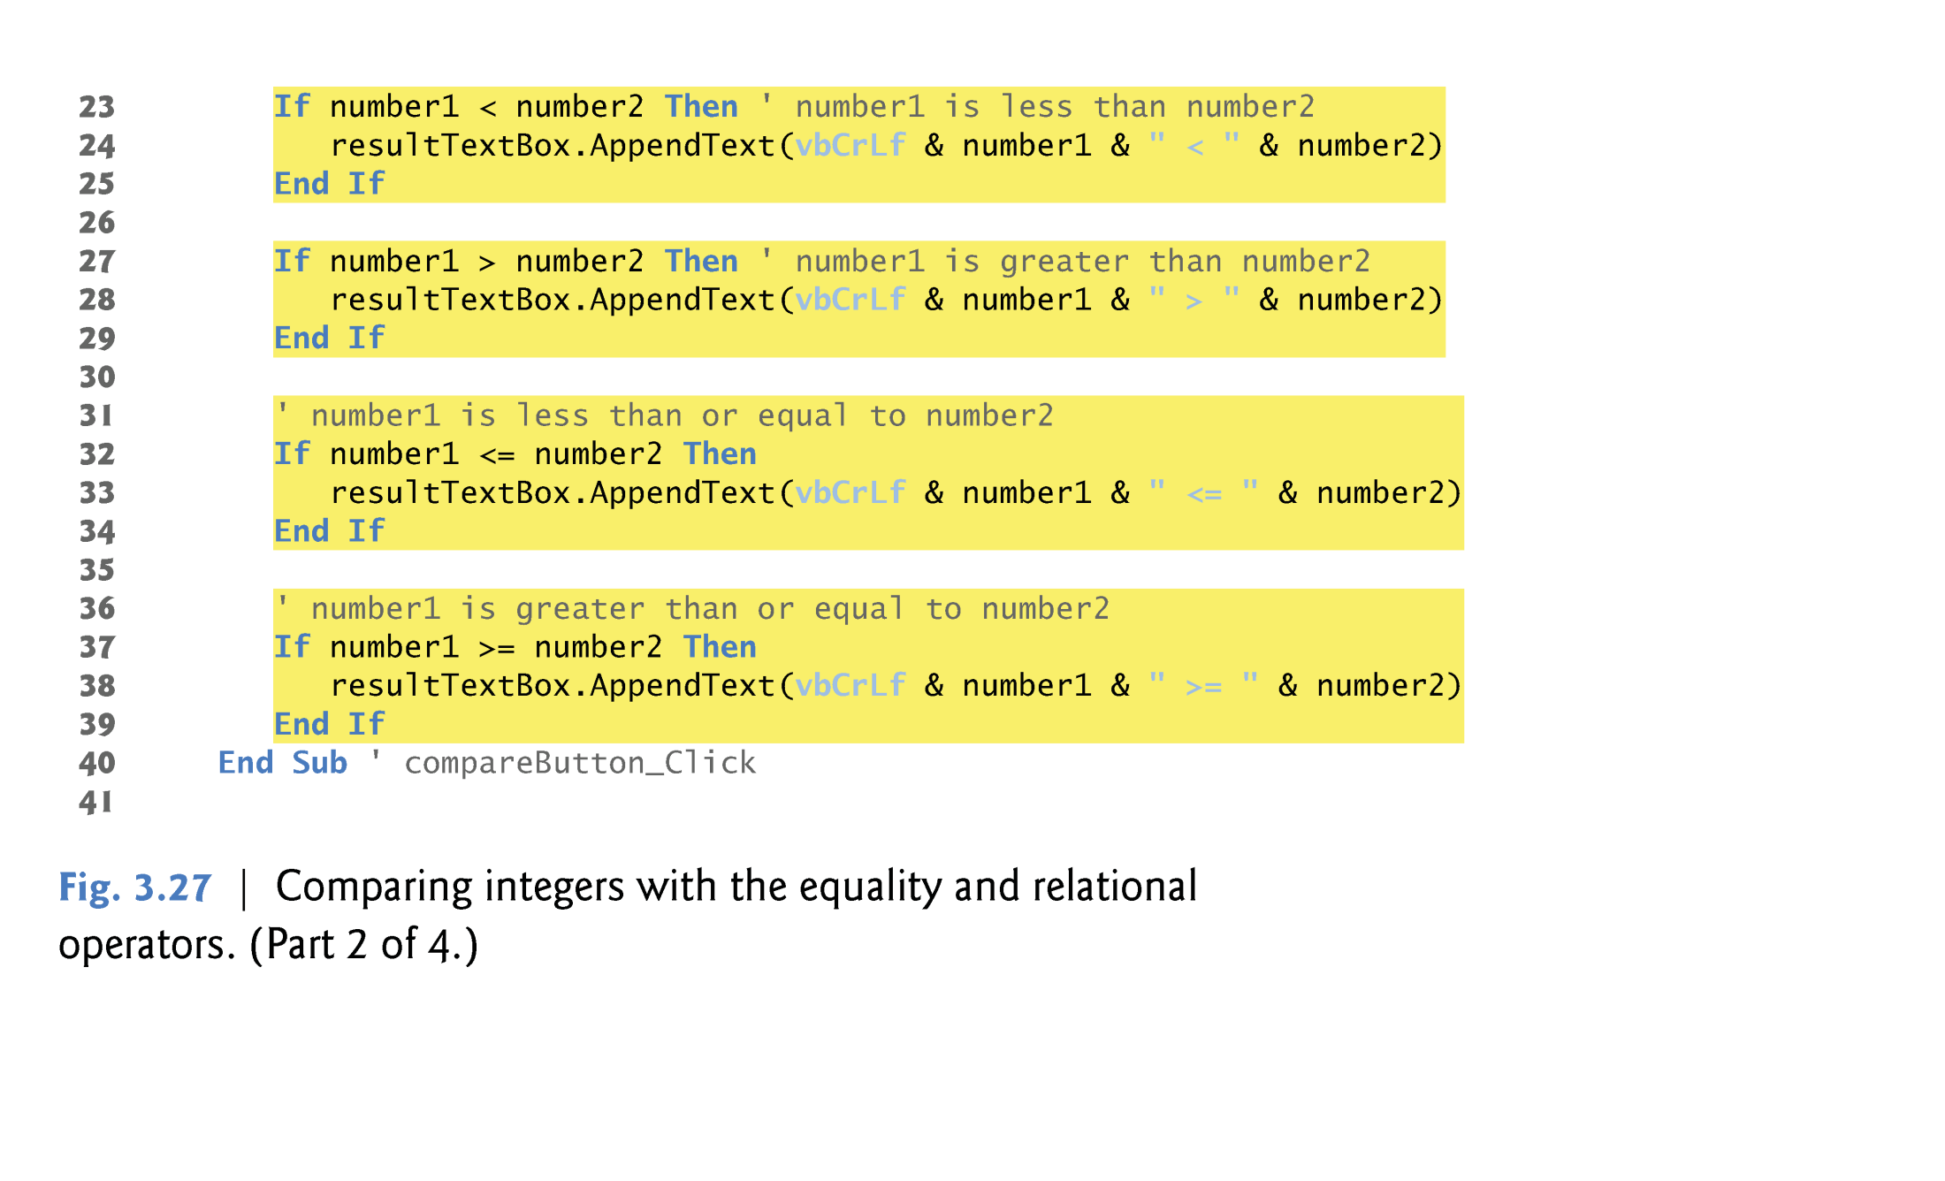
Example 1: (Code) If...Then...End If (2of3)
© 1992-2011 by Pearson Education, Inc. All Rights Reserved.

Slide 9
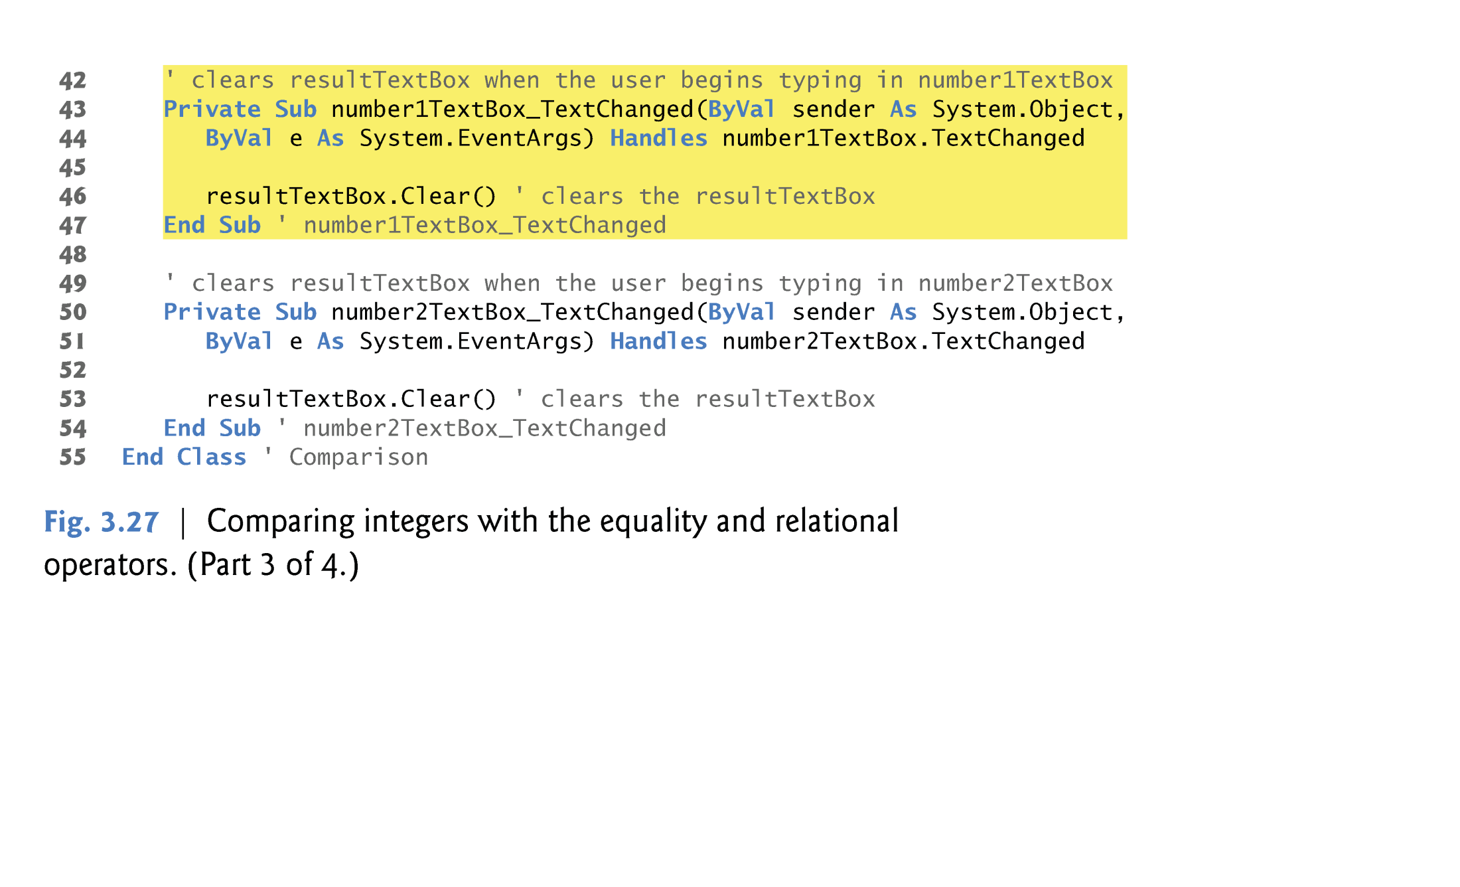
Example 1: (Code) If...Then...End If (3of3)
© 1992-2011 by Pearson Education, Inc. All Rights Reserved.

Slide 10
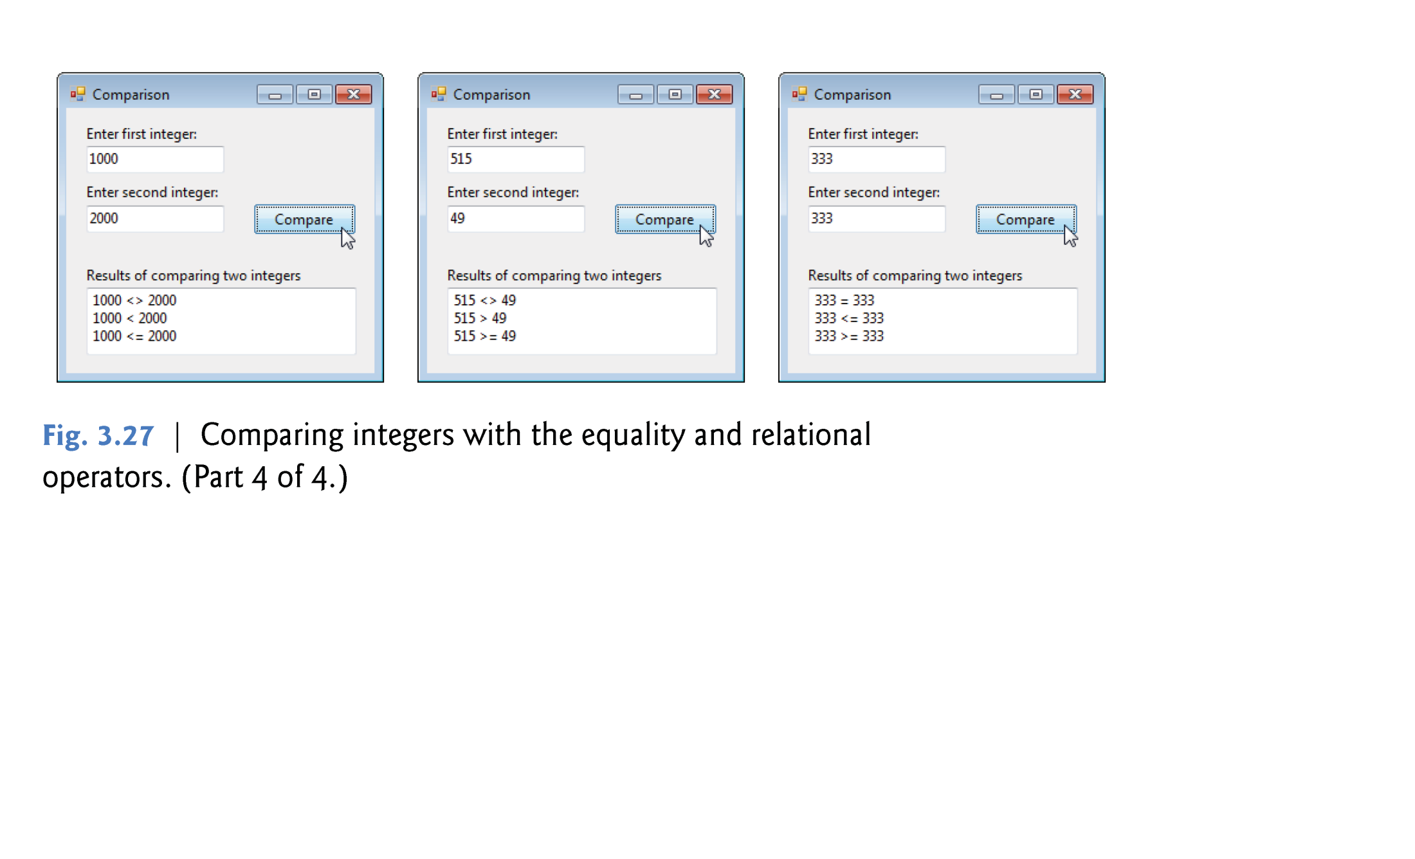
Example 1: (Output) If...Then...End If
© 1992-2011 by Pearson Education, Inc. All Rights Reserved.

Slide 11

Comparing Integers with the Equality and Relational Operators
  The Comparison program uses six If…Then statements to compare two numbers entered into a program by the user.
  If the condition in any of these statements is true, the body associated with that If…Then executes.
  The user enters these values, which are stored in variables number1 and number2.
  Then the comparisons are performed and the results are displayed in a multiline TextBox.
© 1992-2011 by Pearson Education, Inc. All Rights Reserved.

Slide 12

Getting the Values Entered By the User
  Lines 9–10 declare the variables that are used in the compareButton_Click event handler.
  Lines 12–13 get the numbers that the user entered and assign the values to Integer variables number1 and number2, respectively.
© 1992-2011 by Pearson Education, Inc. All Rights Reserved.

Slide 13

  The If…Then statement in lines 15–17 compares the values of the variables number1 and number2 for equality.
    If the values are equal, the statement in line 16 outputs a string indicating that the two numbers are equal.
  The keyword End If (line 17) end the body of the If…Then statement.
  Assignment and the equality operator both use the = symbol.
    Example: Using (=) symbol for different purposes:
    a. Assignment b. Equality
Dim number As Integer
number = 10
If x = z Then
TextBox1.Clear()
End if
© 1992-2011 by Pearson Education, Inc. All Rights Reserved.

Slide 14
Displaying Text in a Multiline TextBox
  In this program, we display several lines of text in a TextBox.
  To enable this functionality, we set the TextBox’s MultiLine property to True in the Properties window.
  We also use the TextBox’s AppendText method, which enables us to add more text to what is already displayed in a TextBox.
© 1992-2011 by Pearson Education, Inc. All Rights Reserved.

Slide 15
Sometimes you give a method values —known as arguments—that the method uses while performing its task.
In line 16 of Fig. 3.27, the expression number1 & " = " & number2 in parentheses is the argument to method AppendText.
In line 16, if number1 = 333 and number2 =333, the argument of AppendText method evaluates as follows:
  number1 & number2 is converted to a string and concatenated with the string " = ”.
  Then the resulting string "333 = 333" is appended to the TextBox’s Text property by method AppendText.
© 1992-2011 by Pearson Education, Inc. All Rights Reserved.

Slide 16

In (lines 19–39), additional strings, including vbCrLf, are appended by resultTextBox.AppendText statements.
vbCrLf is a predefined value, known as a constant, makes a new line. In other words, it has the same effect of the key Enter in the keyboard.
© 1992-2011 by Pearson Education, Inc. All Rights Reserved.

Slide 17

The TextChanged event is a TextBox’s default event that happens when you double click on the textBox.
Lines 43–47 and 50–54 show the TextChanged event handlers for number1TextBox and number2TextBox.
These methods are called when the user types in the corresponding TextBoxes.
There are two ways to clear the content of a TextBox’s Text:
  Clear method, which removes the text that is currently displayed in the TextBox as follows: resultTextBox.Clear().
  You can also clear a Label’s or TextBox’s Text property by assigning it the value String.Empty as follows: resultTextBox.Text= String.Empty.
© 1992-2011 by Pearson Education, Inc. All Rights Reserved.

Slide 18
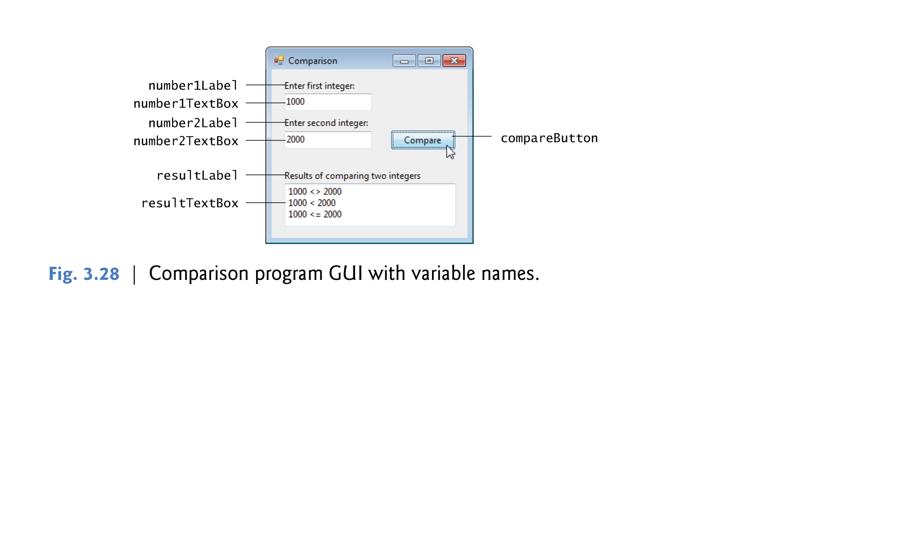
© 1992-2011 by Pearson Education, Inc. All Rights Reserved.

Slide 19

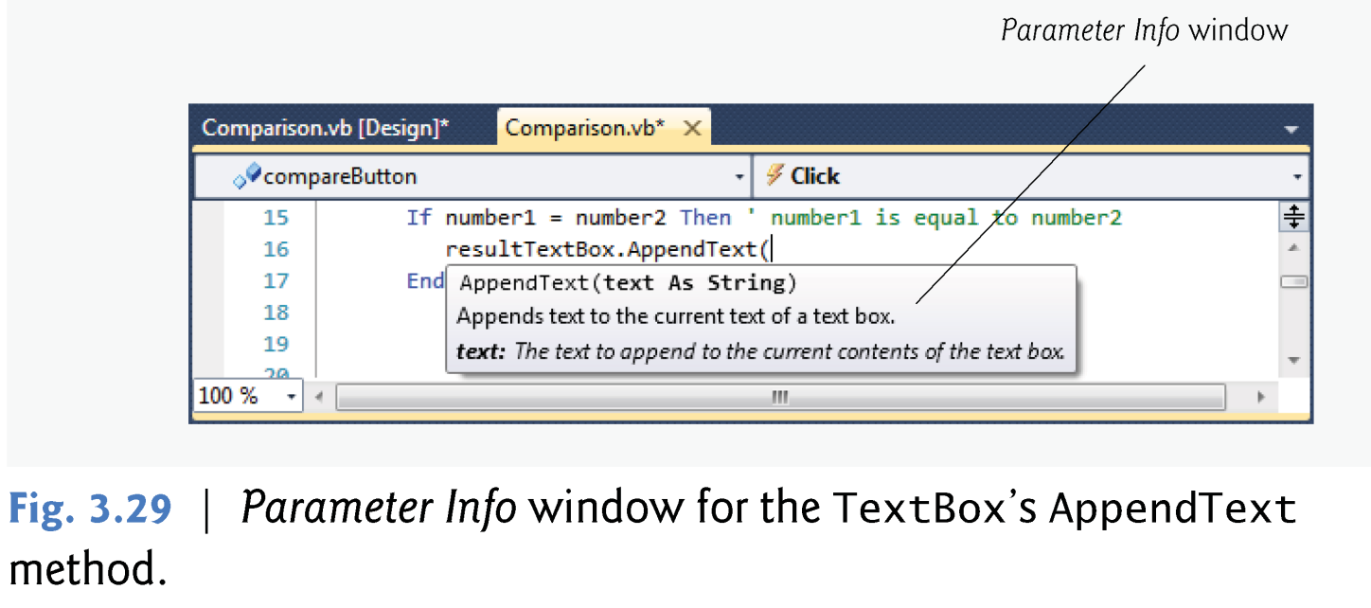
Entering the Code; Introducing the Parameter Info Window
  Enter the code from Fig. 3.27 into the three event handlers to complete the application.
  When you’re typing line 16, the IDE displays the Parameter Info window as you type the opening left parenthesis character, (, after resultTextBox.AppendText.
© 1992-2011 by Pearson Education, Inc. All Rights Reserved.

Slide 20

Operator Precedence
  Figure 3.30 shows the precedence of the operators introduced in this chapter.
  The operators are displayed from top to bottom in decreasing order of precedence.
© 1992-2011 by Pearson Education, Inc. All Rights Reserved.

Slide 21
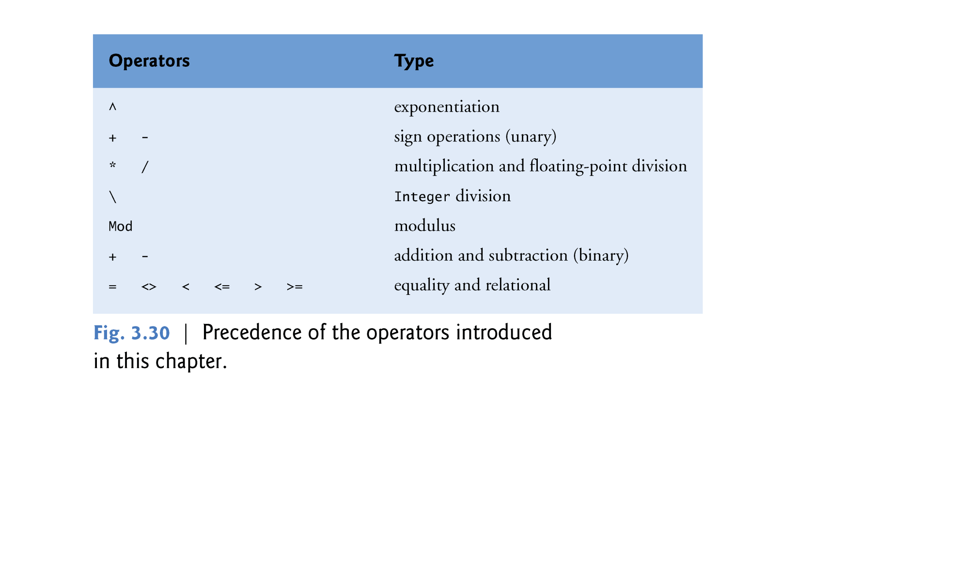
© 1992-2011 by Pearson Education, Inc. All Rights Reserved.

Slide 22

If (x+y^2)-u <> z\4*3 Then
3
1
2
4
5
6
Note: Don’t forget that parenthesis () has the highest priority amongst all the operators & anything inside them should be executed first.
© 1992-2011 by Pearson Education, Inc. All Rights Reserved.

Slide 23

A selection statement chooses among alternative courses of action.
Suppose that the passing grade on an examination is 60.Then the pseudocode statement
      If student’s grade is greater than or equal to 60 then
      Display “Passed”
Pseudocode is an informal language that helps you develop algorithms and it is not executed in the program.
Determines whether the condition “student’s grade is greater than or equal to 60” is true or false.
  If the condition is true, then “Passed” is displayed
  If the condition is false, the display statement is ignored
© 1992-2011 by Pearson Education, Inc. All Rights Reserved.

Slide 24

The preceding pseudocode If statement may be written in Visual Basic as
    If studentGrade >= 60 Then
    resultLabel.Text = "Passed" ' display "Passed"
    End If
The statement in the body of the If…Then statement displays the string "Passed" on resultLabel.
© 1992-2011 by Pearson Education, Inc. All Rights Reserved.

Slide 25

  Single Line If…Then statement
If…Then selection statement also could be written on a single line as
If studentGrade >= 60 Then resultLabel.Text = "Passed“
In the multiple-line format, all statements (there can be many) in the If…Then’s body execute if the condition is true.
In the single-line format, only the statement immediately after the Then keyword executes if the condition is true.
© 1992-2011 by Pearson Education, Inc. All Rights Reserved.

Slide 26

The If…Then…Else selection statement allows you to specify that a different action (or sequence of actions) is to be performed when the condition is true than when the condition is false.
For example, the pseudocode statement
      If student’s grade is greater than or equal to 60 then
      Display “Passed”
      Else
      Display “Failed”
  Displays “Passed” if the student’s grade is greater than or equal to 60,
  Displays “Failed” if the student’s grade is less than 60.
© 1992-2011 by Pearson Education, Inc. All Rights Reserved.

Slide 27
The preceding pseudocode If…Else statement may be written in Visual Basic as
    If studentGrade >= 60 Then
    resultLabel.Text = "Passed" ’ display "Passed"
    Else
    resultLabel.Text = "Failed" ’ display "Failed"
    End If
The body of the Else clause is indented so that it lines up with the body of the If clause.
© 1992-2011 by Pearson Education, Inc. All Rights Reserved.

Slide 28

Any thing between Then and Else (Body_1) will be executed only when the Condition(s) is/are met (true)
    If Condition(s) Then
    Body_1
    Else
    Body_2
    End If
Any thing between Else and End If (Body_2) will be executed only when the Condition(s) is/are not met (false)
© 1992-2011 by Pearson Education, Inc. All Rights Reserved.

Slide 29

Nested If…Then…Else statements test for multiple conditions by placing If…Then …Else statements inside other If…Then…Else statements.
For example, the pseudocode in Fig. 4.4 displays
  “A” for exam grades greater than or equal to 90,
  “B” for grades in the range 80–89,
  “C” for grades in the range 70–79,
  “D” for grades in the range 60–69
  and “F” for all other grades.
The pseudocode may be written in Visual Basic as shown in Fig. 4.5.
© 1992-2011 by Pearson Education, Inc. All Rights Reserved.

Slide 30
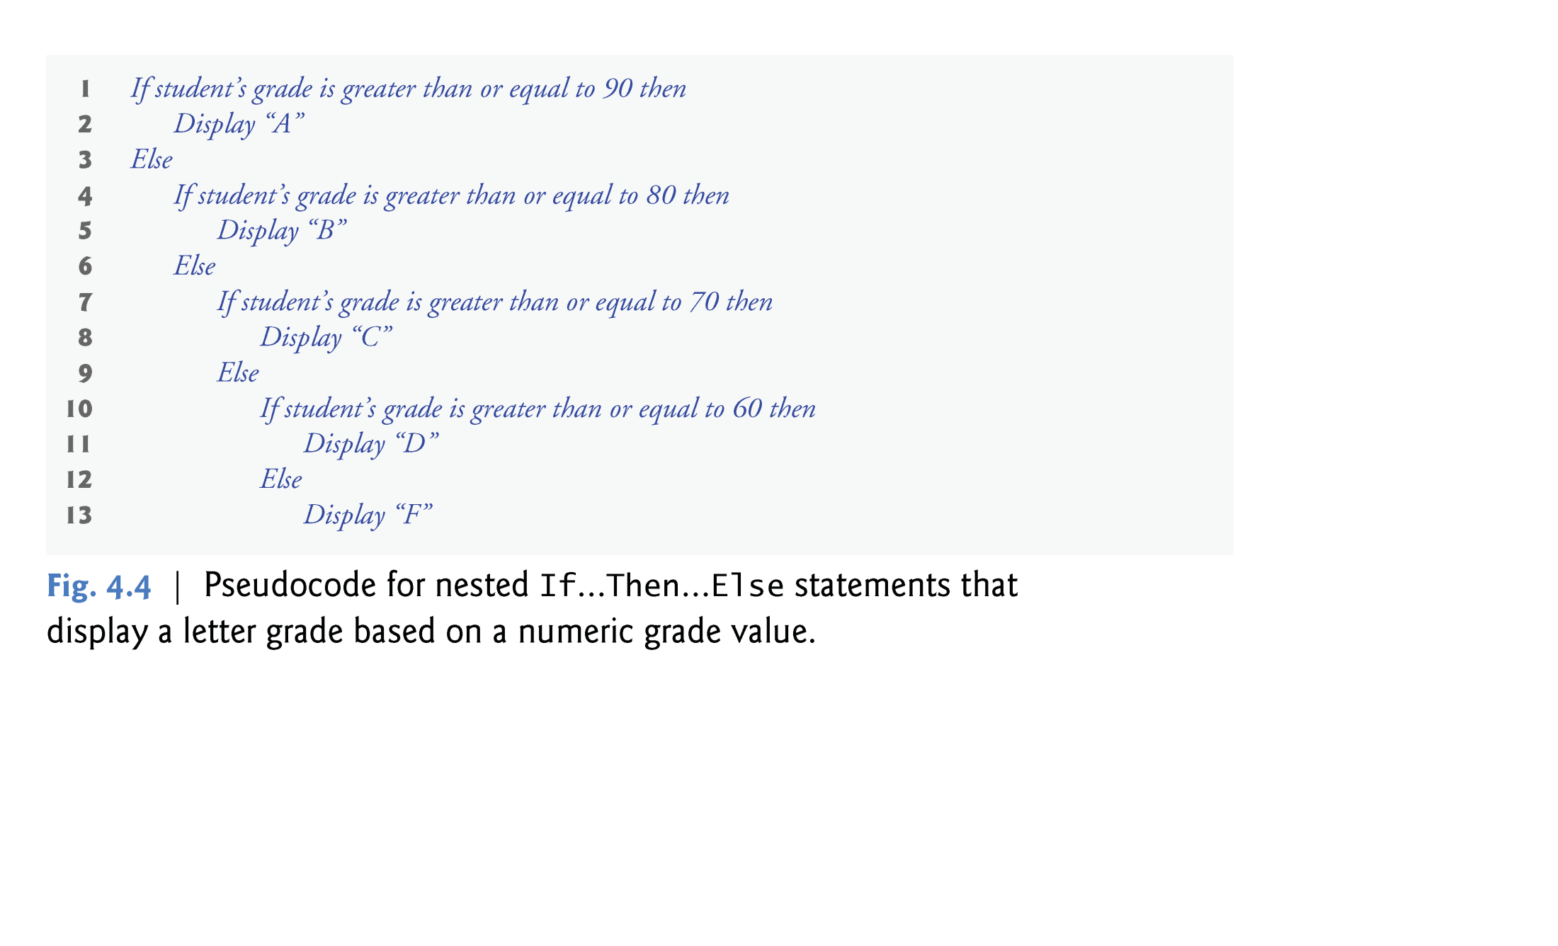
© 1992-2011 by Pearson Education, Inc. All Rights Reserved.

Slide 31
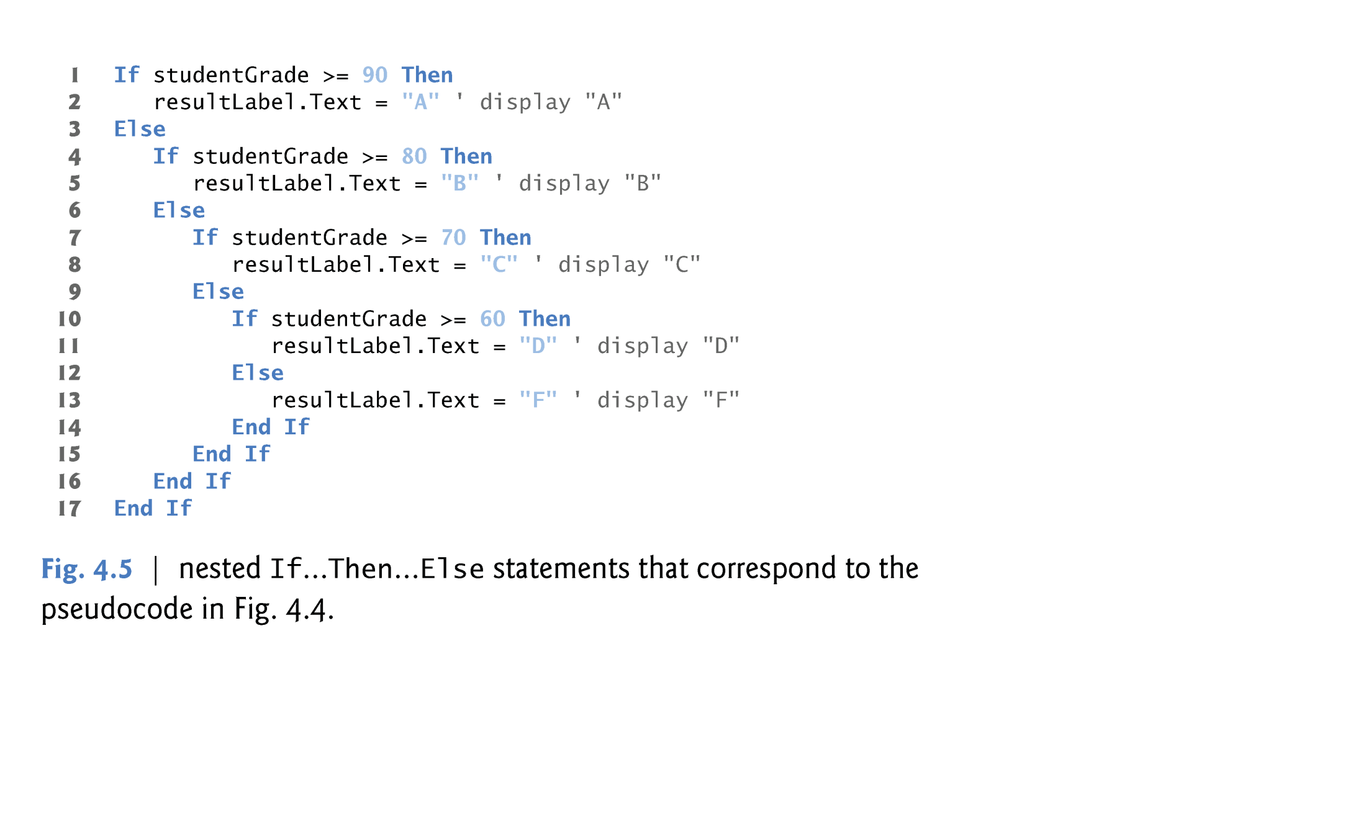
© 1992-2011 by Pearson Education, Inc. All Rights Reserved.

Slide 32
  ElseIf
Most programmers prefer to write the nested If…Then…Else statements from Fig. 4.5 using the ElseIf keyword as shown in Fig. 4.6.
Both forms are equivalent.
In nested If…Then…Else statements, if you type Else If on one line, the Visual Basic editor will automatically convert it to ElseIf as in Fig. 4.6.
© 1992-2011 by Pearson Education, Inc. All Rights Reserved.

Slide 33
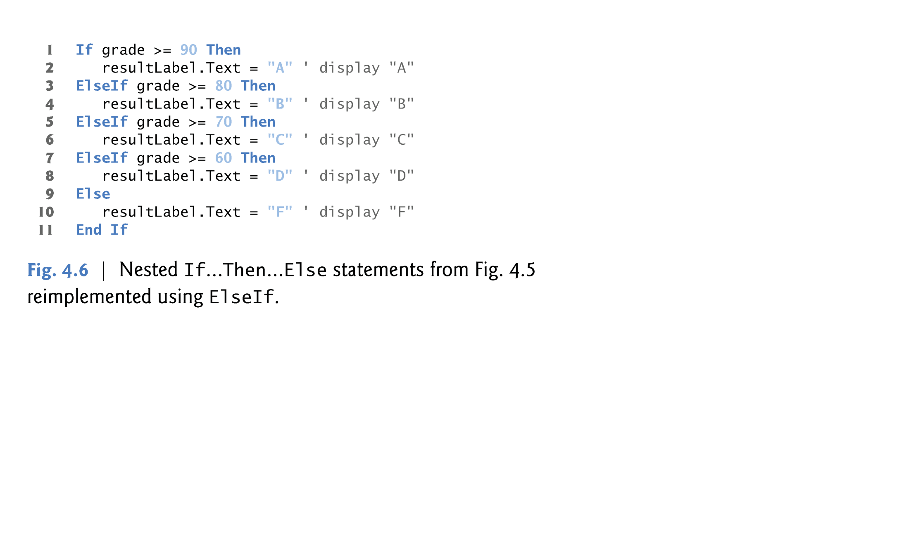
© 1992-2011 by Pearson Education, Inc. All Rights Reserved.

Slide 34

The compound assignment operators enable you to abbreviate assignment statements.
  For example, the statement
      value = value + 3
  Can be abbreviated with the addition assignment operator, += as
      value += 3
The += operator adds the value of the right operand to the value of the left operand and stores the result in the left operand’s variable.
Figure 4.8 summarizes the compound assignment operators.
© 1992-2011 by Pearson Education, Inc. All Rights Reserved.

Slide 35
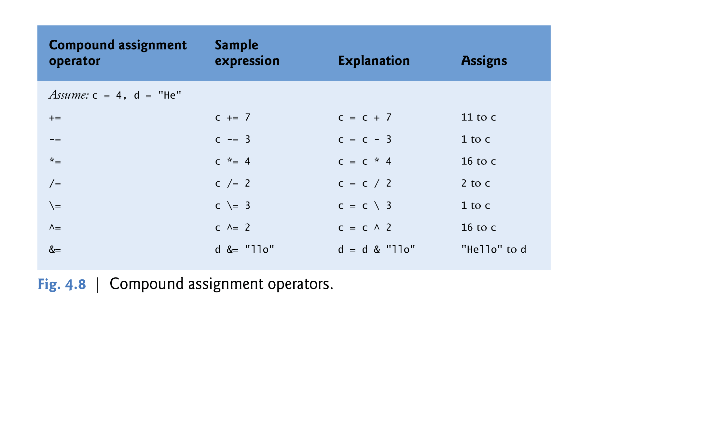
© 1992-2011 by Pearson Education, Inc. All Rights Reserved.

Slide 36
The variable on the left side of an assignment operator must be an a modifiable variable or property
The =, +=, -=, *=, /=, \=, ^= and &= operators are always applied last in an expression.
When an assignment (=) is evaluated, the expression to the right of the operator is always evaluated first, then the value is assigned to the left side variable.
© 1992-2011 by Pearson Education, Inc. All Rights Reserved.

Slide 37

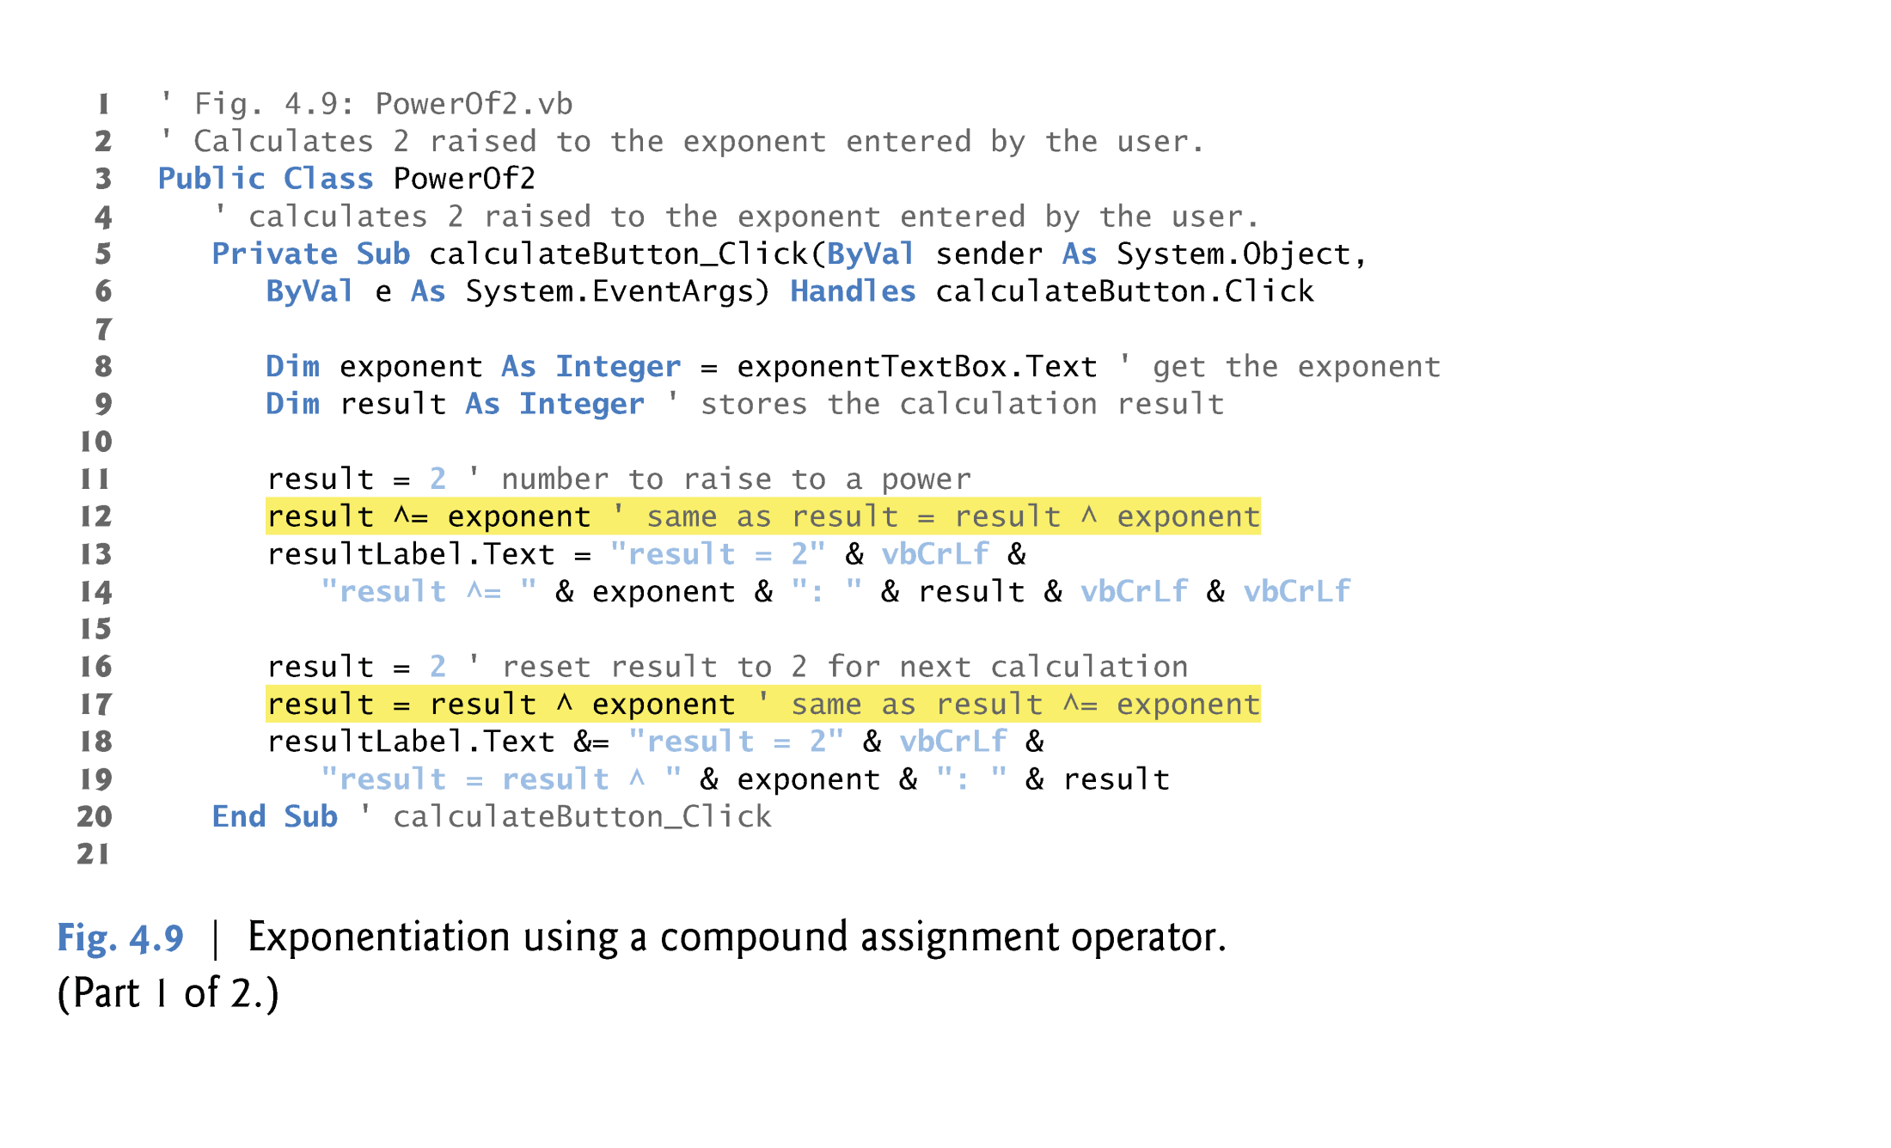
© 1992-2011 by Pearson Education, Inc. All Rights Reserved.

Slide 38
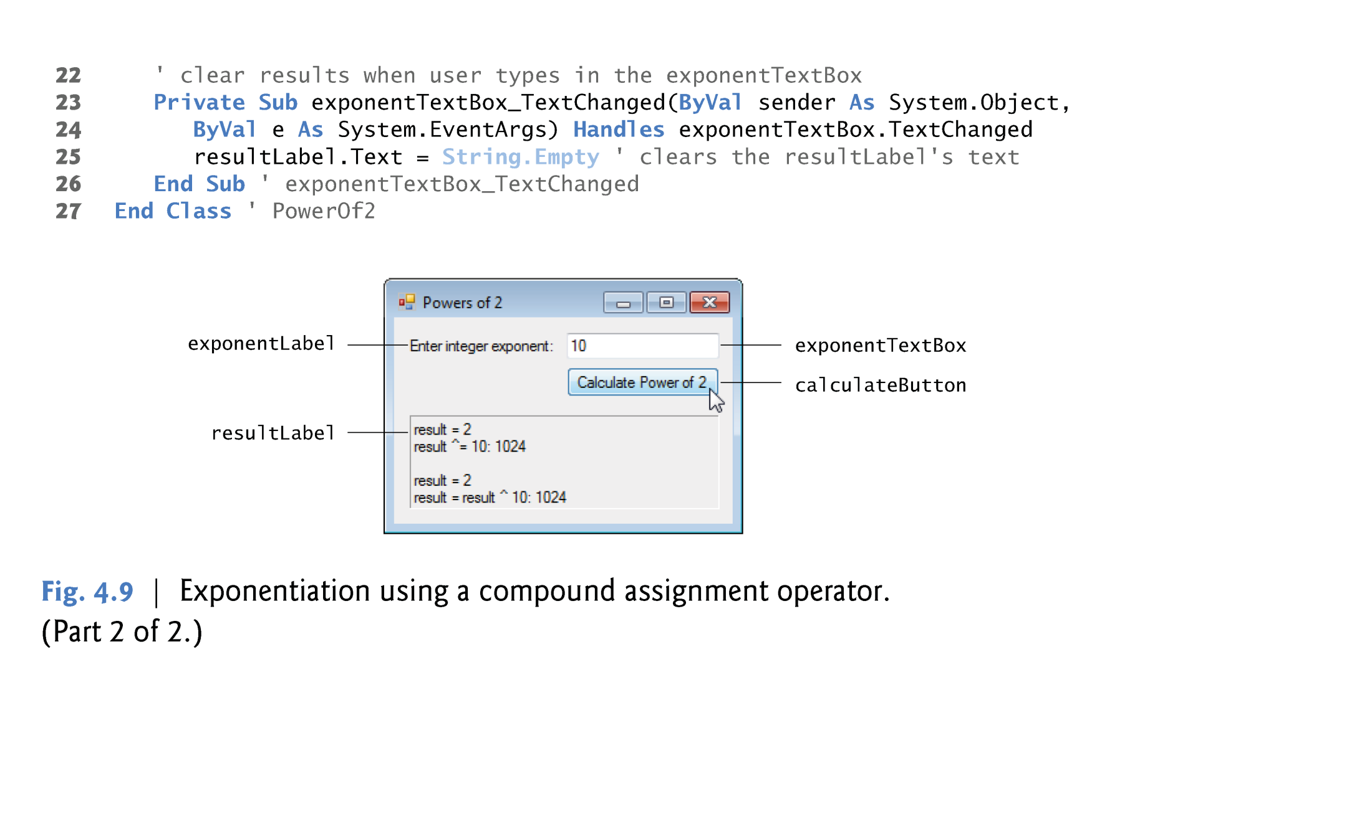
4.9 Example: Compound Assignment Operators
© 1992-2011 by Pearson Education, Inc. All Rights Reserved.

