Slide 1

© 1992-2011 by Pearson Education, Inc. All Rights Reserved

Slide 2

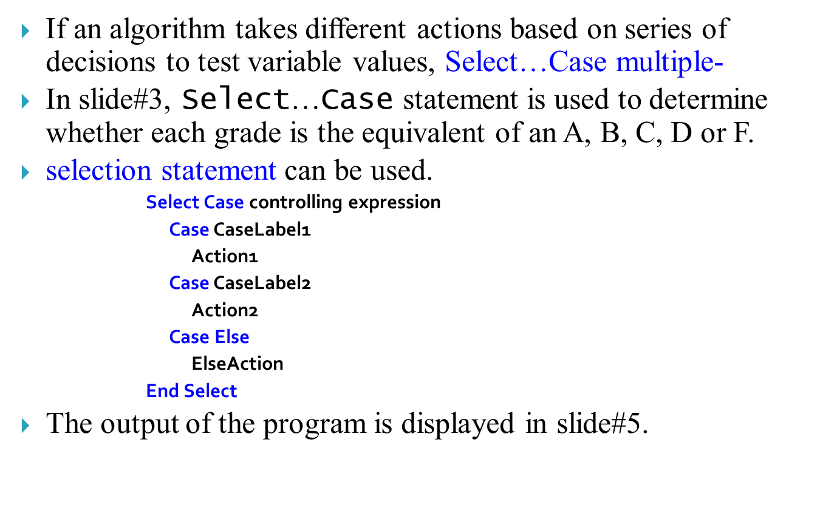
© 1992-2011 by Pearson Education, Inc. All Rights Reserved

Slide 3
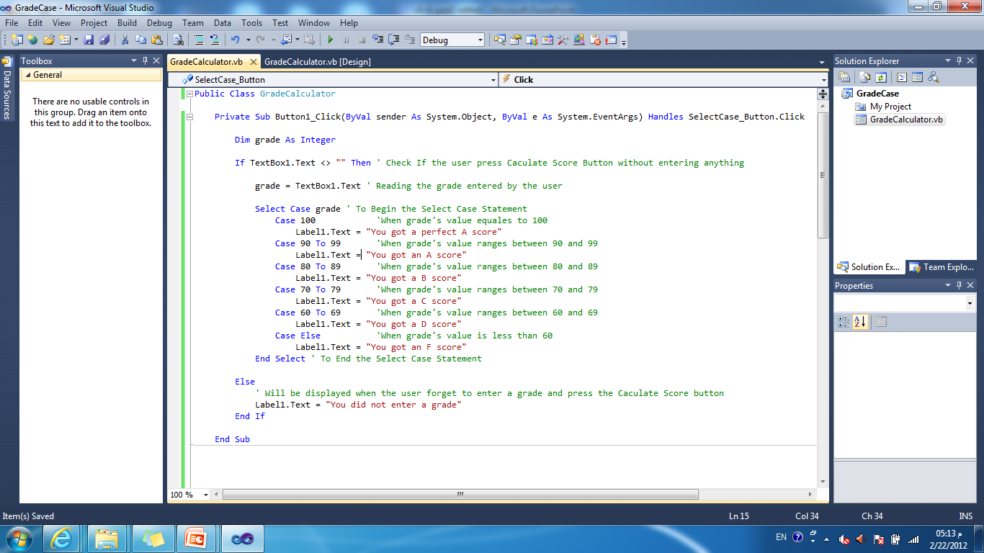
The above program Use the Select Case Statement to determine the grade
© 1992-2011 by Pearson Education, Inc. All Rights Reserved

Slide 4
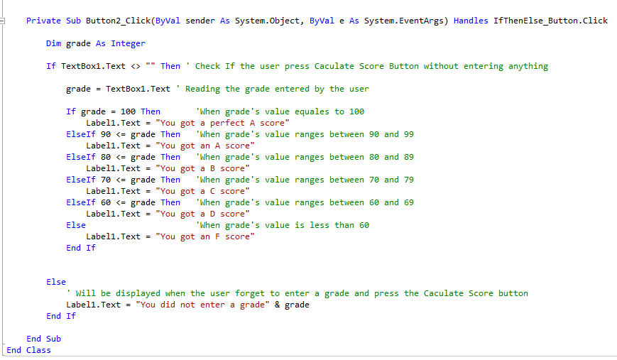
The above program Use If Then ElseIf Statement to determine the grade
- This program is equivalent to the one in previous slide#3 that uses Select Case
© 1992-2011 by Pearson Education, Inc. All Rights Reserved

Slide 5
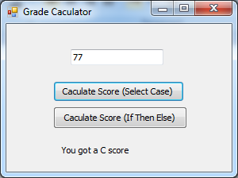
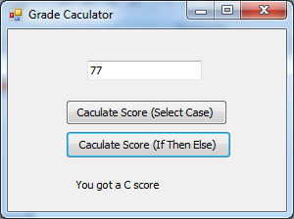
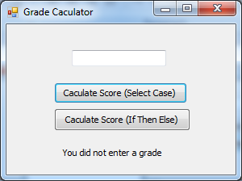
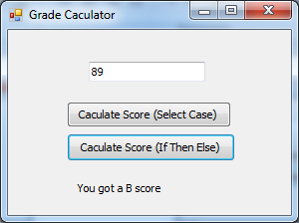
When The user enters grade 77 and press the Calculate Score button of the Select Case Statement (The code in Slide#3)
When The user enters grade 77 and press the Calculate Score button of the If Then Else Statement (The code in Slide#4)
When The user Press one of the Calculate Score Button Without Entering any score in the TextBox
When The user enters grade 89 and press one of the Calculate Score button
© 1992-2011 by Pearson Education, Inc. All Rights Reserved

Slide 6

A grade in the range:
  100 represents a Perfect A
  90–99 represents an A,
  80–89 represents a B,
  70–79 represents a C,
  60–69 represents a D
  and 0–59 represents an F.
We assume that the user enters a grade in the range 0–100.
The expression following the keywords Select Case (in this case, grade) is called the controlling expression.
It is compared in order with each Case.
If a matching Case is found, the code in the Case executes, then program control proceeds to the first statement after the Select…Case statement.
© 1992-2011 by Pearson Education, Inc. All Rights Reserved

Slide 7

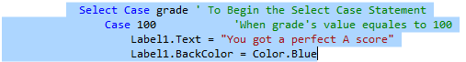
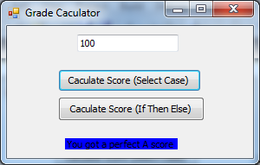
A Case statement can specify multiple actions:
  Example: The Following Case has two actions:
  The output will be as follows:
Keyword To specifies the range;
  Example:
  Case 80 To 89
  Means all the values [80,81,82,….,87,88,89] ranging between 80 to 89
© 1992-2011 by Pearson Education, Inc. All Rights Reserved

Slide 8
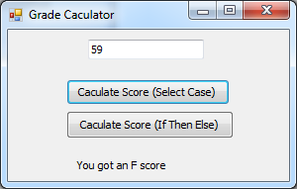
If no match occurs between the controlling expression’s value (grade) and a Case label, the optional Case Else executes.
It is not necessary to write the Case Else .
  Example:
    In Slide#3: If the User enters the value 59, the action of the Case Else will be executed as follows:
© 1992-2011 by Pearson Education, Inc. All Rights Reserved

Slide 9

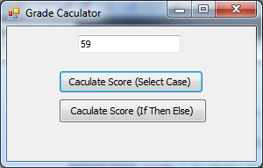
If no match occurs and the Select…Case does not contain a Case Else, program control simply continues with the first statement after the Select…Case.
  Example:
    If the code in slide#3 does not have the Case Else as bellow, when the user Enters the number 59 nothing will happen.
Nothing is displayed
© 1992-2011 by Pearson Education, Inc. All Rights Reserved

Slide 10

Case Else commonly is used to deal with invalid values.
In this example, we assume all values entered by the user are in the range 0–100.
When used, the Case Else must be the last Case.
The required End Select keywords terminate the Select…Case statement.
© 1992-2011 by Pearson Education, Inc. All Rights Reserved

Slide 11
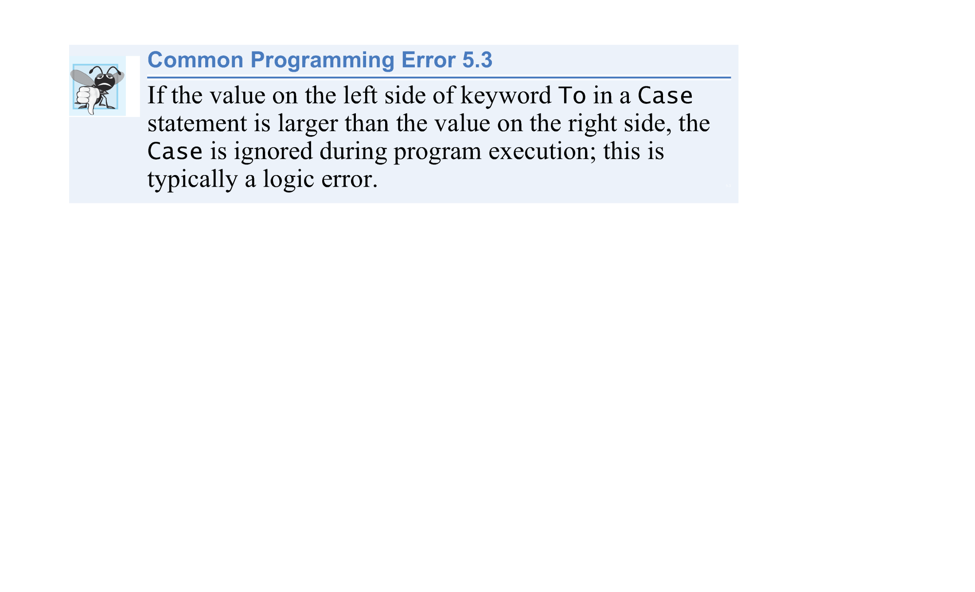
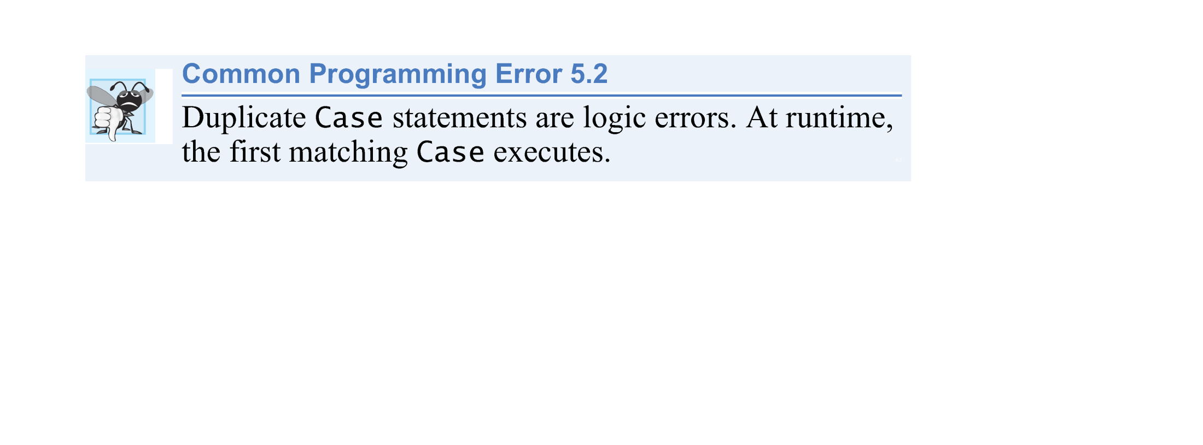
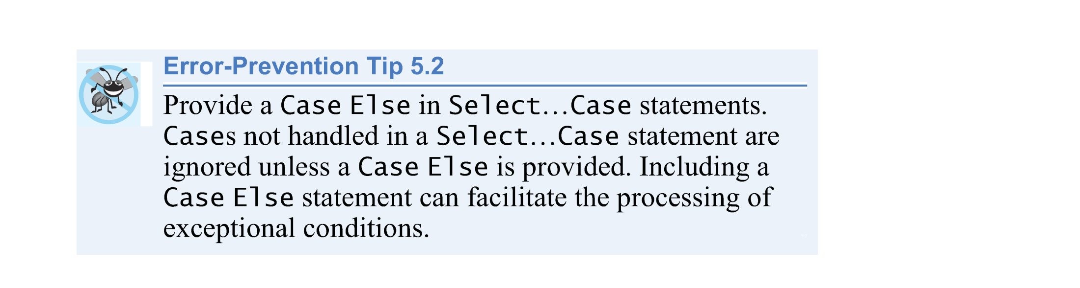
© 1992-2011 by Pearson Education, Inc. All Rights Reserved

Slide 12
Types of Case Statements
  Case statements also can use relational operators to determine whether the controlling expression satisfies a condition.
    For example:
  uses keyword Is along with the relational operator, <, to test for values less than 0.
Select Case grade
Case Is < 0
Equivalent
If grade < 0 Then
© 1992-2011 by Pearson Education, Inc. All Rights Reserved

Slide 13
Types of Case Statements
  Multiple values can be tested in a Case statement by separating the values with commas ( , ) as in
      Case 0, 5 To 9
  which tests for the value 0 or values in the range 5–9.
  Also, Cases can be used to test String values
© 1992-2011 by Pearson Education, Inc. All Rights Reserved

Slide 14
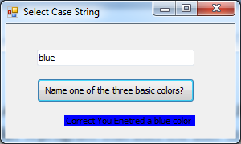
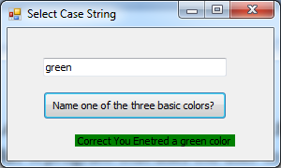
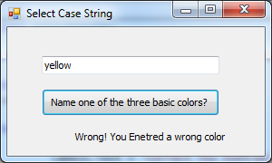
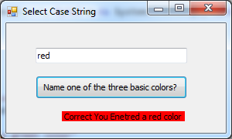
Select…Case Statement to test String values
  Example: (The Select Color Example) A program that asks the user to enter one of the three basic colors (red,green,blue) if the input is correct the label change its color to the entered color.
© 1992-2011 by Pearson Education, Inc. All Rights Reserved

Slide 15

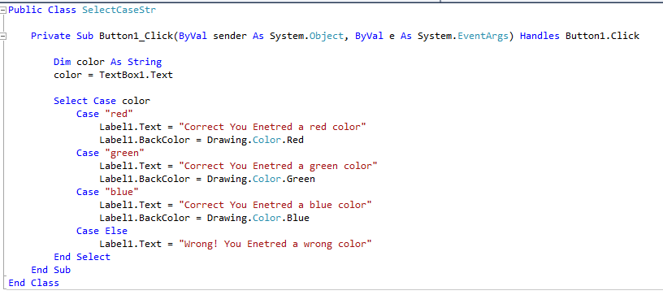
(The Select Color Example Program)
© 1992-2011 by Pearson Education, Inc. All Rights Reserved

Slide 16

A condition is an expression that results in a Boolean value—True or False.
So far, we’ve studied only simple conditions, such as count <= 10, total > 1000 and number <> -1.
Each selection and repetition statement evaluated only one condition with one of the operators >, <, >=, <=, = and <>.
© 1992-2011 by Pearson Education, Inc. All Rights Reserved.-Edited By

Slide 17
To handle multiple conditions more efficiently, the logical operators can be used to form complex conditions by combining simple ones.
Logical operators are And, Or, Xor and Not.
© 1992-2011 by Pearson Education, Inc. All Rights Reserved.-Edited By

Slide 18
Logical And Operator
  Suppose we wish to ensure that two conditions are both True in a program before a certain path of execution is chosen.
  In such a case, we can use the logical And operator as follows:
      If gender = "F" And age >= 65 Then
      seniorFemales += 1
      End If
  This If…Then statement contains two simple conditions.
© 1992-2011 by Pearson Education, Inc. All Rights Reserved.-Edited By

Slide 19
The condition gender = "F" determines whether a person is female and the condition age >= 65 determines whether a person is a senior citizen.
The two simple conditions are evaluated first, because the precedence of = and >= are both higher than the precedence of And.
    If gender = "F" And age >= 65
True
True
If both are True then the condition of the If Statement is met
© 1992-2011 by Pearson Education, Inc. All Rights Reserved.-Edited By

Slide 20
When this combined condition is True, the seniorFemales count is incremented by 1.
The readability of the preceding combined condition can be improved by adding parentheses:
    (gender = "F") And (age >= 65)
gender = "F" | age >= 65 | Is the If Condition met?
True | True | True
True | False | False
False | True | False
False | False | False
© 1992-2011 by Pearson Education, Inc. All Rights Reserved.-Edited By

Slide 21
Logical Or Operator
  Now let’s consider the Or operator.
  Suppose we wish to ensure that either or both of two conditions are True before we choose a certain path of execution.
  We use the Or operator as in the following program segment:
    If (semesterAverage >= 90 Or finalExam >= 90) Then
    resultLabel.Text = "Student grade is A"
    End If
  This statement also contains two simple conditions.
© 1992-2011 by Pearson Education, Inc. All Rights Reserved.-Edited By

Slide 22
The condition semesterAverage >= 90 is evaluated to determine whether the student deserves an “A” in the course because of his performance throughout the semester.
The condition finalExam >= 90 is evaluated to determine whether the student deserves an “A” in the course because of his performance on the final exam.
© 1992-2011 by Pearson Education, Inc. All Rights Reserved.-Edited By

Slide 23
The If…Then statement then considers the combined condition
    (semesterAverage >= 90 Or finalExam >= 90)
and awards the student an “A” if either or both of the conditions are True.
The text "Student grade is A" is displayed, unless both of the conditions are False.
The And operator has a higher precedence than Or.
© 1992-2011 by Pearson Education, Inc. All Rights Reserved.-Edited By

Slide 24
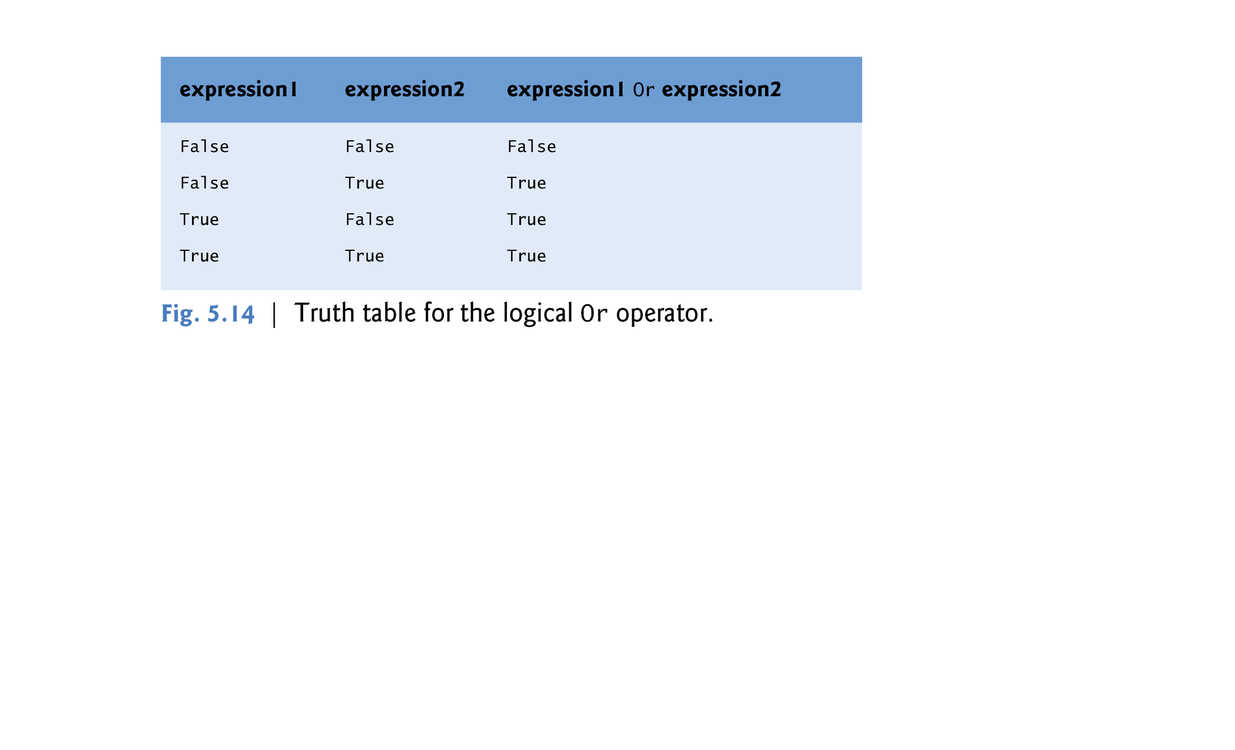
© 1992-2011 by Pearson Education, Inc. All Rights Reserved.-Edited By

Slide 25
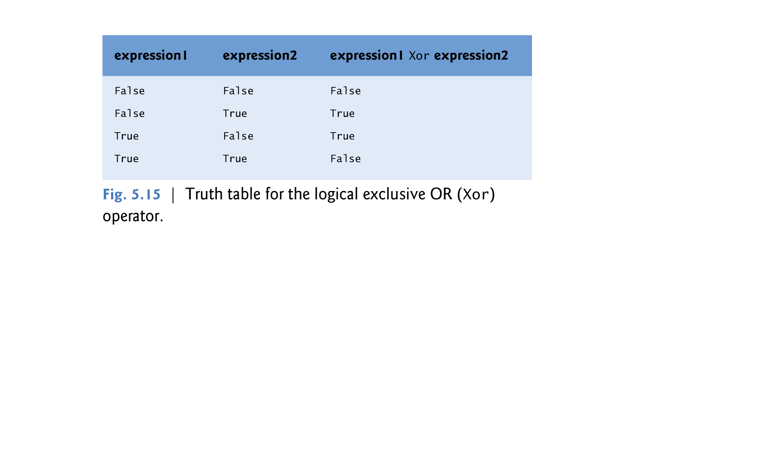
Logical Xor Operator
  A condition containing the logical exclusive OR (Xor) operator is True if and only if one of its operands results in a True value and the other results in a False value.
  If both operands are True or both are False, the entire condition is False.
© 1992-2011 by Pearson Education, Inc. All Rights Reserved.-Edited By

Slide 26
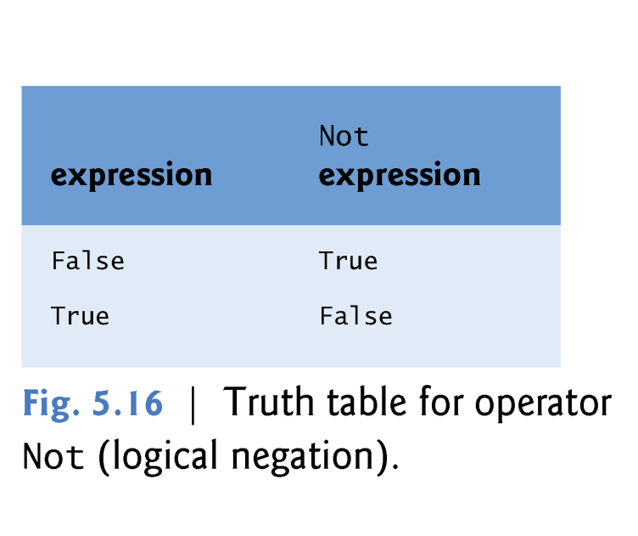
Logical Operators
Logical Not Operator
  The Not (logical negation) operator enables you to “reverse” the meaning of a condition.
  Unlike the logical operators And, Or and Xor, which each combine two conditions, the logical negation operator is a unary operator, requiring only one operand.
© 1992-2011 by Pearson Education, Inc. All Rights Reserved.-Edited By

Slide 27
The logical negation operator is demonstrated by the following program segment:
    If Not (value = 0) Then
    resultLabel.Text = "The value is " & value
    End If
The parentheses around the condition value = 0 are necessary because the logical negation operator (Not) has a higher precedence than the equality operator.
© 1992-2011 by Pearson Education, Inc. All Rights Reserved.-Edited By

Slide 28
In most cases, you can avoid using logical negation by expressing the condition differently with relational or equality operators.
This flexibility helps you express conditions more naturally.
For example, the preceding statement can be written as follows:
Can be written as
If Not (value = 0) Then
If value <> 0 Then
© 1992-2011 by Pearson Education, Inc. All Rights Reserved.-Edited By

Slide 29

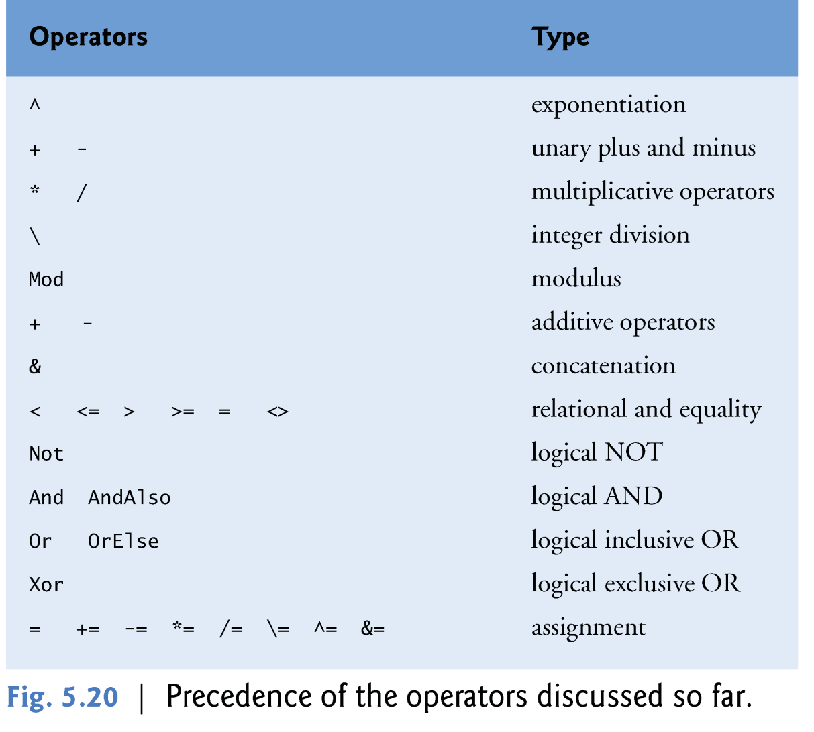
© 1992-2011 by Pearson Education, Inc. All Rights Reserved

Slide 30
Example #1
X += ( 4 \ y * 2 ) ^ ( x – 2 )
1
2
3
4
5
© 1992-2011 by Pearson Education, Inc. All Rights Reserved

Slide 31
Example #2
If Not( x * y < 0 ) And ( x ^ 2 >= 100 Mod 4 )
1
3
4
2
5
6
7
© 1992-2011 by Pearson Education, Inc. All Rights Reserved

