Slide 1

Visual Basic 2010 How to Program

Slide 2

A repetition statement (also called a looping statement, an iteration statement or a loop) allows you to specify that an action should be repeated, depending on the value of a loop-continuation condition or a loop-termination condition.

Slide 3

Counter-controlled repetition statements includes the Do While…Loop – Do ...Loop While – For...Next statement.
Counter-controlled repetition requires:
  the name of a control variable (or loop counter) that is used to determine whether the loop continues to iterate
  the initial value of the control variable
  the increment (or decrement) by which the control variable is modified each time through the loop
  the condition that tests for the final value of the control variable (that is, whether looping should continue).

Slide 4

Milk
Tomatoes
Bread
Strawberry
Coffee
The pseudocode statements
      While there are more items on my shopping list
      Put next item in cart
      Cross it off my list
The loop-continuation condition “there are more items on my shopping list”
  If it’s true, the following actions are performed (execute repeatedly while the condition remains true):
    “Put next item in cart”
    “Cross it off my list”
  The condition becomes false, when the last remaining item on the shopping list has been purchased and crossed off the list.
Shopping List

Slide 5
  Performing a Calculation in a Do While…Loop Repetition Statement
Consider a program segment designed to find the first power of 3 larger than 100.
    product = 3 ' Initialaization
    Do While product <= 100
    product = product * 3 ' compute next power of 3
    Loop

Slide 6
When the Do While…Loop statement begins execution, product is 3.
The body statement repeatedly multiplies product by 3, so it takes on the values 3, 9, 27, 81 and 243, successively.
When product becomes 243, the condition
  product <= 100 becomes false
This terminates the repetition with 243 as product’s final value.
Then, execution continues with the next statement after the keyword Loop.
If the condition in a Do While…Loop is initially false, the body statement(s) do not execute.

Slide 7
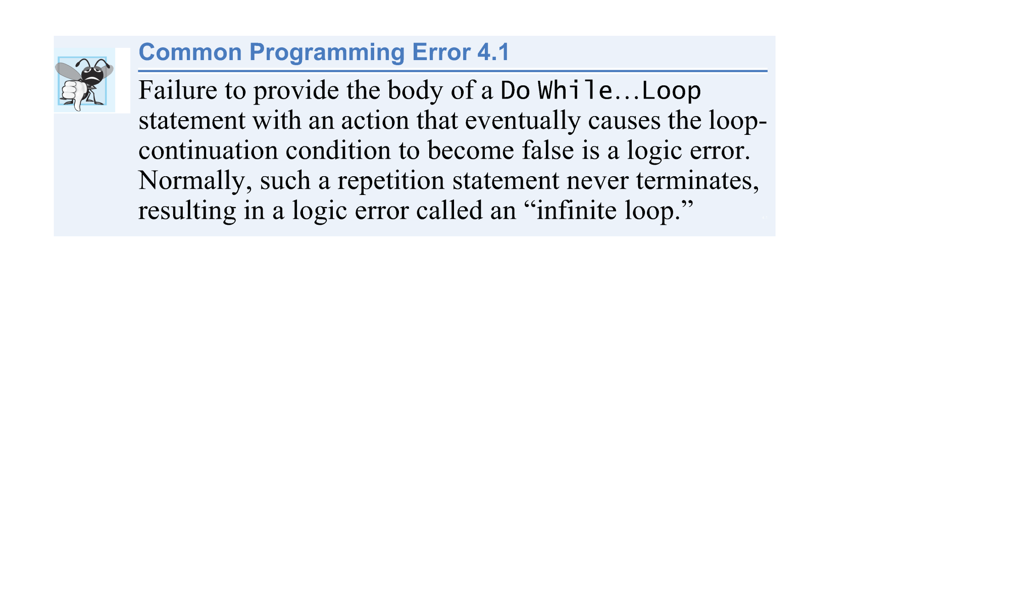
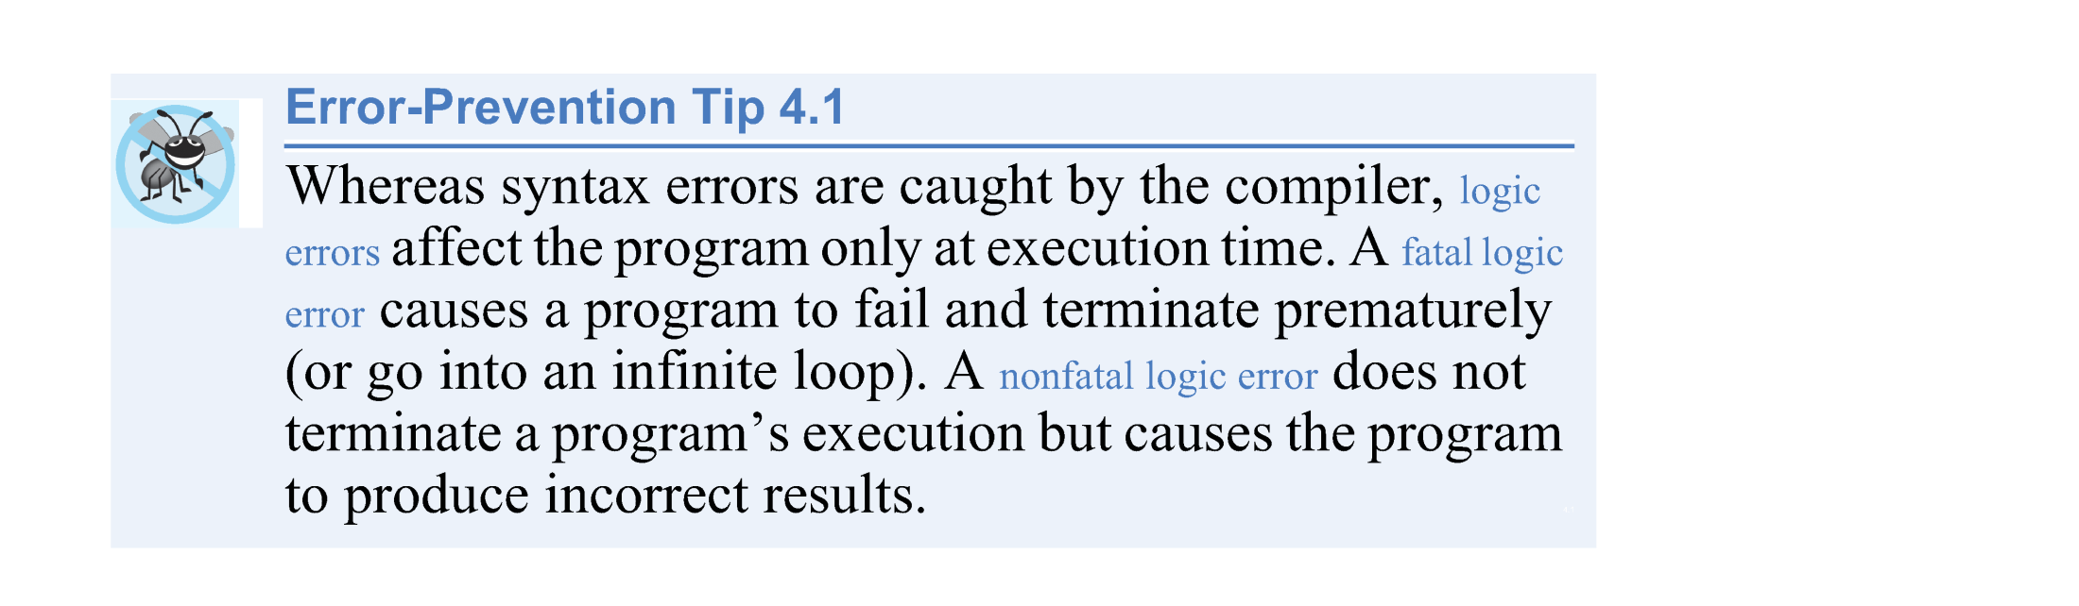

Slide 8
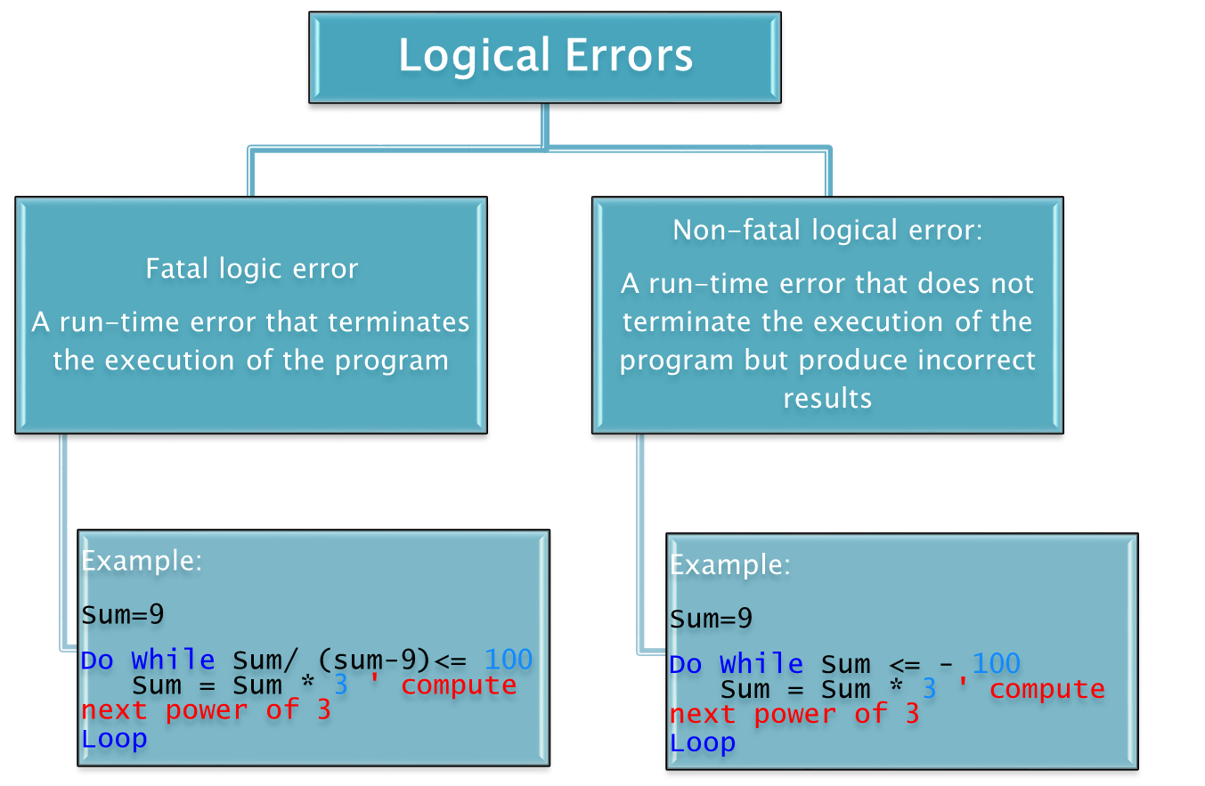

Slide 9

The Do…Loop While repetition statement is similar to the Do While…Loop statement.
In the Do While…Loop statement, the loop-continuation condition is tested at the beginning of the loop, before the body of the loop is performed, so these are referred to as pre-test loops.

Slide 10

The Do…Loop While statement tests the loop-continuation condition after the loop body is performed, so it’s referred to as a post-test loop.
In a Do…Loop While statement, the loop body is always executed at least once.
When a Do…Loop While statement terminates, execution continues with the statement after the Loop While clause.
The program in Fig. 5.11 uses a Do…Loop While statement to output the even integers from 2 to 10.

Slide 11
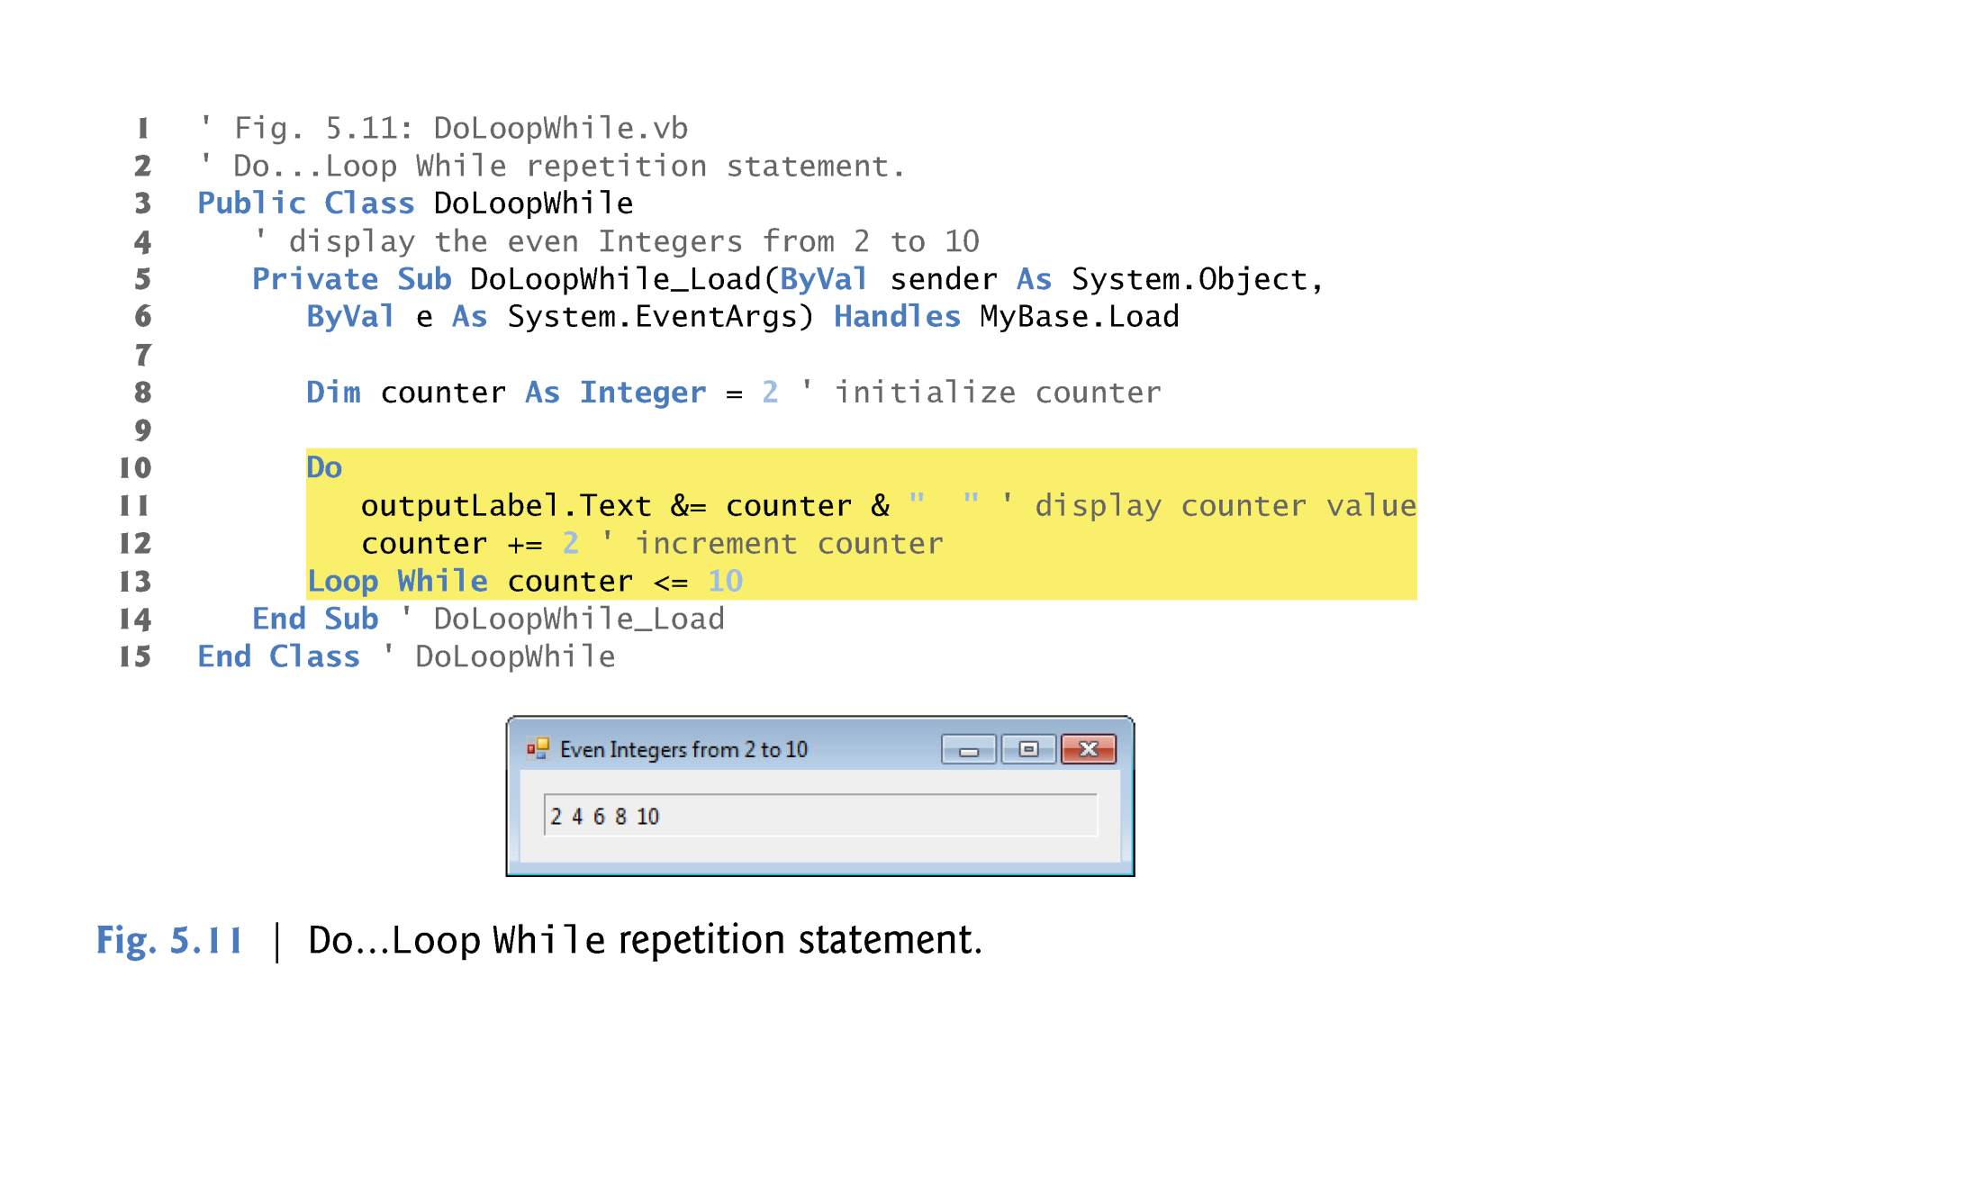

Slide 12

When lines 11–12 execute, it displays the value of counter (at this point, 2), then increments counter by 2.
Then the loop-continuation condition in line 13 is evaluated.
Variable counter is 4 <= 10, so the Do…Loop While statement executes lines 11–12 again.
In the 5th iteration of the statement, line 11 outputs the value 10, and line 12 increments counter to 12.
At this point, the loop-continuation condition in line 13 evaluates to false, and the program exits the Do…Loop While statement.

Slide 13

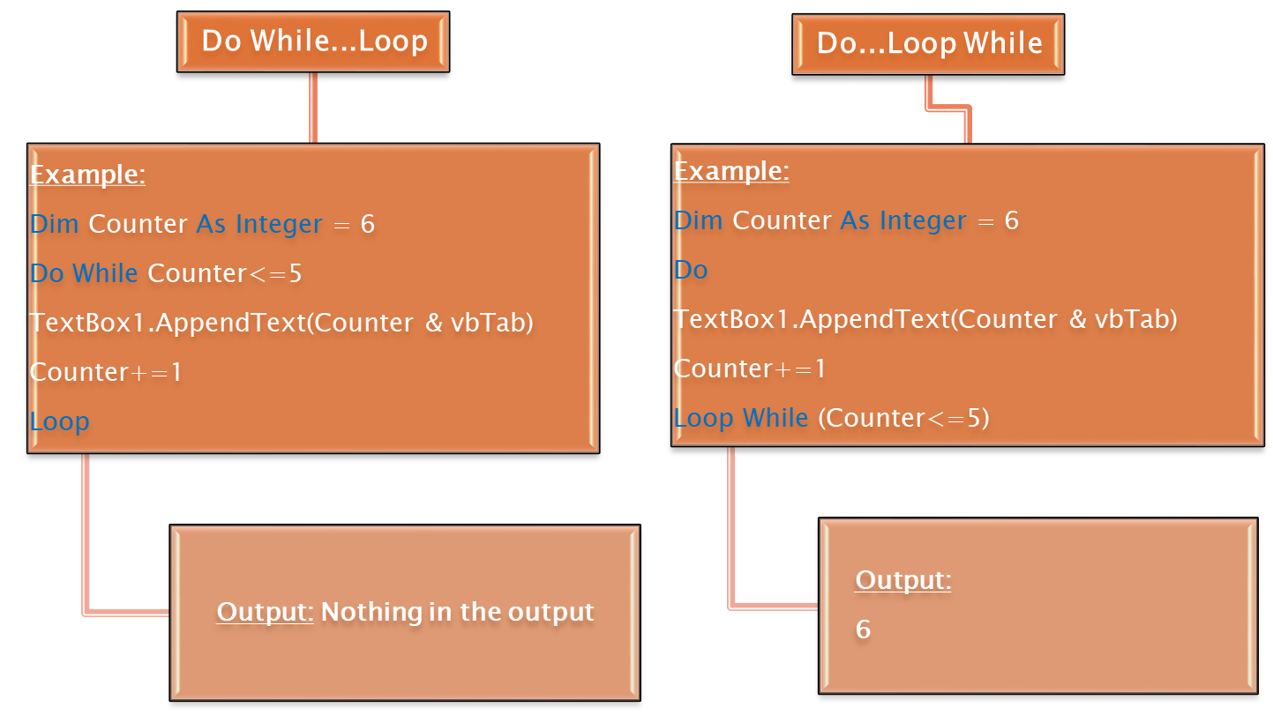

Slide 14

The general form of the For…Next statement is
    For initialization To finalValue Step increment
    statement
    Next
initialization expression initializes the loop’s control variable,
finalValue determines whether the loop should continue executing
increment specifies the amount the control variable should be incremented (or decremented) each time through the loop.

Slide 15
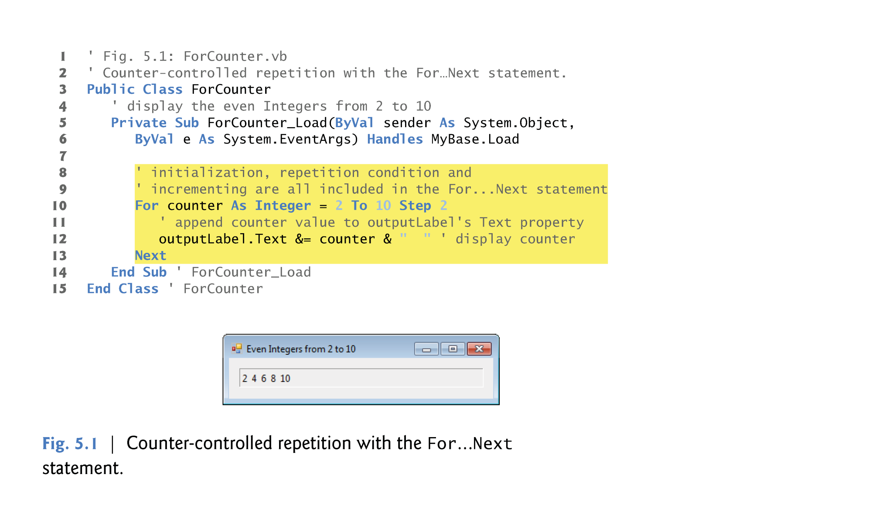
This means that when the Form of the Program Loads, this event handler will be executed
This equivalent to:
counter+=2
Or counter =counter+2

Slide 16

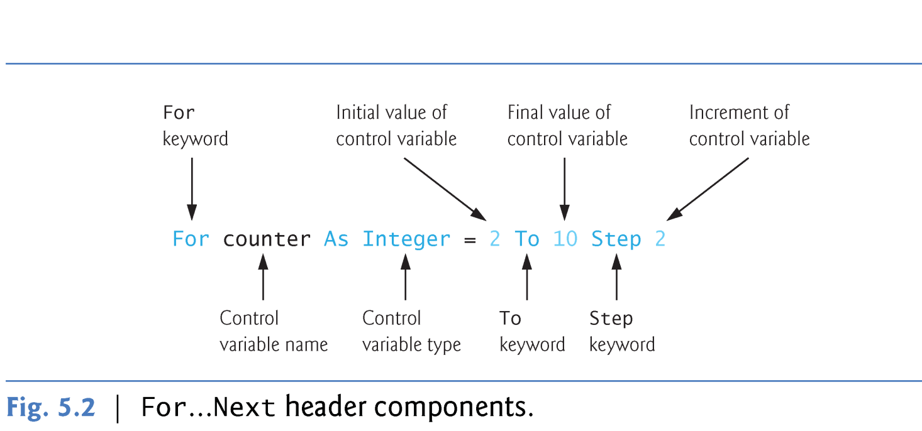
The For…Next repetition statement specifies counter-controlled repetition details in a single line of code.

Slide 17
At(lines 10–13) the control variable counter is declared as an Integer and initialized to 2.
Next, the loop-continuation condition counter <= 10 is tested.
The To keyword is required in the For…Next statement.
The optional Step keyword specifies the increment, that is, the amount that’s added to counter at each iteration.
If Step and the value following it are omitted, the increment defaults to 1.
  Example: Removing the Step keyword
      Code: Output:
  For Counter As Integer=2 To 10
  Label1.Text&=Counter & ” “ 2 3 4 5 6 7 8 9 10
  Next

Slide 18

The increment of a For…Next statement could be negative, in which case it’s called a decrement, and the loop actually counts downward.
Example:
For counter As Integer = 6 To 1 Step -1
Label1.Text &= counter & " "
Next

Slide 19

If the loop-continuation condition is initially false (for example, if the initial value is greater than the final value and the increment is positive), the For…Next’s body is not performed.
Instead, execution proceeds with the first statement after the For…Next.
Example:
For counter As Integer = 6 To 1
Label1.Text &= counter & " "
Next

Slide 20
First Iteration of the Loop
  In Fig. 5.1, the initial value of counter is 2, so:
    loop-continuation condition (counter <= 10) is true,
    And the counter’s value 2 is appended to outputLabel’s Text property (line 12).
  When Next is reached, variable counter is incremented by the Step value (2), and then the loop-continuation test is performed again.

Slide 21

Second and Subsequent Iterations of the Loop
  Now, the control variable is equal to 4.
  This value still does not exceed the final value, so the program performs the body statement again.
  This process continues until the counter value 10 is displayed which means:
    The control variable counter is incremented to 12
    The loop-continuation test fails and the loop to terminate.
  The program continues by performing the first statement after the For…Next statement (line 14).

Slide 22
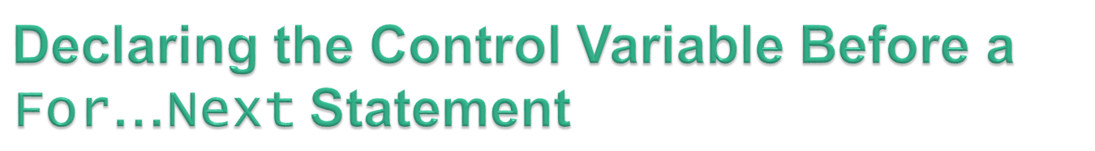
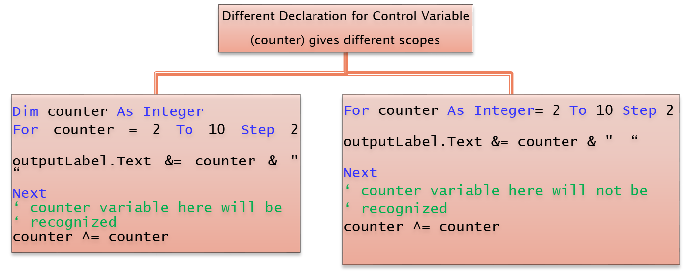
In Fig. 5.1, the counter variable is declared and initialized in the For…Next header.
The counter variable may be declared before the For…Next statement. Example
A
B

Slide 23
The difference between the two forms of declaration in the previous example:
  If the control variable is declared as in A it can be used inside the For…Next body and after it
  If the control variable is declared as in B the control variable can be used only inside the body of the For…Next
The variable’s scope specifies where the variable can be used in a program.

Slide 24
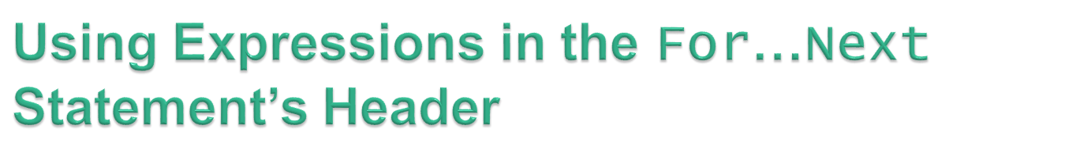
The starting value, ending value and increment portions of a For…Next statement can contain arithmetic expressions.
The expressions are evaluated once and used as the For..Next header.
  For example, assume that x = 2 and y = 10.
  The header
      For j As Integer = x To 4 * x * y Step y \ x
  is equivalent to the header
      For j As Integer = 2 To 80 Step 5

Slide 25
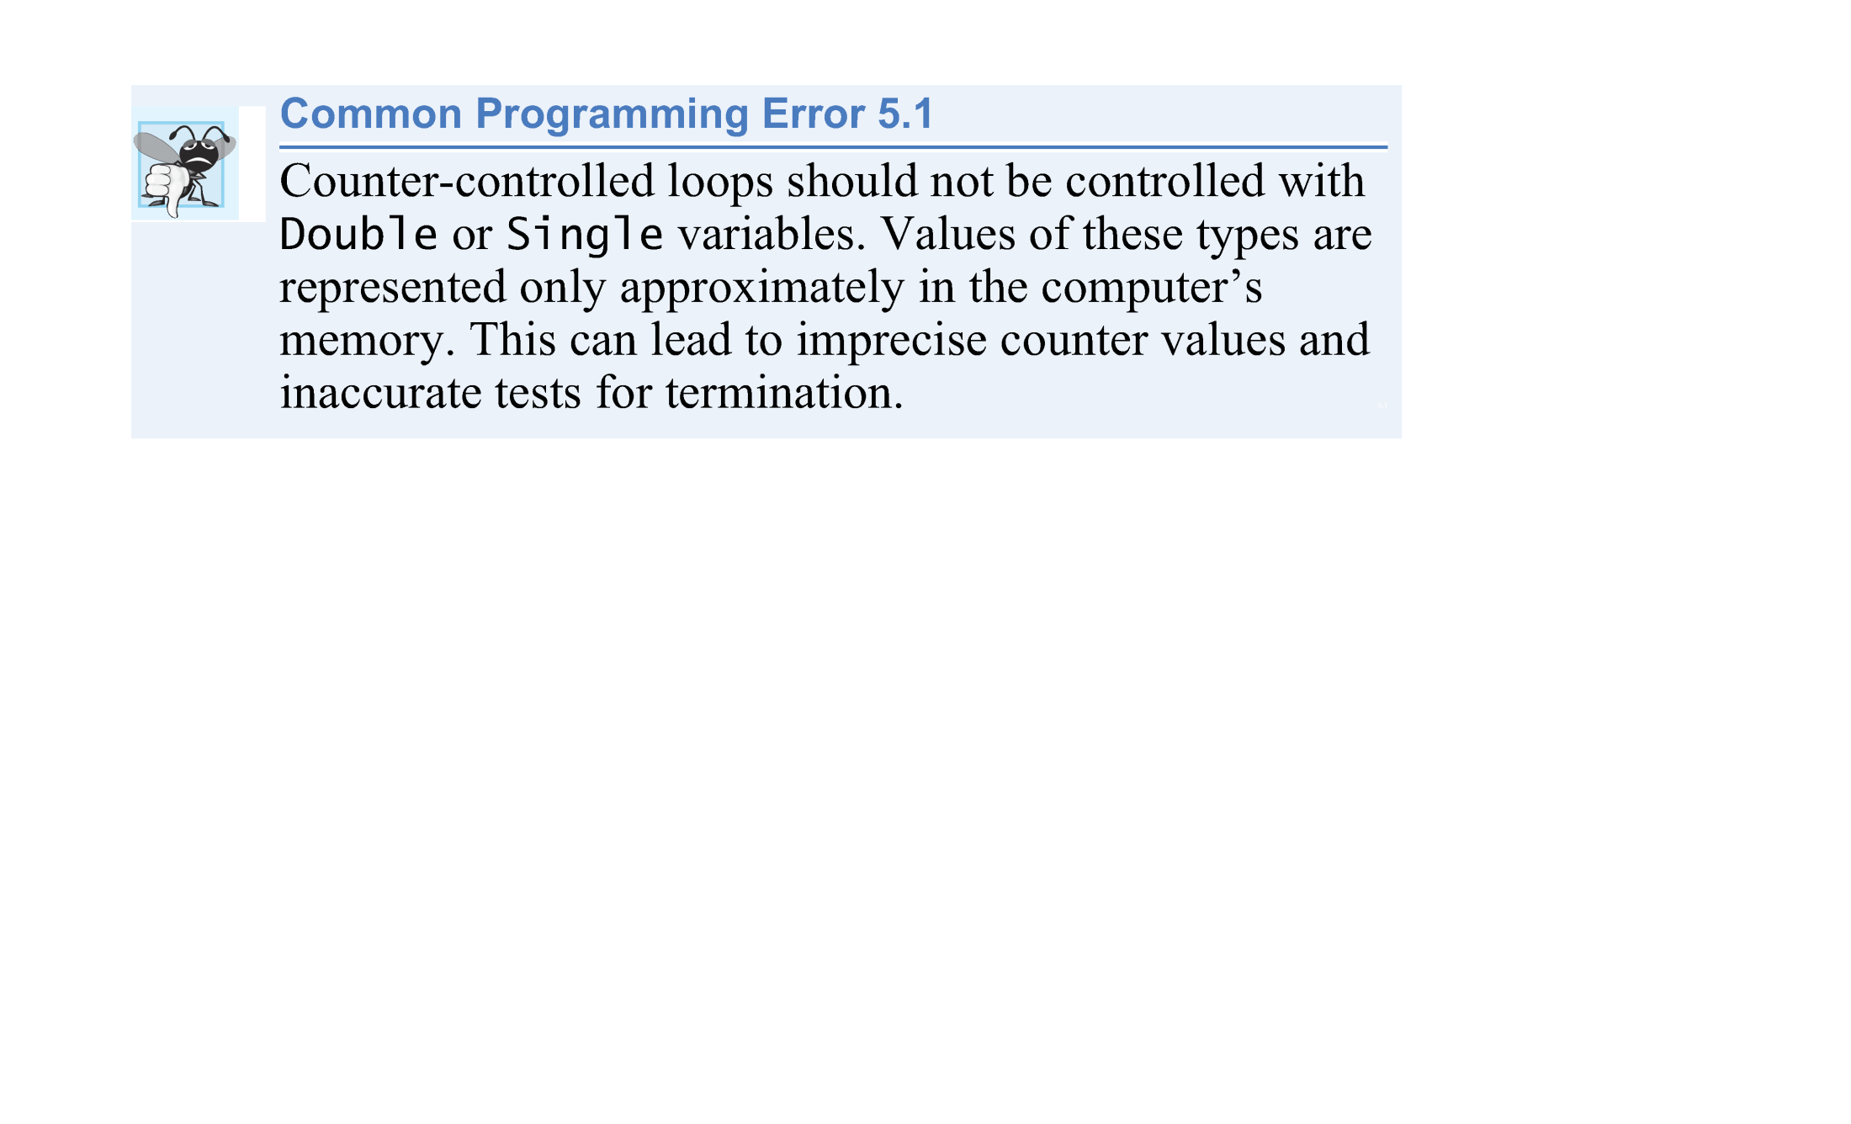

Slide 26

The For…Next header can be written as one of the following:
    Dim counter As Integer
    For counter = 1 To 10
    2) For counter As Integer = 1 To 10
    3) For counter = 1 To 10
In the 3rd case, counter is of type Integer because it is initialized with an Integer literal (1).

Slide 27

The following examples demonstrate different ways of varying the control variable in a For…Next statement.
  Vary the control variable from 1 to 100 in increments of 1.
    For i = 1 To 100 or For i = 1 To 100 Step 1
  Vary the control variable from 100 to 1 in increments of -1 (decrements of 1).
    For i = 100 To 1 Step -1
  Vary the control variable over the sequence of the following values: 99, 88, 77, 66, 55, 44, 33, 22, 11, 0.
    For i = 99 To 0 Step -11

Slide 28
  Vary the control variable from 7 to 77 in increments of 7.
    For i = 7 To 77 Step 7
  Vary the control variable from 20 to 2 in increments of -2 (decrements of 2).
    For i = 20 To 2 Step -2
  Vary the control variable over the sequence of the following values: 2, 5, 8, 11, 14, 17, 20.
    For i = 2 To 20 Step 3

Slide 29
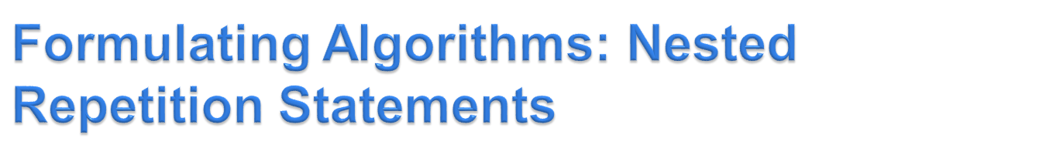
Consider the following problem statement:
  Write a program that displays in a TextBox a filled square consisting solely of one type of character, such as the asterisk (*). The side of the square and the character to be used to fill the square should be entered by the user. The length of the side should be in the range 1 to 20.

Slide 30
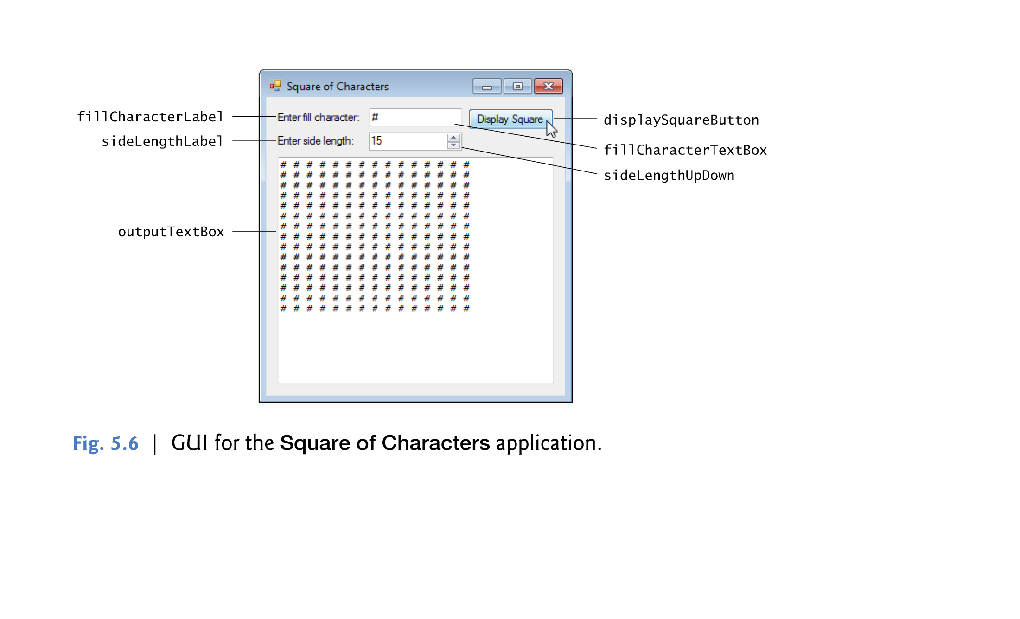

Slide 31
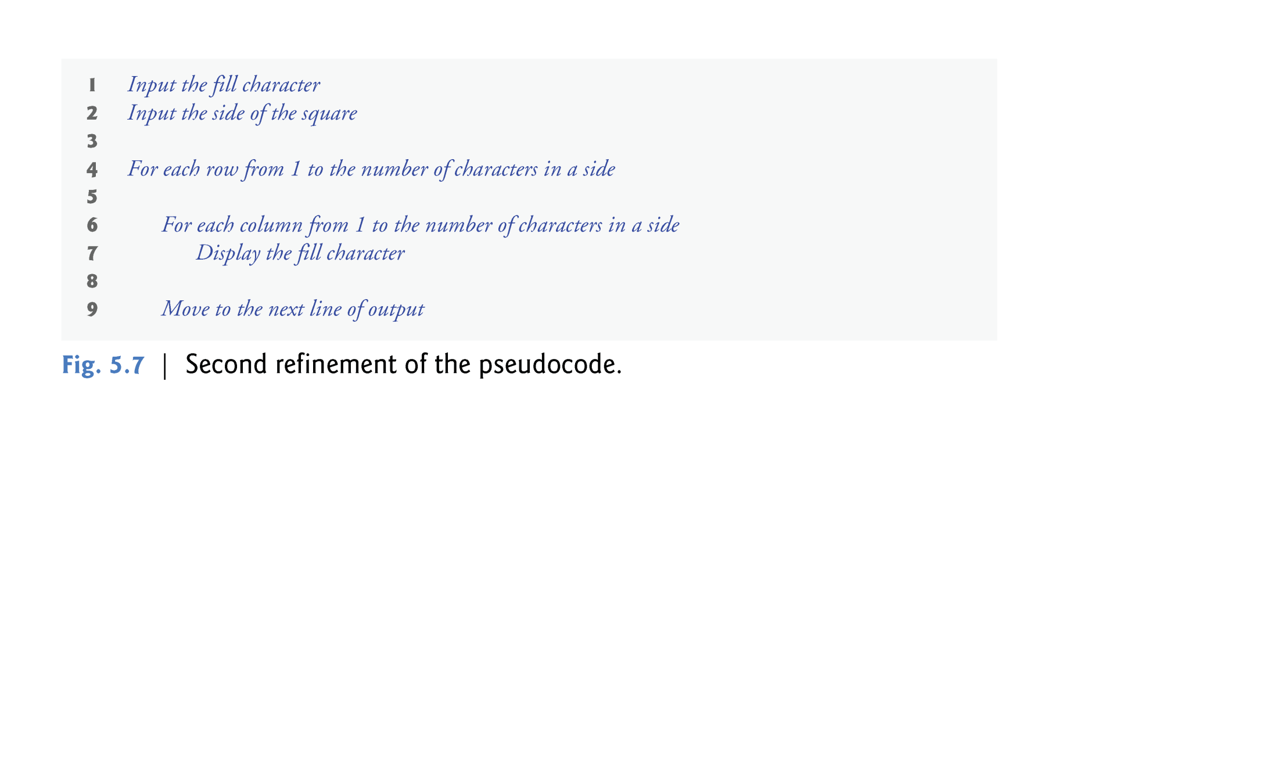

Slide 32
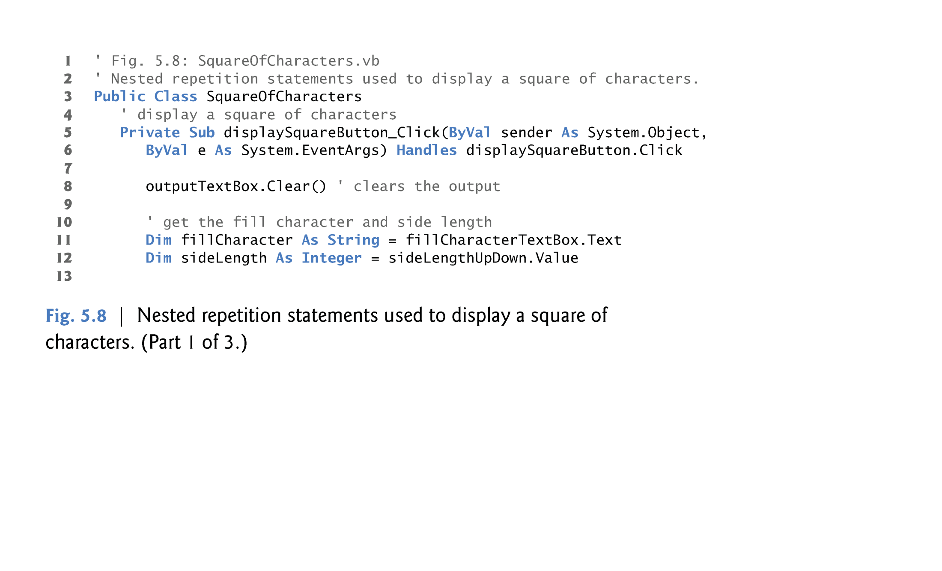

Slide 33
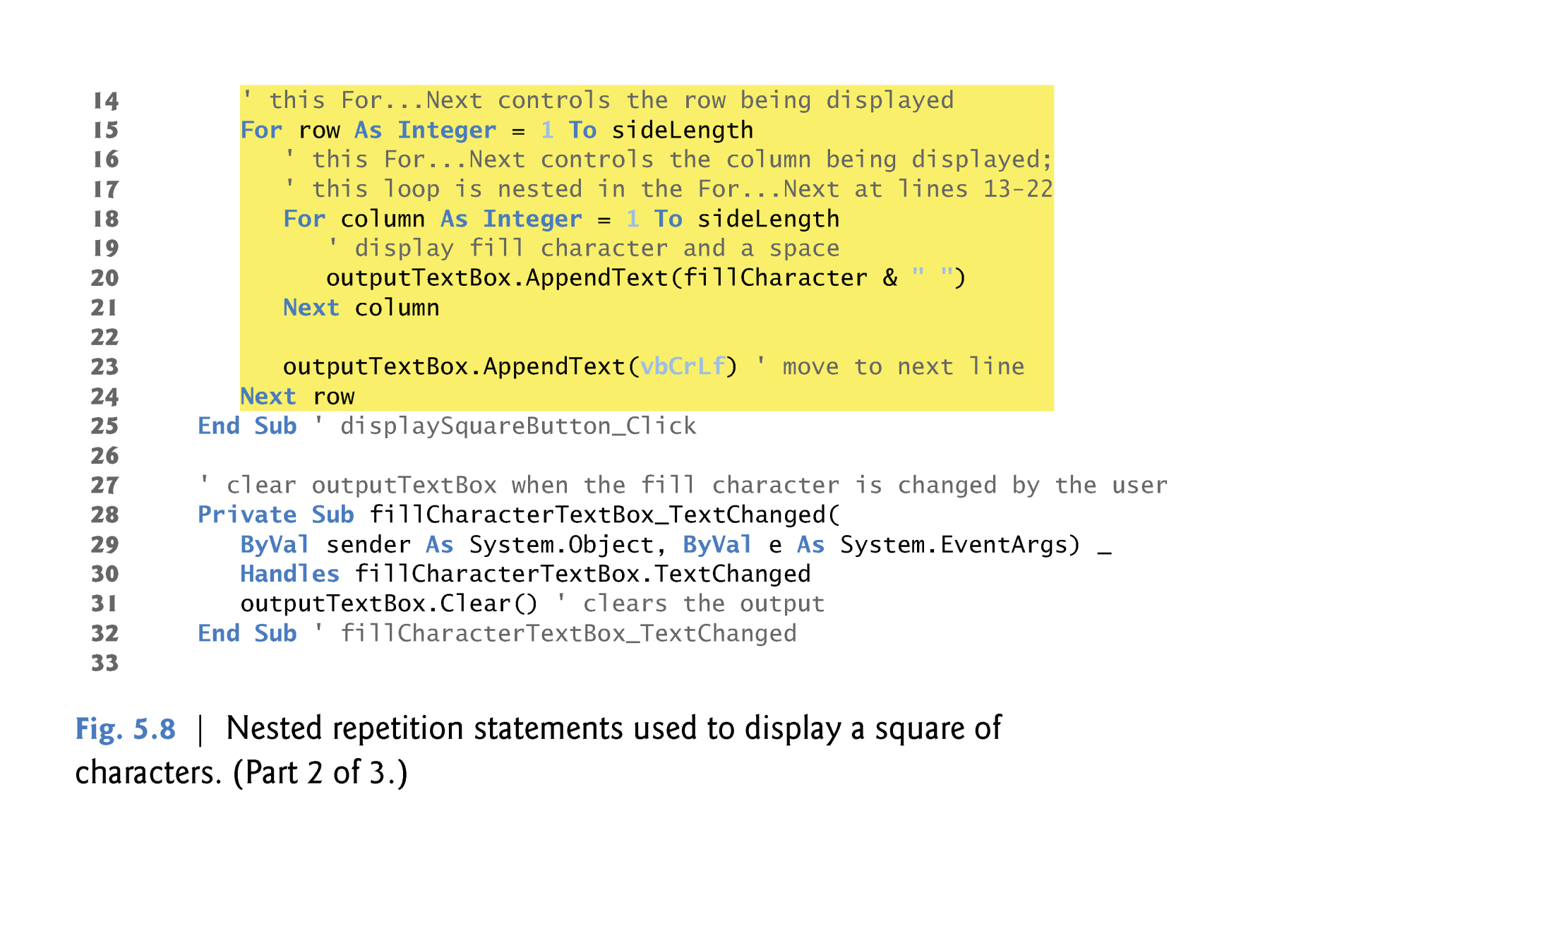

Slide 34
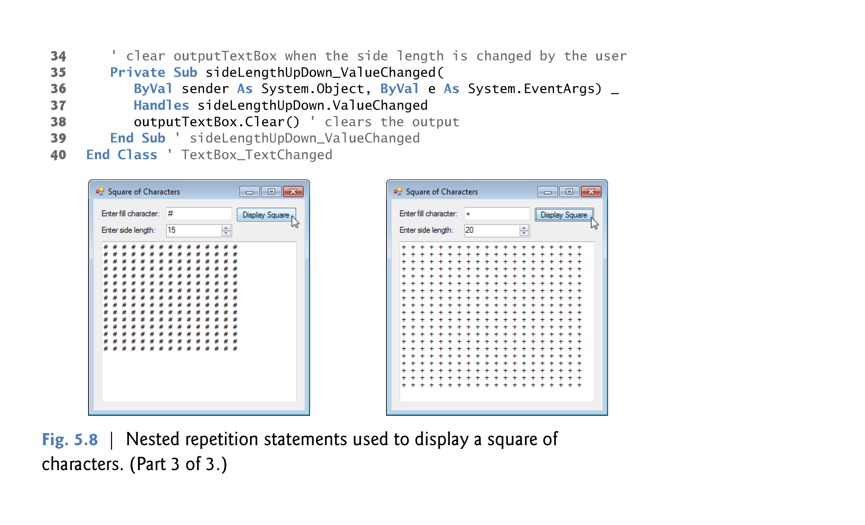

Slide 35


Slide 36

The Assignment Statement is used to assign values to a property of an object such as a control.
The general form of the assignment statement is shown here.
Object.Property = Value
Assign a student name to the Text property of the TextBox control named NameTextBox and a student’s major to the TextBox control named MajorTextBox. The assignment statements to do this are:
NameTextBox.Text = “Nora Ali"
MajorTextBox.Text = “IT"
Notice that the value is enclosed within double-quote marks – this indicates the value is a string of characters and only string data is stored to the Text property of a TextBox control.

Slide 37

The Clear method is used to clear the contents of a TextBox control. The general way to execute a method is shown here:
NameTextBox.Clear()
Or
NameTextBox.text = “”

Slide 38
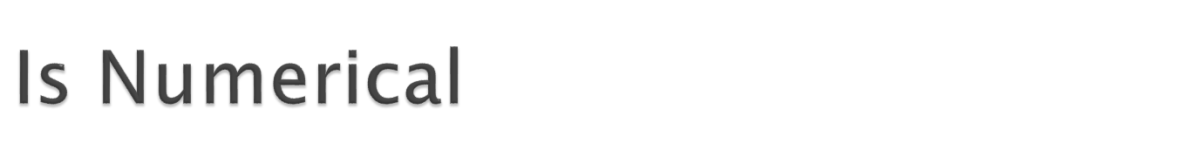
Function IsNumeric
which has the following declaration:
Public Function IsNumeric(ByVal Expression As Object) As Boolean
Return boolean value:
  True: If it gets number
  False: Otherwise

Slide 39

  Dim a, b, c, d, e, f, g As Double
  a = 8.0
  b = 3.0
  c = 4.0
  d = 2.0
  e = 1.0
  f = a - b + c / d * e ' The preceding line sets f to 7.0. Because of natural operator ' precedence and associativity, it is exactly equivalent to the ' following line.
  f = (a - b) + ((c / d) * e)
  Ex:

Slide 40

The Close method is used to close a form.

Slide 41

VB will save your project files every time you build or execute a project after your initial save.
VB projects consist of many different files and folders within folders.
Save files as you work by clicking the Save All button on the button toolbar.
DO NOT USE the File-Save As menu at any time to try to save the project – if you do, you will likely only save an individual file, not the entire project, and you will not have a complete project saved.

Slide 42
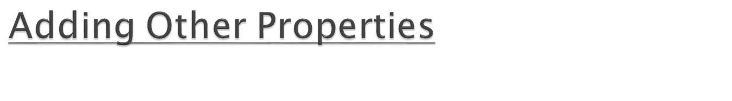
BorderStyle property – Labels, TextBox and PictureBox controls all have a BorderStyle property – this property makes controls appear as either flat or three-dimensional.
BorderStyle property -- set to an appropriate value to enhance the appearance of a form and add a professional touch to a project.
BorderStyle property values:
  None – flat appearance with no border.
  FixedSingle – a flat appearance with black border.
  Fixed3D – for a TextBox, this looks about like FixedSingle. For a Label control, the appearance is a three-dimensional, recessed appearance.
The TextBox control default value for BorderStyle is Fixed3D.
The Label and PictureBox controls default value for BorderStyle is None.

Slide 43

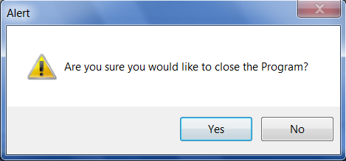
Dialog title
PromptText
Icon
Buttons

Slide 44





The message box function takes 3 main parameters:
Msgbox (Prompt Text, Buttons+Icon, DialogTitle)
[ Prompt : a Text which contains the message. ]
Button Constant
vbOKOnly
vbOkCancel
vbYesNo
vbYesNoCancel
vbAbortRetryIgnore
vbRetryCancel
Icon Constant | Icon
vbQuestion
vbInformation
vbExclamation
vbCritical

Slide 45

MsgBox("Are you sure you would like to close the Program?", vbYesNo + vbExclamation, "Alert")

Slide 46

Dim randomNumber As Random = New Random
Variable name
Data type
Initialization

Slide 47

Next()
    Non-negative random integer
NextDouble()
    A double between 0.0 and 1.0
Next(IntegerValue)
    A positive integer < IntegerValue
Next(IntValue1,IntValue2)
    IntValue1 <= an integer < IntValue2

Slide 48

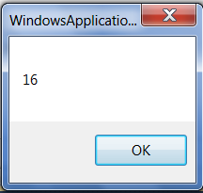
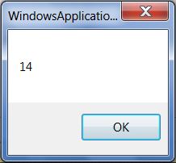
Dim randomNumber As Random
randomNumber = New Random
Dim number As Integer
number = randomNumber.Next(12, 20)
MsgBox(number)

Slide 49

The constants vbCrLf and vbTab represent the carriage return/linefeed character and the tab character, respectively.
In the case of vbCrLf, the value represented is the combination of the carriage return and linefeed characters, which cause subsequent output to print at the beginning of the next line.

Slide 50

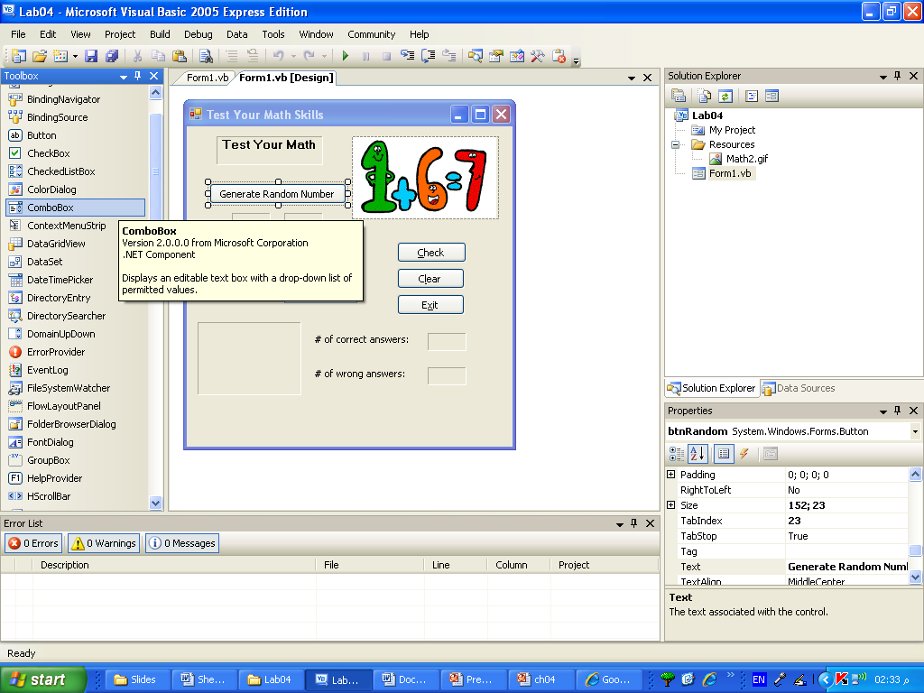
Add a Combobox control
Add items to the list
assign the choice to a variable
choice = comboBox1.Text()

