Slide 1

Visual Basic 2010 How to Program
© 1992-2011 by Pearson Education, Inc. All Rights Reserved. -

Slide 2
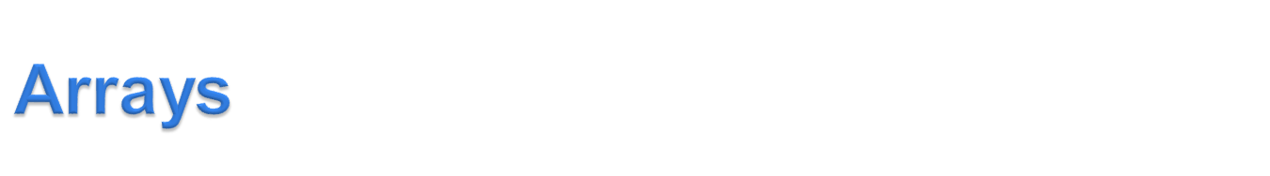
An array is a group of variables (called elements) containing values that all have the same type.
To refer to a particular element in an array, we specify the name of the array and the position number of the element to which we refer.
© 1992-2011 by Pearson Education, Inc. All Rights Reserved. -

Slide 3
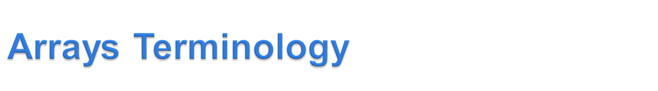
Dim arrayName(n) As DataType
0 is the lower bound of the array
n is the upper bound of the array–the last available subscript in this array
The number of elements, n + 1, is the size of the array.
      You can determine the size of the array using the system method (length) arrayName.Length
© 1992-2011 by Pearson Education, Inc. All Rights Reserved. -

Slide 4
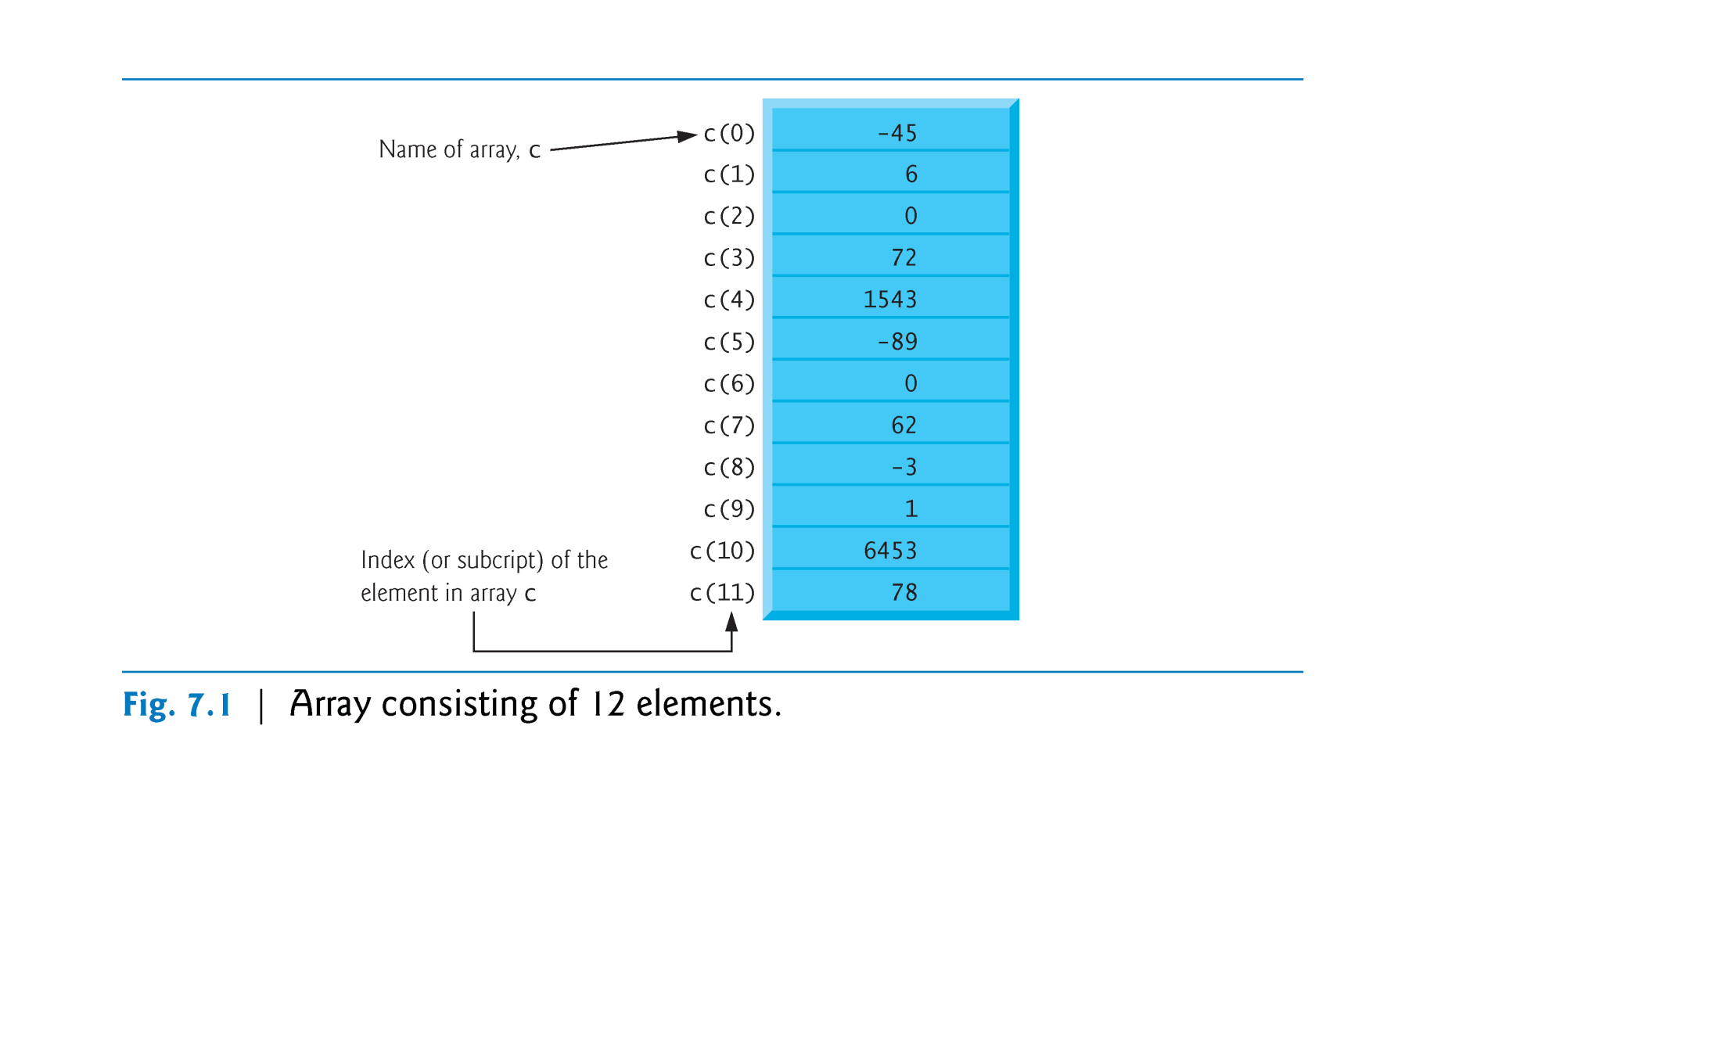
© 1992-2011 by Pearson Education, Inc. All Rights Reserved. -

Slide 5

Dim C(11) As Integer
0 is the lower bound of the array
C(0) value equals to -45
11 is the upper bound of the array
C(11) value equals to 78
The number of elements, 12 , is the size of the array
C.Length = 12
© 1992-2011 by Pearson Education, Inc. All Rights Reserved. -

Slide 6
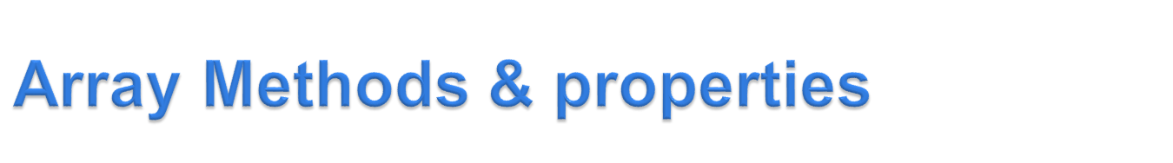
arrayName.Count | number of elements
arrayName.Length | number of elements
arrayName.Max | highest value
arrayName.Min | lowest value
arrayName.First | first element
arrayName.Last | last element
arrayName.GetUpperBound(0) | The upper bound value
arrayName.GetLowerBound(0) | The lower bound value
numArrayName.Average | average value of elements
numArrayName.Sum | sum of values of elements
© 1992-2011 by Pearson Education, Inc. All Rights Reserved. -

Slide 7

Dim array1() As Integer = {6,2,8}
array1.Count | 3
array1.Length | 3
array1.Max | 8
array1.Min | 2
array1.First | 6
array1.Last | 8
array1.GetUpperBound(0) | 2
array1.GetLowerBound(0) | 0
array1.Average | 5.3
array1.Sum | 16
© 1992-2011 by Pearson Education, Inc. All Rights Reserved. -

Slide 8

  The position number in parentheses is called an index it can be:
    Nonnegative integer . Example: C(3)
    Or integer expression. Example:
    if value1 =5, value2 = 6
      c(value1 + value2) += 2
      c(5 + 6) += 2
      c(11) += 2
      C(11) = C(11) + 2
      C(11) = 78 +2
      C(11) =80
+ 2
C(11)
78
C(11)
80
© 1992-2011 by Pearson Education, Inc. All Rights Reserved. -

Slide 9

Values stored in arrays can be used in calculations.
For example,
    sum = c(0) + c(1) + c(2)
    sum = -45 + 6 + 0
    sum = -39
    result = c(6) \ 2
    result = 0 \ 2
    result = 0
© 1992-2011 by Pearson Education, Inc. All Rights Reserved. -

Slide 10

Different ways to declare array:
    Dim c(0 To 3) As Integer
    Dim c(3) As Integer
    Dim c() As Integer = {9, 2, 6, 1}
    Dim c() = {1, 2, 3, 6}
  The lower bound of all the three arrays above is 0 and the upper bound is 3.
  The size of all the three arrays above equals to 4.
  In the last two array declarations, we declared & initialize the array without specifying the upper bound value.
© 1992-2011 by Pearson Education, Inc. All Rights Reserved. -

Slide 11

    Dim c() As Integer = {9, 2, 6, 1}
    Dim c() = {1, 2, 3, 6}
When the initializer list is used, you cannot specify the upper bound value.
So, if you write the above declaration as follows:
Dim c(3) As Integer = {9, 2, 6, 1}
You will get a Syntax Error
Initializer List
X
© 1992-2011 by Pearson Education, Inc. All Rights Reserved. -

Slide 12

When you do not provide an initializer list, the elements in the array are initialized to the default value for the array’s type as follows:
  0 for numeric primitive data-type variables
  False for Boolean variables
  Nothing for String and other class types.
© 1992-2011 by Pearson Education, Inc. All Rights Reserved. -

Slide 13

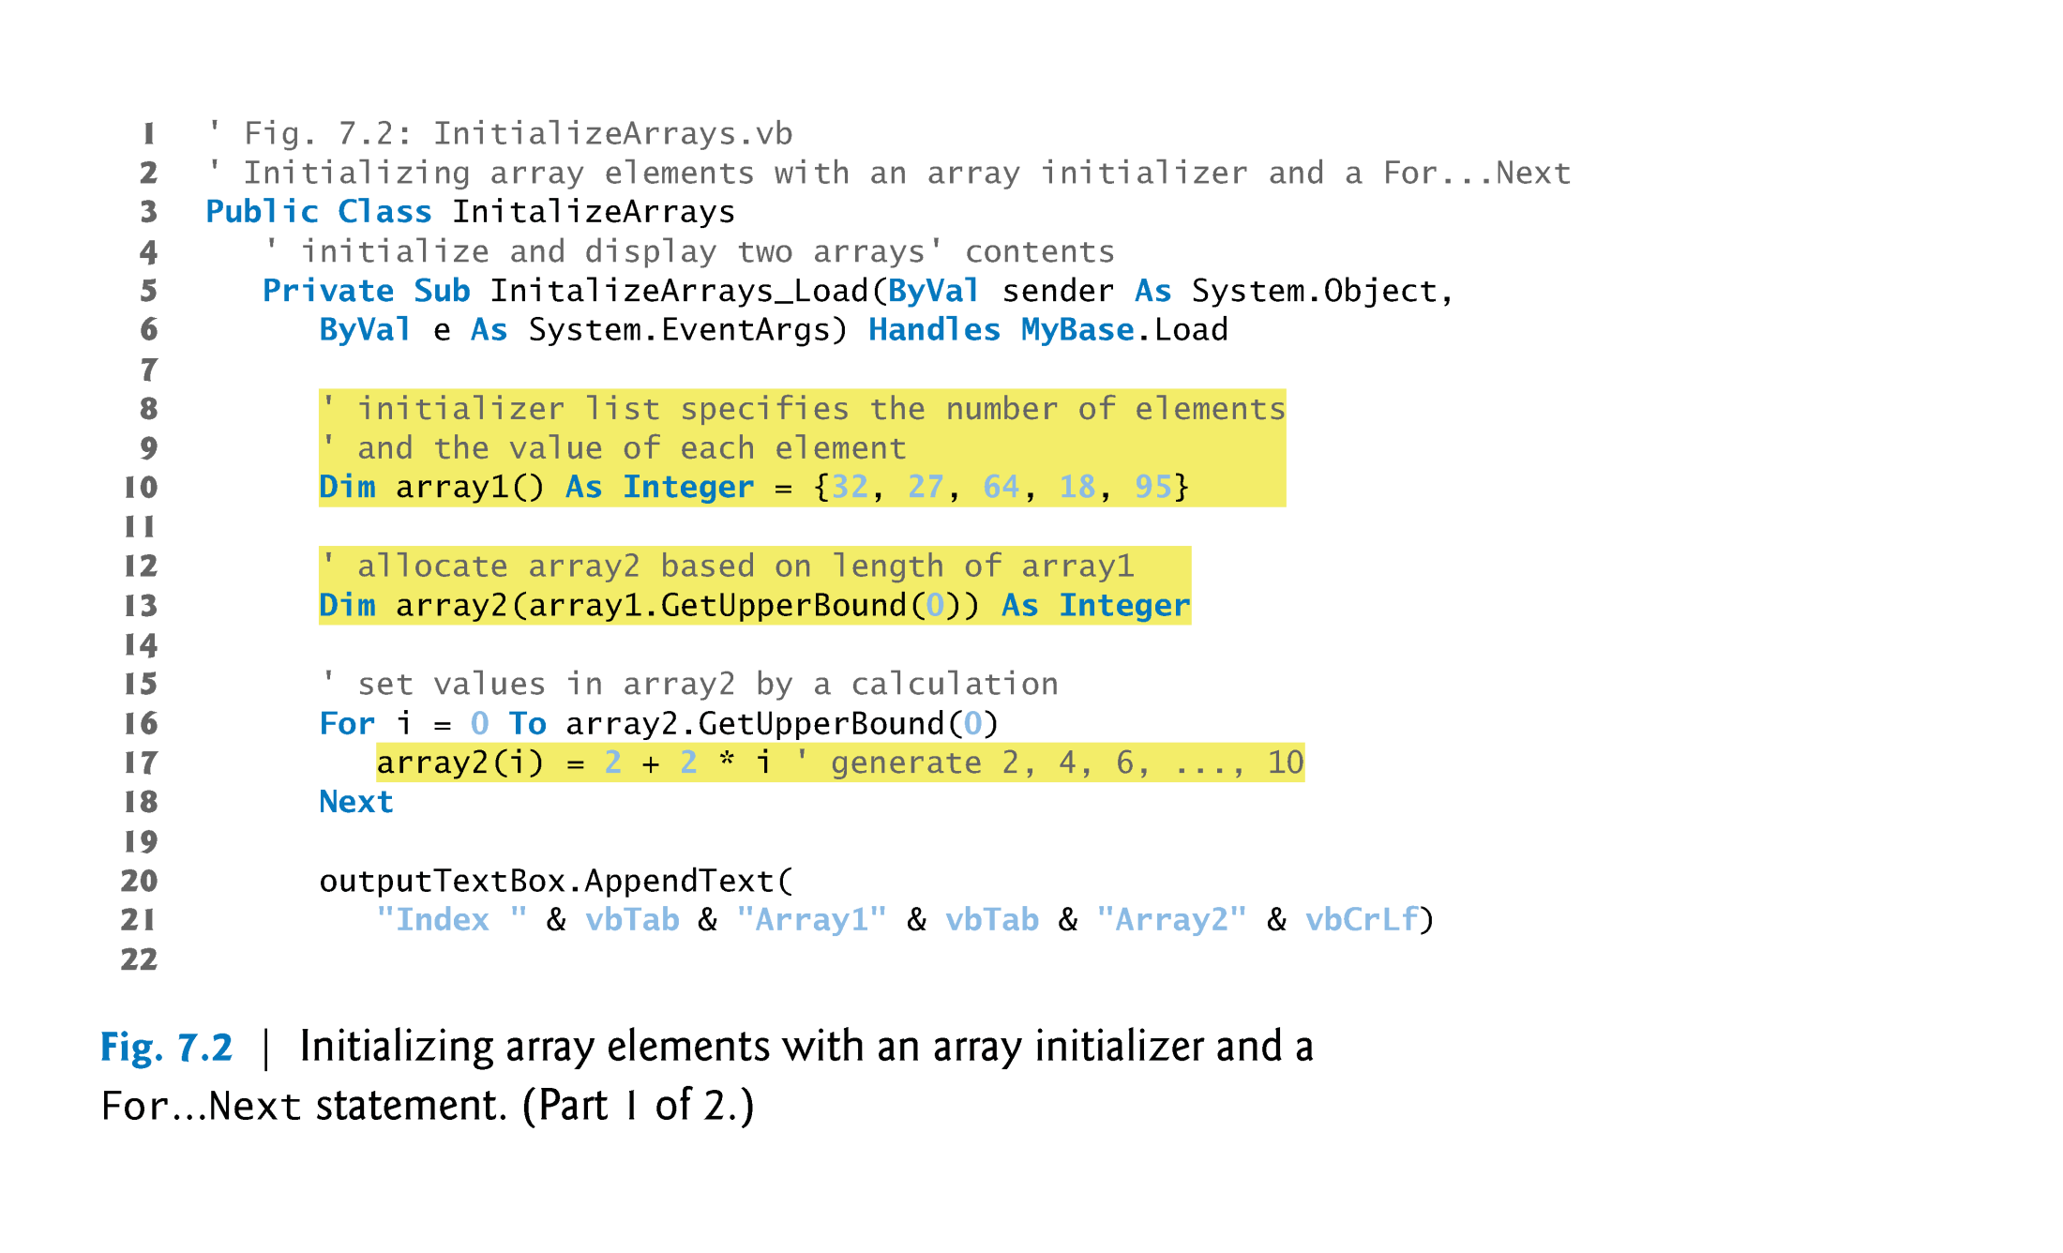
© 1992-2011 by Pearson Education, Inc. All Rights Reserved. -

Slide 14
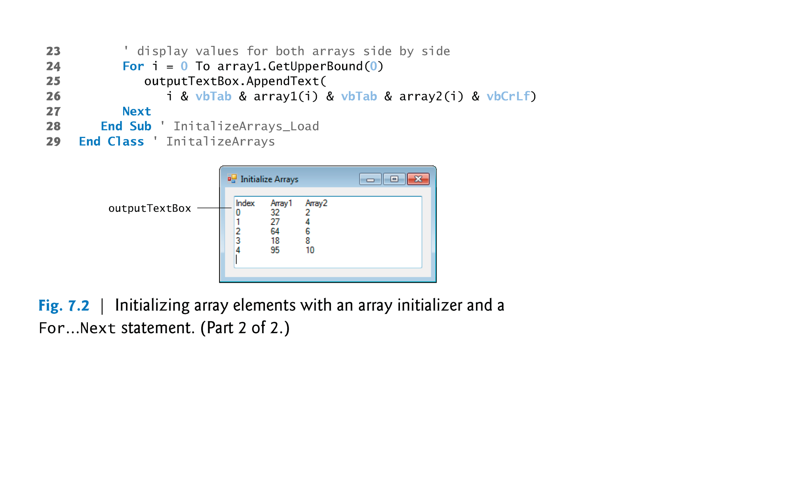
© 1992-2011 by Pearson Education, Inc. All Rights Reserved. -

Slide 15
Figure 7.2 creates two five-element integer arrays and sets their element values, using an initializer list and a For…Next statement that calculates the element values, respectively.
Line 13 declares and allocates array2, whose size is determined by the expression
  array1.GetUpperBound(0) = 4
  array1.GetLowerBound(0) = 0
  Array1.Length = 5
© 1992-2011 by Pearson Education, Inc. All Rights Reserved. -

Slide 16



Dim array2(array1.GetUpperBound(0)) As Integer
Dim array2(4) As Integer
This means that array2 will have the same size of array 1:
  array2.GetUpperBound(0) = 4
  array2.GetLowerBound(0) = 0
  Array2.Length = 5
© 1992-2011 by Pearson Education, Inc. All Rights Reserved. -

Slide 17

In Example 6 the greatest value in a numeric array ages is determined.
The value of the variable max is set to the first element of the array.
Then a For…Next loop successively examines each element of the array and resets the value of max when appropriate.
© 1992-2011 by Pearson Education, Inc. All Rights Reserved. -

Slide 18

Dim ages() As Integer = {55, 56, 61, 52, 69,
64, 46, 54, 47} 'last 9 presidents
Dim max As Integer = ages(0)
For i As Integer = 1 To ages.Count - 1
If ages(i) > max Then
max = ages(i)
End If
Next
txtOutput.Text = "Greatest age: " & max
Output: Greatest age: 69
© 1992-2011 by Pearson Education, Inc. All Rights Reserved. -

Slide 19

i | ages(i) | max
1 | ages(1) = 56 | 55
2 | ages(2) = 61 | 56
3 | ages(3) = 52 | 61
4 | ages(4) = 69 | 61
5 | ages(5) = 64 | 69
6 | ages(6) = 46 | 69
7 | ages(7) = 54 | 69
8 | ages(8) = 47 | 69
9 | _ | _
© 1992-2011 by Pearson Education, Inc. All Rights Reserved. -

Slide 20

Have type Boolean
Used when looping through an array
Provide information to be used after loop terminates. Or, allows for the early termination of the loop.
© 1992-2011 by Pearson Education, Inc. All Rights Reserved. -

Slide 21

Dim Names() As String = {"hend", "manal", "asma", "sarah“, “nouf”, “Lamya”}
Dim nameFound As Boolean = False ‘ The Flag Variable
Dim Name_Start_with_A As String = Nothing
Dim upperName As String = Nothing
Dim i As Integer = 0
Do While ( Not nameFound )
upperName = Names(i).ToUpper
If upperName.StartsWith("A") Then 'Search a name that starts with ‘A’
nameFound = True
Name_Start_with_A = Names(i)
End If
i += 1
Loop
Label1.Text = "A Name that starts with A = " & upperName
© 1992-2011 by Pearson Education, Inc. All Rights Reserved. -

Slide 22


© 1992-2011 by Pearson Education, Inc. All Rights Reserved. -

Slide 23

i | Names(i) | upperName | nameFound | Not namesFound | Name_Start_with_A
0 | hend | HEND | False | True | Nothing
1 | manal | MANAL | False | True | Nothing
2 | asma | ASMA | True | False | asma
3 | _ | _ | _ |  | _
Loop will stop here (when i =3) because the Do While ....Loop condition is not met
(When the flag variable nameFound = True Not nameFound = False )
© 1992-2011 by Pearson Education, Inc. All Rights Reserved. -

Slide 24

For i As Integer = 1 To ages.Count - 1
If ages(i) > max Then
max = ages(i)
End If
Next
can be replaced with
For Each age As Integer In ages
If age > max Then
max = age
End If
Next
© 1992-2011 by Pearson Education, Inc. All Rights Reserved. -

Slide 25

In the For…Next loop, the counter variable i can have any name.
In the For Each loop, the looping variable age can have any name.
The primary difference between the two types of loops is that in a For Each loop no changes can be made in the values of elements of the array.
© 1992-2011 by Pearson Education, Inc. All Rights Reserved. -

Slide 26

A statement of the form
numVar = Array.IndexOf(arrayName, value)
assigns to numVar the index of the first occurrence of value in arrayName. Or assigns -1 if the value is not found.
© 1992-2011 by Pearson Education, Inc. All Rights Reserved. -

Slide 27
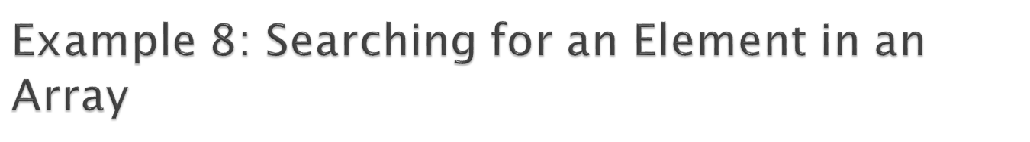
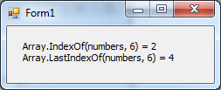
Dim numbers() As Integer = {8, 2, 6, 6, 6}
Label1.Text = "Array.IndexOf(numbers, 6)=" &
Array.IndexOf(numbers, 6) & vbCrLf
Label1.Text &= "Array.LastIndexOf(numbers, 6)=" & Array.LastIndexOf(numbers, 6)
© 1992-2011 by Pearson Education, Inc. All Rights Reserved. -

Slide 28

If arrayOne and arrayTwo have been declared with the same data type, then the statement
arrayOne = arrayTwo
makes arrayOne an exact duplicate of arrayTwo. Actually, they share the same location in memory.
© 1992-2011 by Pearson Education, Inc. All Rights Reserved. -

Slide 29

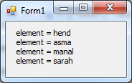
Dim Names() As String = {"hend", "asma", "manal", "sarah"}
Dim Names2(1) As String
Names2 = Names
For Each element In Names2
Label1.Text &= “element = " & element & vbCrLf
Next
© 1992-2011 by Pearson Education, Inc. All Rights Reserved. -

Slide 30

Split can convert a string containing comma-separated data into a string array.
ArrayName = StringName.Split(“SplitCharacter”)
Split Character also called delimiter could be:
  Comma “,”
  Dot “.”
  Start “*”
  Semicolon “;”
  Or any other character
If no character is specified, the space character “ “ will be used as the delimiter.
© 1992-2011 by Pearson Education, Inc. All Rights Reserved. -

Slide 31

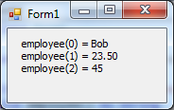
Dim employee() As String
Dim line As String = "Bob;23,50;45"
employee = line.Split(“;")
For i = 0 To employee.GetUpperBound(0)
Label1.Text &= "employee(" & i & ") = " & employee(i) & vbCrLf
Next
sets the size of employees to 3
sets employees(0) = “Bob”
sets employees(1) = “23,50”
sets employees(2) = “45”
© 1992-2011 by Pearson Education, Inc. All Rights Reserved. -

Slide 32

The reverse of the Split method is the Join function.
Join concatenates the elements of a string array into a string containing the elements separated by a specified delimiter.
© 1992-2011 by Pearson Education, Inc. All Rights Reserved. -

Slide 33

Dim greatLakes() As String = {"Huron","Ontario",
"Michigan","Erie","Superior"}
Dim lakes As String
lakes = Join(greatLakes, ",")
txtOutput.Text = lakes
Output: Huron,Ontario,Michigan,Erie,Superior
© 1992-2011 by Pearson Education, Inc. All Rights Reserved. -

Slide 34

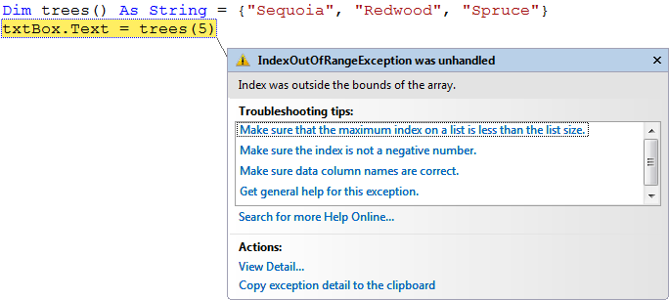
The following code references an array element that doesn't exist. This will cause an error.
© 1992-2011 by Pearson Education, Inc. All Rights Reserved. -

Slide 35

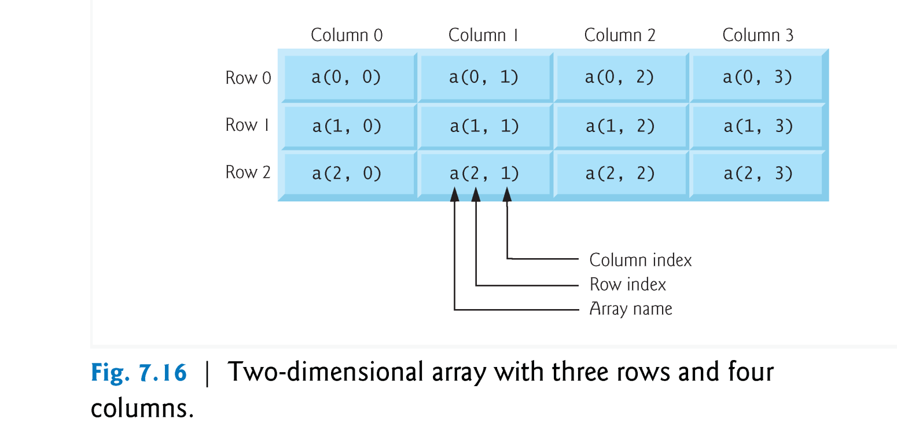
two-dimensional arrays are often used to represent tables of values consisting of data arranged in rows and columns (Fig. 7.16).
© 1992-2011 by Pearson Education, Inc. All Rights Reserved-

Slide 36

  A two-dimensional array letters with two rows and two columns can be declared and initialized with
      ' numbers in a 2 by 2 array
      Dim letters(1, 1) As Char
      letters(0, 0) = “a”
      letters(0, 1) = “b”
      letters(0, 2) = “c”
      letters(1, 0) = “d”
      letters(1, 1) = “e”
      letters(1, 2) = “f”
column0 | column1 | column2
Row0
Row1
a | b | c
d | e | f
© 1992-2011 by Pearson Education, Inc. All Rights Reserved-

Slide 37
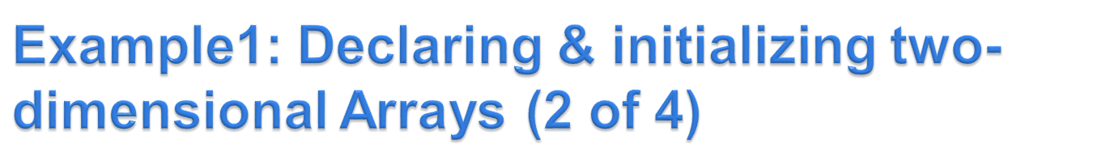
  Alternatively, the initialization can be written on one line, as shown in the two examples bellow:
Dim letters = {{“a”,“b”,”c”}, {“d”,“e”,”f”}}
Dim letters(,) As Char = {{“a”,“b”,”c”}, {“d”,“e”,”f”}}
© 1992-2011 by Pearson Education, Inc. All Rights Reserved-

Slide 38

Important Notes:
letters.Initialize() - initializes all the elements of the array by its default value.
  For example:
    if we declare array of Integer this function will initialize all elements by zero
    if we declare array of String this function will initialize all elements by the keyword Nothing
letters.GetUpperBound(0) = number of rows in letters -1 = 2 -1 = 1
letters.GetUpperBound(1) = number of columns in letters -1 = 3 -1 = 2
© 1992-2011 by Pearson Education, Inc. All Rights Reserved-

Slide 39
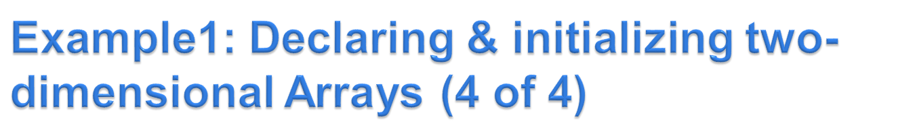
Important Notes (Continued):
letters.Length = number of elements in all dimensions (rows x columns) in values
  letters.Length = 2 rows x 3 columns = 6 elements
You cannot use some functions in two dimensional arrays such as:
  letters.count() X
  letters.SetValues(value Of element , Index) X
© 1992-2011 by Pearson Education, Inc. All Rights Reserved-

Slide 40
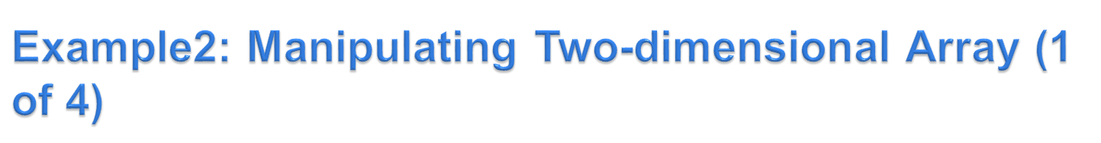
The program in the next slide initializes 2 by 3 array ( array with 2 rows and 3 columns) called values.
Then uses nested For…Next loops to traverse the array (that is, to manipulate every array element).
The contents of the array are displayed in outputTextBox.
© 1992-2011 by Pearson Education, Inc. All Rights Reserved-

Slide 41
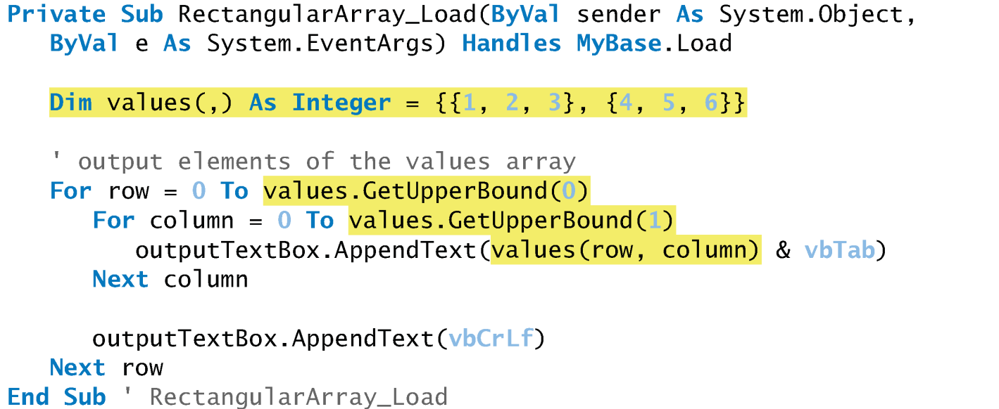
Example2: Manipulating Two-dimensional Array (2 of 4) (The Code)
© 1992-2011 by Pearson Education, Inc. All Rights Reserved-

Slide 42
Example2: Manipulating Two-dimensional Array (3 of 4) (Trace)
values.GetUpperBound(0) = number of rows – 1 = 1
values.GetUpperBound(1) = number of columns – 1 = 2
row < = 1 | column <= 2 | values(row , column) | outputTextBox.AppendText
0 | 0 | values(0,0) = 1 | 1
0 | 1 | values(0,1) = 2 | 1 2
0 | 2 | values(0,2) = 3 | 1 2 3
0 | 3 | - | -
1 | 0 | values(1,0) = 4 | 1 2 3 4
1 | 1 | values(1,1) = 5 | 1 2 3 4 5
1 | 2 | values(1,2) = 6 | 1 2 3 4 5 6
1 | 3 | - | -
2 | - | - | -
© 1992-2011 by Pearson Education, Inc. All Rights Reserved-

Slide 43
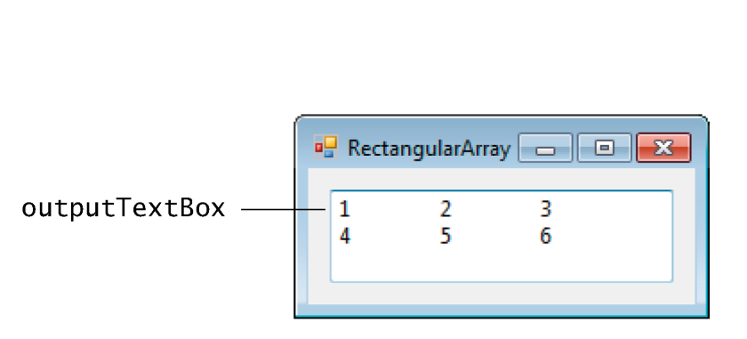
Example2: Manipulating Two-dimensional Array (4 of 4) (The Output)
© 1992-2011 by Pearson Education, Inc. All Rights Reserved-

Slide 44

 | Riyadh | Jeddah | Dammam | Hail
Riyadh | 0 | 846 | 390 | 600
Jeddah | 846 | 0 | 1236 | 715
Dammam | 390 | 1236 | 0 | 950
Hail | 600 | 715 | 950 | 0
© 1992-2011 by Pearson Education, Inc. All Rights Reserved-

Slide 45

Dim rm(,) As Double = {{0, 846, 390, 600},
{846, 0, 1236, 715},
{390, 1236, 0, 950},
{600, 715, 950, 0}}
declares and initializes an array of road-mileages. Some elements of the array are
rm(0,0)=0, rm(0,1)= 846, rm(1,2)= 1236
© 1992-2011 by Pearson Education, Inc. All Rights Reserved-

Slide 46
Column Row | 0 | 1 | 2 | 3
0 | 0 | 846 | 390 | 600
1 | 846 | 0 | 1236 | 715
2 | 390 | 1236 | 0 | 950
3 | 600 | 715 | 950 | 0
© 1992-2011 by Pearson Education, Inc. All Rights Reserved-

