Slide 1

Groupboxes , Checkboxes, tooltips , listboxex, comoboBoxes

Slide 2
Outlines
Using Groupboxes and Panels
Using a List Box for Input
Using Combo box for Input
Using Radio Buttons for Input
Using Check Boxes for Input
Events Raised by Selections

Slide 3
1. GroupBoxes and Panels
They’re typically used to group several controls that are related in a GUI.
All of the controls that you drag onto a GroupBox or a Panel move together when you move the GroupBox or Panel to a new position the Form in Design view.
To attach controls to a group box, create the group box and then place the controls into the group box.

Slide 4
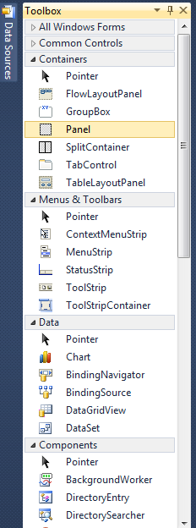
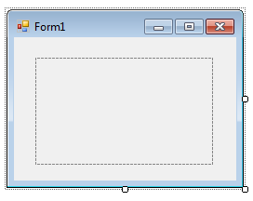
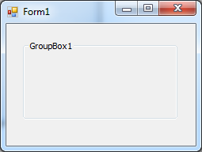
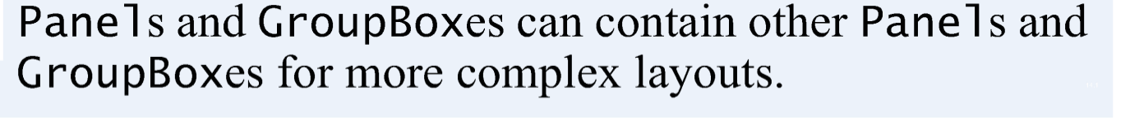
GroupBoxes and Panels
GroupBoxes
Panels
Can display a text caption
Cannot have scrollbars
Example:
Cannot have a text caption
Can display scrollbars
Example:
Text Caption

Slide 5
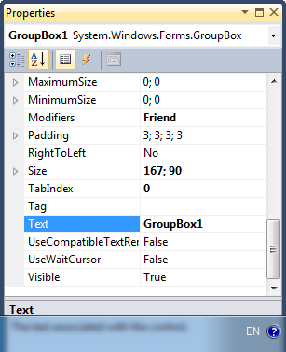
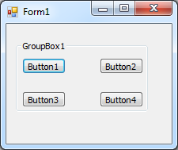
Groupboxes
Changing the caption text of a group box

Slide 6
Example #1: Groupboxes
This program will display in a label box the Text name of the pressed button in a Groupbox (Groupbox1)
Private Sub Button1_Click(ByVal sender As System.Object, ByVal e As System.EventArgs) Handles Button1.Click, Button2.Click, Button3.Click, Button4.Click
Label1.Text = "You pressed " & CType(sender, Button).Text
End Sub

Slide 7
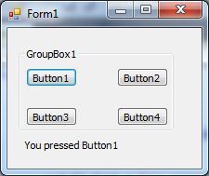
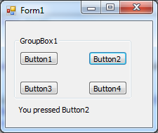
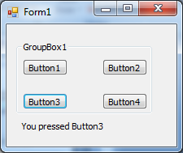
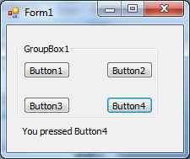
Example#1: Output

Slide 8
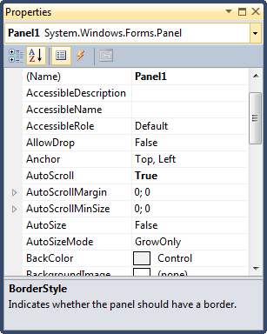
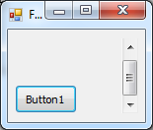
Panels
To enable the scrollbars, set the Panel’s AutoScroll property to True.
Scrollbar

Slide 9
Panels
When you click one of these Buttons, the event handler (lines 5–11) changes the Text on the outputLabel to "You pressed: " followed by the Text of the clicked Button.

Slide 10
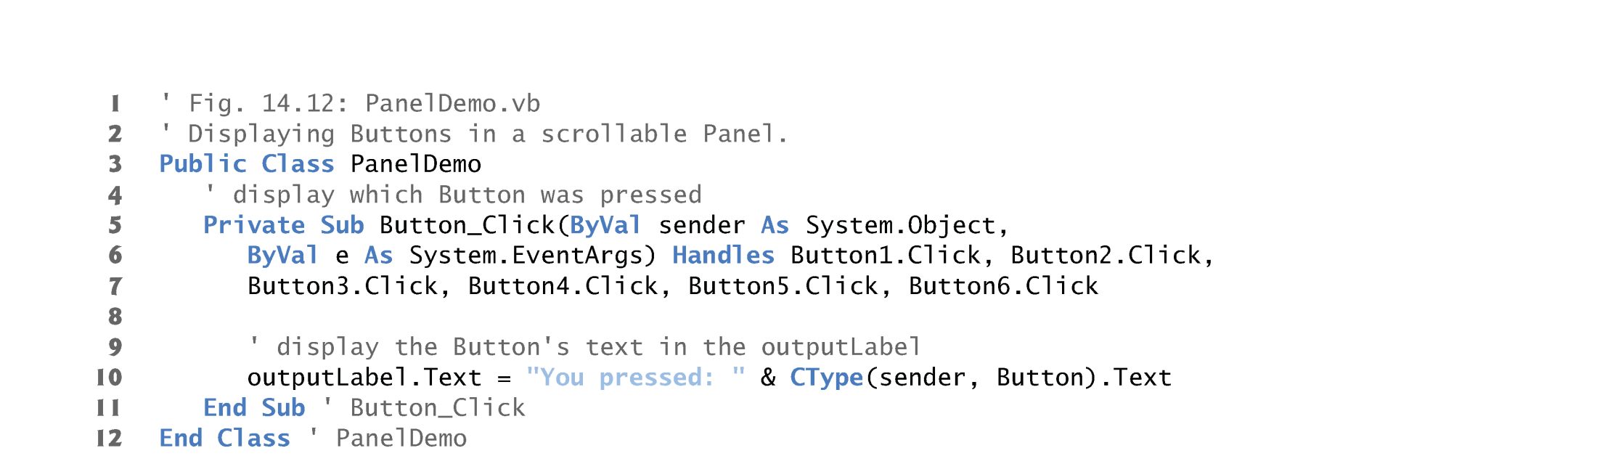
Example#2: Panels

Slide 11
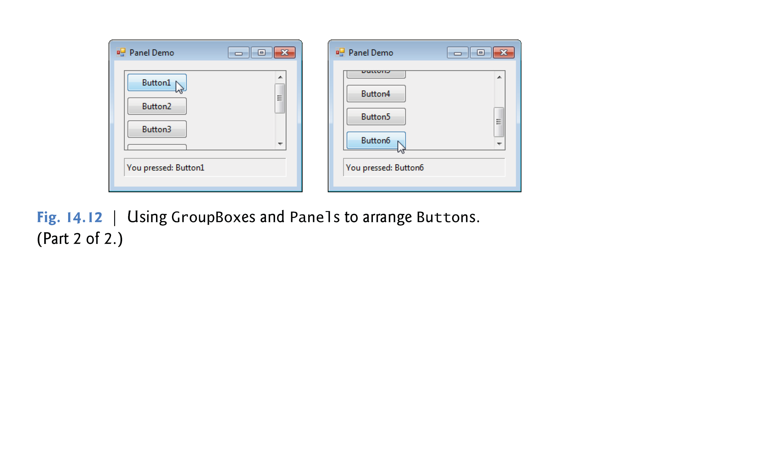
Example2: Output

Slide 12
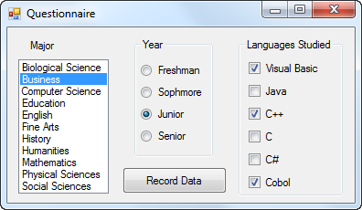
The Three Types of Controls Used for Selection
list box
radio buttons
check boxes

Slide 13
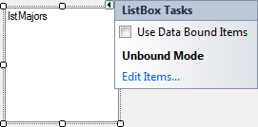
2. List Boxes
Fill a List Box at Design Time via its String Collection Editor
Tasks button
click here to invoke string collection editor

Slide 14
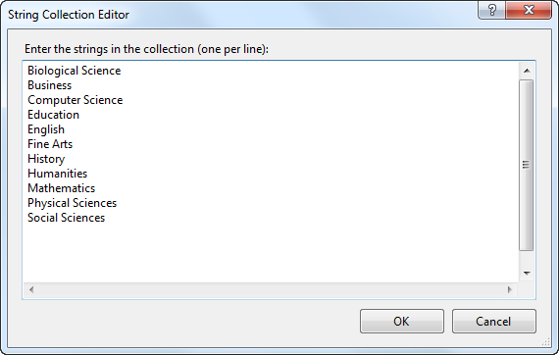
String Collection Editor
Fill by direct typing or by copying and pasting from a text editor or a spreadsheet.

Slide 15
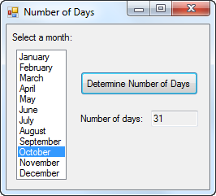
List Box at Run Time
lstMonths
selected item
The value of the list box (lstMonths) is the string consisting of the selected item.

Slide 16
Example #3: Code for btnDetermine.Click
Dim daysInMonth As String
Select Case lstMonths.Text
Case "September", "April", "June", "November"
daysInMonth = "30"
Case "February"
daysInMonth = "28 or 29"
Case Else
daysInMonth = "31"
End Select
txtDays.Text = daysInMonth

Slide 17
3. The Combo Box Control
A list box combined with a text box
The user has the option of filling the text box by selecting from a list or typing directly into the list box.
Essentially same properties, events, and methods as a list box
DropDownStyle property specifies one of three styles

Slide 18
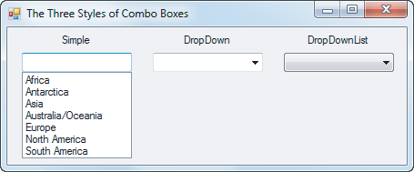
Combo Box Styles

Slide 19
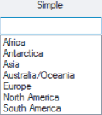
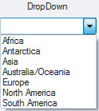
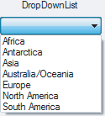
Styles at Run Time after Arrows are Clicked
The value of comboBox.Text is the contents of the text box at the top of the combo box.

Slide 20
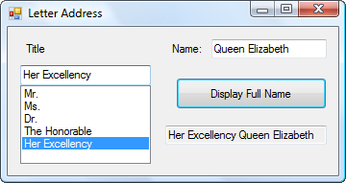
Example#4
Private Sub btnDisplay_Click(...) _ Handles btnDisplay.Click
txtDisplay.Text = cboTitle.Text & " " &
txtName.Text
End Sub
txtName
cboTitle
cboTitle
txtDisplay

Slide 21
4. Radio Button Properties
To determine if the button is selected or not
If (radButton.Checked = true)Then
Statement...
End If
has value True if button is on.
To turn a radio button on
radButton.Checked = True
radButton.Checked = False
radButton.Checked = True

Slide 22
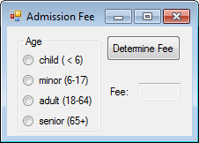
Example#5: Form
radChild
radMinor
radAdult
radSenior

Slide 23
Example 5: Code for Button
If radChild.Checked Then
txtFee.Text = FormatCurrency(0)
ElseIf radMinor.Checked Then
txtFee.Text = FormatCurrency(5)
ElseIf radAdult.Checked Then
txtFee.Text = FormatCurrency(10)
ElseIf radSenior.Checked Then
txtFee.Text = FormatCurrency(7.5)
Else
MessageBox.Show("Must make a selection.")
End If

Slide 24
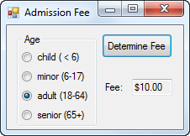
Example#5: Output
Note: FormatCurrency() is a built-In function that
displays the dollar sign ($) in the output

Slide 25
5. The Check Box Control
Consists of a small square and a caption
Presents the user with a Yes/No choice
During run time, clicking on the check box toggles the appearance of a check mark.
Checked property has value True when check box is checked and False when not
CheckedChanged event is raised when the user clicks on the check box

Slide 26
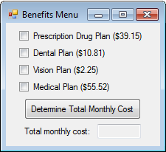
Example 6: Form
chkDrug
chkDental
chkVision
chkMedical

Slide 27
Example#6: Code for Button
Important Note:
We used here simple If...Then...EndIf statement to check the selection of the checkboxes instead of using If....Then...Else...EndIf
The reason: when we find one checkbox is selected we can continue checking the other checkboxes if they were selected or not
Dim sum As Double = 0
If chkDrugs.Checked Then
sum += 39.15
End If
If chkDental.Checked Then
sum += 10.81
End If
If chkVision.Checked Then
sum += 2.25
End If
If chkMedical.Checked Then
sum += 55.52
End If
txtTotal.Text = FormatCurrency(sum)

Slide 28
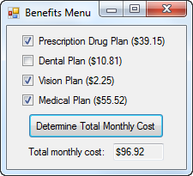
Example #6: Output

Slide 29
Events Raised by a Selection
SelectedIndexChanged – raised when a new item of a list box is selected
CheckedChanged - raised when the user clicks on an unchecked radio button or a check box; that is, when the value of the Checked property is changed.

Slide 30
Example #7: Code
Private Sub checkBox_Changed(...) Handles _
chkDrugs.CheckedChanged,
chkDental.CheckedChanged,
chkVision.CheckedChanged,
chkMedical.CheckChanged
Dim sum As Double = 0
If chkDrugs.Checked Then
sum += 39.15
End If
(continued on next slide)

Slide 31
Example #7: Code (continued)
If chkDental.Checked Then
sum += 10.81
End If
If chkVision.Checked Then
sum += 2.25
End If
If chkMedical.Checked Then
sum += 55.52
End If
txtTotal.Text = FormatCurrency(sum)
End Sub

Slide 32
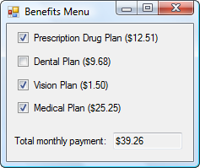
Example #7: Output

Slide 33
7. The ToolTip Control
Appears in component tray of form with default name ToolTip1
Allows a tooltip to appear when user hovers over a control (such as a text box)
Text displayed in tooltip is the setting of the “ToolTip on ToolTip1” property of the control to be hovered over

Slide 34
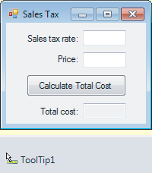
Example #8 : Form
txtRate
“ToolTip on ToolTip1” property of txtRate has the setting “Such as 5, 5.25, 5.5 …”

Slide 35
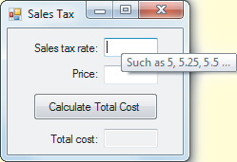
Example #8: Output

