Slide 1

Menus ,MonthCalender, DateTimePicker, MDI ,Tree View, List View,

Slide 2

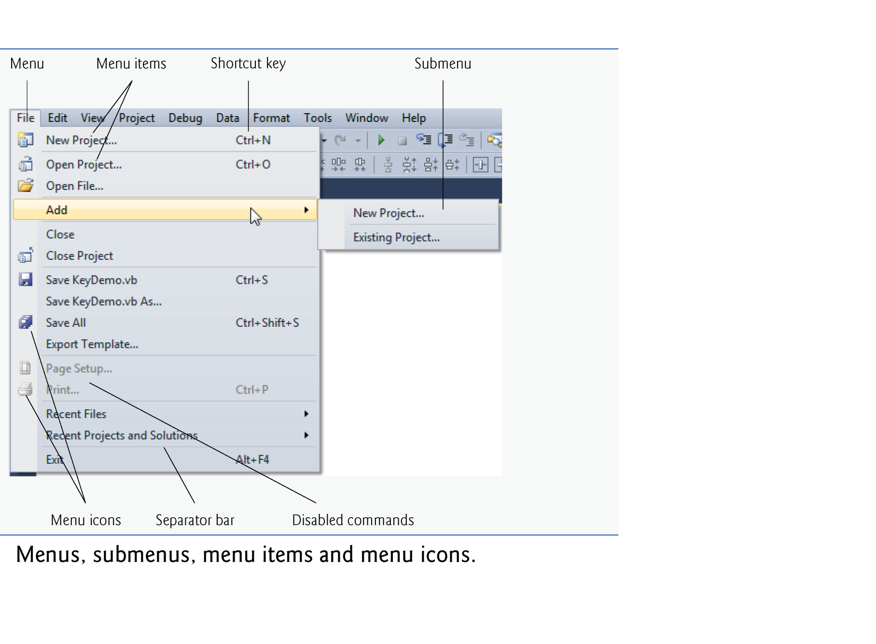
© 1992-2011 by Pearson Education, Inc. All Rights Reserved. Edited By Maysoon AlDuwais

Slide 3

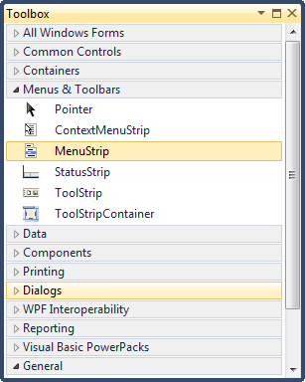
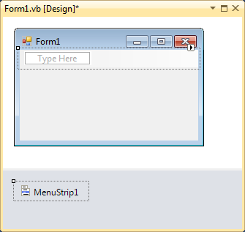
Drag and drop MenuStrip in your form or double click on MenuStrip
© 1992-2011 by Pearson Education, Inc. All Rights Reserved. Edited By Maysoon AlDuwais

Slide 4

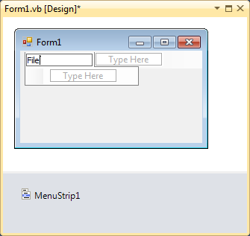
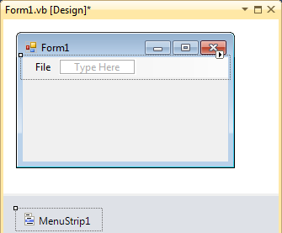
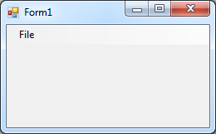
1. Click here
2. Type the name of the menu you want then press Enter
3. It will
look like this
4. If you run the program it will look like this
© 1992-2011 by Pearson Education, Inc. All Rights Reserved. Edited By Maysoon AlDuwais

Slide 5

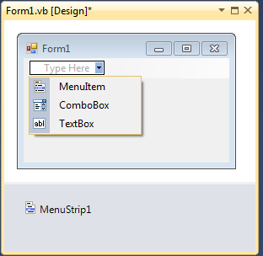
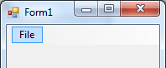
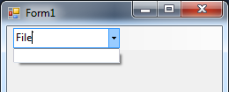
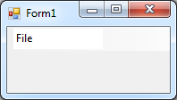
Look like this in the program
© 1992-2011 by Pearson Education, Inc. All Rights Reserved. Edited By Maysoon AlDuwais

Slide 6

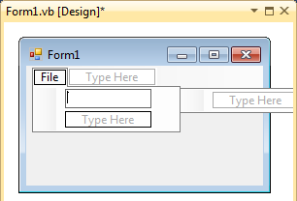
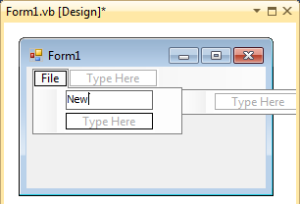
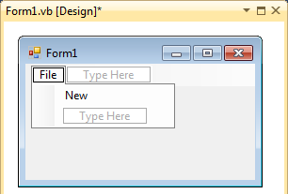
To create items in File menu that we created in slide#4,
Click inside the Type Here box.
2. Enter the name of the item you want for example “New”
3. Press the enter key
4. Your menu will then look like this:
© 1992-2011 by Pearson Education, Inc. All Rights Reserved. Edited By Maysoon AlDuwais

Slide 7

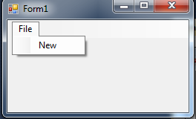
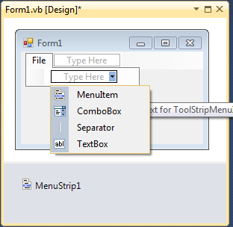
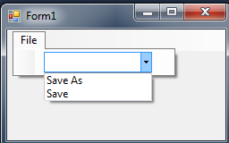
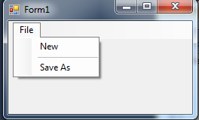
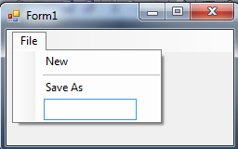
© 1992-2011 by Pearson Education, Inc. All Rights Reserved. Edited By Maysoon AlDuwais

Slide 8

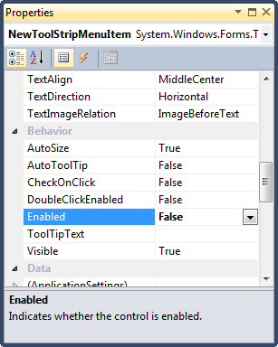
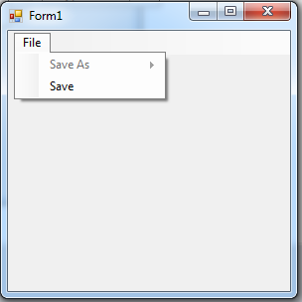
You can disable any of the items of the menu items by changing the property “Enabled” to False
By changing the property Enabled to False, this prevents the user from clicking the menuItem “Save As” as in the example below:
So the menuItem “Save As” appears as follows
© 1992-2011 by Pearson Education, Inc. All Rights Reserved. Edited By Maysoon AlDuwais

Slide 9

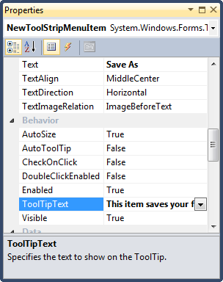
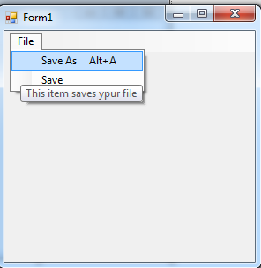
You can show a tool tip text for your menu item to explain its job.
In the following example, the menuItem “Save As” we set the ToolTipText property to the following text: “This item saves your file”
So the menuItem “Save As” appears as follows
© 1992-2011 by Pearson Education, Inc. All Rights Reserved. Edited By Maysoon AlDuwais

Slide 10

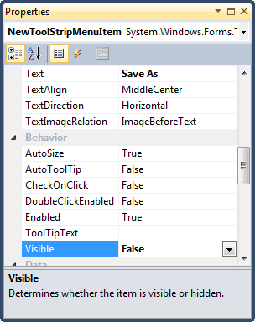
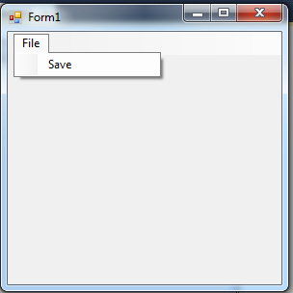
You can hide or show your menu item using the menuItem property “Visible”
In the following example, the menuItem “Save As” we set the Visible property to false. When we run the program the “Save As” menuItem is hidden:
So the menuItem “Save As” appears as follows
© 1992-2011 by Pearson Education, Inc. All Rights Reserved. Edited By Maysoon AlDuwais

Slide 11

Shortcut Keys
  All menu items can have Alt key shortcuts (also called access shortcuts or hotkeys),
  They are accessed by pressing Alt and the underlined letter (for example, Alt F expands the File menu).
© 1992-2011 by Pearson Education, Inc. All Rights Reserved. Edited By Maysoon AlDuwais

Slide 12

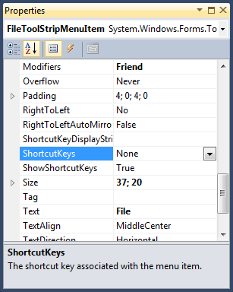
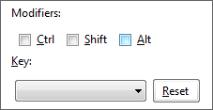
1. Click on the menu you want to add shortcut key for (click on File)
2. Go to the ShortcutKeys property in the Property Window of the File MenuItem
3. Open the dropdown list and select the keys you want for example:
Select Alt
From the drop down list of Keys, choose the letter F
© 1992-2011 by Pearson Education, Inc. All Rights Reserved. Edited By Maysoon AlDuwais

Slide 13
When you Run the program you can open the file menu by pressing Alt + F
© 1992-2011 by Pearson Education, Inc. All Rights Reserved. Edited By Maysoon AlDuwais

Slide 14

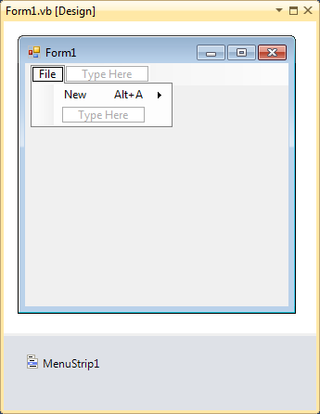
1. Click on the New menu Item
2. Set the shortcut key property
Ex: Alt+A
3. The shortcutKey is displayed.
4. When you Run you program, you can open the New menu by clicking Alt+A
© 1992-2011 by Pearson Education, Inc. All Rights Reserved. Edited By Maysoon AlDuwais

Slide 15

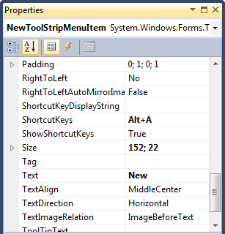
You can hide the shortcut keys by setting property ShowShortcutKeys to False
You can modify how the control keys are displayed in the menu item by modifying property ShortcutKeyDisplayString.
The shortcutkey string that appears in front of the menuItem
The shortcutkey property
Control the appearance of the shortcutkey
© 1992-2011 by Pearson Education, Inc. All Rights Reserved. Edited By Maysoon AlDuwais

Slide 16
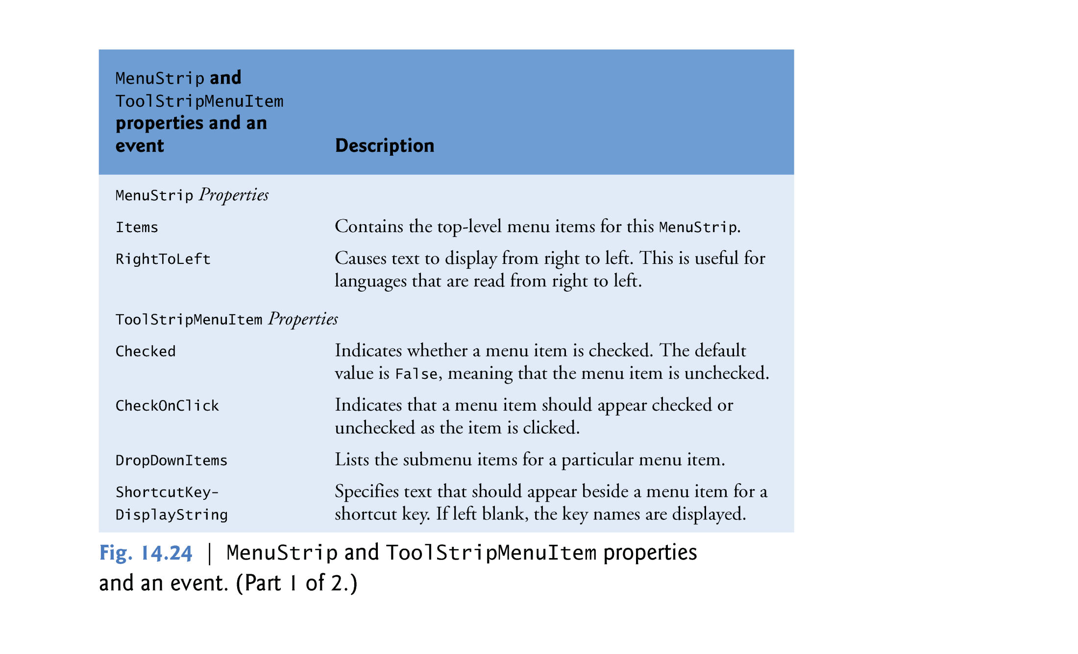
© 1992-2011 by Pearson Education, Inc. All Rights Reserved. Edited By Maysoon AlDuwais

Slide 17
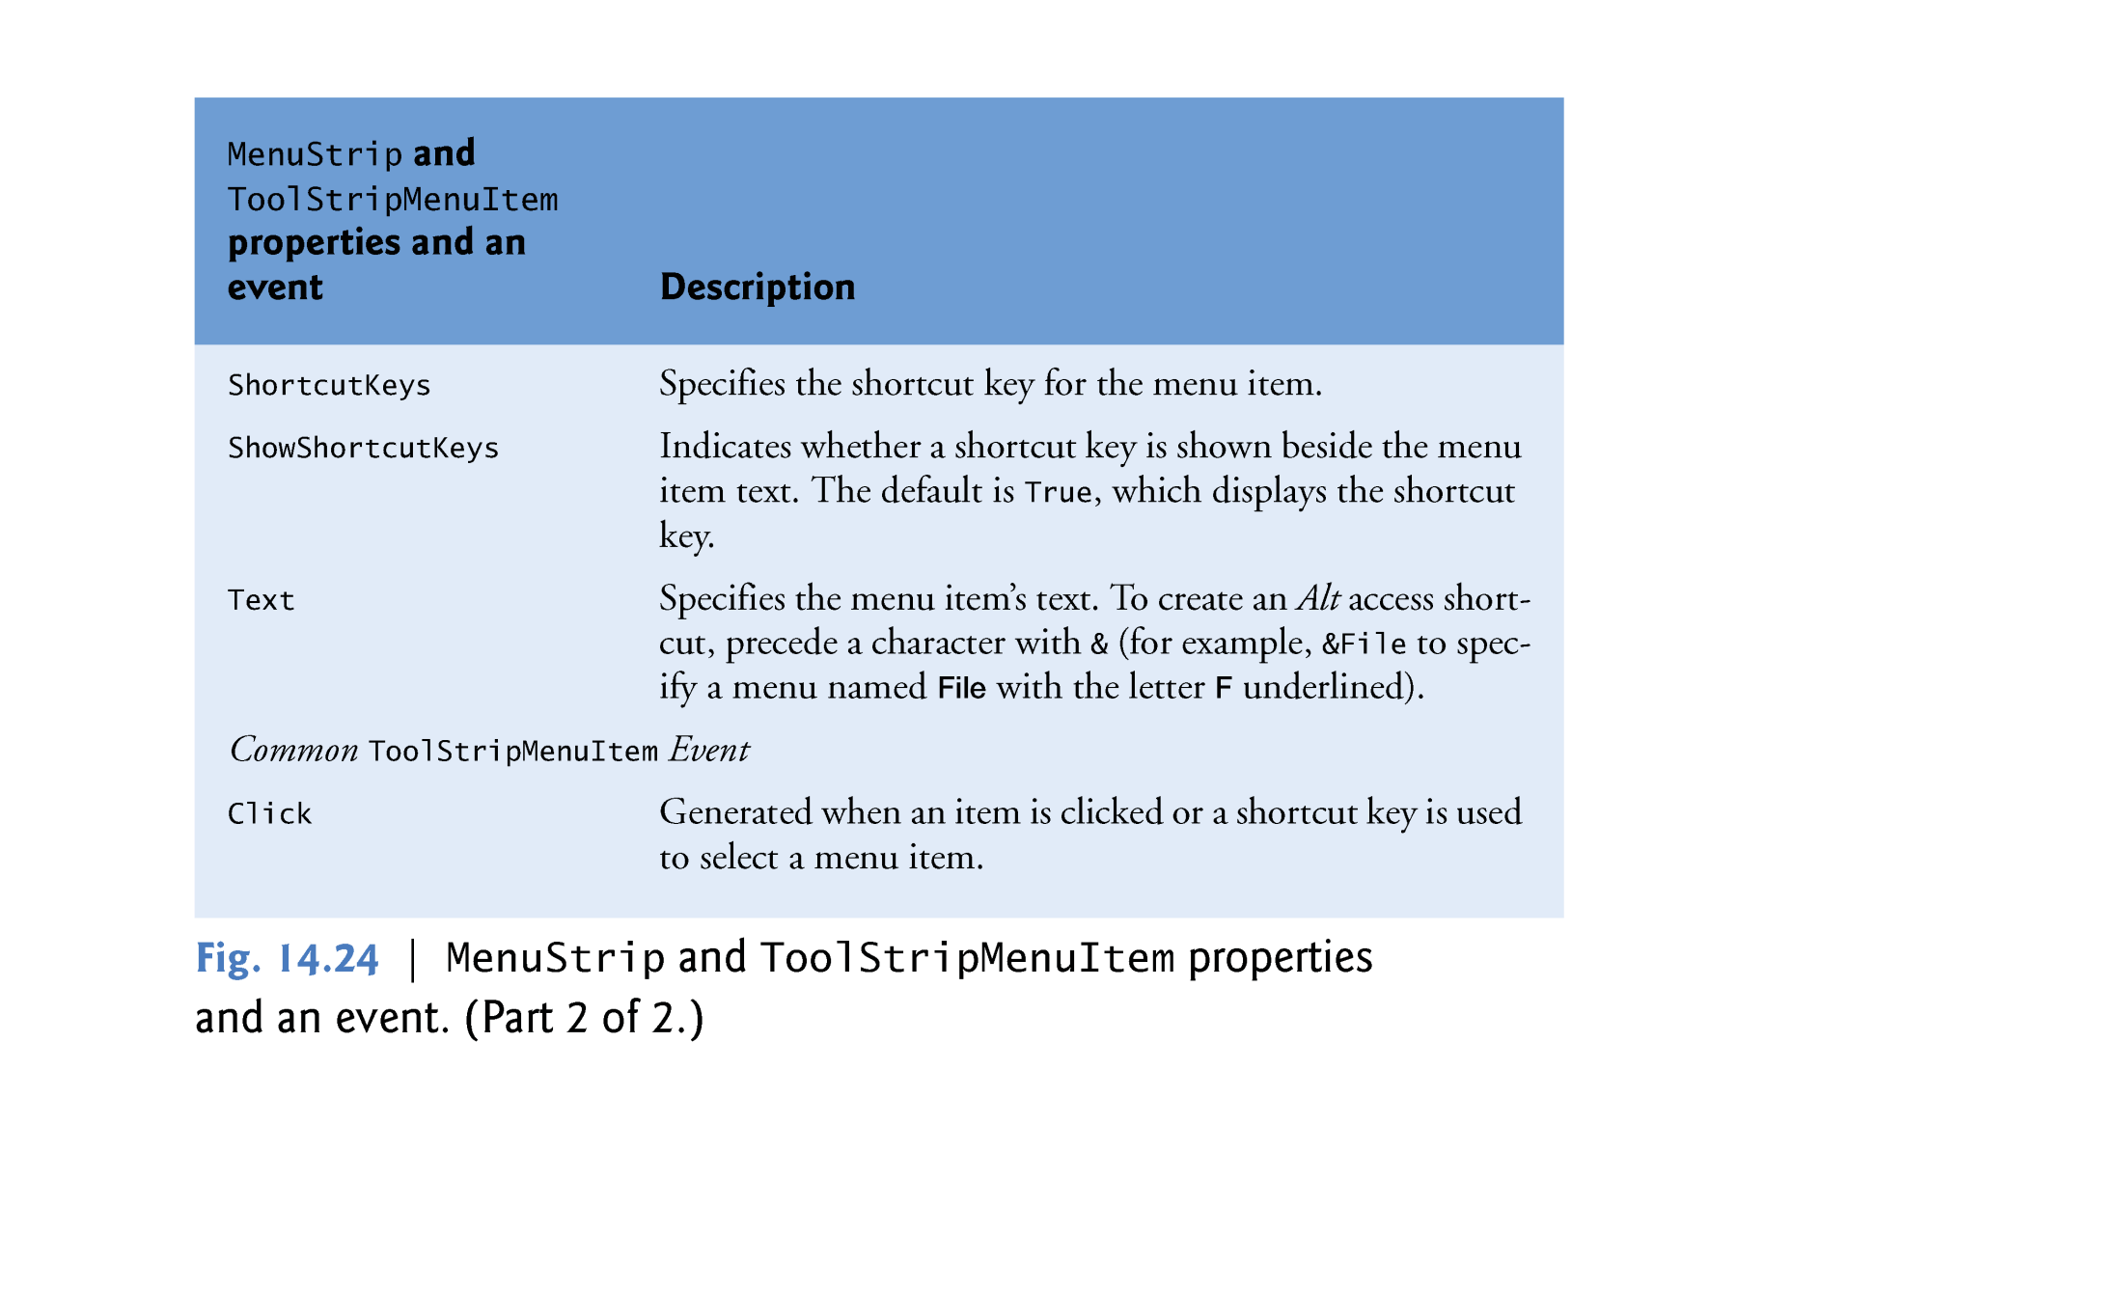
© 1992-2011 by Pearson Education, Inc. All Rights Reserved. Edited By Maysoon AlDuwais

Slide 18

You can link an event to a menu item so that when a user click on the name of the menu item an event happens.
Steps to add an event to existing menu item is as follows:
  In the design view, double click on the menuItem you want to add the event to, for example New menuitem:
1
© 1992-2011 by Pearson Education, Inc. All Rights Reserved. Edited By Maysoon AlDuwais

Slide 19

  This will direct you to the code view with an event that is linked to the New menu item as follows:
  Write any code you want inside the body of the New menuItem sub procedure as follows:
Private Sub NewToolStripMenuItem_Click(ByVal sender As System.Object, ByVal e As System.EventArgs) Handles NewToolStripMenuItem.Click
End Sub
Private Sub NewToolStripMenuItem_Click(ByVal sender As System.Object, ByVal e As System.EventArgs) Handles NewToolStripMenuItem.Click
Label1.Text = "Hello World"
Label1.BackColor = Color.Yellow
MessageBox.Show("Hello World :)")
End Sub
© 1992-2011 by Pearson Education, Inc. All Rights Reserved. Edited By Maysoon AlDuwais

Slide 20

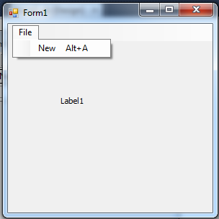
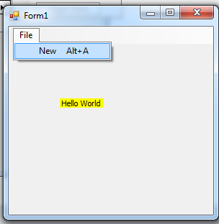
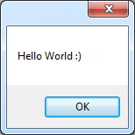
  Now when we run the program it look like this.
After we click on the New menuItem the label will be changed
© 1992-2011 by Pearson Education, Inc. All Rights Reserved. Edited By Maysoon AlDuwais

Slide 21

In vb.net we have two controls to retrieve date and time information MonthCalendar and DateTimePicker.
  The MonthCalendar control displays a monthly calendar.
  The DateTimePicker control is similar to the MonthCalendar control, but displays the calendar when the user clicks the control’s down arrow.
© 1992-2011 by Pearson Education, Inc. All Rights Reserved. Edited By Maysoon AlDuwais

Slide 22

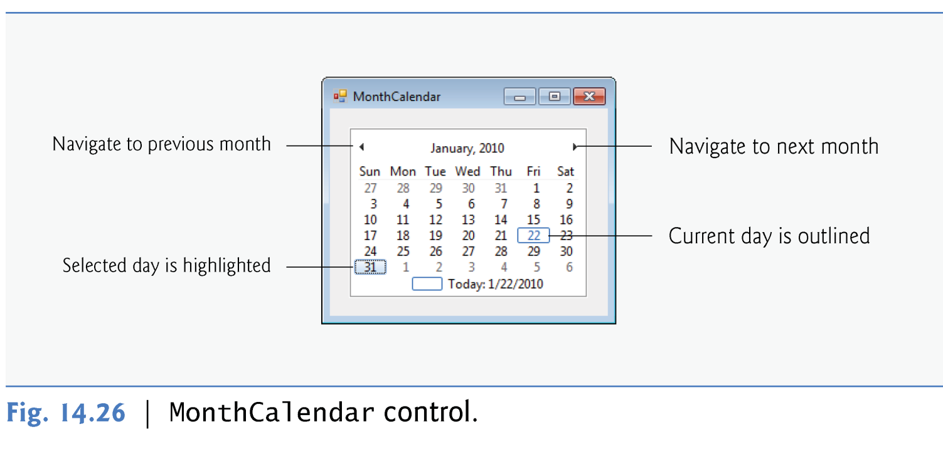
A range of dates can be selected by clicking one date on the calendar, then holding the Shift key while clicking another date.
© 1992-2011 by Pearson Education, Inc. All Rights Reserved. Edited By Maysoon AlDuwais

Slide 23

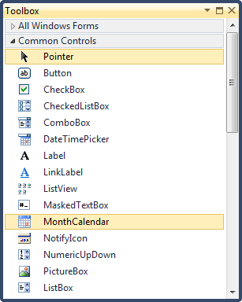
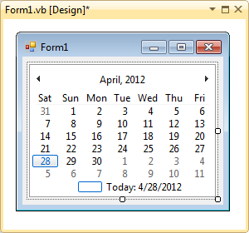
(Adding MonthCalender) Drag and drop MonthCalendar control from the toolbox menu as follows:
© 1992-2011 by Pearson Education, Inc. All Rights Reserved. Edited By Maysoon AlDuwais

Slide 24
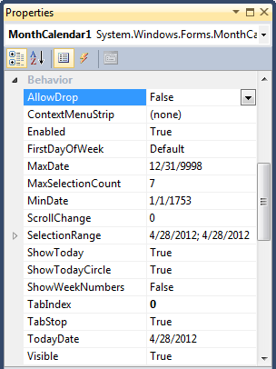
(Modifying MonthCalendar Properties) by clicking on the monthCalendar on the design view all of its properties will be shown in the properties window as follows:
© 1992-2011 by Pearson Education, Inc. All Rights Reserved. Edited By Maysoon AlDuwais

Slide 25
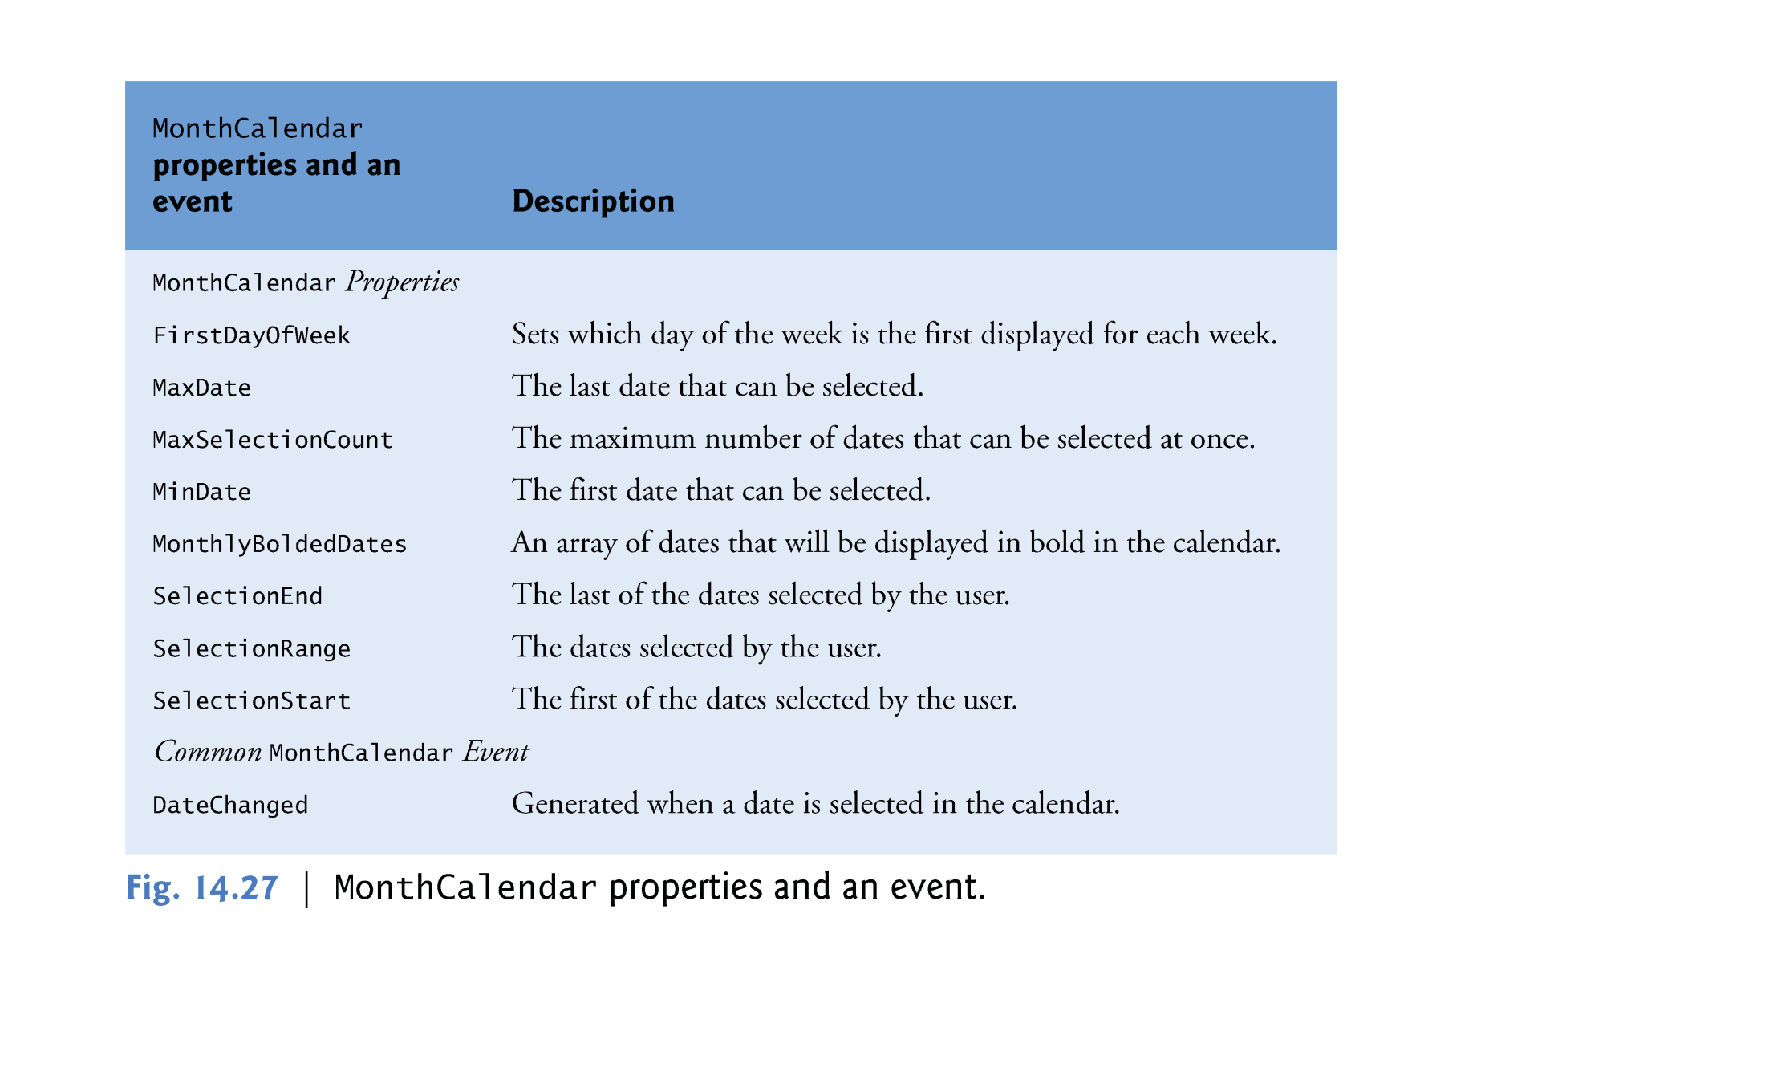
A. MonthCalendar Control
© 1992-2011 by Pearson Education, Inc. All Rights Reserved. Edited By Maysoon AlDuwais

Slide 26
(Adding event to MonthCalendar) The default event for this control is DateChanged, which occurs when a new date is selected.
(Adding event to MonthCalendar) To add DateChanged to the month calendar, double click on the monthCalendar in the design view:
Private Sub MonthCalendar1_DateChanged(ByVal sender As System.Object, ByVal e As System.Windows.Forms.DateRangeEventArgs) Handles MonthCalendar1.DateChanged
End Sub
2. This code will be displayed in the code view
Double click on
the MonthCalendar
© 1992-2011 by Pearson Education, Inc. All Rights Reserved. Edited By Maysoon AlDuwais

Slide 27
(Adding event to MonthCalendar) Write the code you want inside the sub procedure event of the monthCalendar:
For example the following code will display the date that is selected by the user:
Private Sub MonthCalendar1_DateChanged(ByVal sender As System.Object, ByVal e As System.Windows.Forms.DateRangeEventArgs) Handles MonthCalendar1.DateChanged
MessageBox.Show("You selected the date " & MonthCalendar1.SelectionRange.Start)
End Sub
© 1992-2011 by Pearson Education, Inc. All Rights Reserved. Edited By Maysoon AlDuwais

Slide 28
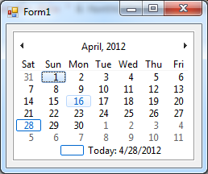
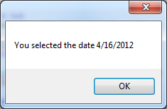
(Adding event to MonthCalendar) When we run this code:
Private Sub MonthCalendar1_DateChanged(ByVal sender As System.Object, ByVal e As System.Windows.Forms.DateRangeEventArgs) Handles MonthCalendar1.DateChanged
MessageBox.Show("You selected the date " & MonthCalendar1.SelectionRange.Start)
End Sub
Run
After clicking on a date, the following message box will appear with the selected date
© 1992-2011 by Pearson Education, Inc. All Rights Reserved. Edited By Maysoon AlDuwais

Slide 29

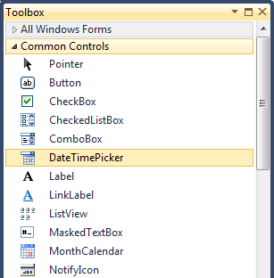
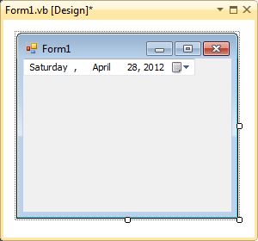
The DateTimePicker can be used to retrieve date and time information from the user.
  (Adding DateTimePicker): To add a date time picker double click on it from the toolbox menu then it will appear on the form in the design view:
© 1992-2011 by Pearson Education, Inc. All Rights Reserved. Edited By Maysoon AlDuwais

Slide 30

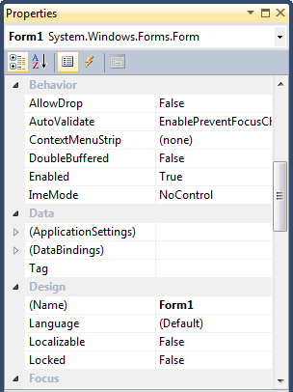
  (Modifying DateTimePicker properties) by clicking on the DateTimePicker on the design view, all of its properties will be shown in the properties window as follows:
© 1992-2011 by Pearson Education, Inc. All Rights Reserved. Edited By Maysoon AlDuwais

Slide 31
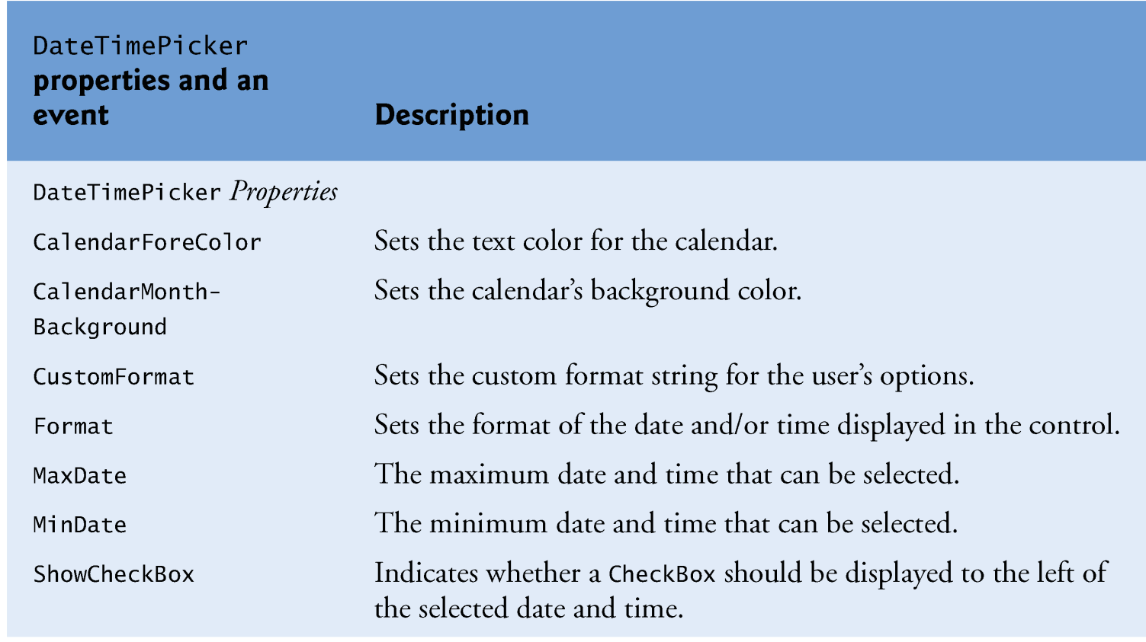
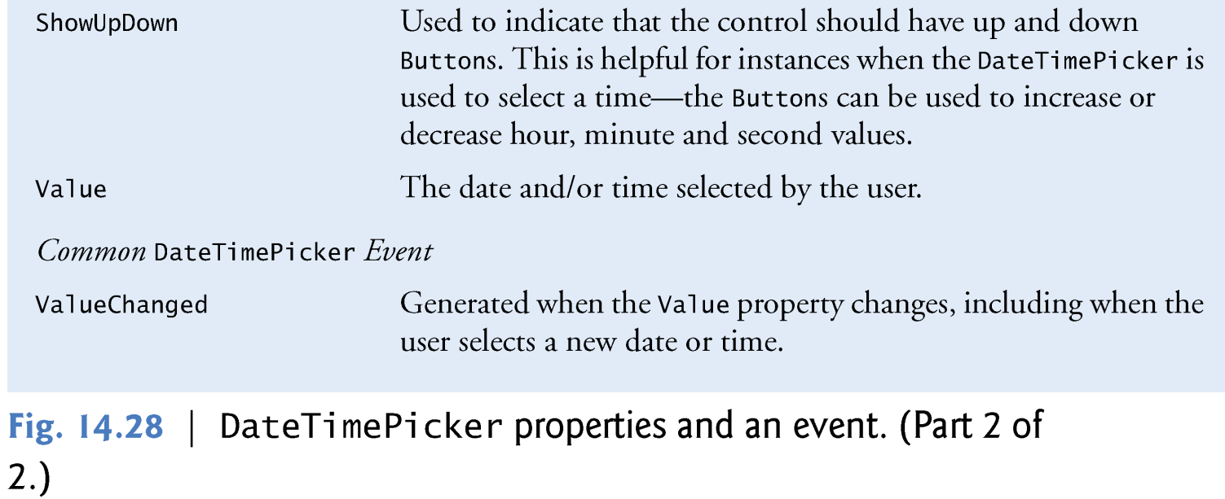
© 1992-2011 by Pearson Education, Inc. All Rights Reserved. Edited By Maysoon AlDuwais

Slide 32
  (Adding Event to the DateTimePicker Control) The default event to dateTimePicker can be added by double clicking on it in the design view. This will display the following code (The default event is ValueChanged, which occurs when a new date is selected.) :
Private Sub DateTimePicker1_ValueChanged(ByVal sender As System.Object, ByVal e As System.EventArgs) Handles DateTimePicker1.ValueChanged
End Sub
© 1992-2011 by Pearson Education, Inc. All Rights Reserved. Edited By Maysoon AlDuwais

Slide 33
  (Adding Event to the DateTimePicker Control) Add the code you want inside the event, For example:
Private Sub DateTimePicker1_ValueChanged(ByVal sender As System.Object, ByVal e As System.EventArgs) Handles DateTimePicker1.ValueChanged
MessageBox.Show("You selected the date: " & DateTimePicker1.Value.ToString())
MessageBox.Show("You selected the Time of the day: " & DateTimePicker1.Value.TimeOfDay.ToString())
End Sub
© 1992-2011 by Pearson Education, Inc. All Rights Reserved. Edited By Maysoon AlDuwais

Slide 34

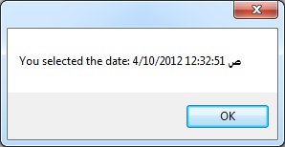
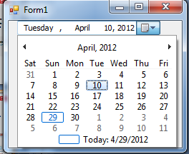
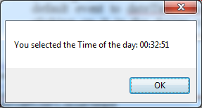
When you select the date 10, April, 2012 the event occur
© 1992-2011 by Pearson Education, Inc. All Rights Reserved. Edited By Maysoon AlDuwais

Slide 35

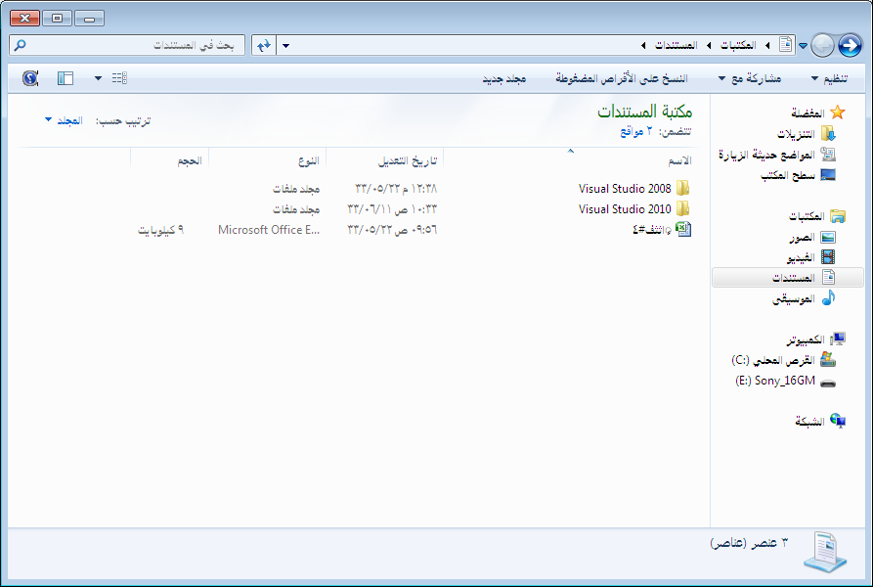
Columns
Items
ListView
SubItems
© 1992-2011 by Pearson Education, Inc. All Rights Reserved. Edited By Maysoon AlDuwais

Slide 36

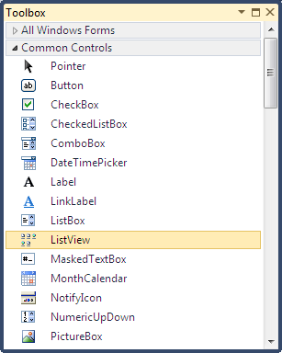

© 1992-2011 by Pearson Education, Inc. All Rights Reserved. Edited By Maysoon AlDuwais

Slide 37





© 1992-2011 by Pearson Education, Inc. All Rights Reserved. Edited By Maysoon AlDuwais

Slide 38



© 1992-2011 by Pearson Education, Inc. All Rights Reserved. Edited By Maysoon AlDuwais

Slide 39




© 1992-2011 by Pearson Education, Inc. All Rights Reserved. Edited By Maysoon AlDuwais

Slide 40


In the following form (Form1) theList View with:
  Two columns (Name – Size)
  One Item (Document.docx)
  One SubItem for Document.docx item (10 kb)
© 1992-2011 by Pearson Education, Inc. All Rights Reserved. Edited By Maysoon AlDuwais

Slide 41


© 1992-2011 by Pearson Education, Inc. All Rights Reserved. Edited By Maysoon AlDuwais

Slide 42






Large Icon
Details
Small Icon
List
Tile
© 1992-2011 by Pearson Education, Inc. All Rights Reserved. Edited By Maysoon AlDuwais

Slide 43

The default event to the list view is SelectedIndexChanged which is triggered when the user change his selection of the item.
Private Sub ListView1_SelectedIndexChanged
(ByVal sender As System.Object,
ByVal e As System.EventArgs)
Handles ListView1.SelectedIndexChanged
‘ Write your Code here
End Sub
Double Click here
© 1992-2011 by Pearson Education, Inc. All Rights Reserved. Edited By Maysoon AlDuwais

Slide 44


Private Sub ListView1_SelectedIndexChanged
(ByVal sender As System.Object,
ByVal e As System.EventArgs)
Handles ListView1.SelectedIndexChanged
MessageBox.Show("You Selected an item")
End Sub
Double Click here
Run
Click on any item
© 1992-2011 by Pearson Education, Inc. All Rights Reserved. Edited By Maysoon AlDuwais

Slide 45


Parent Nodes
Child Nodes
Nodes
© 1992-2011 by Pearson Education, Inc. All Rights Reserved. Edited By Maysoon AlDuwais

Slide 46



© 1992-2011 by Pearson Education, Inc. All Rights Reserved. Edited By Maysoon AlDuwais

Slide 47



© 1992-2011 by Pearson Education, Inc. All Rights Reserved. Edited By Maysoon AlDuwais

Slide 48


2
1
3
© 1992-2011 by Pearson Education, Inc. All Rights Reserved. Edited By Maysoon AlDuwais

Slide 49


2
1
3
© 1992-2011 by Pearson Education, Inc. All Rights Reserved. Edited By Maysoon AlDuwais

Slide 50


© 1992-2011 by Pearson Education, Inc. All Rights Reserved. Edited By Maysoon AlDuwais

Slide 51

1
2
3
© 1992-2011 by Pearson Education, Inc. All Rights Reserved. Edited By Maysoon AlDuwais

Slide 52



Private Sub TreeView1_AfterSelect(ByVal sender As System.Object, ByVal e As System.Windows.Forms.TreeViewEventArgs) Handles TreeView1.AfterSelect
MessageBox.Show("You Selected an item")
End Sub
Double Click here
Run
The default event of the TreeView is AfterSelect which is triggred when the user select a node from the tree.
© 1992-2011 by Pearson Education, Inc. All Rights Reserved. Edited By Maysoon AlDuwais

