Slide 1

Visual Basic 2010 How to Program

Slide 2
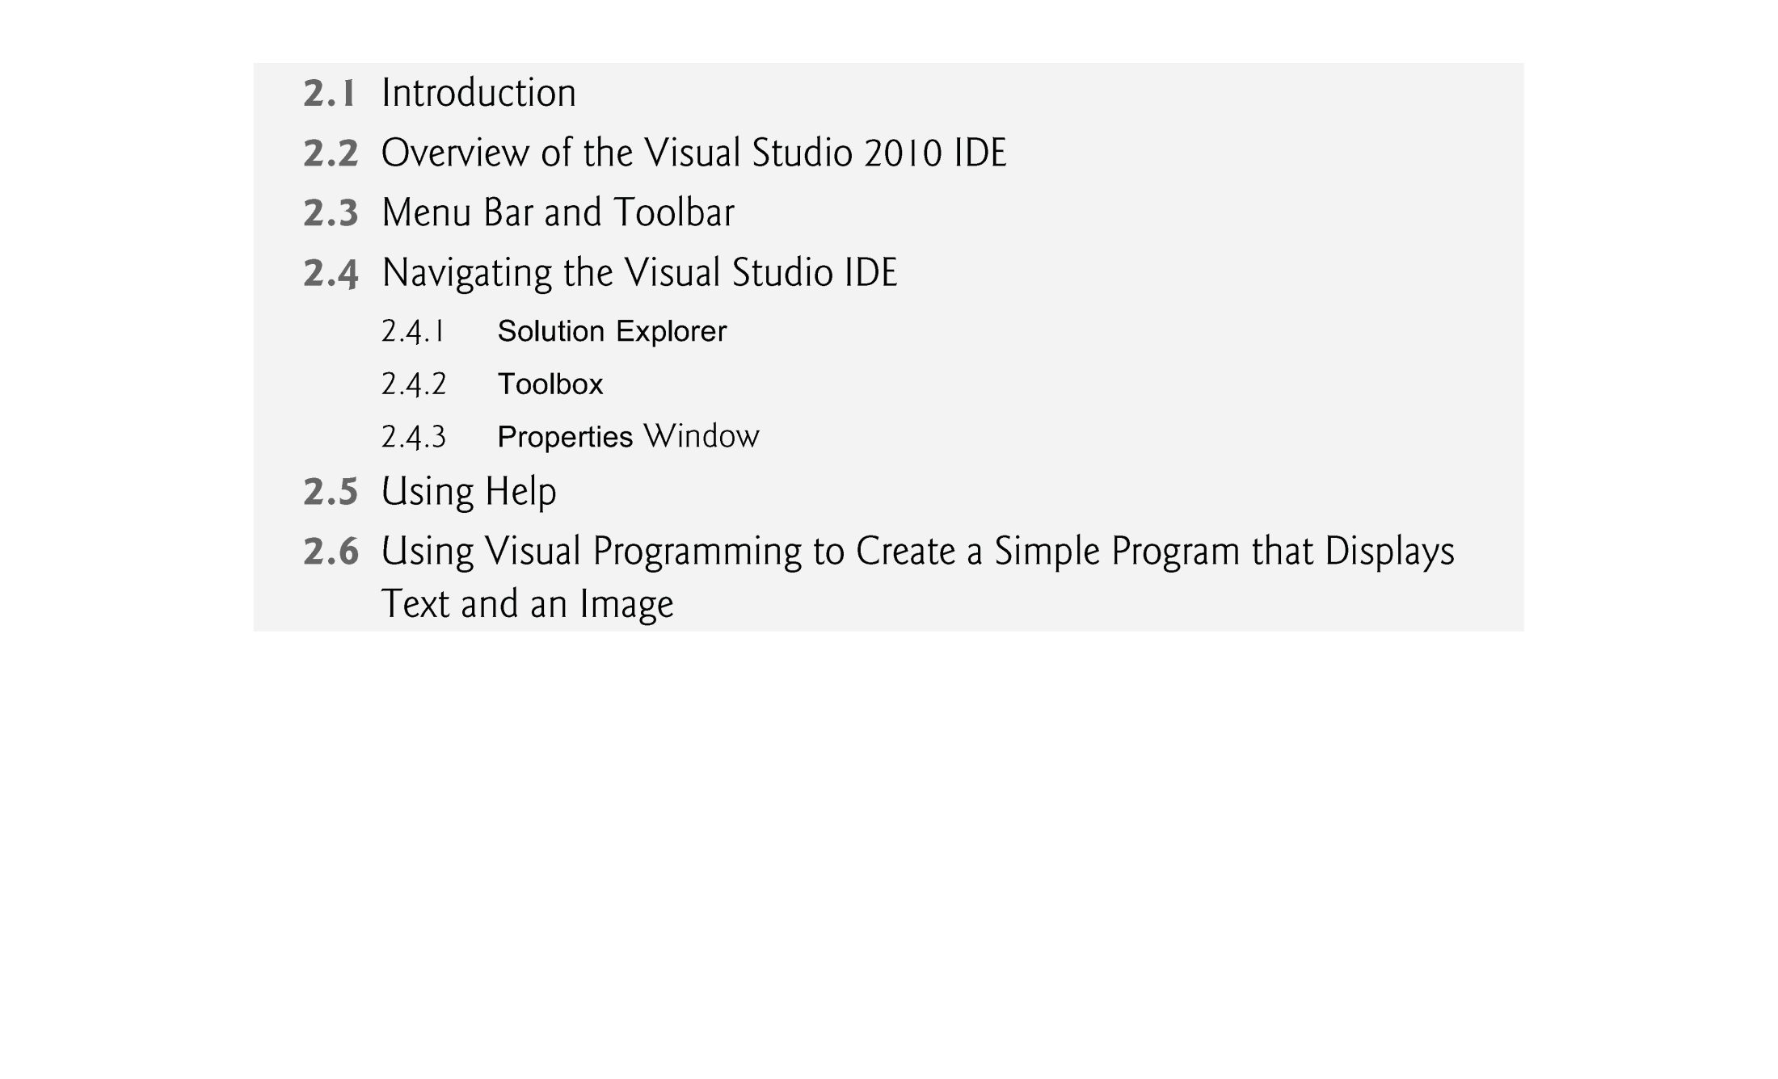
© 1992-2010 by Pearson Education, Inc. All Rights Reserved.

Slide 3

Visual Studio 2010 is Microsoft’s Integrated Development Environment (IDE) for creating, running and debugging programs (also called applications) written in various .NET programming languages.
© 1992-2010 by Pearson Education, Inc. All Rights Reserved.

Slide 4

Introduction to Microsoft Visual Basic 2010 Express Edition
  To start Microsoft Visual Basic 2010 Express Edition, select Start > All Programs > Microsoft Visual Studio 2010.
  The Start Page displays.
  The Start Page: The Start Page links are organized into sections—Recent Projects, Get Started and Latest News
  At any time, you can return to the Start Page by selecting View > Start Page.
© 1992-2010 by Pearson Education, Inc. All Rights Reserved.

Slide 5
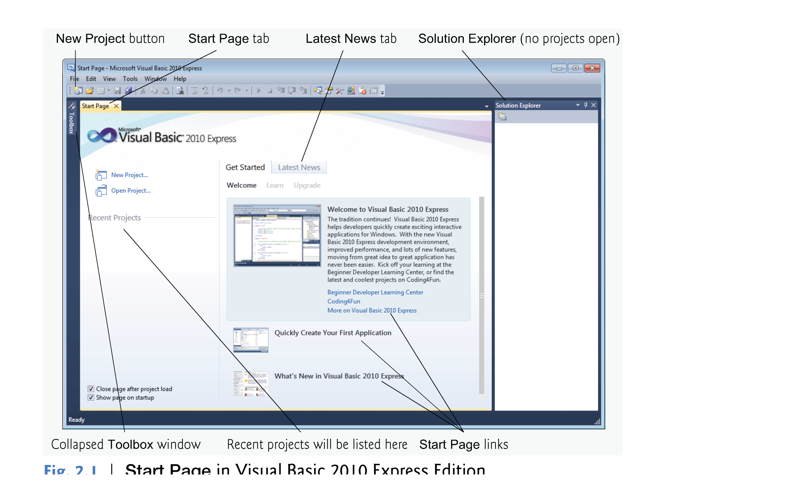
© 1992-2010 by Pearson Education, Inc. All Rights Reserved.

Slide 6
The Recent Projects section contains information on projects you’ve recently created or modified.
The Get Started section focuses on using the IDE for creating programs and learning Visual Basic.
The Latest News tab provides links to the latest Visual Basic developments (such as updates and bug fixes).
© 1992-2010 by Pearson Education, Inc. All Rights Reserved.

Slide 7
Customizing the IDE and Creating a New Project
  To begin programming in Visual Basic, you must create a new project or open an existing one.
  To create new project:
    File > New Project
    Or from the Start Page ->New Project
  To Open existing project:
    File > Open Project
    Or from Start Page -> Recent Projects
    Or also from Start Page -> Open Projects
© 1992-2010 by Pearson Education, Inc. All Rights Reserved.

Slide 8
A project is a group of related files, such as the Visual Basic code and any images that might make up a program.
solutions is a group folder contains one or more projects.
Multiple-project solutions are for large-scale programs.
Each program we create consists of a single project.
Visual Studio provides several templates.
Templates are the project types users can create in Visual Basic—Windows Forms applications, console applications, WPF applications and others.
© 1992-2010 by Pearson Education, Inc. All Rights Reserved.

Slide 9
In this chapter, we build a Windows Forms Application.
A Windows Forms application executes within a Windows operating system and has a graphical user interface (GUI)—the visual part of the program with which the user interacts.
© 1992-2010 by Pearson Education, Inc. All Rights Reserved.

Slide 10
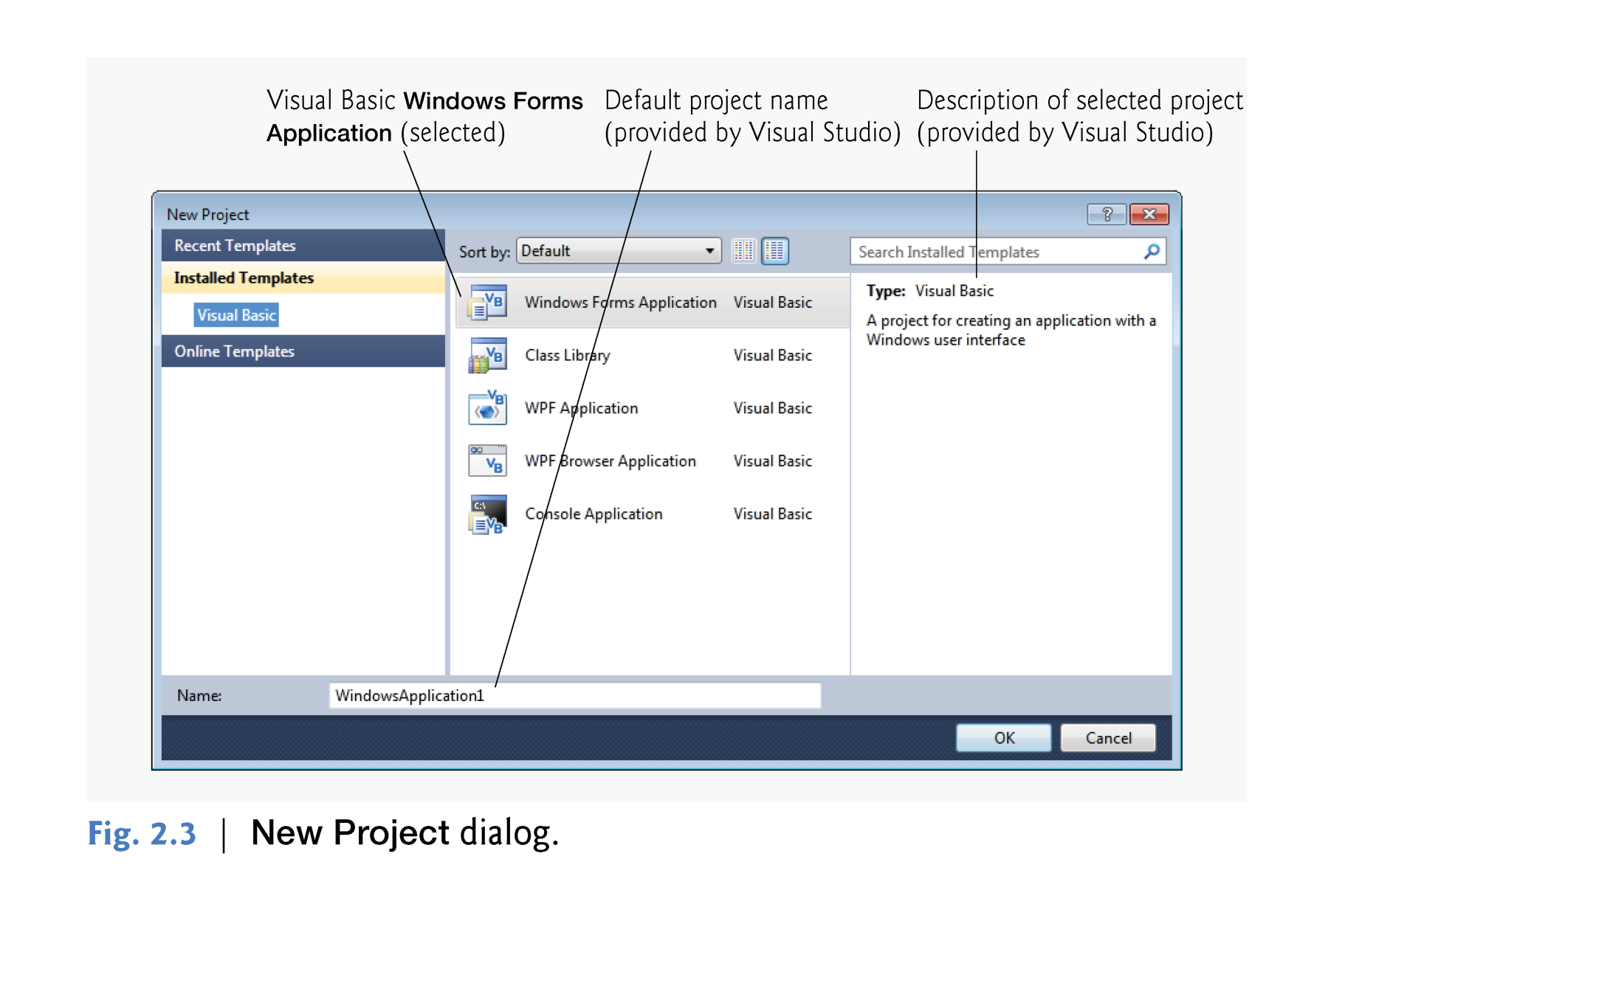
© 1992-2010 by Pearson Education, Inc. All Rights Reserved.

Slide 11
By default, Visual Studio assigns the name WindowsApplication1 to a new Windows Forms Application project and solution.
Select Windows Forms Application, then click OK to display the IDE in Design view, which contains the features that enable you to create programs.
© 1992-2010 by Pearson Education, Inc. All Rights Reserved.

Slide 12

Viewing the Form
  Design Mode
  To view the Form in its design mode:
    double click on the Form’s name in the Solution Explorer Window.
    The Form will appear with tab having the following “FormName.vb [Design]”
  Code Mode
  To view the Form in its Code mode:
    Right click on the Form.
    Select View Code
    Then the code will be viewed in a separate tab with the same name “FormName.vb”
© 1992-2010 by Pearson Education, Inc. All Rights Reserved.

Slide 13
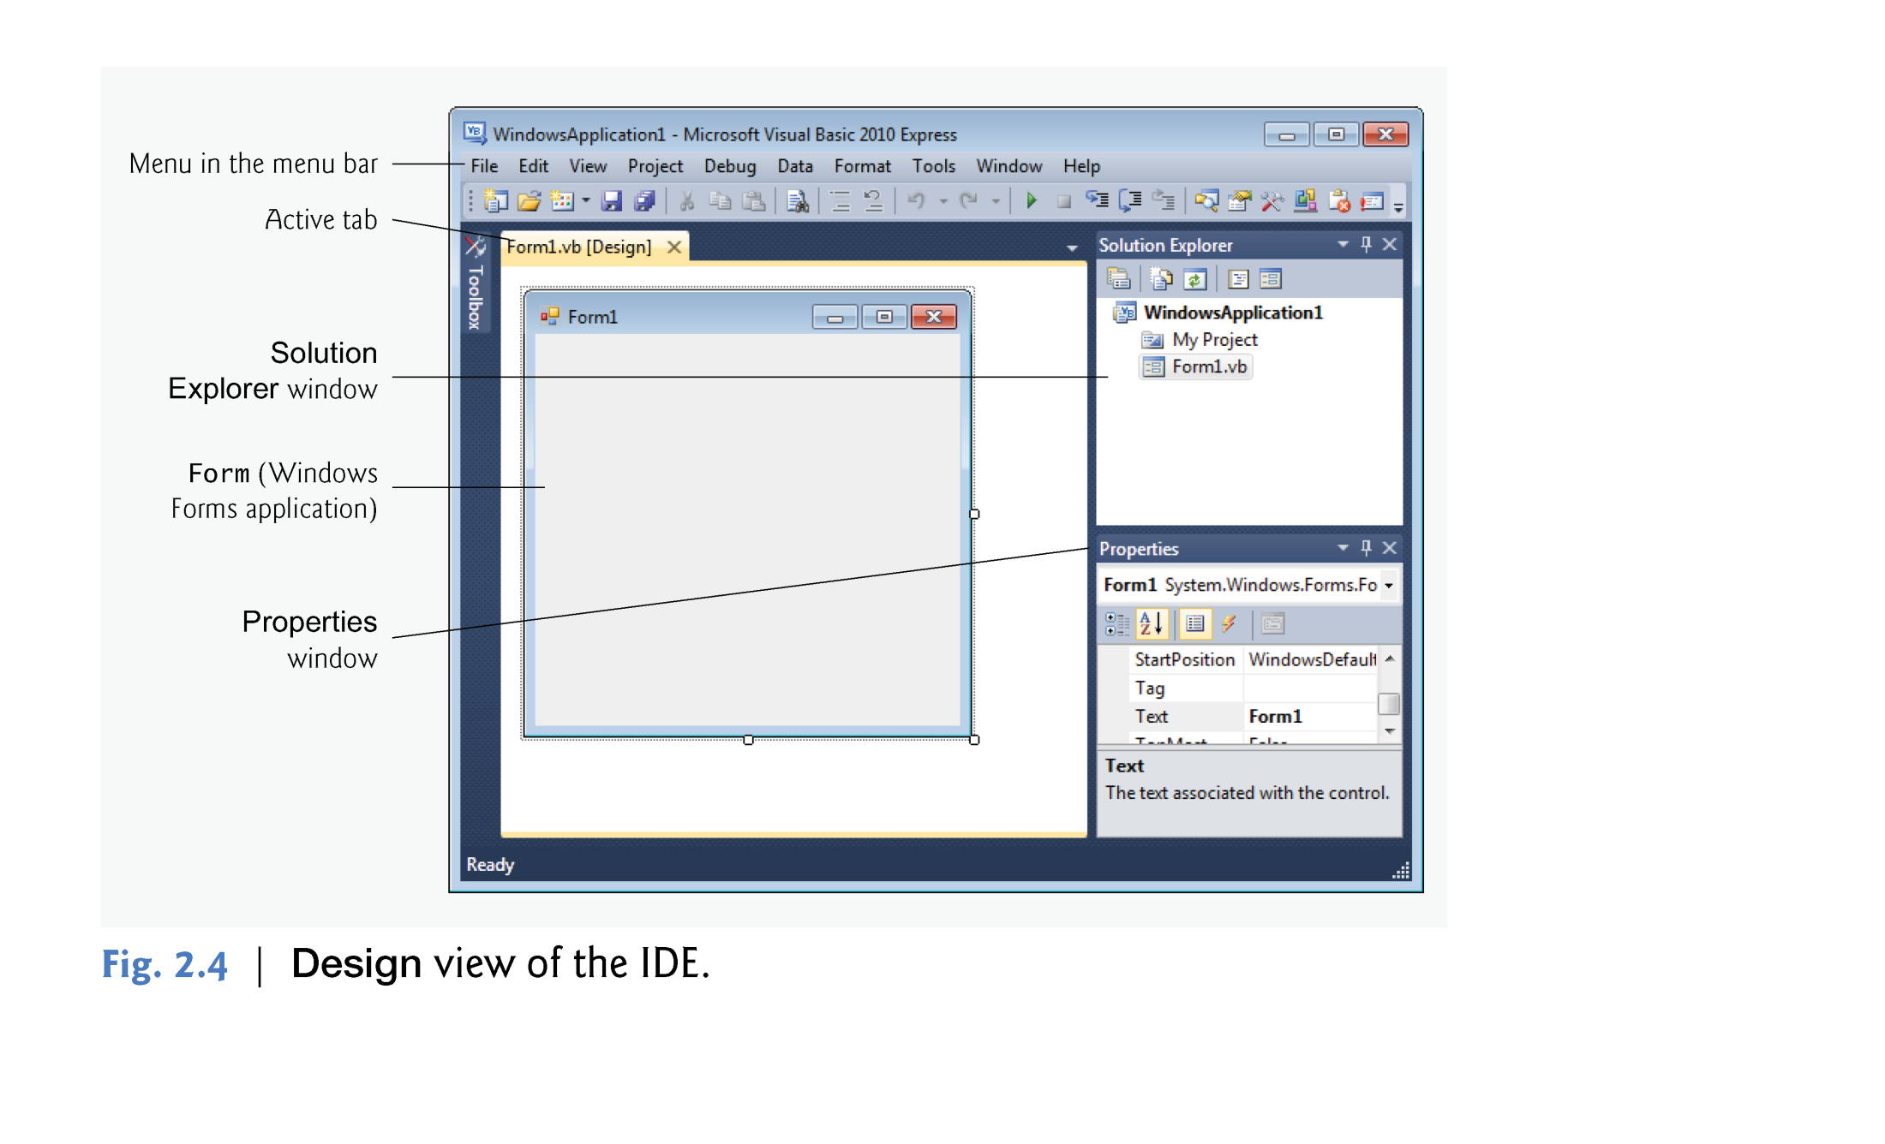
© 1992-2010 by Pearson Education, Inc. All Rights Reserved.

Slide 14
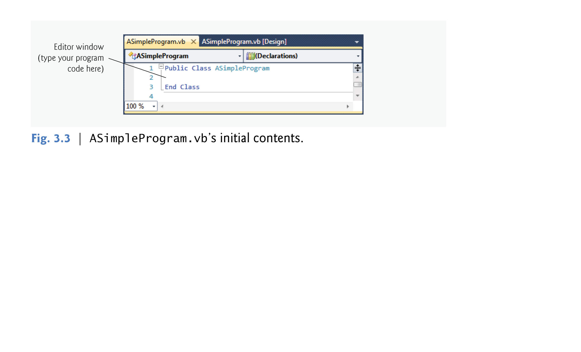
© 1992-2010 by Pearson Education, Inc. All Rights Reserved.

Slide 15
The rectangle in the Design area titled Form1 (called a Form) represents the main window of the Windows Forms application that you’re creating.
Visual Basic applications can have multiple Forms (windows).
You can customize the Form by adding GUI controls
GUI controls includes Textboxes, buttons, labels, combobox,..etc.
© 1992-2010 by Pearson Education, Inc. All Rights Reserved.

Slide 16
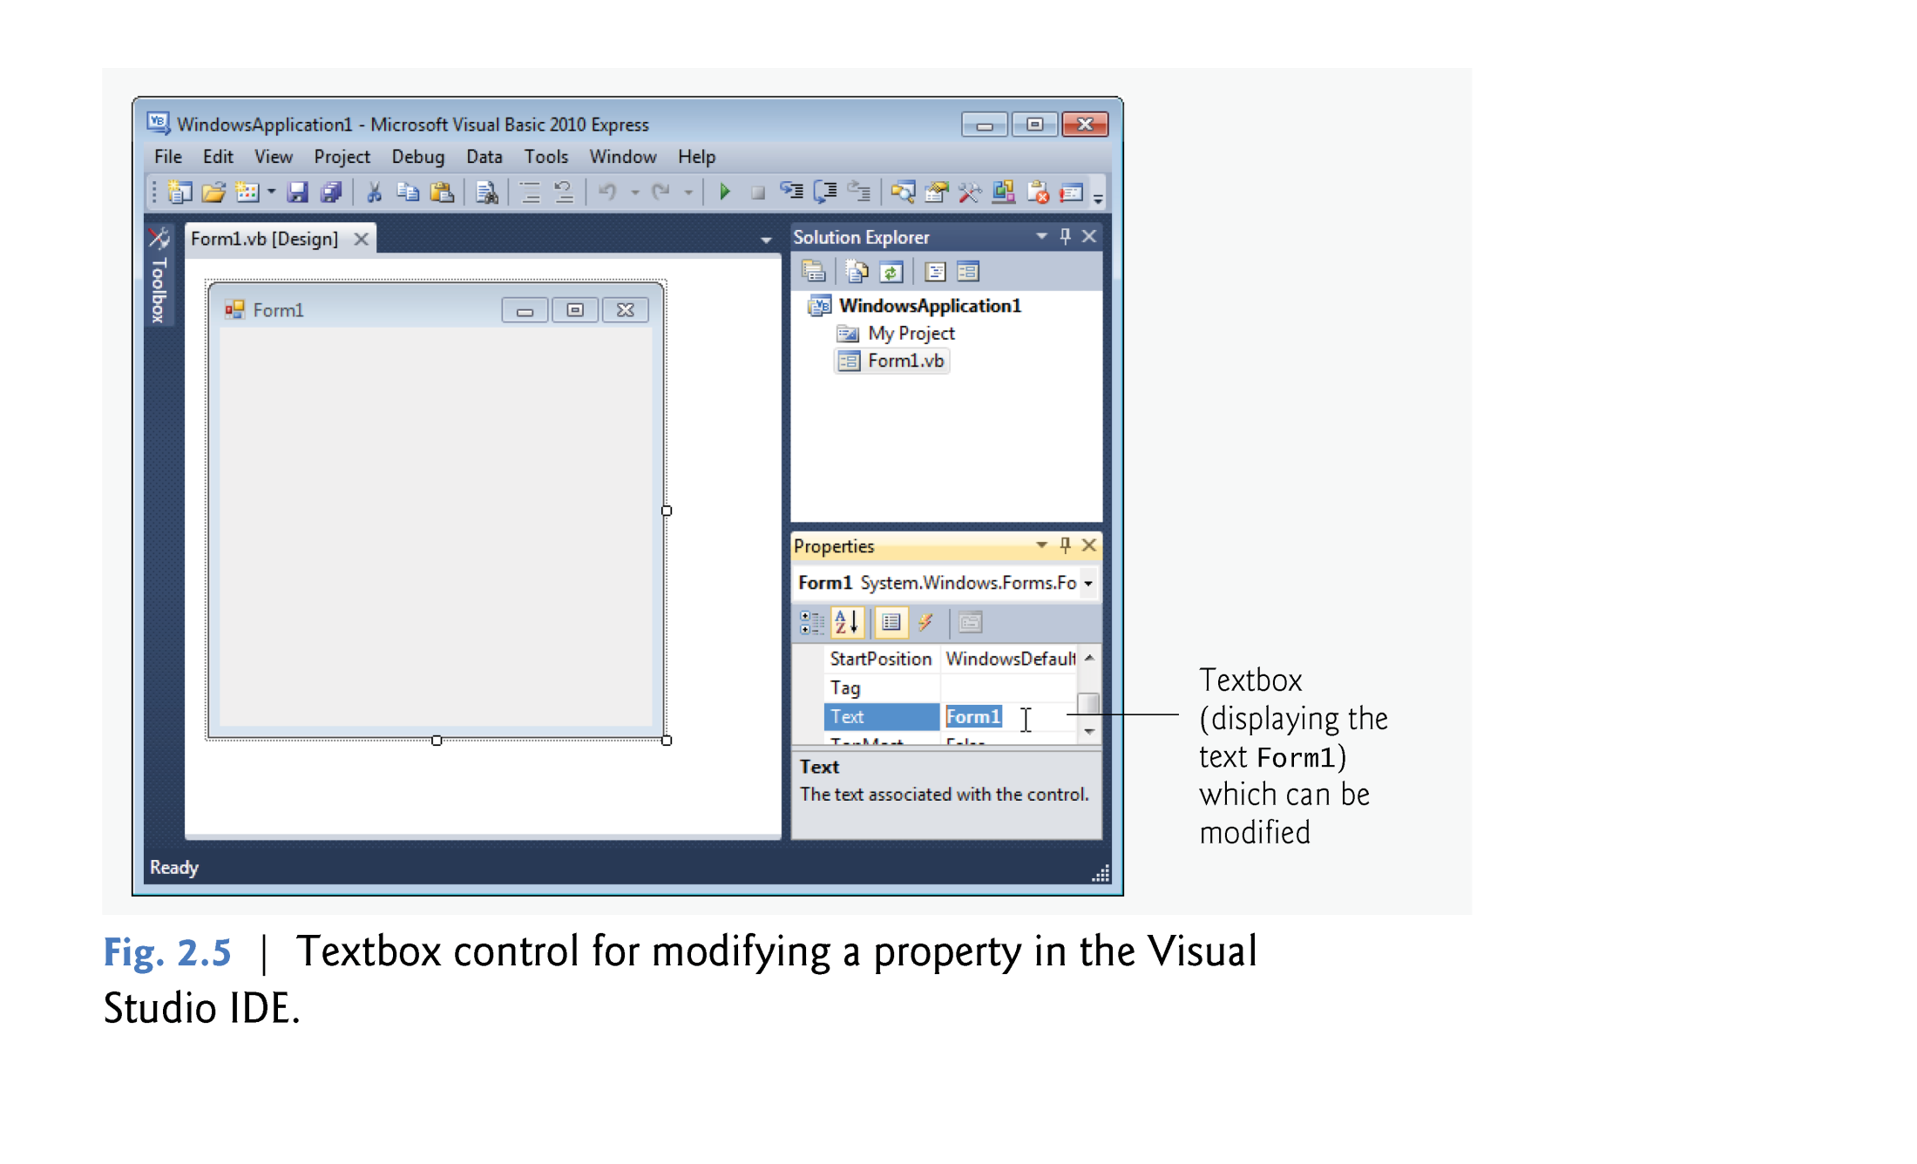
© 1992-2010 by Pearson Education, Inc. All Rights Reserved.

Slide 17
Collectively, the Form and controls make up the program’s GUI.
Users enter data (inputs) into the program by typing at the keyboard, by clicking the mouse buttons and in a variety of other ways.
Programs use the GUI to display instructions and other information (outputs) for users to view.
© 1992-2010 by Pearson Education, Inc. All Rights Reserved.

Slide 18

Commands for managing the IDE and for developing, maintaining and executing programs are contained in menus, which are located on the menu bar of the IDE
The set of menus displayed depends on what you’re currently doing in the IDE.
© 1992-2010 by Pearson Education, Inc. All Rights Reserved.

Slide 19
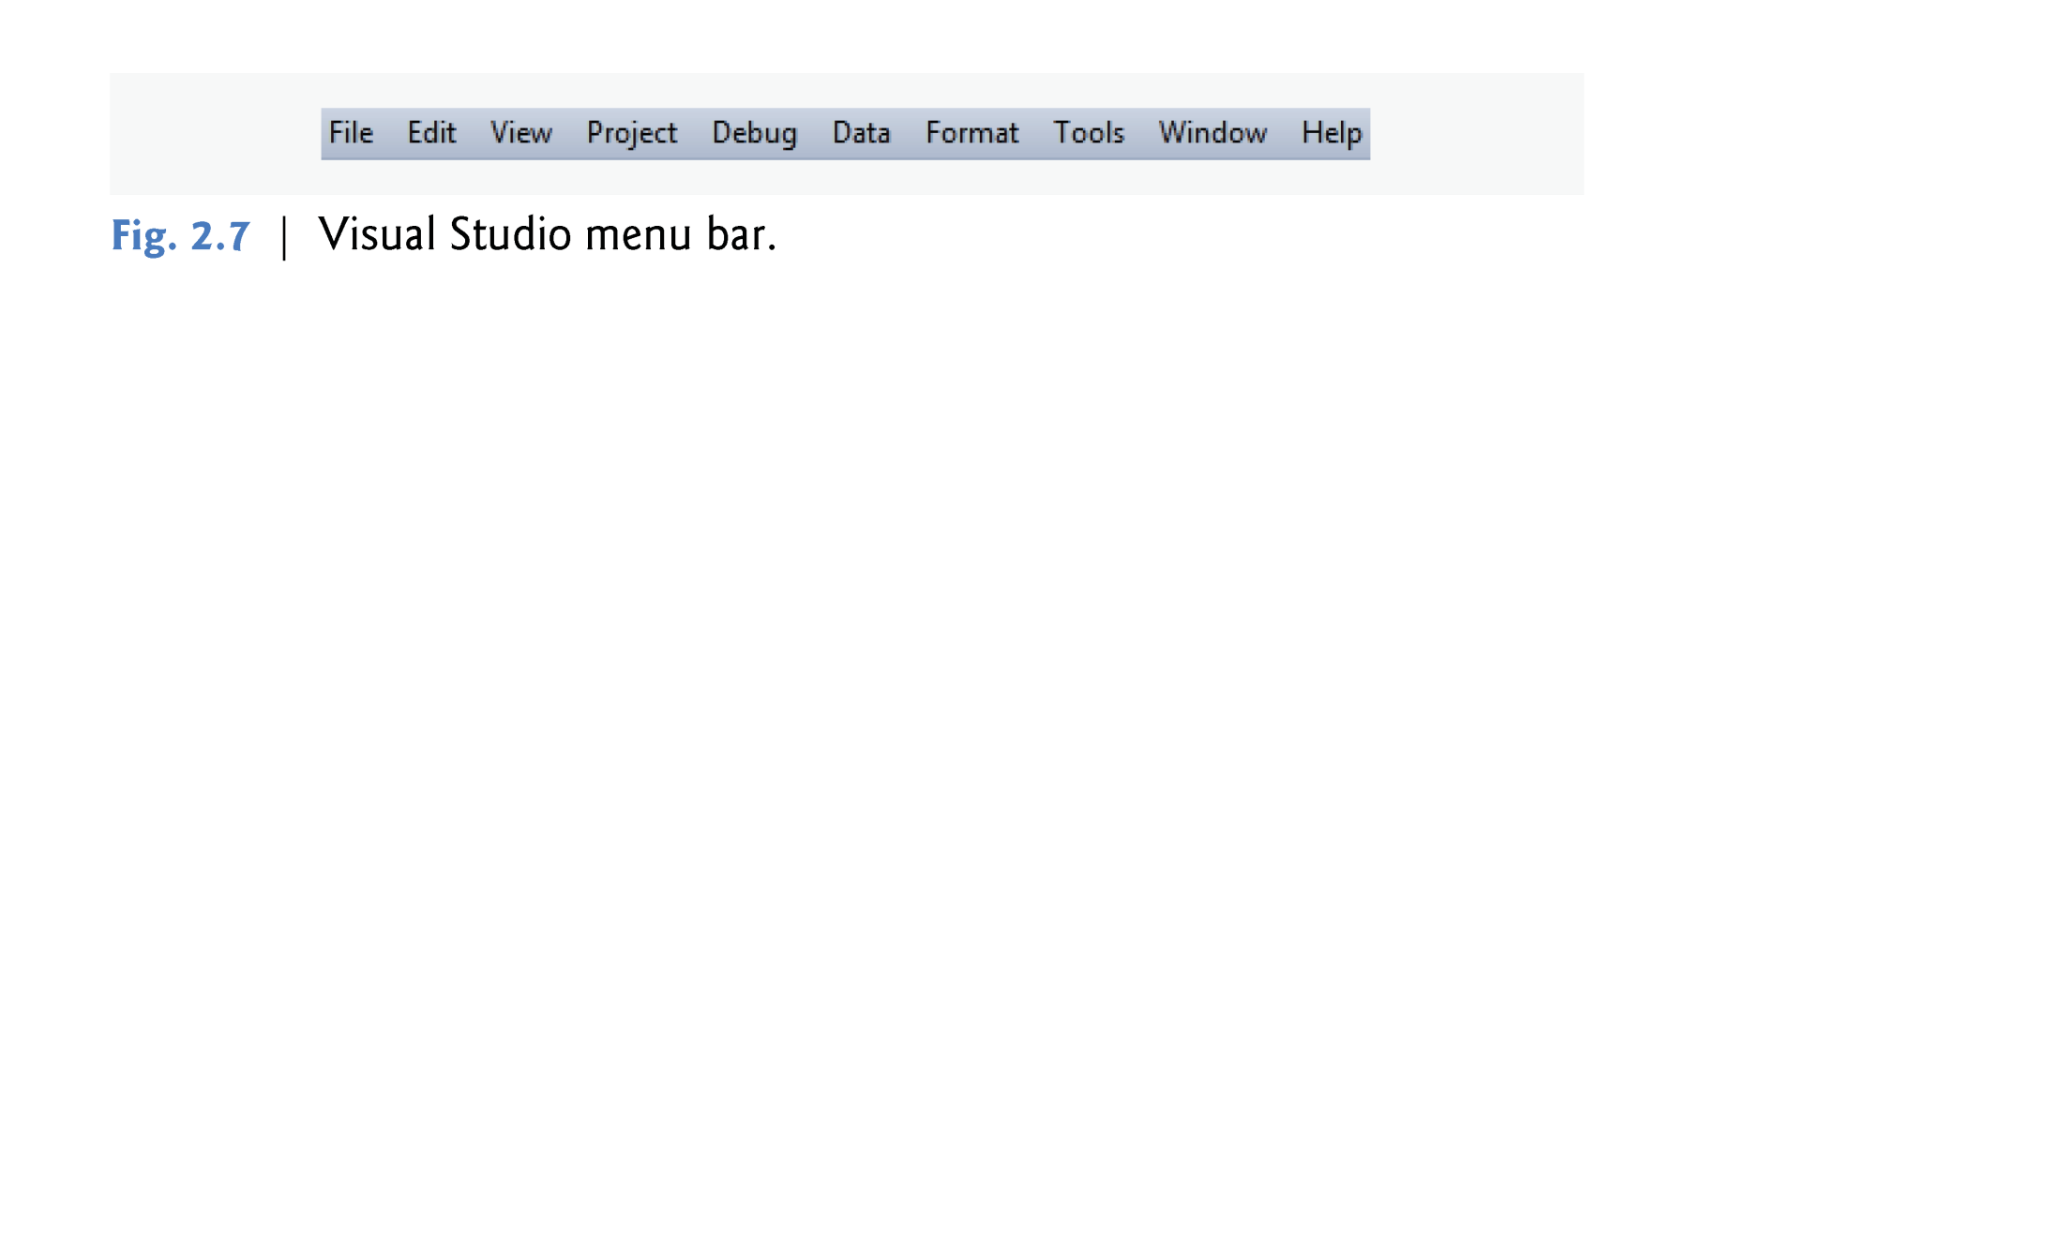
© 1992-2010 by Pearson Education, Inc. All Rights Reserved.

Slide 20
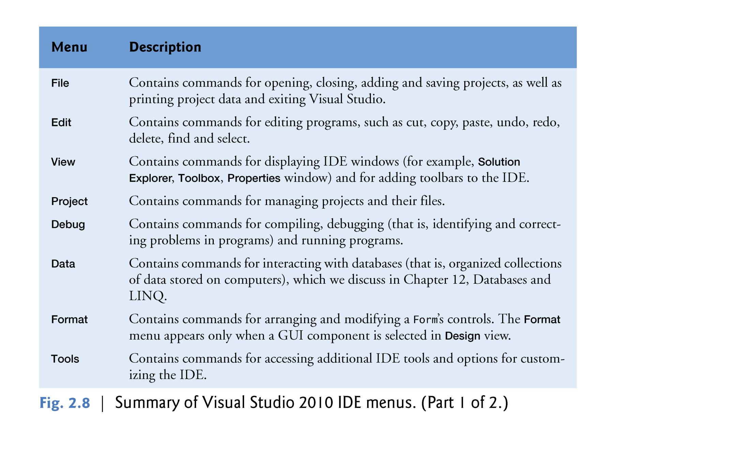
© 1992-2010 by Pearson Education, Inc. All Rights Reserved.

Slide 21
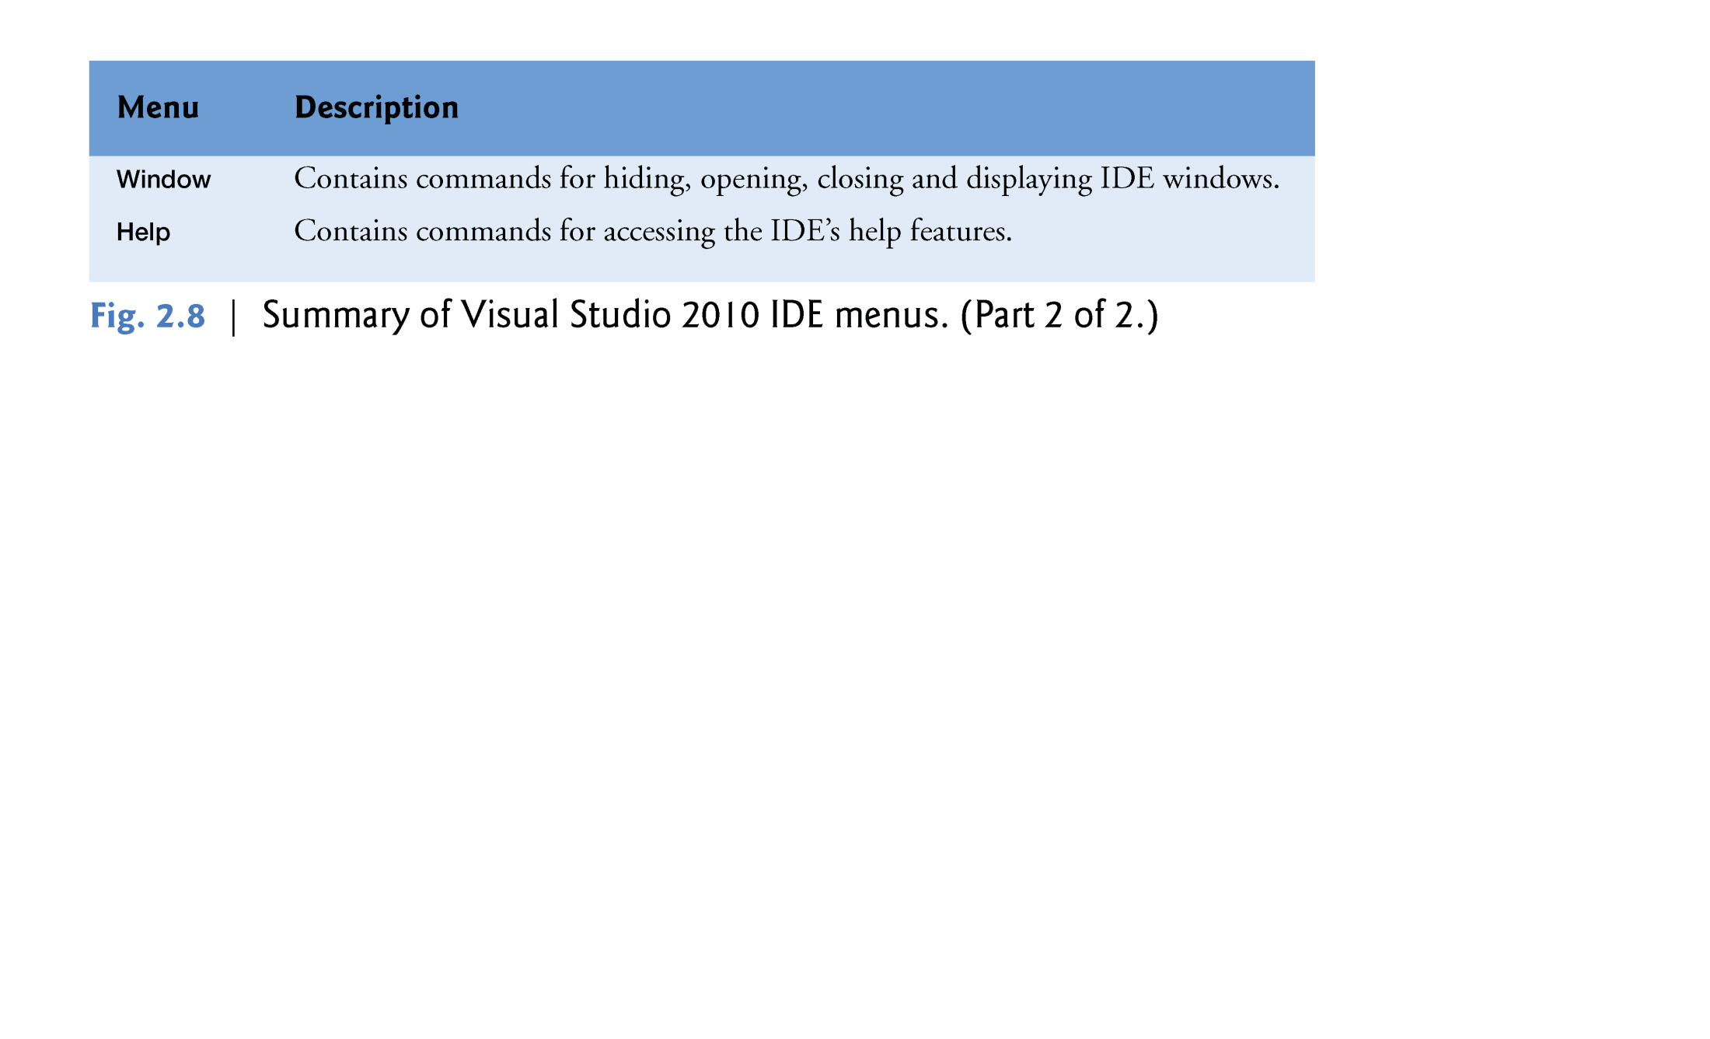
© 1992-2010 by Pearson Education, Inc. All Rights Reserved.

Slide 22
You can access many of the more common menu commands from the toolbar.
The standard toolbar it contains icons for the most commonly used commands, such as opening a file, adding an item to a project, saving files and running applications .
© 1992-2010 by Pearson Education, Inc. All Rights Reserved.

Slide 23
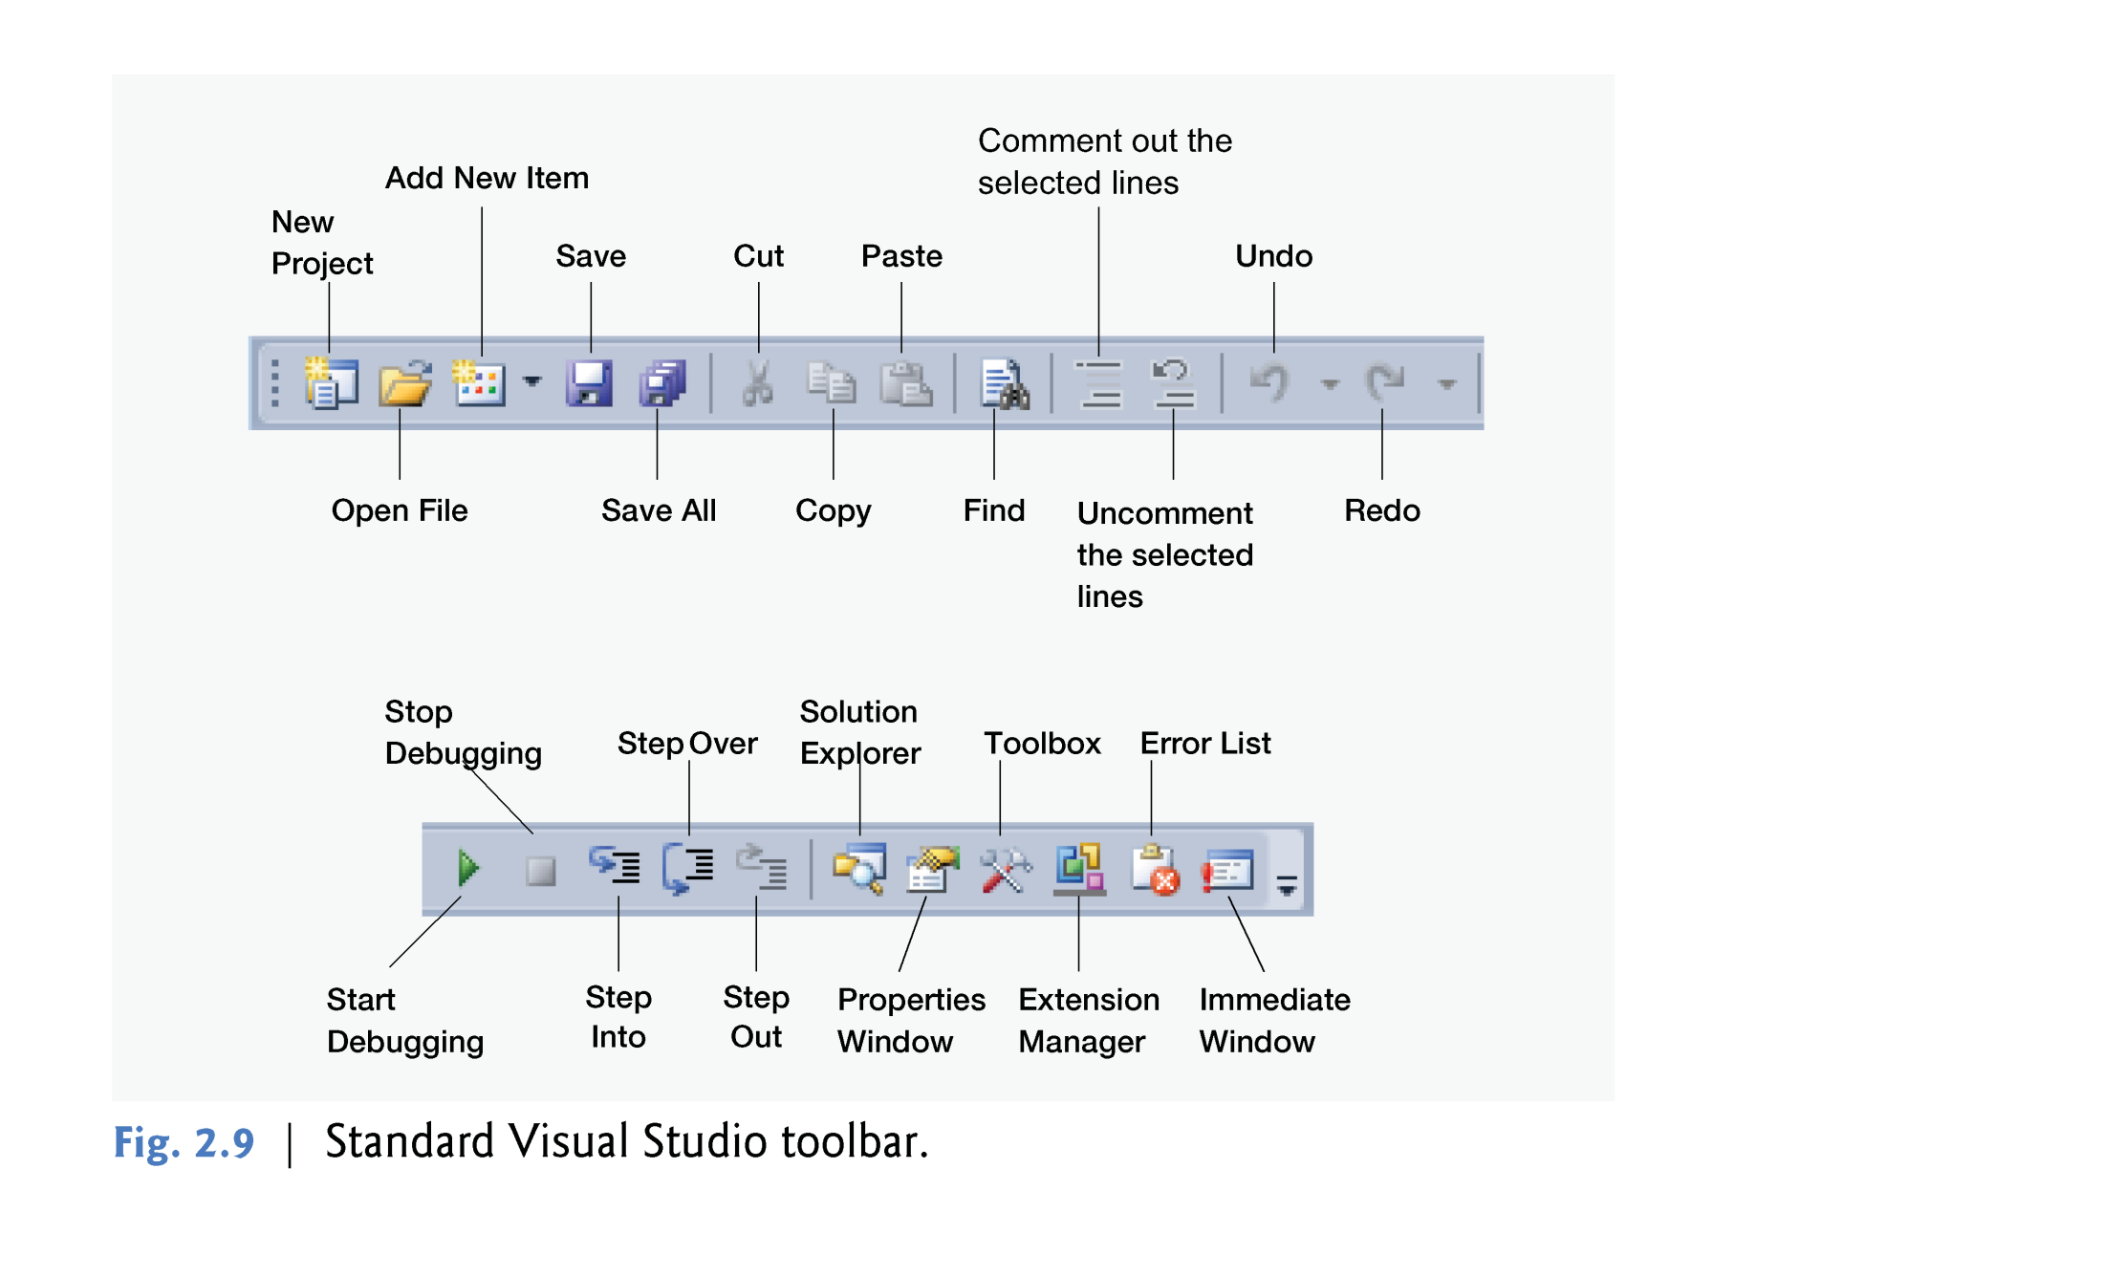
© 1992-2010 by Pearson Education, Inc. All Rights Reserved.

Slide 24
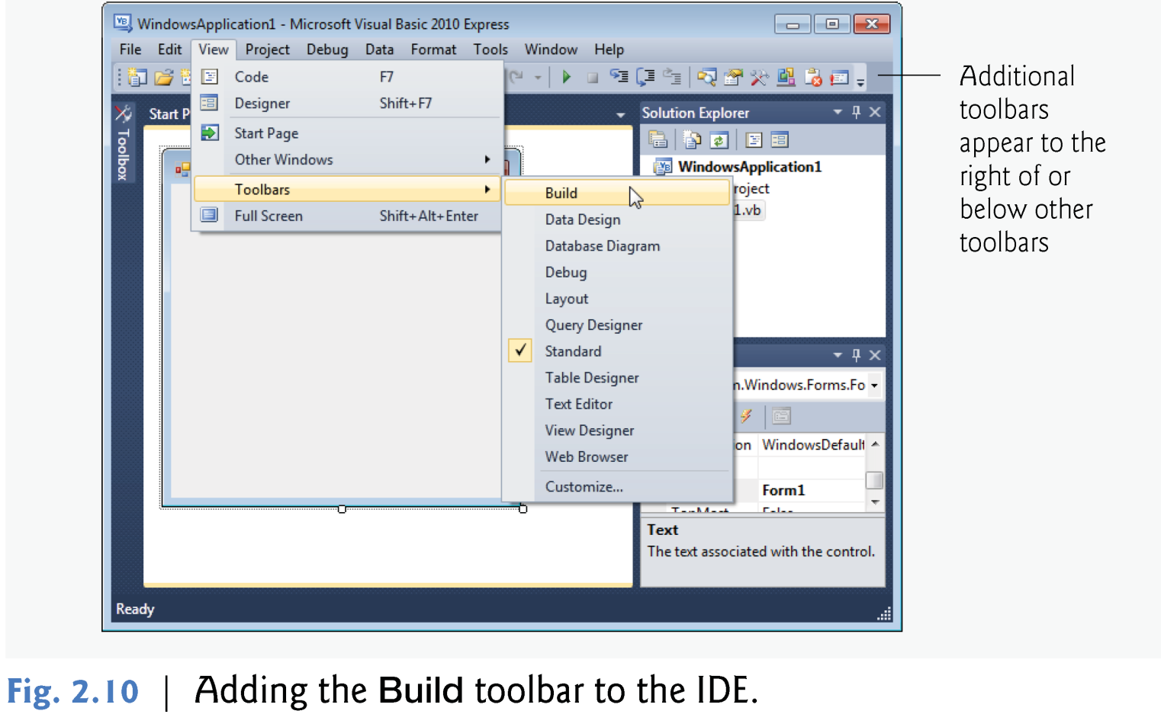
You can customize the IDE’s toolbars.
Select View > Toolbars .
© 1992-2010 by Pearson Education, Inc. All Rights Reserved.

Slide 25

The IDE provides windows for accessing project files and customizing controls.
This section introduces several windows that you’ll use frequently when developing Visual Basic programs.
These windows can be accessed via the toolbar icons or by selecting the desired window’s name in the View menu.
© 1992-2010 by Pearson Education, Inc. All Rights Reserved.

Slide 26
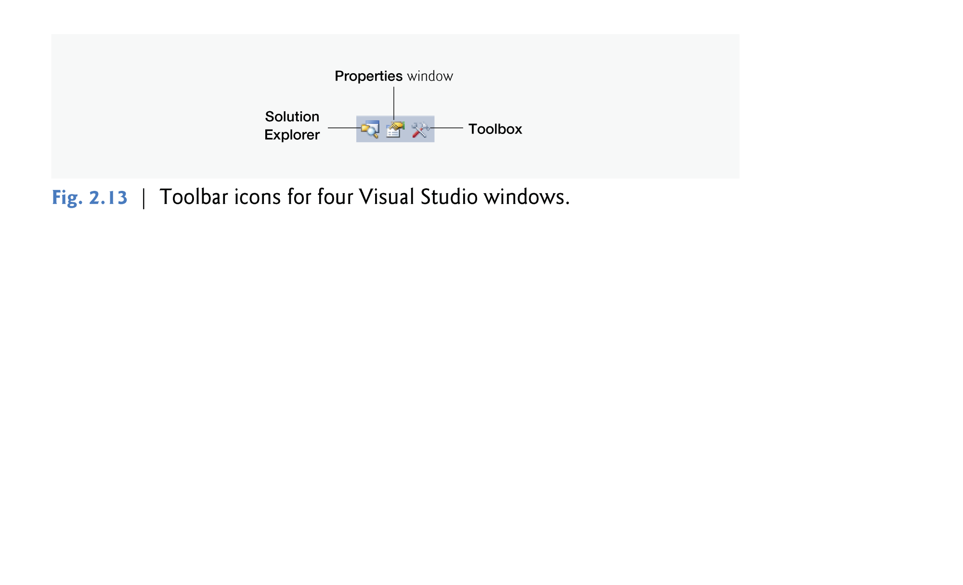
© 1992-2010 by Pearson Education, Inc. All Rights Reserved.

Slide 27
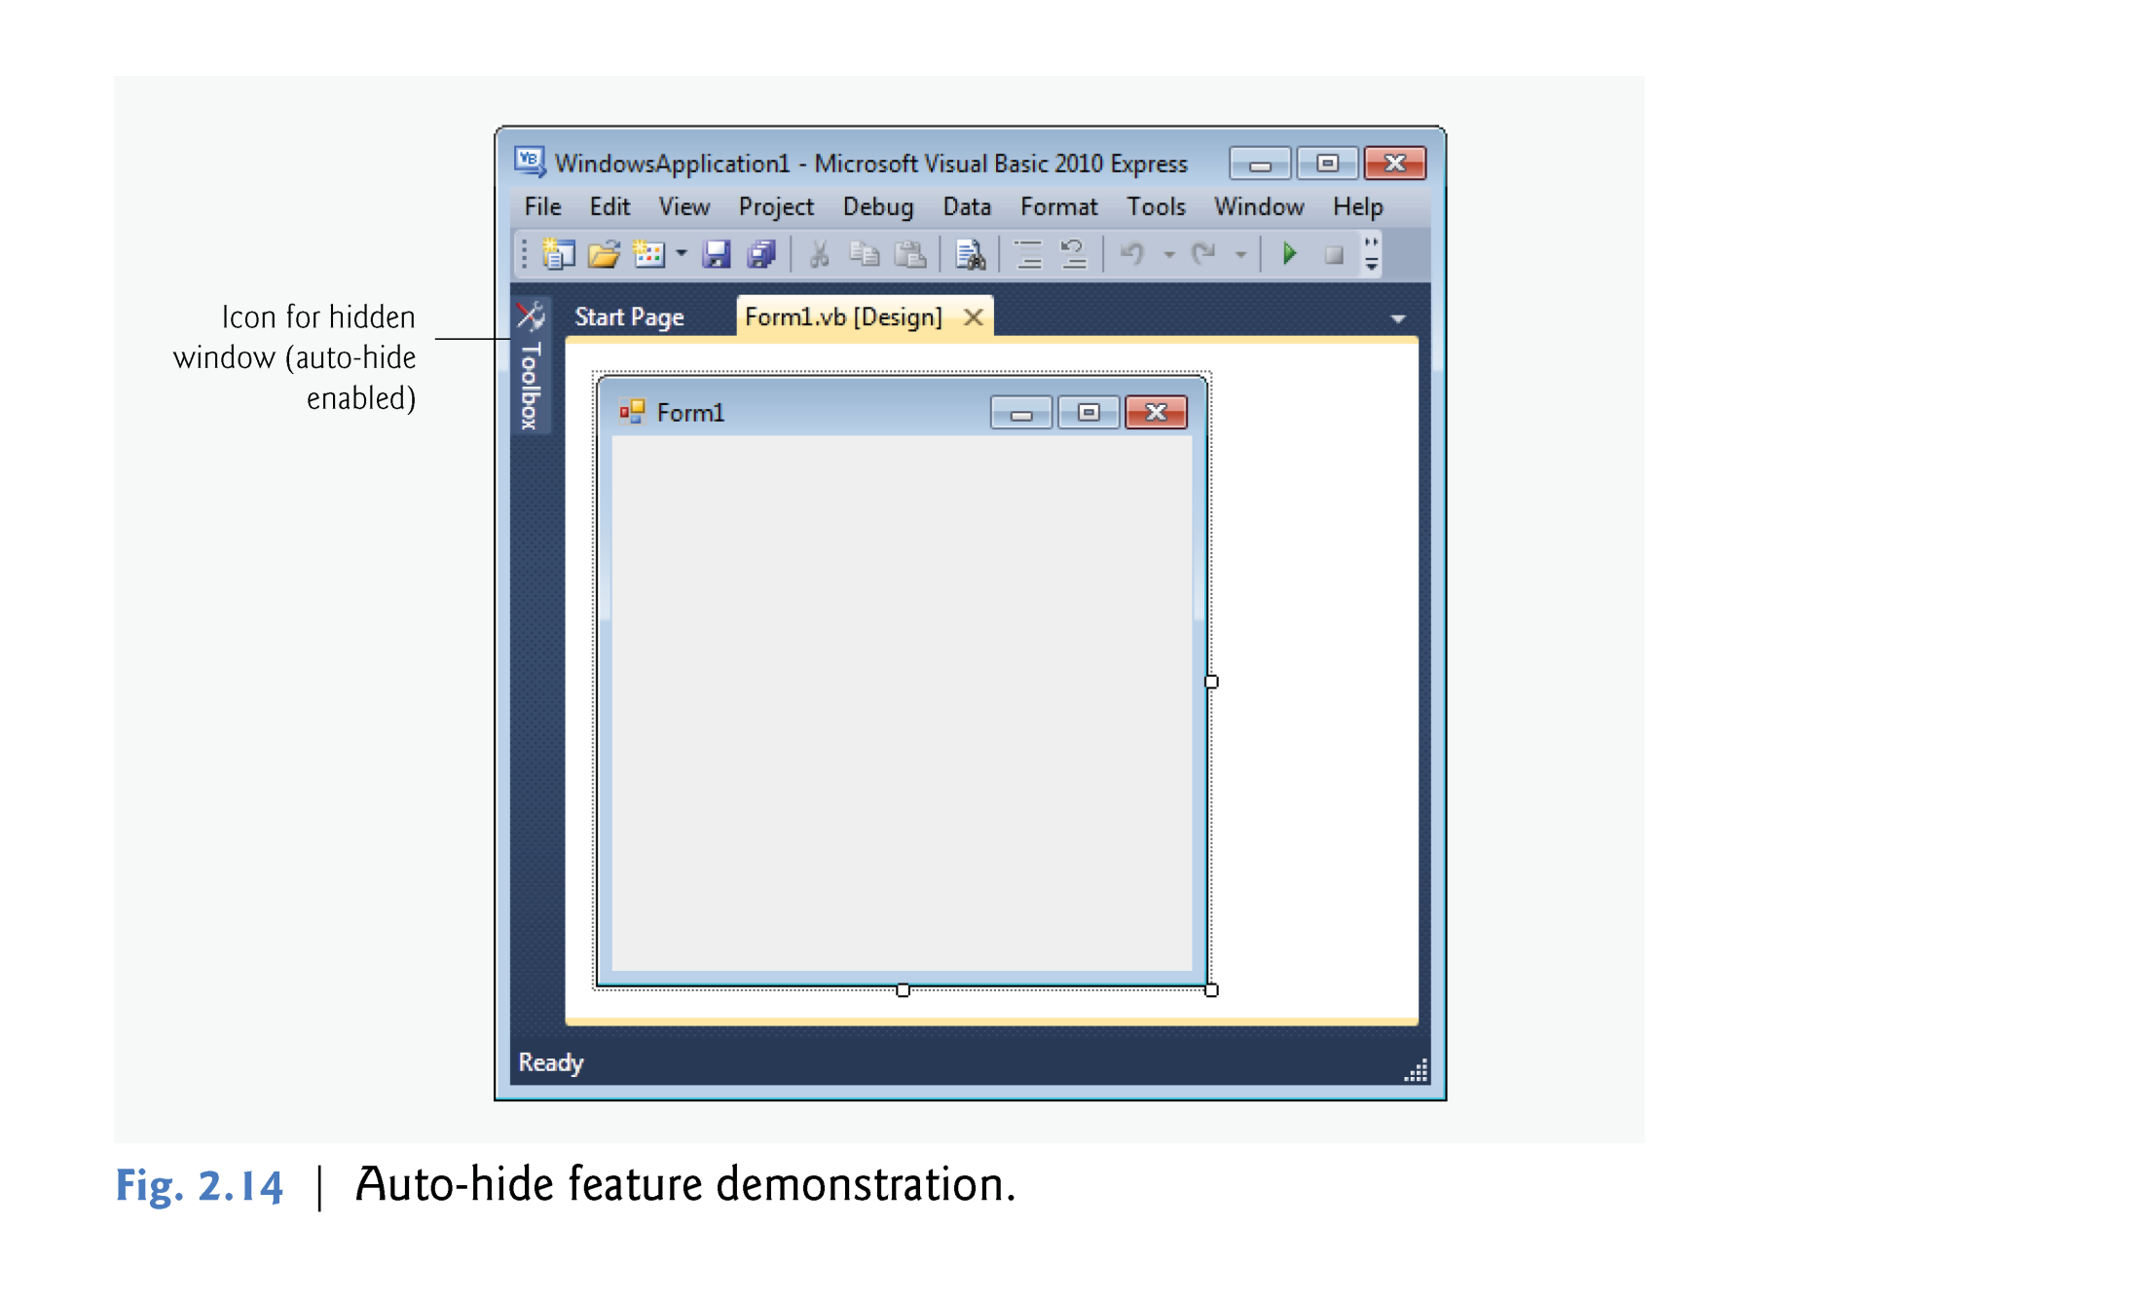
© 1992-2010 by Pearson Education, Inc. All Rights Reserved.

Slide 28
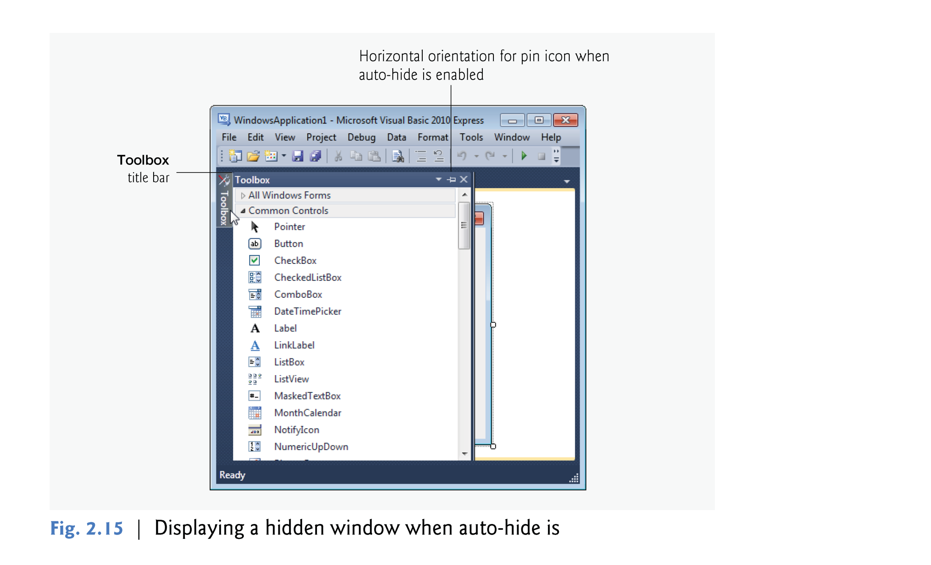
© 1992-2010 by Pearson Education, Inc. All Rights Reserved.

Slide 29
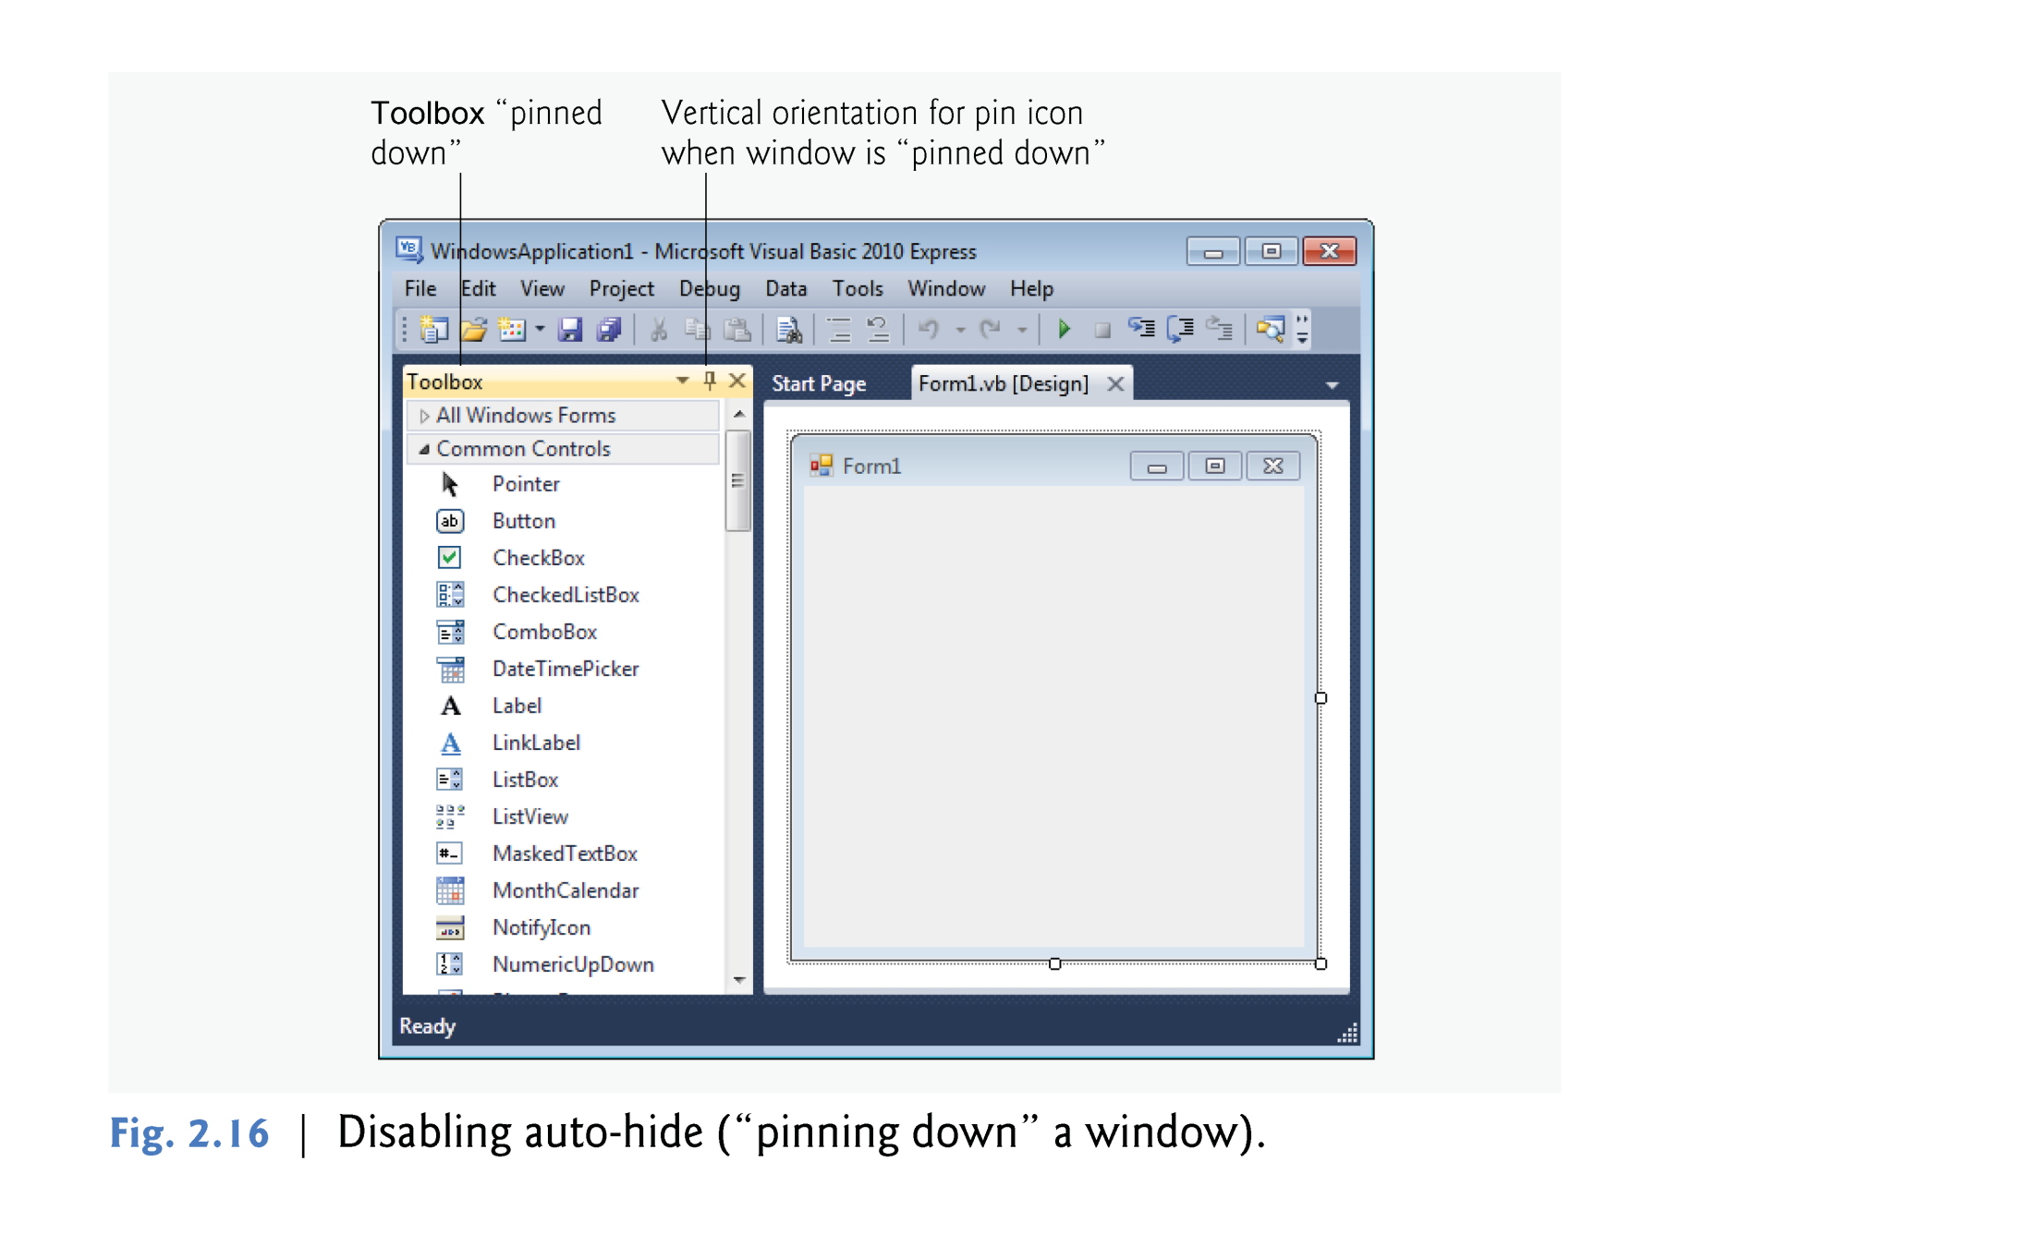
© 1992-2010 by Pearson Education, Inc. All Rights Reserved.

Slide 30
The next few sections cover three of Visual Studio’s main windows—the Solution Explorer, the Properties window and the Toolbox.
These windows display project information and include tools that help you build your programs.
© 1992-2010 by Pearson Education, Inc. All Rights Reserved.

Slide 31

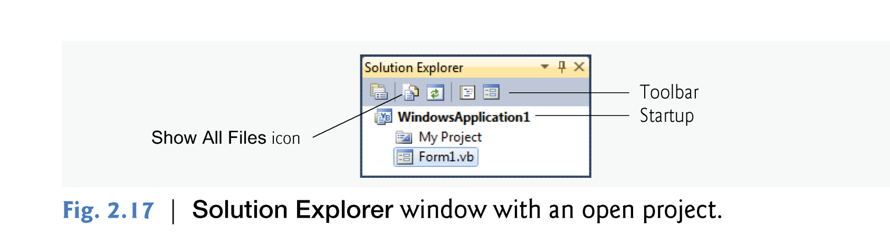
The Solution Explorer window provides access to all of a solution’s files.
If it’s not shown in the IDE, do the following:
  Click the Solution Explorer icon in the IDE -> select View > Other Windows > Solution Explorer
  or type <Ctrl> <Alt> L.
© 1992-2010 by Pearson Education, Inc. All Rights Reserved.

Slide 32
By default, the IDE displays only files that you may need to edit—other files that the IDE generates are hidden.
The Solution Explorer window includes a toolbar that contains several icons.
Clicking the Show All Files icon displays all the solution’s files, including those generated by the IDE .
Clicking the arrows to the left of a file or folder expands or collapses the project tree’s nodes.
© 1992-2010 by Pearson Education, Inc. All Rights Reserved.

Slide 33

The Toolbox (View > Other Windows > Toolbox) contains icons representing controls used to customize Forms.
With visual programming, you can “drag and drop” controls onto the Form.
© 1992-2010 by Pearson Education, Inc. All Rights Reserved.

Slide 34
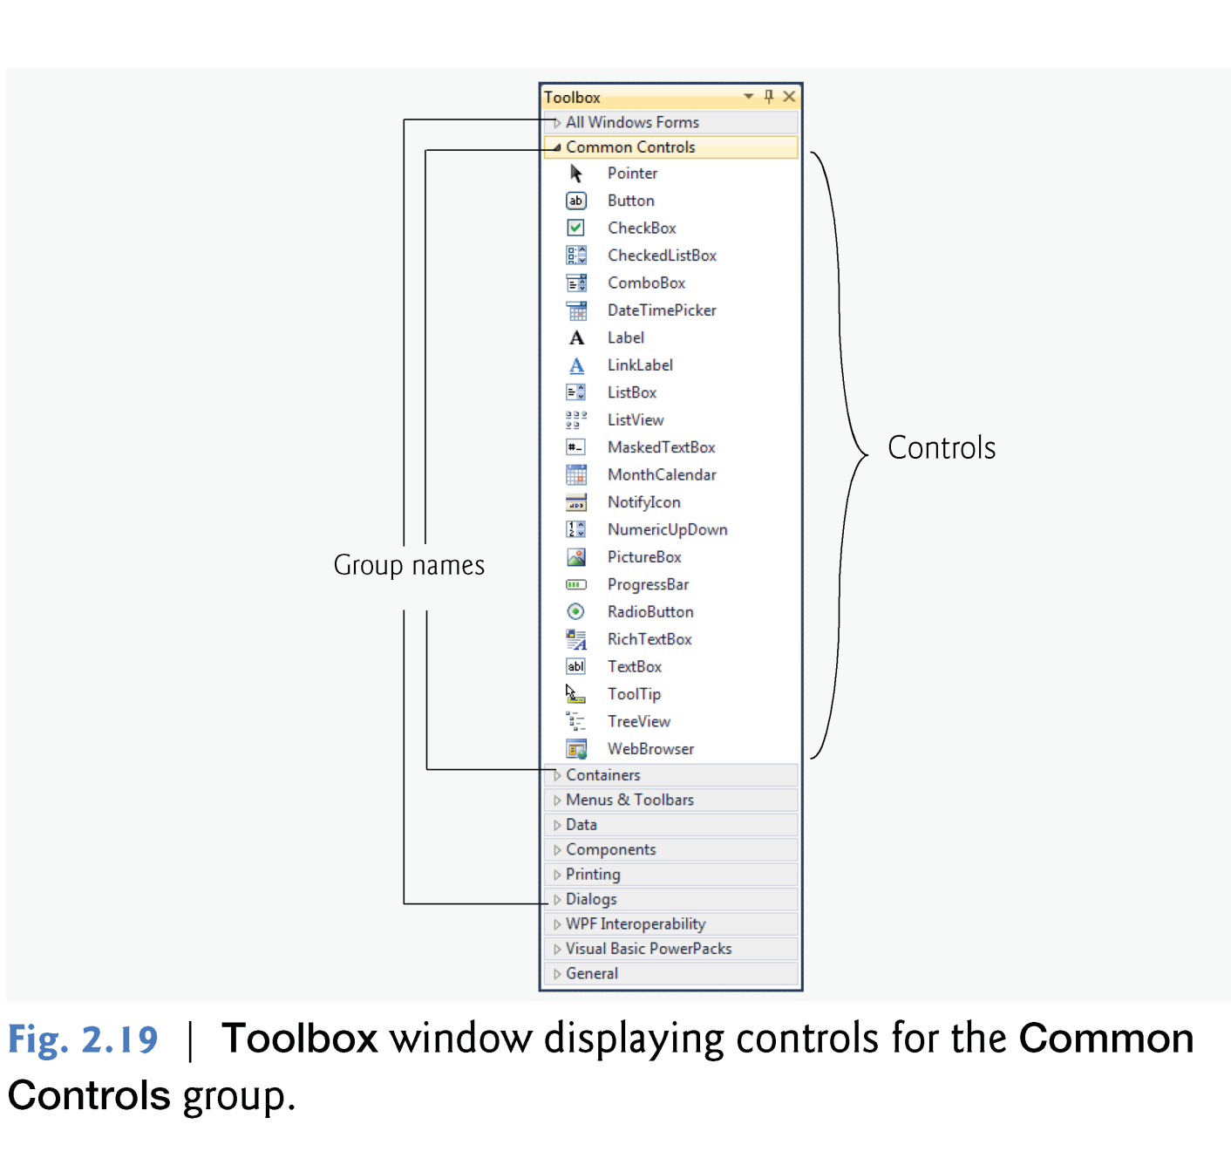
© 1992-2010 by Pearson Education, Inc. All Rights Reserved.

Slide 35
The Toolbox groups the GUI controls into categories as follows:
  All Windows Forms
  Common Controls
  Containers
  Menus & Toolbars
  Data
  Components
  Printing
  Dialogs
  WPF Interoperability
  Visual Basic PowerPacks
  General
© 1992-2010 by Pearson Education, Inc. All Rights Reserved.

Slide 36

To display the Properties window:
  select View > Other Windows > Properties Window,
  click the Properties window toolbar ,
  or press the F4 key.
The Properties window displays the properties for the currently selected Form, control or file in Design view.
Properties specify information about the Form or control, such as its size, color and position.
© 1992-2010 by Pearson Education, Inc. All Rights Reserved.

Slide 37
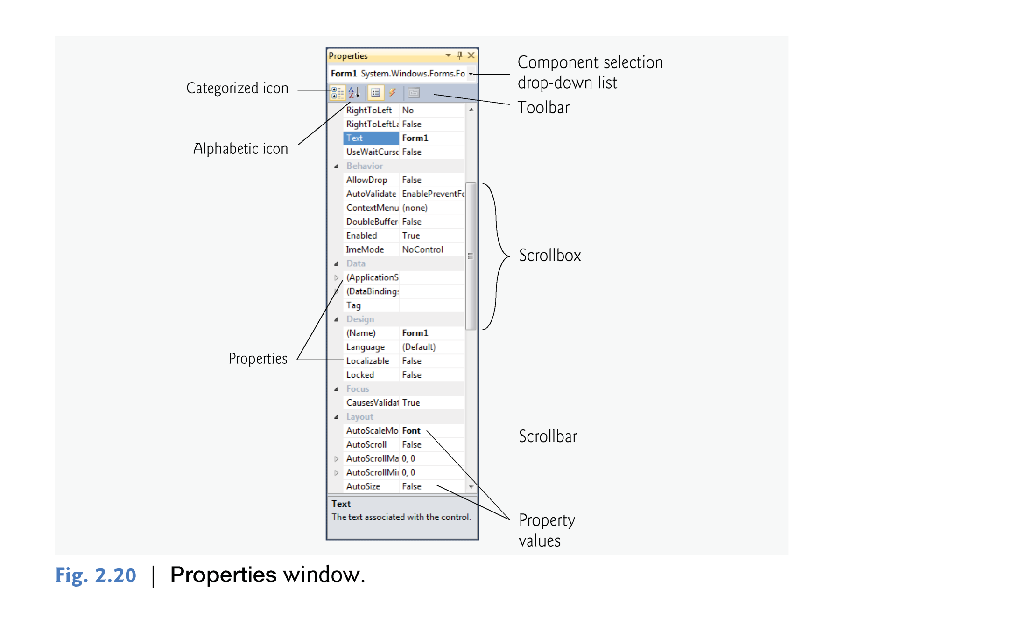
© 1992-2010 by Pearson Education, Inc. All Rights Reserved.

Slide 38
You can sort the properties window:
  Alphabetically from (A-Z or (Z-A) (by clicking the Alphabetical icon)
  or categorically (by clicking the Categorized icon).
Alphabetically icon
Event icon
Property icon
© 1992-2010 by Pearson Education, Inc. All Rights Reserved.

