Slide 1
Internet protocol – IP
الأستاذ المساعد
عبدالهادي محمد ادخيل

Slide 2
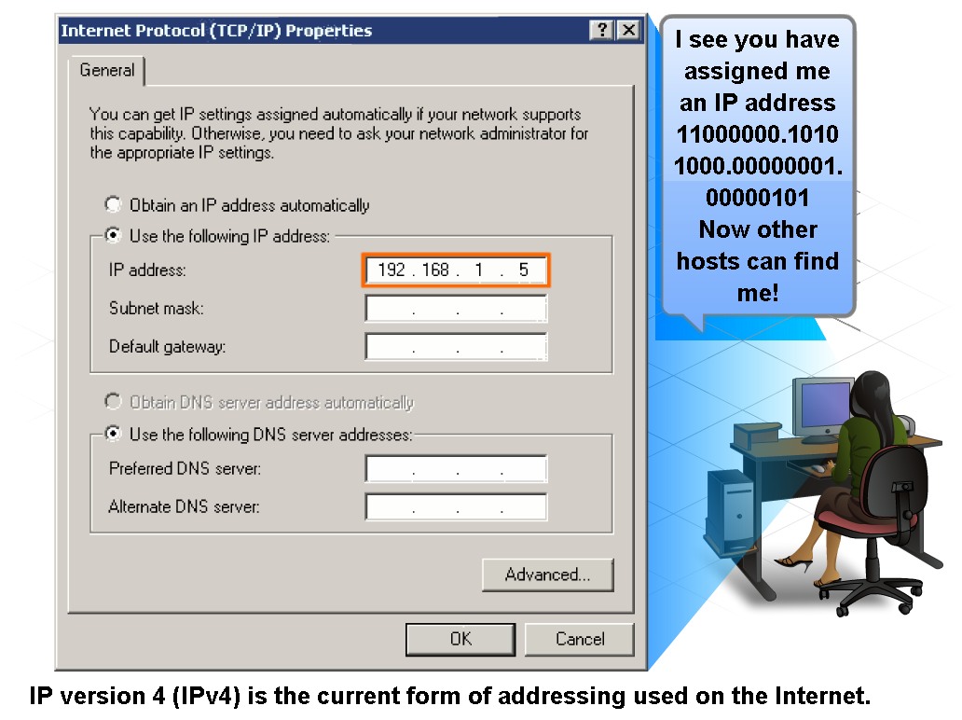
IP Addressing Structure
Describe the dotted decimal structure of a binary IP address and label its parts

Slide 3
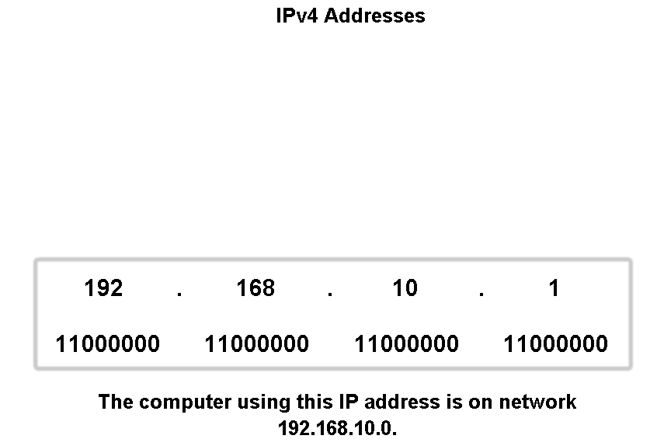
IP Addressing Structure
Describe the general role of 8-bit binary in network addressing and convert 8-bit binary to decimal
10101000
00001010
00000001

Slide 4
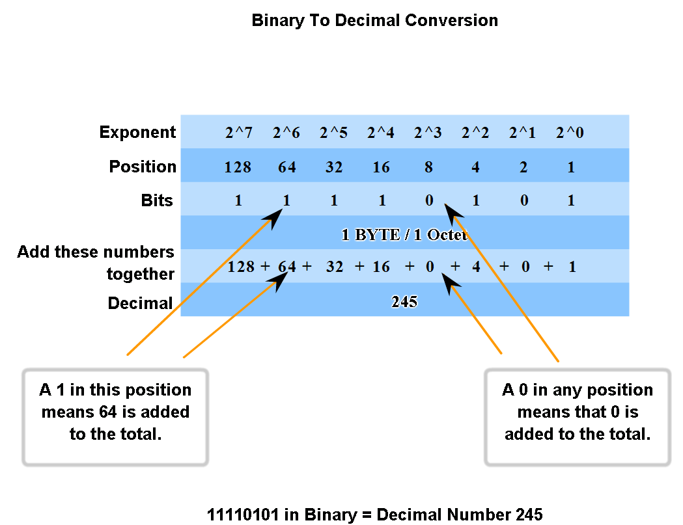
IP Addressing Structure
Practice converting 8-bit binary to decimal

Slide 5
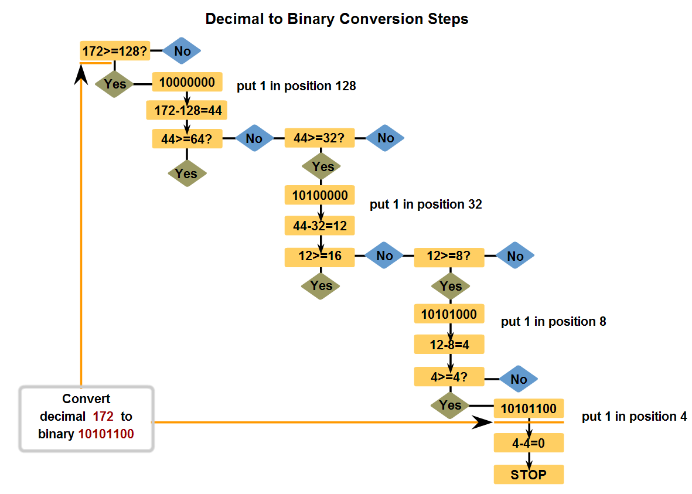
IP Addressing Structure
Convert decimal to 8-bit binary

Slide 6
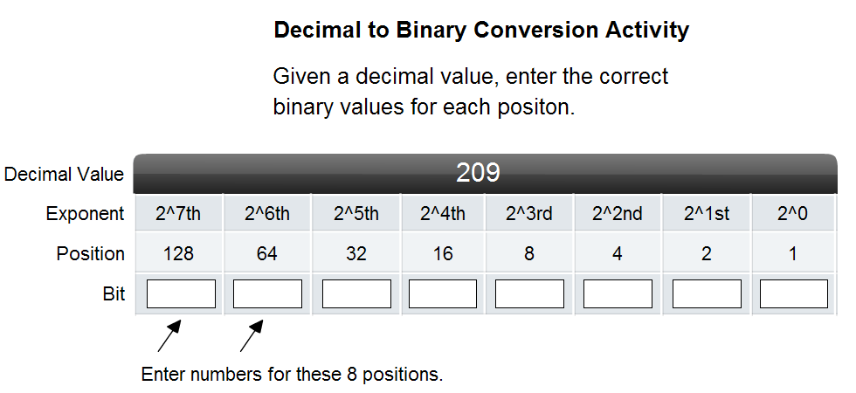
IP Addressing Structure
Practice converting decimal to 8-bit binary

Slide 7
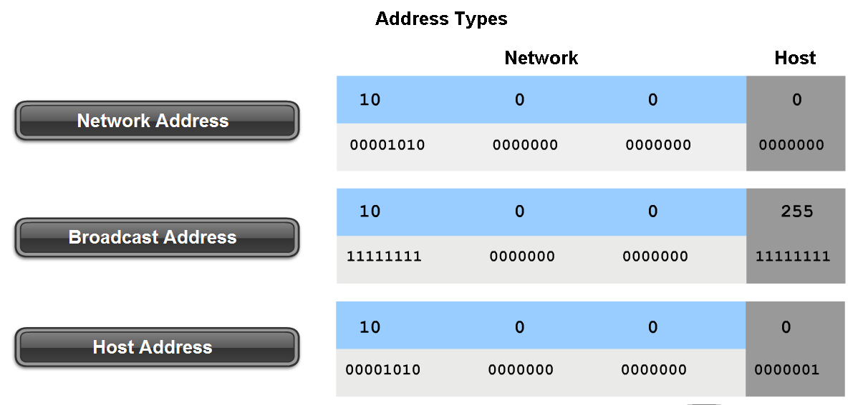
Classify and Define IPv4 Addresses
Name the three types of addresses in the network and describe the purpose of each type
/ 24
1

Slide 8
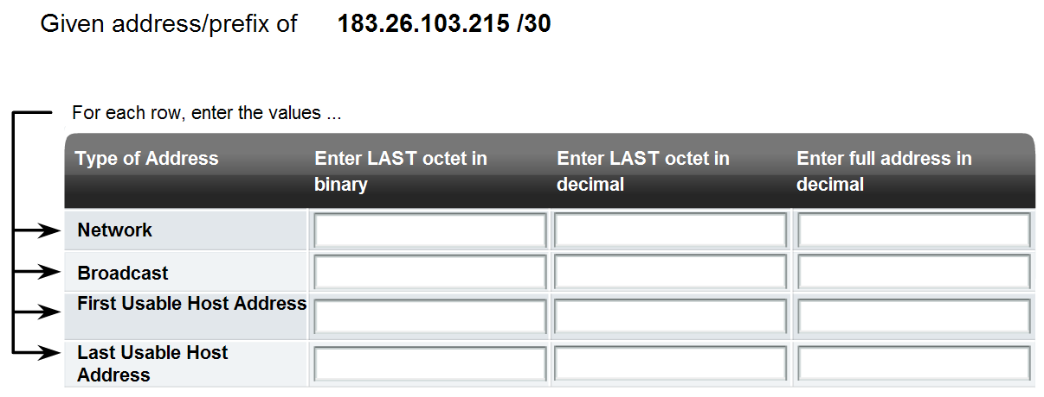
Classify and Define IPv4 Addresses
Determine the network, broadcast and host addresses for a given address and prefix combination
215 : 1 1 0 1 0 1 1 1 / 30
11010100
212
183.26.103.212
11010111
215
183.26.103.215
11010101
213
183.26.103.213
11010110
214
183.26.103.214

Slide 9
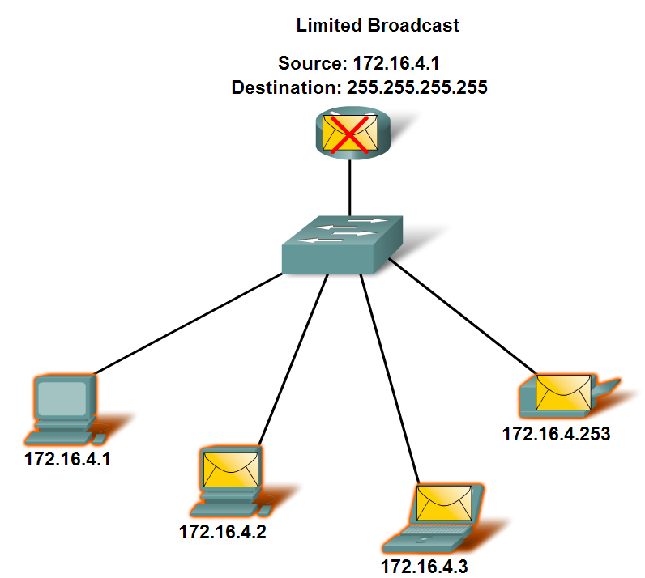
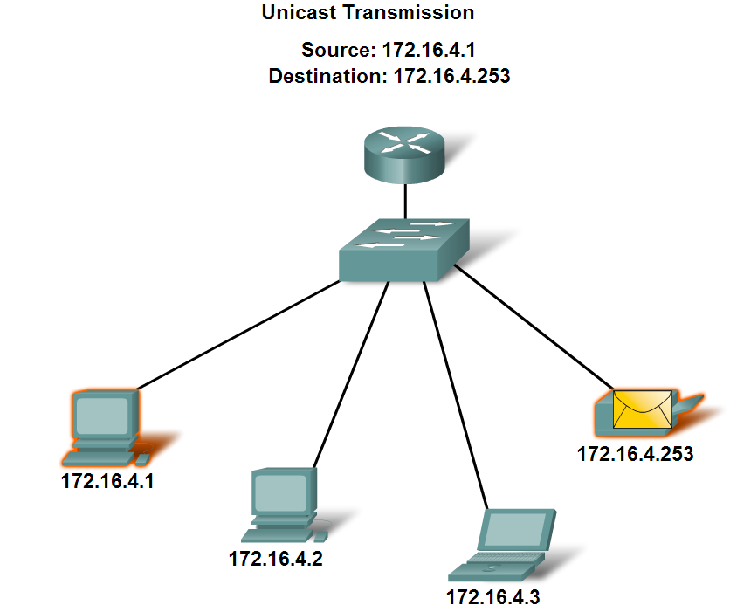
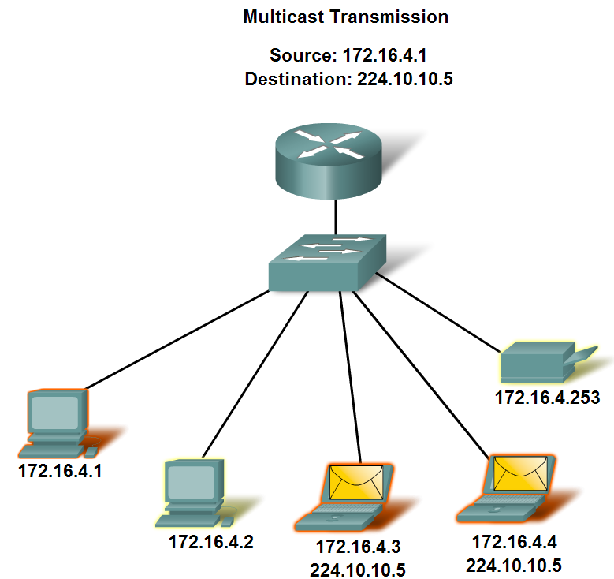
Classify and Define IPv4 Addresses
Name the three types of communication in the Network Layer and describe the characteristics of each type
Unicast, Multicast, Broadcast
Local BC 172.16.255.255

Slide 10
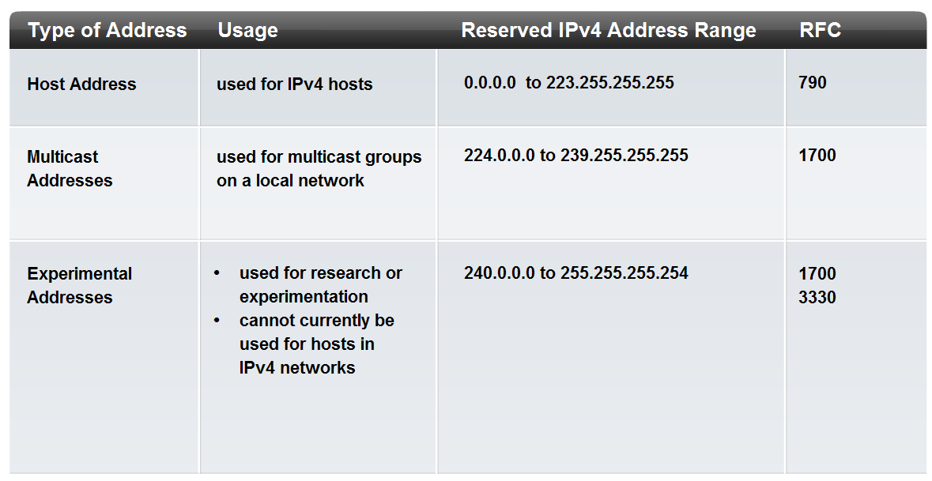
Classify and Define IPv4 Addresses
Identify the address ranges reserved for these special purposes in the IPv4 protocol
Reserved IPv4 Address Ranges

Slide 11
Private IP Addresses
Class | Invisible Ranges (non routed addresses) | abbreviated
A | 10.0.0.1 – 10.255.255.254 ≅ 16000000 | 10.0.0.0 / 8
B | 172.16.0.1 – 172.31.255.254 ≅ 10000000 | 172.16.0.0 / 12
C | 192.168.0.1 – 192.168.255.254 ≅ 65000 | 192.168.0.0 / 16
Routers block private IP from Internet

Slide 12
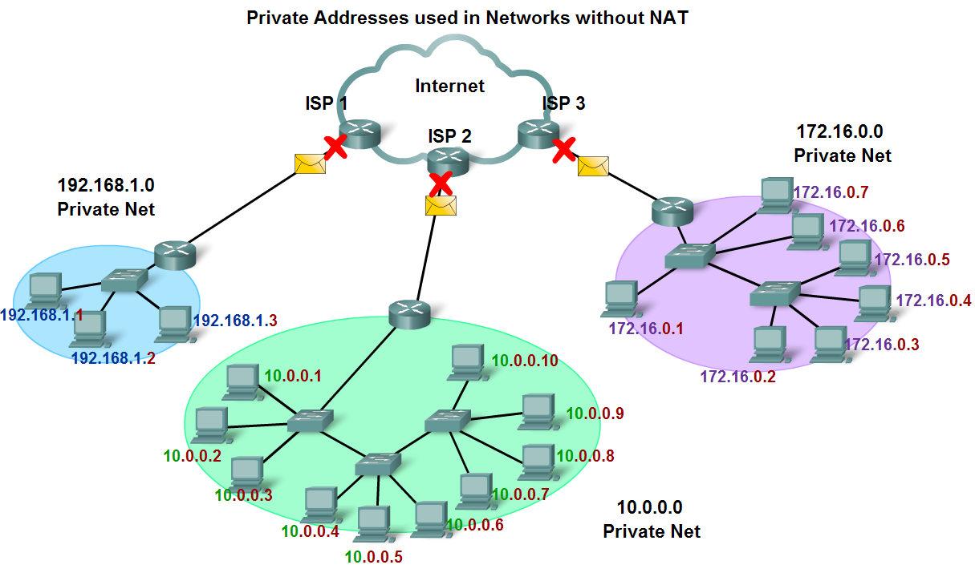
Classify and Define IPv4 Addresses
Define public address and private address

Slide 13
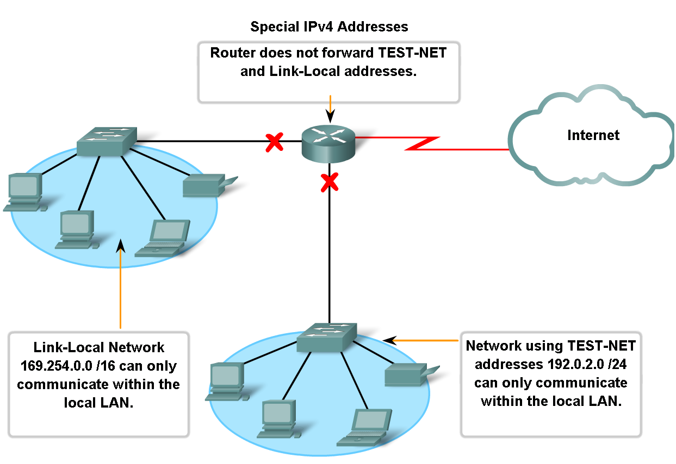
Classify and Define IPv4 Addresses
Other special addresses

Slide 14
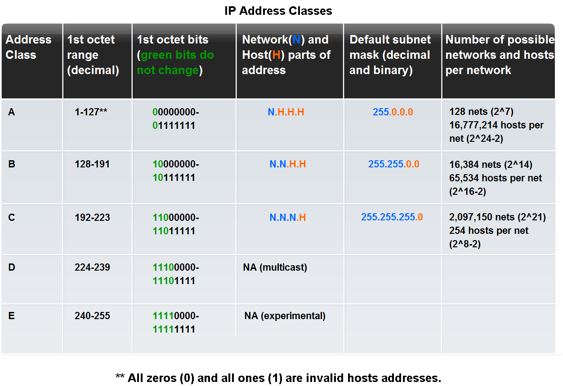
Classify and Define IPv4 Addresses
Identify the historic method for assigning addresses and the issues associated with the method

Slide 15
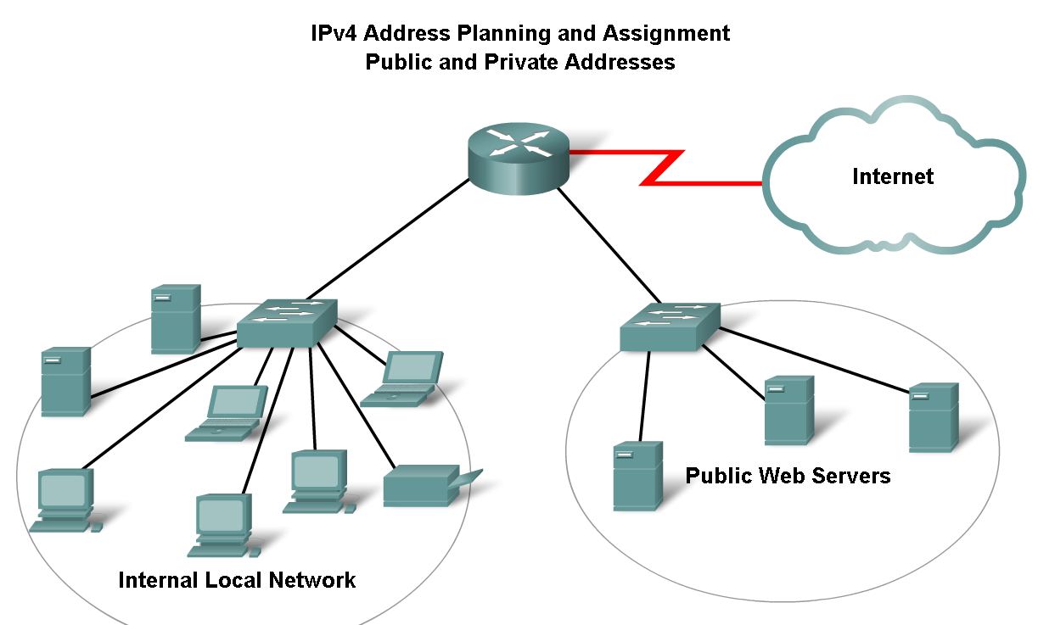
Assigning Addresses
Explain the importance of using a structured process to assign IP addresses to hosts and the implications for choosing private vs. public addresses

Slide 16
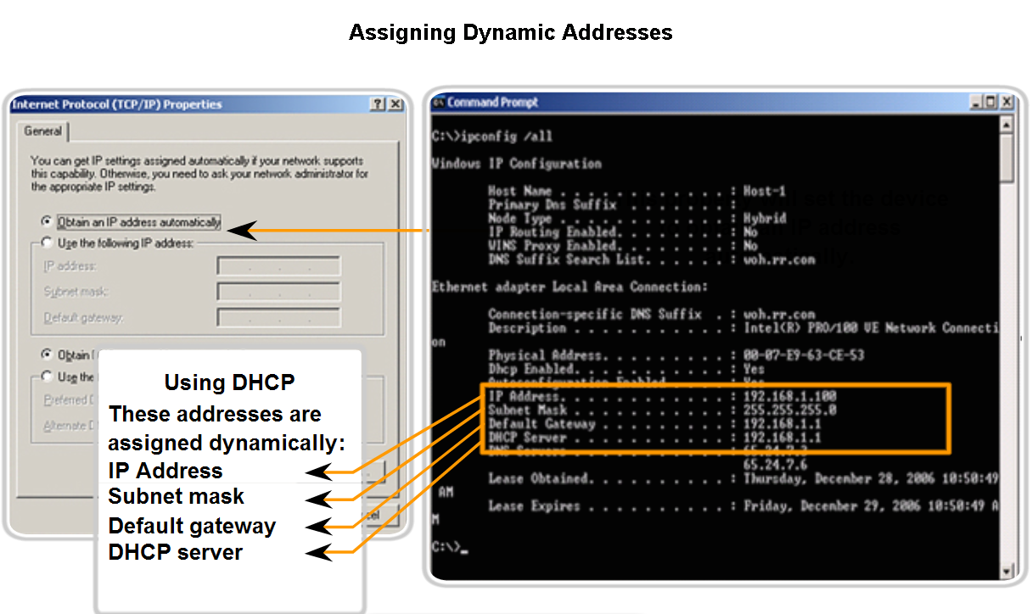
Assigning Addresses
Explain how end user devices can obtain addresses either statically through an administrator or dynamically through DHCP

Slide 17
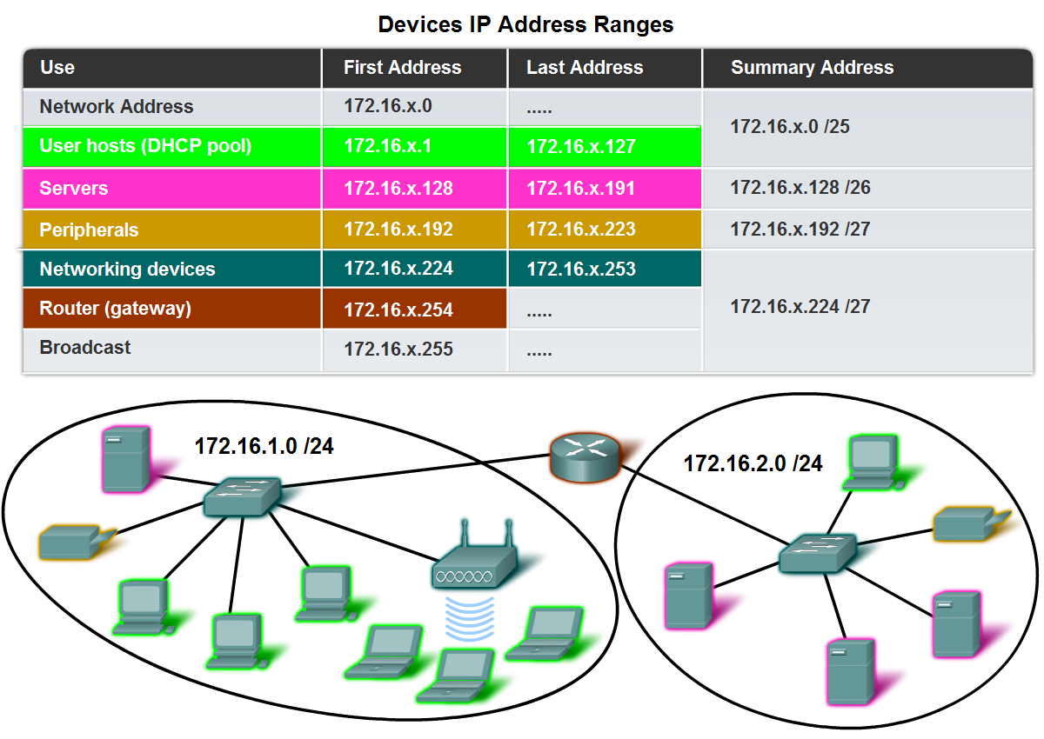
Assigning Addresses
Static IP is recommended and should be for : Servers ; Routers ; Printers.

Slide 18
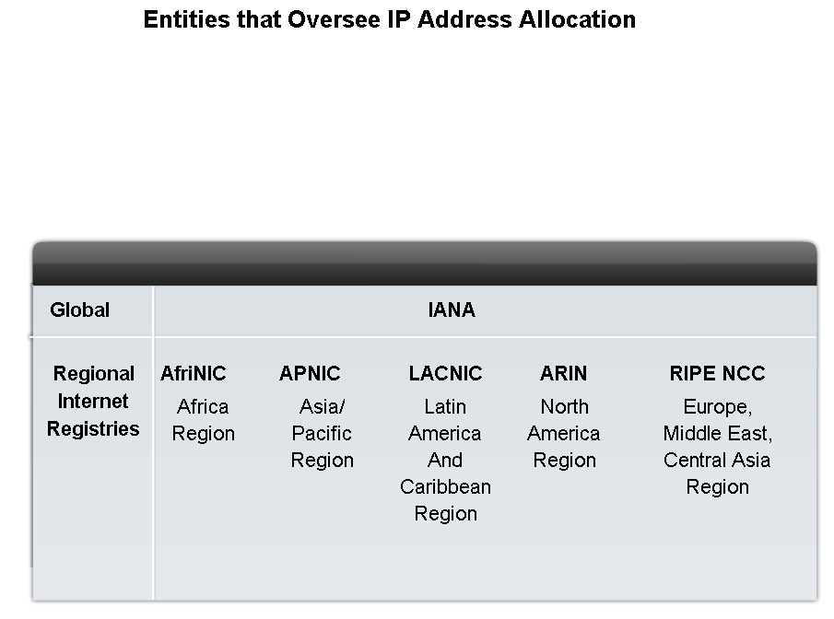
Assigning Addresses
Describe the process for requesting IPv4 public addresses, the role ISPs play in the process, and the role of the regional agencies that manage IP address registries
Entities that control IP Addresses

Slide 19
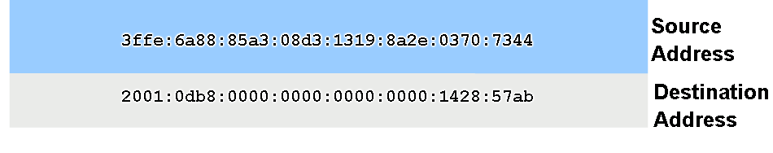
Assigning Addresses
Identify several changes made to the IP protocol in IPv6 and describe the motivation for migrating from IPv4 to IPv6.
IPv6 vs IPv4
16 Bytes → 3.4 x 10 ³⁸ IP Addresses
4 Bytes → 4.3 x 10 ⁹ IP Addresses
Features :
More IPs (primary reason)
Authentication & Encryption
Including Data Type & Sevices

Slide 20
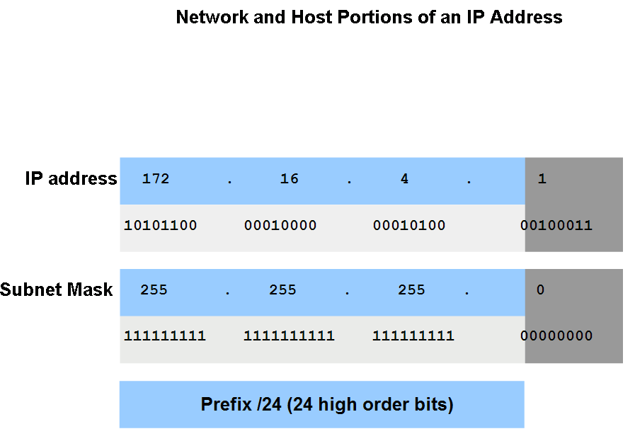
Determine the network portion of the host address and the role of the subnet mask
Describe how the subnet mask is used to create and specify the network and host portions of an IP address
00000100
00000001

Slide 21
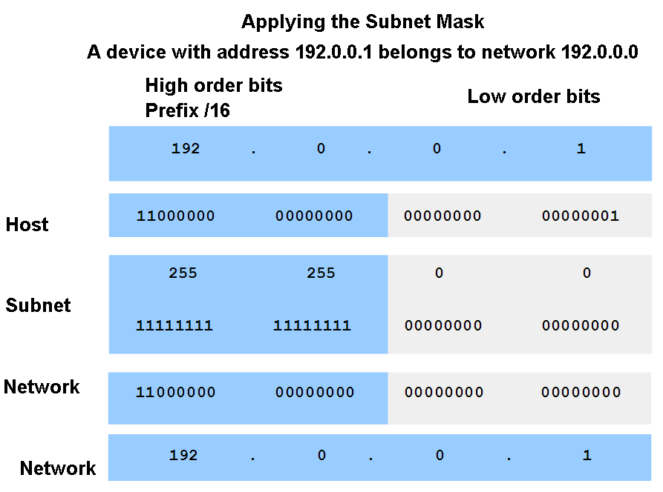
Determine the network portion of the host address and the role of the subnet mask
Use the subnet mask and ANDing process to extract the network address from the IP address.
0

Slide 22
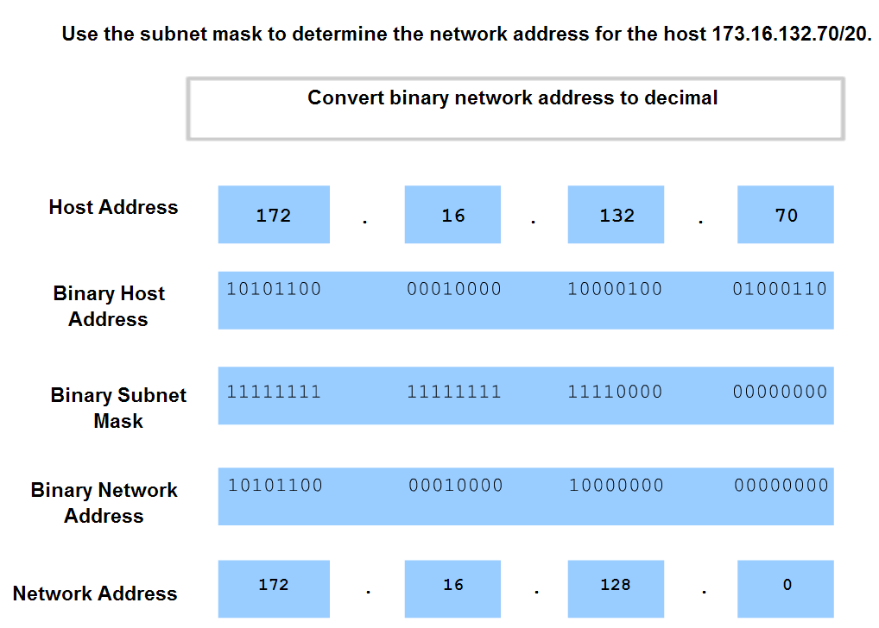
Determine the network portion of the host address and the role of the subnet mask
Observe the steps in the ANDing of an IPv4 host address and subnet mask
Multiply

Slide 23
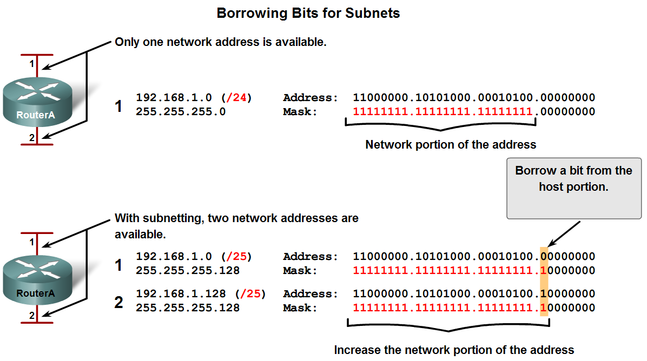
Calculating Addresses
Use the subnet mask to divide a network into smaller networks and describe the implications of dividing networks for network planners

Slide 24
Subnetting Class C
The net 200.10.10.0 has to be divided into 5 subnets.
Before Subnetting :
Net IP = 200.10.10.0
Net Mask = 255.255.255.0
Mask = 11111111.11111111.11111111.00000000
Rules :
Total no. of subnets = 2^{M} (M : borrowing bits)
Usable no. of subnets = 2^{M} – 2
No. of hosts in each subnet = 2^{K} (K : remaining bits)
Usable IP addresses = 2^{K} – 2
Calculations :
5 = 2^{M} – 2 → M = 3 → Subnets = 6
no of Hosts → 2 ⁸⁻³ – 2 = 30

Slide 25
After Subnetting :
Net Mask = 255.255.255.224
Mask = 11111111.11111111.11111111.11100000
Broad Cast | Address Range | Network | 32 | 64 | 128
200.10.10.63 | 200.10.10.33 – 200.10.10.62 | 200.10.10.32 | 1 | 0 | 0
200.10.10.95 | 200.10.10.65 – 200.10.10.94 | 200.10.10.64 | 0 | 1 | 0
200.10.10.127 | 200.10.10.97 – 200.10.10.126 | 200.10.10.96 | 1 | 1 | 0
200.10.10.159 | 200.10.10.129 - 200.10.10.158 | 200.10.10.128 | 0 | 0 | 1
200.10.10.191 | 200.10.10.161 - 200.10.10.190 | 200.10.10.160 | 1 | 0 | 1
200.10.10.223 | 200.10.10.193 - 200.10.10.222 | 200.10.10.192 | 0 | 1 | 1
-------------- | Unused | 200.10.10.0 | 0 | 0 | 0
-------------- | Unused | 200.10.10.224 | 1 | 1 | 1

Slide 26
Check
Suppose that the host 200.10.10.45 wants to connect with 200.10.10.120, does it shout or route to the destination ?
Sender IP : 11001000.00001010.00001010.00101101
Sender Mask : 11111111.11111111.11111111.11100000
ANDing value: 200 . 10 . 10 . 32
Receiver IP : 11001000.00001010.00001010.01111000
Sender Mask : 11111111.11111111.11111111.11100000
ANDing value: 200 . 10 . 10 . 96
Different values enforce the sender to route to the receiver through --------------- ?
Note : Total no. of IP Addresses before subnetting = 256
Total no. of IP Addresses after subnetting = 180
Where does the difference (76) go ?
Two IP / each used subnet + Thirty two IP / unused subnet

Slide 27
Subnetting Class B
You need to divide the 172.16.0.0 into 14 subnets.
Mask in decimal 255 . 255 . 0 . 0
in binary 11111111 . 11111111 . 00000000 . 00000000
no. of Subnets = 2^{M} – 2
to get 14 subnets, we have to borrow 4 bits
no. of Subnets = 2⁴ – 2 = 16 – 2 = 14
no. of Hosts per each Subnet = 2^{K} – 2
no. of Hosts / Subnet = 2¹² – 2 = 4094

Slide 28
Mask in binary is 11111111.11111111.11110000.00000000
128 64 32 16 8 4 2 1
1 1 1 1 0 0 0 0
128 + 64 + 32 + 16 + 0 + 0 + 0 + 0 = 240
The Subnet Mask is 255 . 255 . 240 . 0
Available IP Addresses
Not used 172.16.0.0 This Network (all zero)
Sub1 172.16.16.1 ---- 172.16.31.254 (256*16-2=4094)
Sub2 172.16.32.1 ---- 172.16.47.254 (256*16-2=4094)
Sub3 172.16.48.1 ---- 172.16.63.254 (256*16-2=4094)
Sub14 172.16.224.1 ---- 172.16.239.254 (256*16-2=4094)
Not used 172.16.240.0 Broadcast (all one)

Slide 29
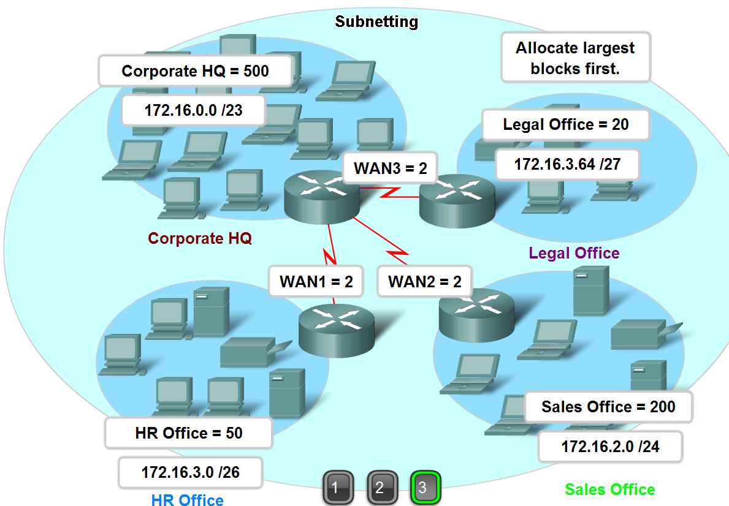
Calculating Addresses
Extract network addresses from host addresses using the subnet mask

Slide 30
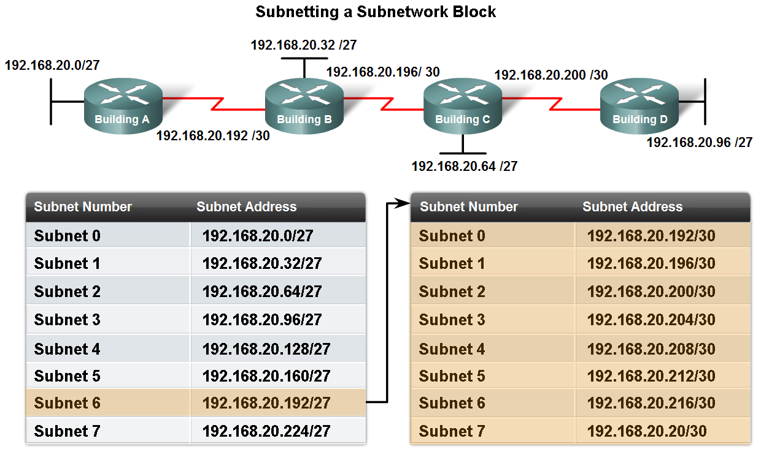
Calculating Addresses
Calculate the number of hosts in a network range given an address and subnet mask

Slide 31
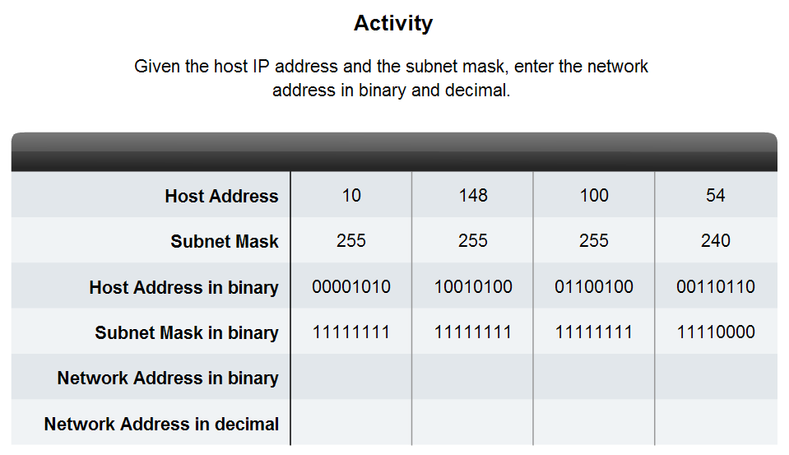
Calculating Addresses
Given a subnet address and subnet mask, calculate the network address, host addresses and broadcast address
10 148 100 48
Jump ?

Slide 32
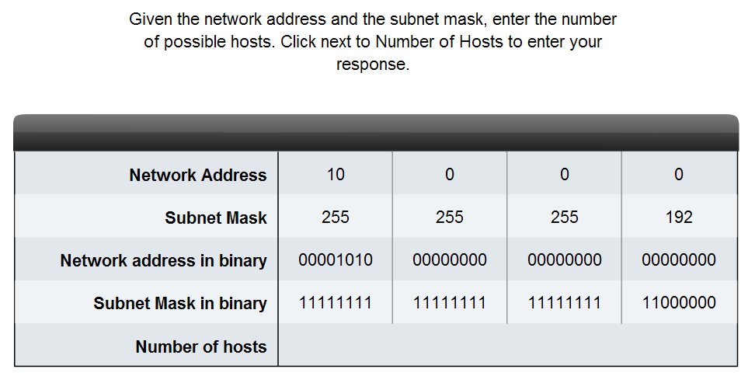
Calculating Addresses
Given a pool of addresses and masks, assign a host parameter with address, mask and gateway
2 ⁶ = 64

Slide 33
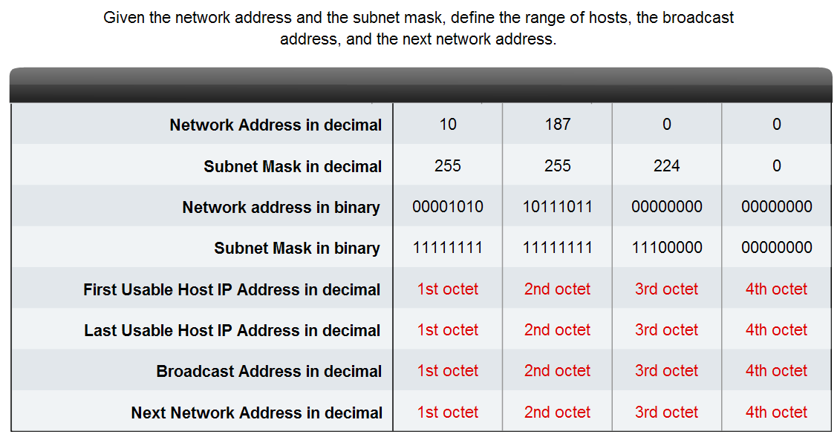
Calculating Addresses
Given a diagram of a multi-layered network, address range, number of hosts in each network and the ranges for each network, create a network scheme that assigns addressing ranges to each network
Jump ?
10
187
0
1
10
187
31
254
10
187
31
255
10
187
32
0

Slide 34
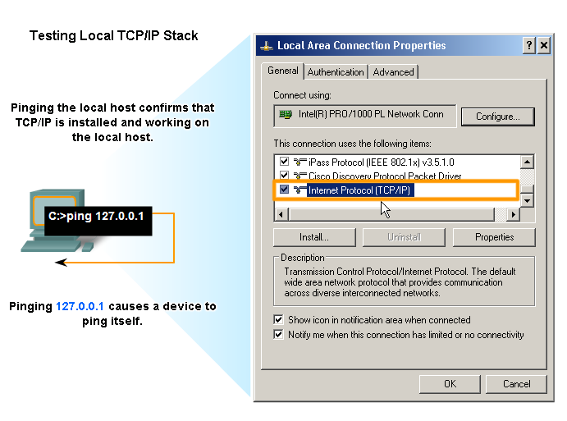
Testing the Network Layer
Describe the general purpose of the ping command, trace the steps of its operation in a network, and use the ping command to determine if the IP protocol is operational on a local host
Validation of Loop Back
127.0.0.1 – 127.255.255.254

Slide 35
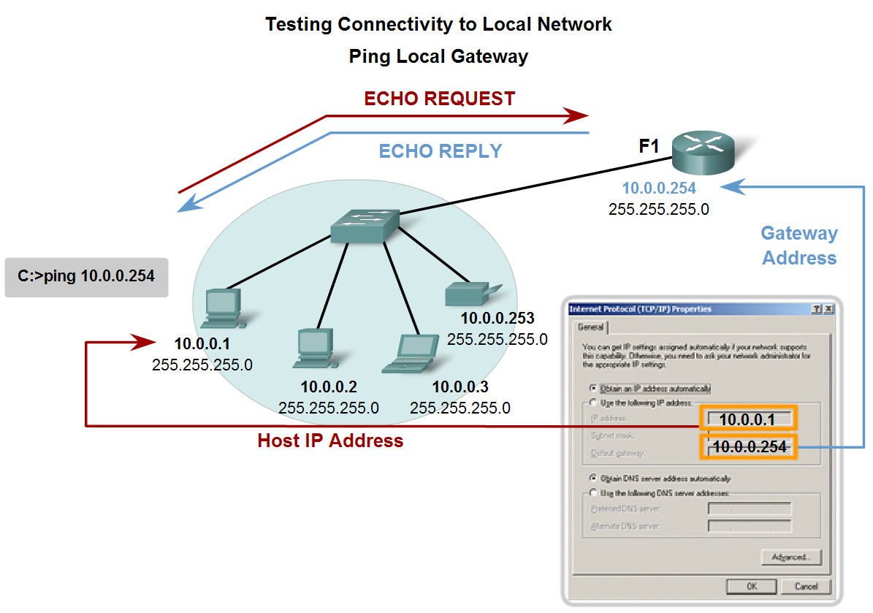
Testing the Network Layer
Use ping to verify that a local host can communicate with a gateway across a local area network

Slide 36
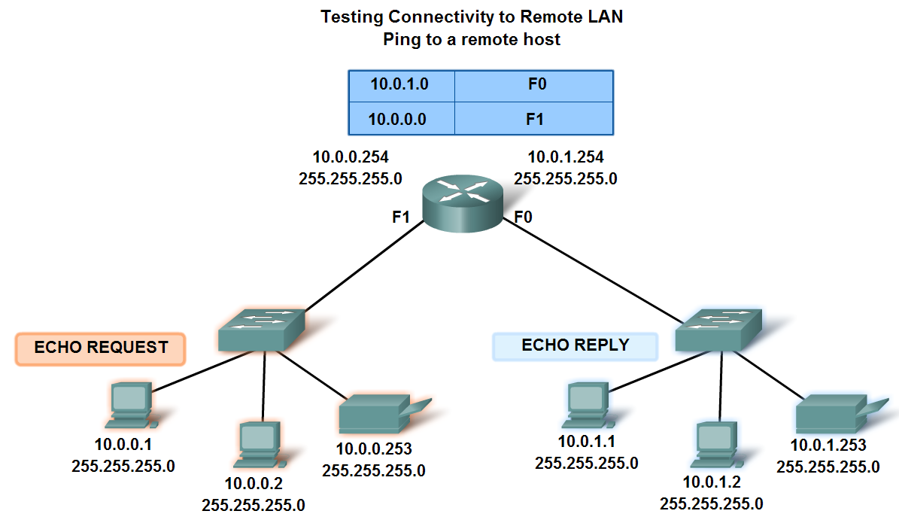
Testing the Network Layer
Use ping to verify that a local host can communicate via a gateway to a device in remote network
Net Port

Slide 37
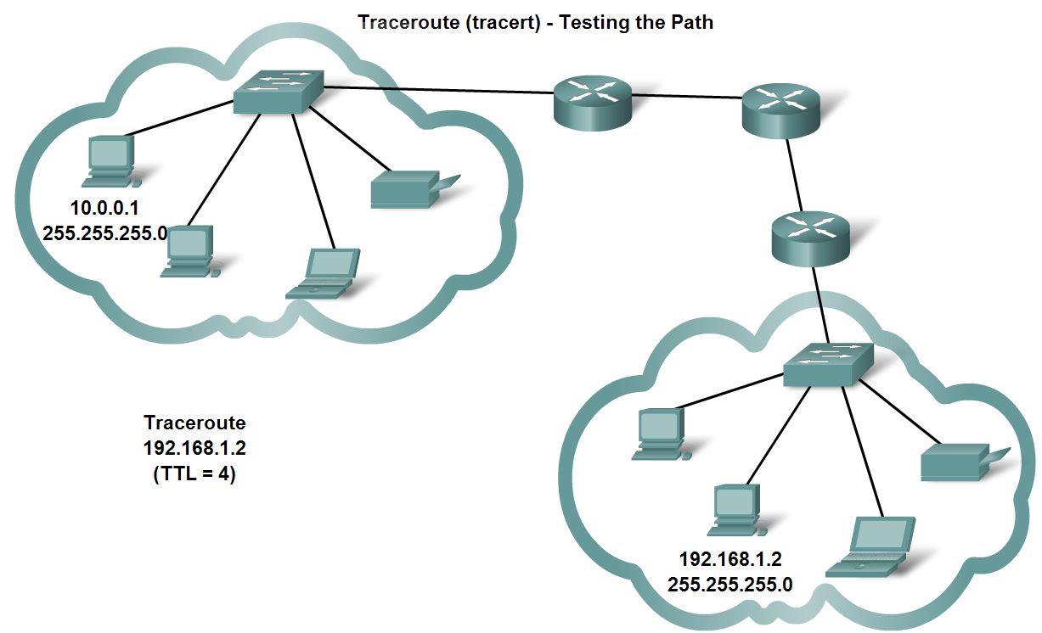
Testing the Network Layer
Use tracert/traceroute to observe the path between two devices as they communicate and trace the steps of tracert/traceroute's operation
Does Routers Pass Private IPs?
If Router receives ICMP with TTL=1 & the destination is far, it will discard it & send a time exceeded msg to the source.

Slide 38
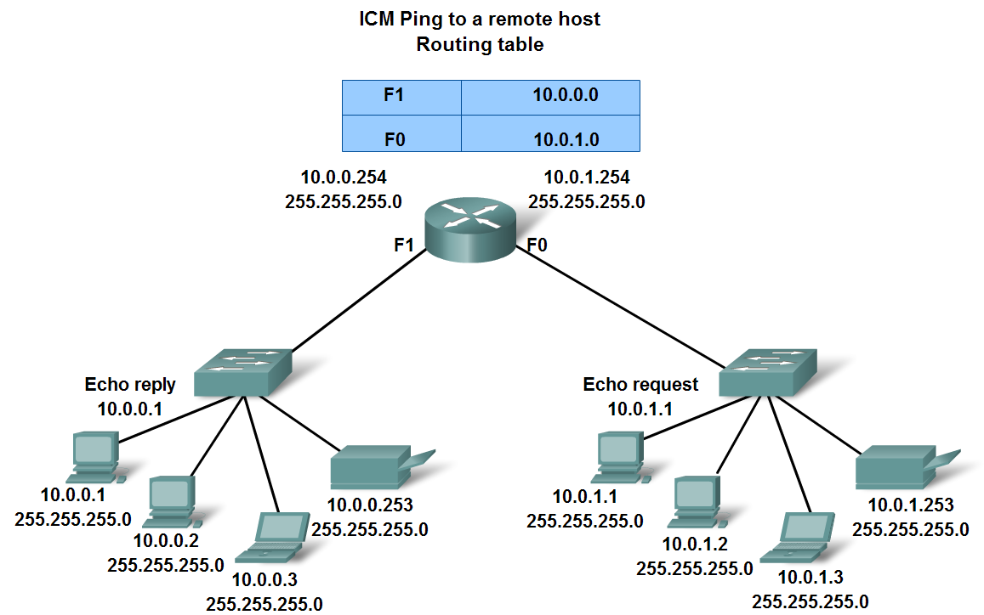
Testing the Network Layer
Describe the role of ICMP in the TCP/IP suite and its impact on the IP protocol

Slide 39
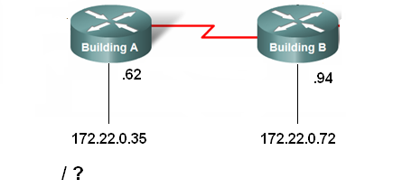
Questions
Which is valid host IP ?
180.10.2.127 / 26
180.10.2.155 / 26
180.10.2.193 / 26
180.10.2.95 / 27
180.10.2.159 / 27
180.10.2.207 / 27

Slide 40

Questions
Internet
Server
200.10.10.8
PCA can communicate with Server, Server can communicate with Internet. PCA can not access Internet ?
PCA
172.20.20.150
Q : Address is 180.50.8.64 , Mask is 255.255.255.224
What the above IP represents ?
Q : What is the mask that yields 510 hosts in class B ?
255.255.0.0
255.255.255.0
255.255.255.128
255.255.254.0
255.255.252.0

Slide 41
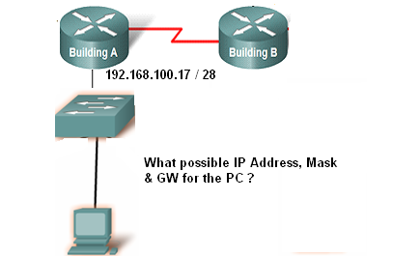
Questions
Q : Give the Net & Mask of the following range ?
172.16.128.0 --- 172.16.159.255
A : 172.16.128.0 , 255.255.224.0

Slide 42
Q : What are the probability of IP Address of PC with GW of 192.168.2.78 / 28
A : 192.168.2.65 – 192.168.2.77
Q : PC1 (192.168.2.105 / 26) can not communicate with PC2 (192.168.2.99 / 27) ?
Incorrect IP Address
Incorrect Net ID
NIC Failure
None of the above
Q : What is the Net Address of the host 160.160.163.160 / 23 ?
10100000. 10100000. 10100011.10100000
10100000. 10100000. 10100000.10100000
10100000. 10100000. 10100010.00000000
10100000. 10100000. 10100011.00000000

Slide 43
Q : What is the problem of the configuration ?
IP of PC 192.168.32.68
Mask 255.255.255.224
GW 192.168.32.61
A : Different Subnets ( can not communicate with outside)
Q : Which of the following represents Broad Cast ?
180.10.10.63 / 26
180.10.10.31 / 26
180.10.10.191 / 26
180.10.10.63 / 27
180.10.10.95 / 27
180.10.10.31 / 27

Slide 44
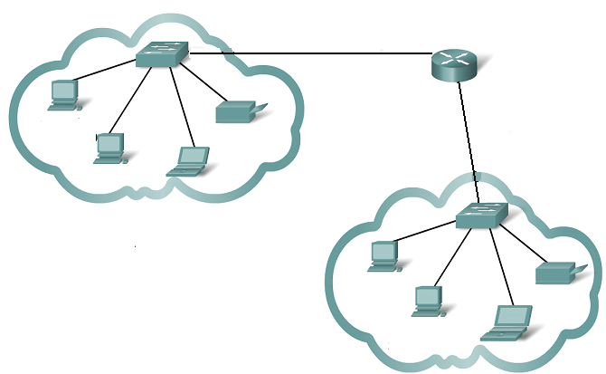
How many subnets required to the following topology ?

