Slide 1



Introduction to Soft Computing
Soft Computing
Prof. (Dr.) Abdul Hadi Mohammed Alaidi
1

Slide 2

Computing
2
 The process or act of calculation
 The action of mathematical calculation.
 Computing is any activity that uses computers to manage, process, and communicate information.
 It includes development of both hardware and software.
 Computing is a critical, integral component of modern industrial technology.
 Major computing disciplines include computer engineering, software engineering,
computer science, information systems, and information technology.

Slide 3
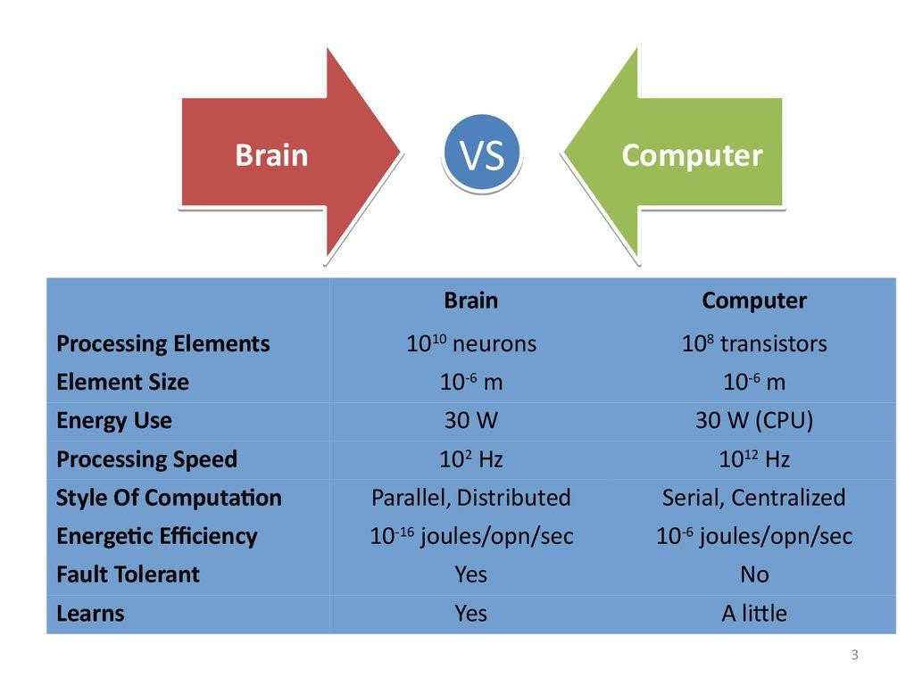
3

Slide 4

Soft Computing
4
 Soft computing is the use of approximate calculations to provide imprecise but usable
solutions to complex computational problems.
 The approach enables solutions for problems that may be either unsolvable or just too time-consuming to solve with current hardware.
 Soft computing is sometimes referred to as computational intelligence.
 With the human mind as a role model, soft computing is tolerant of partial truths, uncertainty, imprecision and approximation, unlike traditional computing models.
 The tolerance of soft computing allows researchers to approach some problems that
traditional computing can't process.

Slide 5

Continue...
5
 Soft computing differs from conventional (hard) computing in that, unlike hard
computing, it is tolerant of imprecision, uncertainty, partial truth, and approximation.
 In effect, the role model for soft computing is the human mind.
 It does not require any mathematical modelling for solving any given problem
 It gives different solutions when we solve a problem of one input from time to time
 Uses some biologically inspired methodologies such as genetics, evolution, particles swarming, the human nervous system, etc.
 Adaptive in nature.

Slide 6

Few Facts on Soft Computing
6
 tolerance of imprecision: the result obtained using soft-computing is not precise.
 uncertainty: the soft-computing algorithm may give different results every time for the same problem.
 robustness: soft-computing algorithms can tackle any kind of input noise
 low solution cost: soft-computing makes it feasible to solve some of the problems which could be computationally very expensive if solved using hard computing.

Slide 7

Advantages of Soft Computing
7
 Since Soft computing methods do not call for wide-ranging mathematical formulation pertaining to the problem, the need for explicit knowledge in a particular domain can be reduced.
 These tools can handle multiple variables simultaneously.
 For optimization problems, the solutions can be prevented from falling into local minima
by using global optimization strategies.
 These techniques are mostly cost effective.
 Dependency on expensive traditional simulations packages can be reduced to some degree by efficient hybridization of soft computing methods.
 These methods are generally adaptive in nature and are scalable.

Slide 8

Applications of Soft Computing
8
 Image processing
 Data Compression
 Fuzzy Logic Control
 Automative systems and Manufacturing
 Neuro-fuzzy systems
 Decision-support systems
 System Control
 Prediction
and many more.

Slide 9

Hard Computing
9
 Hard computing, i.e., conventional computing, requires a precisely stated analytical
model and often a lot of computation time.
 Many analytical models are valid for ideal cases.
 Real world problems exist in a non-ideal environment.
 Premises and guiding principles of Hard Computing are – Precision, Certainty, and rigor.
 Many contemporary problems do not lend themselves to precise solutions such as – Recognition problems (handwriting, speech, objects, images – Mobile robot coordination, forecasting, combinatorial problems etc.

Slide 10

Difference Between Hard Computing and Soft Computing
10
Hard Computing
Soft Computing
 The analytical model required by hard computing must be precisely represented
 It is based on uncertainty, partial truth tolerant of imprecision and approximation.
 Computation time is more
 It depends on binary logic, numerical systems, crisp software.
 Computation time is less
 Based on approximation and dispositional.
 Soft computing can perform parallel
computations.
 Soft computing works on ambiguous and noisy data.
 Hard computing performs sequential
computations.
 Hard computing works on exact data.

Slide 11

Difference Between Hard Computing and Soft Computing....
11
Hard Computing
Soft Computing
 Hard computing uses two-valued logic.
 Soft computing will use multivalued
logic.
 Soft computing incorporates randomness .
 Soft computing will emerge its own programs.
 Soft computing produces approximate
results.
 Soft computing is stochastic in nature.
 Hard computing is settled.
 Hard computing requires programs to be written.
 Hard computing produces precise results.
 Hard computing is deterministic in
nature.

Slide 12

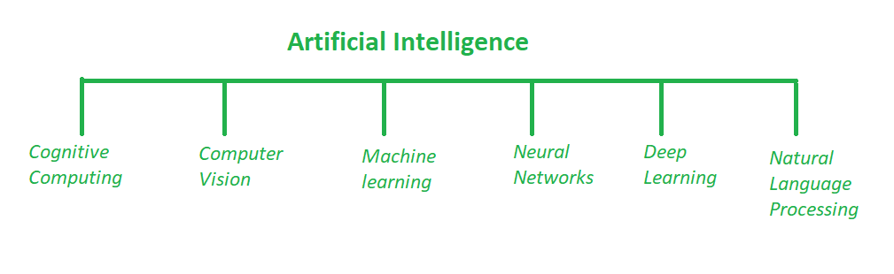
Artificial Intelligence (AI)
12
 AI manages more comprehensive issues of automating a system. This computerization should be possible by utilizing any field such as image processing, cognitive science, neural systems, machine learning etc.
 AI manages the making of machines, frameworks and different gadgets savvy by
enabling them to think and do errands as all people generally do.

Slide 13

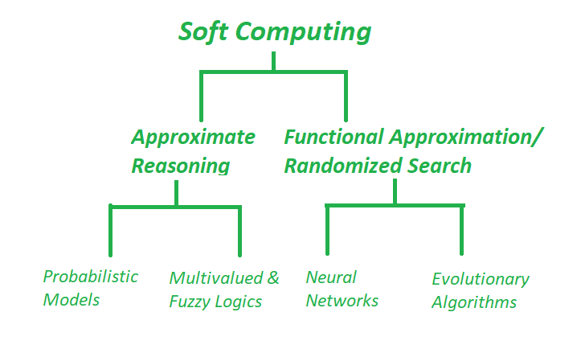
Soft Computing
13
 Soft Computing could be a computing
model evolved to resolve the non-linear
issues that involve unsure, imprecise
and approximate solutions of a tangle.
 These sorts of issues square measure thought of as real-life issues wherever the human-like intelligence is needed to resolve it.

Slide 14

Differentiate Between AI and Soft Computing
14
AI
Soft Computing
 Artificial Intelligence is the art and science of
developing intelligent machines.
 AI plays a fundamental role in finding missing pieces between the interesting real world problems.
 Branches of AI :
Reasoning
Perception
Natural language processing
 Soft Computing aims to exploit tolerance for
uncertainty, imprecision, and partial truth
 Soft Computing comprises techniques which are inspired by human reasoning and have the potential in handling imprecision, uncertainty and partial truth.
 Branches of soft computing :
Fuzzy systems
Evolutionary computation
Artificial neural computing

Slide 15

Differentiate Between AI and Soft Computing
15
AI
Soft Computing
 They are used in science and engineering disciplines such as data mining, electronics, automotive, etc.
 It aims at accommodation with the pervasive imprecision of the real world.
 They not require all programs to be written,
they can evolve its own programs.
 They can deal with ambiguous and noisy data.
 AI has countless applications in
healthcare and widely used in analyzing
complicated medical data.
 Goal is to stimulate human-level intelligence in machines
 They require programs to be written.
 They require exact input sample.

Slide 16

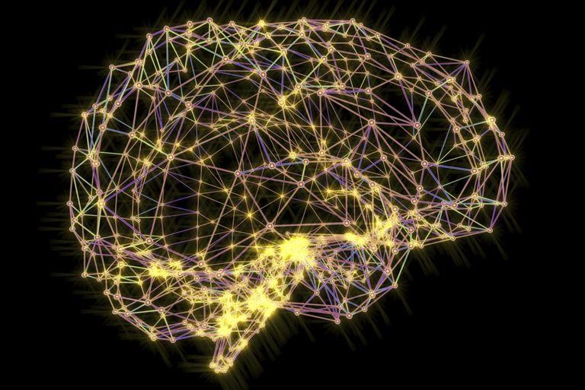
Artificial Neural Network
16
Neural Network is a network of artificial neurons, inspired by
biological network of neurons, that uses mathematical models as information processing units to discover patterns in data which is too complex to notice by human.
There are millions of neurons in the human brain, and the
information passes from one neuron to another. A neural network works similar to that and is capable of performing computations faster.

Slide 17

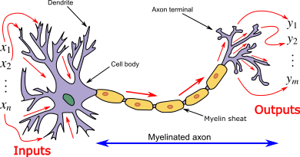
Artificial Neural Network
17
Dendrite: Receives neighbouring neurons Soma: Accumulates
signals
from
the signals
received through the dendrites
Axon: Transmits signal from soma to the axon terminals
Axon terminals: propagates stimulus to neighbouring neurons

Slide 18
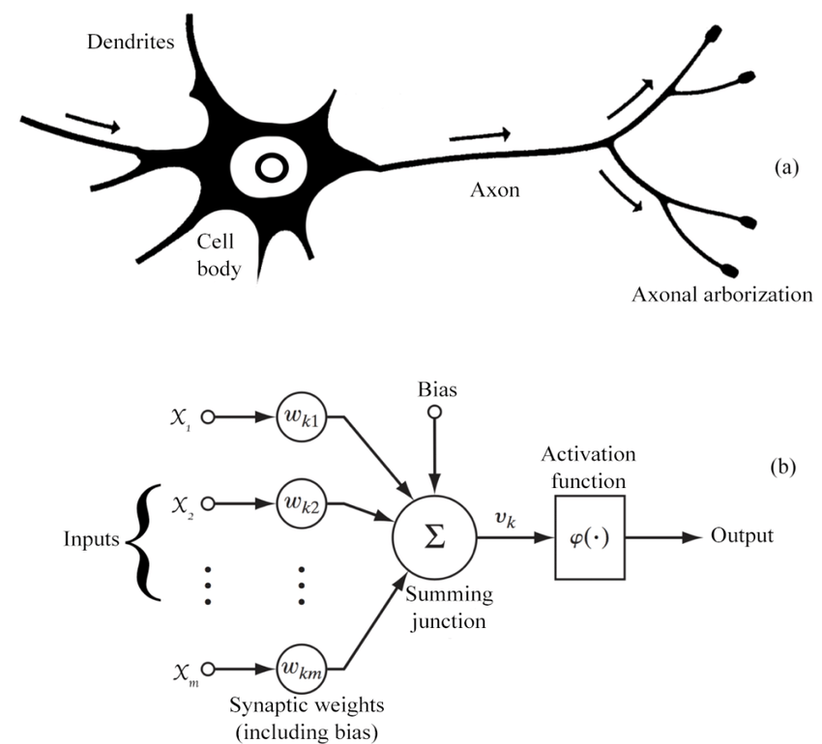
18

Slide 19

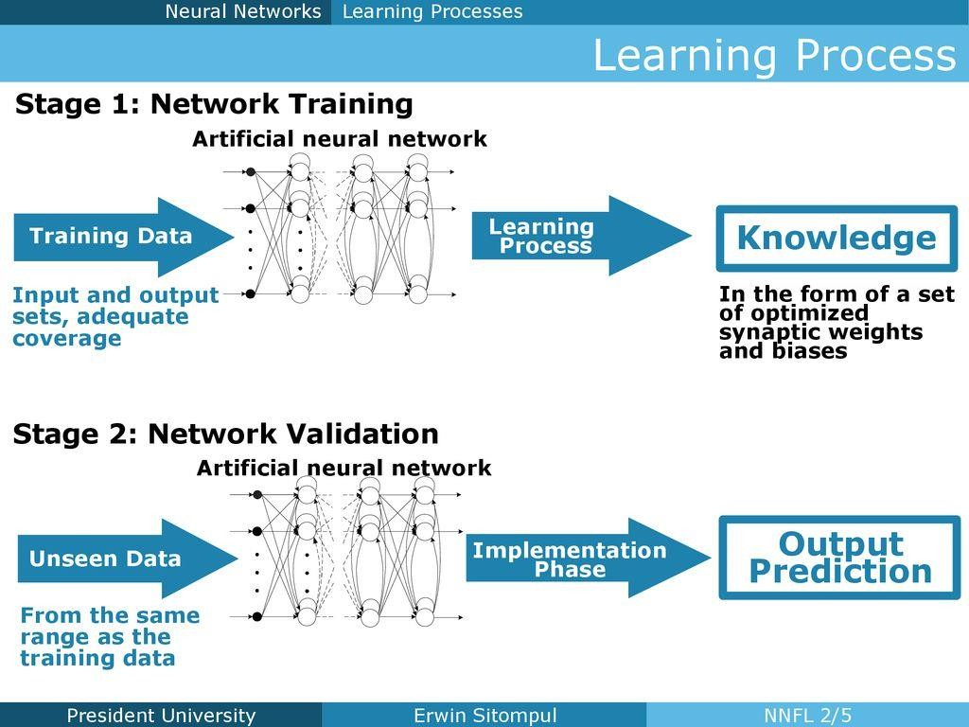
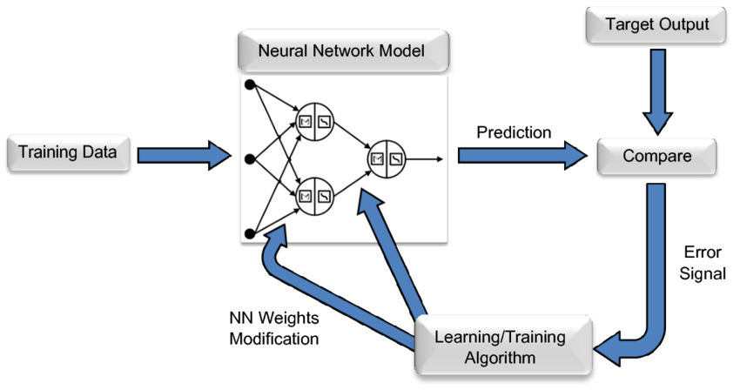
Process of Neural Network Application
19

Slide 20
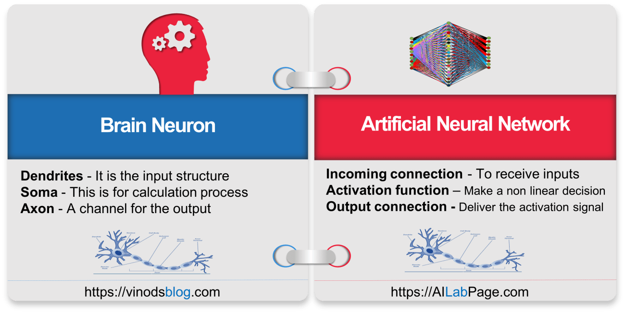
20

Slide 21
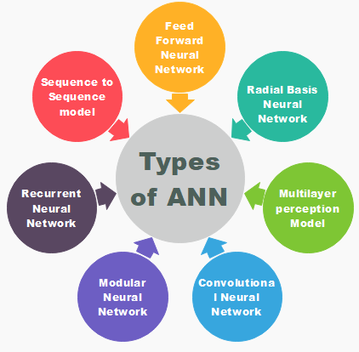
21

Slide 22

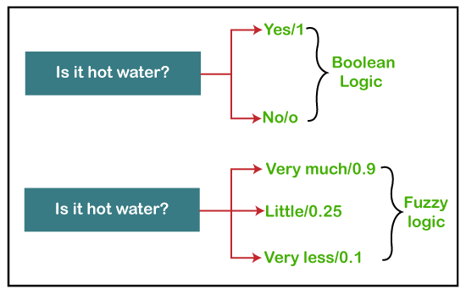
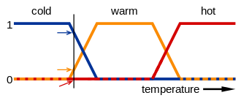
Fuzzy Logic
22
Fuzzy-”Not Clear, distinct, or precise; blurred”
Fuzzy logic is a reasoning method that is similar to human reasoning. In other words, a fuzzy logic-based system can make decisions similar to a human.
Fuzzy Logic is a technique that understands the vagueness of a solution and presents the solution with a degree of vagueness which is practical to human decision. It is widely applied in several applications of Artificial Intelligence for reasoning.

Slide 23
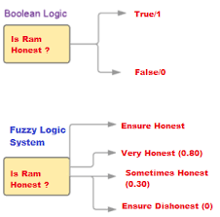
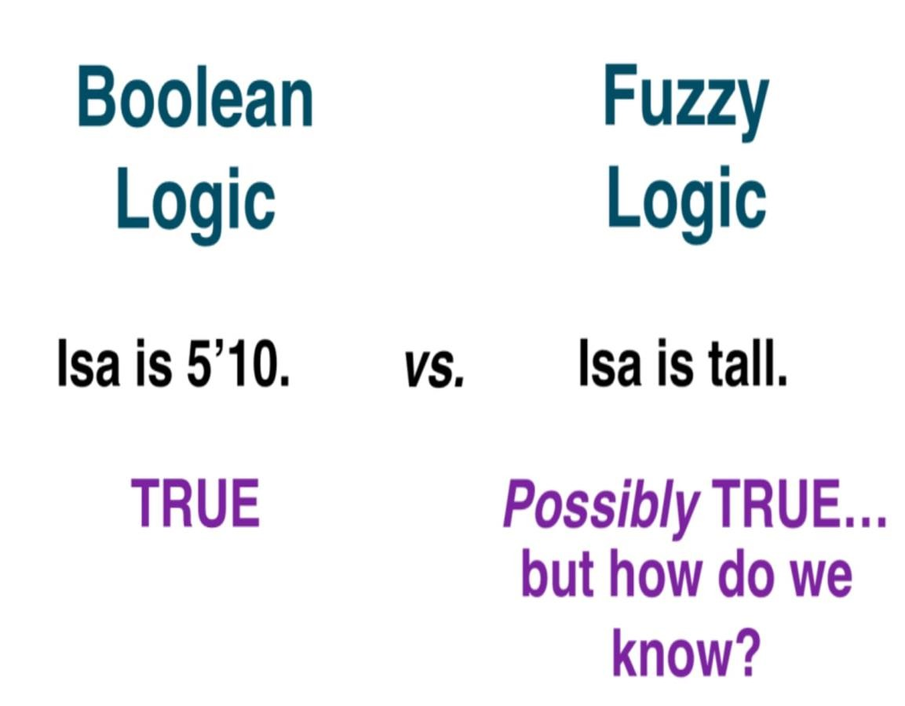
23

Slide 24
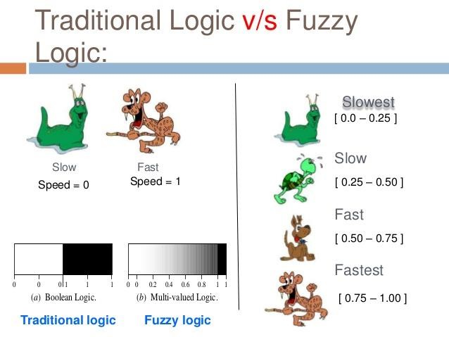
24

Slide 25

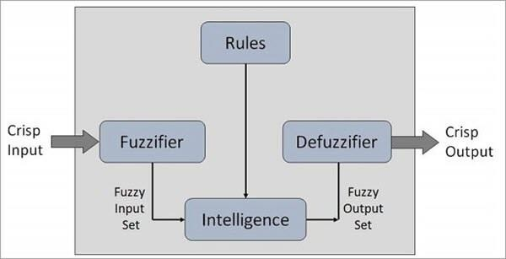
Process of Fuzzy Logic
25

Slide 26
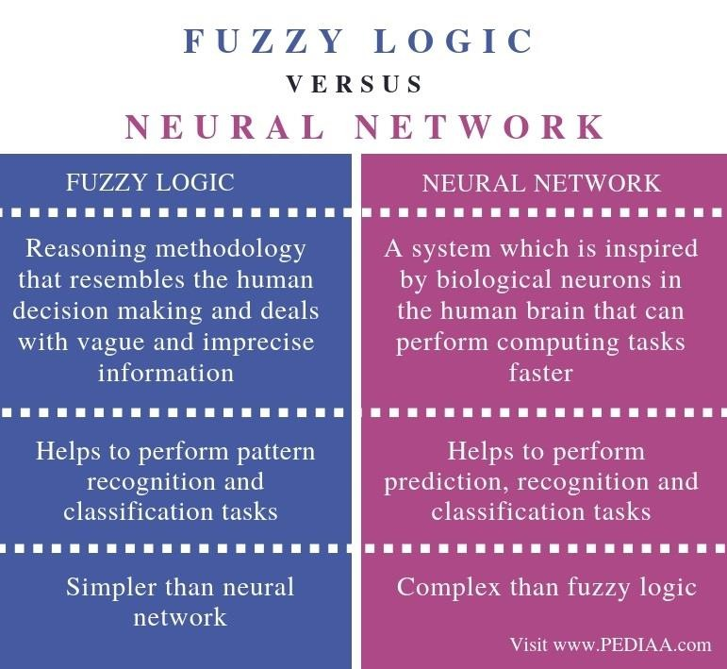
26

Slide 27

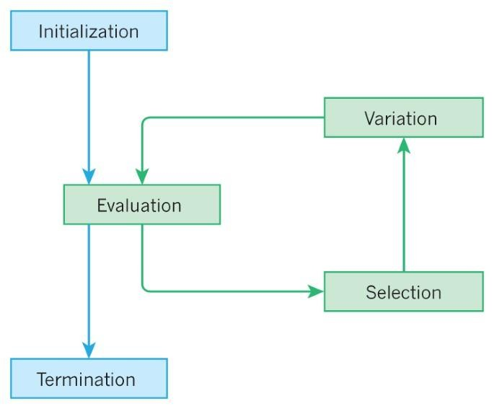
Evolutionary Computation
27
Evolutionary Computation is a family
of optimization algorithms that are inspired by biological evolution such as Genetic Algorithm, survival of creatures such as Particle Swarm Intelligence, Ant Colony Optimization, Artificial Bee Colony optimization etc. or any biological processes.

Slide 28
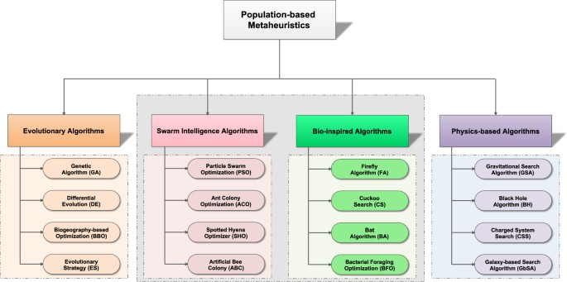
28

Slide 29
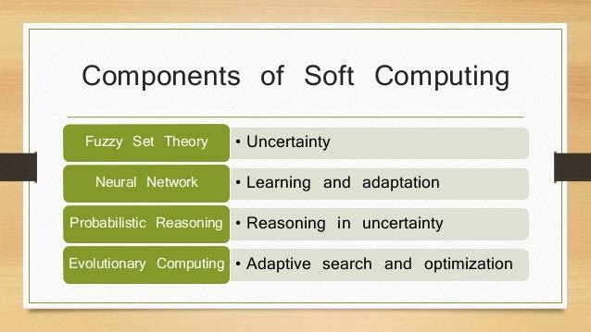
29

Slide 30


Books
30
Haykin, Simon S. "Neural networks and learning machines/Simon Haykin." (2009).
Ross, Timothy J. Fuzzy logic with engineering applications. Vol. 2.
New York: wiley, 2004.
Sivanandam, S. N., and S. N. Deepa. Principles of soft computing (with CD). John Wiley & Sons, 2007.
Jang, Jyh-Shing Roger, Chuen-Tsai Sun, and Eiji Mizutani. "Neuro- fuzzy and soft computing-a computational approach to learning and machine intelligence [Book Review]." IEEE Transactions on automatic control 42.10 (1997): 1482-1484.

Slide 31

Questions
31
 Differentiate between Soft Computing and Hard Computing?
 How the concept of ANN, FL and Evolutionary Optimization is applied in various engineering applications? Give a general outline briefly on these three techniques?
 What is fuzzy Logic?
 What is Artificial Neural Network?
 What is Evolutionary based Computation/Optimization ?
 Differentiate between the Biological Neuron and Artificial Neuron?
 Differentiate between a Boolean logic and fuzzy logic

Slide 32


32

