Slide 1

XML
Alain Stucky

Slide 2
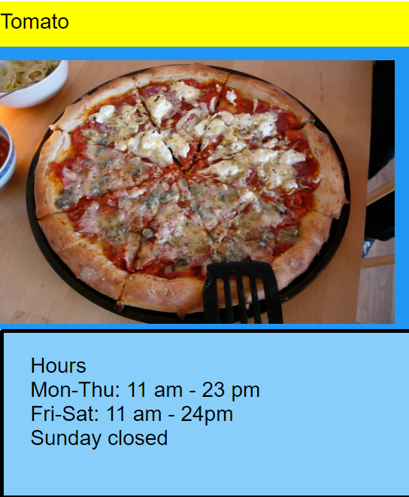
Kurze nicht redundante Beschreibung
Bild aus xml

Slide 3
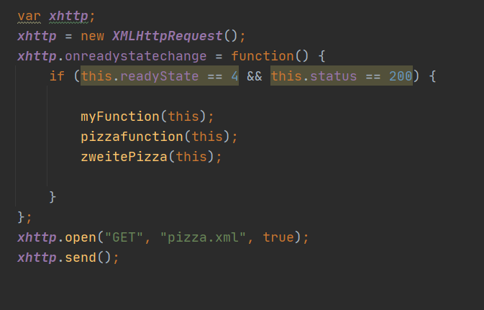
Kernelemente
Variabledekleration
Initialisierung des XMLObjekts
Serveranswercode

Slide 4
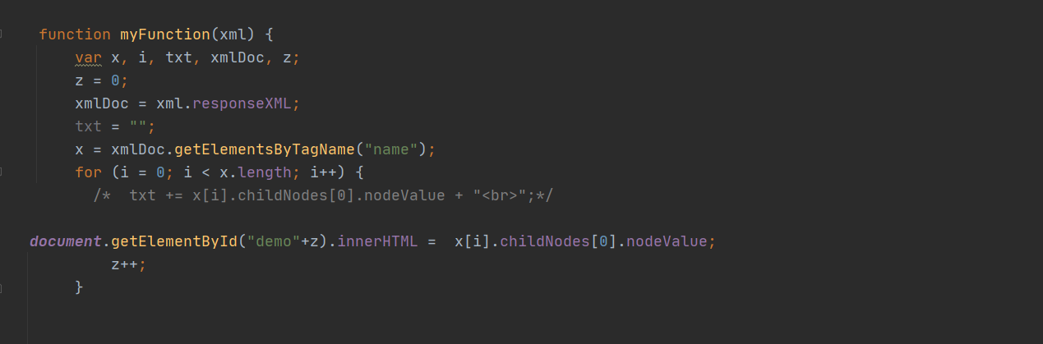
Acessing the particular element in the xml tree structur.

Slide 5
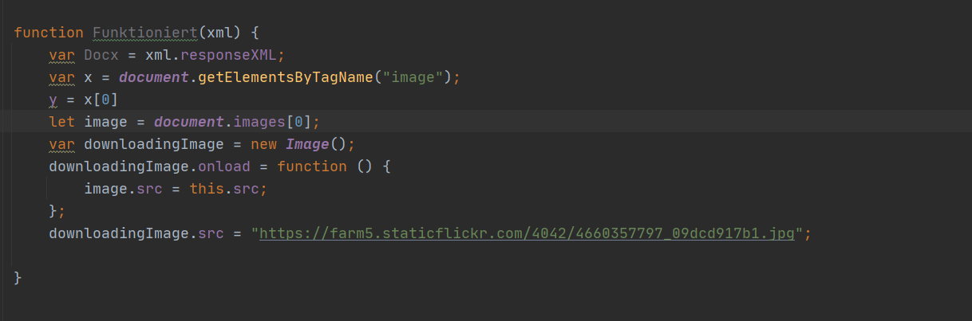
Imageobject creates the link
Just not worked all the time, also created the link manual for certency.

Slide 6
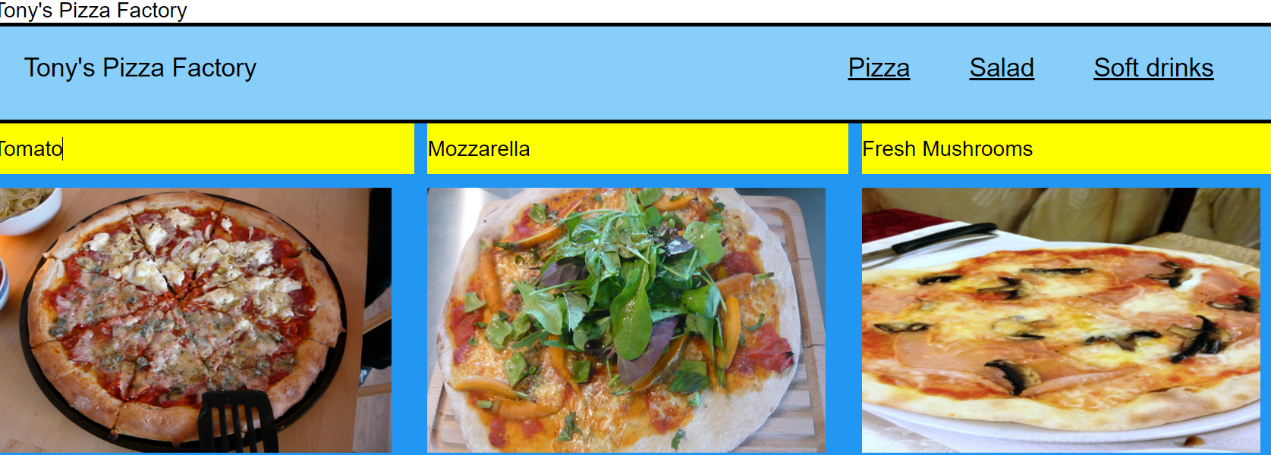
Thank you for you attention

