Slide 1
Getting credit (Part II): Making your data make sense
Alaina Pearce
azp271@psu.edu
Open Scholarship Bootcamp
5/11/2026

Slide 2
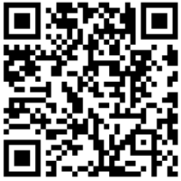
Provost Endorsement:
Research Data Stewardship
Workshops:
Research Data Management (this one)
Data Documentation (later this afternoon)
Research Data Policy (at least once a semester on zoom)
Activities:
Document a dataset
Create a Research Data Strategy (like an SOP for data)
Register

Slide 3
How to prepare your data
Good Enough Data Practices
(slides and resources available on website)
FAIR Data
Metadata
Data Standards
Institutional Resources
Open
Findable
Reusable
Accesible
Interoperable
Version
Control
Best Practices
Back-Up
Tidy Data
Metadata
Code

Slide 4
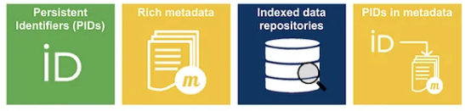
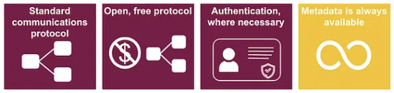
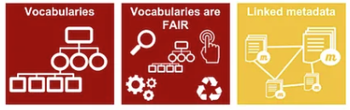
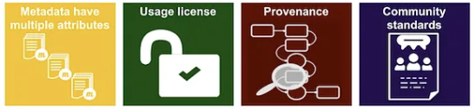
FAIR Data
Findable
Accessible
Interoperable
Reusable
image: ARDC

Slide 5
FAIR Data - Your Job
Findable
Accessible
Data is documented with rich metadata, has a unique and persistent identifier (e.g., DOI), and is in a resource that can be searched or indexed.
Metadata and data is both human and machine readable and is stored in a trusted repository.
Interoperable
Reusable
Data is in open formats with a common structure and metadata uses accepted, disciplinary terminology (e.g., controlled vocabulary or ontologies)
Data has clear licenses and provenance and align with community/disciplinary standards

Slide 6
How to prepare your data
Good Enough Data Practices
(slides and resources available on website)
FAIR Data
Metadata
Data Standards
Institutional Resources
Open
Findable
Reusable
Accesible
Interoperable
Version
Control
Best Practices
Back-Up
Tidy Data
Metadata
Code

Slide 7
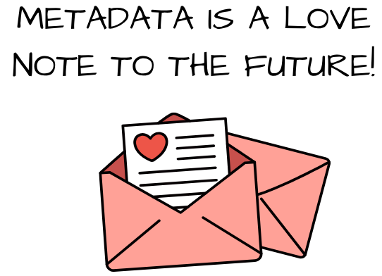
Metadata
Highly structured data laid out in fields, often with controlled vocabularies
the who, what, when, where, and why of data
Types of metadata for today:
README files
Data dictionaries

Slide 8

Metadata
READMEs Recommended Content
The Basics/Minimal
Title for dataset
Name, institution, address & email for PI, co-investigators, and contact person
Dates of data collection and curation
Information about geographic location of data collection
Keywords
Language
Funding information

Slide 9

Metadata
READMEs Recommended Content
Better if also includes:
Information about the files it accompanies
Describe the directory structure
Project description or summary
How to use the data/files being shared
Information about necessary software
License
Can also include your data dictionary (all variables and definitions)

Slide 10
README Template Worksheet

Slide 11
Metadata
Data Dictionary Recommended Content
The Basics/Minimal
Variable names and definition
Data units and formats
Coded values (e.g., factor levels) and their meanings
Null/NA representations

Slide 12
Metadata
Data Dictionary Recommended Content
Better if also includes:
Allowable values or min/max
Number of missing data points
Known issues with the data
Relationships with other variables
How it was measured
Can you link it to the measurement tool?

Slide 13
How to prepare your data
Good Enough Data Practices
(slides and resources available on website)
FAIR Data
Metadata
Data Standards
Institutional Resources
Open
Findable
Reusable
Accesible
Interoperable
Version
Control
Best Practices
Back-Up
Tidy Data
Metadata
Code

Slide 14
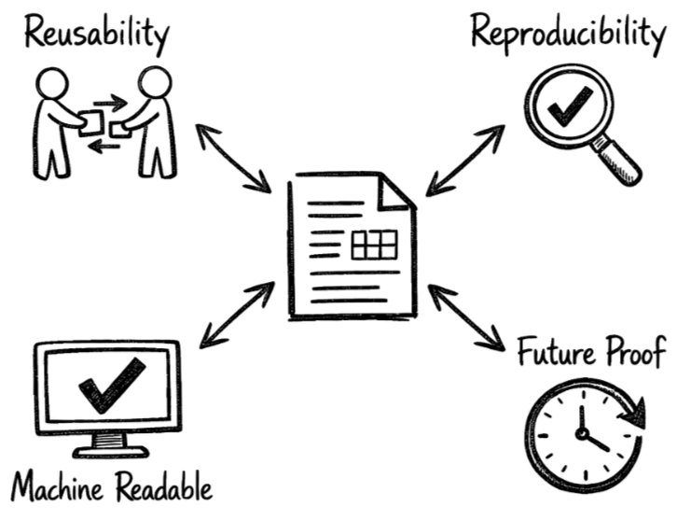
Benefits
Agreed upon within fields (sometimes required)
Ensures consistency across datasets - easier to share and use
Code can be applied across datasets more easily
Helps to ensure FAIR data
You do not need to make as many choices - just follow the standard
Data Standards
Rules, definitions, and formats to ensure consistent and interoperable data.
Image is AI generated

Slide 15
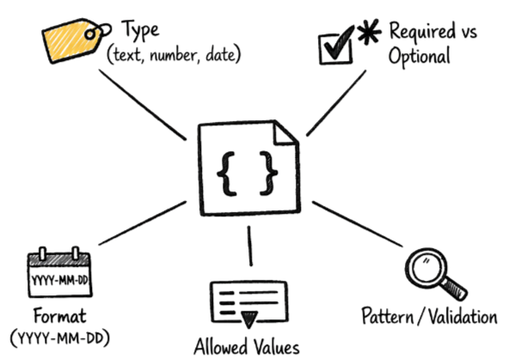
Types of Rules
Format: how to name and structure files and directories
Variables: common vocabulary, required fields (e.g., Common Data Elements from NIH)
Metadata: what information is required and in what format
Data Standards
Rules, definitions, and formats to ensure consistent and interoperable data.
Image is AI generated

Slide 16
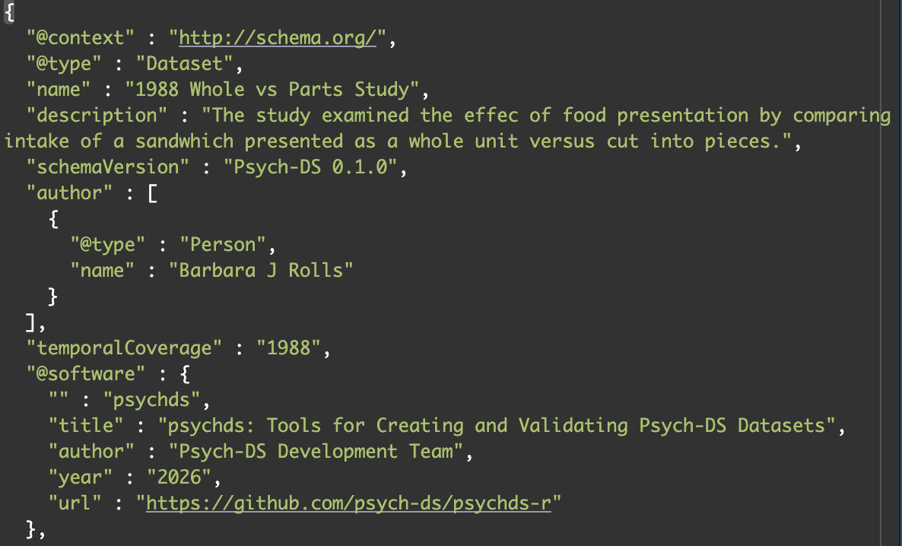
Plain text file format that allows for structured information
Human and machine readable
Structured fields = can capture simple and complex metadata
Supports schemas - like a form with instructions
rules that define what a valid JSON file looks like
Why JSON Files?
JSON - JavaScript Object Notation

Slide 17
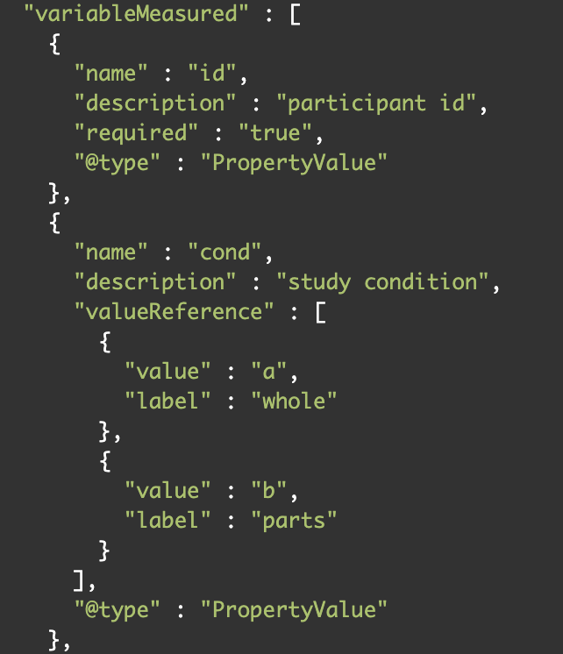
Plain text file format that allows for structured information
Human and machine readable
Structured fields = can capture simple and complex metadata
Supports schemas - like a form with instructions
rules that define what a valid JSON file looks like
Why JSON Files?
JSON - JavaScript Object Notation

Slide 18
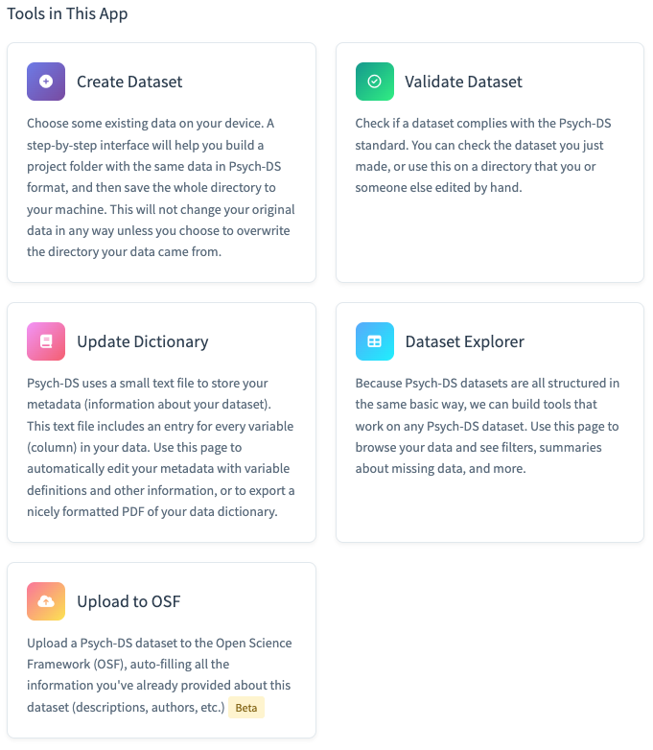
Psych-DS
Relatively simple, general data that can be used for data that does not fall under other data standards.
Has online validator
Has R shiny app to help build documentation via a GUI
Data Standards
Existing General Data Standards
https://psych-ds.github.io/psychds-r/

Slide 19
Data Dictionary Example using R

Slide 20
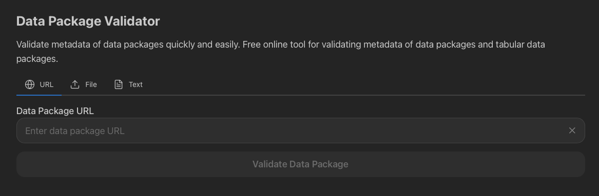
Frictionless’s Data Package
Relatively simple, general data that can be used for data that does not fall under other data standards.
Packages available for most syntax-based applications (e.g., R, Python, Java, Julia)
Adopted by Dryad
Has online validator
Data Standards
Existing General Data Standards
https://datapackage.org/

Slide 21
How to prepare your data
Good Enough Data Practices
FAIR Data
Repositories
Metadata
Institutional Resources
Open
Findable
Reusable
Accesible
Interoperable
Version
Control
Best Practices
Back-Up
Tidy Data
Metadata
Code

Slide 22
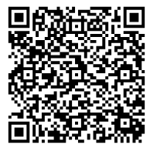
Institutional Tools & Resources
Research Data Stewardship Program
Free Consultations:
Data Visualization
Data Sharing
Statistical Results Interpretation
Data Analysis Planning
Code & Software Troubleshooting
Research Data Management
Data Management and Sharing Plans
Bookings Page

Slide 23
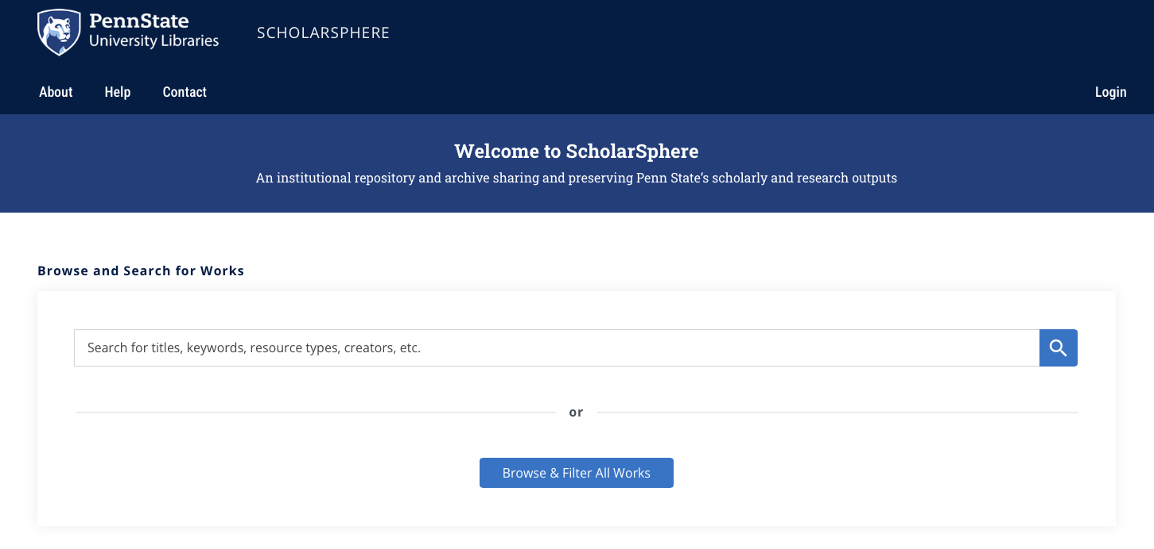
Institutional Tools & Resources
ScholarSphere
scholarsphere.psu.edu
Notes:
Self-deposit for PSU faculty, staff, and students at no cost
Supports data sharing requirements and “F.A.I.R” principles
Findable. Accessible. Interoperable. Reusable.
Satisfies requirements of PSU Open Access Policy (AC02)
Work drafts and versioning
Flexible access and visibility controls
Persistent access and preservation of work through DOI minting​
Monthly reports tracking download statistics
Curation services from PSU Librarians and the Data Curation Network​

Slide 24
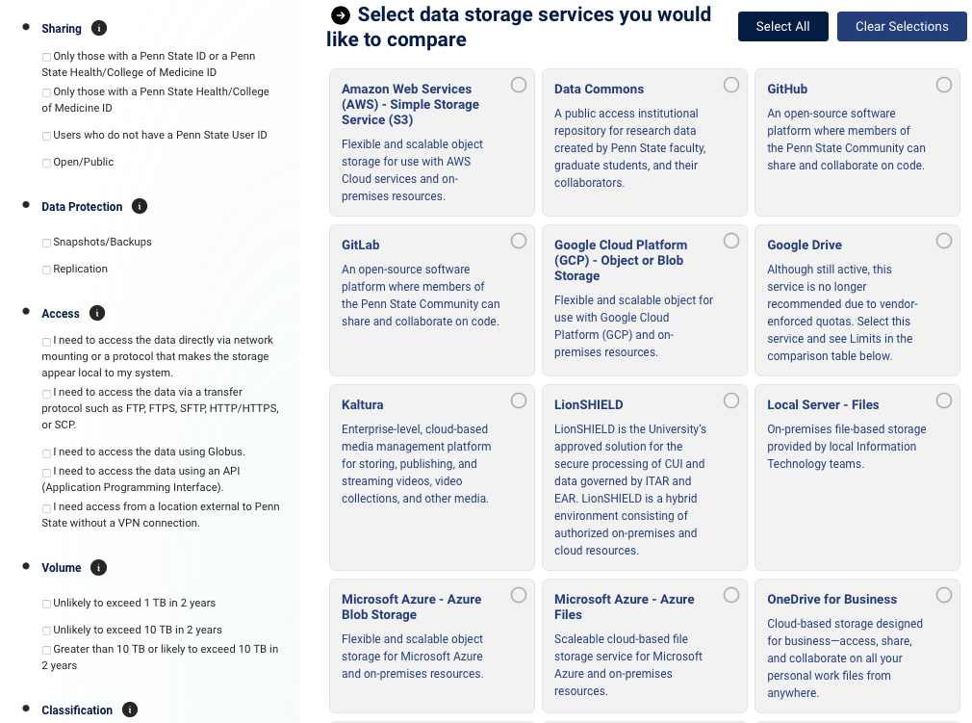
Institutional Tools & Resources
Penn State Data Storage Finder
datastoragefinder.psu.edu

Slide 25
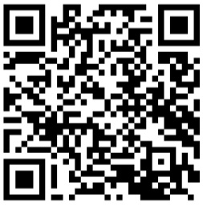
Provost Endorsement:
Research Data Stewardship
1. Register
2. Workshop Completion

Slide 26
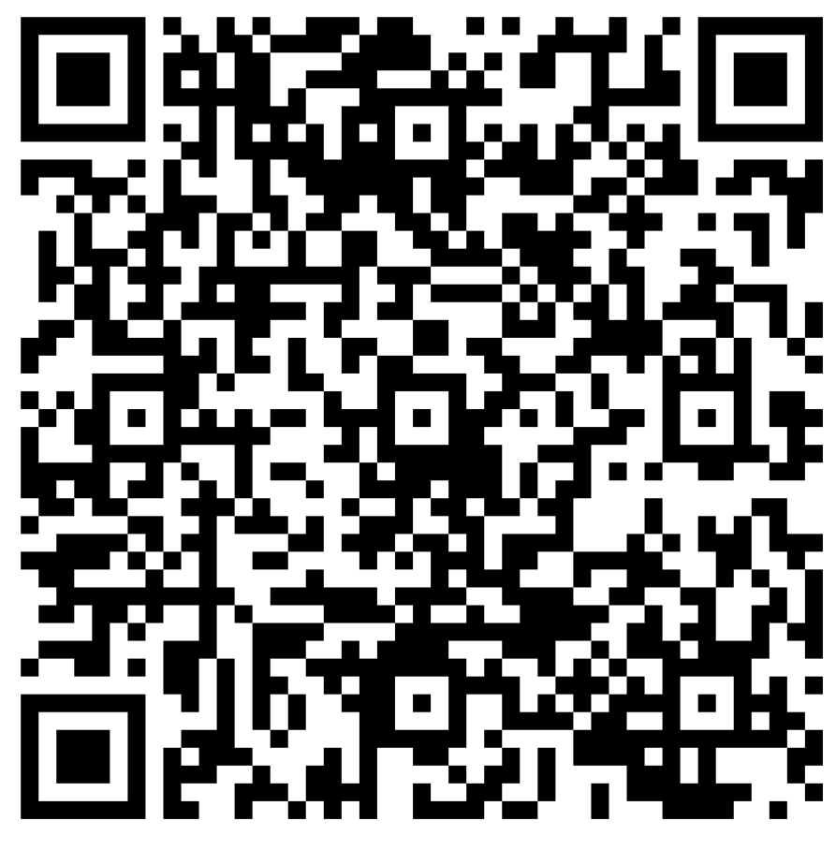
Feedback
Workshop Name: Bootcamp Metadata

