Slide 1
Environment Manager Troubleshooting and Debugging

Slide 2
Environment Manager Policy Troubleshooting and Debugging

Slide 3
Common Questions
“Nothing happens at logon”
“The users drive is not being mapped”
“The desktop is not being redirected”
“The users icons are not on the desktop”
The Environment Vars are not being set
“The user doesn’t get all the policy actions applied”

Slide 4
Possible reasons for EM Policy not working..
An issue with the deployment and the AppSense software
Or
A problem with the configuration and the environment we are running in....

Slide 5
Possible reasons for EM Policy not working..
There is no licence installed in the Management Centre or target machine
Machine is not in the correct deployment group
The deployment group has not been assigned the EM Agent or config
The config being used is not being updated on the client machine
The agent or config has downloaded but not been installed on the client machine
EM Agent.exe is not running on the target machine
EM Notify is not running and is not getting messages from winlogon
EM Agent is running, but it is not starting an EMAgentAssist.exe for each user
EM is running under the SYSTEM account, but in the context of the user and the user does not have access to map to the printer/drive in question

Slide 6
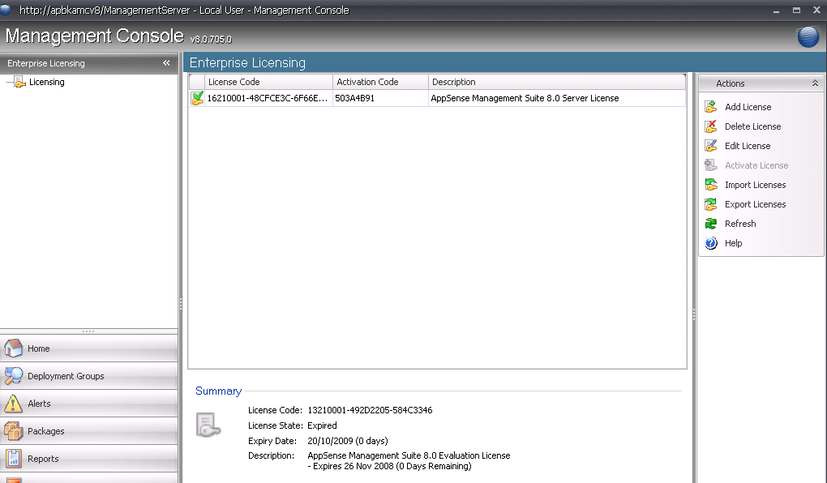
Check the licence

Slide 7
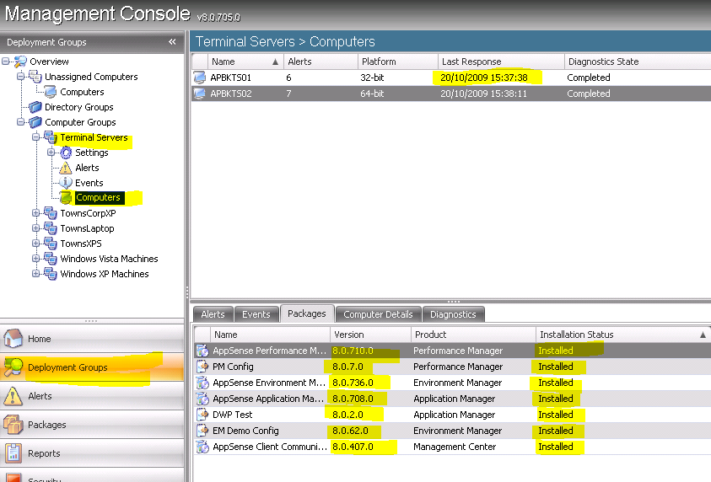
Confirm machine has been deployed to

Slide 8
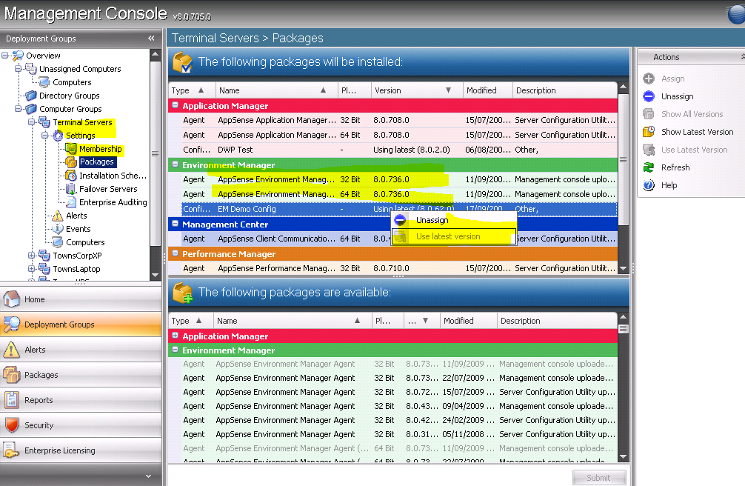
Confirm correct packages and latest version...

Slide 9
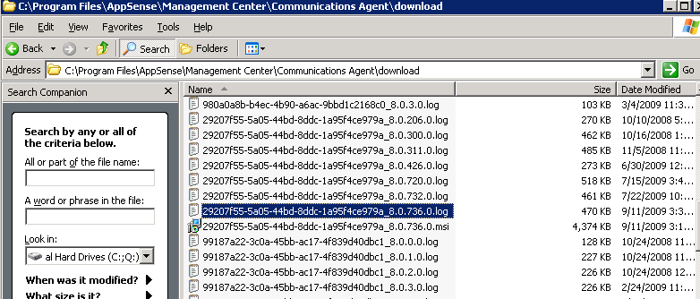
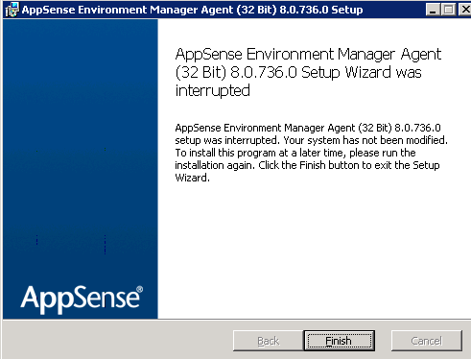
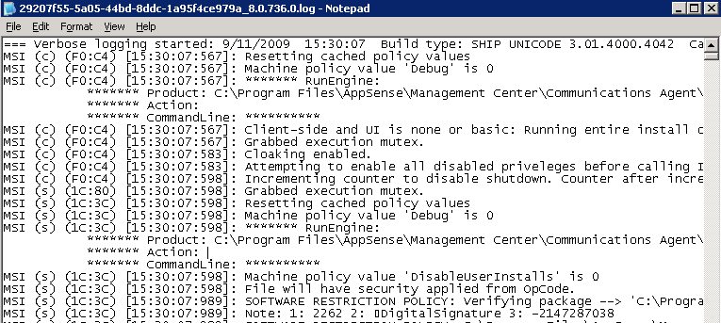
The agent or config has downloaded but not been installed on the client machine

Slide 10
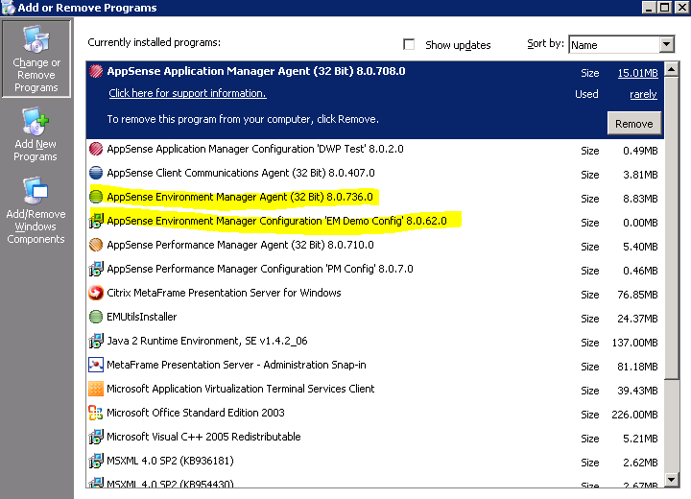
Check add remove programs on client machine

Slide 11
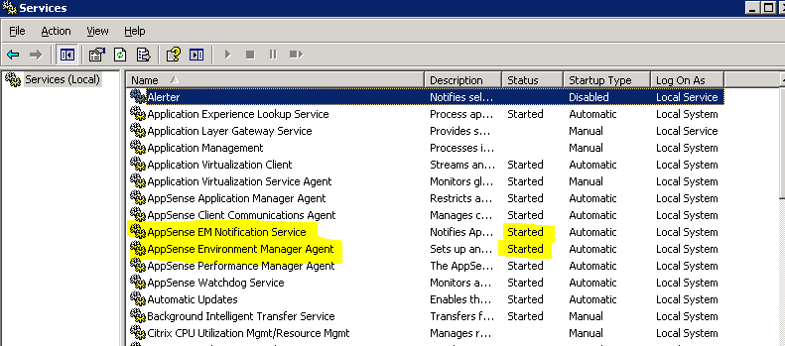
Check the services tab and make sure that both AppSense Environment Manager Agent and EM Notify Services are enabled and started.

Slide 12
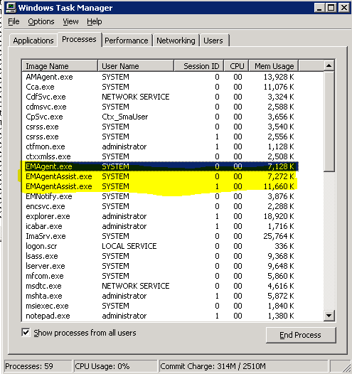
Check Task Manager on client machine and confirm EMAgent.exe is running
Check Task Manager whilst logged on as the user – There should be at least 2 EMAgent Assist .exe running – one for the system, one per session
NOTE! There will be 2 EM AgentAssists per session on a 64bit OS

Slide 13
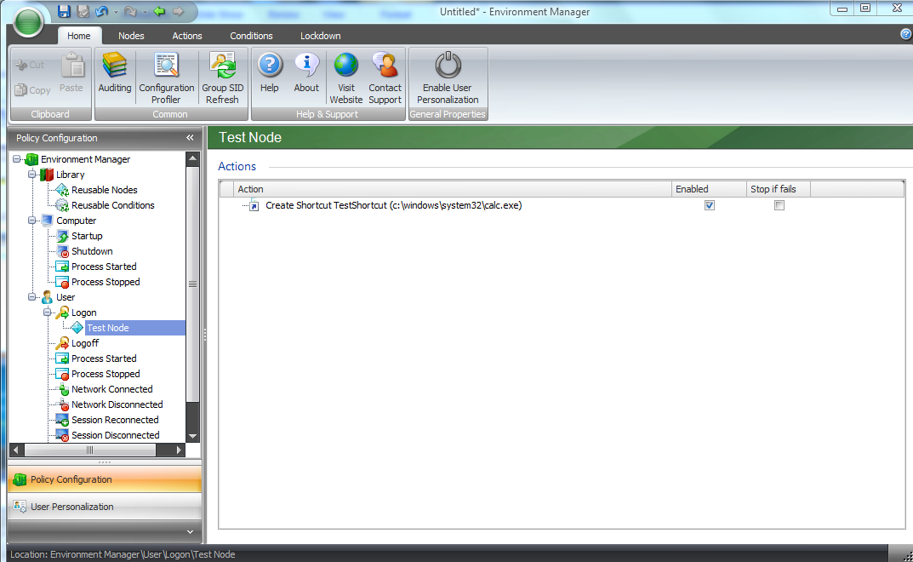
Place “test” – Place a shortcut on the desktop

Slide 14
“BUT I HAVE DONE ALL THAT SIMON!... and EM Policy is STILL not applying...”
It’s a problem with the configuration and the environment we are running in....

Slide 15
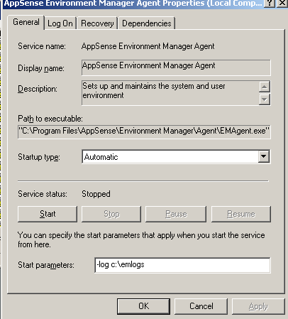
Enable Logging

Slide 16
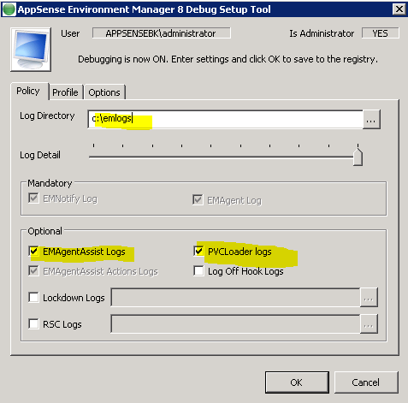
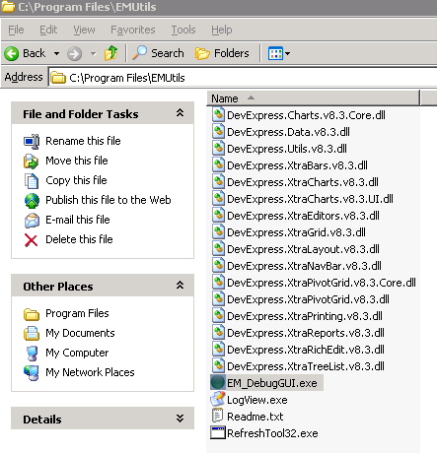
EM Logger tool
Use the tool when troubleshooting Machine Start Up Actions as it set reg keys which will not be forgotten post reboot
Always enabled EMAgentAssist logs
There is a seperate 64bit version

Slide 17
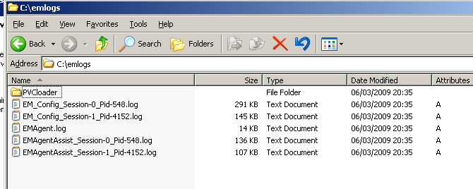
Collect the logs
Match the user to the session ID and look into the EM Agent Config logs
EM_Config_Session log shows the POLICY errors Use the EM Log viewer to analyse errors
Run reports to see what the timings of logon are.

Slide 18
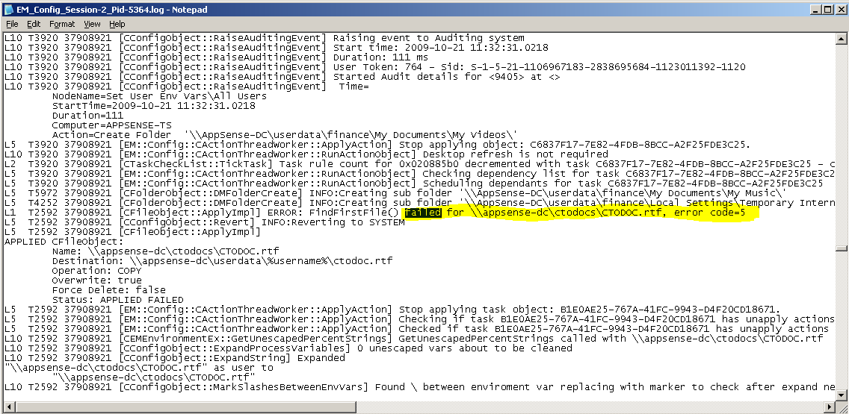
View the Config Session log....
Search for “failed” or “error code=“

Slide 19
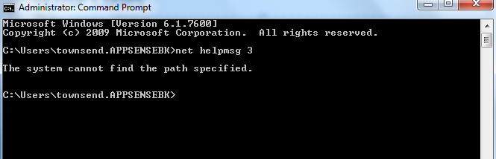
Error Codes
Error Code = 2 “file not found”
Error Code = 3 “path not found”
Error Code = 5 “access denied”
Error Code = 53 “network path not found”

Slide 20
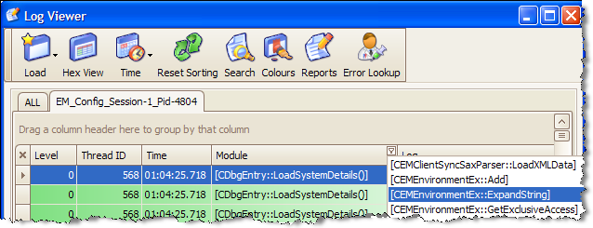
Alternatively.....use the Log Viewer
A graphical viewer for the logs which highlights difference threads (actions and criteria) and allows you to sort by time.

Slide 21
Log Viewer – Button Bar
Time -> Drop Down Options
Time & Date Displays time and date in the time column
Time Only Displays only the time in the time column
Ticks Replaces the time column with the tick count
Sync Time Synchronises the time to the selected log line
Zero Time Sets the first line to 0 and sync the rest to it
Reset Sorting
Resets the sorting back to the original load order

Slide 22
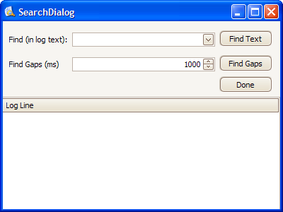
Log Viewer – Button Bar (Search)
Brings up the Search Dialog
Find Text
SQL Query of current view
Find Gaps
Gaps in a thread’s execution
Results
Displays “clickable” list
When the dialog is closed the list can be traversed with F3 and Alt-F3

Slide 23
Log Viewer – Button Bar (Reports)
Reports
Best done on ALL (with Config Session and Agent Session Logs)
Sorts data by time
Displays the reports dialog

Slide 24
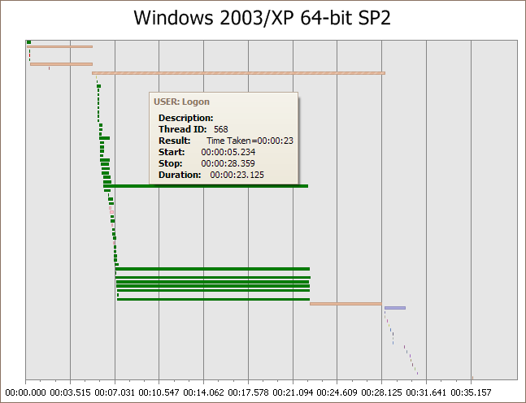
Log Viewer – Reports View

Slide 25
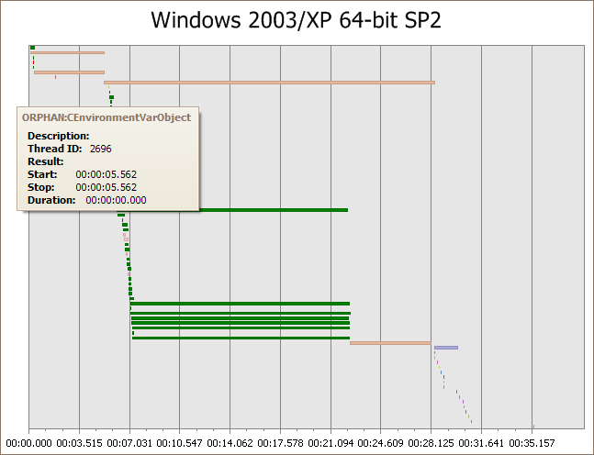
Log Viewer – Reports View

Slide 26
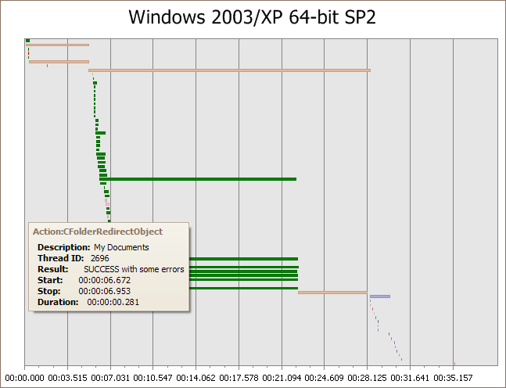
Log Viewer – Reports View

Slide 27
Demo

Slide 28
Environment Manager Personalization Troubleshooting and Debugging

Slide 29
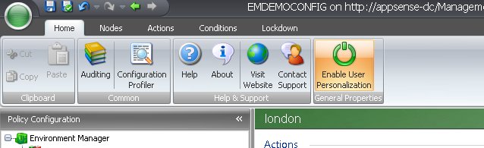
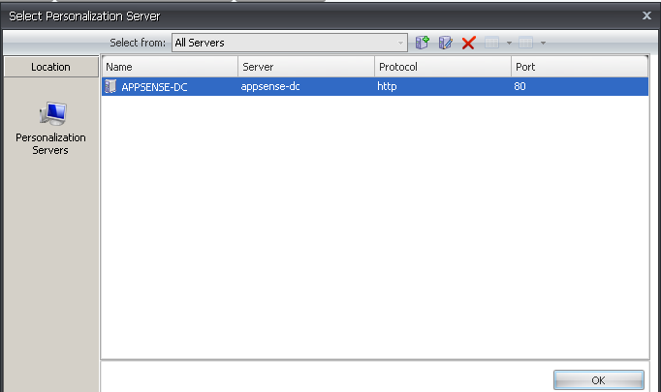
Personalisation
Confirm you have enabled the Personalization Server in the Policy side of the configuration

Slide 30
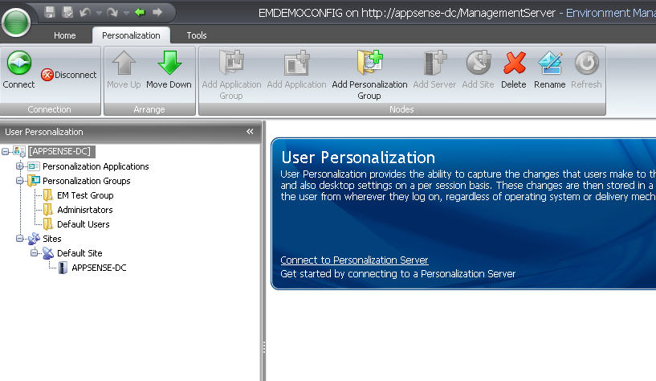
Confirm you have at least one site

Slide 31
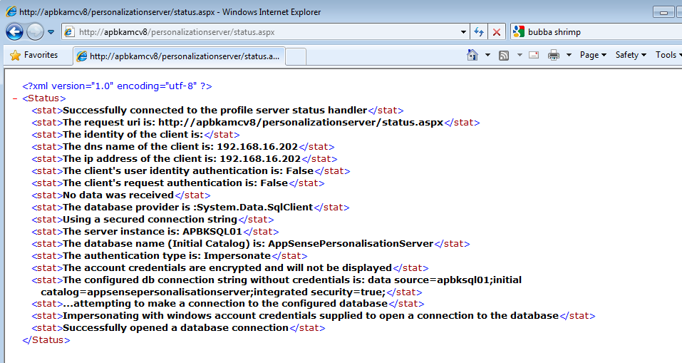
How to test the Personalisation Server Connection
http://machinename/personalizationserver/status.aspx

Slide 32
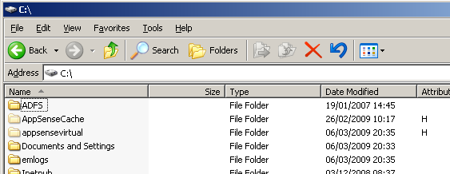
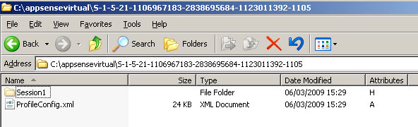
How to test the Personalisation Server Connection
Check the client machine and look for the ProfileConfig.XML
C:\AppSenseCache\SID\ProfileConfig.XML

Slide 33
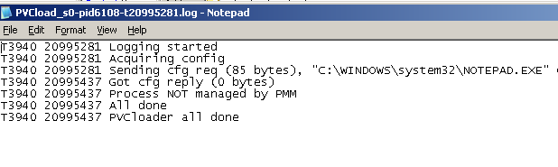
Check the PVC has loaded..

Slide 34
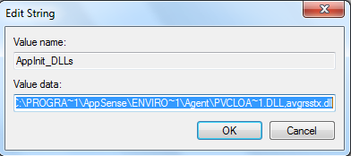
Check the AppInit Key...
HKEY_LOCAL_MACHINE\SOFTWARE\Microsoft\Windows NT\CurrentVersion\Windows

Slide 35
And finally....a summary.....
ProcessID
A decimal number representing the process ID of the module
SessionID
A decimal number representing the current user session ID (or 0)
ProcessName
The name of the process that has been hooked by lockdown
TickCount
The number of milliseconds that have elapsed since the system was started

Slide 36
Questions

Slide 37
Other Resources...
AppSense Blogs
http://www.appsense.com/community/
Updated daily by Marketing, pre sales, support, product managers
Videos
www.appsense.com/media
AppSense Consultant – Jon Wallace (MVP)
www.insidetheregistry.com
AppSense Pre Sales / System Engineering
RoWPreSales@AppSense.com
AppSense un official forums
http://www.apug.info/

